Slide 1
APPENDIX K
TRAINING MODULE FOR SCHOOL LIAISON WHO WILL COMPLETE COMPETITIVE FOODS CHECKLIST
School Nutrition Dietary Assessment Study IV
(OMB No.: 0584-0527)
Project Officer: Fred Lesnett
Office: Office of Research and Analysis
Food and Nutrition Service
Room 1014
3101 Park Center Drive
Telephone: 703-605-0811
FAX: 703-305-2576
Email: Fred.Lesnett@FNS.USDA.GOV

Slide 2
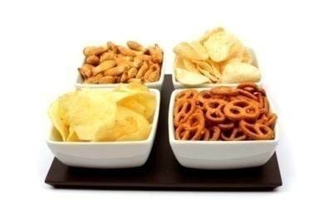
School Nutrition Dietary Assessment Study (SNDA-IV)
Training
If you have any questions, call us toll free at (xxx) xxx-xxxx or
email akelly@mathematica-mpr.com

Slide 3
Your Role
Complete two forms for your school about:
Vending machines
Other sources of foods and beverages
Complete both forms within one week of receiving this e-mail
Fax completed forms back to Mathematica

Slide 4
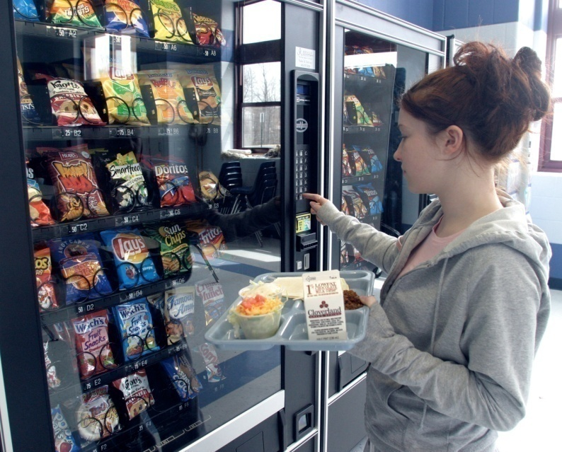
Goals Of This Training
Introduce the two data collection forms
Clarify the types of information to be collected
Provide guidance about how to complete the forms
Please have the forms in front of you as you go through the rest of this document!
Notes:
4

Slide 5
Vending Machine Form

Slide 6
Vending Machine Form
Collects information about every machine available to students during the school day (including before or after school), including:
Location
Type of machine
Capacity/size of machine
Contents (types of items available)
Separate sections for:
Beverage machines
Snack machines

Slide 7
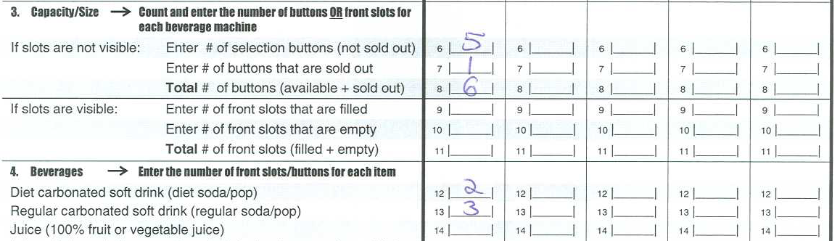
Filling in the Form
Each column should contain information for only one vending machine

Slide 8
Vending Machine Locations
In Cafeteria
Includes the entire cafeteria area, including the serving lines and the seating/eating area
Outside but Near (within 20 feet) Cafeteria or Seating/Eating Area
Adjacent to the cafeteria area (within 20 feet) but outside of the cafeteria walls
Elsewhere in School Building(s)
Any other location that is accessible to students and inside the walls of the school building(s)
Outside School Building(s) but on School Grounds
Areas on school grounds, but outside of the walls of the building(s)
For each machine, choose only ONE location:

Slide 9
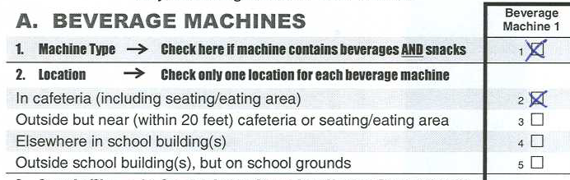
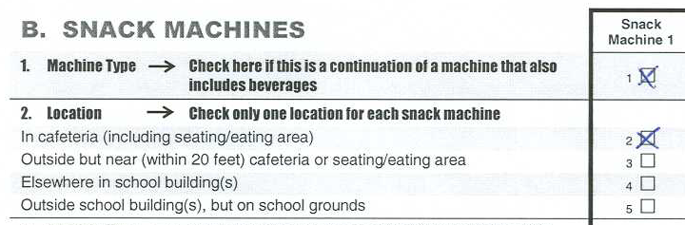
Vending Machine Type (Use only for combination beverage and snack machines)
Step 1:
In Section A (Beverage Machines), check the box for “Machine Type” to indicate that the machine includes both beverages and snacks. Then record information about the beverages in the machine.
Step 2:
In Section B (Snack Machines), check the box for “Machine Type” to indicate that the machine includes both beverages and snacks. Then record information about the snacks in the machine.

Slide 10
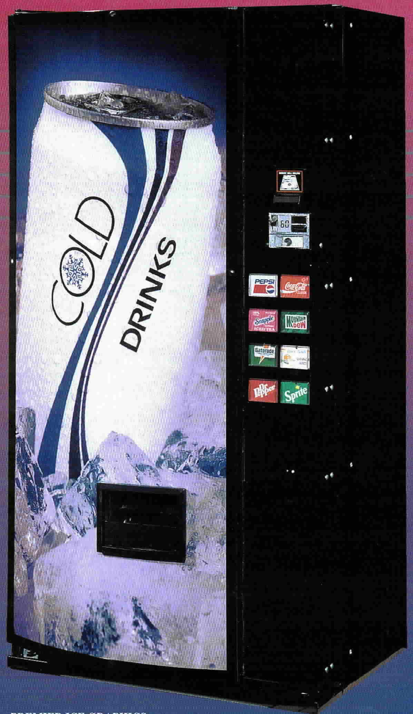
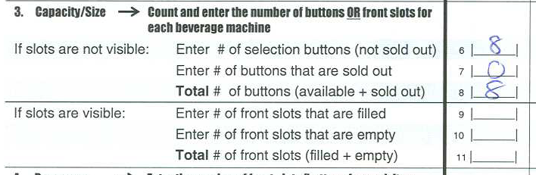
Vending Machine Capacity/Size: If Slots Are Not Visible
If slots are not visible, enter the number of buttons THAT ARE NOT SOLD OUT
This machine has eight buttons. None are sold out.

Slide 11
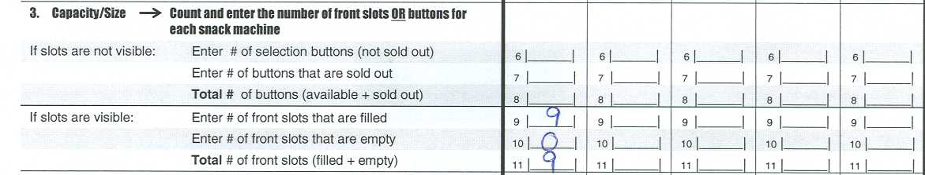
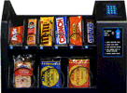
Vending Machine Capacity/Size: If Slots Are Visible
Count the number of front slots that are filled
Count the number of front slots that are empty
Total the number of filled and empty slots
This machine has nine front slots. None of the front slots are empty.

Slide 12
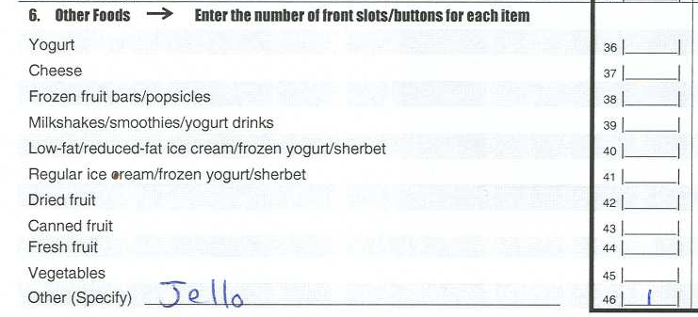
Vending Machine Contents
Record the number of slots (or buttons) dedicated to each type of food or beverage
For machines with visible slots, base your counts on the item in the front slot
If you observe any items that are not on the list, record them on the lines marked “Other (Specify)”

Slide 13
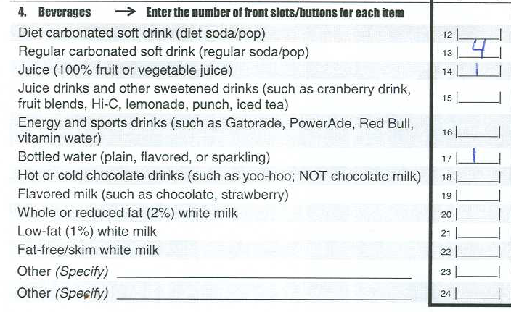
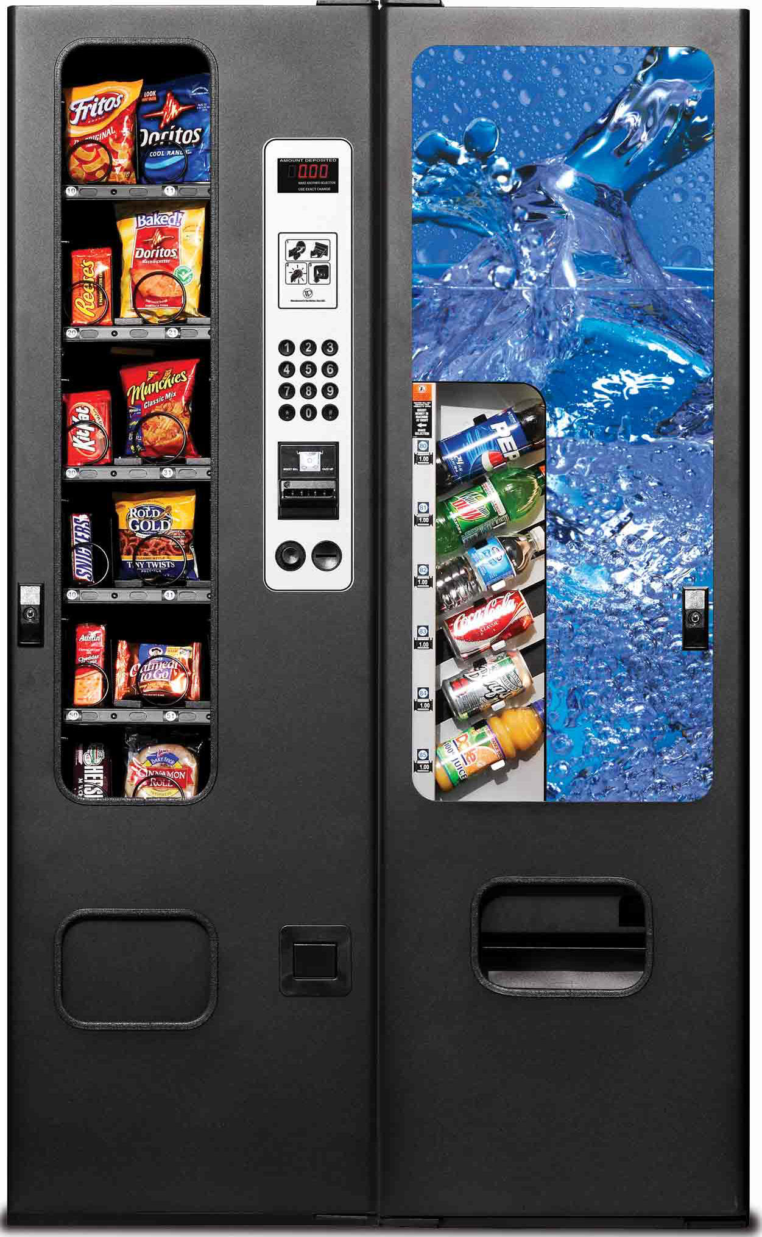
Example #1 - Beverages

Slide 14
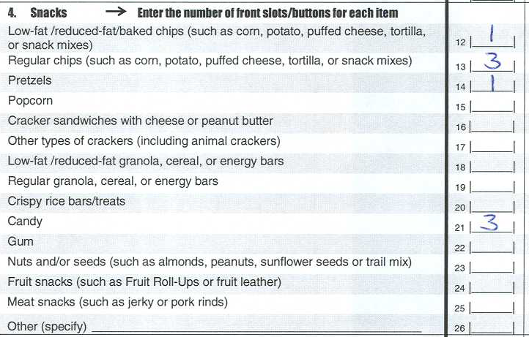
Example #2 - Snacks

Slide 15
Other Sources of Foods/Beverages Form

Slide 16
Other Sources of Foods/Beverages Form
Documents the availability of:
School stores
Snack bars outside the cafeteria
Food carts/kiosks outside the cafeteria
Fundraisers
Other sources
For each available source, documents:
Location(s)
Types of items available

Slide 17
Other Sources of Foods/Beverages Form
Do NOT include foods or beverages from these sources on this form:
Vending machines
Cafeteria
Kiosks, tables or other venues used to distribute free fruits and vegetables through USDA’s Fresh Fruit and Vegetable Program
We will alert you if your school participates in this program

Slide 18
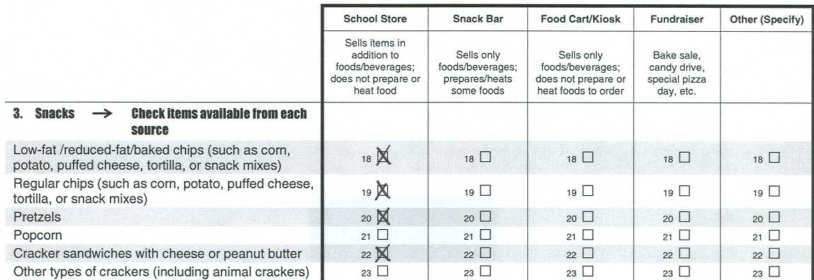
Filling in the Form
Note that the column headings on this form refer to specific types of food sources, not individual vending machines
Also note that you do not need to enter counts, simply check the box if the item is available

Slide 19
Other Food Source Locations
School Store
-Sells other items in addition to food and beverages
-Does not prepare or heat food
-May be located in the cafeteria
Snack Bar
-Sells only food and beverages
-Prepares or heats some foods
-Includes canteens and cafes
-Located outside of the cafeteria
Food Cart/Kiosk
-Contains only food and beverages
-Does not prepare or heat foods to order
-Contains already prepared and pre-packaged food
-Located outside of the cafeteria
Fundraisers
-Includes bake sales, candy drives, or other sales that raise money for special school needs or charity
-May be sold inside of the cafeteria

Slide 20
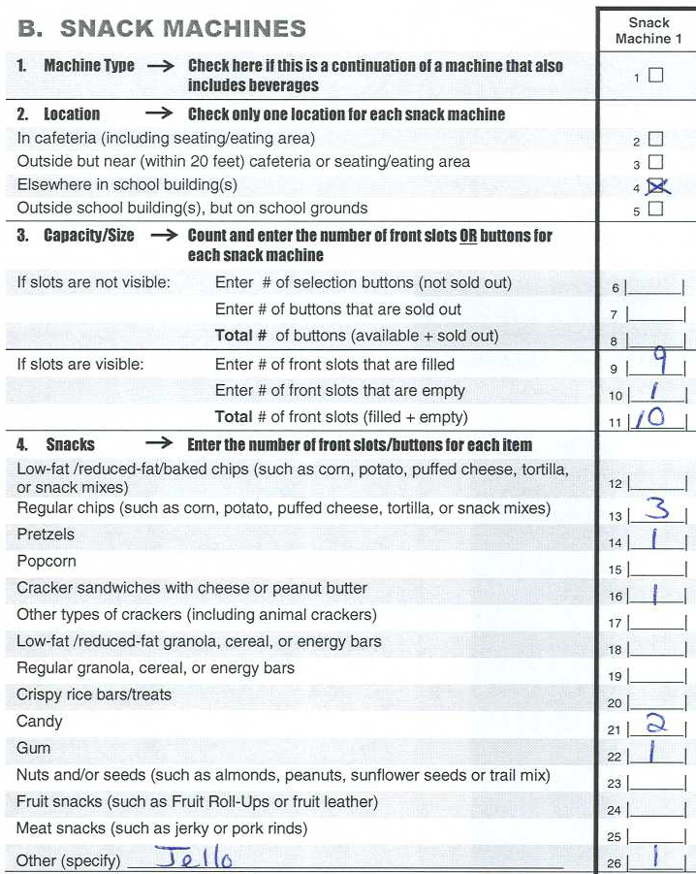
Before You Return Your Forms
Carefully review all of your entries on both forms to be sure they are complete and accurate
Check that the sum of ALL items in each vending machine matches your entry for the “# of selection buttons (not sold out)” or your entry for the “# of front slots that are filled”
Be sure you have filled in your name and other important contact information
3+1+1+2+1+1=9

Slide 21
Returning Your Completed Forms
*Please complete your forms within one week of receiving your e-mail
*Remember to return both forms even if there are no vending machines or other food sources in your school
Please return your forms by fax to:
(xxx) xxx-xxxx
Attention: [MPR STAFF PERSON]
If you do not have access to a fax machine, please mail your forms to:
[MPR STAFF PERSON]
Mathematica Policy Research
P.O. Box 2393
Princeton, NJ 08543-2393

Slide 22
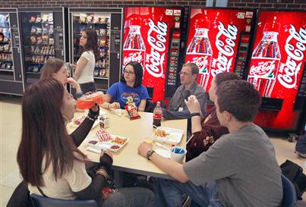
Thank you very much!
Please allow 4 weeks from the date we receive your forms to receive your payment

