Slide 1
Non-Federal Employee Information System
Screen Shots

Slide 2
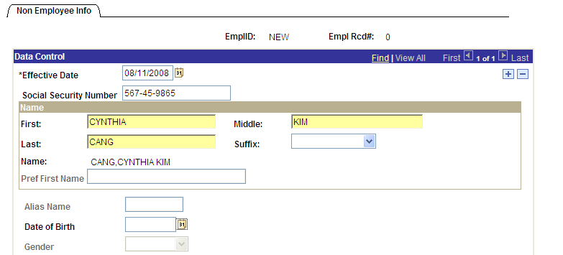
Module C: Finding or Creating a Non-Employee Information Record
C-6
C-7
Step C-6. Effective Date: Enter the effective date of contract performance.
Step C-7. Social Security Number: Enter the Non-Employee’s 9-digit Social Security Number (SSN) with hyphens included.

Slide 3
Module C: Finding or Creating a Non-Employee Information Record
C-8
Step C-8. Name (First, Middle, Last, and Suffix): Enter the Non-Employee’s name in these fields. If the Non-Employee does not have a middle name, leave this field blank. Please note that Preferred First Name is masked and therefore does not permit user entry.
Note: You must enter the person’s name as shown on their government-issued ID, such as a driver’s license or passport. If the information does not match, the Non-Employee will have problems during the enrollment process.
3
Notes:
3

Slide 4
Module C: Finding or Creating a Non-Employee Information Record
C-9
C-10
Step C-9. Alias Name: This field is masked and therefore does not permit data entry.
Step C-10. Date of Birth: Enter the Non-Employee’s date of birth (mm/dd/yyyy), or use the lookup function to select it from the calendar.

Slide 5
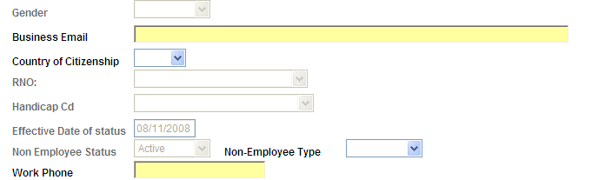
Module C: Finding or Creating a Non-Employee Information Record
C-11
C-12
C-13
Step C-11. Gender: This field is masked and therefore does not permit data entry.
Step C-12. Business Email: Enter the Non-Employee’s business email address. This will be used for enrollment notification. The applicant will not receive enrollment notifications if business email is entered incorrectly. If the Non-Employee does not have an email address, enter the email address for a Point of Contact who will coordinate enrollment activities, such as a Human Resources Manager or Security Officer.
Step C-13. Country of Citizenship: Use the drop down list to select the 3-letter code for the Non-Employee’s Country of Citizenship.

Slide 6
Module C: Finding or Creating a Non-Employee Information Record
C-14
C-15
C-16
C-17
Step C-14. RNO: This field is masked and therefore does not permit data entry.
Step C-15. Handicap Cd: This field is masked and therefore does not permit data entry.
Step C-16. Effective Date of Status: This field is masked and therefore does not permit data entry.
Step C-17. Non-Employee Status: This field is masked and therefore does not permit data entry.

Slide 7
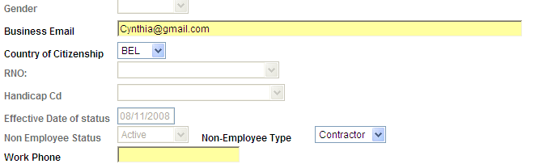
Module C: Finding or Creating a Non-Employee Information Record
C-18
C-19
Step C-18. Non-Employee Type: Use the drop down list to select the appropriate Non-Employee type.
Step C-19. Work Phone: This field is masked and therefore does not permit data entry.

Slide 8
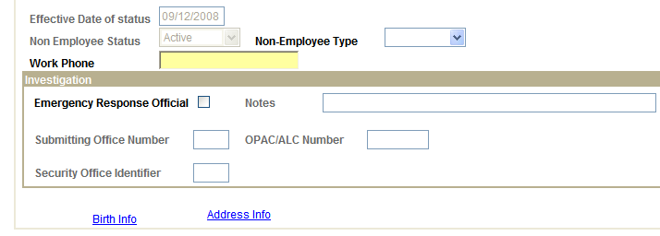
Module C: Finding or Creating a Non-Employee Information Record
C-20
C-21
Step C-20. Emergency Response Official.
Caution: This optional field only applies to an Agency-identified contractor-employee serving in an Emergency Response Official capacity. Contact your Security Officer for more information.
If the Non-Employee has emergency response duties in the event of a disaster, check this option. This designation will be printed on the Non-Employee’s USDA LincPass.
Step C-21. Notes: This field is masked and therefore does not permit data entry.

Slide 9
Module C: Finding or Creating a Non-Employee Information Record
C-22
C-23
C-24
Step C-22. Submitting Office Number: This field is masked and therefore does not permit data entry.
Step C-23. OPAC/ALC Number: This field is masked and therefore does not permit data entry.
Step C-24. Security Office Identifier: This field is masked and therefore does not permit data entry.
9
Notes:
9

Slide 10
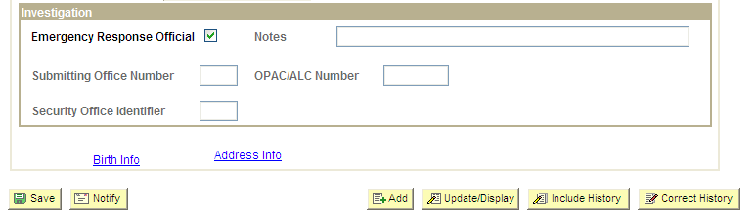
Module C: Finding or Creating a Non-Employee Information Record
C-25
C-26
Step C-25. Do not click the Birth Info hyperlink. If you click this link before you will be redirected to another screen and will lose information entered on this page. Information accessed by this link is masked and therefore does not permit data entry.
Step C-26. When you are finished entering information on this screen, click Save.

Slide 11
Module C: Finding or Creating a Non-Employee Information Record
C-27
Step C-27. After saving, click the Address Info hyperlink at the bottom of the screen. You will be redirected to another screen where you will enter the Non-Employee’s Address Information.

Slide 12
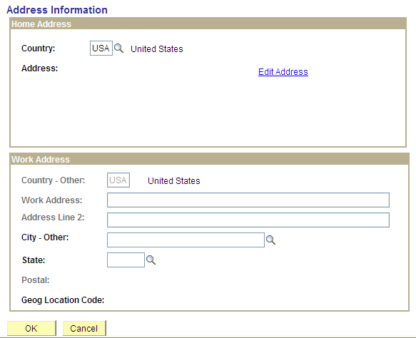
Module C: Finding or Creating a Non-Employee Information Record
C-28
C-29
Step C-28. On the Address Information screen, use the lookup feature (magnifying glass) to select the Country Code for the Non-Employee’s Home Address.
Step C-29. Next, click the Edit Address hyperlink.

Slide 13
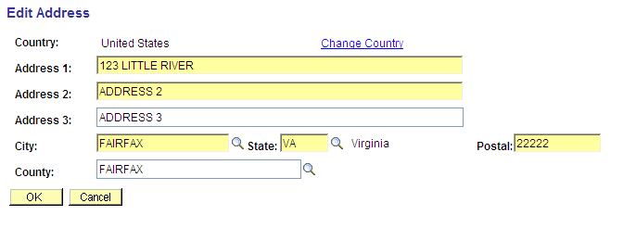
Module C: Finding or Creating a Non-Employee Information Record
C-30
C-31
Step C-30. Enter the Non-Employee’s home address. Address 2 and Address 3 are optional. County is not required; however, this information is populated based on City and State selected.
Step C-31. When you are done, click the OK button to return to the Address Information screen.

Slide 14
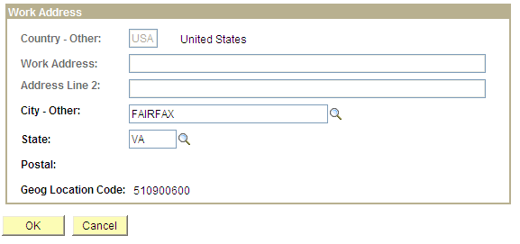
Module C: Finding or Creating a Non-Employee Information Record
C-32
C-33
C-34
Step C-32. Now you will enter information on the Non-Employee’s Work Address. Country: This field is masked and therefore does not permit data entry.
Step C-33. Work Address: This field is masked and therefore does not permit data entry.
Step C-34. Address Line 2: This field is masked and therefore does not permit data entry.

Slide 15
Module C: Finding or Creating a Non-Employee Information Record
C-35
C-36
C-37
C-38
Step C-35. City-Other: Use the lookup feature (magnifying glass) to select the City.
Step C-36. State: Use the lookup feature (magnifying glass) to select the State.
Step C-37. Postal: This field is masked and therefore does not permit data entry.
Step C-38. Geog Location Code: The information in this field will be populated based on the City and State selected. This field is masked and therefore does not permit data entry.
15
Notes:
15

Slide 16
Module C: Finding or Creating a Non-Employee Information Record
C-39
Step C-39. Click the OK button to save information entered. If you click the Cancel button, information on this screen will not be saved.
After you click OK, you will return to the main Non-Employee Information screen. Now the Non-Employee record is ready to be sponsored.
16
Notes:
16

