Slide 1
Disaster Recovery Grant Reporting System Training for NSP Users
Day 2
Presented by:
Lockheed Martin Community Connections & the Department of Housing and Urban Development
Notes:
Welcome to our second day of training!

Slide 2
Today’s Agenda
Quick overview of yesterday’s material
User roles and accounts
Key HUD roles within each module
Troubleshooting/Referral Activity
Q&A Session
Notes:
Here is our agenda for today. (Read through). Much like yesterday, you are welcome to ask questions as we go through the training, but keep in mind there will be a Q&A session at the end of the day.
We’re going to focus on the processes that you’ll likely encounter as Field Office staff and review the reports that Field Office users have access to and can use to troubleshoot grantee problems.

Slide 3
User Role and Account Information
Registering a new HUD staff account
• Viewing grantee user reports
Notes:
During this section, we will review the user account reports available to HUD staff as well as discuss how Field Office staff can troubleshoot grantee account issues.

Slide 4
Registering a new HUD staff account
New HUD users in DRGR must have their supervisor submit a CHAMPS
request to add DRGR to their systems profile. They will want to request “write” rights to DRGR. After ADP Security confirms
that this has been completed, DRGR system administrators can create
an account in DRGR for the user. HUD staff should include the following
in their message for each user account request:
  Full name
  "H" number
  Field Office
  Address
  Phone number with extension
  Fax number
  E-mail address
Notes:
This is the information you’ll need to submit to DRGR_Help@hud.gov to gain access to DRGR. Submit a CHAMPS request before e-mailing DRGR_Help@hud.gov. Please make sure you include all of the requested information.

Slide 5
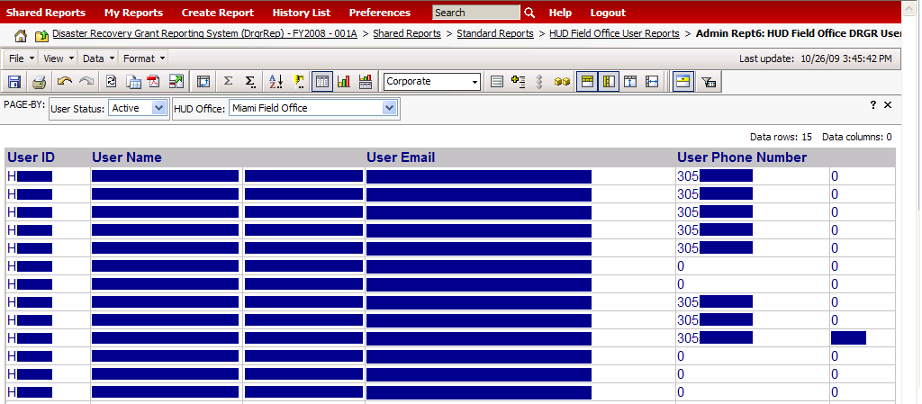
HUD Field Office DRGR Users
Admin Rep: HUD Field Office DRGR Users
This is a master list of all HUD Field Office DRGR user accounts. If contact information displayed is incorrect, DRGR users can use the PROFILE link under the UTILITIES section of the left navigation frame to update or correct the information there.
Notes:
Source: MSTR Reference Guide, pg. 24
Once you have access to the system, you will be able to see the HUD users in each Field Office (you can toggle between different field offices using the HUD Office dropdown menu).

Slide 6
A Tip for Your Grantees
Make sure your grantees have at least
one System Administrator,
one Request Drawdown user, and
one Approve Drawdown user.
Notes:
As we saw yesterday, there are a number of reports that show grantee user account status and user roles. To prevent any slow downs in the drawdown or reporting process, you should make sure that each grantee has at least one Administrator, one person with the ‘Request Drawdown’ role, and one person with the ‘Approve Drawdown’ role. Remember, no one user can have both the ‘Request’ and ‘Approve’ draw roles.

Slide 7
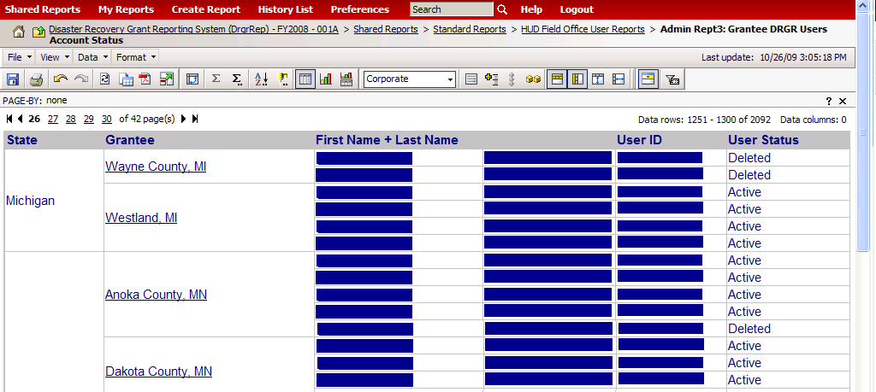
Grantee DRGR Users Account Status
Admin Rept: Grantee DRGR Users Account Status
This is a master list of all grantee DRGR user accounts. The field office version shows the grantee name and state as columns.
Notes:
Source: MSTR Reference Guide, pg. 21
You can check grantee user account status here. If grantee users are shown as inactive or deleted, they will have to contact you and you will have to ask the Help Desk to reinstate their access. If a user is not showing up on this list, they are NOT in the DRGR system yet.

Slide 8
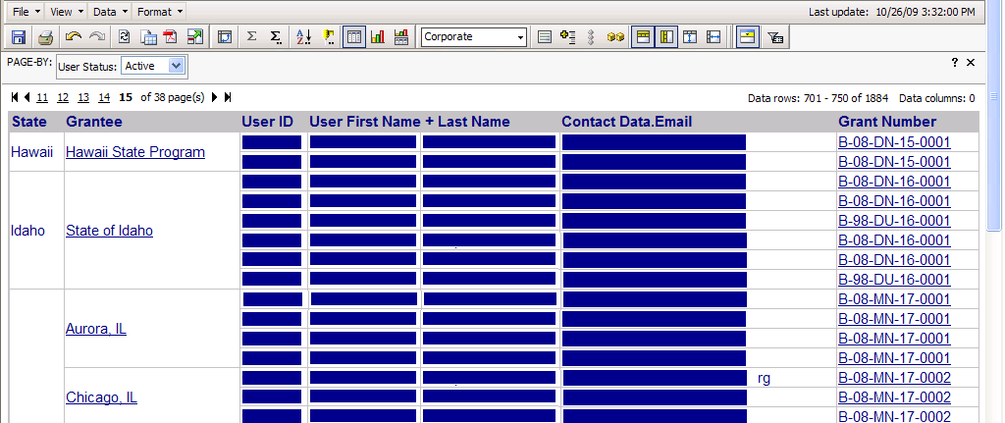
Grantee DRGR Users Access by Grant
Admin Rept: Grantee DRGR Users Access by Grant
This report will only show active users assigned to grants by grantee system administrators. This step must be done when new grantee user accounts or grants are added to DRGR.
Notes:
Source: MSTR Reference Guide, pg. 23
If a user does not show on this report but does show on the user account status report, it indicates that the grantee system administrator has not completed this step. The field office version shows the grantee name and state as columns.

Slide 9
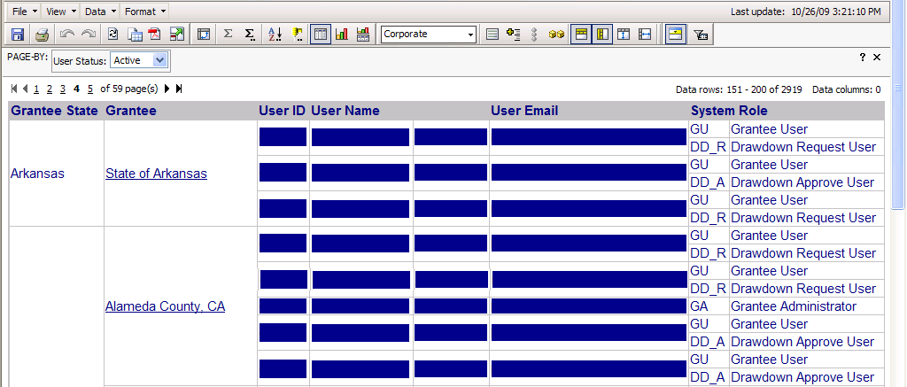
Grantee DRGR Users with System Role
Admin Rept4: Grantee DRGR Users with System Role
This report will only show active users assigned to grants by grantee system administrators.
Notes:
Source: MSTR Reference Guide, pg. 22
You can use this report – or have your grantees use it – to verify their roles within DRGR.

Slide 10
Practice ID Information
Here are the test IDs you’ll be using and their accompanying roles. You will insert the number you were assigned where the ## signs are.
The password for each role is Hud!2010 .
User ID | Role
TS##GA | Grantee Admin & Approve Drawdown
TS##GR | Request Drawdown
TS##FO | Field Office user
Notes:
We’ll be using the TS##FO ID today.

Slide 11

Case Study #1
Checking the Status of Grantee User Accounts
Notes:
Now let’s look at the first case study for today.

Slide 12
Review of DRGR Modules
Action Plans • Drawdowns • QPRs • Reports
Notes:
We’ll now do a brief review of the basics of each module in the DRGR system.

Slide 13
Action Plans
Purpose
Action Plans are where grantees add projects and activities, and provide a template for the QPR. Getting the Action Plan right helps grantees identify the data required to set up budgets and performance goals.
HUD FO role
Approval or rejection of the Action Plan, initially and after any changes have been made.
What we’ll review today
How and where to review and approve or reject the Action Plan; where to enter Action Plan comments; tips on what to look for when deciding to approve or reject; where to find the status of the Action Plan.
Notes:
During the Action Plan module session, we’ll examine the approval/rejection process for Action Plans and go over what to look for when deciding what action to take.

Slide 14
Drawdowns
Purpose
The drawdown module is where all financial transactions take place. This is where grantees will obligate funds, create, revise, approve, and reject vouchers and voucher line items, and check on the status of draws.
HUD FO role
Give policy recommendations on when/how to obligate, help grantees troubleshoot drawdown issues, make referrals (when appropriate), approve draws over a certain threshold.
What we’ll review today
Policy around obligations; how to deal with blocked draws; what to do with draws over the NSP-1 DRGR threshold.
Notes:
We get a lot of questions at the Help Desk about obligations. As there are policy questions involved, it’s important that you as HUD staff can field them. We will also review how you can determine if a grantee has a grant or activity that is blocked for draws and what to do with vouchers that are sent to you for approval for being over the DRGR draw threshold limit.

Slide 15
QPRs
Purpose
QPRs allow grantees to report on obligations, expenditures, accomplishments, etc. for the quarter.
HUD FO role
Approval or rejection of the QPR in a timely manner, entering comments in DRGR, sharing comments with grantees (if desired).
What we’ll review today
Where and how to take action on a QPR (review, approve, reject); QPR checklist recommendations; how to enter comments; what comments are for; how to send comments to grantees.
Notes:
As far as QPRs, we’ll go over the commenting process as well as the key points from the QPR checklist.

Slide 16
Reports
Purpose
Reports provide a relatively quick and easy way of accessing the most up-to-date information in DRGR related to user accounts, obligations and drawdowns, report status, etc.
HUD FO role
Reports allow FO staff to access information about grantees, including their activity budgets, user roles, report status, etc.
What we’ll review today
Detailed review of what reports FO users have access to and what information they contain.
Notes:
Reports are one of the most underutilized features of DRGR. We’ll review the reports that Field Office staff have access to, discuss how to use them for troubleshooting purposes, and practice modifying and saving reports.

Slide 17
Action Plans
Tips for Approval/Rejection • How to Approve/Reject
• Action Plan Comments • Determining Action Plan Status • Action Plan Reports
Notes:
Let’s take a look at Action Plans from the field office perspective.

Slide 18
Remember…
Grantees must estimate performance
measures in the Action Plan before
they can report on them in the QPR.
Notes:
An important reminder for your grantees…

Slide 19
Action Plan Checks
Check that:
  Action Plans contain projects and activities (without activities, grantees will not be able to complete draws).
  DRGR projects align with NSP Eligible Uses.
  Activities are broken out by national objective, responsible organization, multifamily complex *, or activity type.
  Properties being counted as LH25 were previously abandoned or foreclosed on.
  Narrative sections are filled out and do not contain special characters.
  * If applicable
Notes:
Here are some of the main things you should look for when considering whether or not to Approve or Reject a DRGR Action Plan.
Grantees will not be able to make draws if they do not have activities in the system.
The system does not have any checks in place to ensure that properties counted as part of the 25% set aside were previously abandoned or foreclosed. Check in with grantees to make sure they understand the policy related to the 25% set aside.

Slide 20
Action Plans Checks (continued)
National objectives
Are they correct/compatible with activity types?
Planning & Admin Activity
No more than 10% of grant; National Objective of “N/A”
  After all activities have been set up:
  Activity budgets = Grant Amount
Notes:
An example of incompatible national objectives and activity types would be the following: According to the NSP FAQs, Land Banking – as a future activity with beneficiaries that cannot be determined at this time – cannot count toward the 25% Requirement; it is classified under the LMMI category. Therefore, an activity type of Land Banking – Acquisition or Land Banking - Disposition should not be classified as LH25 in DRGR.
If all a grantee’s sub awards have been made, the total amount budgeted for all their activities should equal the grant amount.

Slide 21
Action Plan Narrative (for NSP)
Many grantees will copy and paste sections from their NSP Substantial Amendment into the ‘Disaster Damage’ and ‘Recovery Needs’ sections of the DRGR Action Plan. This is acceptable.
Appropriation-specific narratives will be coming soon.
Tip: Make sure that the DRGR Action Plan and NSP Published Action Plan/Substantial Amendment are similar.
Notes:
It can be confusing for NSP grantees to figure out what to put in the Action Plan narrative sections, as the titles of them are geared more toward Disaster Recovery grantees.

Slide 22
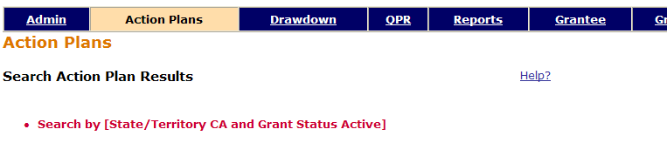
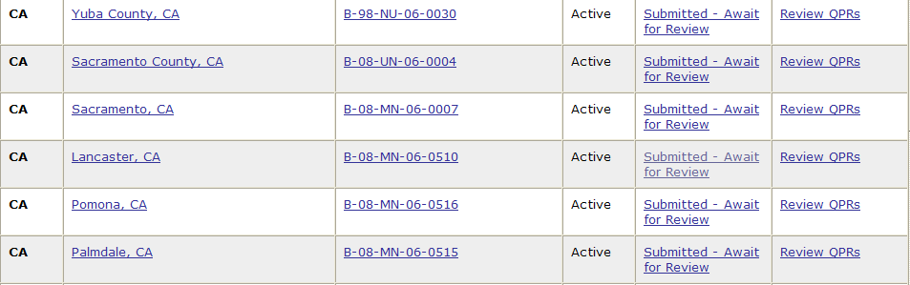
Approving/Rejecting Action Plans
Current DRGR Release 6.4
Notes:
This is the process you would follow to review and take action on the DRGR Action Plan. Click on the Action Plan module and do a blank search. Click on the status of the desired Action Plan in the system.

Slide 23
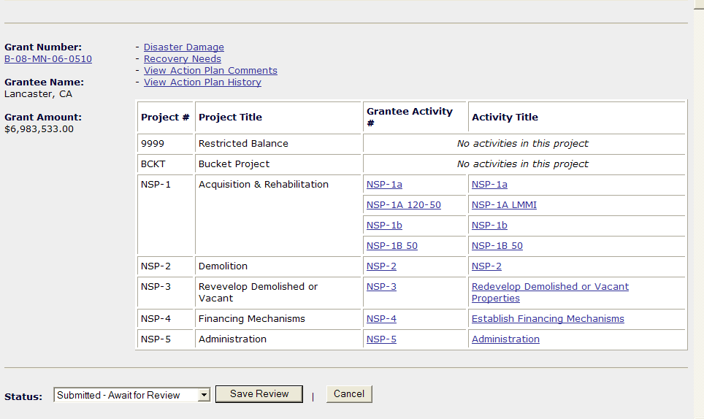
Approving/Rejecting Action Plans
Current DRGR Release 6.4
Notes:
You can change the status of the Action Plan in the drop down menu beneath the activity breakdown box at the top of the Action Plan. If you do not see this dropdown menu, this means the grantee has not submitted their Action Plan yet (HUD FO staff CAN view grantee’s Action Plans and QPRs before they are officially submitted). Make sure you hit ‘Save Review’ (after making comments) and choosing to either Approve or Reject.

Slide 24
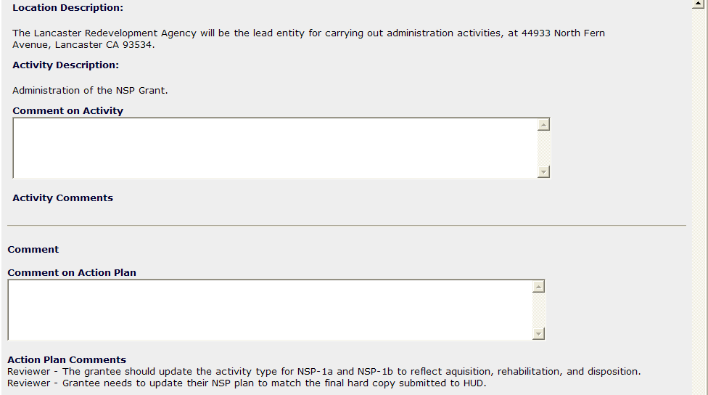
Action Plan Comments
NEEDED: Screenshot of where HUD Field Office staff enter AP comments
Current DRGR Release 6.4
Notes:
HUD FO Staff can make comments on the Activity level as well as on the overall Action Plan. Action Plan comments are only visible to HUD staff and are mainly for internal/monitoring purposes. However, HUD staff can use a variety of methods – e-mail, Word documents, and the AP Comment Report – to send comments to grantees if they want to.

Slide 25
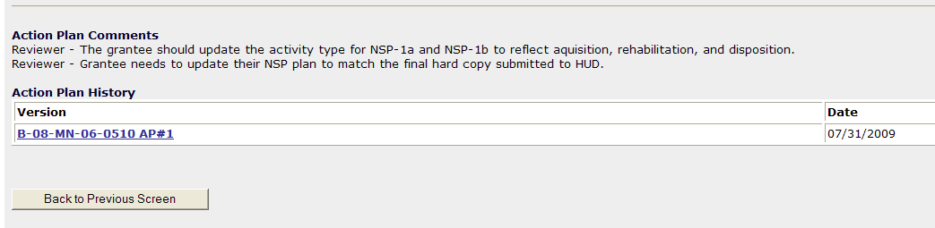
Action Plan Comments
At the bottom of the Action Plan screen…
Current DRGR Release 6.4
Notes:
Once an Action Plan review has been saved, the comments will appear to HUD staff at the bottom of the Action Plan.

Slide 26
Case Study #2
Take Action on the Action Plan
Notes:
Let’s go over this process in the system.

Slide 27
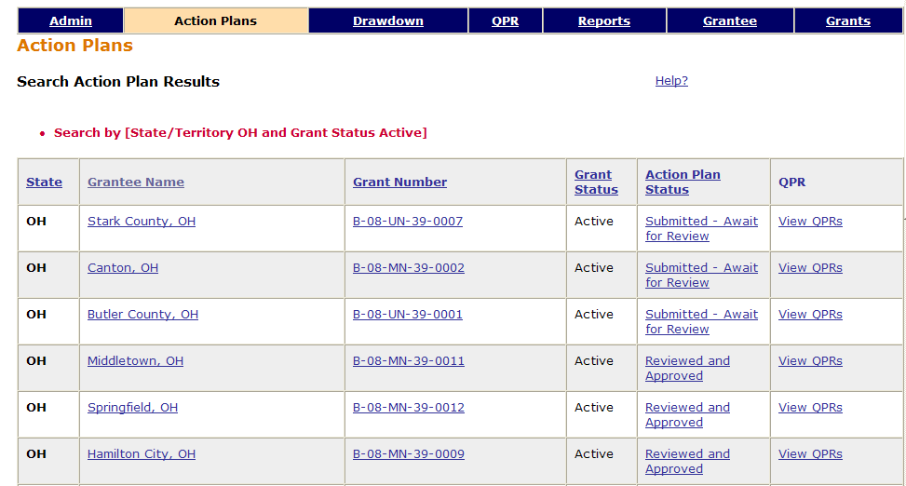


Determining Action Plan Status
Current DRGR Release 6.4
Notes:
There are two different ways to determine Action Plan status – by using the Action Plan module and pulling the Action Plan status report. By clicking on the Action Plan module, you should be able to pull up the Action Plans of your grantees and access their statuses.

Slide 28
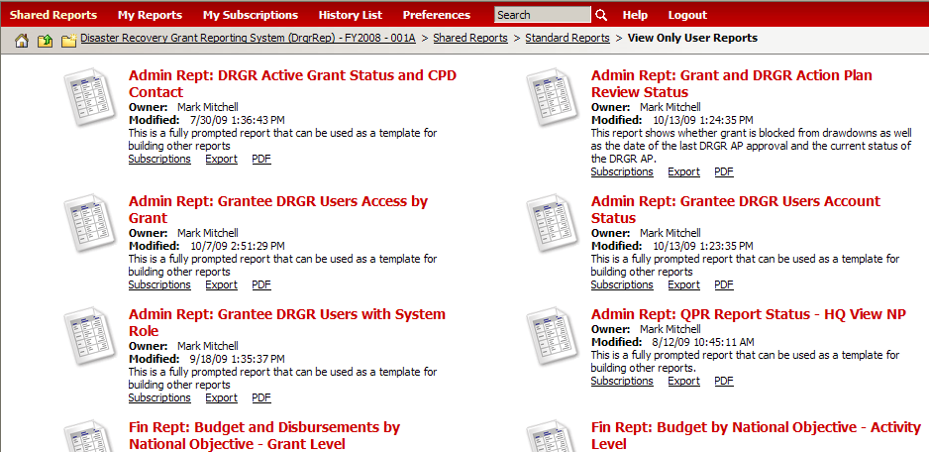
Determining Action Plan Status
Lists AP status for all grantees in your Field Office.
Notes:
You can also choose the Grant and DRGR Action Plan Review status report under the Reports tab to view Action Plan status and the most recent CPD Approval Date for each Action Plan.

Slide 29
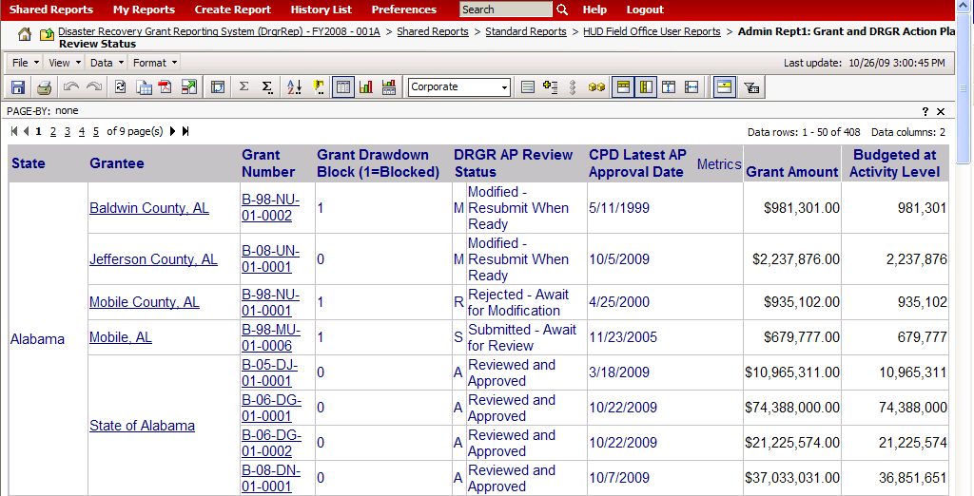
Grant and DRGR AP Review Status
Admin Rept: Grant and DRGR Action Plan Review Status
This report shows whether a grant is blocked from drawdowns as well as the date of the last DRGR AP approval and the current status of the DRGR AP. It also includes the amount of funds budgeted at the activity level. The field office version includes grantee name and state as columns.
Notes:
Source: MSTR Reference Guide, pg. 19

Slide 30
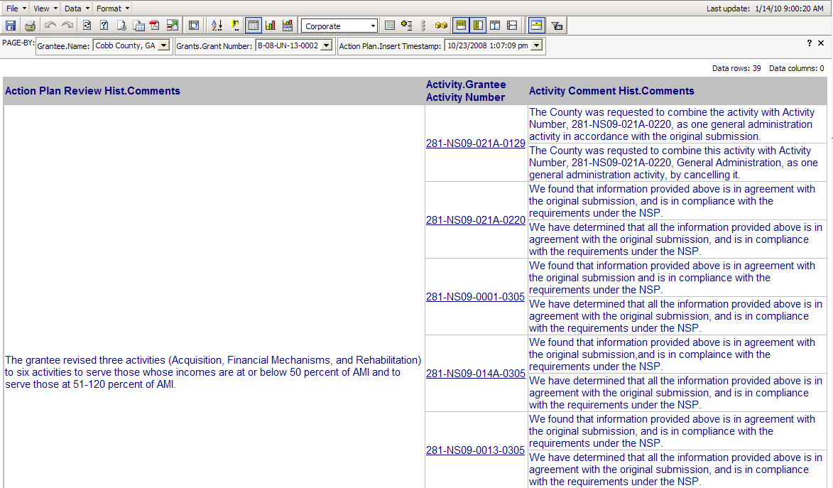
DRGR Action Plan Comment Report
Notes:
Source: MSTR Reference Guide, pg. 25
The Action Plan Comment Report provides a quick way of sending comments to grantees (if desired) and a nice way to view the overall and activity-level comments made on an Action Plan. This report will look different in the future – the overall comment field (now in the left column) will move to the top of the right column.
Here are some other useful reports related to Action Plans…

Slide 31
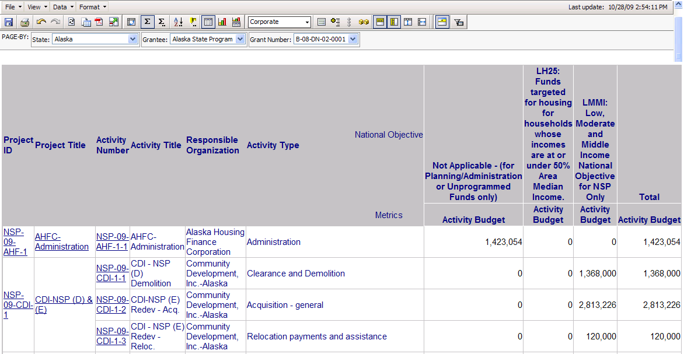
DRGR AP Budget by Nat’l Objective – Activity Level
Notes:
Source: MSTR Reference Guide, pg. 26
This report can be used to create a master list of activities for each grant. This report provides a quick way to see how grantees are doing as far as fulfilling the 25% set aside requirement.

Slide 32
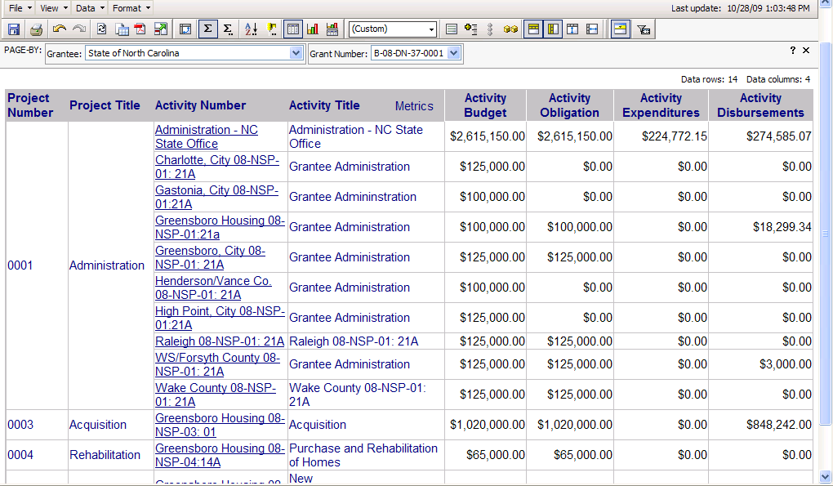
Grant Funds Cumulative Financial Summary –
Activity Level by Project
Notes:
Source: MSTR Reference Guide, pg. 30
This is a report showing data at the activity level from the latest DRGR Action Plan and across all QPRs (regardless of QPR status) SORTED BY PROJECT. The data here is real-time. This report is also available sorted by Responsible Organization, National Objective, and Activity Type.
Use this report to examine expenditures vs. draws and check out grantee obligations.

Slide 33
Case Study #3
Check on Activity Budgets
Notes:
Let’s go over this process in the system.

Slide 34
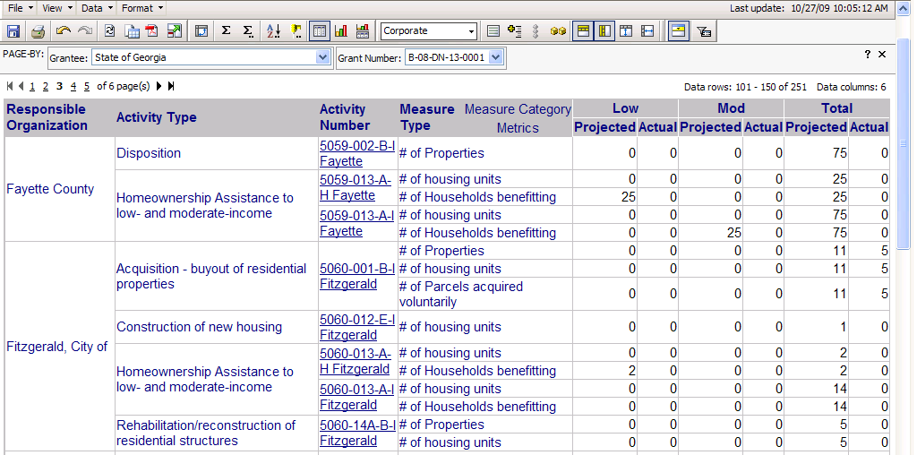
Projected vs. Cumulative Totals for Performance Measure
Sorted by Responsible Organization and Activity Type
Notes:
Source: MSTR Reference Guide, pg. 33
This reports shows data from the latest DRGR Action Plan and all QPRs (regardless of QPR status). This is the same report as the grantee report, but field office users must select which grantee to view before selecting the grant. This report is also available sorted by activity number.
This report is useful in examining grantee progress towards meeting the goals expressed in their Action Plan. It measures projected data (from the Action Plan) and actual data (from the QPR).

Slide 35
Obligations &
Drawdowns
Obligations • Draws over the Daily Threshold • Blocked Drawdowns • Acceptable Vouchers
Notes:
On to obligations and drawdowns!

Slide 36
Obligations in DRGR
How does HUD determine when NSP funds have been obligated?
“Funds are obligated for an activity when orders are placed, contracts are awarded, services are received, and similar transactions have occurred that require payment by the state, unit of general local government, or subrecipient during the same or a future period. Note that funds are not obligated for an activity when subawards (e.g., grants to subrecipients or to units of local government) are made.”
In other words, HUD expects grantees to obligate funds to specific activities.
Notes:
Source: http://www.hud.gov/offices/cpd/communitydevelopment/programs/neighborhoodspg/pdf/nsp_faq_timeliness.pdf
This information is coming directly from the NSP-1 FAQs posted on hud.gov. Here are some of the guidelines you can use to help grantees figure out when to obligate funds and what constitutes an obligation according to NSP policy. Remind them that they MUST obligate funds in DRGR before completing a drawdown. You can check the number of funds obligated to an activity in a number of different reports.

Slide 37
Obligations in DRGR
How does HUD determine when NSP funds have been obligated?
The following are examples of obligations for a “specific activity”:
Execution of an agreement with a REO holder to acquire one or more foreclosed upon properties.
Execution of a contract to rehabilitate an abandoned or foreclosed upon property.
Execution of a loan agreement.

Slide 38
Obligations in DRGR (continued)
How does HUD determine when NSP funds have been obligated?
Issuance of a purchase order for equipment/supplies used to maintain acquired property.
Execution of a demolition contract.
Administrative action necessary to assign a staff person to work on NSP activities.
The execution of a subrecipient agreement would NOT qualify as an activity that counts toward meeting the 18-month obligation requirement.
SOURCE: NSP-1 TIMELINESS FAQs
http://www.hud.gov/offices/cpd/communitydevelopment/programs/neighborhoodspg/pdf/nsp_faq_timeliness.pdf
Notes:
Again, the execution of a subrecipient agreement does NOT qualify as an activity that counts toward meeting the 18 month obligation requirement for NSP 1.

Slide 39
Obligation Policy & Addresses:
How does the grantee link an obligation
or drawdown to a specific address?
There is no way to attach individual addresses to draws
except in the case of multi-family properties,
which would each have their own activity
(if properly recorded).
The same attachment would not be possible in the case of
single family properties since there can be
multiple SF addresses per activity.
Notes:
Many grantees have questions about how to link an obligation or a drawdown to a specific address. There is no way to do this other than to separate multi-family addresses into different activities and to report on single-family addresses in their QPR. Grantees need not worry about reporting on draws on SF addresses individually within DRGR. Multi-family addresses may be entered in the location field in an activity under the Action Plan and single family addresses are entered in the address field of the QPR. The Addresses by Activity Report shows information for addresses across activities and QPRs.
It is a good idea for Field Reps to examine whether or not addresses and performance data are entered when draws show for an activity.

Slide 40
Draws Over the Threshold
HUD sets a maximum amount for draw requests in a voucher in DRGR. For example, the draw limit for NSP1 is $5 million. If a grantee’s draw request amount exceeds the limit set for the grantee, that draw request will route to HUD for review and show a status of [Approved Pending HQ].
Look for information such as a invoice or purchase order with sufficient detail to demonstrate that the draw request was created, reviewed by the grantee, and approved in accordance with grantee procedures. For NSP1, the HUD Rep must consult with Mark Mitchell, Jessie Handforth Kome, or Jan Opper at HUD Headquarters prior to approval of the draw request, to ensure that the approval is properly handled and documented.
Notes:
Though, for the most part, grantees will perform all the necessary actions on their own vouchers, if they attempt to make a draw of $5 million or more, the voucher will come to you for approval. You MUST consult with Headquarters staff listed above before taking action on the voucher, regardless of whether you intend to approve or reject it. Again, HUD wants to turn vouchers around in 72 hours, so make sure you are checking in with grantees, looking at the Voucher Line Item status report, etc. HUD HQ staff will let you know if at some point they are okay with you approving or rejecting these draws without consulting them first.
The draw limits will be different for NSP-2 and NSP-TA.

Slide 41
Blocked Draws
Draws can be blocked at the grant and activity level by HUD (such as in the next slide) or at the activity level by the grantee
COMMUNICATE WITH HQ if draw is blocked by HUD
Check for Restricted Balance projects
Notes:
You should be in communications with Headquarters regarding the status of grants blocked for draws. If your grantees have Restricted Balance projects, let HQ know when grantees have set up their Action Plan properly.

Slide 42
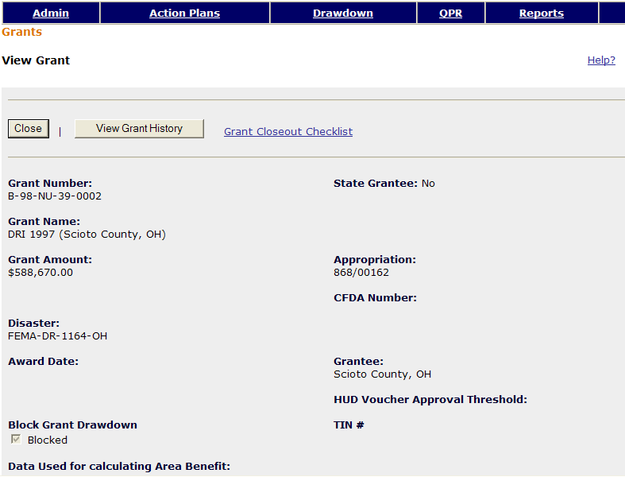
Blocked Draws – Grant Level
Current DRGR Release 6.4
Notes:
Here is the screen that shows if a grant is blocked for draws or not. You can navigate here by clicking on a grantee’s Grant Number (by pulling up the Action Plan screen, by searching for it, etc.)

Slide 43
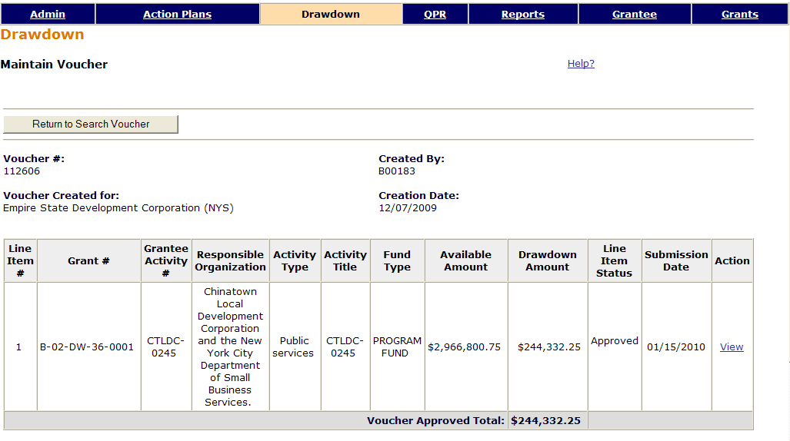
Acceptable Vouchers
Current DRGR Release 6.4
Notes:
Here’s a look at what an acceptable voucher looks like.
(Read out each field.)

Slide 44
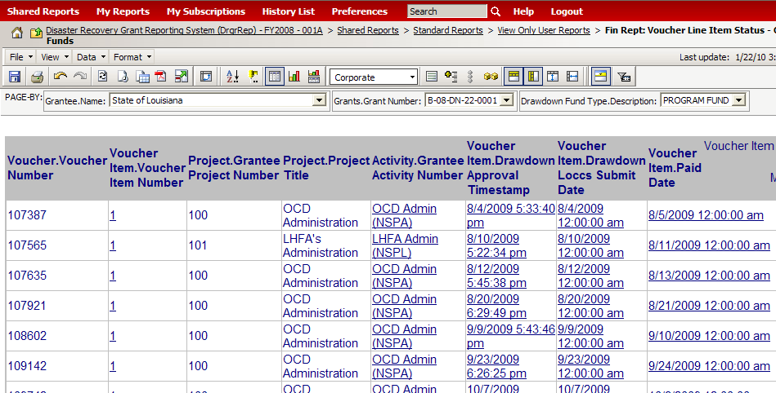
Voucher Line Item Status – Grant Funds
Notes:
Source: MSTR Reference Guide, pg. 27
This is a report showing the status and action dates of voucher line items (note: draws before Jan.1, 2009 are simulated from QPRs). This report is sorted by voucher number and voucher item number. Status of each voucher line item shows in columns with a total amount in each category showing at the bottom of the report. This report is also available sorted by Project.
If a certain column is not showing (e.g, Approved Pending HQ), it’s because no data is available for that field.

Slide 45
Case Study #4
Pull Drawdown Voucher Line Item Status Report
Notes:
Let’s pull this report from the system.

Slide 46
Quarterly Performance Reports (QPRs)
QPR Deadlines • QPR Checklist Points • Commenting on QPRs • QPR Reports
Notes:
Now let’s look at QPRs.

Slide 47
QPR Deadlines
First QPR is due: 30 days after the first full quarter after the grant agreement is executed.
Remaining QPRs are due: within 30 days of the end of the calendar quarter.
HUD Action on QPRs is due: within 30 days of QPR submission.
Notes:
The due date of the first QPR is triggered by the contract effective date (often the date of the second signature in LOCCS). Remaining QPRs are due by the 30 days of the end of the calendar quarter. The data that the system pulls down on the QPR is a snapshot of the information available in the system on the last day of the quarter. You must take action on a grantee’s QPR within 30 days of grantee QPR submission.

Slide 48
QPR Checks – NSP Checks
Single-family addresses served during the quarter are entered in the QPR.
Multifamily addresses are separate activities.
25% LH activities are separate from other activities.
Notes:
Now we’ll review some of the major checks that need to be made on a grantee’s QPR. The list here is not exhaustive – we’ve included the entire QPR checklist in your binder.
One of the biggest issues within QPRs is the question of how to report on addresses. Make sure grantees understand that single family addresses should ONLY be listed here, and that each multi-family address should be a separate activity. They should also be aware that their 25% set-aside activities for people with an AMI of 50% or less should be separate from their other activities.

Slide 49
QPR Checks – Financial
Are expenditures on track to meet NSP deadline?
IS PROGRAM INCOME
  Recorded in the QPR on the proper activity?
  Being drawn down?
MATH RULES
  Does project budget + project budget = grant amount?
  Are drawdowns and expenditures reasonably close?
  Are the administration budget and obligations at or under 10% of the total grant amount?
Notes:
Depending on the nature of their subrecipient agreements, some grantees may be required to spend their Program Income first before dipping into NSP funds. Grantees may choose to either offset draws from program funds or add activities to their Action Plans to spend down PI. Program Income is included in their 18 month obligation requirement. If you see a grantee’s Program Income growing, encourage them to include why this is the case and their intentions for the funds in their QPR narrative. If drawdowns and expenditures seem off base, communicate with your grantees to find out why this is the case.

Slide 50
QPR Checks – Narrative
Do the narratives provide HUD with enough information to determine if sufficient progress is being made on this activity to enable the grantee to meet the 18-month and
4-year deadlines?
Read the Overall Progress Narrative. Is this sufficient to explain the progress or lack of progress of this grant?
Notes:
There is no strict guidance in terms of what grantees enter in their narratives, so you, as Field Representatives, can make the call on what kind of information you’d like to see. If grantees are cutting and pasting narratives from other documents, remind them that special characters and tables will not copy properly and will garble the text. It’s a good idea to recommend they save documents in .txt format and then copy the text from there.

Slide 51
QPR Checks – Activity Progress
For the activities that do not appear in the QPR, do you have any information that would indicate the reason for the lack of progress?
Select an activity to review. Is the Responsible Organization listed as the one carrying-out the activity? Is there only one Responsible Organization discussed in the activity?
Are the right performance measures showing for this activity?
Notes:
If Performance Measures are not showing in the QPR, it is most likely because the grantee did not enter beneficiary estimates in their Action Plan. Remind grantees to record their Program Income in the quarter it was received.
Activities with no financial activity during the quarter or information in the narrative section will not show up in the final submitted version of the QPR.

Slide 52
QPR Comments
Which of the following is true about comments on APs and QPRs? (More than one correct answer possible).
Viewable to grantees and HUD staff.
Grantee can see comments once they open their QPR.
Comments are for internal and auditing purposes – only visible to HUD staff.
If HUD staff want grantees to see comments, they should consider copying comments into a Word document, e-mail, etc.
Notes:
Let’s test our knowledge of QPR comments.

Slide 53
QPR Comments
C & D are correct.
Viewable to grantees and HUD staff.
Grantee can see comments once they open their QPR..
Comments are for internal and auditing purposes – only visible to HUD staff.
If HUD staff want grantees to see comments, they should consider copying comments into a Word document, e-mail, etc.
Notes:
Comments are only visible to HUD staff and are maintained mainly for internal and monitoring purposes. It is acceptable for HUD staff to send comments to grantees, but they will have to do so using some method outside of the DRGR system. You should consider e-mailing, inserting them into a word document, or sending the QPR Comment report to the grantee.
If the QPR is missing required information, you must alert the grantee within 10 days of receiving the QPR. Request the necessary corrections and reject the QPR.

Slide 54
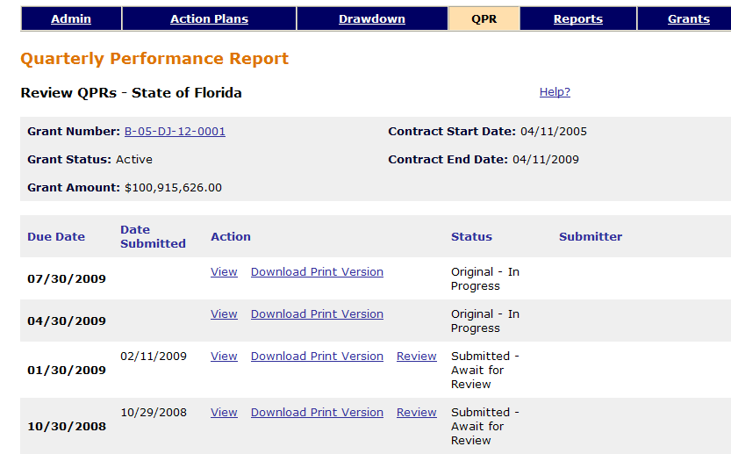
QPR Review
Current DRGR Release 6.4
Notes:
Click “Review” next to the QPR you want to take action on.

Slide 55
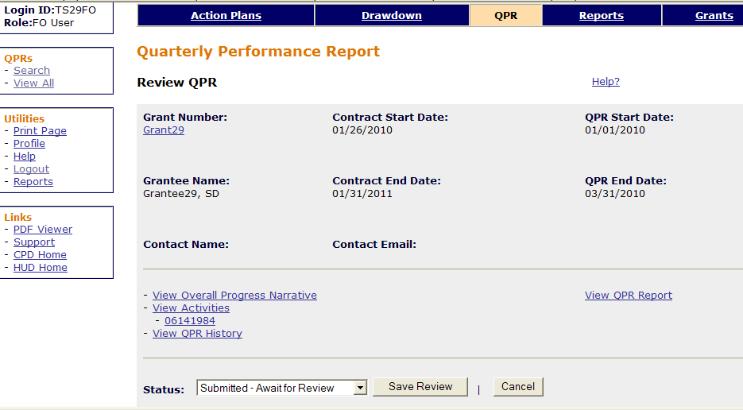
Approving/Rejecting the QPR
Current DRGR Release 6.4
Notes:
Just like with the Action Plan, you will use the drop down box at the top of the page to Approve or Reject a QPR.

Slide 56
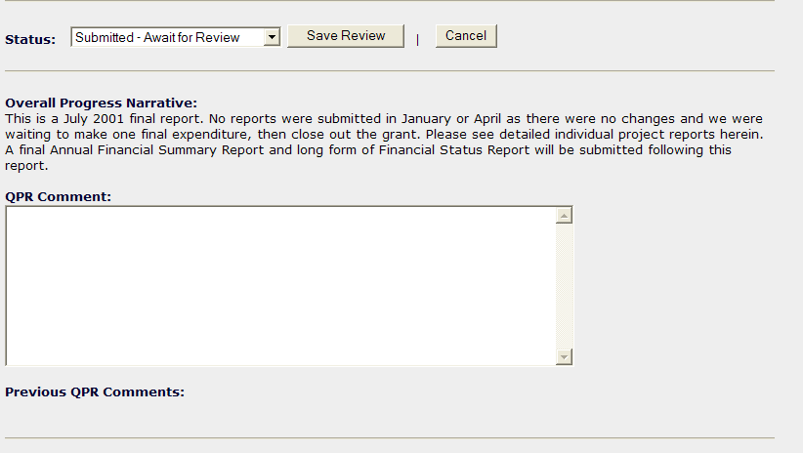
Where to Make QPR Comments
Current DRGR Release 6.4
Notes:
This is the box where you will enter comments about the QPR as a whole. Always put “Reviewed by” and your initials in the overall comment field. Save. Put overall Review Comments here. If you reject the QPR, you will also briefly describe why here. Save.

Slide 57
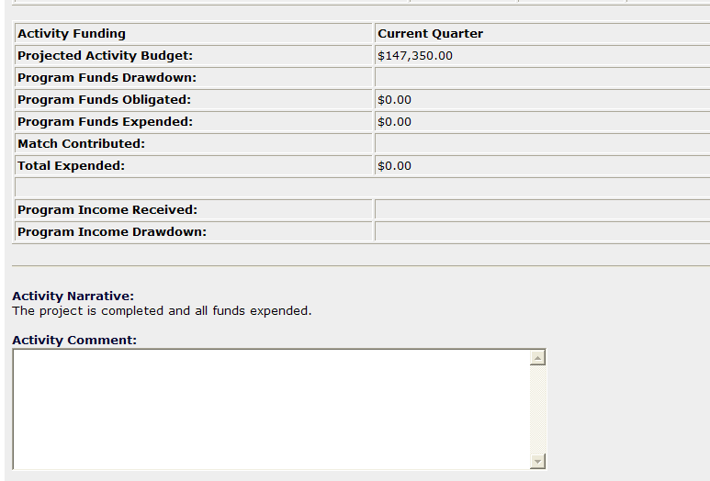
Where to Make QPR Comments
Enter QPR comments on the activity level here.
Current DRGR Release 6.4
Notes:
You can also insert comments at the activity level in the QPR.

Slide 58
Case Study #5
Review the QPR
Notes:
Let’s review a QPR in the system.

Slide 59
QPR Comment Report
Notes:
Source: MSTR Reference Guide, pg. 20
This report provides an easy way to access all the comments made on QPRs for a particular grantee (at the time the training materials were produced, the QPR comment report screenshot was not available, so this is the AP Comment Report screenshot). Field Office staff may find this report to be a useful tool to use in sending comments to grantees.

Slide 60
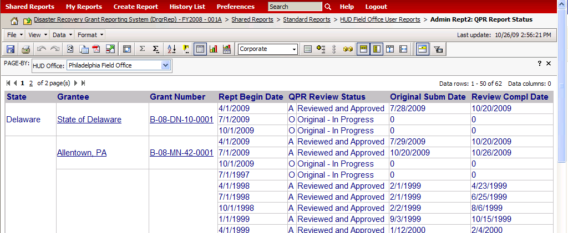
QPR Report Status
Notes:
Source: MSTR Reference Guide, pg. 20
The QPR report status report can be useful for ensuring that your review, as well as the grantee’s original QPR submission, are being completed on time. This report will only show the status of QPRs that have been added by grant. Grantees must add each QPR as they are due. The Field Office version shows the grantee name and state as columns.

Slide 61
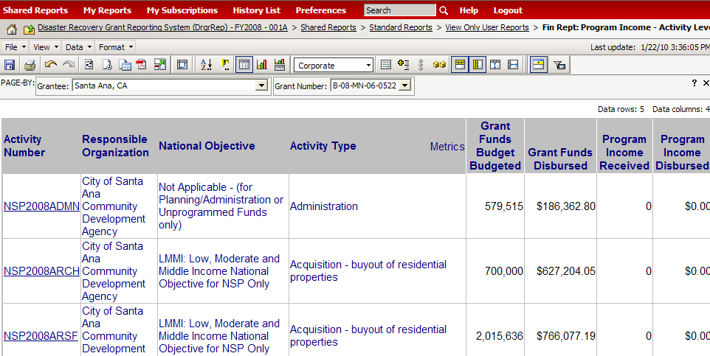
Program Income – Activity Level
Notes:
Source: MSTR Reference Guide, pg. 29
This is a report showing data at the activity level Program Income disbursements recorded in the drawdown module and across all QPRs (regardless of QPR status).

Slide 62
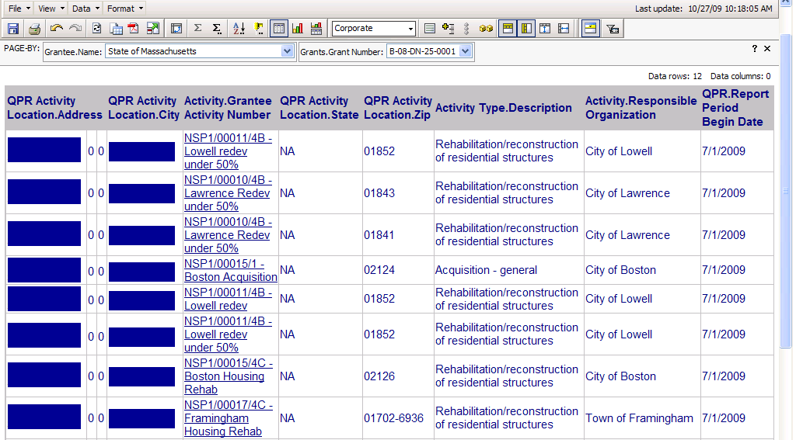
Addresses by Activity and Responsible Organization
PERF REPT: Addresses by Activity and Responsible Organization
This report is intended to show addresses across activities and QPRs. Each QPR normally only shows addresses entered in that report.
Notes:
Source: MSTR Reference Guide, pg. 34
This report will show all the addresses that are entered into all the QPRs and Action Plan activities for any particular grantee.

Slide 63
Case Study #6
Modify the ‘Addresses by Activity’ Report
Notes:
Let’s look at Case Study #6.

Slide 64
Troubleshooting Jeopardy
Please organize into teams of three or four.
I will present you with a potential grantee issue and
you will tell me what measures you would take
to help them solve it.
Answers may include referring the grantee to a Help Desk, walking them through solving the problem,
or solving the problem for them.
Notes:
There may be multiple correct answers for any particular question – you must give me at least one correct response. You will receive multiple points if you provide more than one correct answer.

Slide 65
Questions?
Notes:
Any questions? I’m happy to answer any lingering questions from yesterday’s or today’s material.
(Before concluding, go over remaining resources in the binder and give out contact information/business card.)

Slide 66
Thank you!
Our training session is now complete.
Please complete the evaluation — your feedback is important to us!
For additional support contact Community Connections at:
1-800-998-9999, Option 3
or
DRGR_Help@hud.gov
Notes:
Thank you so much for your time and participation! I will stay after to answer any remaining questions, and to receive any feedback you may have.

