Slide 1
Notes:
Straightforward Scenario - Cassandra and Miguel Rodriguez just moved into the 3-bedroom house at 4694 Main St. They previously lived in a larger house with their two children Inez and Jose. But since Inez and Jose moved out and started families of their own, Cassandra and Miguel wanted a smaller house because no one else lives or stays in the house with them.
Complex Scenario - The Rodriguez family lives in the 3-bedroom house at 4694 Main St. The family has four members: Cassandra and Miguel Rodriguez, and their two children Inez and Jose. Cassandra and Miguel stay in the master bedroom, and Inez and Jose each have a room of their own. Inez always stays in her room, but Jose is a college student. Although his legal address is 4694 Main St, he lives at the college dorms all year, including summers, and only comes home for holidays and vacations.

Slide 2
Notes:
Straightforward Scenario – Brian and Brad went to college together and after graduation they decided to live together in a rented 2-bedroom apartment. They share rent, are not related, and they are not in a relationship.
Complex Scenario - Brian and Brad live together in a 2-bedroom house. Brian owns the house and Brad pays rent to Brian. Brad has his own room and access to certain parts of the house. They are not related.

Slide 3
Notes:
Straightforward - The Carter family lives in a suburban area in the Midwest. They own a single family home, which has a small yard that surrounds the house and their house is not attached to any other house.
Complex - The Carter family lives in a 2 story townhouse. The townhouse is broken into two apartments, one on each floor. There is also a basement apartment that is not currently inhabited, so the Carters and the other family use it for storage.

Slide 4
Notes:
Straightforward - The Carters designed and began building their own home after they were married in 1973. It was finished in 1974.
Complex - The Carters designed and began building their own home after they were married in 1998. It was finished in 2000.

Slide 5
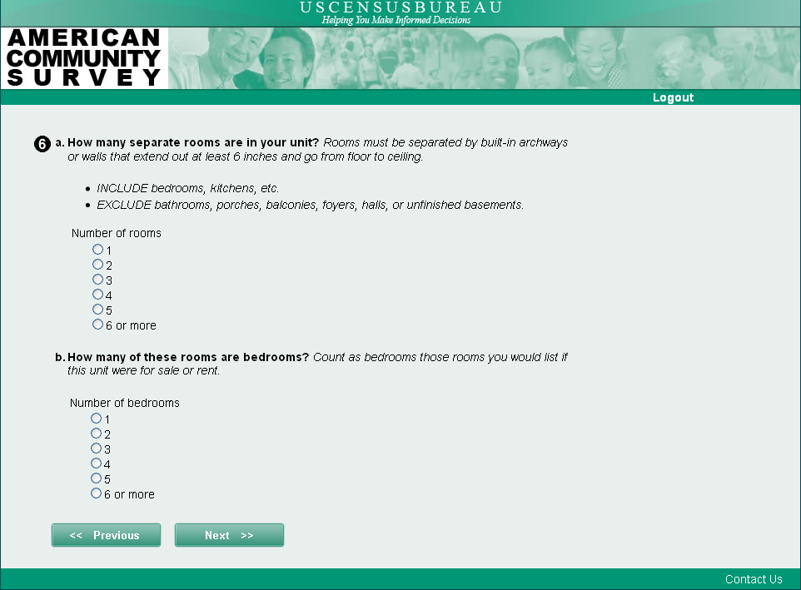
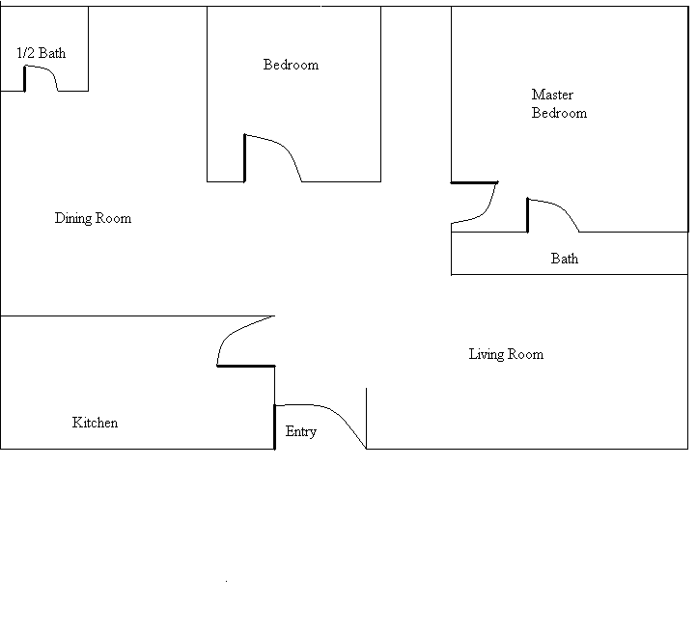
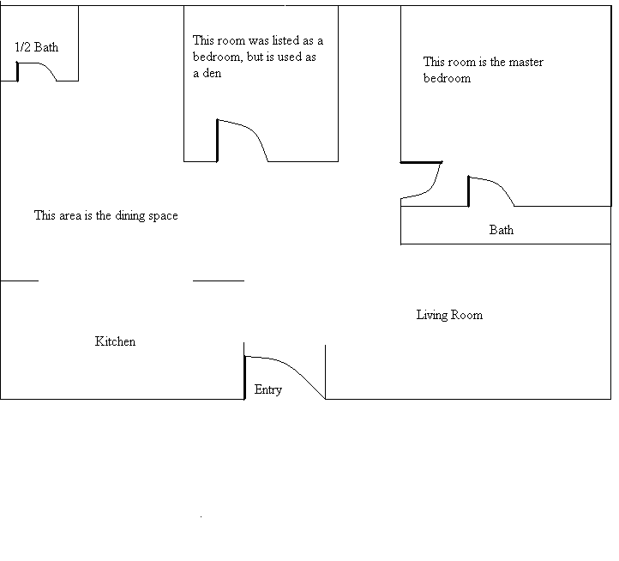
Notes:
Straightforward - Susie lives in an apartment building in New York City. The floor plan is below:
Complex - Susie lives in an apartment building in New York City. The floor plan is below:

Slide 6
Notes:
Straightforward– Robert lives alone in Chicago, Il. He subscribes to Sprint's cell phone service and carries a working cellular phone with him that can make and receive calls, but does not have a landline at his apartment.
Complex -Robert lives with his wife and two teenage children in Chicago, Il. He subscribes to Sprint's cell phone service and carries a working cellular phone with him that can make and receive calls. No one else in the family has a cell phone and his house does not have a landline telephone.

Slide 7
Notes:
Straightforward - The O'Brien family has 2 cars, which they use daily to drive to work. They keep the cars parked in their garage when they are not in use. They have no other vehicles.
Complex - The O'Brien family has a recreational vehicle (RV) that they use for vacations. They keep it parked in their driveway when it is not in use. They have no other vehicles.

Slide 8
Notes:
Straightforward - The Millers live in Phoenix, Arizona. Since Phoenix is warm year round, they do not need to heat their home using any type of fuel. Rather, they just use extra blankets if the temperature drops.
Complex - The Millers use a geothermal heat pump to heat their home. Geothermal heat pumps force the transfer of heat from the earth instead of the air because the earth temperature is more constant than the air temperature.

Slide 9
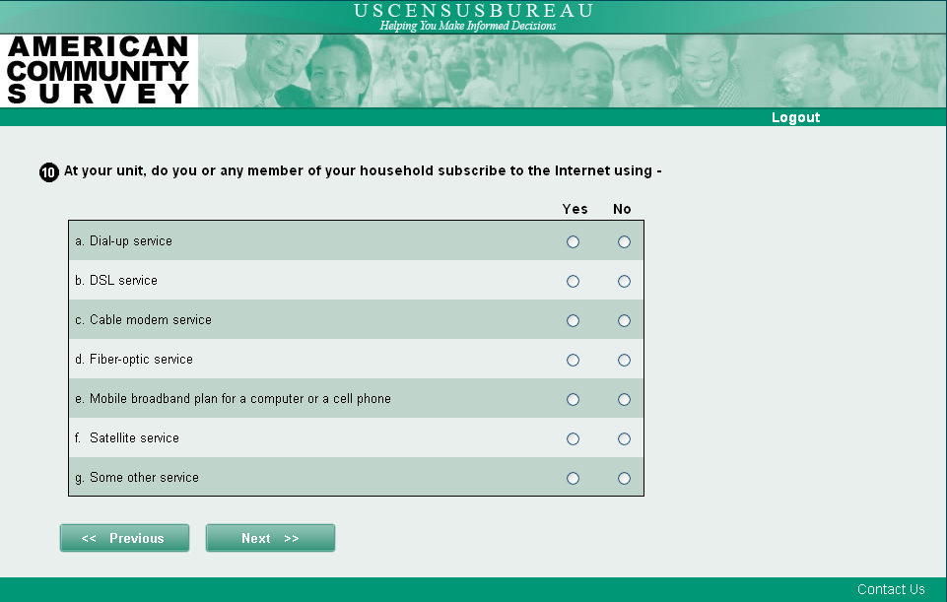
Notes:
Straightforward - Joyce has a traditional cable modem, which uses a cable wire to connect to the Internet, and pays her Internet bill to Comcast.
Complex - Joyce has a package deal through Verizon for land-based phone, highest speed Internet, and cable television.

Slide 10
Notes:
Straightforward - Michael was born in Russia to Russian parents and lived there for many years until moving to the United State 2 years ago. He also identifies as Russian.
Complex - Michael's grandmother on his father’s side was of Spanish descent. His mother’s family is from Germany. Michael does not identify with his father's side of the family.

Slide 11
Notes:
Straightforward - Erica's biological mother is Caucasian, as is her biological father. She was raised by her biological parents. She also identifies as White.
Complex - Erica's biological mother was African American and her biological father was Caucasian. She was adopted by an African American family and identifies as African American.

Slide 12
Notes:
Straightforward - Robin is currently single and has never been married
Complex - Robin and her partner Jen have lived together for 10 years without any type of recognized commitment. Last year they had a wedding ceremony in Illinois last year. Illinois does not recognize same sex marriages. Neither Robin nor her partner has been previously married.

Slide 13
Notes:
Straightforward - Joe Smith is currently a junior at George Washington University, majoring in Business Administration. He is registered for five classes in the current semester and regularly attends all of them. Classes began in September and it is currently October.
Complex - Joe Smith has a Master’s degree in electrical engineering which he received in 2004. Last month, at the request of his employer, he attended a 2-day seminar in communication cabling which earns him continuing education credits.

Slide 14
Notes:
Scenario - Dylan graduated from a 4-year university last year. He will be starting a Masters program next year.
Straightforward Question – No headings
Complex Question – With headings

Slide 15
Notes:
Straightforward - Colin is a healthy, active young adult. For exercise, he walks 2 miles every day and also jogs up and down the bleachers at the local high school.
Complex - Colin sprained his ankle during a soccer game. He will be on crutches for the next week.

Slide 16
Notes:
Straightforward - Stephanie works as a high school teacher and is paid on an annual 52-week contract. The school year runs from September through June and consists of two 18-week semesters. It is currently October.
Complex - Stephanie works as a high school teacher and is paid on an annual 52-week contract. The school year runs from September through June and consists of two 18-week semesters. It is currently August.

Slide 17
Notes:
Straightforward - David has been directly employed by the U.S. Department of Justice for the past 5 years in Washington, DC. David worked at the Department of Justice last week and has not worked at any other job.
Complex - David worked as a government employee for the Department of Justice for 35 years before retiring in 2009. After he retired, he became an independent contractor and obtained a contract with his old agency, the Department of Justice. This is the only job he worked last week.

Slide 18
Notes:
Straightforward - For the past year, Julie has worked a regular 9 to 5 job with the Federal government, which works out to 40 hours per week. She never works overtime, has not taken sick leave, and has not be on vacation this year. She does not have another job.
Complex - For the past year, Julie has spent 40 hours per week in the office at her government job. In the last six months Julie has been trying to start her own business in addition to her government job. So when she gets home, she spends 2 hours each weeknight working on starting her own business.

Slide 19
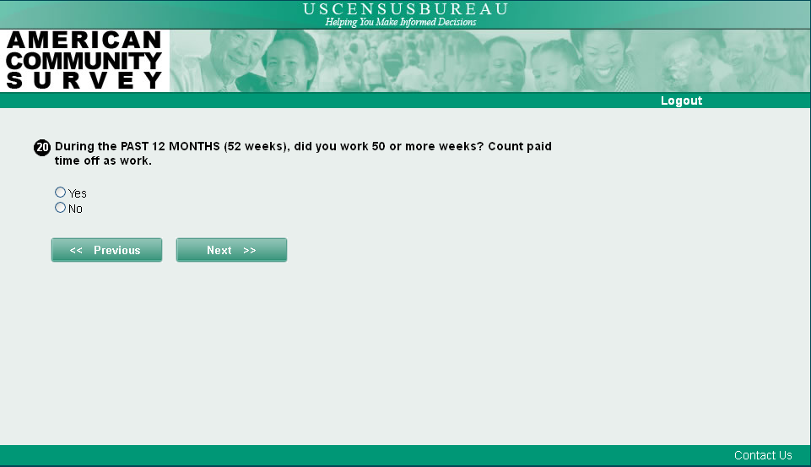
Notes:
Scenario - Jill worked most of the year as a librarian but was laid off for the last three weeks of the year and did not find other employment
Straightforward Question - a) During the PAST 12 MONTHS (52 weeks), did this person work 50 or more weeks? Count paid time off as work. If yes, b) How many weeks DID this person work, even for a few hours, including paid vacation, paid sick leave, and military service?
Complex Question - How many weeks did this person work DURING THE PAST TWELVE MONTHS? Count paid vacation, paid sick leave, and military service in the total.

Slide 21
Notes:
Straightforward - Meredith lives over an hour away from her company's office and there is no convenient public transportation near her home. Therefore, she has to drive her car to work every day.
Complex - Meredith does sales for a pharmaceutical company. There is no corporate office nearby, so her office is at her home. She makes daily sales visits to doctor’s offices around the metro area. She drives a car to these appointments.

