Slide 1
Spanish Version of RI WEB

Slide 2
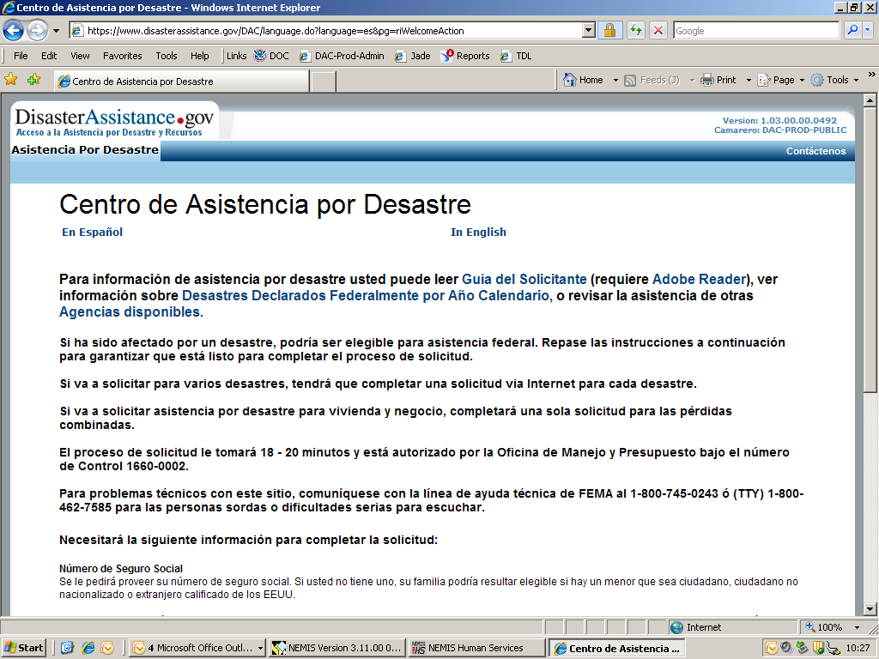
Notes:
Information Screen

Slide 3
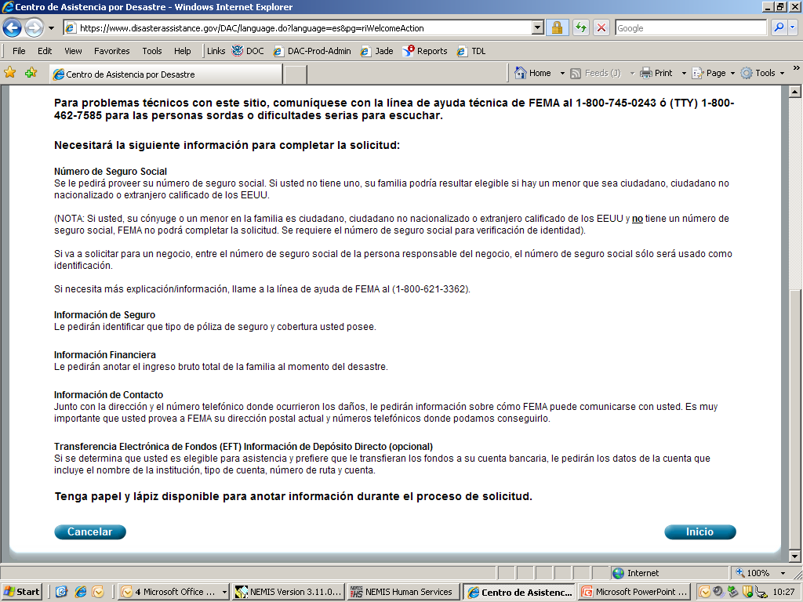
Notes:
Continued Additional Information Screen

Slide 4
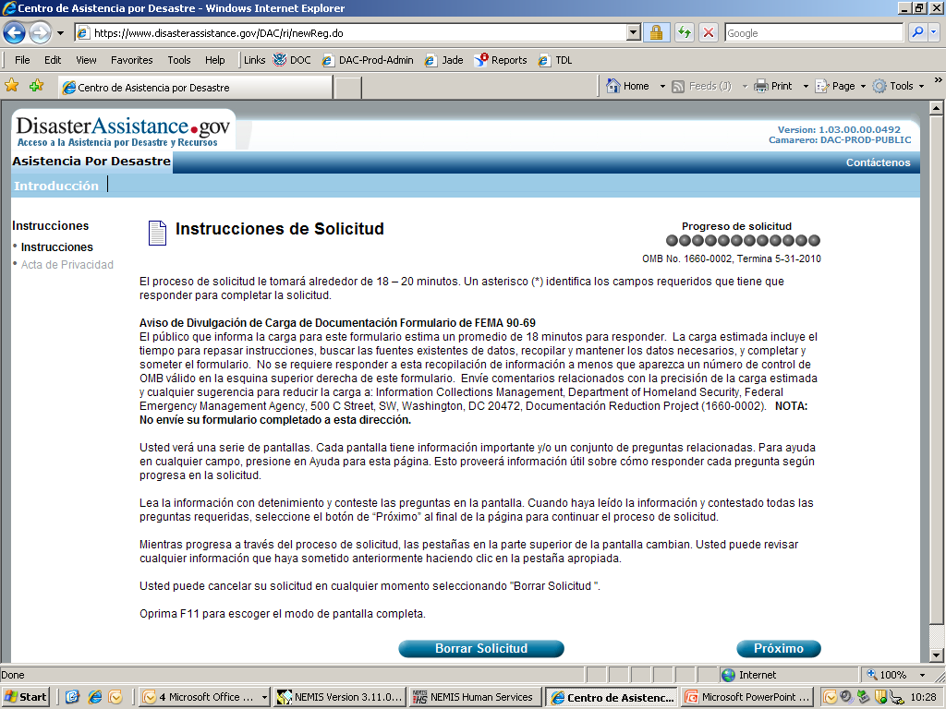
Notes:
Instruction Screen

Slide 5
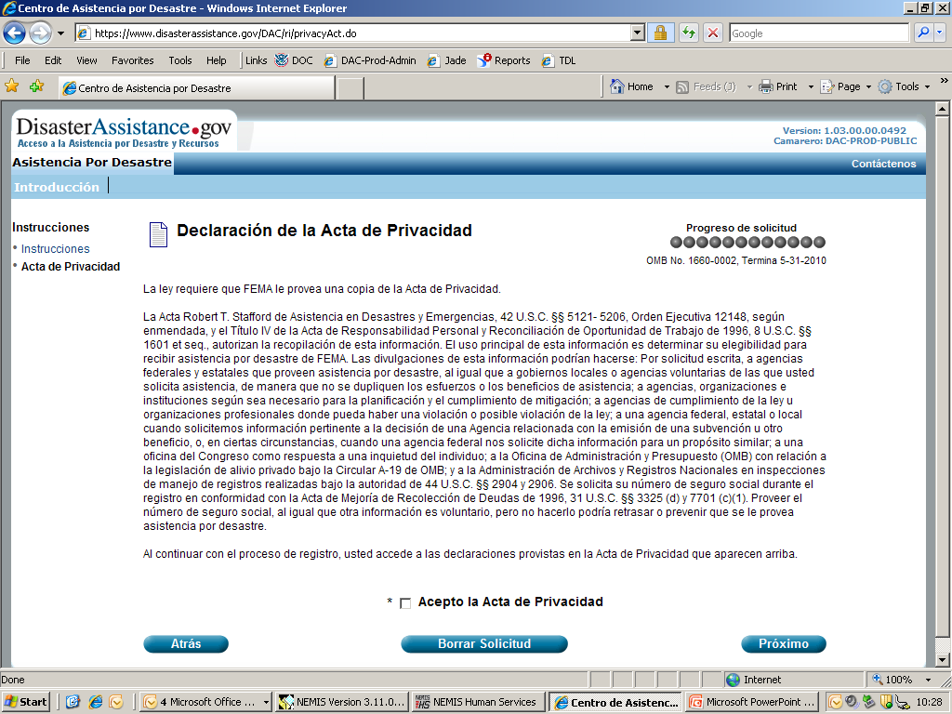
Notes:
Privacy Act Screen

Slide 6
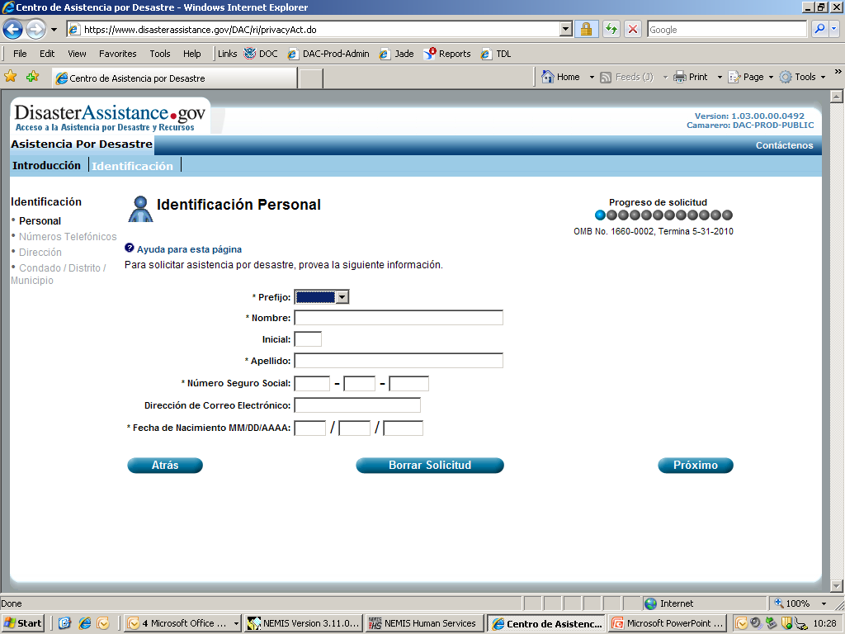
Notes:
Identification/Personal Information Screen

Slide 7
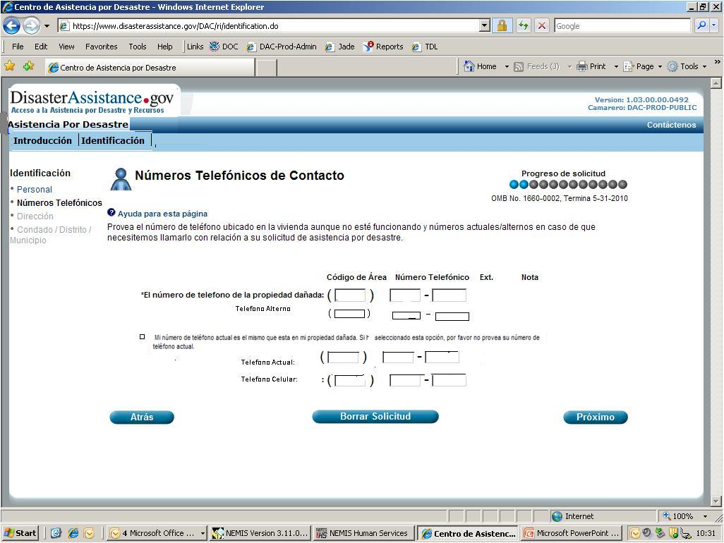
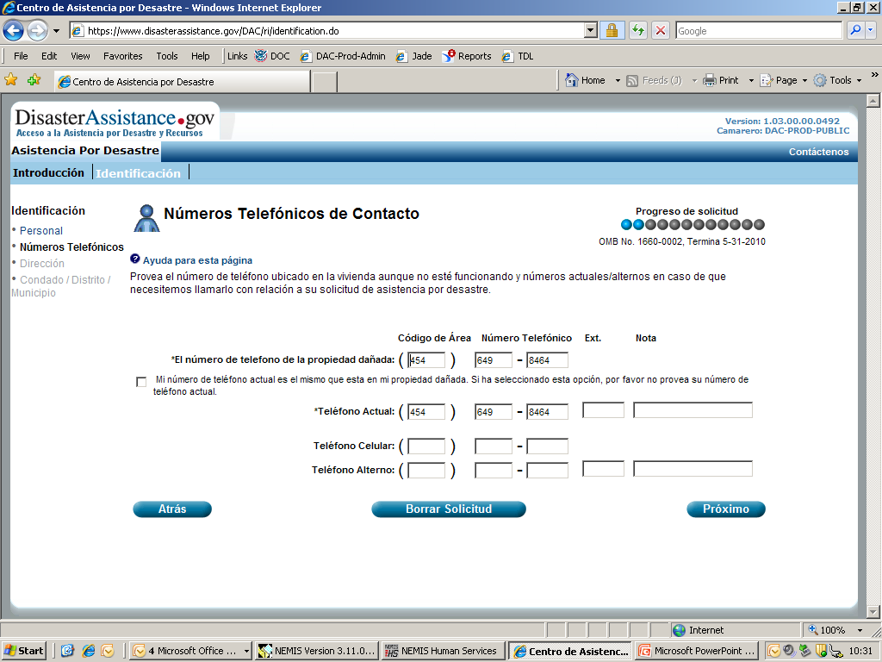
Notes:
Contact/Phone Information Screen

Slide 8
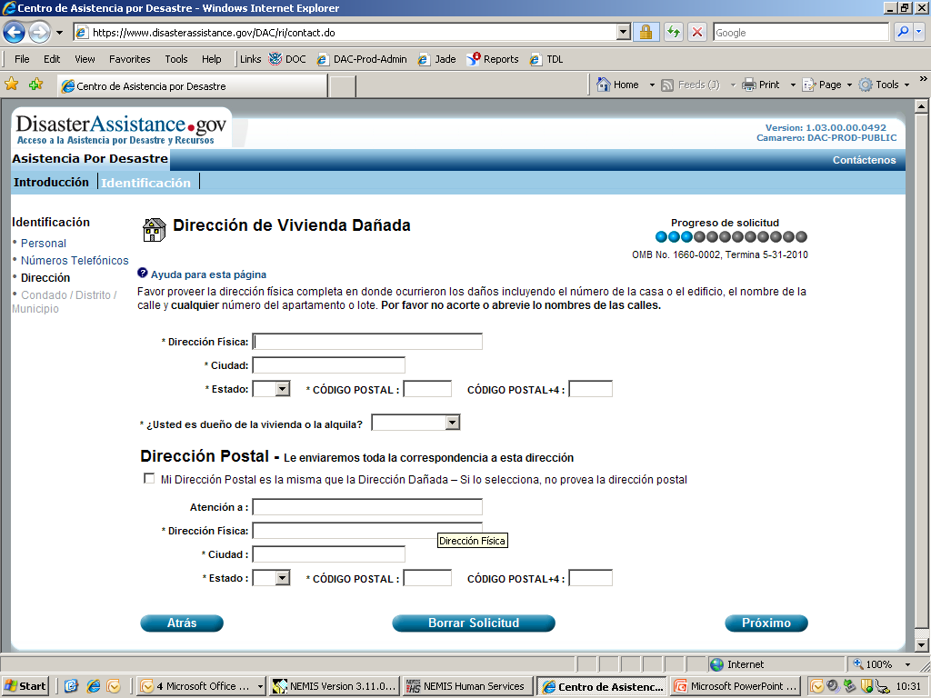
Notes:
Address/Postal Screen

Slide 9
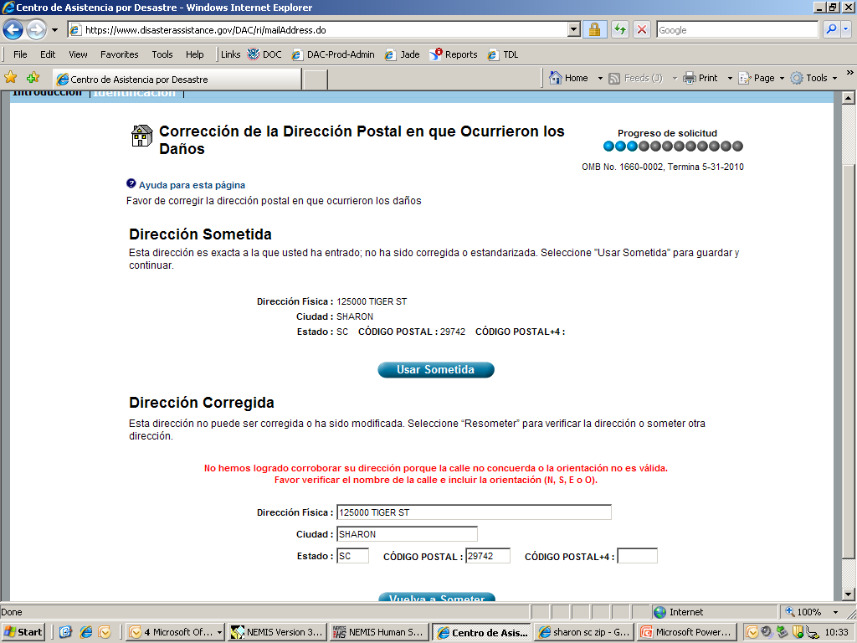
Notes:
Address Correction Screen

Slide 10
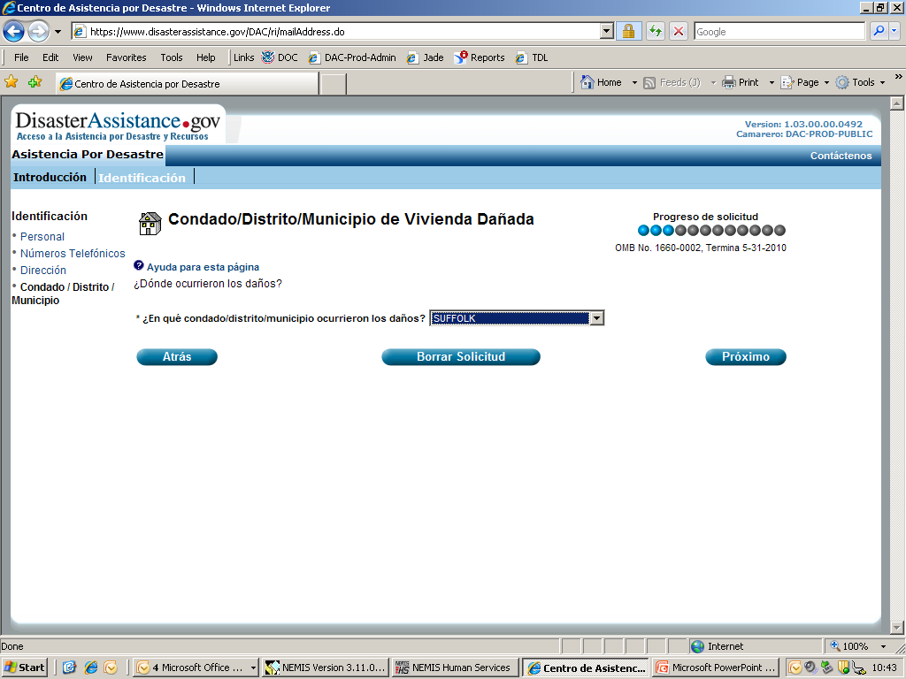
Notes:
District/ County Screen

Slide 11
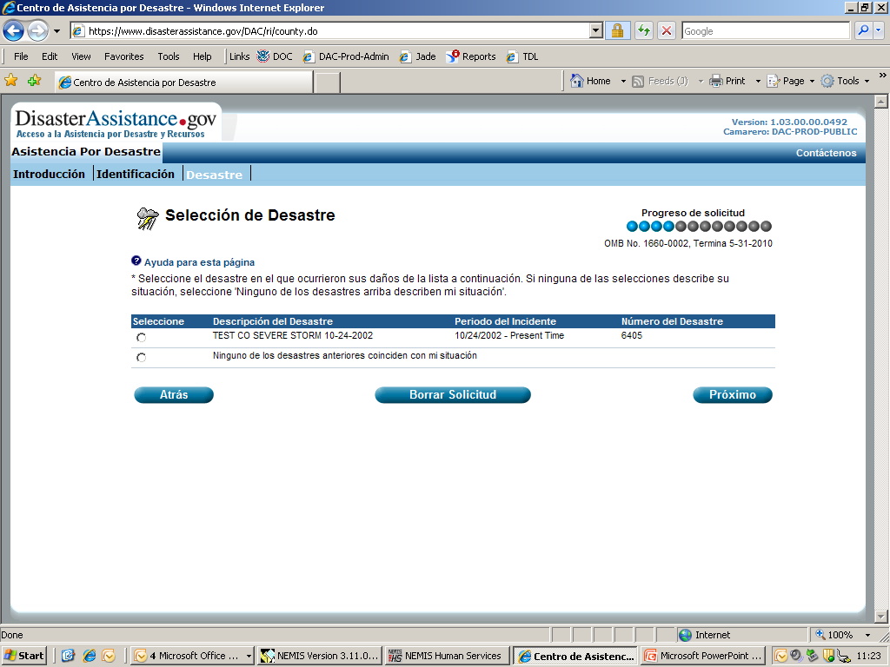
Notes:
Disaster Selection Screen

Slide 12
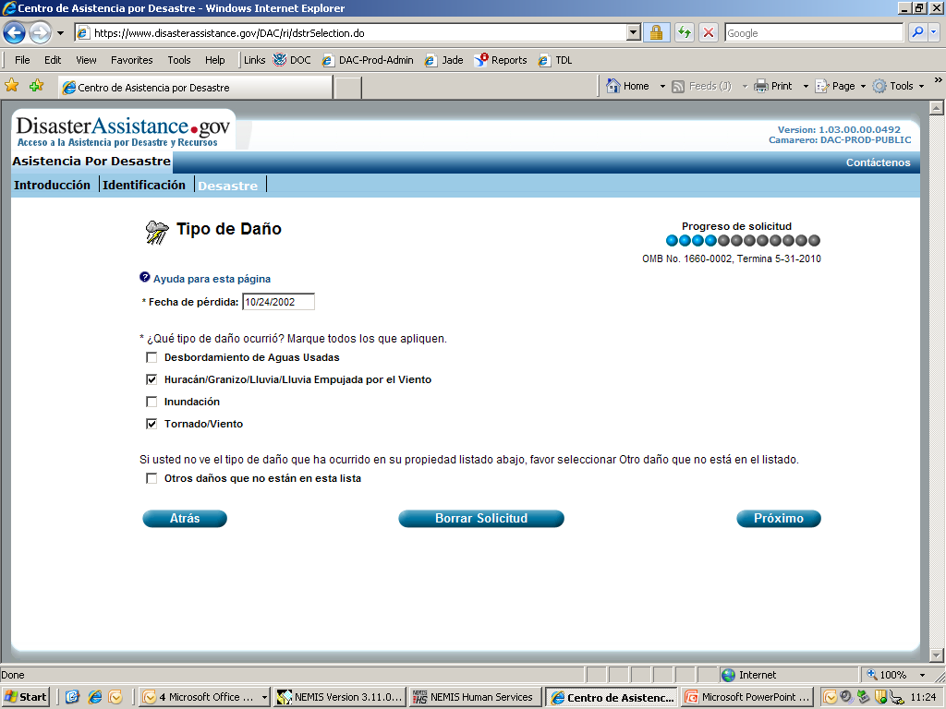
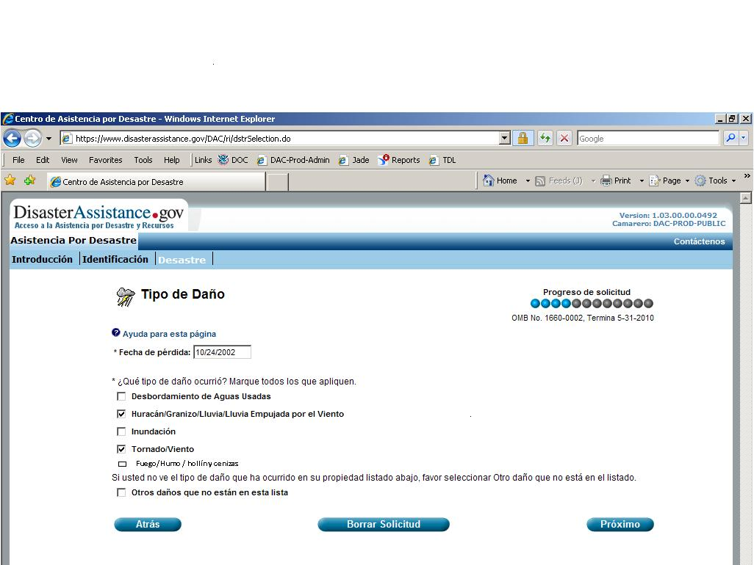
Notes:
Damage Selection Screen

Slide 13
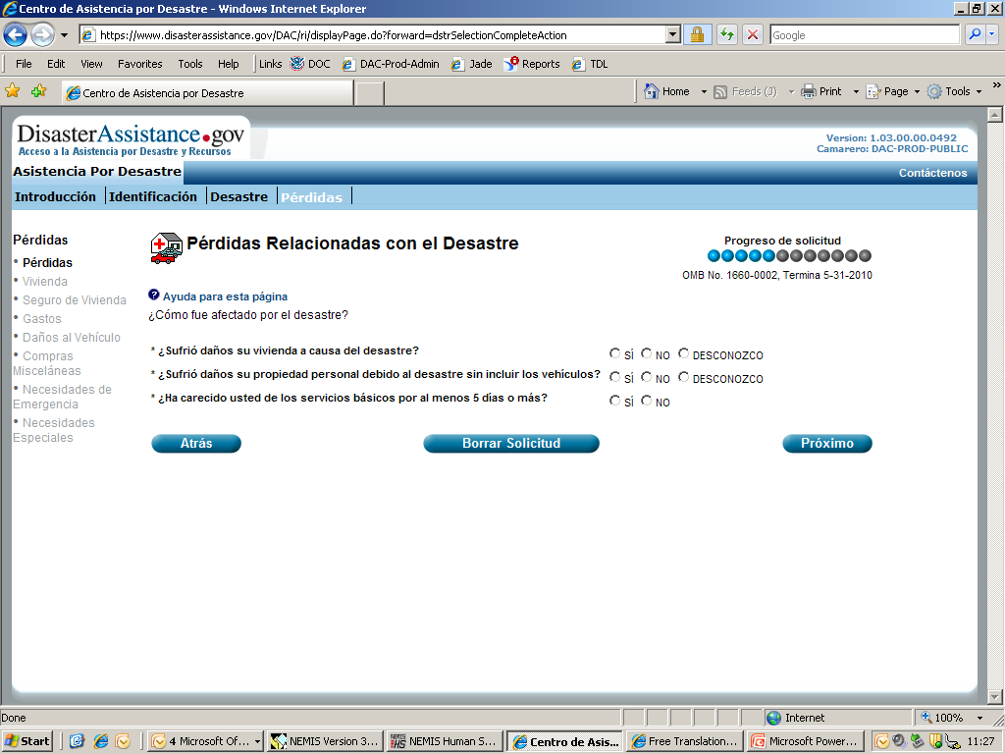
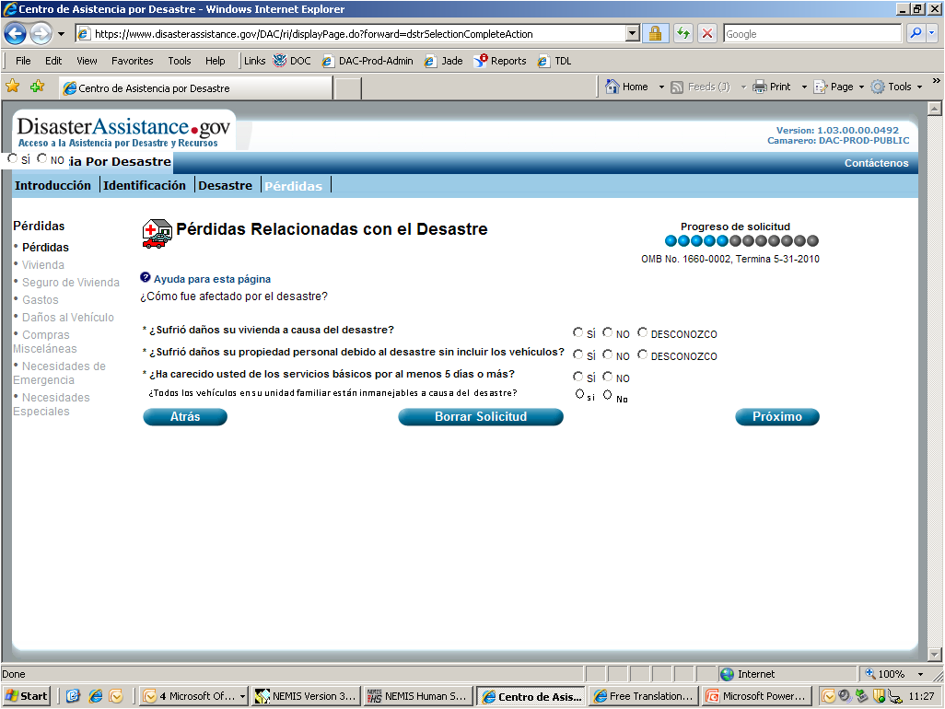
Notes:
Home/PP Damage Selection Screen

Slide 14
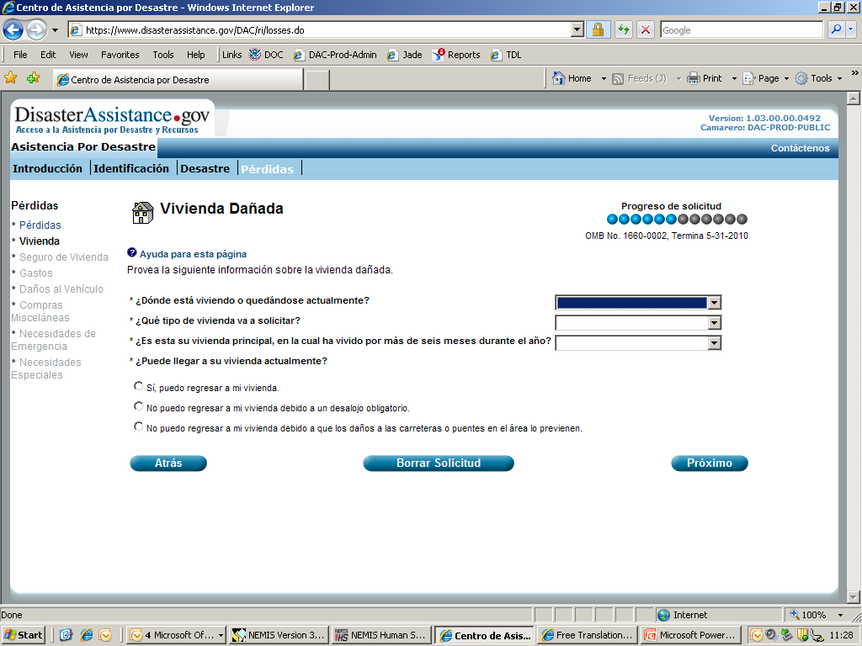
Notes:
Type of Home that was Damage Screen

Slide 15
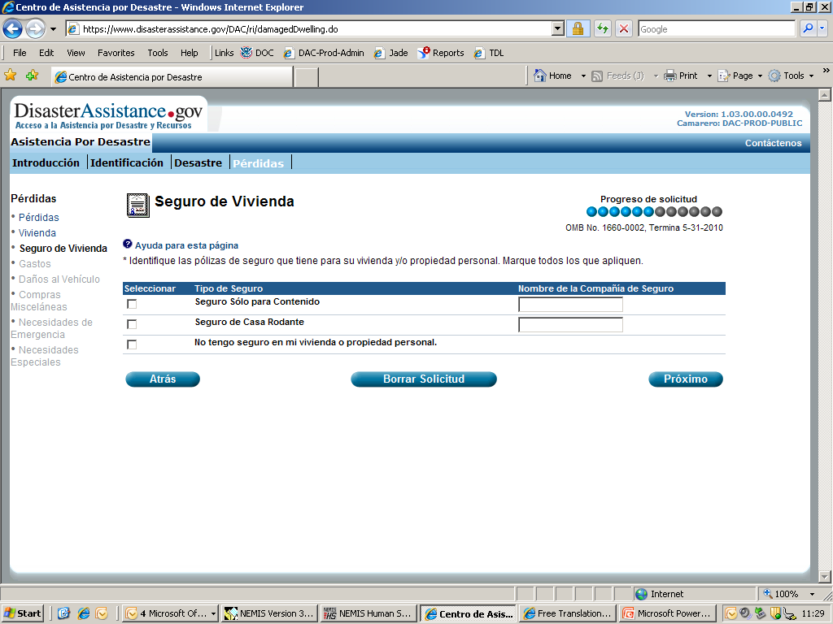
Notes:
Insurance Selection Screen

Slide 16
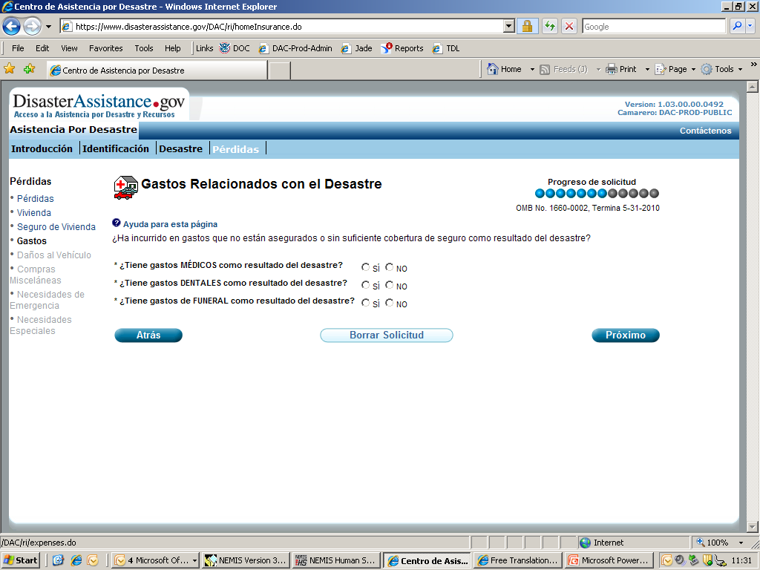
Notes:
Medical/Dental and Funeral Screen

Slide 17
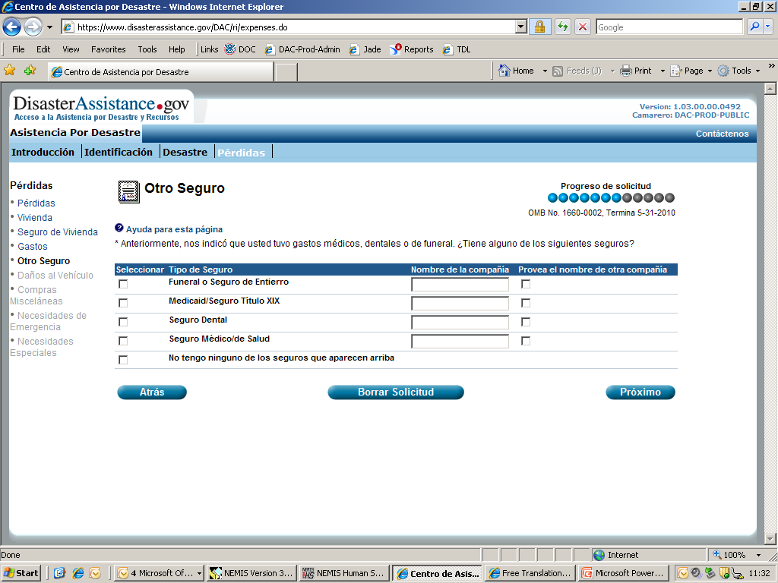
Notes:
Medical/Dental and Funeral Insurance Screen

Slide 18
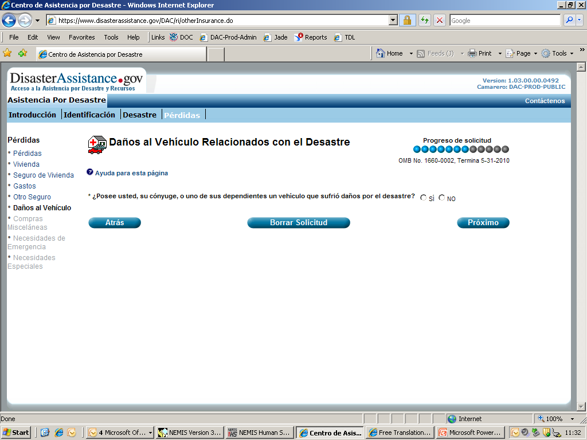
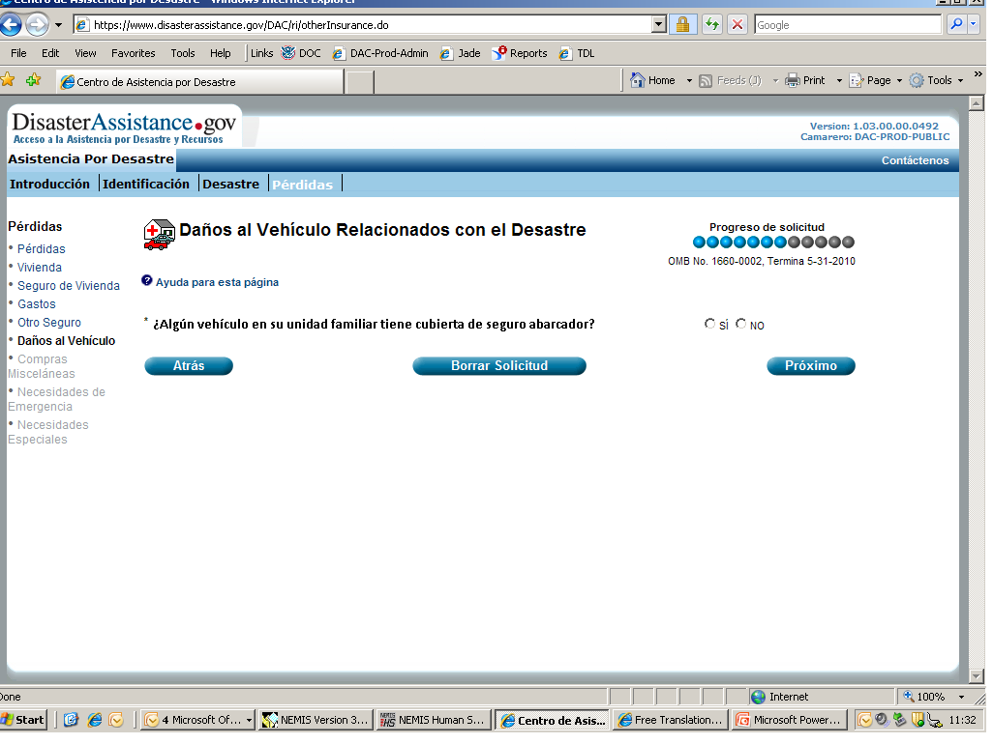
Notes:
Vehicle Damage Selection Screen

Slide 19
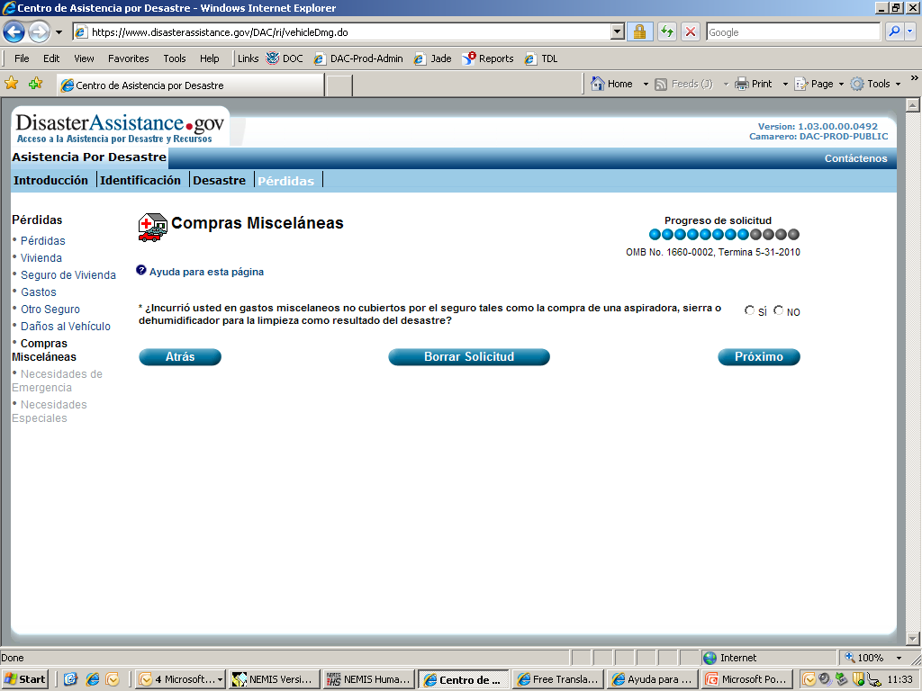
Notes:
Miscellaneous Items Selection Screen

Slide 20
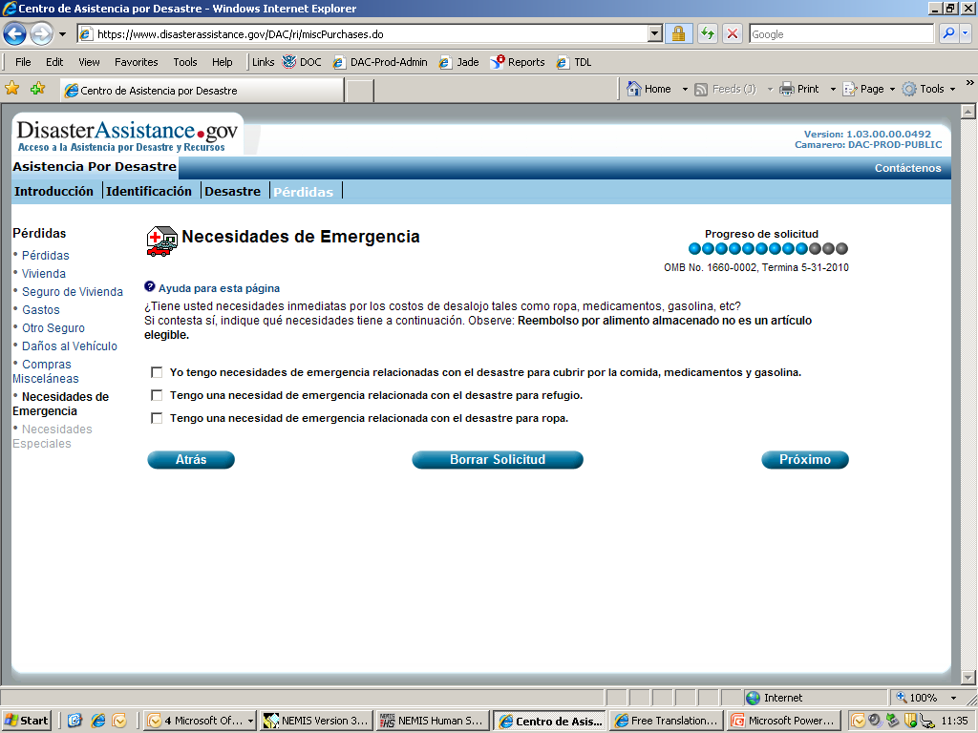
Notes:
Emergency Needs Selection Screen

Slide 21
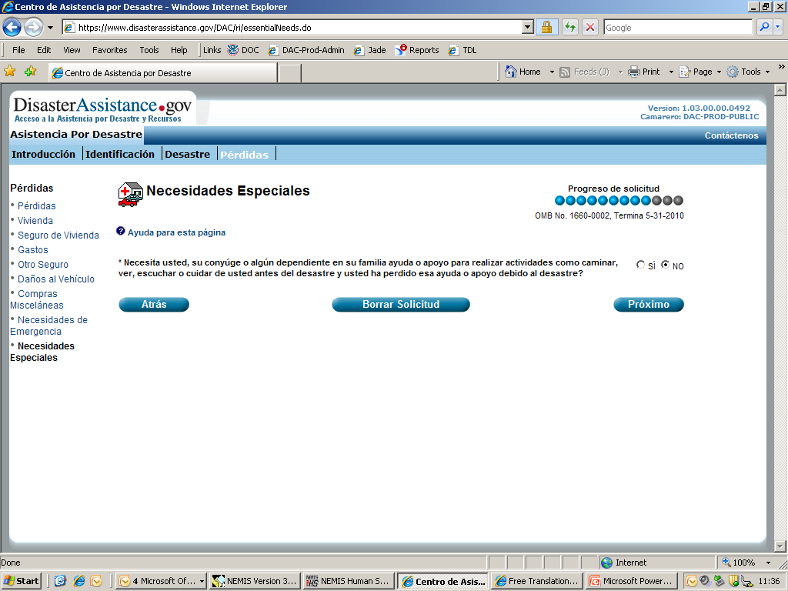
Notes:
Loss of Support Selection Screen

Slide 22
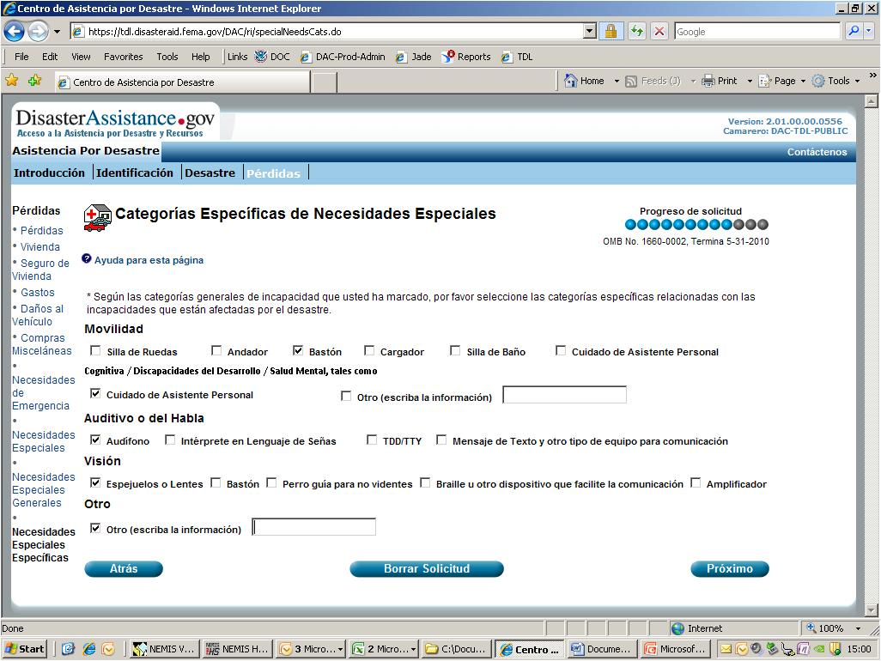

Slide 23
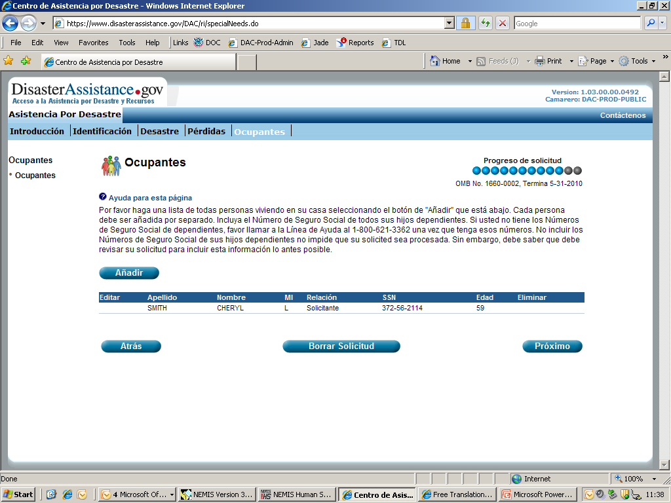
Notes:
Additional Occupants Screen

Slide 24
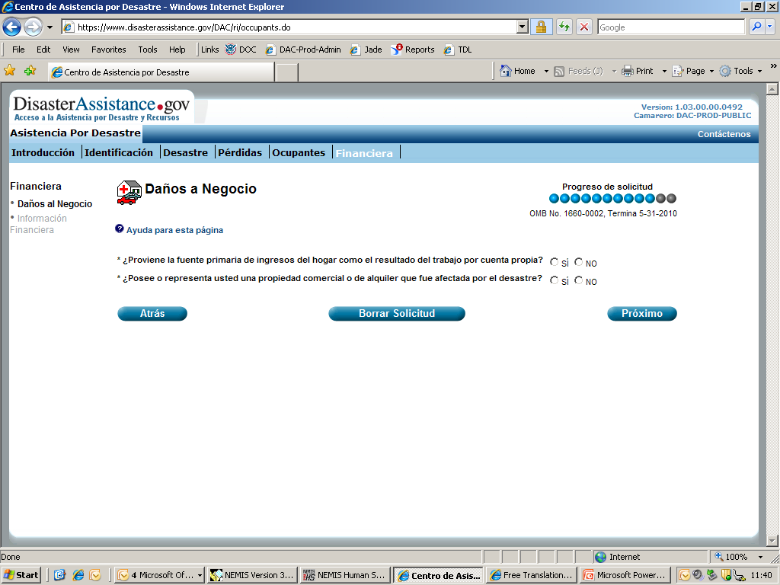
Notes:
Financial Selection for Self-Employment and Business Screen

Slide 25
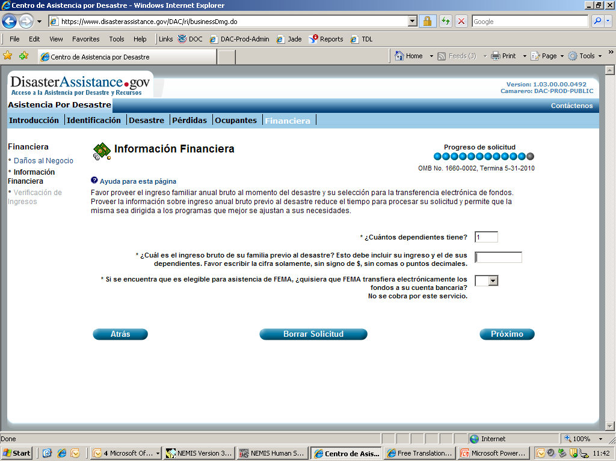
Notes:
Financial Information Screen

Slide 26
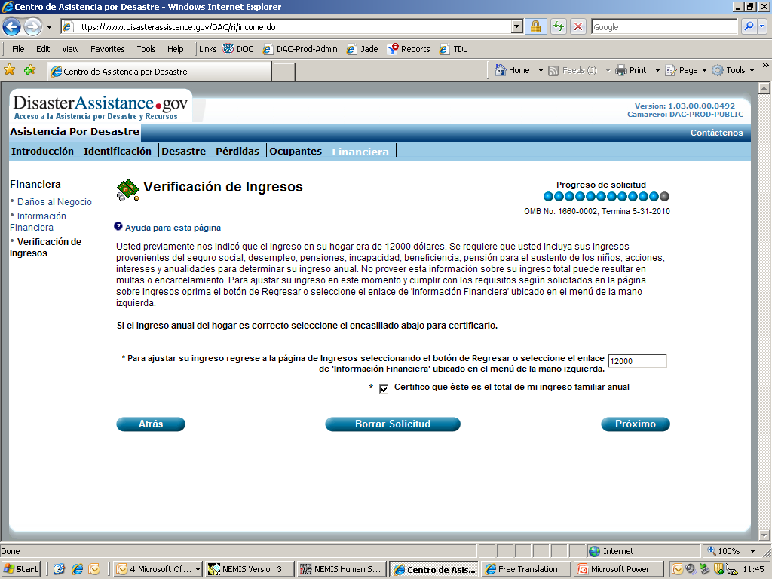
Notes:
Verification of Income Screen

Slide 27
Notes:
Help for Verification of Income Screen

Slide 28
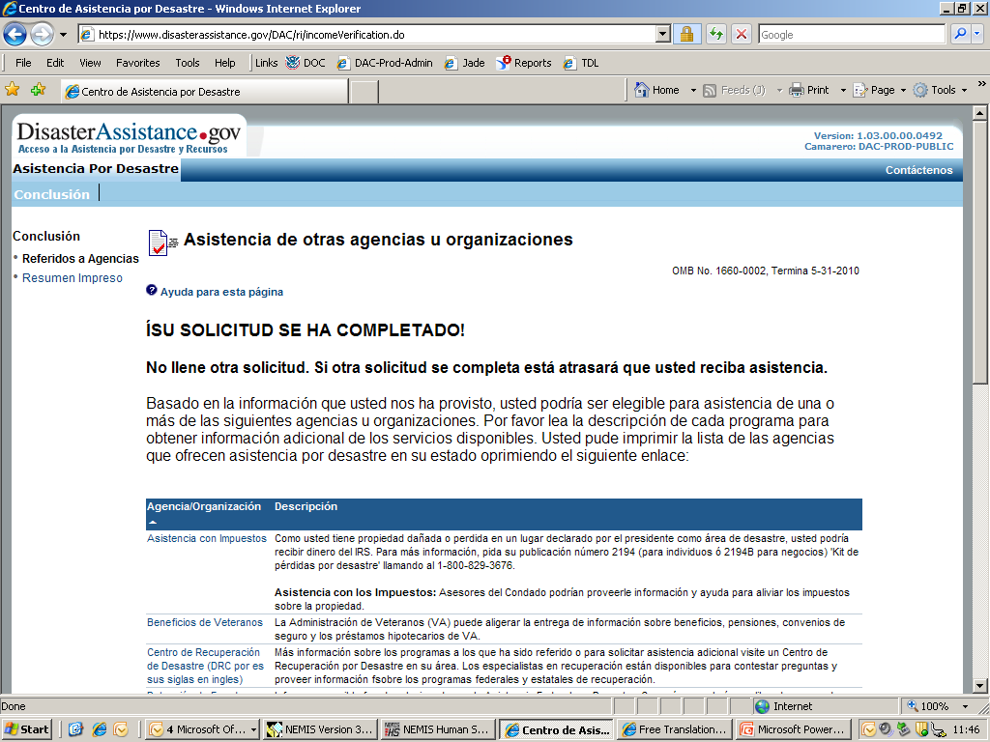
Notes:
Conclusion Screen

Slide 29
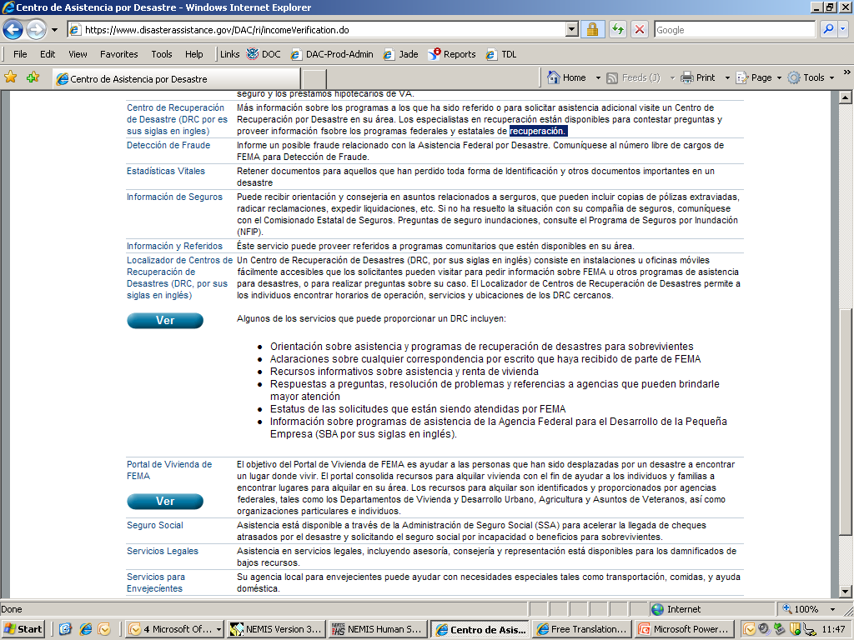
Notes:
Continuation of Conclusion Screen

Slide 30
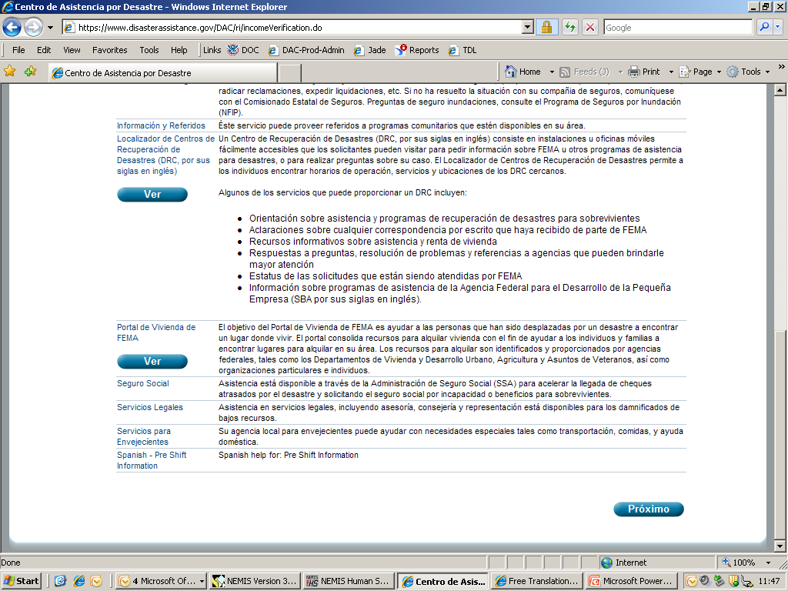
Notes:
Continuation of Conclusion Screen

Slide 31
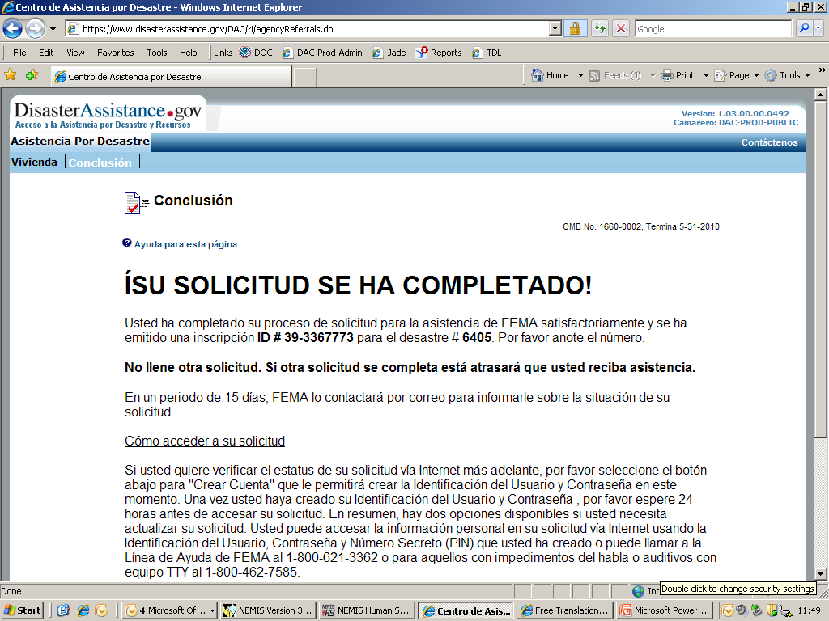
Notes:
Continued Conclusion Screen

Slide 32
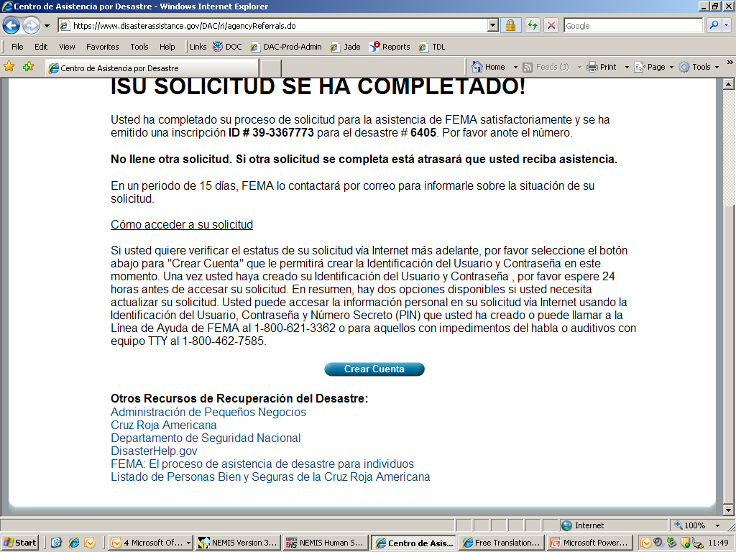
Notes:
Continued Conclusion Screen

