Slide 1
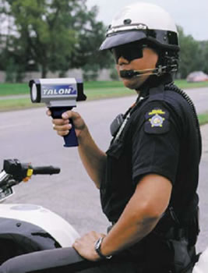
Increased Penalties & Enforcement
Higher Penalties
Increased Police Presence
MPH over Limit | Current Fine | Higher Fine
1-5 | $93 | $116
6-10 | $113 | $141
11-15 | $144 | $180
16-20 | $175 | $219
21-25 | $206 | $258
26-30 | $247 | $309
31-35 | $298 | $373
36-40 | $349 | $436
Over 40 | $411 | $514
Higher fines for higher speeds and/or repeat speeders |  | Increased number of police patrols and “speed traps” which increases chances of getting caught speeding
Targets only drivers who are caught speeding
Targets all speeders

Slide 2
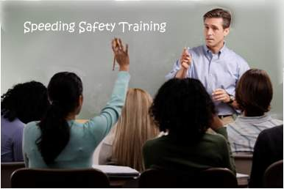
Speed-Awareness Course
Multi-session “classroom” course that teaches the dangers of speeding and speed awareness strategies
Targets repeat and/or dangerous speeders

Slide 3
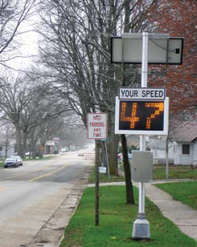
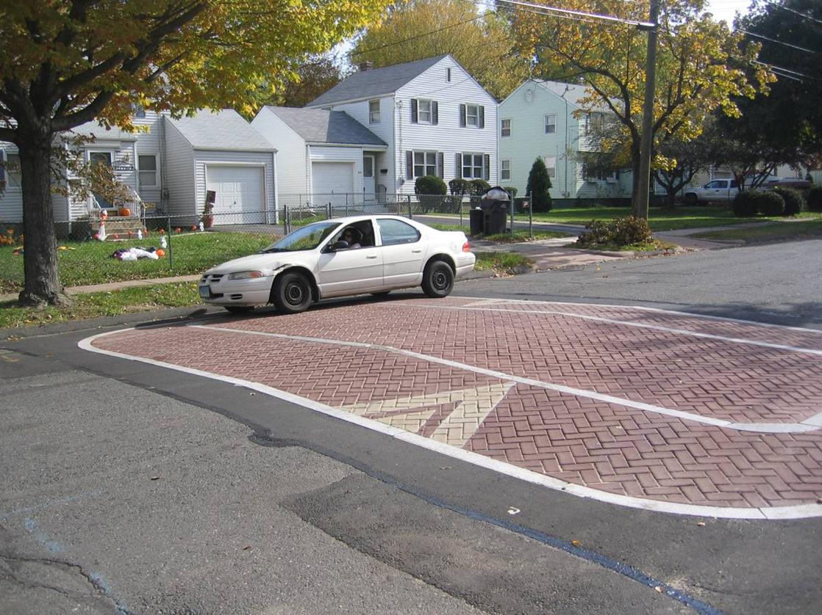
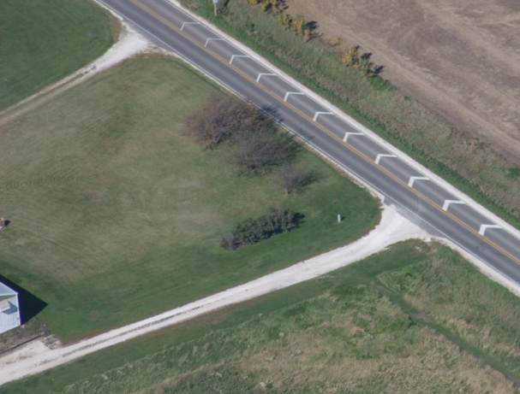
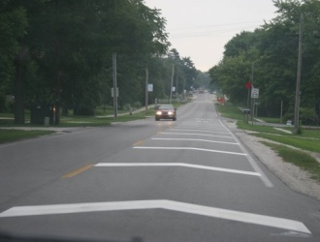
Roadway Countermeasures
Rumble/Vibration Treatments
Pavement Markings
Speed Displays
Surface treatments that are “uncomfortable” to cross at higher speeds |  | Markings that make it seem drivers are traveling faster than they really are |  | Changeable signs that remind drivers of their current speed
Targets all drivers, whether they are speeders or not

Slide 4
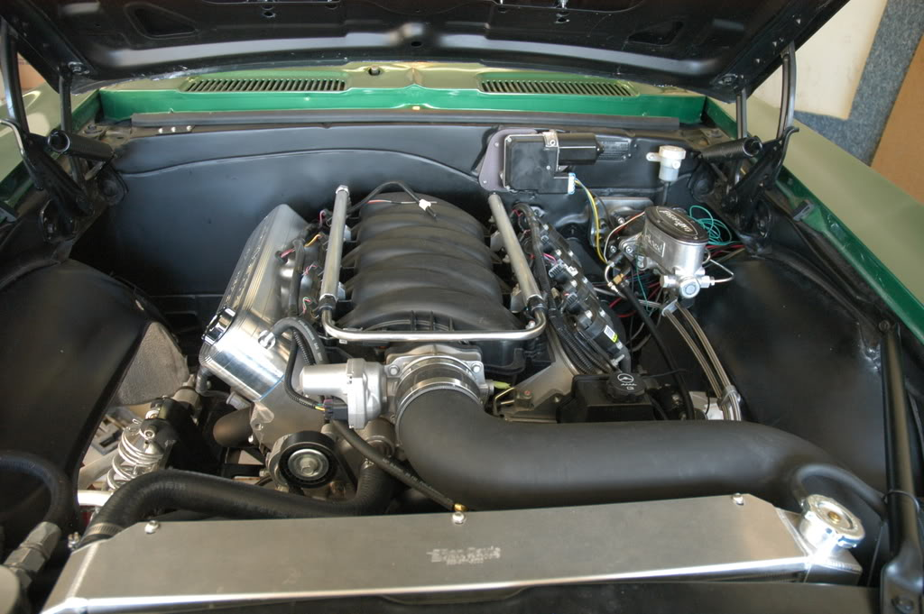
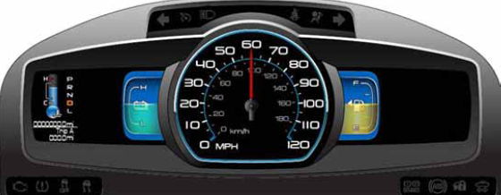

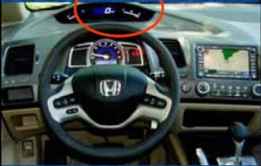
Vehicle-based Countermeasures
Speed Limiter in Engine
In-vehicle Speed Limit Display
Fuel Economy Display
Instrument installed in engine that physically limits vehicle speed |  | Display shows posted speed even when signs are not visible or nearby |  | Electronic display of real-time fuel economy, which encourages “non-aggressive” driving
Option 1: Targets repeat and/or dangerous speeders
Option 2: Installed on new vehicles
Installed on new vehicles – targets all drivers

Slide 5
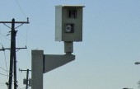
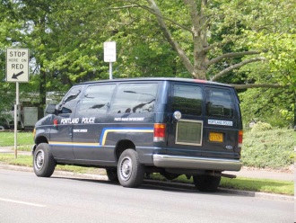
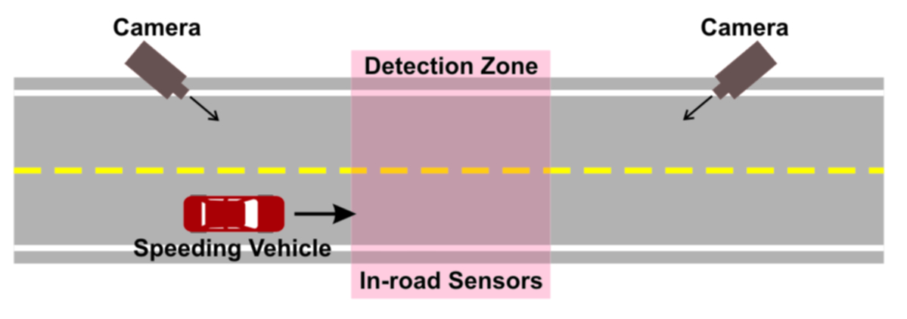
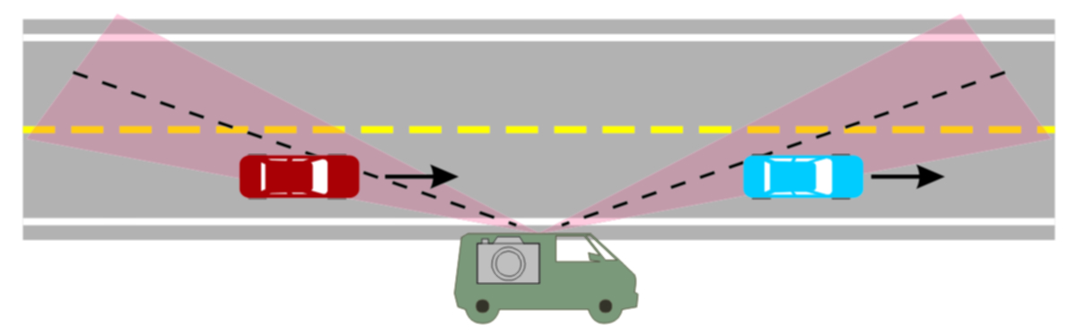
Automatic Enforcement
Fixed Location
Random Location
Fixed cameras detect speeding vehicles through a permanent detection zone and issue tickets by mail |  | Truck-mounted cameras detect speeding vehicle speeds and issue tickets by mail
Targets speeders at the same “trouble-spot” location
Targets speeders at different locations each day

