Slide 1
Registrants Enter Proceedings Information in CCR
Reporting and Use of Information Concerning Integrity and Performance of Recipients of Grants and Cooperative Agreements (ICR 3090-0293)

Slide 2
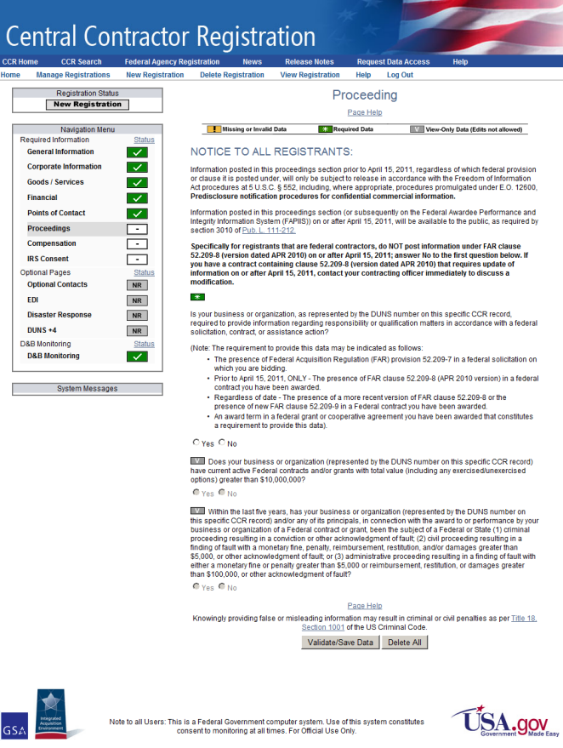
CCR Proceeding Page
As part of the CCR registration process, registrants must answer a series of conditional questions:
If they answer Yes on the first question, the second question is activated
If they answer Yes on the second question, then the last question is activated
After answering the last question, they click the Validate/Save Data button
If they answered Yes to the last question, the Proceeding Detail and Primary Point of Contact sections are displayed

Slide 3
Proceeding Page Text
Note: If you entered information on this page before April 15, 2011, it is only available to authorized individuals in accordance with the Freedom of Information Act procedures at 5 U.S.C § 552. Information posted on or after April 15, 2011 will be available to the public. See Section 3010 of Pub. L. 111-212.
If you are a federal contractor, do not post information under FAR clause 52.209-8 (version dated APR 2010) on or after April 15, 2011; answer No to the first question below. If you have a contract containing clause 52.209-8 (version dated APR 2010) that requires update of information on or after April 15, 2011, contact your contracting officer immediately to discuss a modification.
The three questions on this page consist of the following:
If your business or organization is required to provide information regarding responsibility or qualification matters in accordance with a federal solicitation, contract, or assistance action, select the first Yes radio button. If you answer no, you are finished on the Proceeding page. Click the Validate/Save Data button and continue to the next page of the registration. See the CCR User's Guide for more information.
If your business or organization (represented by the DUNS number on this specific CCR record) has current active federal contracts and/or grants with total value (including any exercised/unexercised options) greater than $10,000,000, select the second Yes radio button. If you answer no, you are finished on the Proceeding page. Click the Validate/Save Data button and continue to the next page of the registration.
If, within the last five years, your business or organization (including parent organization, all branches, and all affiliates worldwide) and/or any of its principals, in connection with the award to or performance by your business or organization of a Federal contract or grant, has been the subject of a Federal or State (1) criminal proceeding resulting in a conviction or other acknowledgment of fault; (2) civil proceeding resulting in a finding of fault with a monetary fine, penalty, reimbursement, restitution, and/or damages greater than $5,000, or other acknowledgment of fault; and/or (3) administrative proceeding resulting in a finding of fault with either a monetary fine or penalty greater than $5,000 or reimbursement, restitution, or damages greater than $100,000, or other acknowledgment of fault, select the third Yes radio button. If you answer no, you are finished on the Proceeding page. Click the Validate/Save Data button and continue to the next page of the registration.

Slide 4
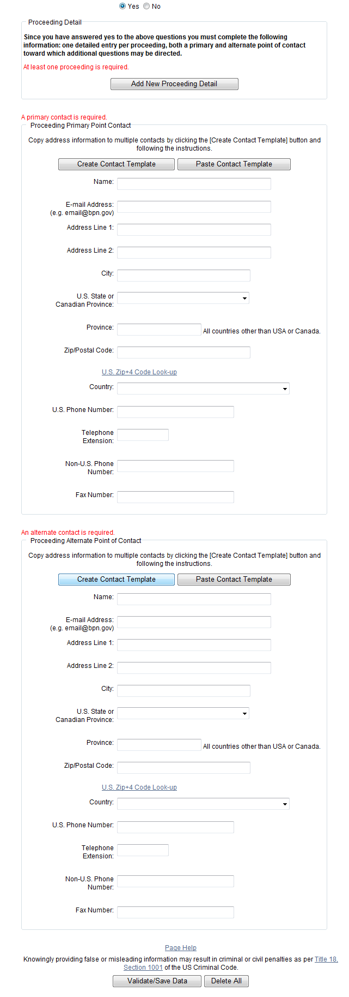
Yes, Proceedings Exist
CCR Screen (Part 1) CCR Screen (Part 2)

Slide 5
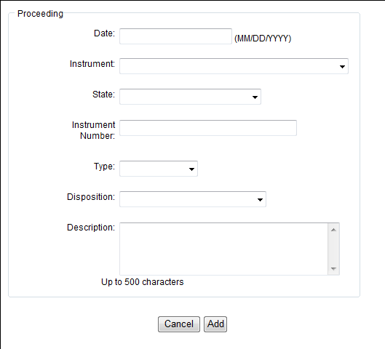
Add New Proceeding Detail (1 of 2)

Slide 6
Add New Proceeding Detail (2 of 2)

