Slide 1


National Hospital
Care Survey (NHCS)
Acute Coronary Syndrome Study
Notes:
We’re here today to talk with you about the National Center for Health Statistics’ National Hospital Care Survey and the Acute Coronary Syndrome Study

Slide 2

Your hospital has already begun participation in the new NHCS. This is one of the special studies we talked about when your hospital was inducted into the survey.
s

Slide 3
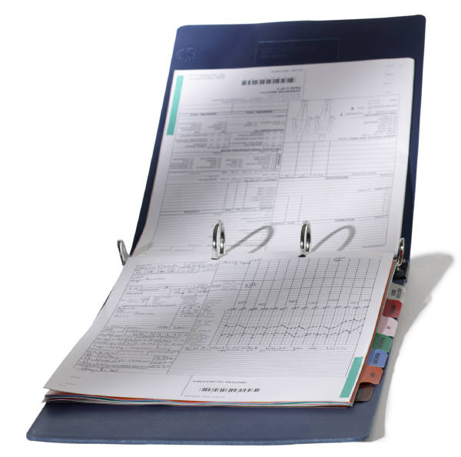
Patient discharge level data
2011 inpatient component:
  Special studies with chart abstraction for a sample of discharges – first one: Acute Coronary Syndrome. With staff assistance we will locate and abstract detailed information on a sample of patients with this diagnosis
Notes:
We had mentioned at induction that there might be a special study

Slide 4
Your hospital will be reimbursed for finding a secure space for our contractor to abstract data, as well assist her in finding the needed information.
Only a few cases will be abstracted.

Slide 5
We are asking for your participation in this special study
Your participation is voluntary. There is no penalty for not participating.
As you are already aware, all information from your hospital or health care center will be used solely for research and statistical purposes.
All information will be kept strictly confidential.

Slide 6
We are asking for your participation in this study.

Slide 7
What is the next step?
ACS study
Identifying a primary contact within the hospital who will coordinate the abstraction of the special data.

Slide 8

Questions

Slide 9
Thank you so much!
Hope we can count on you!

Slide 10
Notice - Public reporting burden for this collection of information is estimated to average 1 hour per response, including time for reviewing instructions, searching existing data sources, gathering and maintaining the data needed, and completing and reviewing the collection of information. An agency may not conduct or sponsor, and a person is not required to respond to, a collection of information unless it displays a currently valid OMB control number. Send comments regarding this burden estimate or any other aspect of this collection of information, including suggestions for reducing burden to: CDC/ATSDR Reports Clearance Officer; 1600 Clifton Road, MS D-74, Atlanta, GA 30333, ATTN: PRA (0920-0212).
Assurances of Confidentiality –All information which would permit identification of any individual, a practice, or an establishment will be held confidential, will be used only by NCHS staff, contractors, and agents only when required and with necessary controls, and will not be disclosed or released to other persons without the consent of the individual or the establishment in accordance with section 308(d) of the Public Health Service Act (42 USC 242m) and the Confidential Information Protection and Statistical Efficiency Act (PL-107-347).

