Slide 1
Welcome to the U.S.
PISA Team!

Slide 2
NBC Nightly News
December 7, 2010
Notes:
Click inside the box, on the video, to play or pause. (A small hand will appear.)
Click outside the box to move on to the next slide.

Slide 3
What is PISA?
PISA stands for:
Program for International Student Assessment
Notes:
Has anyone here seen news clips like this recently? Do you know where they’re getting this information?
<click> The results are from the Program for International Student Assessment, or PISA.
Has anyone heard of PISA before?

Slide 4
What is PISA?
PISA is the world’s largest international education study.
PISA measures how well 15-year-old students apply knowledge to real-world problems in reading, mathematics, problem solving and financial literacy.
PISA helps the United States learn about our international competitiveness.
Notes:
<click> PISA is the world’s largest international education study.
<click> It measures how well 15-year-old students apply what they’ve learned in school to real-world problems in reading, mathematics, problem solving and financial literacy.
<click> Like we just saw in the news clip, PISA provides people with information about how well students in the United States are performing in comparison to students in other countries around the world.

Slide 5
What is PISA?
“Today’s PISA results show that America needs to urgently accelerate student learning to remain competitive in the global economy of the 21st century.
- Secretary Arne Duncan
Notes:
When the results from PISA come out, it’s all over the news – from the evening shows to newspapers all over the country.
<click> Our Secretary of Education and even our President reference PISA when they talk about the advances we need to make in education.
So now we see how important this assessment is. By participating in this assessment, you are performing a national service.

Slide 6
Who participates in PISA?
In 2012, 65 countries will participate.
Notes:
I want you to understand how far-reaching this assessment is. Think about this map. Talk with someone next to you. How many countries, around the world, do you think participate in this assessment?
Any ideas?
<click> In 2012, 65 countries will participate in PISA. Think of PISA as an Olympics of the mind!

Slide 7
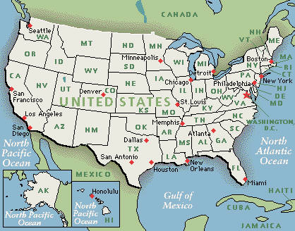
Who participates in PISA?
In the United States,
less than 100 schools
will be asked to participate
in the field test for PISA 2012.
Notes:
In the United States, PISA will invite schools across the country to participate in the assessment. Talk with your partner about how many schools you think participate in PISA in the United States.
Thoughts?
Your school has been selected to take part in the PISA field test this spring. The field test is used to try out new questions in preparation for the main study next year.
<click> In the United States, fewer than 100 schools will participate in the field test for PISA 2012.
<click> Not every school in every state is asked to participate. PISA relies on a sample of students and schools to represent all the students and schools like them across the country.

Slide 8
Who participates in PISA?
You are one of only 42 students in our school and 1,800 students across the entire United States to be invited to participate in this prestigious assessment.
By participating, you will represent thousands of other students across the country. PISA results help our country improve the education system.
Notes:
In our school, you are one of only 42 students and 1,800 students across the entire United States to be invited to participate in this prestigious assessment.
The invitations were based on a random sample of students in our school, so not everyone has this opportunity.
By participating, you represent thousands of other students across the country. The results of PISA help our country improve our education system.

Slide 9
What should I expect?
You may be asked questions in reading, mathematics, problem solving or financial literacy, or a combination, based on real-life situations.
You may be asked to take the assessment on the computer, with paper and pencil, or both.
The questions will have multiple-choice and short-answer responses.
The assessment also includes questions about you and your attitudes and experiences in school.
Notes:
If you choose to accept the invitation to participate, you may be asked questions in reading, mathematics, problem solving or financial literacy, based on real-life situations. You may be asked questions in just one subject or a combination of subjects. Remember, this about applying the knowledge you have learned, not just memorizing facts.
You may be asked to take the assessment on the computer, with paper and pencil, or both.
The questions will have multiple-choice and short-answer responses.
<click> The assessment also includes questions about you and your attitudes and experiences in school. This is to help policymakers have context for the results and learn more about students perceptions toward education.

Slide 10
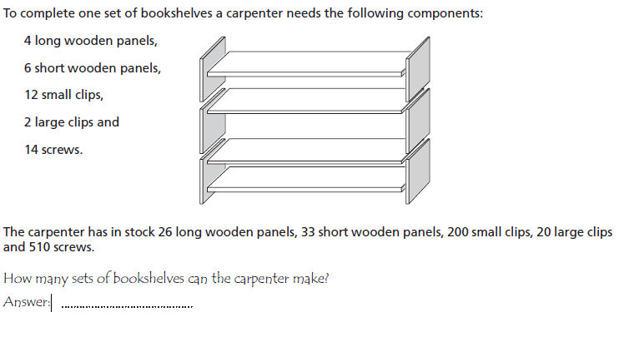
Sample Math Question
Notes:
Now I know some of you may be wondering what “real-world” assessment questions might look like, so let’s take a look.
<click> This is an example of a math item on the assessment. In this question, you are given information about how many wood panels, clips, and screws a carpenter needs to build a set of bookshelves. Students are told how many materials the carpenter has, and are asked to determine how many bookshelves the carpenter can make.

Slide 11
Sample Reading Question
According to the article, why should sports shoes not be too rigid?
One part of the article says, “A good sports shoe should meet four criteria.” What are these criteria?
Notes:
This is an example of text students may see for a reading question. Here, students read about sports shoes and how they can prevent injuries.
Students will be asked a few questions for each passage they read.
<click> These are two examples of questions students were asked to answer after reading the text about sports shoes.

Slide 12
What should I expect?
Students who take PISA will have different test booklets. The assessment has so many questions that no one student can answer them all, so the questions are split up.
B1
B2
B3
B2
B1
B3
B2
B3
B2
B1
B2
B1
B3
B2
B1
B2
B3
B2
B1
B3
B2
B3
B2
B1
B3
B2
B1
B2
B1
B2
Notes:
Students who take PISA will have different test booklets. There are SO many questions included in PISA that no single student can take them all! To make sure that EACH question is taken by a certain number of American students, there are various PISA booklets that have unique sets of questions.

Slide 13
What should I expect?
Because no one student takes the entire assessment, unlike many tests you take, you will not get your own score on PISA.
Lessons and results from the field test will be used to make PISA 2012 the best it can be, so it can show just how much students in the United States know!
The assessment takes place here at the school and will take no more than 4 hours. You will be called out of class to participate.
Notes:
Because no one student takes the entire assessment, unlike many tests you take, you will not get your own score on PISA.
<click> The field test for PISA, that we are participating in, will make PISA 2012 the best it can be. It will give researchers information about how to make the test questions more clear and to make sure that all questions are fair to U.S. students. All of this will help the United States truly show how much our students know!
<click> The assessment takes place here at the school and will take no more than 4 hours, depending on whether or not you are asked to take the assessment on the computer, with paper and pencil, or both. We will call you out of class when the time comes.

Slide 14
Why should I participate?
Participating in PISA is a national service.
Each student who participates in PISA represents thousands of students across the United States.
PISA results from the United States will be compared to 64 other countries.
Your participation can help to improve the United States education system for future students.
Notes:
If you are debating about whether or not to participate, I just want to remind you of a few things.
<click> By participating in this assessment you are performing a national service.
<click> Each student who participates represents thousands of students across the nation.
<click> Results from the United States will be compared to 64 other countries, providing information about how globally competitive we can and will be in the future.
<click> Important decisions about education are made using results from PISA, and your participation can help to improve the education system for students who come after you.

Slide 15
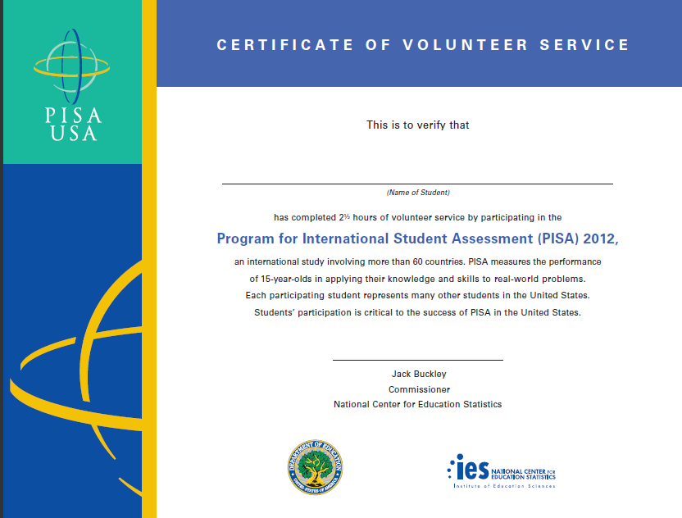
Why should I participate?
As a thank you for participating in PISA, you will receive $25.
You will also receive a Certificate of Volunteer Service awarding you 4 hours of service time.
Notes:
As a thank you for participating:
<click> You will receive $25.
<click> You will receive a Certificate of Volunteer Service awarding you 4 hours of service time.

Slide 16
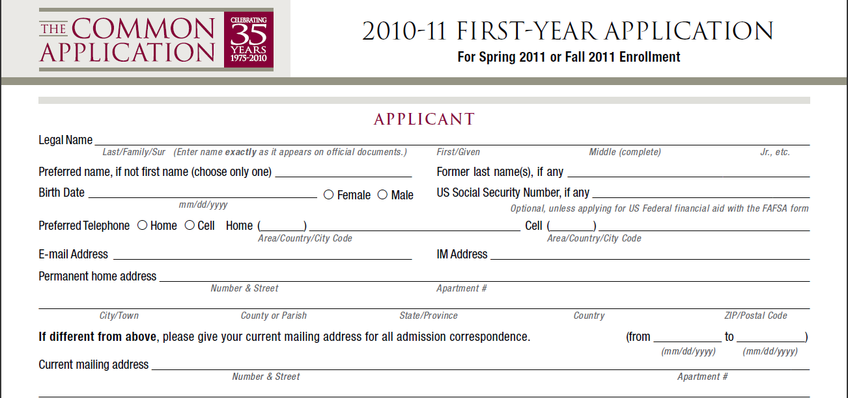
Why should I participate?
You can also mention your participation in PISA on future resumes and college applications.
Notes:
<click> And you can also mention your participation in PISA on future resumes and college applications, as an important assessment to which you contributed.

Slide 17
Thank You!
PISA will be held:
Date:
Time:
Location:
Questions?
Notes:
Here are the details of when PISA will be happening in our school.
<click> Are there any questions now?

Slide 18
Good luck,
U.S. PISA Team!
Notes:
Thank you for your time and coming to learn more about PISA. I know you all will do a great job. Good luck!

