Slide 1
Text2PTO:
Modernizing Patent Application Filing
A Proposal for Submitting Text Applications to the USPTO

Slide 2
The Big Picture
The USPTO is building a new, modern patent examination software system.
One part of this is modernizing how patent applications are filed.
Applicants will receive many benefits from this with minimal changes in their existing work practices.

Slide 3
Main Goal
Provide a safe, easy way for applicants to file the text version of their patent applications online.

Slide 4
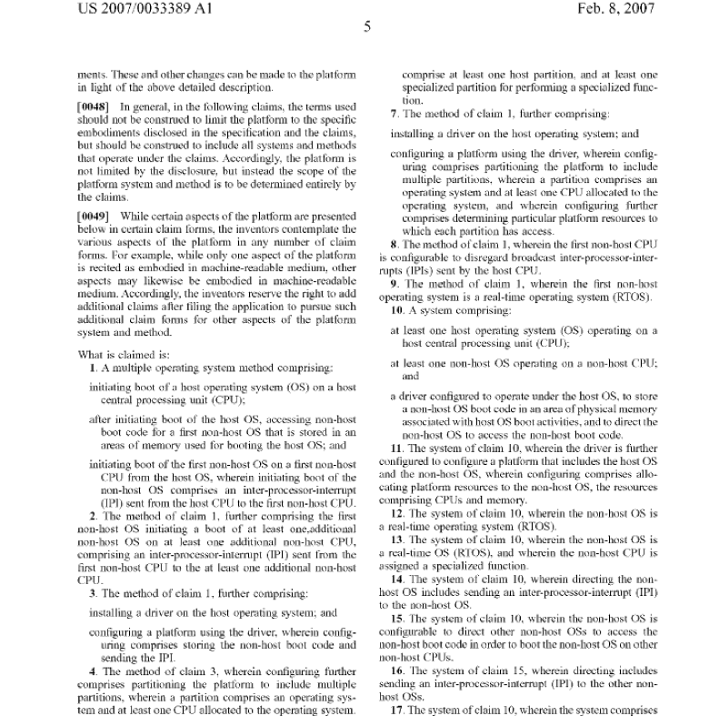
Benefits
Currently: A Scanned Image

Slide 5
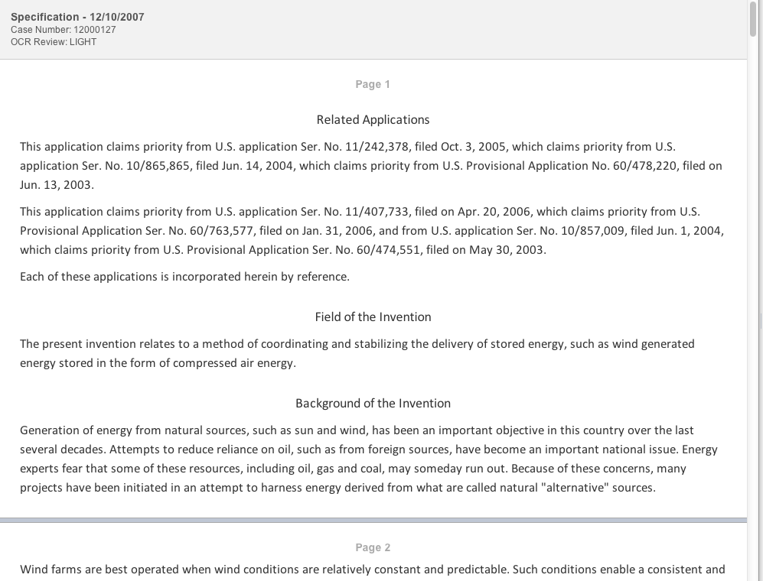
Goal: Text

Slide 6
Benefits
Increased accuracy in filings
Automated formalities checks
Additional useful automated information
  Claims trees
  Patent family information
Will enable better tools for patent examiners
Will provide large cost savings for USPTO

Slide 7
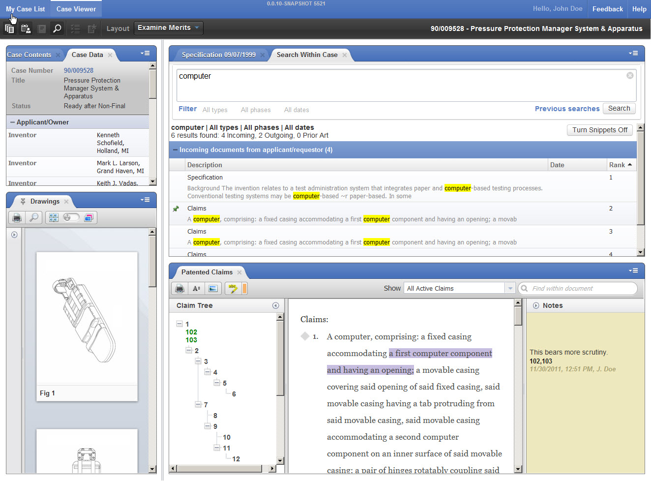
Modern Software for Patent Examiners

Slide 8
Focus:
Ease of Use for Applicants
Eliminates the need to:
  Scan or pdf the file
  Upload four different files
  Figure out the number of pages for each file
Amendments can be made on a copy of the original.
  Cover sheet can be conveniently added for you.
  Amendments can be authored using Track Changes
No software to download or install

Slide 9
Main Idea
Author your application in Word, and then upload it t.

Slide 10

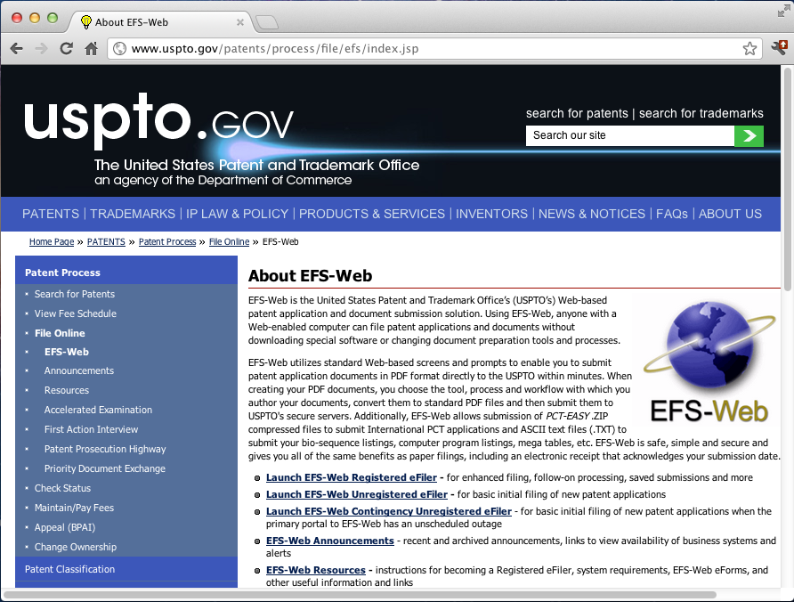


Author your application in Word, and then upload it to USPTO.
Law Office
USPTO
EFS Web
V1
Acknowledgement

Slide 11
Applicants’ Concerns
What if we left track changes on?
What if we left private information in?
How can we be sure the contents of the application have not changed?

Slide 12
We Have Solutions for
Applicants’ Concerns
What if we left track changes on?
  USPTO is providing a validation tool that will alert you about this.
What if we left private information in?
  The validation tool will tell you this as well.
How can we be sure the contents of the application have not changed?
  USPTO is providing a code that allows you to easily and quickly verify that we have a verbatim copy of the text that you submitted.

Slide 13
Validator Tool, Part 1
Check for Track Changes and Private Information

Slide 14
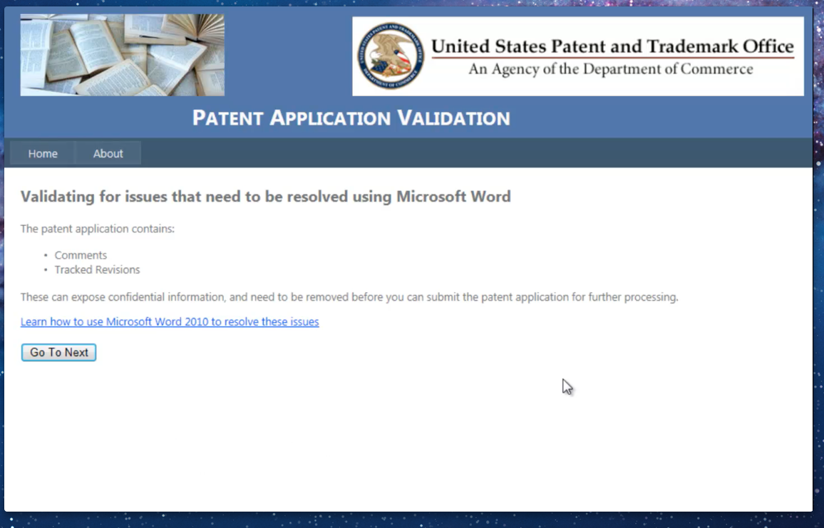
Make sure you did not include any private information.
Run the validator tool in a web browser on your own computer.
Law Office
Text2PTO Validator Tool
V1
“Warning: Track changes left on”
It tells you if you included private information or left on track changes and tells you how to remove it.
V1
Applicant follows instructions to remove track changes and resends through validator tool
Document is ready to submit.

Slide 15
What Video Should Show
2 minutes max (all timing info below is maximum)
No need for audio; we’ll speak over it.
  Scroll through two different applications [45 sec]
    Show the same application but with two radically different looks (fonts, layout, etc)
    In one of the files, show there are some track changes visible but only if you switch the View (from final to final showing markup, for example)
  First check:
    Upload the document with markup into the tool [5 sec]
    Show the warning message and the “how to” screen. [30 sec]
  Show the user doing the repair, maybe doing “accept all changes”
  Show the user re-running the tool on the file and getting an “ok” message.

Slide 16
Validator Tool, Part 2
Check for Disallowed Markup (such as embedded fonts, colored text).
Optionally Fix It.

Slide 17
Check for and change any disallowed formatting.
Run the validator tool in a web browser on your own computer.
Law Office
Text2PTO Validator Tool
V1
If your file has any disallowed formatting, either:
Follow the instructions to remove it, or
Let the tool remove it for you, step by step.
Description of disallowed formatting.
V1
Applicant follows instructions to modify the formatting
Document is ready to submit.

Slide 18
What Video Should Show
Two examples
1st example: Text with color highlighting behind it. [30 sec]
    Step through the tool detecting it and then step through the user correcting each one by one
2nd example: disallowed font [30 sec]
  Show the “before” look
  Show the user selecting an offered alternative and applying the change to all instances.
Show the document now getting an “ok”
Show the tool keeping track of and saving the latest version of the corrected file.
  (Should they rename the file? Does the tool have access to a directory of versions?)

Slide 19
Validator Tool, Part 3
Make sure the section headings are each on their own line.

Slide 20
Make sure sections headings are recognized.
Run the validator tool in a web browser on your own computer.
Law Office
Text2PTO Validator Tool
V1
Verify the tool found the abstract, claims, and specification sections.
Make small adjustments if not.
Warning: section was not recognized
V1
Applicant follows instructions to modify the formatting
Document is ready to submit.

Slide 21
What Video Should Show
Show two examples:
  Wrong words to identify the specification [30 sec]
    Just have system say it can’t identify the spec and then show the allowed wordings for this header.
    Show the user editing the document and re-running the tool and getting an “ok” message
  Section heading not on its own line [30 sec]
    Show system guessing the right location but warning user they have to put in a blank line.
    Show user doing this and then getting an “ok” message.

Slide 22
Ensuring the Document Remains Unchanged
Text2PTO supplies an identifier is created based on the text itself.

Slide 23
Ensuring the Document
Remains Unchanged
A standard way to do this is to create a unique identifier that is based on the actual text of the file.
  This is called a “hash code”.
The validator tool will produce this unique ID for you.
If your document changes even by one space, the unique ID cannot be recomputed from the file.
  This ID lets you prove to yourself and others that the file has not changed (or has changed if that is the case).

Slide 24

Create a unique ID for this version of the document.
Run the validator tool in a web browser on your own computer.
Law Office
Text2PTO Validator Tool
V1
The tool generates a Hash Code ID and optionally places it on the document.
Hash code ID is created and returned to applicant.
#

Slide 25
What Video Should Show
30 sec for this sequence
Show user getting an “ok” message for the entire document
Show message offering to create a hash ID from the document text.
Show user accepting this.
Show the resulting document including th hash tag.

Slide 26
How Long Does This Take?
Only a couple of minutes if your document is properly formatted.
If it isn’t, then we predict from 5 to 15 minutes depending on the number of changes needed.

Slide 27
Make sure sections headings are recognized.
Law Office
USPTO
Text2PTO Validator Tool
V1
All notifications
V1
Applicant makes necessary changes.
Document submitted to USPTO.
#
Document is ready to submit.
V1
#

Slide 28
Optional:
Formalities CheckS
Check abstract length, show claims tree and any errors in claim numbering, see patent family information.

Slide 29
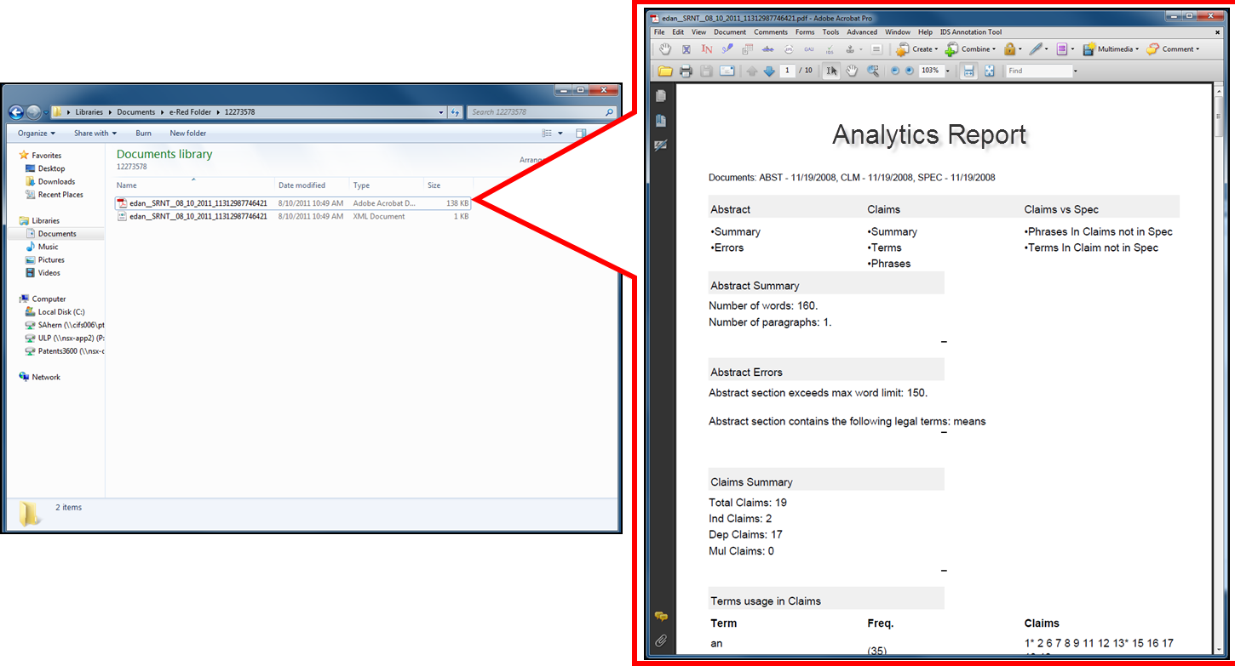
Results of Formalities Checks

Slide 30
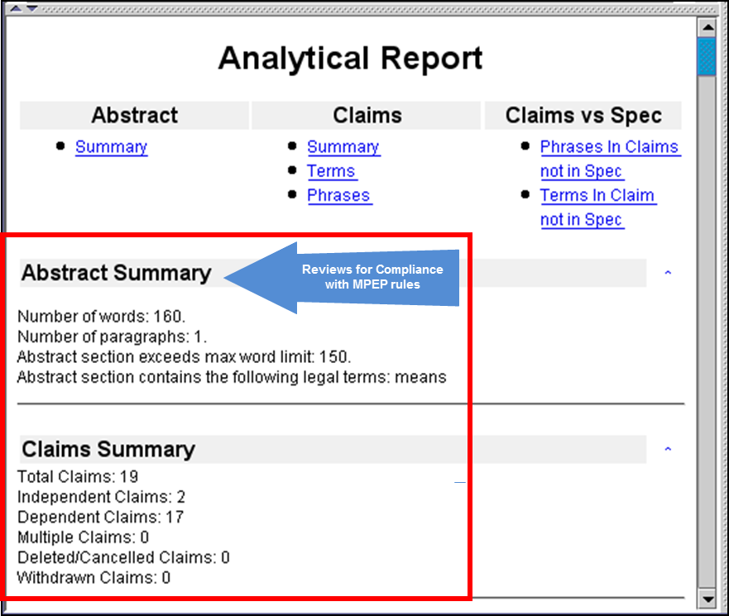
Results of Formalities Checks (con’t)

Slide 31
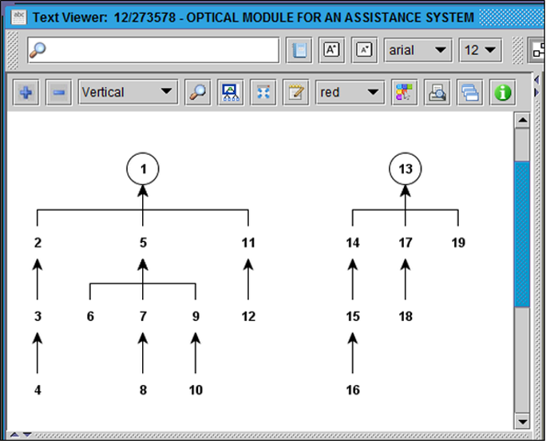
Results of Formalities Checks (con’t)
CLAIMS
TREE

Slide 32
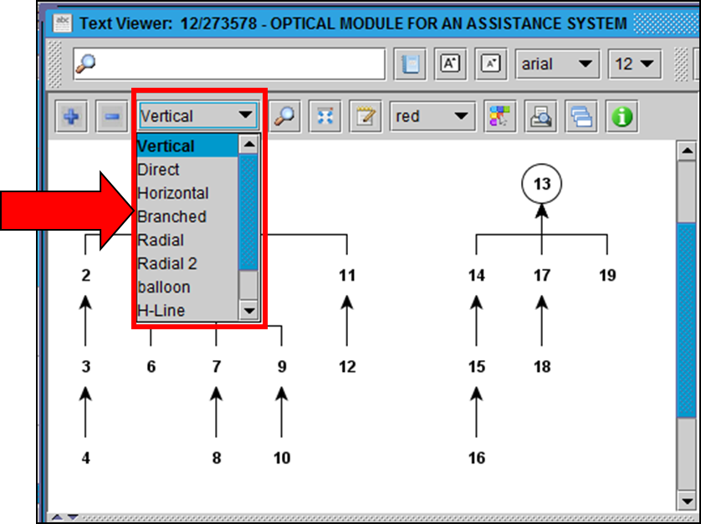
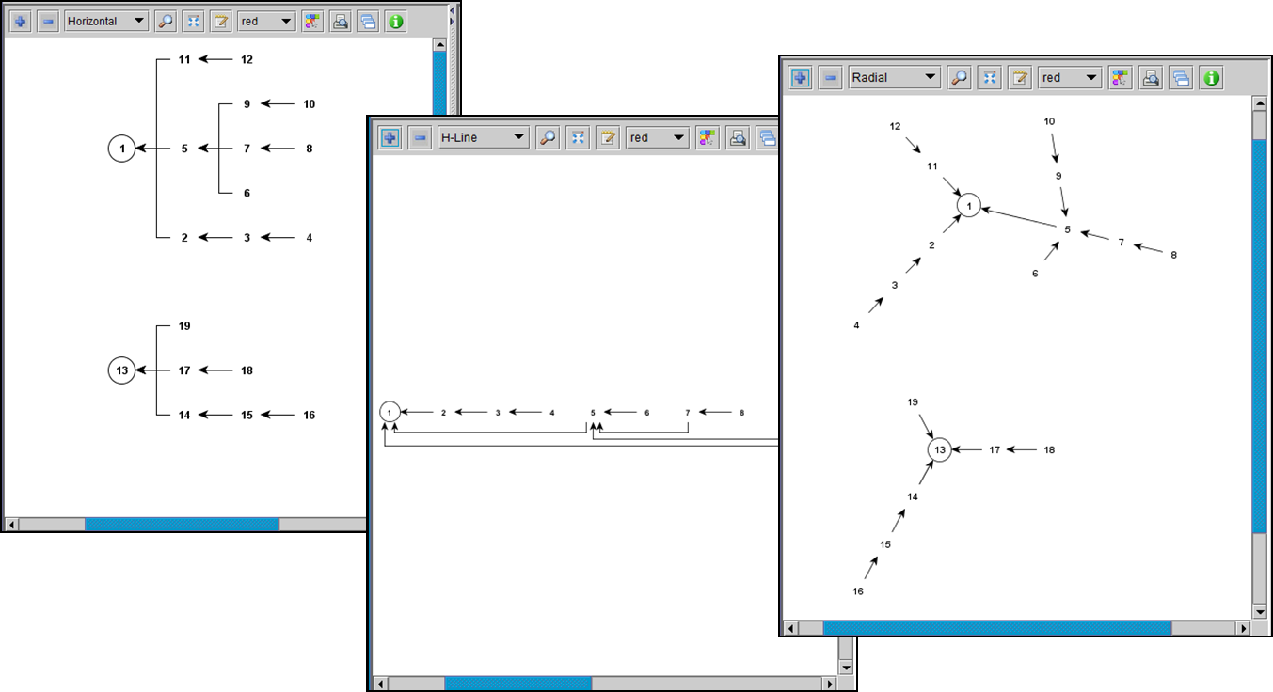
Results of Formalities Checks (con’t)
Claim tree
layout options

Slide 33
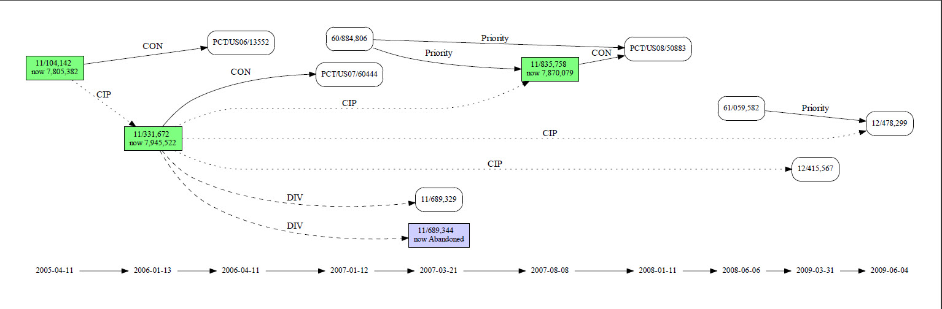
Results of Formalities Checks (con’t)
Patent Family Map Showing Continuity

Slide 34
Amendments
Modify a copy of your original document
Optional automated official markup.

Slide 35
Amendments
Start with your submitted Word file
  If you lost it, get a copy from the USPTO.
Edit it with track changes on.
  Delete and add material to the claims and specification.
Run it through the Amendment Validator.
  (Optional) It will automatically reformat the edits you did into the USPTO required format.
  (Optional) It will generate a cover page and description of the changes.

Slide 36
Edit copy of original file to create amendments.
Law Office
USPTO
V1
Applicant retrieves original application (or uses their own copy)
#
Text2PTO Amendment Validator
V2
Applicant edits amendments, creating new document V2.
Document optionally
converted to PTO amendment format.
Document submitted to USPTO.
A2
#
EFS Web
Applicant checks results, and then submits to USPTO.

Slide 37
What Video Should Show
Making the edits on claims for amendments [90 sec]
  Show the user making a copy of the original document.
  Show user deleting one claim, editing one claim, and adding one claim using track changes.
  Show user uploading the document to the amendment validator.
  Show the claims transformed into PTO format.
  If possible, show the before and after side by side.

Slide 38
What Video Should Show
Making the edits on the spec for amendments [60 sec]
  Show the user adding and deleting text from the spec.
  Show user uploading the document to the amendment validator.
  Show the spec transformed into PTO format.
  If possible, show the before and after side by side.

Slide 39
What Video Should Show
Making the cover sheet for the amendments [90 sec]
  Show the generated cover sheet for the changes made in the previous two segments.

Slide 40
Added Value:
Paragraph Numbering
Automatically added paragraph numbers; keeps track of version numbers

Slide 41
Paragraph Numbering
The validator tool can automatically number the paragraphs.
Additionally, these numbers can be augmented with the version number of the document.
  Application version 1
  Amendment version 3
This allows for easier communication between the applicant and the examiner about changed material.

Slide 42
What Video Should Show
[30 sec]
Show text of original application with its paragraph numbers
Then show editing of that document to create amendments.
The numbering should automatically work if they start with the version that was uploaded to the PTO.

Slide 43
Benefits:
Filing Applications as Text
Better for applicants:
  No scanning
  Re-use the text for amendments
  Some formalities checks
Better for examination:
  Cost savings
  Higher accuracy
  Enables fantastic new tools for patent examiners.

Slide 44
We Welcome Your Feedback!
What do you think?

Slide 45
Technical Details

Slide 46
Some Technical Details
The new patent examination tools make use of XML to represent documents in the system.
Modern versions of word processing tools like Word store documents in OpenXML, an open format.
USPTO can transform OpenXML documents into the format needed by the new tools.

Slide 47
More Technical Details
Word allows certain kinds of markup that the USPTO does not want to see in the XML.
The Validator Tool checks for this kind of markup and warns you.
  You can remove the markup yourself,
  Or let the Validator Tool remove it for you.

Slide 48
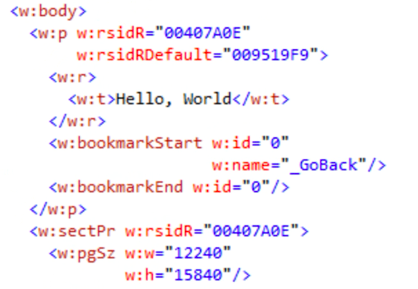
A Fragment of OpenXML

Slide 49
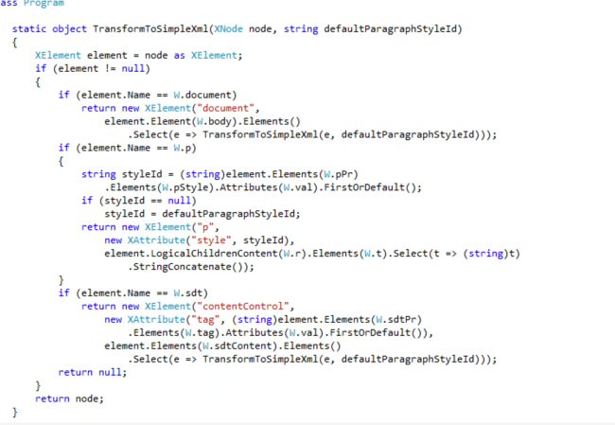
Some Transformation Code

Slide 50
More Technical Details:
Hash Codes as IDs
It is standard practice to create a document “signature” from a hash function.
[Details about which hash function we will be using should go here.]

