Slide 1
Engagement Strategy 1: Time-Saver
16

Slide 2
Health professionals have far too much to do, and far too little time in which to do it. Patients are more informed than ever, and want to spend time discussing their options and decisions—but how do HPs find the time to spend? HPs feel they are already making the best decisions for their patients. While they understand the importance of evidence to guide their decisions, they don’t have time to review individual comparative studies to make evidence-based decisions about which works best, or to explain their recommendation with their patients. How to make this process more productive and, above all else, more efficient?

Slide 5
Engagement Strategy 2: Built for You

Slide 6
Health professionals are worried about one-size-fits-all medicine, about comparative research and guidelines that don’t match their patient’s particular situation. The same holds true for information that isn’t tailored to their needs: it’s always either too much detail, or not enough. AHRQ’s investment in very rigorous research, and its commitment to making that research available in a wide variety of forms, allows HPs to find as much (or as little) information as they want, when they want it. From in-depth reports to at-a-glance summaries, AHRQ’s CER can be expanded or condensed to suit HP needs—and always lets them decide when and how to use it.

Slide 8
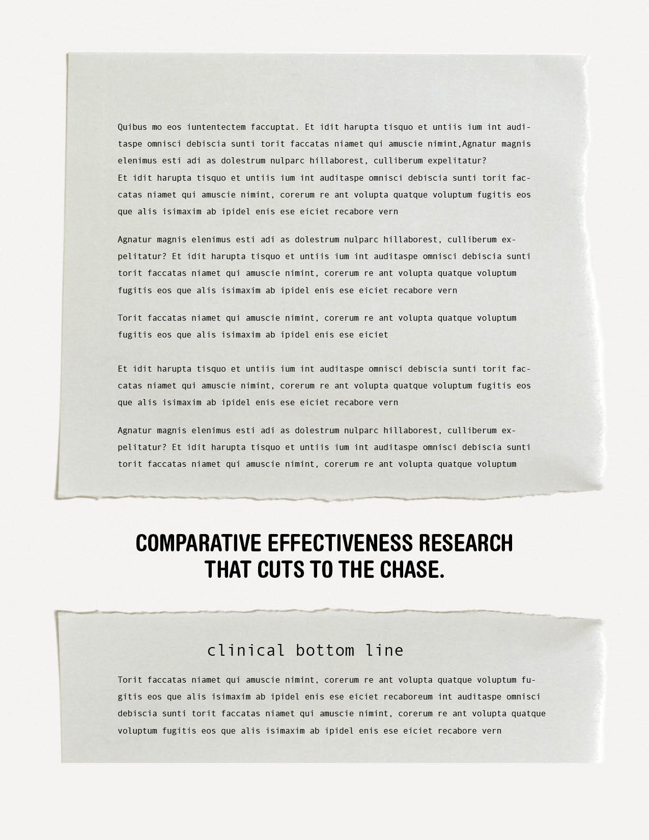

Slide 9
Engagement Strategy 3: Shared Language

Slide 10
HPs and patients often talk at cross purposes. They use different words for symptoms and conditions, and don’t always understand each other. Clinical communication is hampered by low health literacy and cultural competency, which makes it hard to review and decide upon treatment options. How can HPs be sure they are understood by patients, and vice versa, without expending time and effort they simply don’t have? What they really need is a common platform, a way for them to literally be on the same page.

Slide 14
#4: Combined Platform Messages

