Slide 1
Tire Purchase Discussion
Workbook Activity
City

Slide 2
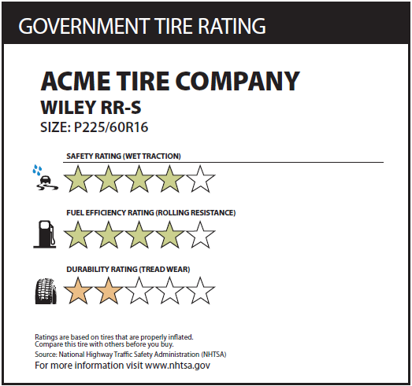
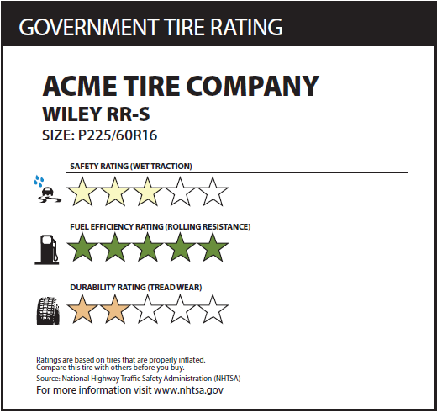
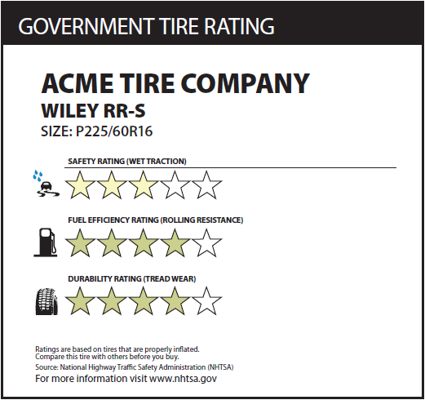
Please assume that all tires are both appropriate for your vehicle and are the same price.
Based on these ratings, please circle above which tire you would choose to purchase.
In your own words, please explain why you selected the tire you did.
On a scale from 1 to 10, how helpful is this rating scale to your tire purchase decision?
On a scale from 1 to 10, how likely are you to look up this rating scale during your tire purchase decision?
One a scale from 1 to 10, how important are these ratings to your tire purchase decision?
Not at all Helpful
Very Helpful
1
2
3
4
5
6
7
8
9
10
Not at all Likely
Very Likely
1
2
3
4
5
6
7
8
9
10
Not at all Important
Very Important
1
2
3
4
5
6
7
8
9
10

Slide 3
Please assume that all tires are both appropriate for your vehicle and are the same price.
Based on these ratings, please circle above which tire you would choose to purchase.
In your own words, please explain why you selected the tire you did.
On a scale from 1 to 10, how helpful is this rating scale to your tire purchase decision?
On a scale from 1 to 10, how likely are you to look up this rating scale during your tire purchase decision?
One a scale from 1 to 10, how important are these ratings to your tire purchase decision?
Not at all Helpful
Very Helpful
1
2
3
4
5
6
7
8
9
10
Not at all Likely
Very Likely
1
2
3
4
5
6
7
8
9
10
Not at all Important
Very Important
1
2
3
4
5
6
7
8
9
10

Slide 4
Please assume that all tires are both appropriate for your vehicle and are the same price.
Based on these ratings, please circle above which tire you would choose to purchase.
In your own words, please explain why you selected the tire you did.
On a scale from 1 to 10, how helpful is this rating scale to your tire purchase decision?
On a scale from 1 to 10, how likely are you to look up this rating scale during your tire purchase decision?
One a scale from 1 to 10, how important are these ratings to your tire purchase decision?
Not at all Helpful
Very Helpful
1
2
3
4
5
6
7
8
9
10
Not at all Likely
Very Likely
1
2
3
4
5
6
7
8
9
10
Not at all Important
Very Important
1
2
3
4
5
6
7
8
9
10

Slide 5
Please assume that all tires are both appropriate for your vehicle and are the same price.
Based on these ratings, please circle above which tire you would choose to purchase.
In your own words, please explain why you selected the tire you did.
On a scale from 1 to 10, how helpful is this rating scale to your tire purchase decision?
On a scale from 1 to 10, how likely are you to look up this rating scale during your tire purchase decision?
One a scale from 1 to 10, how important are these ratings to your tire purchase decision?
Not at all Helpful
Very Helpful
1
2
3
4
5
6
7
8
9
10
Not at all Likely
Very Likely
1
2
3
4
5
6
7
8
9
10
Not at all Important
Very Important
1
2
3
4
5
6
7
8
9
10

Slide 6
Please assume that all tires are both appropriate for your vehicle and are the same price.
TIRE 3
Tire 1 is marked with an EnergyStar label
Tire 2 is marked with an SmartWay label
Tire 3 is not marked with an EnergyStar or SmartWay label
Based on these ratings, please circle above which tire you would choose to purchase.
In your own words, please explain why you selected the tire you did.
On a scale from 1 to 10, how helpful is this rating scale to your tire purchase decision?
On a scale from 1 to 10, how likely are you to look up this rating scale during your tire purchase decision?
One a scale from 1 to 10, how important are these ratings to your tire purchase decision?
Not at all Helpful
Very Helpful
1
2
3
4
5
6
7
8
9
10
Not at all Likely
Very Likely
1
2
3
4
5
6
7
8
9
10
Not at all Important
Very Important
1
2
3
4
5
6
7
8
9
10

Slide 7
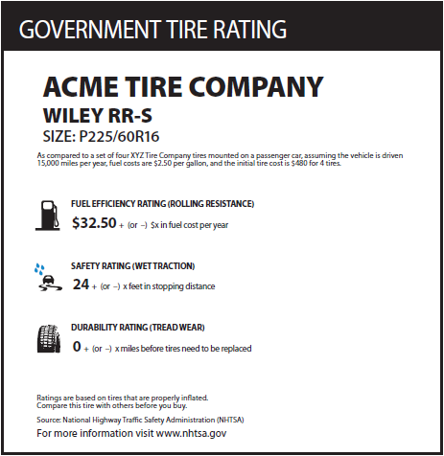
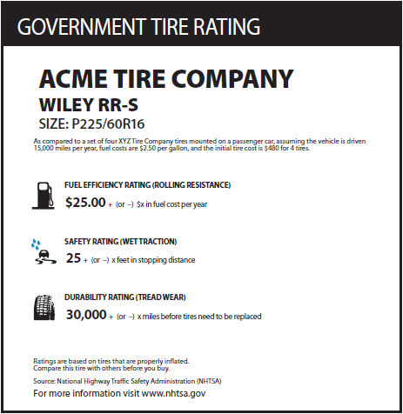
Please assume that all tires are both appropriate for your vehicle and are the same price.
Based on these ratings, please circle above which tire you would choose to purchase.
In your own words, please explain why you selected the tire you did.
On a scale from 1 to 10, how helpful is this rating scale to your tire purchase decision?
On a scale from 1 to 10, how likely are you to look up this rating scale during your tire purchase decision?
One a scale from 1 to 10, how important are these ratings to your tire purchase decision?
Not at all Helpful
Very Helpful
1
2
3
4
5
6
7
8
9
10
Not at all Likely
Very Likely
1
2
3
4
5
6
7
8
9
10
Not at all Important
Very Important
1
2
3
4
5
6
7
8
9
10

Slide 8
Additional Handouts for Group Discussion

Slide 9
Sample of Label with an Overall Score

