Slide 1
Consent Focus Group:
Understanding What Factors Are Most Important To Make Informed Consent Decisions
APP Design Team 2012 Patient Focus Groups Supporting U.S. Department of Health and Human Services eConsent Trials Contract # HHSP23320110023WC
OMB Approval: XXXXXXXXX

Slide 2
Our Goal Today
We want to better understand what information you need so you can make informed decisions about providing others access to your health information.
15 Minutes: Introduction to Consent and How Health Care Professionals and Health Care Payers might electronically access your Health Care Information
40 Minutes: Group discussion
5 Minutes: Wrap up and thank you
Our Agenda for the Next Hour
2

Slide 3
About Us
U.S. Department of Health and Human Services contracted the APP Design Team to develop Consent educational materials and technology
We are conducting focus groups with New Yorkers (YOU!) to help us identify what Consent topics are most important to you
The results of the focus groups will help us to develop better Consent educational materials and technology
FACILITATOR 1 PHOTO AND NAME
FACILITATOR 2 PHOTO AND NAME
3

Slide 4



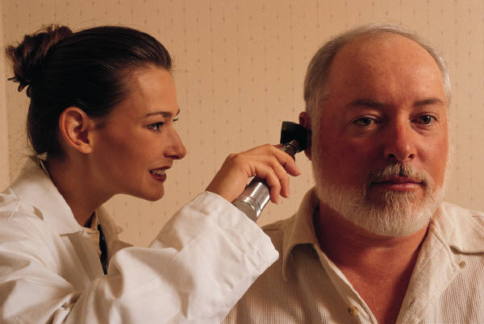
How Might My Health Care Information Be Electronically Collected and Accessed?
Medication History
Lab Results
Health Information Exchange (HIE)
Pharmacy
Visits
Laboratory
Visits
Insurance Records
Radiology Results
Health Insurance
Treatment History
Complete Health Record
Health Facility Visits
Radiology Visits
In most cases within New York, sharing your Health Care Information requires your written consent
4

Slide 5
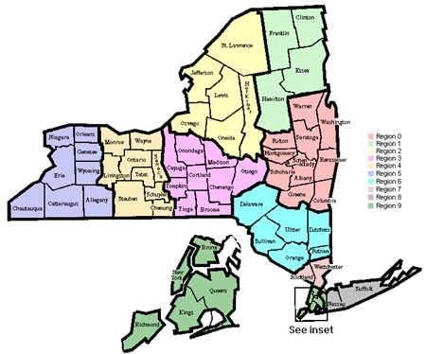

Who is My Health Information Exchange?
HEALTHeLINK is the Health Information Exchange (HIE) for Western New York
Collaborates with health care providers
in Western New York
Provides a safe, secure network for
exchange of data
Non-Profit organization focused on improving the quality of health care
5

Slide 6
In this Area, Health Information Exchange Participants Include:
Hospitals | Radiology Centers | Labs
Kaleida Health System | Windsong | Quest
Catholic Health System | Spectrum Radiology | X-Cell Laboratories
ECMC | Southtowns Radiology | Genetic Diagnostic Laboratories
Roswell Park Cancer Institute | Buffalo MRI
Niagara Falls Memorial | Diagnostic Imaging
WCA (Jamestown)
Mt. Saint Mary's
United Memorial Medical Center
Upper Allegheny Health System (Olean)
Brooks Memorial
New participants are added each month
6

Slide 7
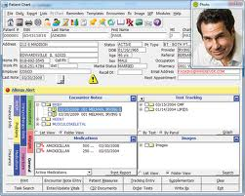
What Parts of My Health Care Information Might Be Electronically Accessible?
Diagnosis
Health history
Laboratory tests
Radiology reports and images
Medication history
May include Sensitive Personal Health Information such as:
Alcohol or drug abuse problems | Mental health conditions
Genetic diseases or tests | Birth control and abortion
HIV/AIDS | Sexually transmitted infections
7

Slide 8




Legal Considerations
Storing, transmitting and accessing patient Health Care Information is subject to specific requirements and guidelines:
Statutes
Laws
… at the Federal, State, and Local levels
Consent is a very complex topic!
Regulations
Policies
8

Slide 9
Who Might Have Access to My Health Care Information?
Health Care Providers, Health Insurance Payer Case Managers, and Health Insurance Payer Disease Management Nurses may access your information:
IF you have given permission and they are directly involved in your care,
OR
In the event of a medical emergency, unless you have specifically denied medical emergency access.
Important Note: The only Health Care Payer personnel that can see your Health Care Information through HEALTHeLINK are Case Managers and Disease Management Nurses.
9

Slide 10
What are My Health Care Information Sharing Consent Options?
Yes: I give consent for all Participants who are involved in my care to access ALL of my electronic health information through HEALTHeLINK.
Yes/Except: I give consent for all Participants who are involved in my care to access ALL of my electronic health information through HEALTHeLINK EXCEPT the following Participants (Participants Name/Address to be listed by patient).
No/Except: I deny consent for all Participants who are involved in my care to access my electronic health information through HEALTHeLINK for any purpose, EXCEPT in a medical emergency.
No/Never: I deny consent for all Participants who are involved in my care to access my electronic health information through HEALTHeLINK for any purpose, INCLUDING in a medical emergency.
10

Slide 11

Focus Group Discussion
Placeholder graphic
11

Slide 12

THANK YOU FOR YOUR TIME!
Your support TODAY will help us build better educational material and technology to enable informed consent decisions TOMORROW
12

Slide 13
BACKUP SLIDES

Slide 14
References – Acronyms
Acronym | Definition
ECMC | Erie County Medical Center
HIE | Health Information Exchange
HIV/AIDS | Human Immunodeficiency Virus/Acquired Immunodeficiency Syndrome
MRI | Magnetic Resonance Imaging
WCA | Women’s Christian Association (Hospital in Jamestown, NY)

Slide 15
References – Links to Additional Information
For additional information on the following topics, please refer to the links provided:
General Information on Federal Laws, Regulations, and Guidance Related to Health Information
http://healthit.hhs.gov/portal/server.pt/community/healthit_hhs_gov__regulations_and_guidance/1496
http://www.healthit.gov/patients-families/protecting-your-privacy-security
Health Insurance Portability and Accountability Act (HIPAA) of 1996
http://www.hhs.gov/ocr/privacy/hipaa/understanding/consumers/index.html
Health Information Technology for Economic and Clinical Health (HITECH) Notice of Proposed Rule
http://www.hhs.gov/ocr/privacy/hipaa/administrative/enforcementrule/hitechenforcementifr.html
http://www.hhs.gov/ocr/privacy/hipaa/understanding/coveredentities/nprmhitech.pdf.

Slide 16
References – Links to Additional Information
For additional information on the following topics, please refer to the links provided:
New York State Statutes/Policies Related to Personal Health Information
http://www.health.ny.gov/technology/statewide_policy_guidance.htm
http://www.nyehealth.org/images/files/File_Repository16/heal5/PrivSec_PPs_V2.pdf
HEALTHeLINK Information and Policies
http://wnyhealthelink.com/
http://wnyhealthelink.com/files/HEALTHeLINK_Policies_09-16-11_v1.pdf

