Slide 1
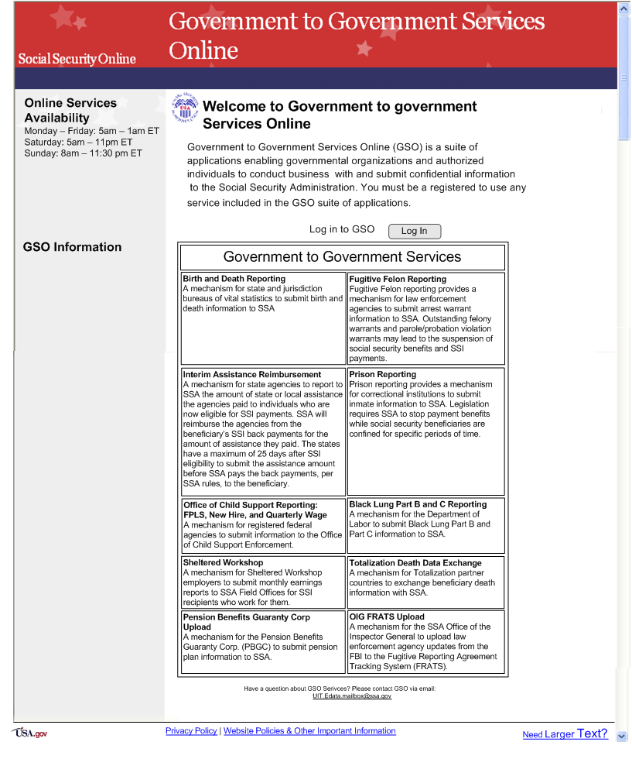
Govt to Govt Services Online
Screen 1

Slide 2
GSO Login
Screen 2

Slide 3
GSO Menu
Screen 3

Slide 4
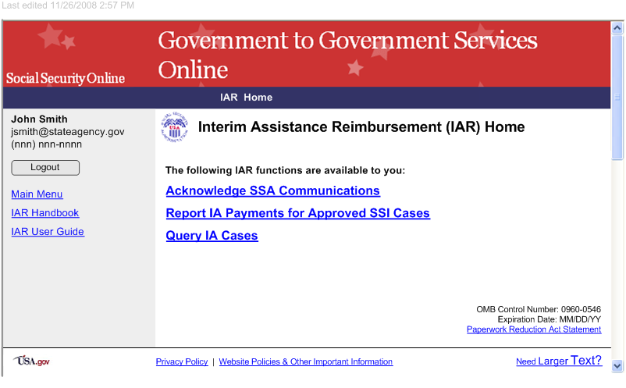
IAR Menu
Screen 4

Slide 5
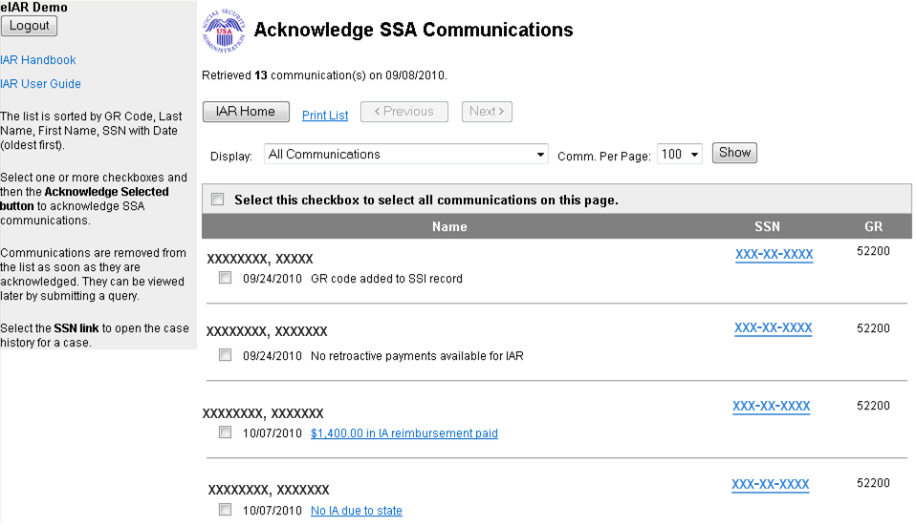
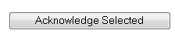
Acknowledge SSA communications
Screen 5

Slide 6
Event descriptions (1)
# | Event | Explanation
1 | GR code added to SSI record | SSA received an electronic notification of receipt or a paper copy of an IA authorization from your agency and added your agency’s GR Code to the related SSI claim record.
2 | SSI claim denied | SSA determined the claimant is not eligible for SSI benefits.
3 | GR code added – SSI record showing a denial | SSA received an electronic notification of receipt or a paper copy of an IA authorization from your agency and added your agency’s GR Code to the related SSI claim. SSA has already determined the claimant is not eligible for SSI benefits.
4 | No retroactive payments available for IAR | SSA determined the person is eligible for SSI. Also, SSA determined no retroactive amount is available for IA reimbursement.
5 | GR code deleted from SSI record | SSA removed your agency’s GR code from the SSI pending record because SSA erroneously recorded your agency’s GR code.
6 | Changed from {0} | SSA added your agency’s GR Code to a SSI pending record and removed another agency’s GR Code because SSA recorded the wrong GR code.
7 | Ineligible for IAR – GR code not reported timely | SSA received an electronic notification of receipt or a paper copy of the IA Authorization for this SSI claim later than the 30-calendar-day deadline. Because your agency missed the deadline, your agency is not eligible for Interim Assistance reimbursement.
8 | Appeal filed | SSA determined the claimant was not eligible for SSI benefits and the claimant has appealed SSA’s denial determination.
9 | Unfavorable appeal decision | The SSI claimant appealed SSA’s denial determination and SSA upheld on appeal the original denial determination.
10 | SSI making presumptive disability or blind payments | The SSI record shows this claimant is receiving payments based on the strong likelihood that the claim will be allowed. The payments are made prior to SSA’s final determination of eligibility and are payable for up to 6 months. The payments are not used to determine the amount of IA reimbursement. Click on the communication description hyperlink for more information on presumptive payments.

Slide 7
Event descriptions (2)
# | Event | Explanation
11 | SSI record terminated | SSA closed the SSI claim for this person on this record. Usually, the reason is that the person is no longer eligible for SSI benefits.
12 | Claimant’s name has changed on SSI record | SSA changed the person’s name on the person’s SSI claim. Either an error was recorded in the name or the person legally changed his/her name.
13 | Changed to {0} | SSA replaced your agency’s GR code with another agency’s GR Code because SSA erroneously recorded your agency’s GR Code.
14 | GR code added – SSI record showing appeal filed | SSA determined the claimant was not eligible for SSI benefits and the claimant has appealed SSA’s denial determination.
15 | SSI awarded – case review pending | SSA determined the person is eligible for SSI. However, SSA must review the case to determine how to distribute the retroactive SSI payments due on the claim. If SSA determines retroactive SSI money remains to reimburse the State, SSA will notify your agency requesting the amount of any IA paid.
16 | SSI case awarded – Request for IA payments State paid | SSA determined the person is eligible for SSI. SSA will send a notification to your agency requesting any IA paid.
17 | SSI case reinstated – Request for IA payments State paid | SSA determined the person is eligible for SSI. SSA will send a notification to your agency requesting the amount of any IA paid.
18 | GR code added – SSI record showing appeal denied | SSA received an electronic notification of receipt or a paper copy of the IA authorization from your agency and added your agency’s GR Code to the related SSI record. The SSI record shows the claimant appealed SSA’s denial determination and SSA upheld on appeal the original denial determination.
19 | GR code added – SSI making presumptive payments | SSA received an electronic notification of receipt or a paper copy of the IA authorization from your agency. SSA added your agency’s GR Code to the related SSI claim. The SSI record shows this claimant is receiving payments based on the strong likelihood that the claim will be allowed. The payments are made prior to SSA’s final determination of eligibility and are payable for up to 6 months. Click on the communication description hyperlink for more information on presumptive payments.

Slide 8
Event descriptions (2)
# | Event | Explanation
20 | Ineligible for IAR – IA payments not reported timely | SSA received an electronic notification of receipt or a paper copy of the IA Authorization for this SSI claim later than the 30-calendar-day deadline. Because your agency missed the deadline, your agency is not eligible for Interim Assistance reimbursement.
21 | {$9,999.99} in IA reimbursement paid | SSA has paid the appropriate amount of the IAR to the agency.
22 | No IA due to state | There are no agency IA payments during the IAR period or there is no reimbursement amount computed and due the agency.
23 | Claimant’s SSN has changed on SSI record | SSA changed the person’s name on the person’s SSI claim. Either an error was recorded in the name or the person legally changed his/her name.
24 | IAR payment returned to SSA | SSA paid the IAR amount to the agency, but for some reason, the amount was returned to SSA, usually by the agency’s financial institution.
25 | State sent IA payment amount to SSA | The agency sent to SSA the monthly IA payment amount paid to the recipient.

Slide 9
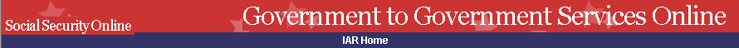
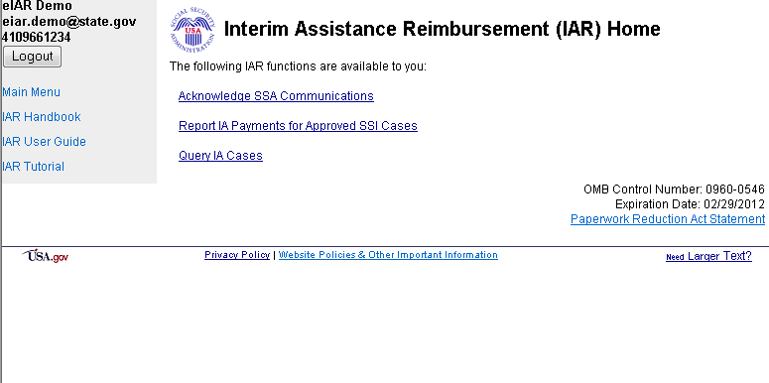
IAR Menu – Submit payment info step 1
Screen 6

Slide 10
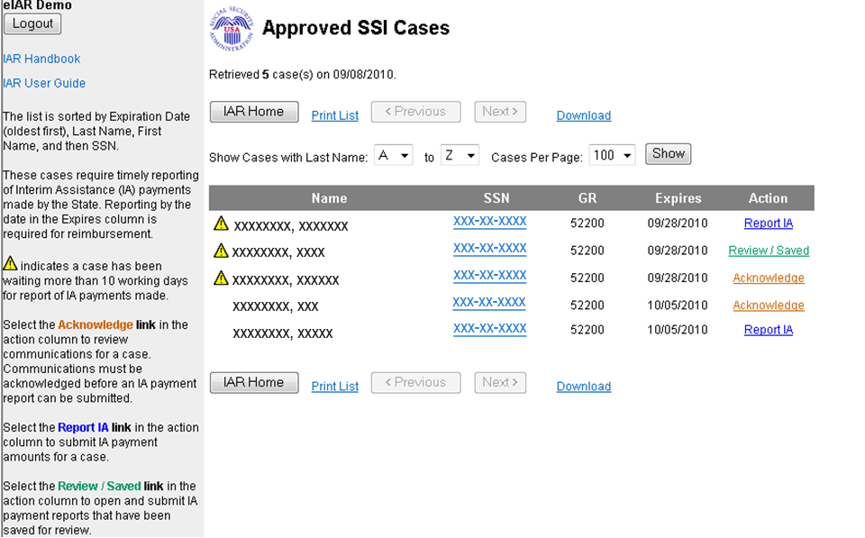
Submit Payment Info step 2
Screen 7

Slide 11
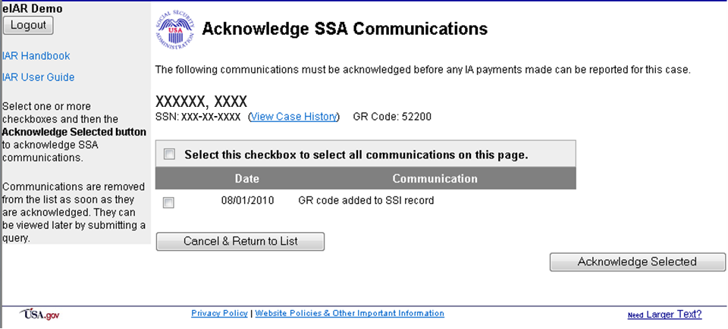
(If acknowledgements are pending)
Screen 8

Slide 12
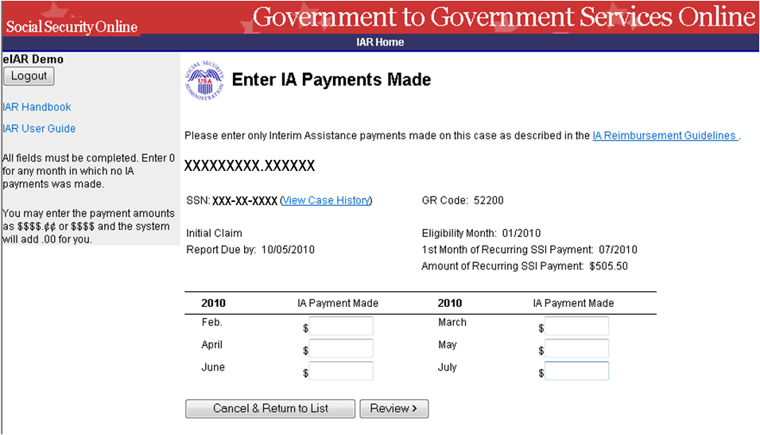
Submit Payment Info step 3
Screen 9

Slide 13
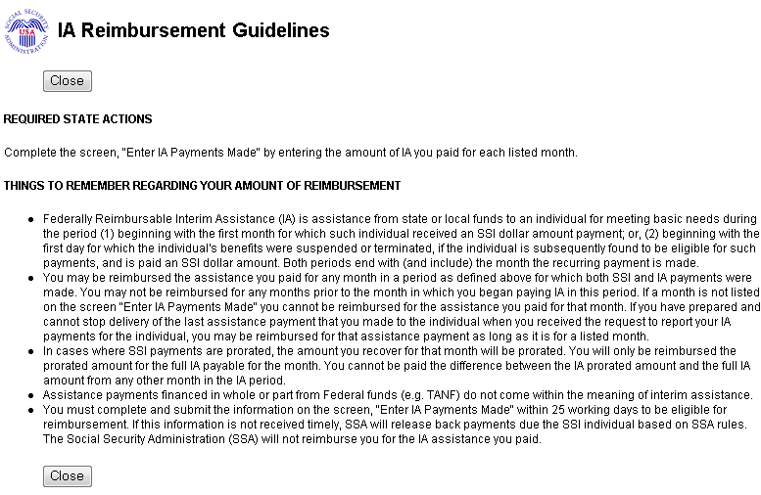
IAR Guidelines
Screen 10

Slide 14
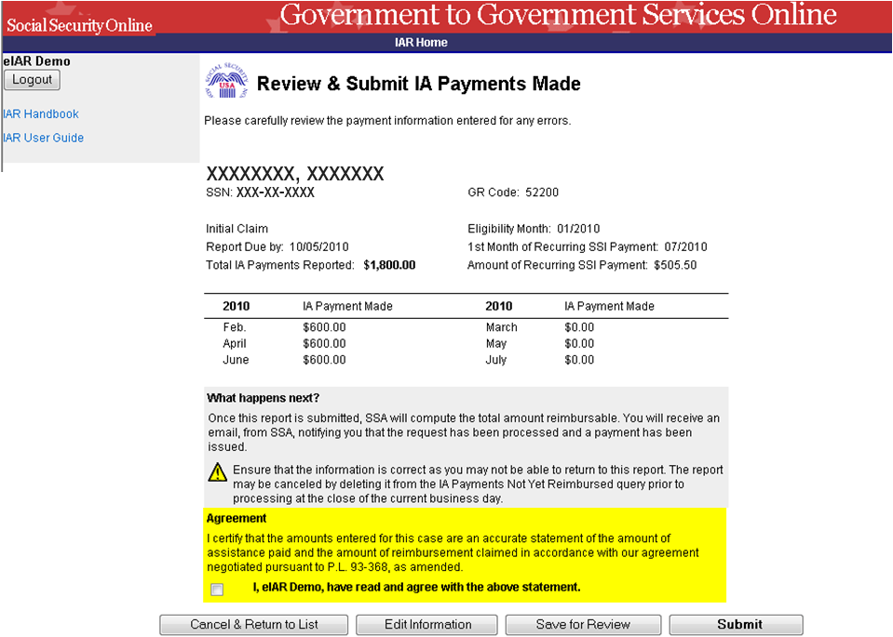
Submit Payment Info step 4
Screen 11

Slide 15
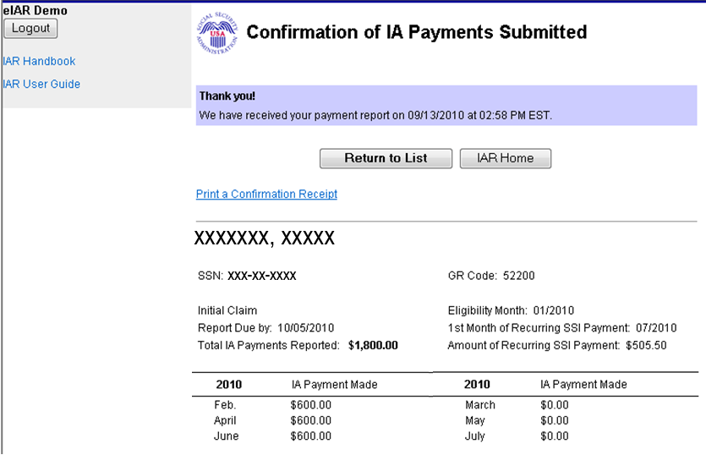
Submit Payment Info step 5
Screen 12

Slide 16
IAR Menu – Queries for State/Local IA workers
Screen 13

Slide 17
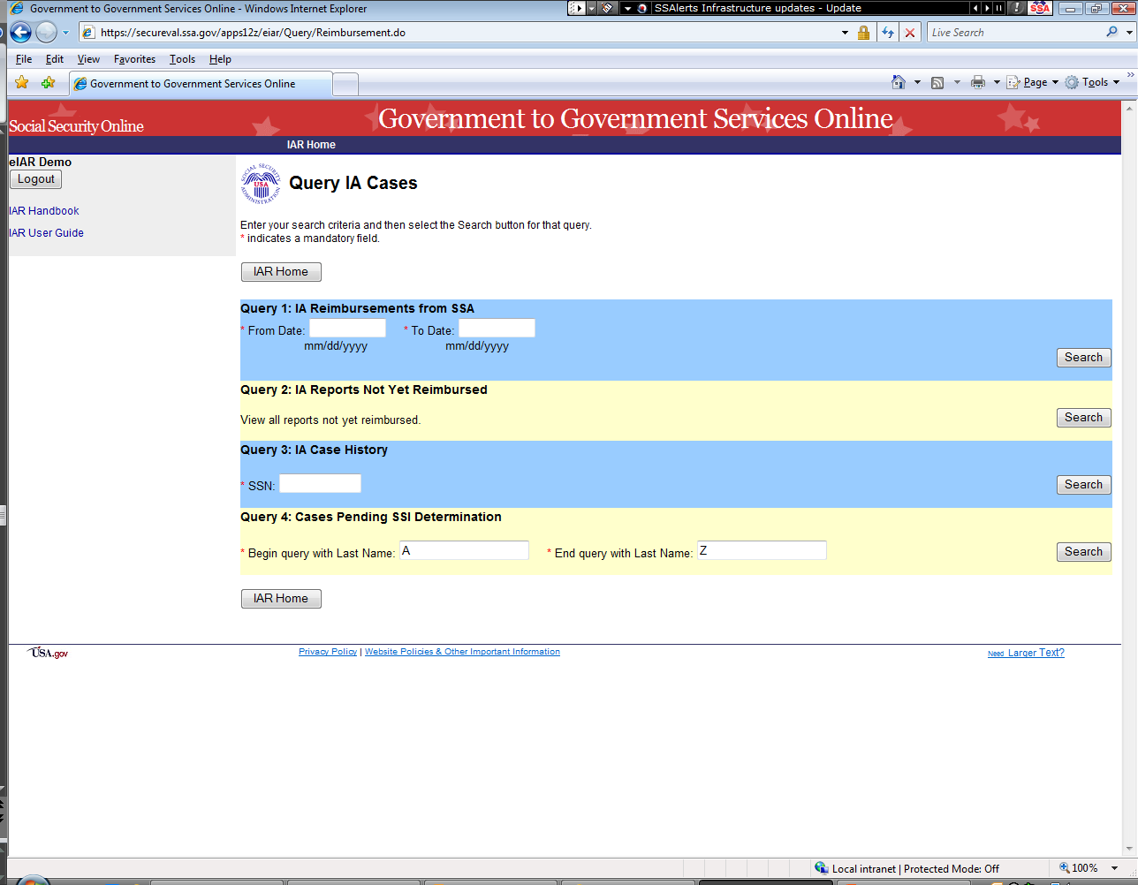
Queries for state/local IA workers
Screen 14

Slide 18
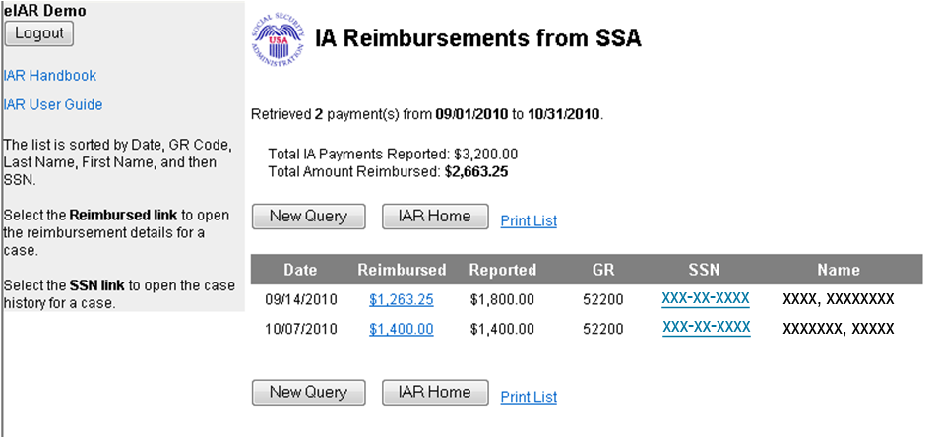
IA reimbursements paid by SSA
Screen 15

Slide 19
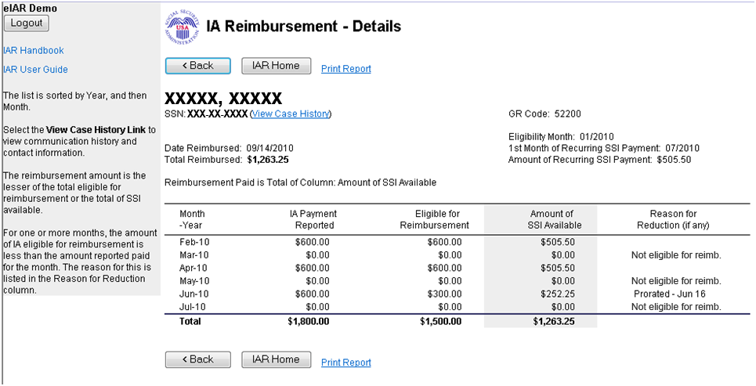
Reimbursement detail
Screen 16
The reimbursement amount is the lesser of the total eligible for reimbursement or the total of SSI available.
For one or more months, the amount of IA eligible for reimbursement is less than the amount reported paid for the month. The reason for this is listed in the 'Reason for Reduction' column.

Slide 20
Queries for state/local IA workers
Screen 17

Slide 21
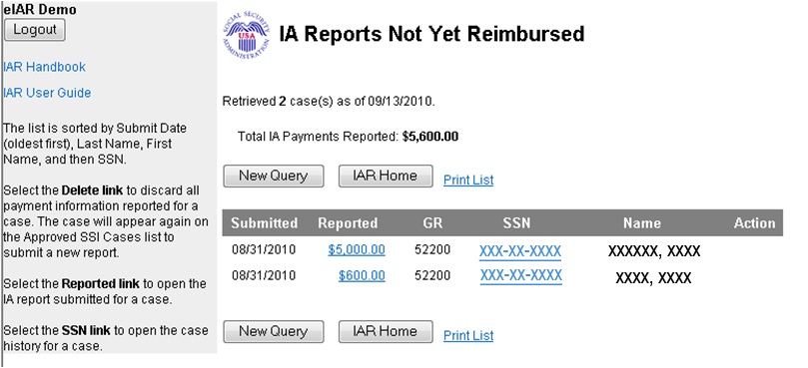
IA reports not yet reimbursed
Screen 18

Slide 22
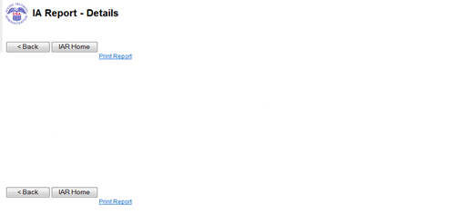
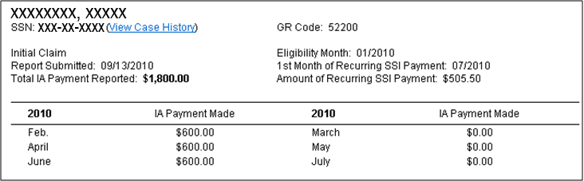
Detail of IA not yet reimbursed
Screen 19

Slide 23
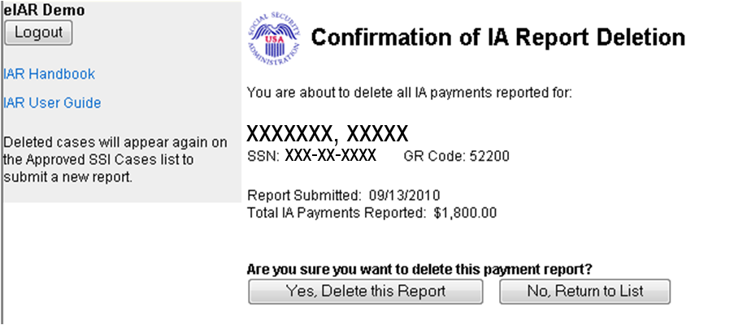
Delete Confirmation
Screen 20

Slide 24
Queries for state/local IA workers
Screen 21

Slide 25
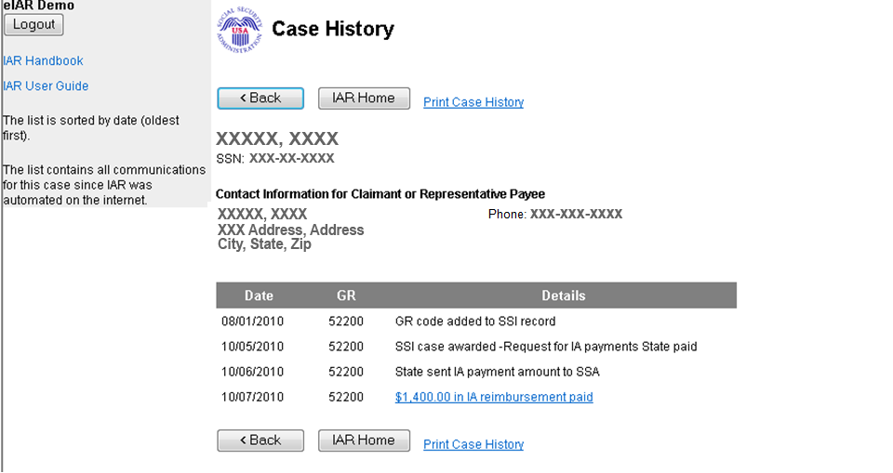
IA Case History
Screen 22

Slide 26
Queries for state/local IA workers
Screen 23

Slide 27
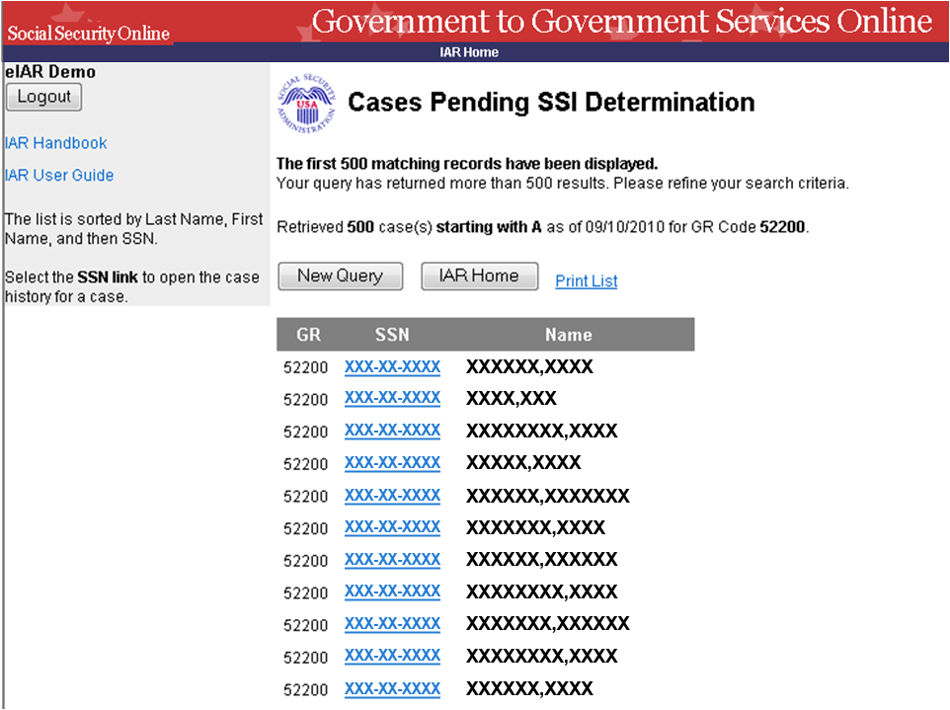
Cases pending SSI determination
Screen 24

