Slide 1
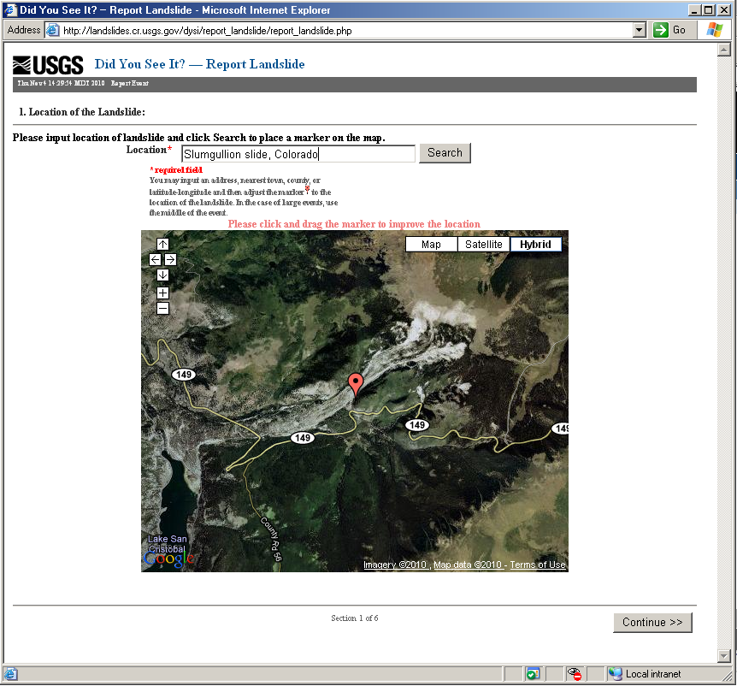
Section 1. Location

Slide 2
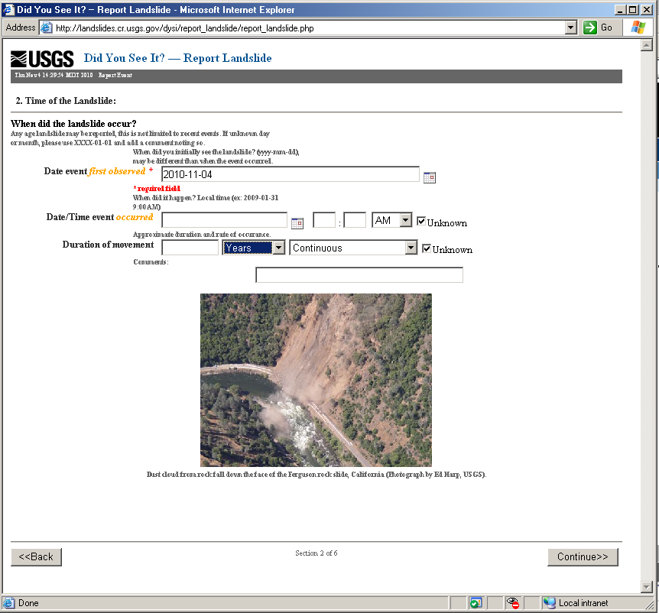
Section 2. When?

Slide 3
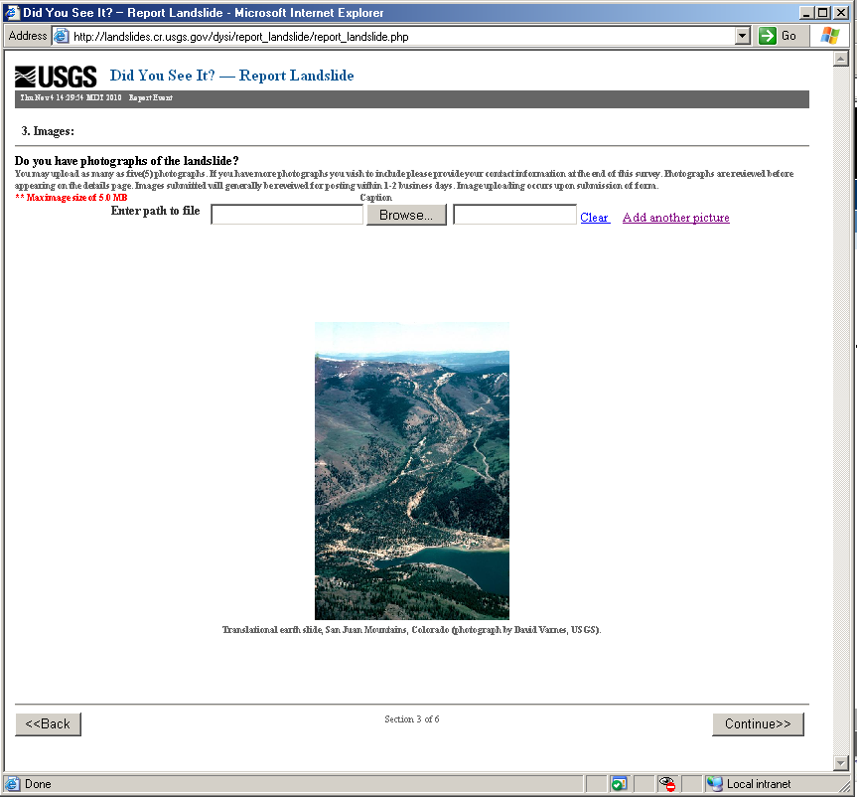
Section 3. Photo upload

Slide 4
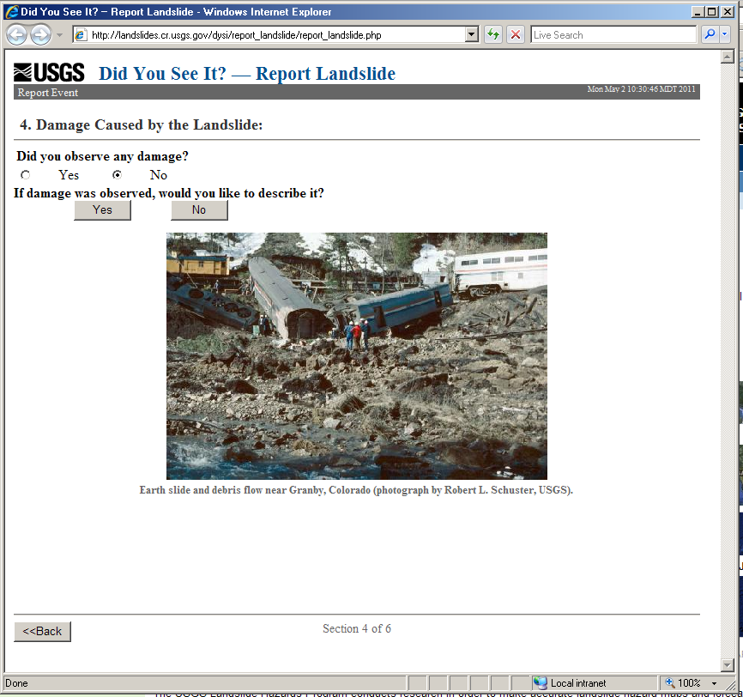
Section 4. Damage—Yes or no?

Slide 5
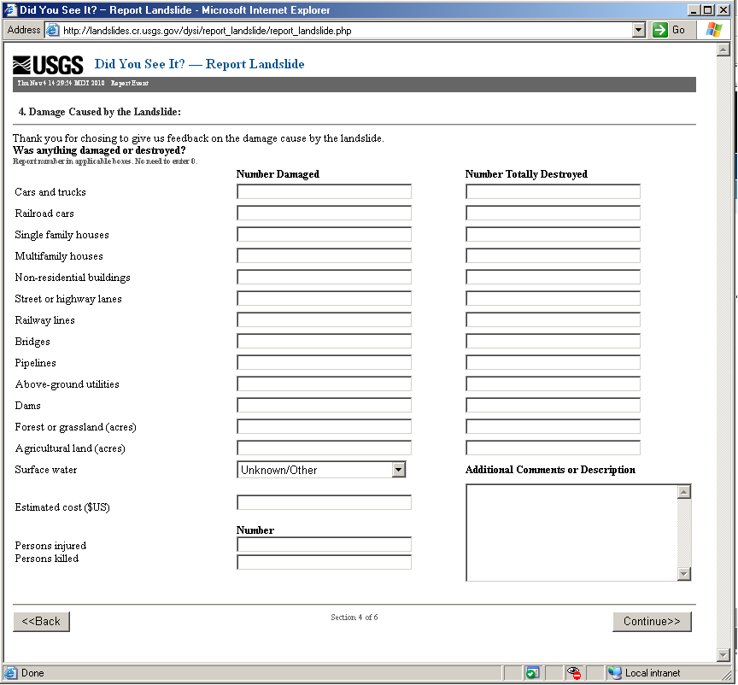
Section 4. Damage Summary

Slide 6
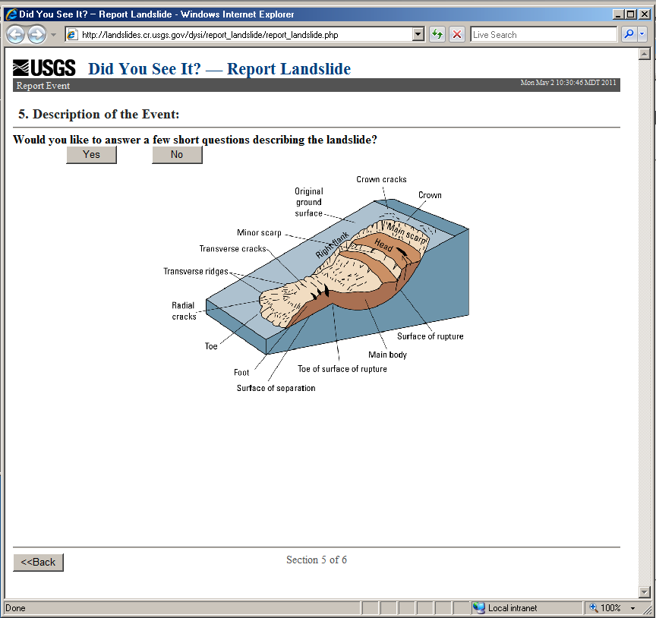
Section 5. Landslide Description, Yes or no?

Slide 7
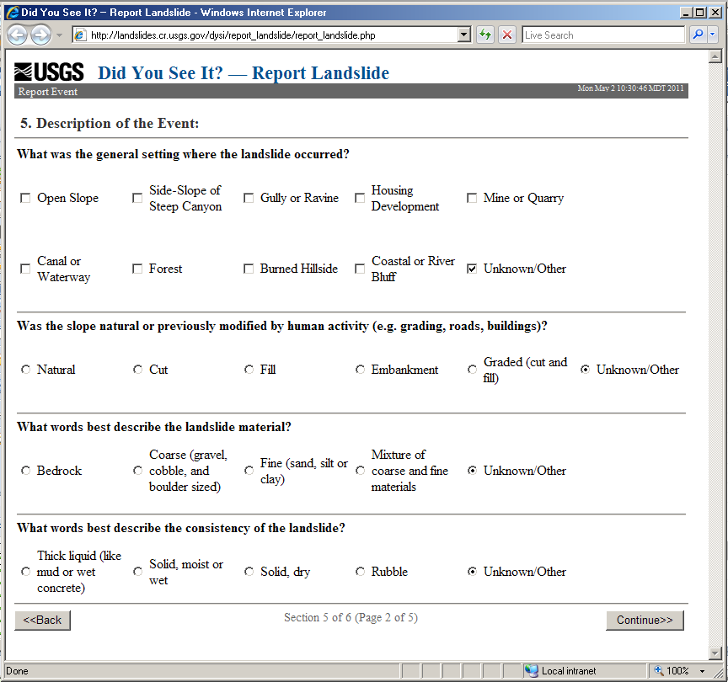
Section 5. Landslide Description, page 2
Questions tailored to landslide types Rotational, Translational, Spread, or Unknown

Slide 8
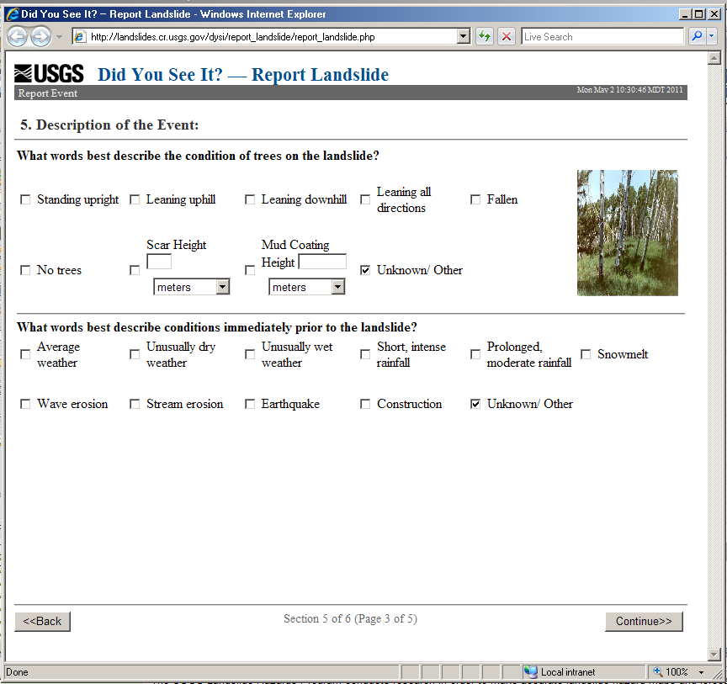
Section 5. Landslide Description, page 3
Questions tailored to landslide types Rotational, Translational, Spread, or Unknown

Slide 9
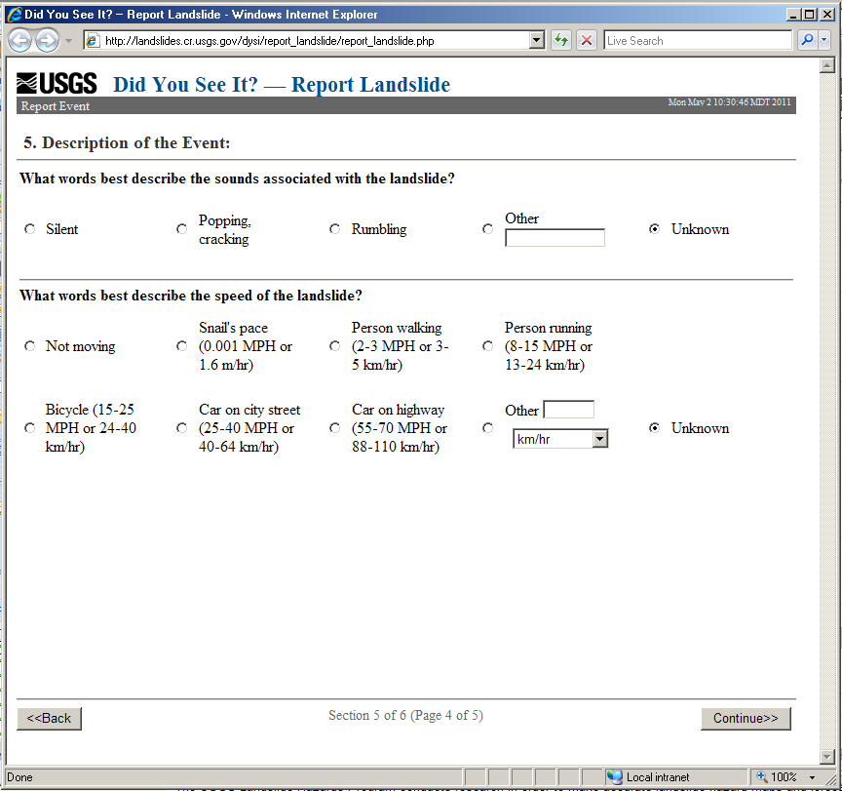
Section 5. Landslide Description, page 4
Questions tailored to landslide types Rotational, Translational, Spread, or Unknown

Slide 10
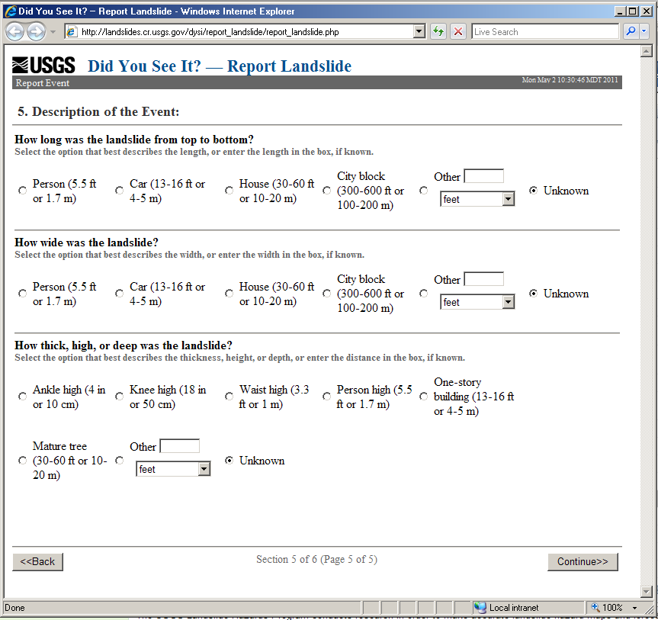
Section 5. Landslide Description, page 5
Questions tailored to landslide types Rotational, Translational, Spread, or Unknown

Slide 11
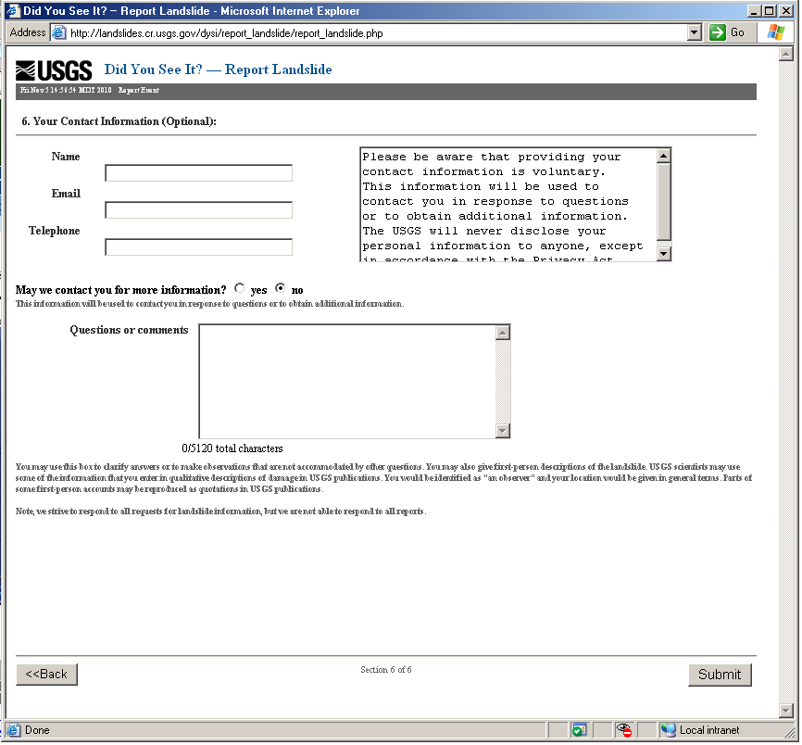
Section 6. Questions, Comments, and Contact Information

Slide 12
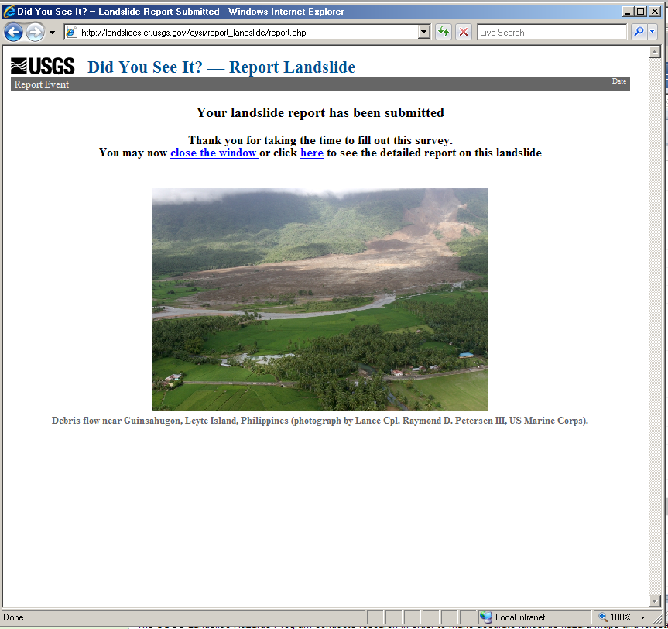
Thank you page—what the user sees after clicking the “Submit” button

