Slide 1
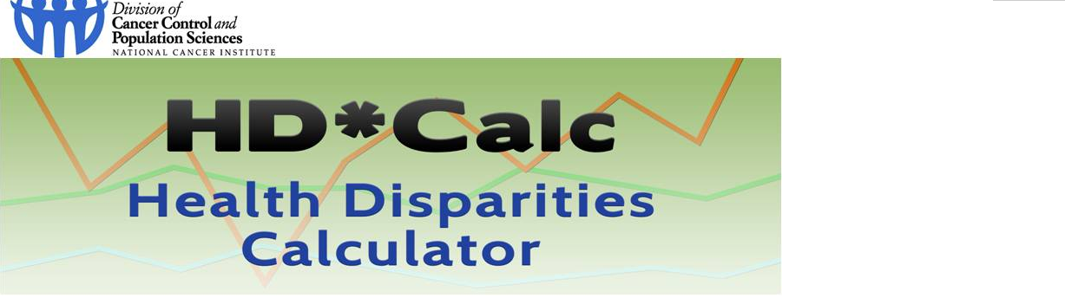
Thank you very much for including the HD*Calc software (http://seer.cancer.gov/hdcalc/) on your website or social media platform. The National Cancer Institute would like to learn how your organization may be using HD*Calc. If you believe that someone else in your organization would be better able to answer these questions, we would greatly appreciate your forwarding the web link for this survey to that person.
OMB No.: 0925-0642-08
Expiration Date: 9/30/2014
Collection of this information is authorized by The Public Health Service Act, Section 412 (42 USC 285 a-1). Rights of study participants are protected by The Privacy Act of 1974. Participation is voluntary, and there are no penalties for not participating or withdrawing from the study at any time. Refusal to participate will not affect your benefits in any way. The information collected in this study will be kept private under the Privacy Act. Names and other identifiers will not appear in any report of the study, but participants may be contacted to follow up on survey responses. Information provided will be combined for all study participants and reported as statistical summaries.
Public reporting burden for this collection of information is estimated to average 10 minutes per response, including the time for reviewing instructions, searching existing data sources, gathering and maintaining the data needed, and completing and reviewing the collection of information. An agency may not conduct or sponsor, and a person is not required to respond to, a collection of information unless it displays a currently valid OMB control number. Send comments regarding this burden estimate or any other aspect of this collection of information, including suggestions for reducing this burden to: NIH, Project Clearance Branch, 6705 Rockledge Drive, MSC 7974, Bethesda, MD 20892-7974, ATTN: PRA (0925-0642-08). Do not return the completed form to this address.
Contact: If you have questions about this questionnaire, please contact hdcalculator@imsweb.com.
Agreement: By clicking “agree,” you are indicating that you have read the above information and agree to participate in this study; then your browser will open a website for you to complete the survey. If you do not wish to participate, please decline participation by clicking “disagree.”

Slide 2
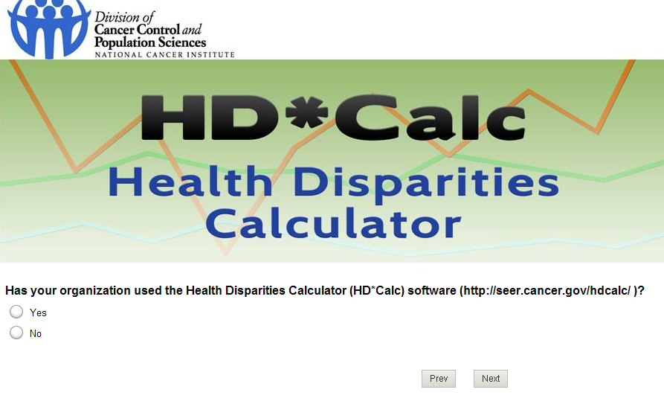

Slide 3
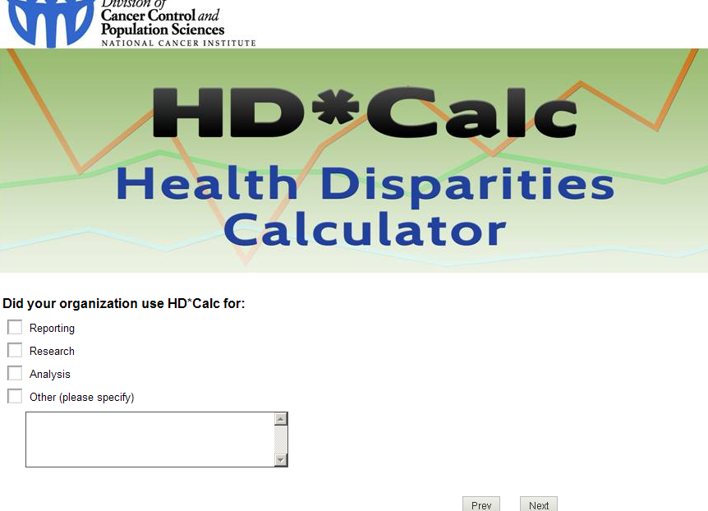

Slide 4
