Slide 1
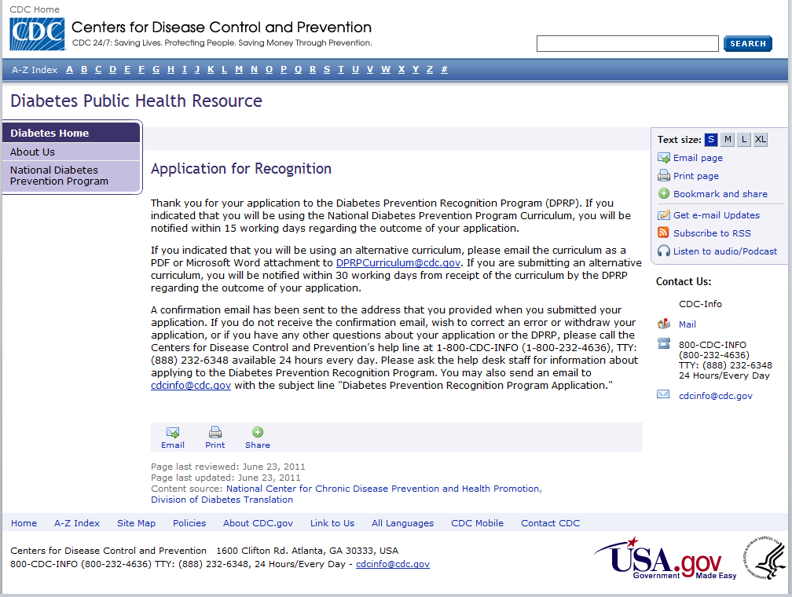
Thank you for your application to the Diabetes Prevention Recognition Program (DPRP). If you indicated that you will be using the National Diabetes Prevention Program Curriculum, you will be notified within 15 working days regarding the outcome of your application.
If you indicated that you will be using an alternative curriculum, please e-mail the curriculum as a PDF or Microsoft Word attachment to DPRPCurriculum@cdc.gov within 10 working days. If you are submitting an alternative curriculum, you will be notified within 30 working days from receipt of the curriculum by the DPRP regarding the outcome of your application.
A confirmation e-mail has been sent to the address that you provided when you submitted your application. If you do not receive the confirmation e-mail, wish to correct an error or withdraw your application, or if you have any other questions about your application or the DPRP, please call the Centers for Disease Control and Prevention’s help line at 1-800-CDC-INFO (1-800-232-4636), TTY: (888) 232-6348 available 24 hours every day. Please ask the help desk staff for information about applying to the Diabetes Prevention Recognition Program. You may also send an e-mail to cdcinfo@cdc.gov with the subject line “Diabetes Prevention Recognition Program Application.”

