Slide 1
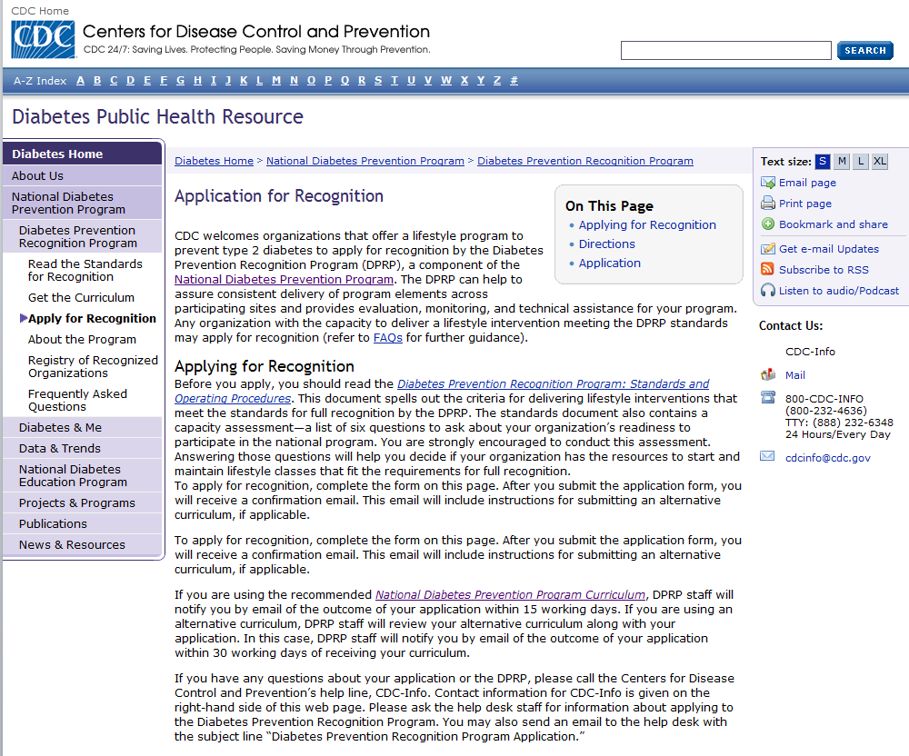
Before you apply, you should read the Diabetes Prevention Recognition Program: Standards and Operating Procedures. This document spells out the criteria for delivering lifestyle interventions that meet the standards for full recognition by the DPRP. The standards document also contains a capacity assessment—a list of six questions to ask about your organization’s readiness to participate in the national program. You are strongly encouraged to conduct this assessment. Answering those questions will help you decide if your organization has the resources to start and maintain lifestyle classes that fit the requirements for full recognition.
To apply for recognition, complete the form on this page. After you submit the application form, you will receive a confirmation e-mail. This e-mail will include instructions for submitting an alternative curriculum, if applicable.
If you are using the recommended National Diabetes Prevention Program Curriculum, DPRP staff will notify you by e-mail of the outcome of your application within 15 working days. If you are using an alternative curriculum, DPRP staff will review your alternative curriculum along with your application. In this case, DPRP staff will notify you by e-mail of the outcome of your application within 30 working days of receiving your curriculum.
If you have any questions about your application or the DPRP, please call the Centers for Disease Control and Prevention’s help line, CDC-Info. Contact information for CDC-Info is given on the right-hand side of this Web page. Please ask the help desk staff for information about applying to the Diabetes Prevention Recognition Program. You may also send an e-mail to the CDC help desk with the subject line “Diabetes Prevention Recognition Program Application.”

Slide 2
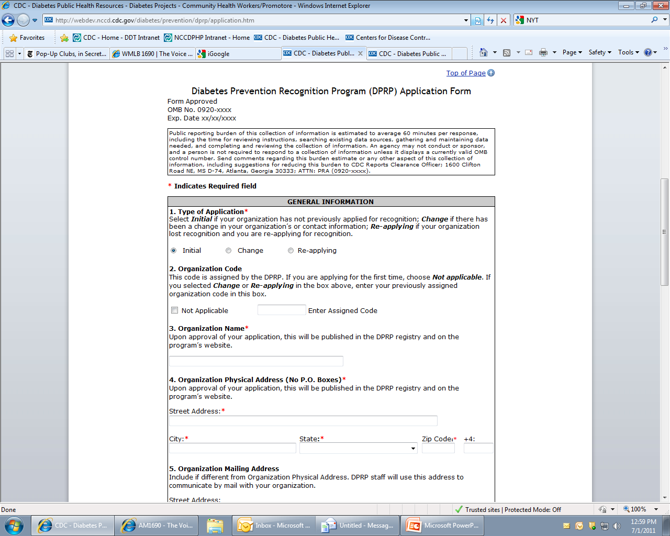

Slide 3
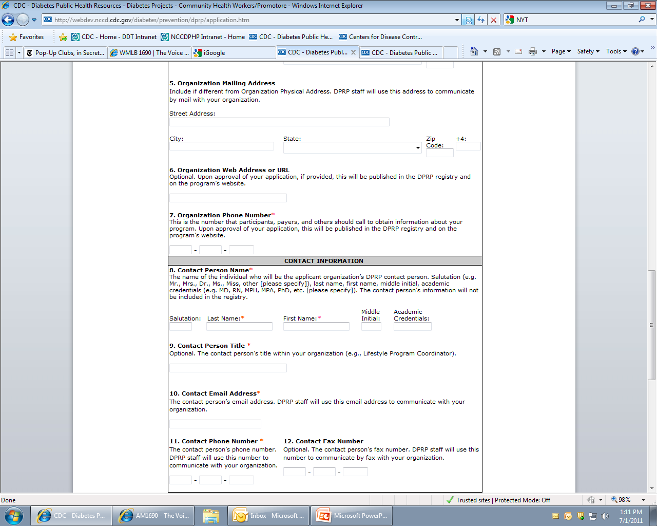
10. Contact E-mail Address*

Slide 4
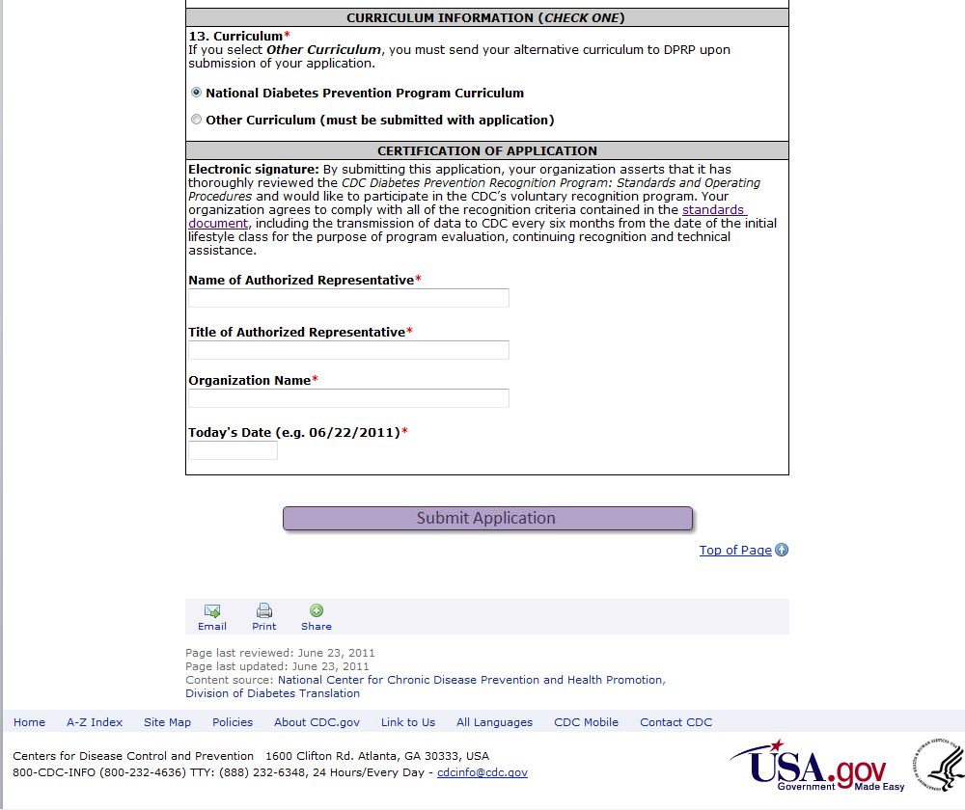
Electronic signature: By submitting this application, your organization asserts that it has thoroughly reviewed the CDC Diabetes Prevention Recognition Program: Standards and Operating Procedures and would like to participate in the CDC’s voluntary recognition program. Your organization agrees to comply with all of the recognition criteria contained in the standards document, including the transmission of data to CDC every 6 months from the date of the initial lifestyle class for the purpose of program evaluation, continuing recognition, and technical assistance.
Today’s Date (e.g., 06/22/2011)*

