Slide 1
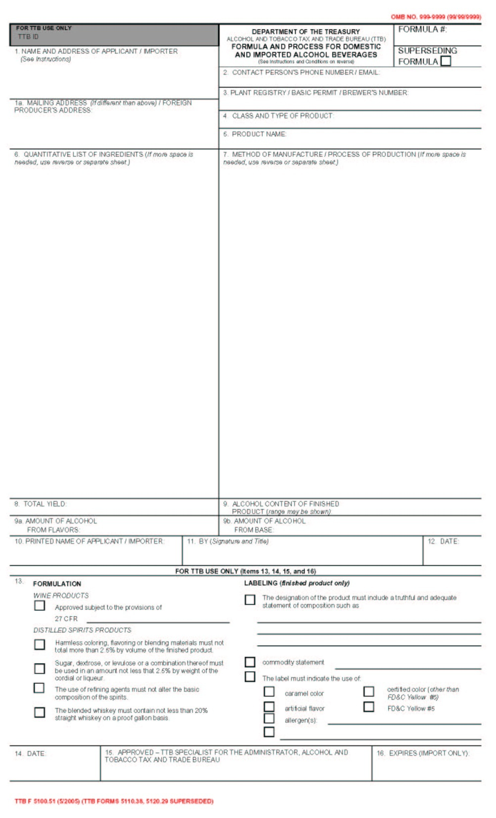
Current Process
Form 5100.51

Slide 2
Paper process for Form 5100.51
Company/Product Identifying Information
(Items 1-5)

Slide 3
Electronic process for Form 5100.51
Formulas Online
(Items 1-3 of 5100.51)

Slide 4
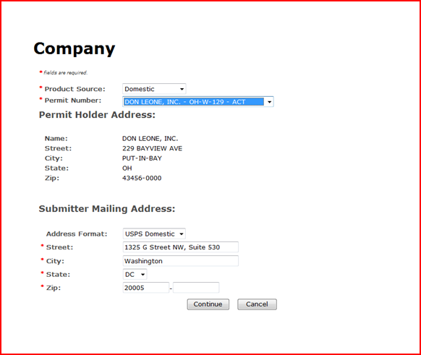
Electronic process for Form 5100.51
Formulas Online
(Items 1-3 of 5100.51)

Slide 5
Electronic process for Form 5100.51
Formulas Online
(Items 1-5 of 5100.51)

Slide 6
Paper process for Form 5100.51
Information pertaining to formula and process of product (Items 6-12)

Slide 7
Electronic process for Form 5100.51
Formulas Online
(Items 8-9 of 5100.51)

Slide 8
Electronic process for Form 5100.51
Formulas Online
(Item 6 of 5100.51)

Slide 9
Electronic process for Form 5100.51
Formulas Online
(Item 7 of 5100.51)

Slide 10
Electronic process for Form 5100.51
Formulas Online
(Comments)

Slide 11
Electronic process for Form 5100.51
Formulas Online
(Supplemental
Documentation)

