Slide 1
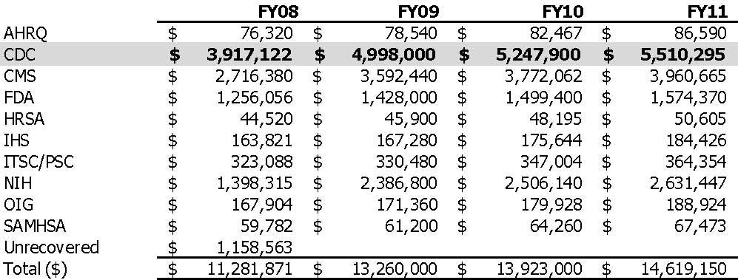
HHS SAS Costs Distributed, 2008-2011
Attachment A – HHS SAS cost distribution, 2008-2011
Source: SAS Strategy Workgroup
Final Report to the CDC Management Board
April 2011

