Slide 1

CDC SAS License Process
Attachment B – CDC SAS license process
January 24, 2013

Slide 2
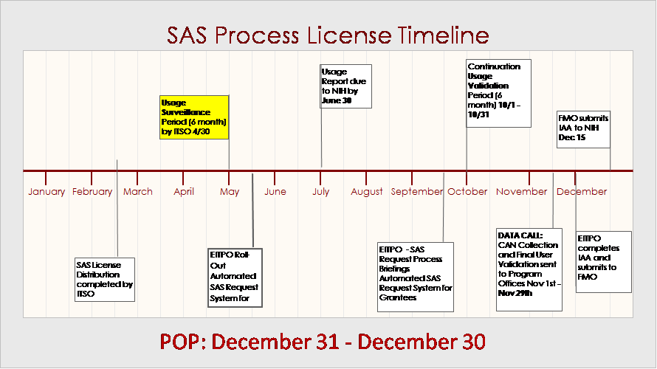
SAS Process Management Plan
Milestone
License Request and Fulfillment Process Improvement Plan (PDCA)
Stakeholder Collaboration (SAS Workgroup/Project Officers)
Grantee SharePoint Process Implementation – May 31, 2012
SAS Internal Usage Surveillance by ITSO: Oct-March
Data Call – CDC Product Validation: May-June (Report due to NIH 6/30)
Data Calls – Continued Use and CAN Collection: Oct-Nov
ITSO Distribution of Renewal Licenses
Source: CDC SAS Workgroup
Notes:
Quality

Slide 3
SAS Process Management Plan
Source: CDC SAS Workgroup
Notes:
FMO must submit IAA to NIH November 30th.

Slide 4

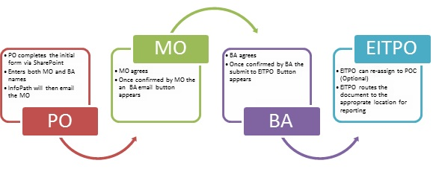
SAS Grantee License Request and Fulfillment Process – SharePoint
Source: CDC SAS Workgroup

