Slide 1
NHTSA Public Meeting Tire Fuel Efficiency Consumer Information Research March 26, 2010
Dan Zielinski
Senior Vice President, Public Affairs
Rubber Manufacturers Association
202-682-4846/dzielinski@rma.org

Slide 2
Tire Fuel Efficiency NPRM
Energy Independence and Security Act
RMA advocated inclusion of national tire fuel efficiency consumer information program
For NHTSA’s rule to be effective RMA believes the program must:
• Provide information at point of sale;
• Provide meaningful information that is easy to understand by consumers
• Provide a meaningful rating system, differentiating tire rolling resistance, traction and tread wear performance among appropriate tire choices for the consumer’s existing vehicle
• Be cost effective to minimize the cost effect of this information to consumers.

Slide 3
RMA Consumer Research
In response to NHTSA’s NPRM, RMA undertook comprehensive consumer research to test a sample of potential tire information formats to provide consumers with information about tire fuel efficiency, traction and tread wear.
Research comments were included in RMA’s response to NPRM (Aug, 2009)

Slide 4
RMA Consumer Research
Methodology
Internet survey – 1,000 participants
Participants screened using same criteria as NHTSA focus group
Five formats tested

Slide 5
RMA Consumer Research
RMA tested five tire information formats based upon those initially tested in NHTSA focus group study
Some formats were altered based upon NHTSA’s focus group research and comments

Slide 6
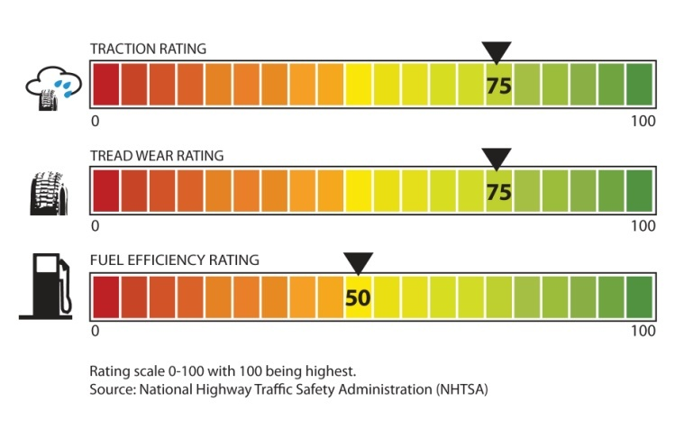
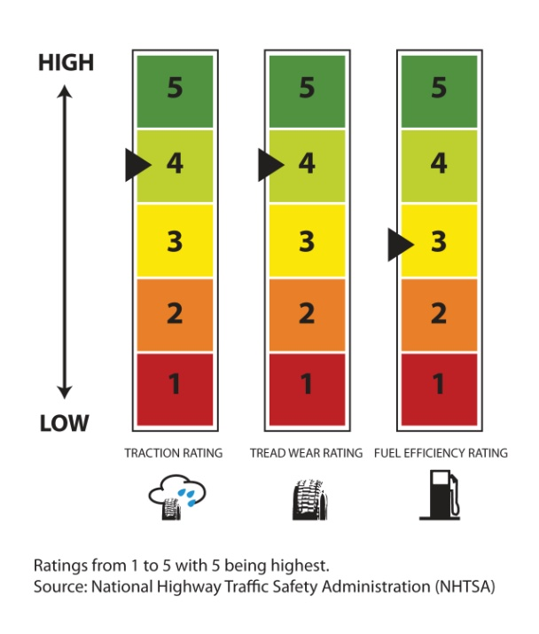
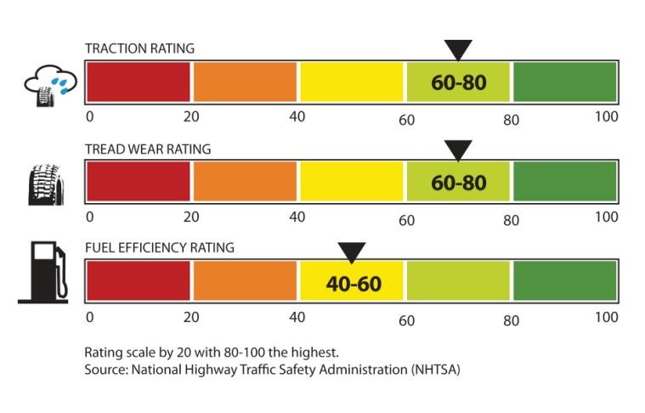
RMA Consumer Research
“Thermometer”
“Stars”
“Thermometer
Category”
“5 Box
Vertical”
“5 Box
Horizontal”

Slide 7
RMA Survey Results
The “Stars” format was highest rated among consumers in RMA survey:
Most Preferred Label
(Asked of n=1,000)

Slide 8
RMA Survey Results
While 29% of respondents chose “Thermometer” as their most preferred, this support drops to 19% when respondents are informed that it would not precisely rate tires.
What Would Consumers Recommend if "Thermometer"
Format Implied Precision That Doesn't Exist
Use Thermometer
Label
19%
Don't Use Any
Label
22%
Use Another Label
59%

Slide 9
Effective Rule Helps Consumers; Spurs Industry Innovation
An effective program will provide useful information to consumers
Tire makers will have additional incentives to compete for consumers’ attention on particular tire traits
Top end of rating scale should be appropriately high to allow for future innovation

Slide 10
Concerns – Information Format
A paper label attached to replacement tires is impractical and ineffective for consumer information
Consumers virtually never see a tire label
Removed or damaged before installation
Consumers typically see tires after installation
Consumer access to information prior to purchase decision is important - web, point-of-sale

Slide 11
Concerns – Information Format
Web-based and point-of-sale information are most practical media for consumers
Web based information allows for consumer research prior to sale
Point of sale information allows consumers to have meaningful tools to help guide tire purchase to suit consumer’s needs

Slide 12
Recommendations for Providing Consumer Information
NHTSA should mandate that tire retailers display tire efficiency program poster and make the rating information available to consumers.
Other forms of information:
tire manufacturer brochures, product catalogues
in-store online access to the NHTSA website
tire manufacturer or retailer’s website with rating information
NHTSA-produced tire fuel efficiency program booklet – similar to agency’s UTQGS publication
Provided to tire dealers nationwide at an annual cost of $3,190.
NHTSA estimates 60,000 tire dealers nationwide.
Small investment to help educate consumers with tire ratings and assist in more fuel efficient tire purchases

Slide 13
Concerns – Rating System
0-100 scale is not practical
Implies a misleading level of precision
Tires within 10-20 points not likely to have significantly different performance
Rolling resistance force will group tire ratings of the same or similar size into a small range of the overall scale, minimizing differentiation
Rolling resistance coefficient is more suitable to provide consumers with range of tire choices within their size range for a given vehicle
Europe and Japan are implementing rating systems based on rolling resistance coefficient

Slide 14
NPRM Tire Efficiency Rating
based on rolling resistance force
Full sized SUV/pickup truck
Full Sized
Rating system does not give individual consumer full range of choices for existing vehicle
Serves to rate vehicles rather than provide useful information about replacement tires
Does not give all consumers choices of high rated tires
Midsized
Compact
Subcompact

Slide 15
Concerns - Research Plan
Additional research should test several formats
NHTSA’s August 19, 2009 survey only tested two formats used in earlier focus group research
RMA research shows consumer preference for a “star” categorical format
Labels, point-of-sale and web-based formats should be tested
Consumer testing should not be limited to one particular type of information media
Appropriate mock-ups should be used to gauge preferences
NHTSA’s August survey was done after NPRM was issued and was not available for comment

Slide 16
Initial Recommendations – Research Plan
Benchmark – Using a benchmark (current UTQG symbols?) as a reference to show whether the alternatives are better than the current design.
Monadic Design - Recommend testing one design variable at a time, within any one style of label, using a monadic design. (Alternatively, if cost is a factor, a sequential monadic design.)
Conclusions - Should be based on differences observed across different cells, not within same respondents.

Slide 17
Initial Recommendations – Research Plan
Rate beyond comprehension - The quantitative research should address "likelihood to be read" or "visually appealing" nature for consumers.
Participant eligibility:
Specific for tire purchasing responsibility -- Household decision maker for vehicle maintenance/repair (e.g. oil changes) may not be the same person making tire purchase.
Participant eligibility -- Exclude those who work in auto, tire or market research industries.

Slide 18
Concerns – Process
Process Concerns
How will stakeholders be able to comment on NHTSA’s final information format recommendations?
Will there be a supplemental or new NPRM?

Slide 19
Concerns – Process
NHTSA schedule (p. 6 of posted research plan)
Does not include milestone to consider and incorporate written comments provided by April 2 deadline
How will stakeholder input be evaluated and incorporated into research plan?
Will NHTSA seek further input from stakeholders before sending plan to OMB?

Slide 20
Summary
Consumers will want to compare performance traits for tires suitable for their vehicle and not to other sizes or types not applicable to their vehicle
RMA has proposed a sound solution to measure tire fuel efficiency
RMA has proposed a rating system that consumer research shows is understandable and acceptable
“Star” format was most preferred in RMA research

Slide 21
Summary (cont.)
A rating system based upon rolling resistance coefficient will provide consumers with the most practical, useful information
Point of sale information and web-based resources are the best conduits for reaching consumers
Paper labels on tires are not an effective way to convey information to consumers

Slide 22
Summary (cont.)
Stakeholder ability to provide input on NHTSA’s consumer information research.
Will further rulemaking notice be required?

Slide 23
Summary (cont.)
RMA will continue to provide NHTSA with well-reasoned and researched comments
Thank you for today’s opportunity for discussion.

