Slide 1
DS-3035 Form for OMB Submission
J Visa Waiver Online (JWOL)
User Interface Design
November 11, 2011

Slide 2
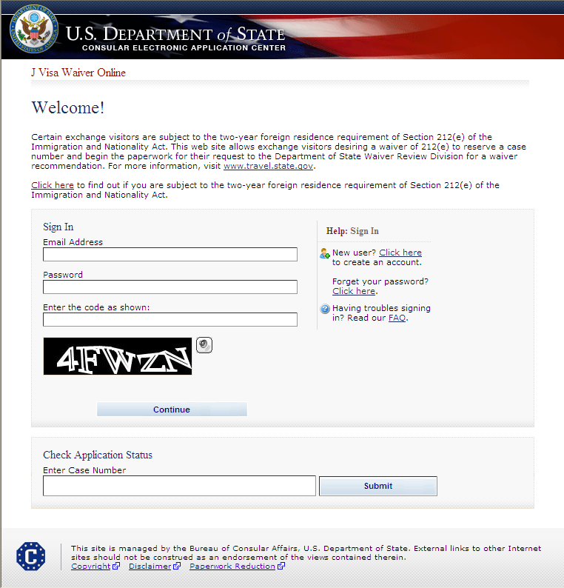
Login to Account
SAMPLE

Slide 3
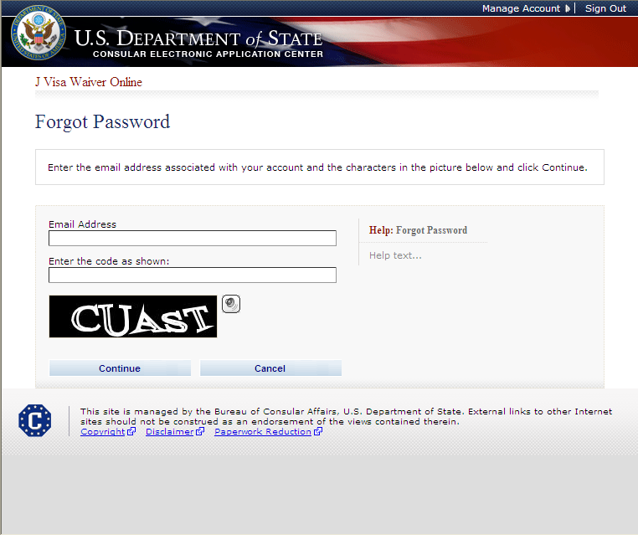
Forgot Password

Slide 4
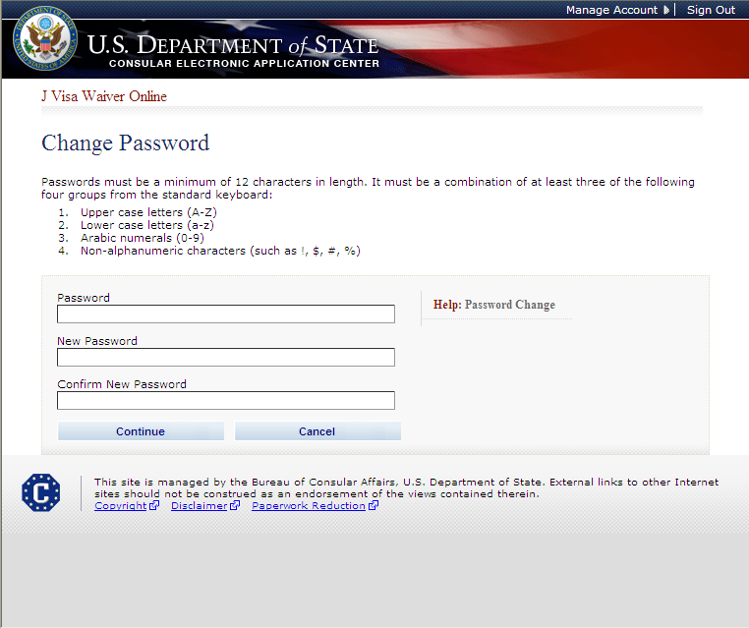
Change Password

Slide 5
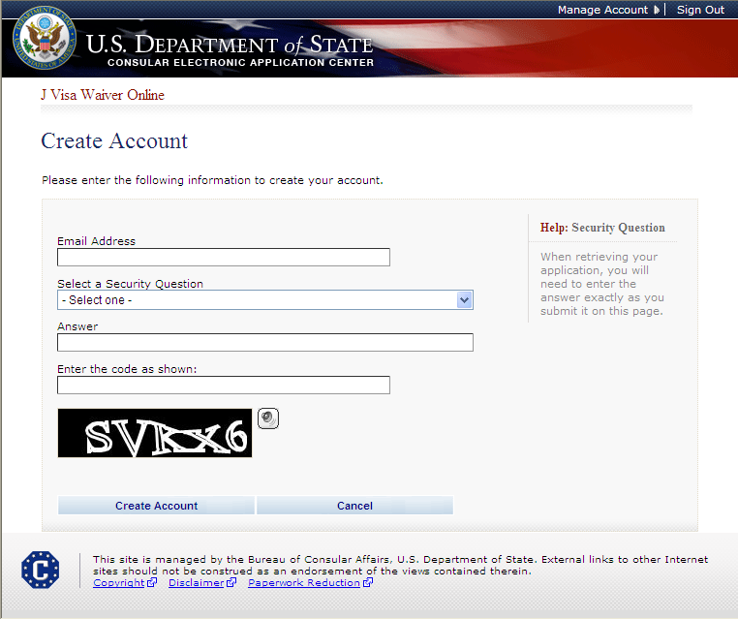
Create New Account

Slide 6
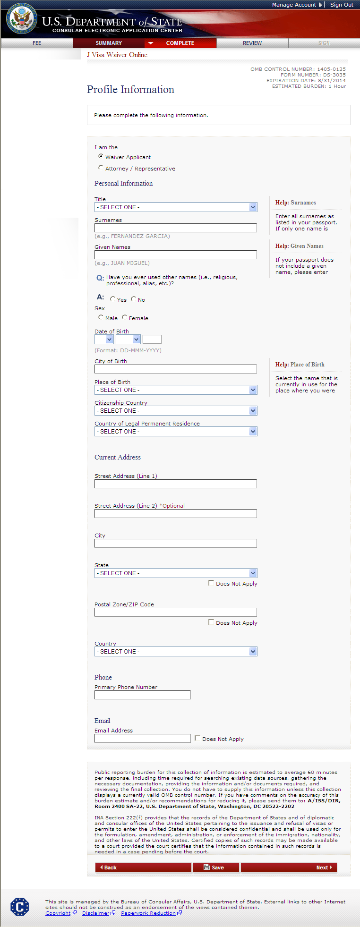
Create Applicant Profile Displayed if Waiver Applicant selected

Slide 7
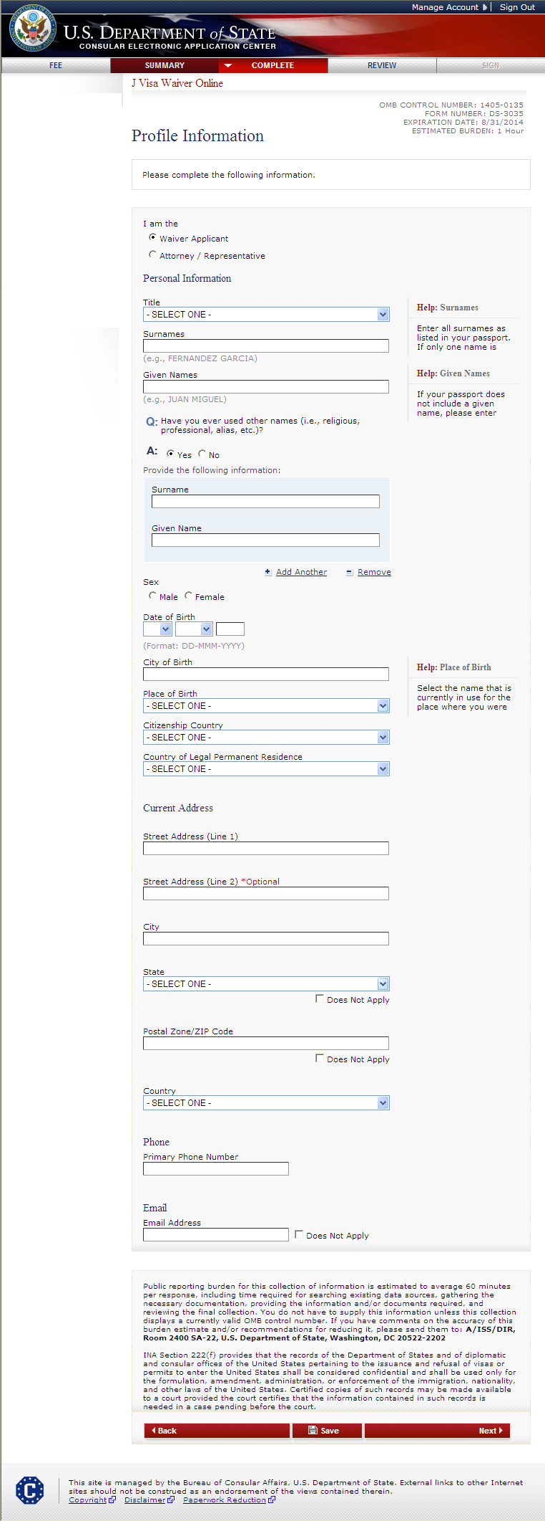
Create Applicant Profile (cont.) Displayed if user indicates they have used other names

Slide 8
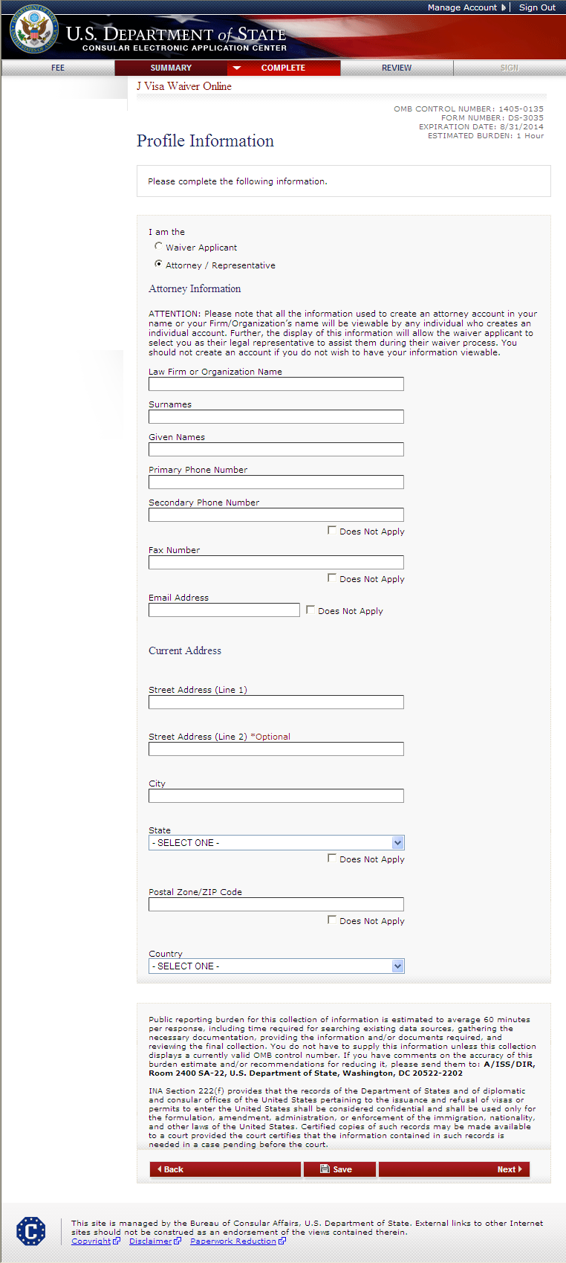
Create Attorney Profile Displayed if Attorney/Representative selected

Slide 9
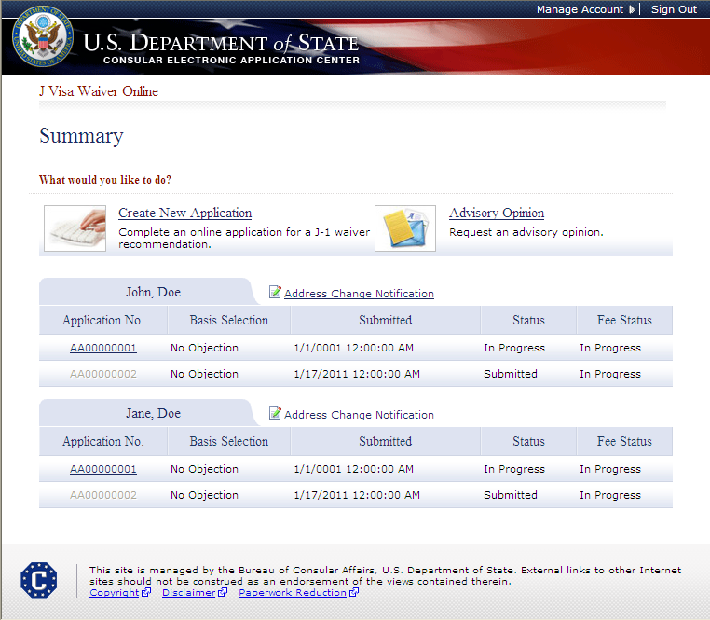
Summary Page Appears for All Users
SAMPLE

Slide 10
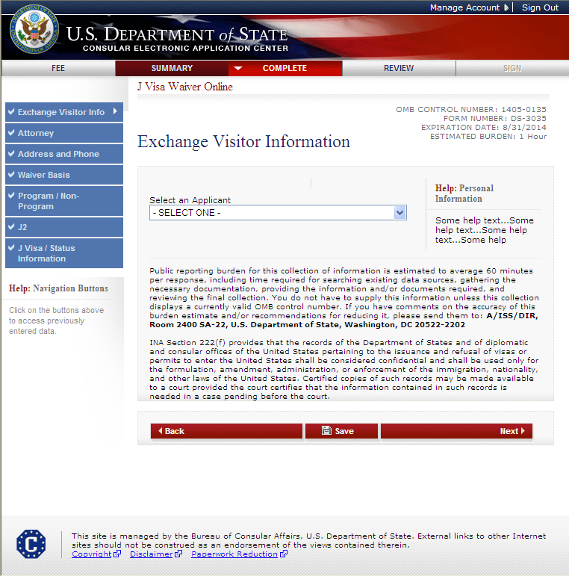
Creating a New Application

Slide 11
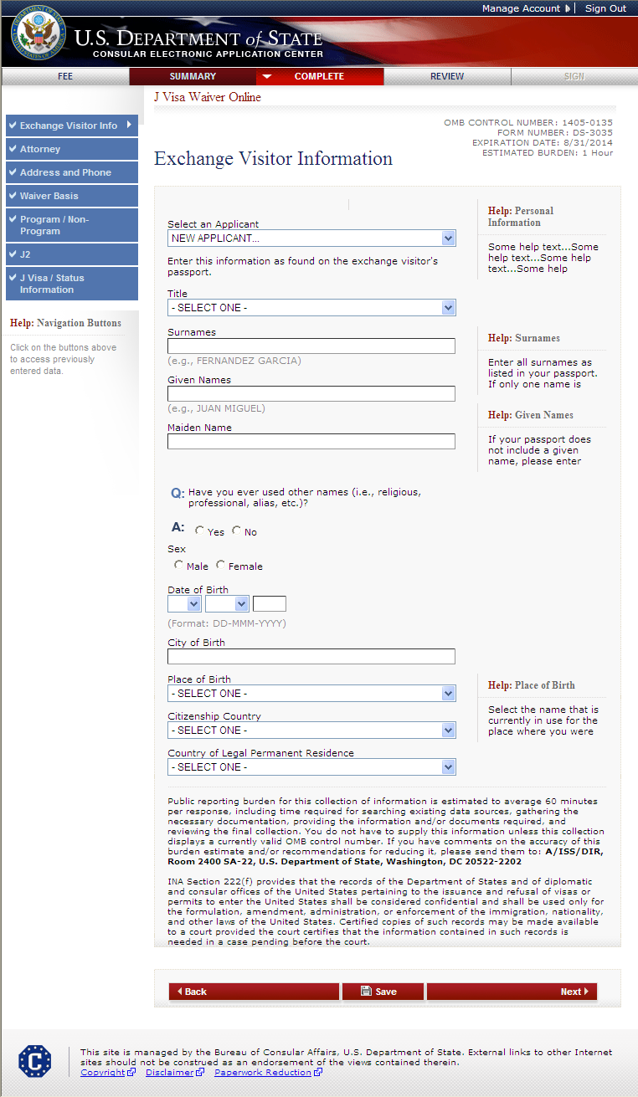
Exchange Visitor Information Page

Slide 12
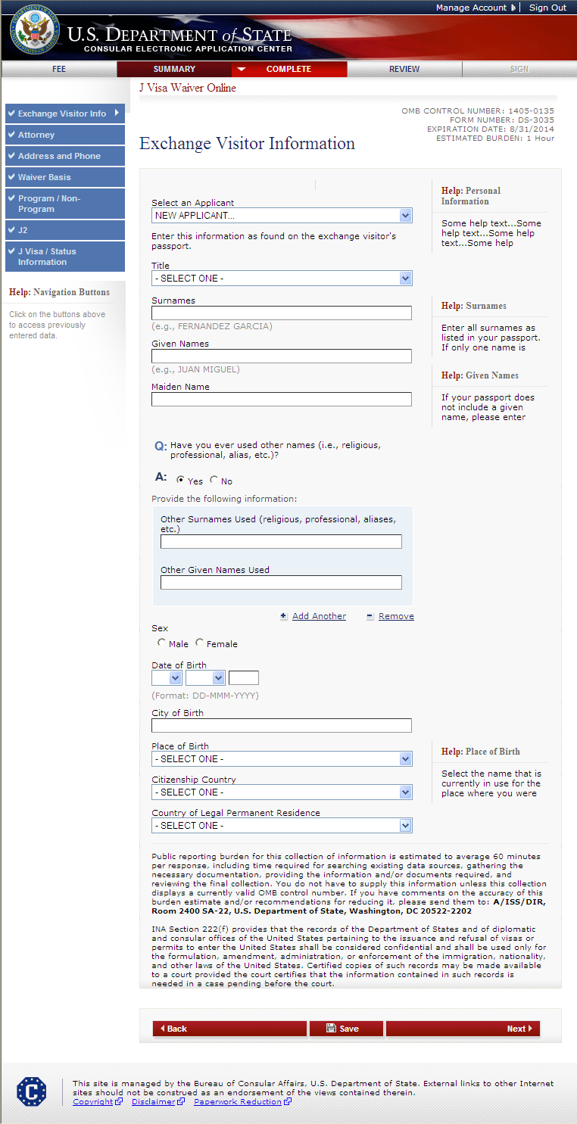
Exchange Visitor Information Page Displays if user indicates other names were used

Slide 13
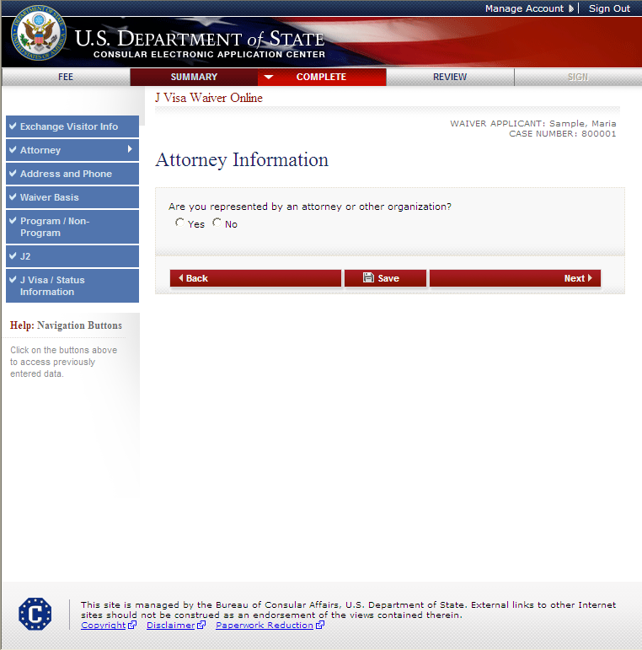
Attorney Information Page

Slide 14
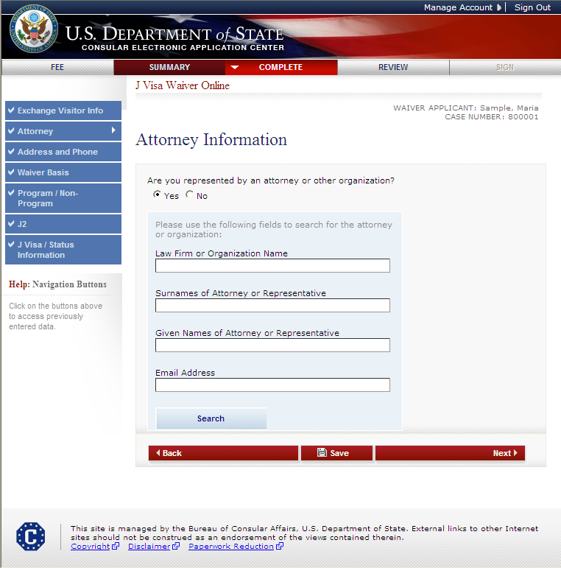
Attorney Information Page (cont.) Displayed if user indicates they are represented by an attorney or other organization
The user must enter information in one or more fields to initiate the search.
The attorney must already be registered.

Slide 15
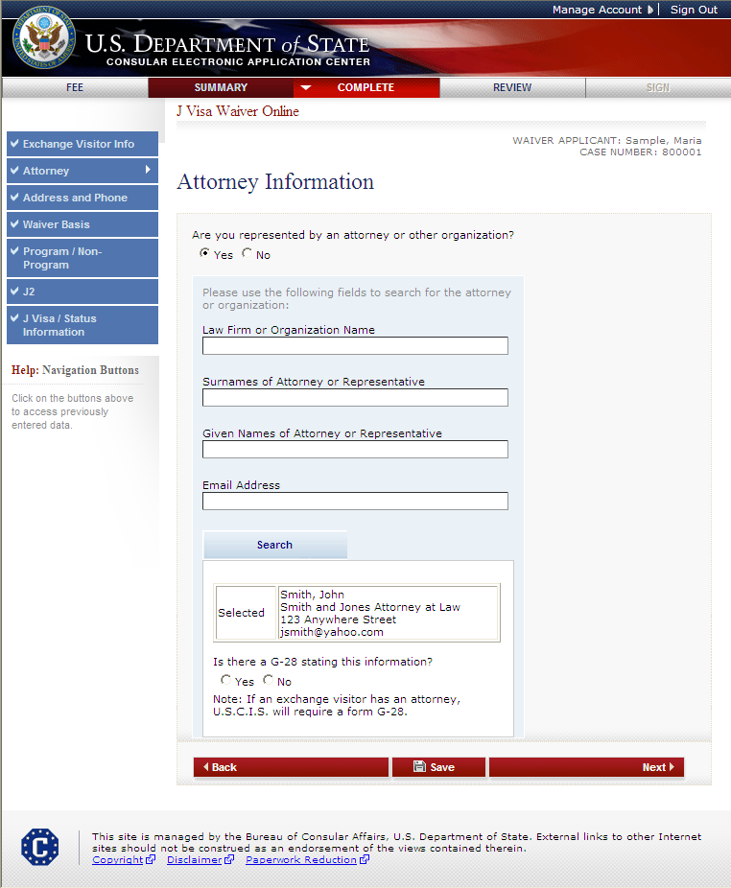
Attorney Information Page (cont.) G-28 question displayed after user selects an attorney/representative

Slide 16
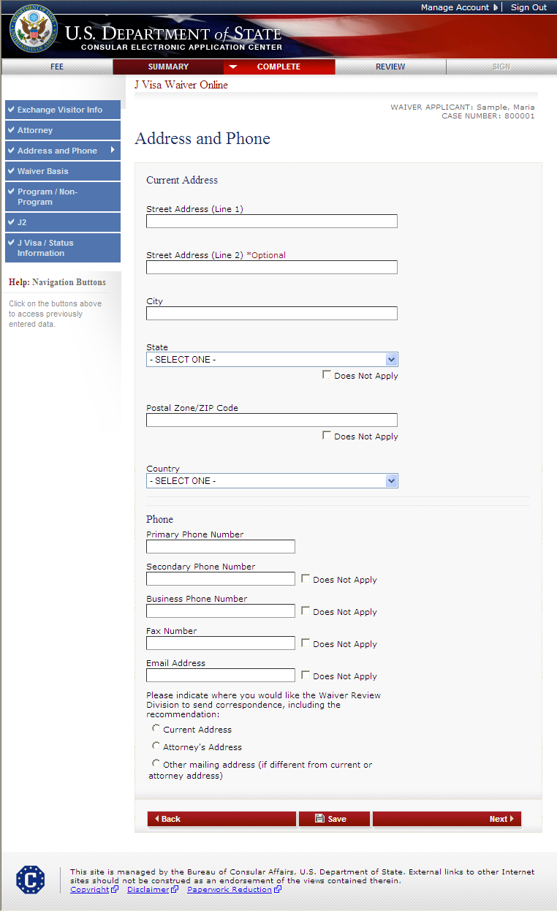
Address and Phone Page

Slide 17
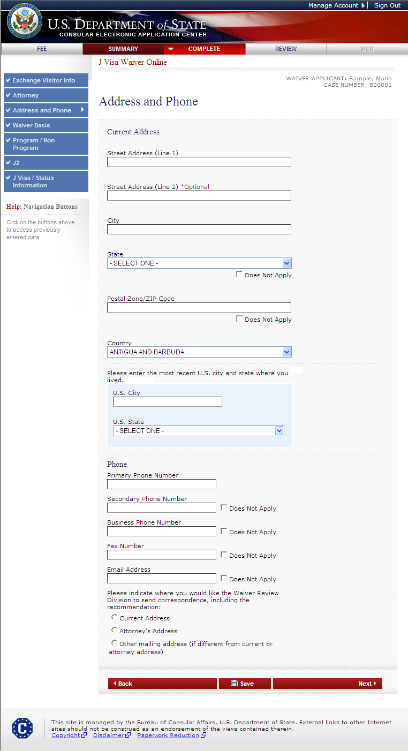
Address and Phone Page (cont.) Displays if current address is not in U.S.

Slide 18
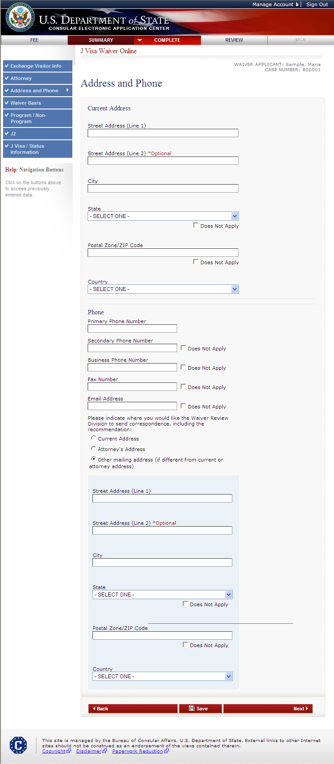
Address and Phone Page (cont.) Displays if another mailing address for correspondence is selected

Slide 19
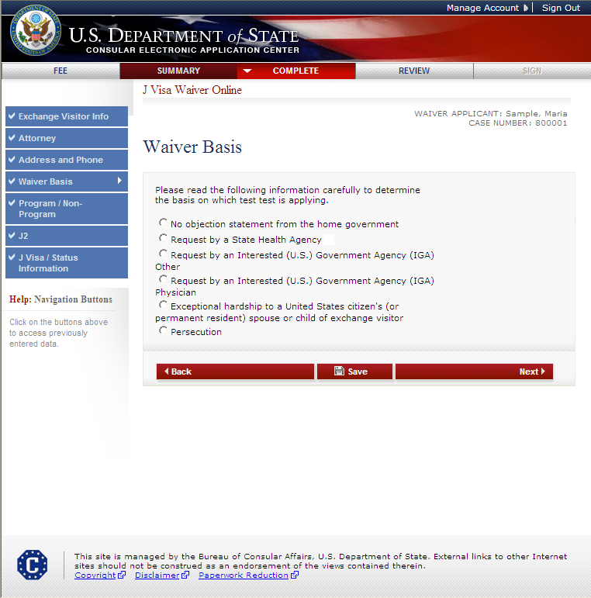
Waiver Basis Page Displayed for all users

Slide 20
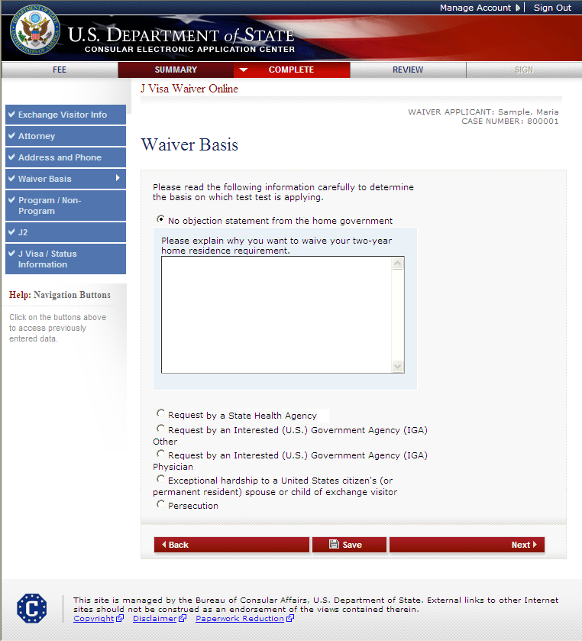
Waiver Basis Page Displays if No objection from home government selected
The user must enter why they want to waive the two-year residence requirement.

Slide 21
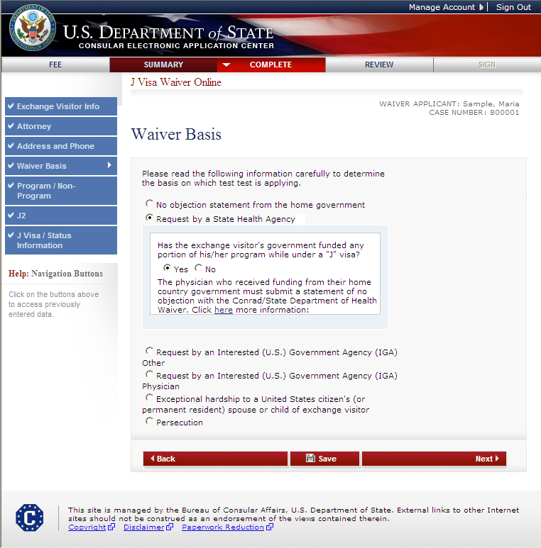
Waiver Basis Page Displays if Request by State Health Agency selected
The user must indicate if the exchange visitor’s government funded any portion of his/her program while under the “J” visa.
If Yes, the user is instructed to submit a statement of no objection with the Conrad/State Department of Health Waiver.

Slide 22
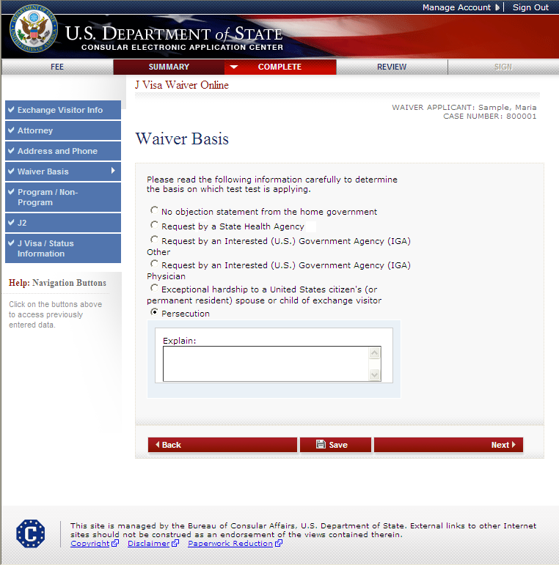
Waiver Basis Page Displays if Persecution selected
The user must enter why they want to waive the two-year residence requirement.

Slide 23
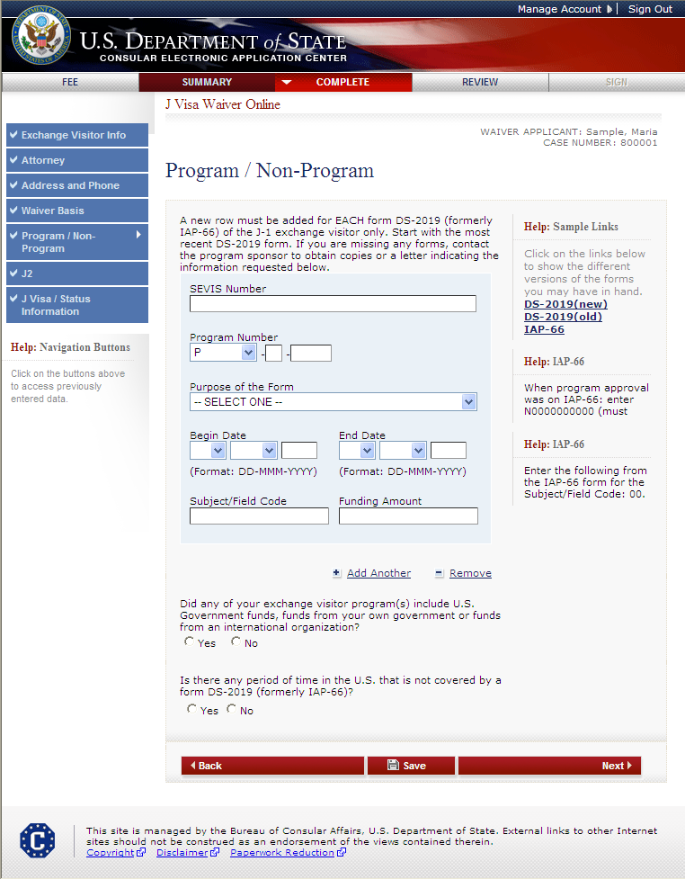
Program/Non-Program Page
The user must enter the following information:
SEVIS Number
Program Number
Purpose of the Form
Begin Date (DD-MMM-YYYY)
End Date (DD-MMM-YYYY)
Subject/Field Code
Funding Amount

Slide 24
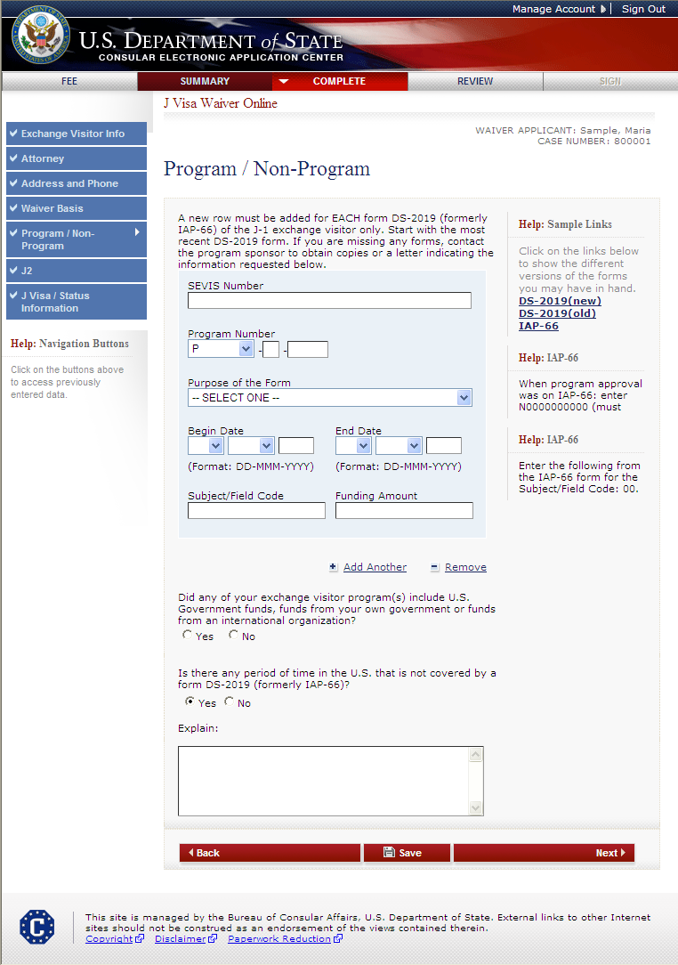
Program/Non-Program Page (cont.) Answers Yes to “Is there any period of time in the U.S. that is not covered by a DS-2019 or IAP-66 form?”
The user must enter an explanation if there was any period of time in the U.S. that was not covered by a form DS-2019 (formerly IAP-66).

Slide 25
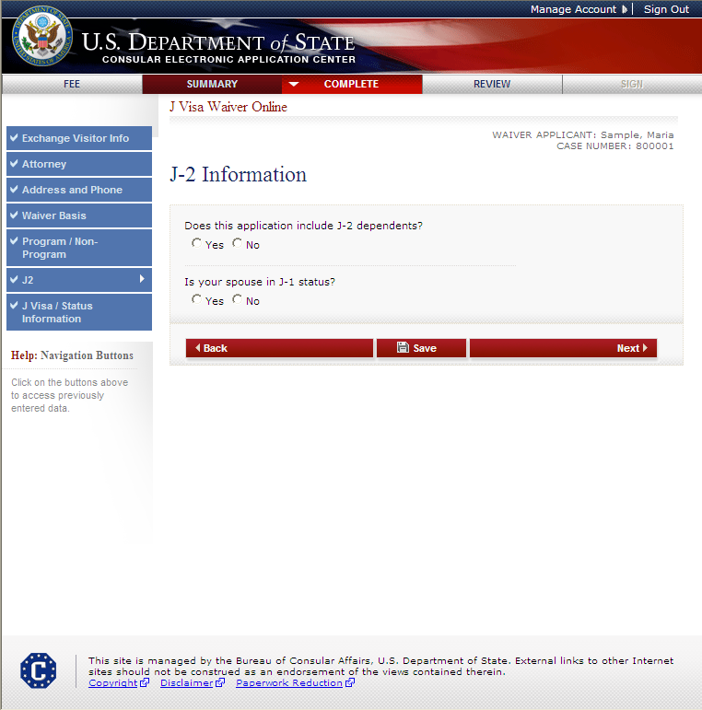
J-2 Information Page

Slide 26
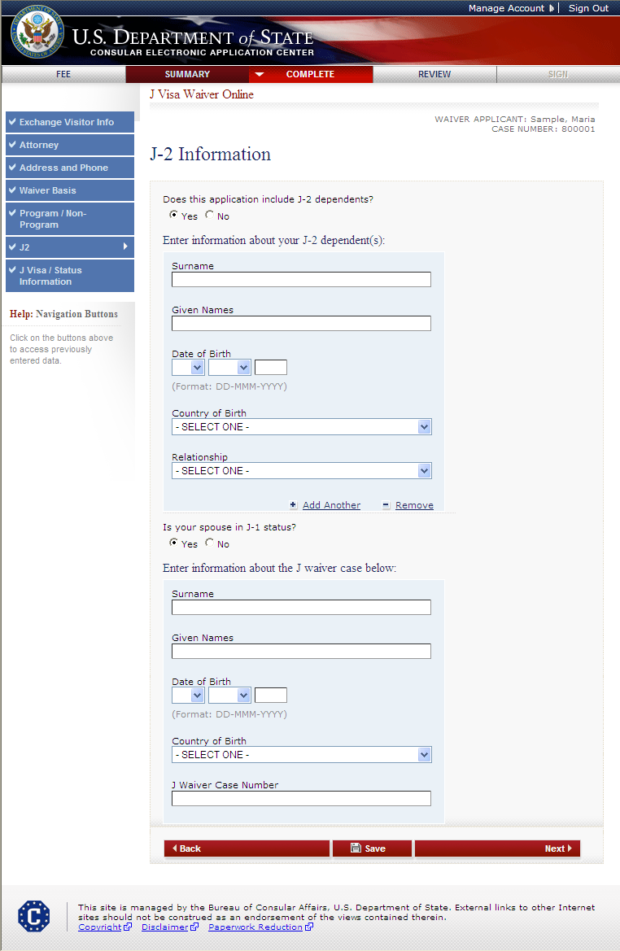
J-2 Information Page Answers Yes to J-2 dependents and spouse in J-1 status
For J-2 dependents, enter the Surname, Given Name, Date of Birth, Country of Birth and Relationship
If spouse in J-1 status, enter the Surname, Given Name, Date of Birth, Country of Birth and J Waiver Case Number

Slide 27
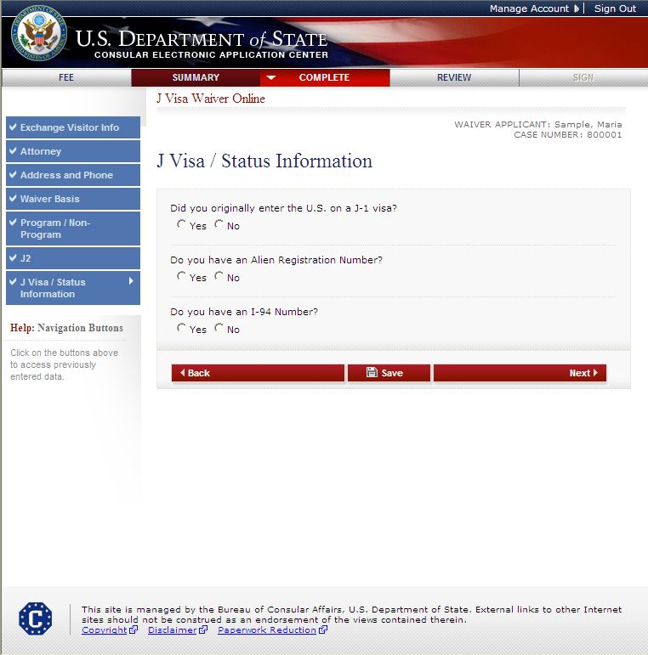
J Visa/Status Information Page

Slide 28
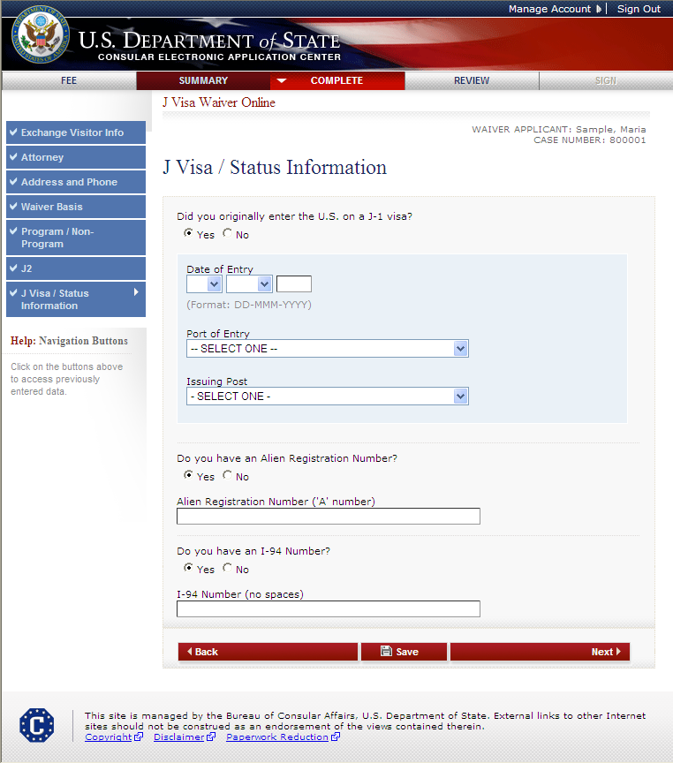
J Visa/Status Information Page (cont.) Answers Yes to all questions
The user must enter the date of entry, select Port of Entry from the drop-down list and select the Issuing Post from the drop-down list.
The user must enter the Alien Registration Number and I-94 Number.

Slide 29
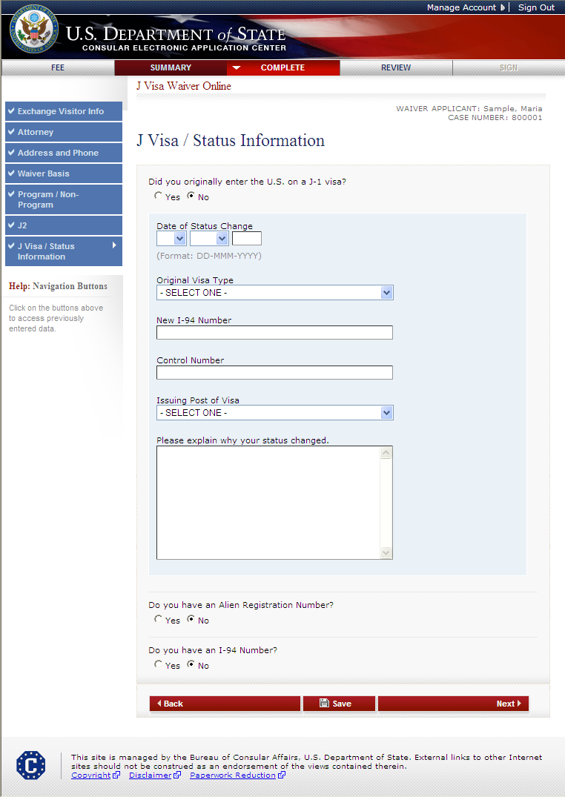
J Visa/Status Information Page (cont.) Answers No to all questions
The user must enter the Date of Status Change, Original Visa Type, New I-94 Number, Control Number, Issuing Post of the Visa and explain why their status changed..

Slide 30
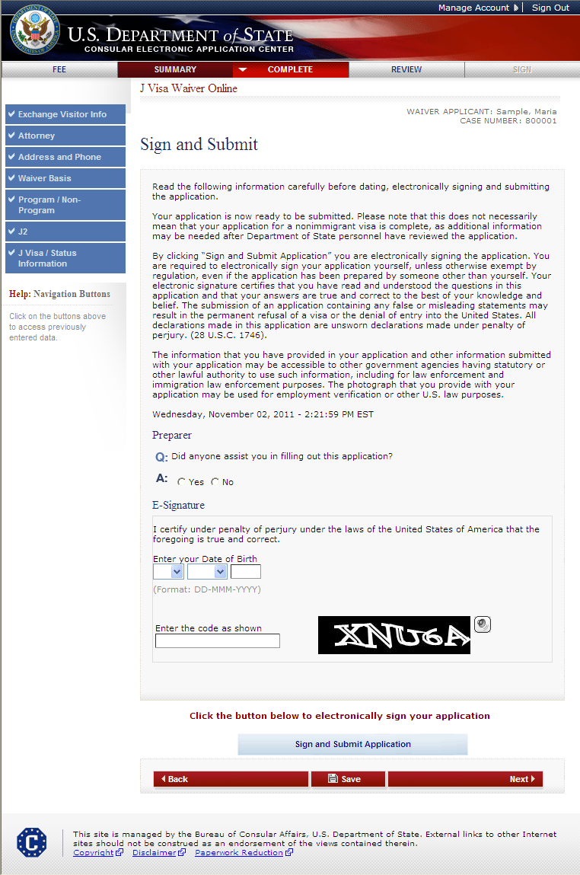
Sign and Submit Page
SAMPLE

Slide 31
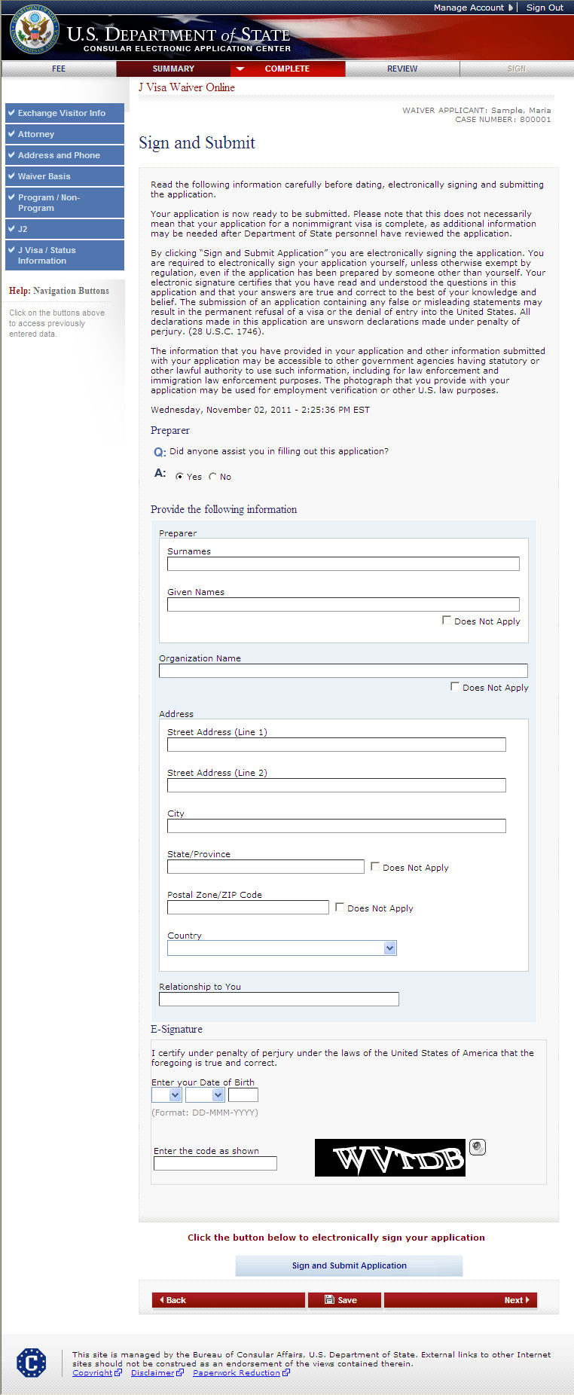
Sign and Submit Page (cont.) Answers Yes to “Did someone assist you in filling out this application?”
SAMPLE

Slide 32
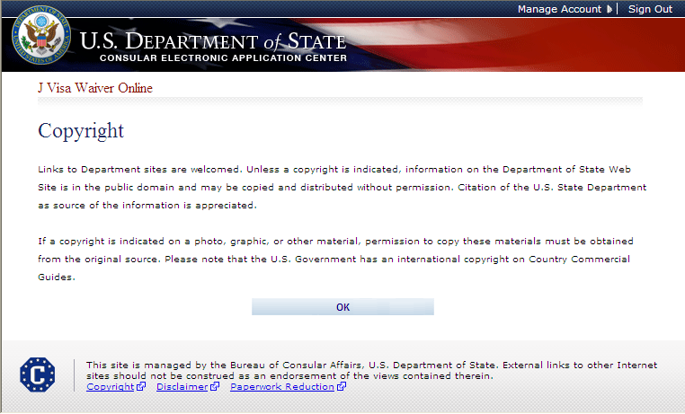
Copyright Page

Slide 33
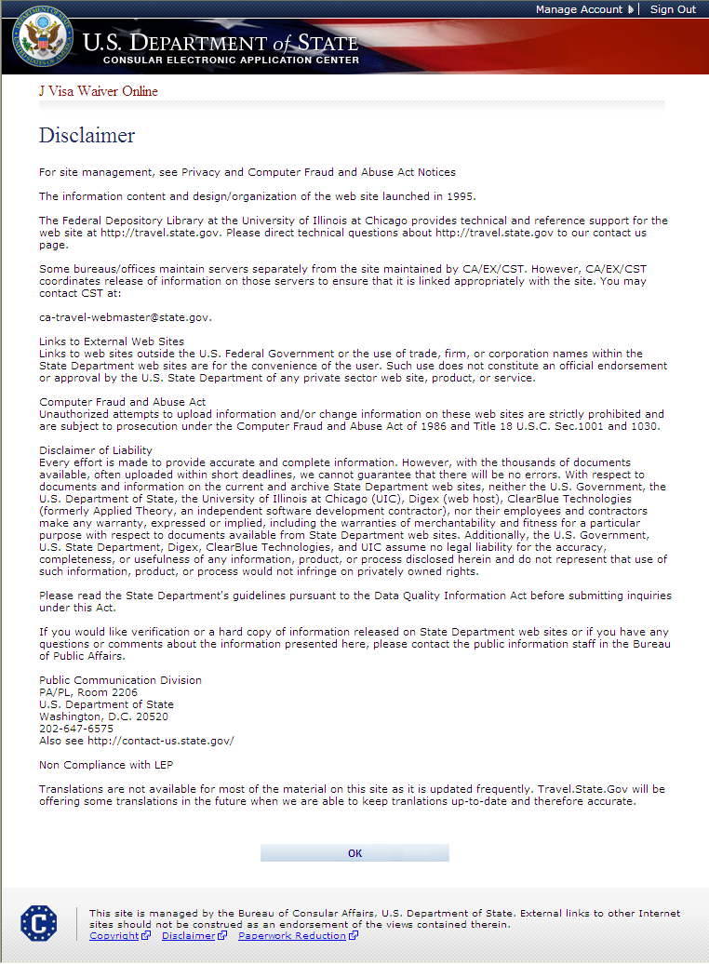
Disclaimer Page

Slide 34
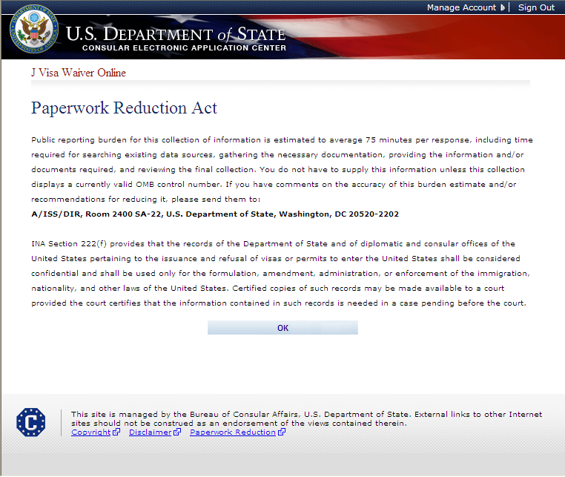
Paperwork Reduction Act Page

