Slide 1
Registration Intake
RIOS Spanish Version
FEMA Form 009-0-02S
(Spanish)
OMB Control Number: 1660-0002
Expiration Date: 8/31/2013

Slide 2
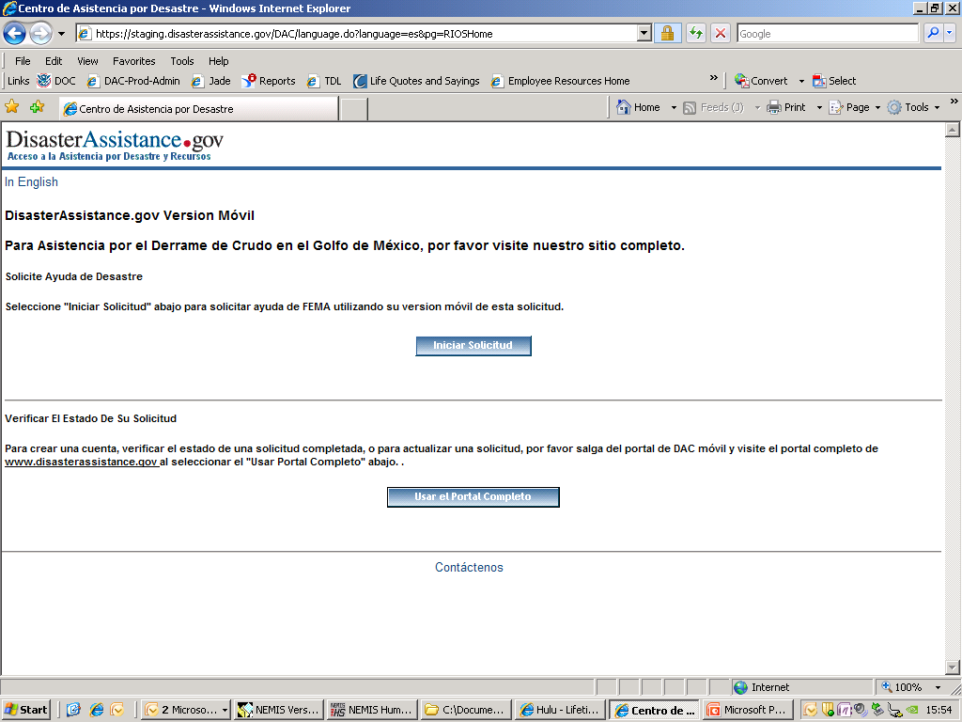

Slide 3
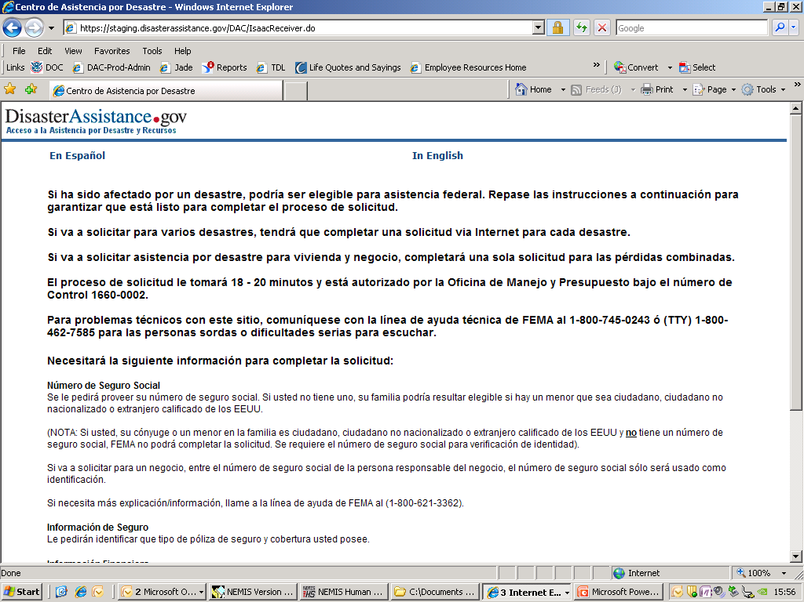
OMB No. 1660-0002. Termina 8-31-2013

Slide 4
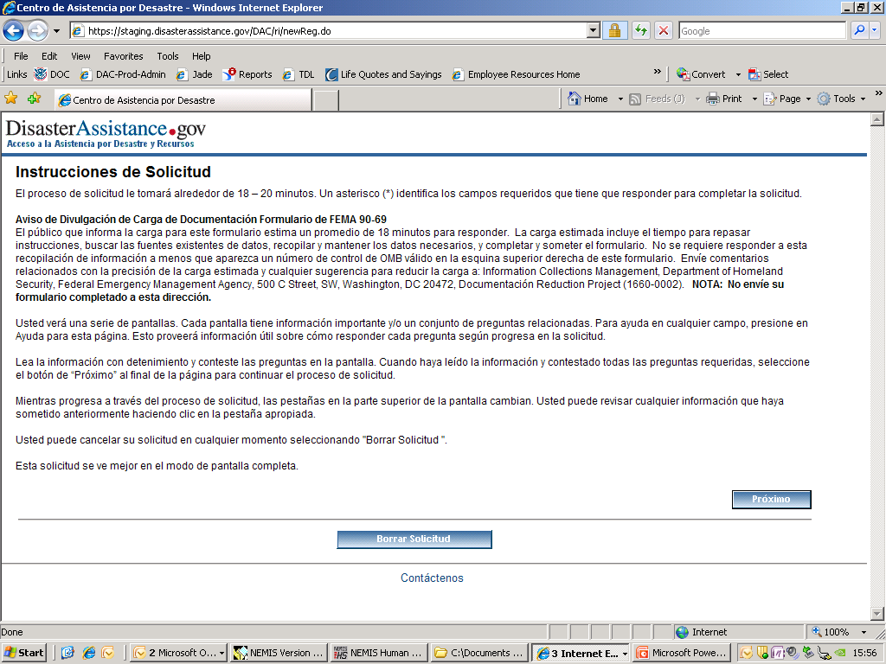
OMB No. 1660-0002. Termina 8-31-2013

Slide 5
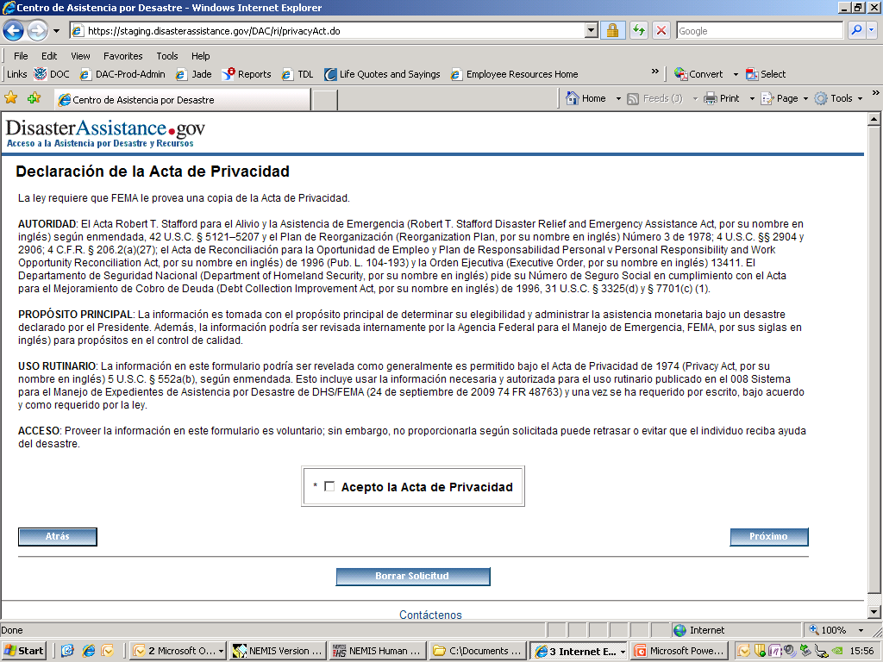
OMB No. 1660-0002. Termina 8-31-2013

Slide 6
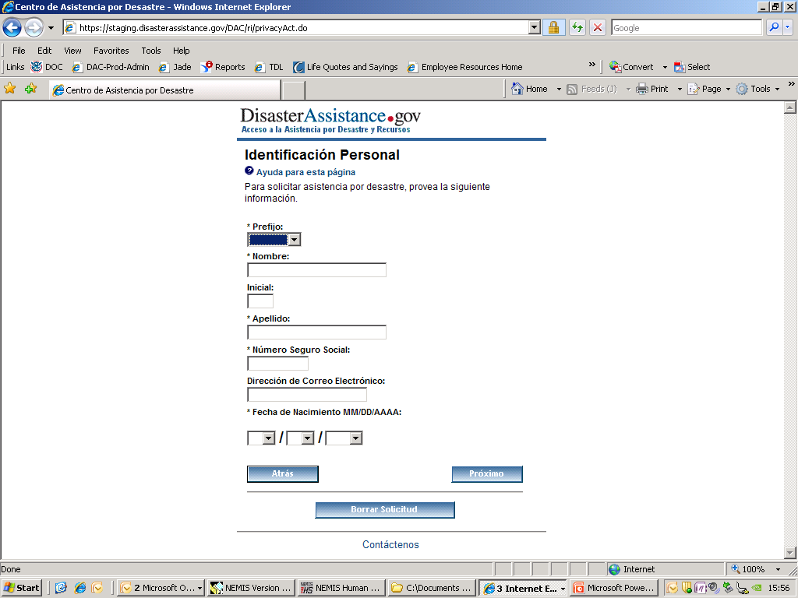
OMB No. 1660-0002. Termina 8-31-2013

Slide 7
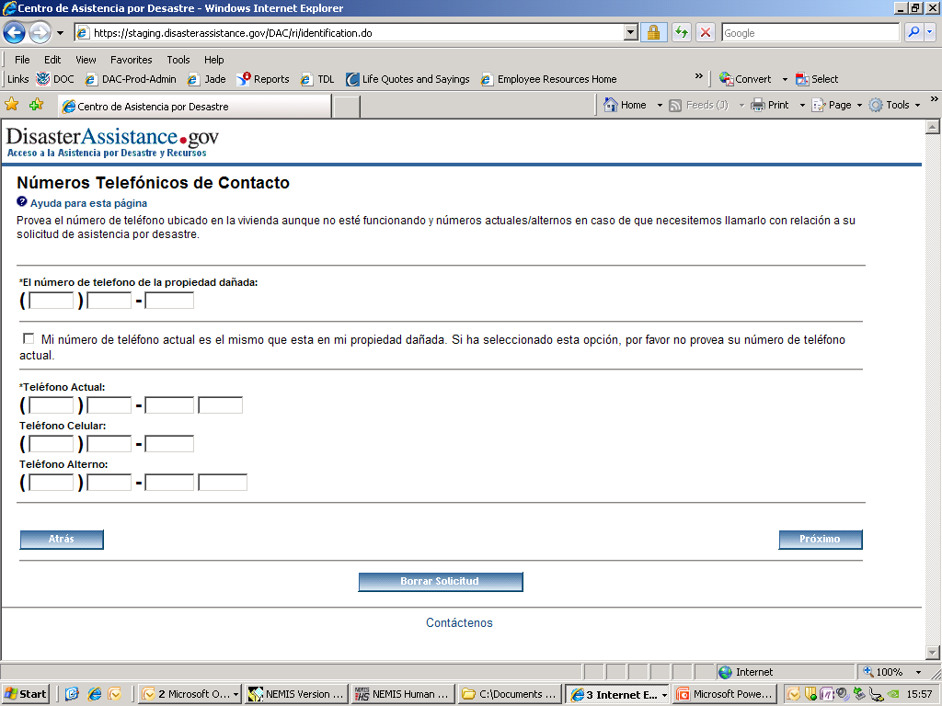
OMB No. 1660-0002. Termina 8-31-2013

Slide 8
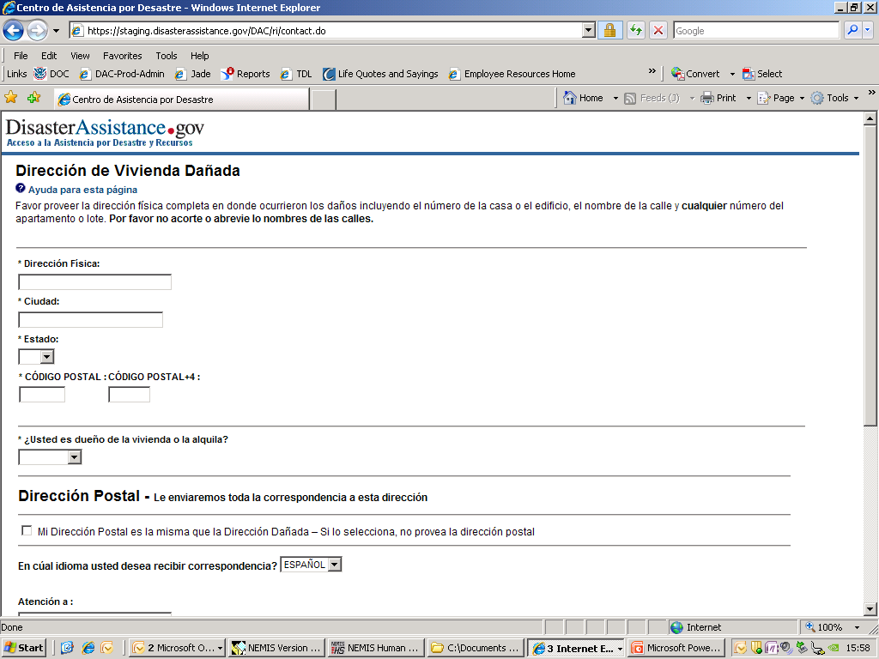
OMB No. 1660-0002. Termina 8-31-2013

Slide 9
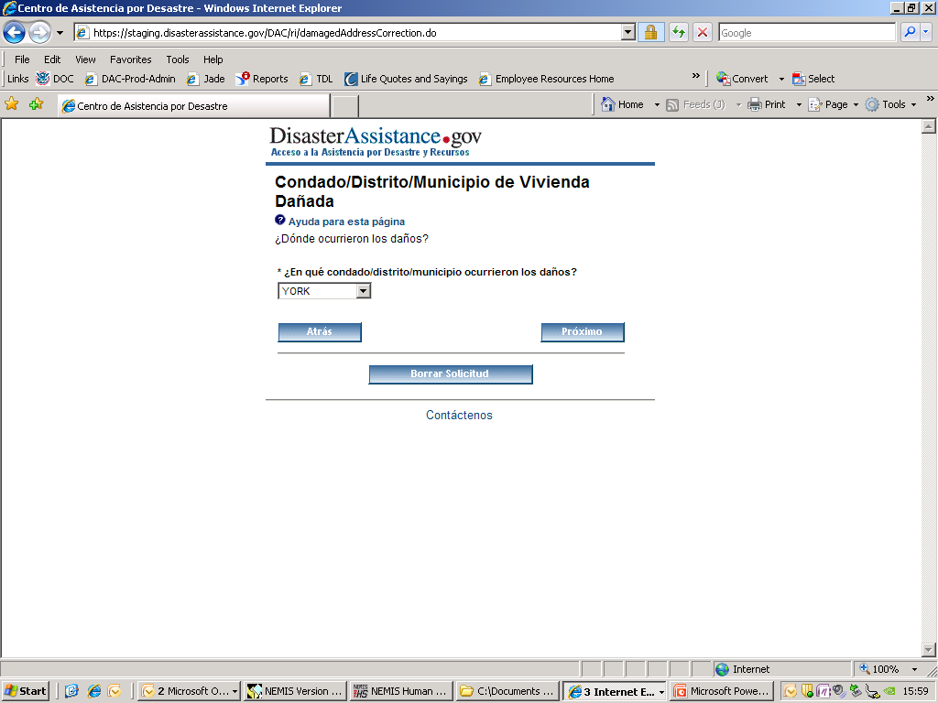
OMB No. 1660-0002. Termina 8-31-2013

Slide 10
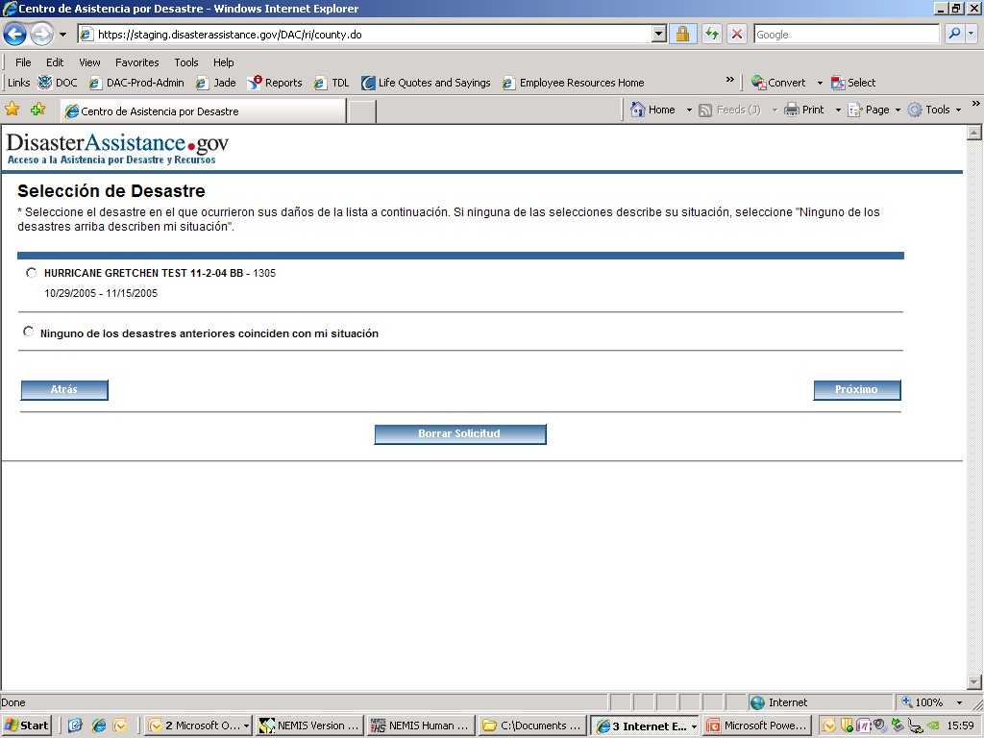
OMB No. 1660-0002. Termina 8-31-2013

Slide 11
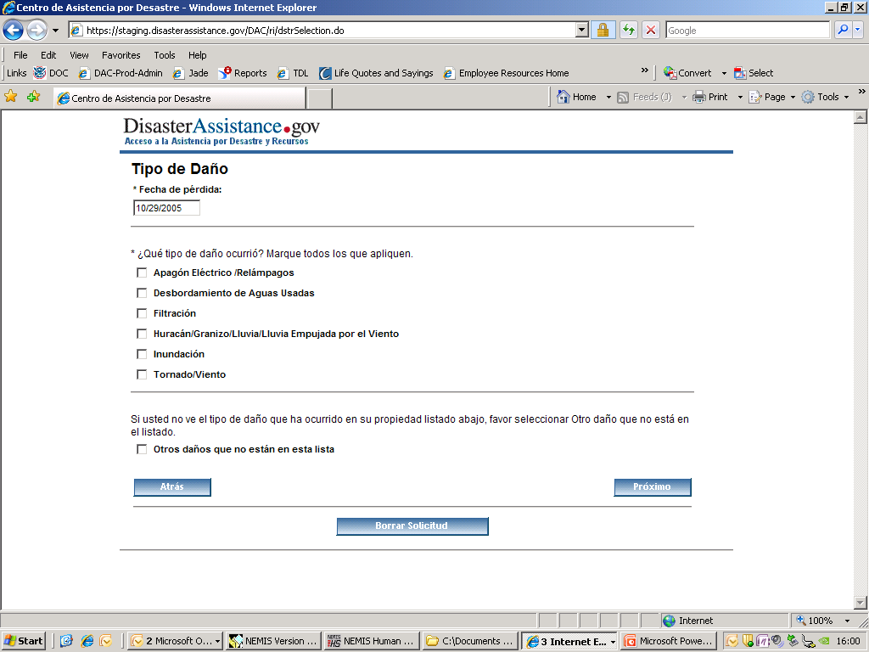
OMB No. 1660-0002. Termina 8-31-2013

Slide 12
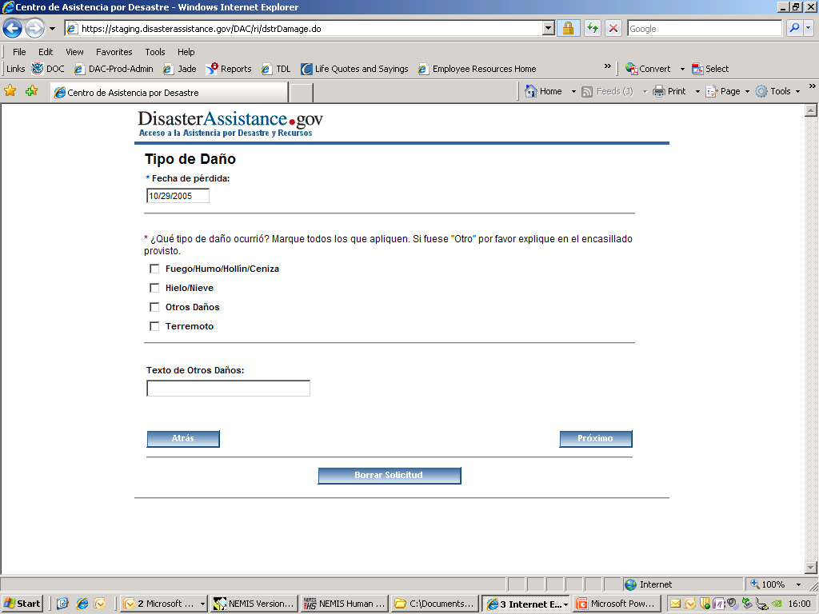
OMB No. 1660-0002. Termina 8-31-2013

Slide 13
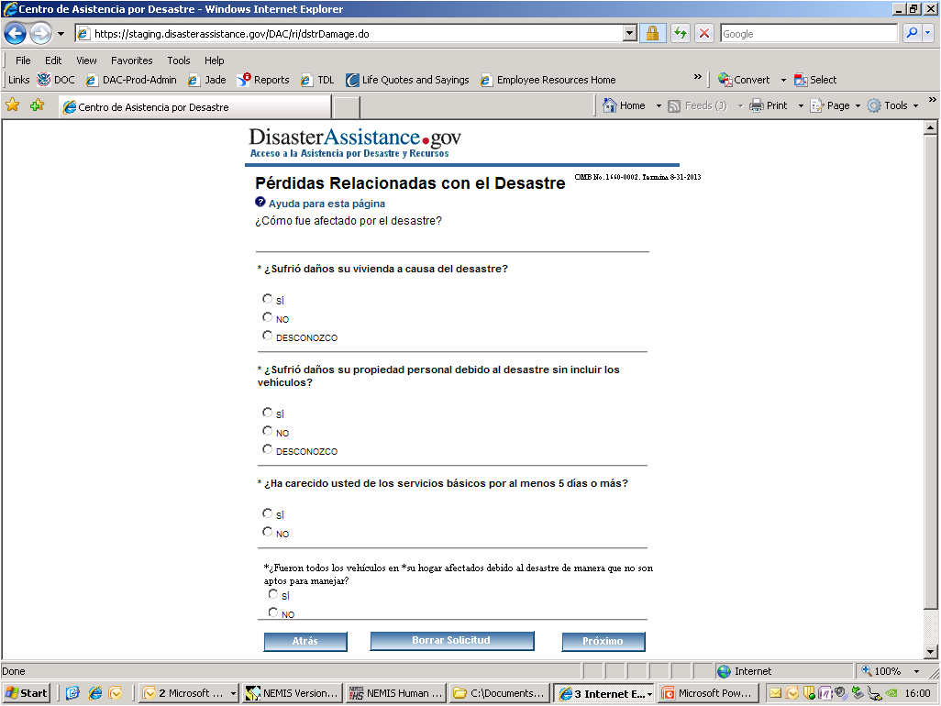
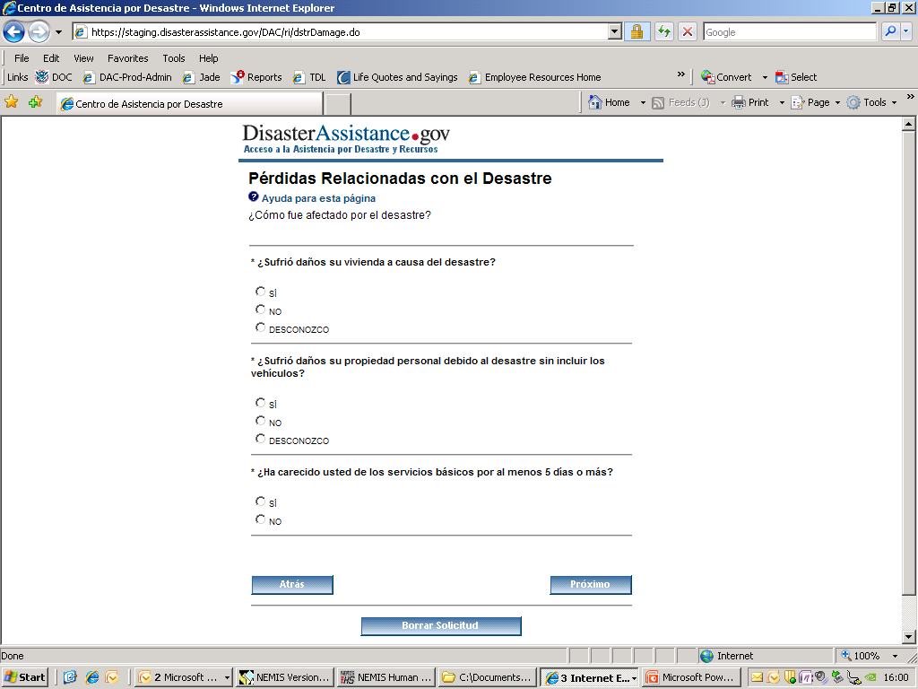
OMB No. 1660-0002. Termina 8-31-2013

Slide 14
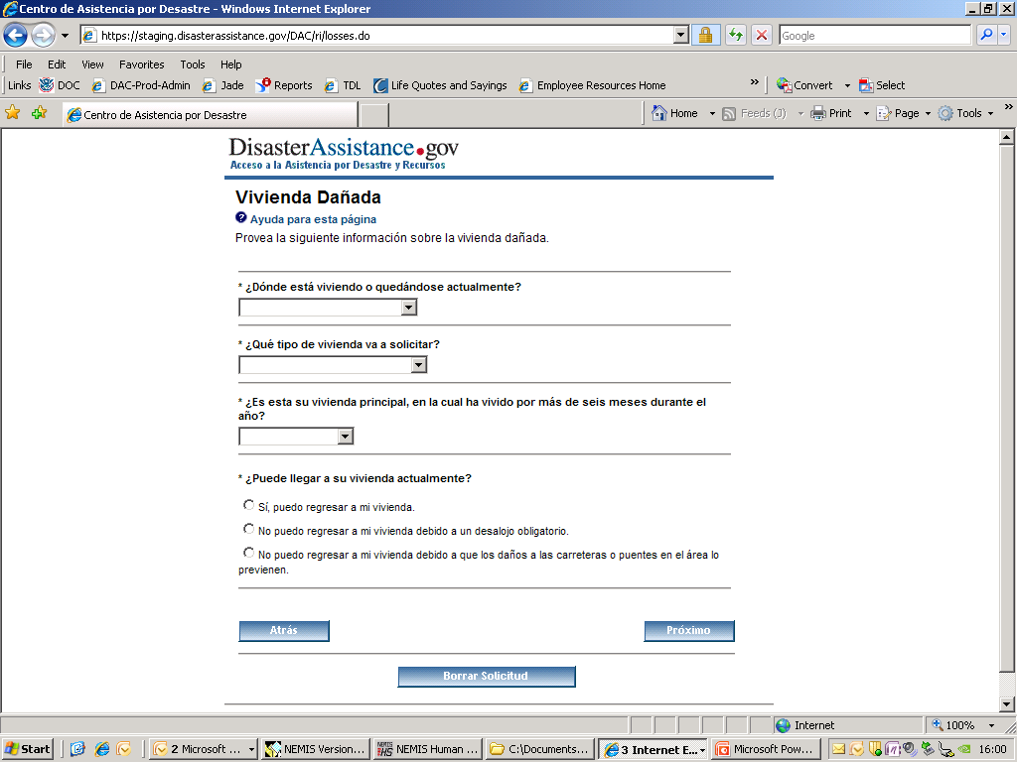
OMB No. 1660-0002. Termina 8-31-2013

Slide 15
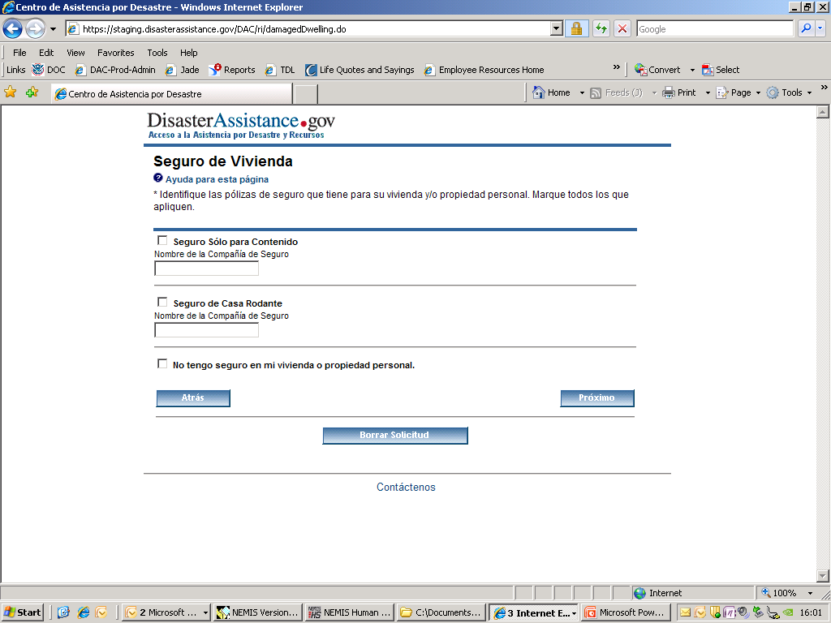
OMB No. 1660-0002. Termina 8-31-2013

Slide 16
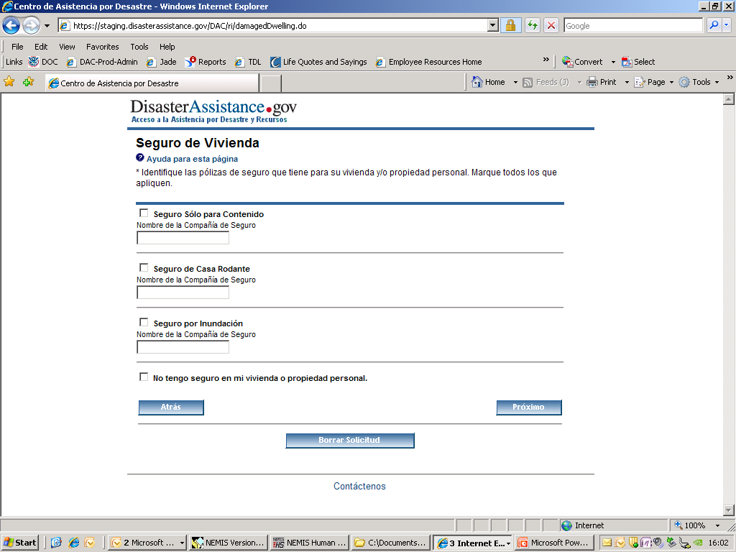
OMB No. 1660-0002. Termina 8-31-2013

Slide 17
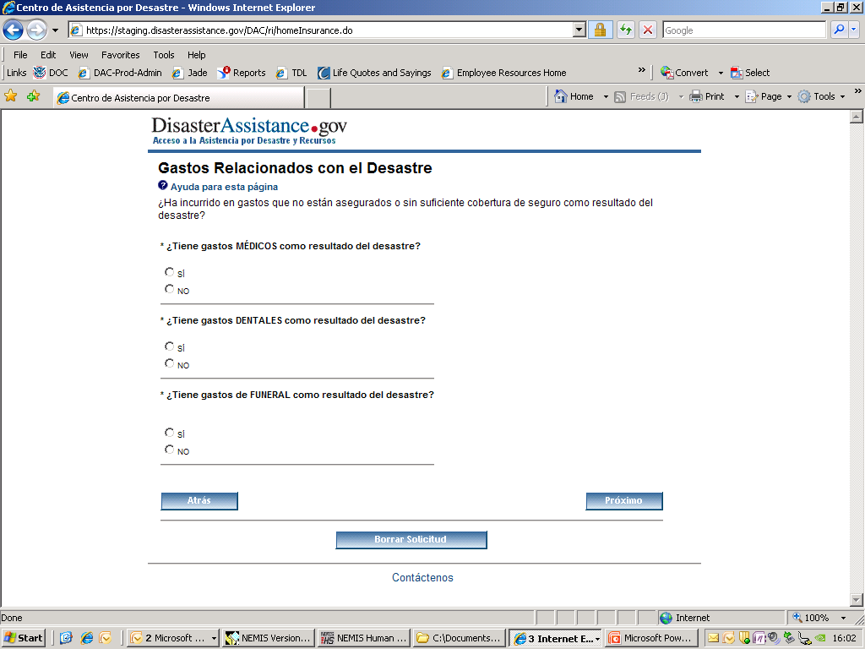
OMB No. 1660-0002. Termina 8-31-2013

Slide 18
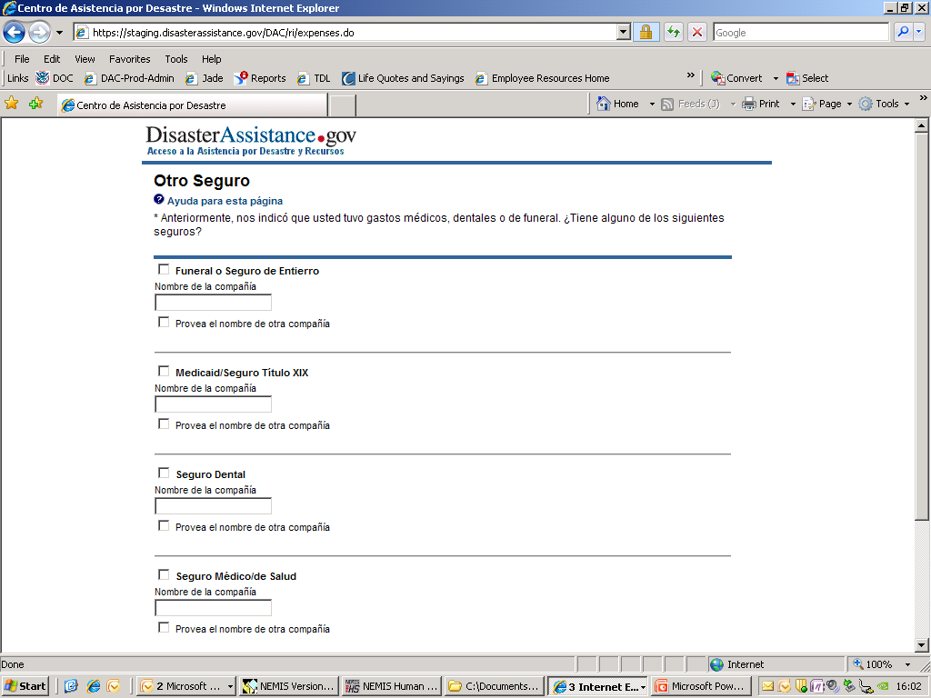
OMB No. 1660-0002. Termina 8-31-2013

Slide 19
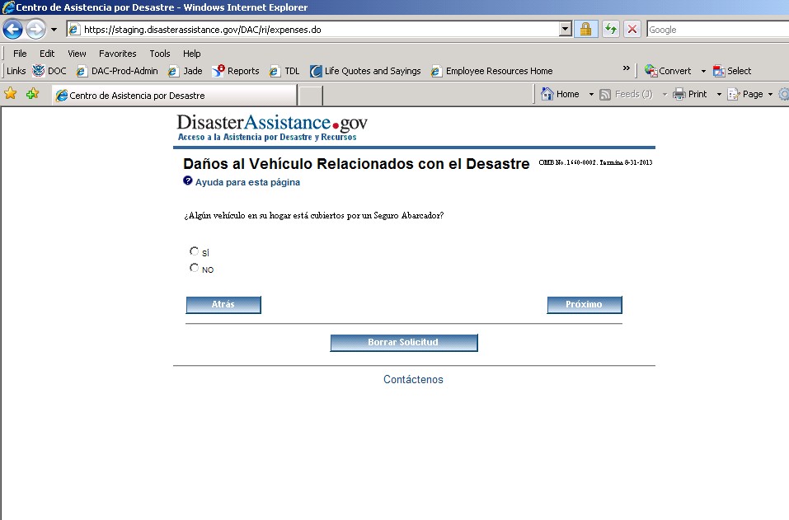
OMB No. 1660-0002. Termina 8-31-2013

Slide 20
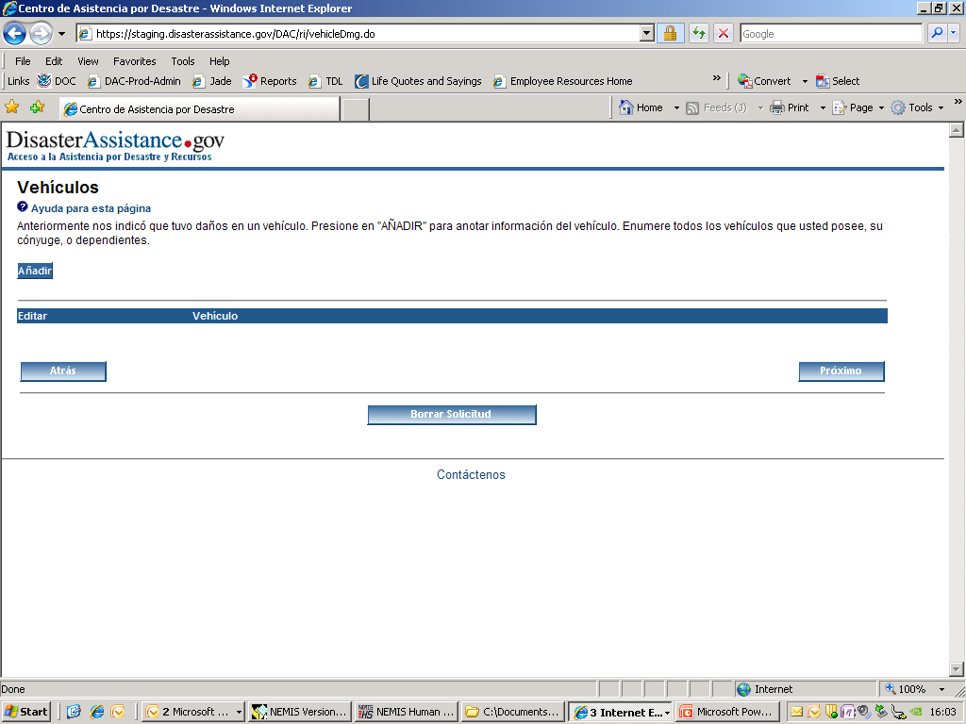
OMB No. 1660-0002. Termina 8-31-2013

Slide 21
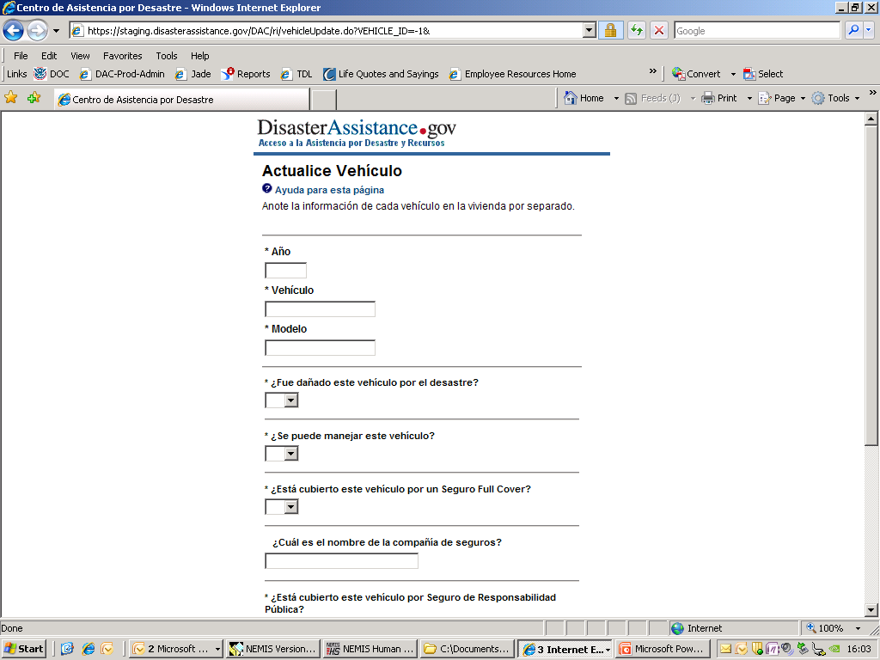
OMB No. 1660-0002. Termina 8-31-2013

Slide 22
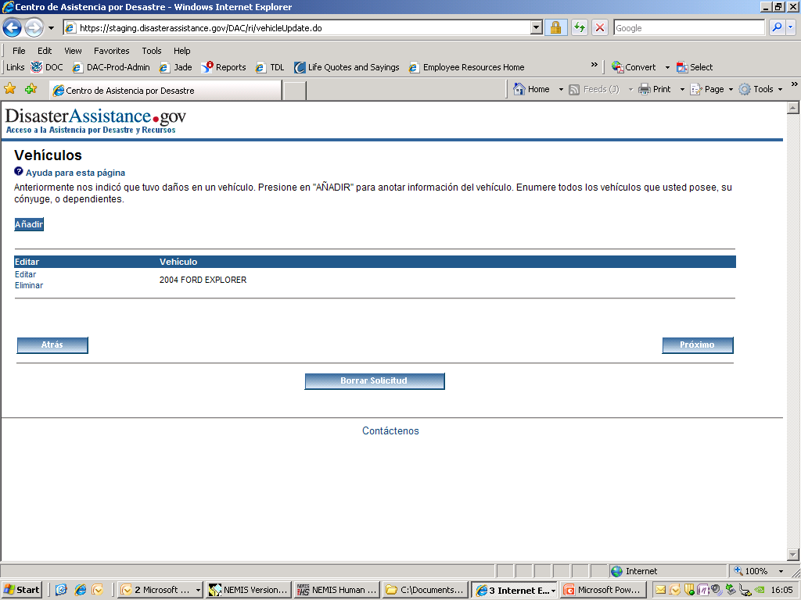
OMB No. 1660-0002. Termina 8-31-2013

Slide 23
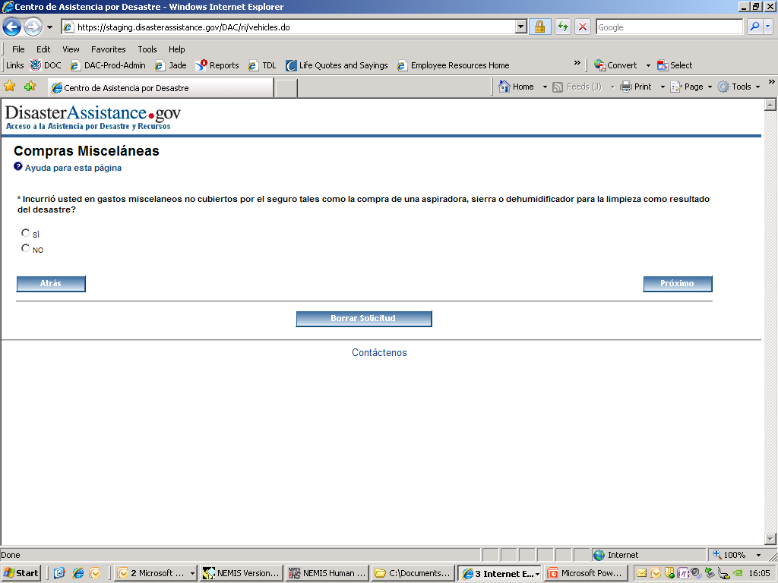
OMB No. 1660-0002. Termina 8-31-2013

Slide 24
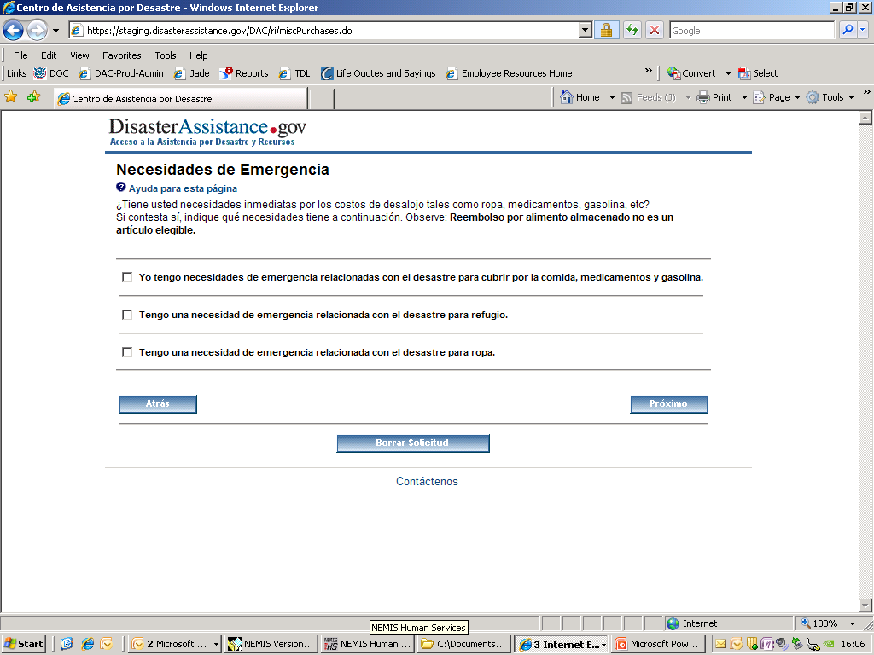
OMB No. 1660-0002. Termina 8-31-2013

Slide 25
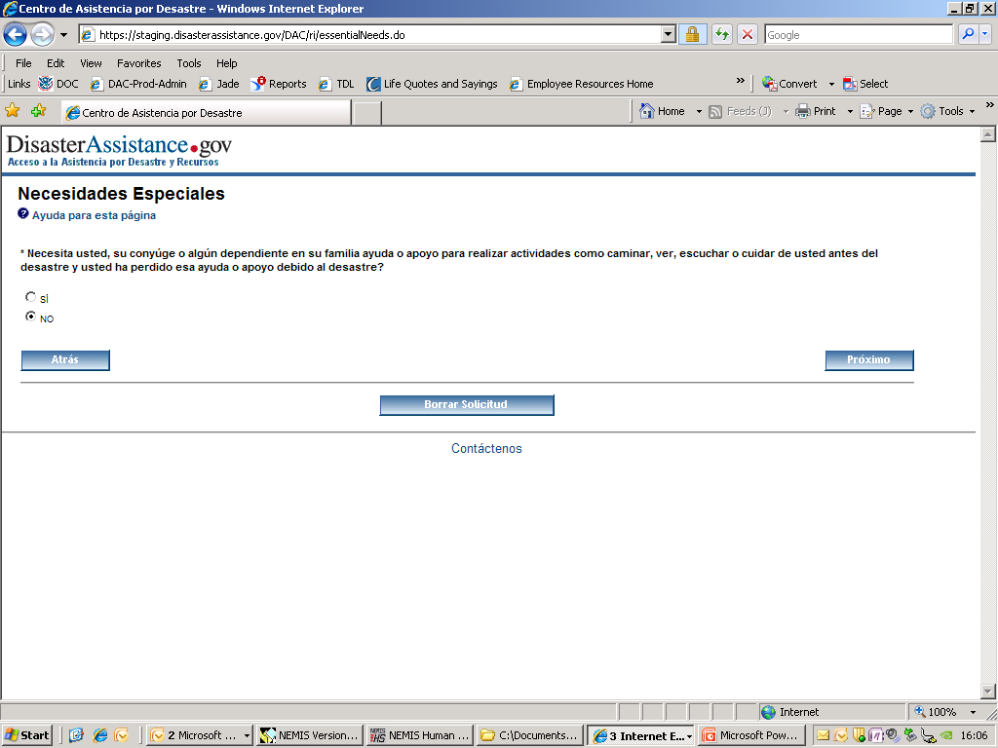
OMB No. 1660-0002. Termina 8-31-2013

Slide 26
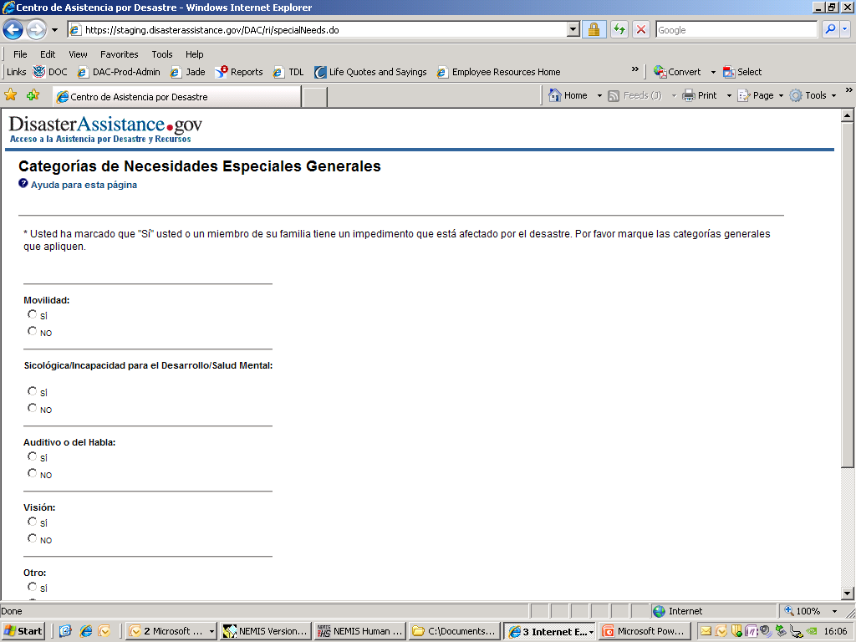
OMB No. 1660-0002. Termina 8-31-2013

Slide 27
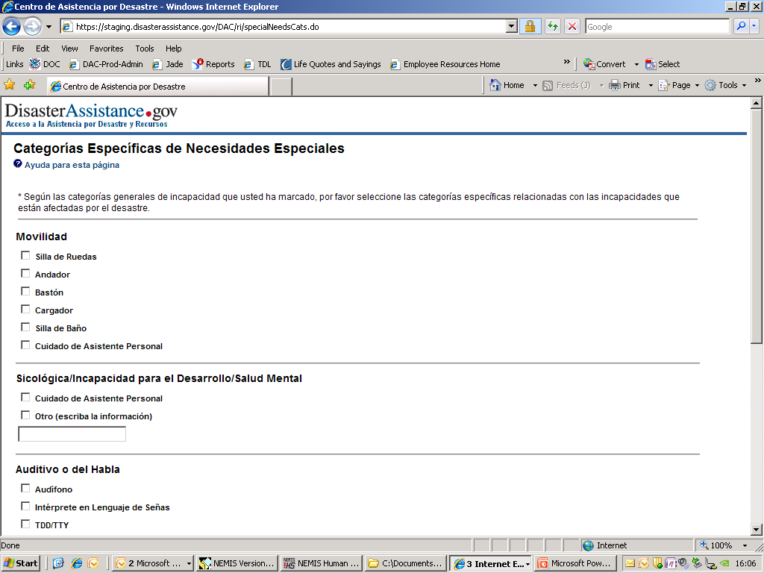
OMB No. 1660-0002. Termina 8-31-2013

Slide 28
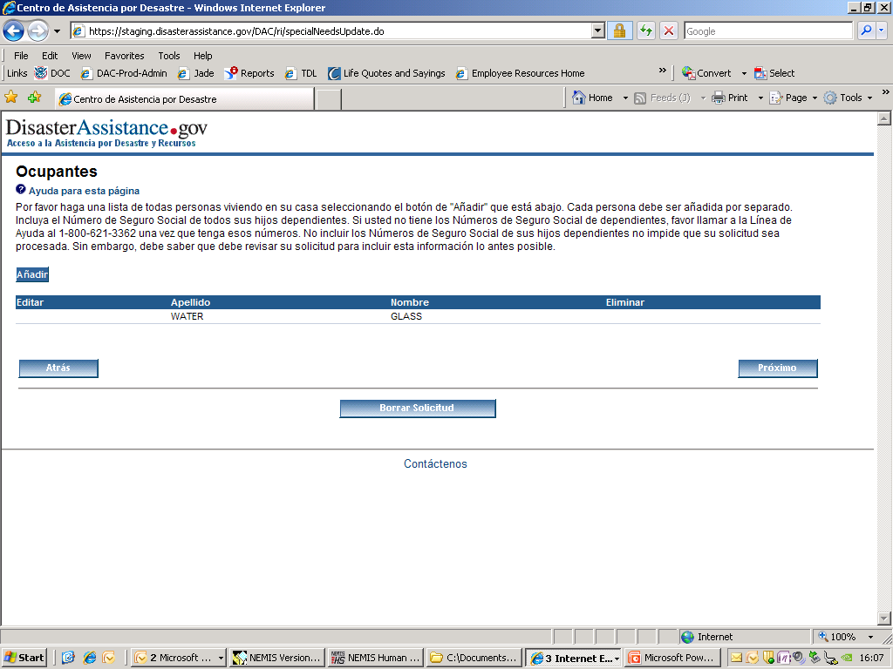
OMB No. 1660-0002. Termina 8-31-2013

Slide 29
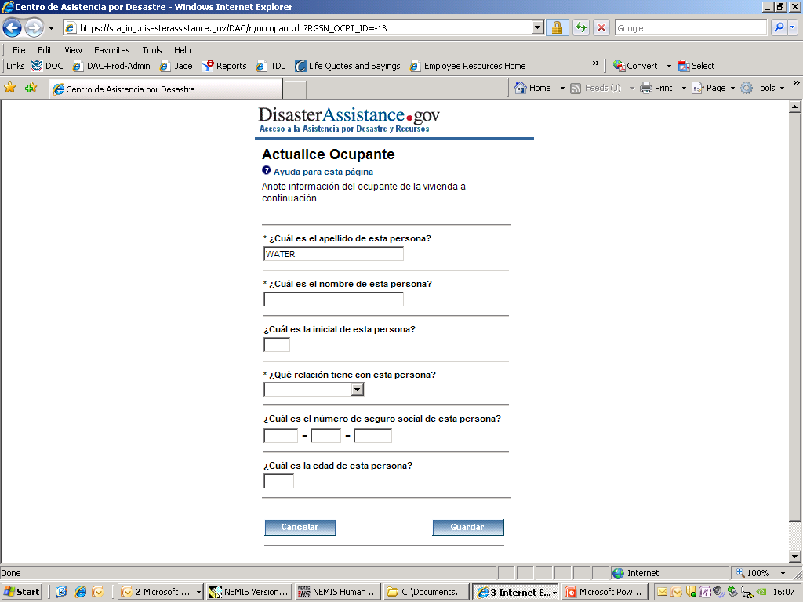
OMB No. 1660-0002. Termina 8-31-2013

Slide 30
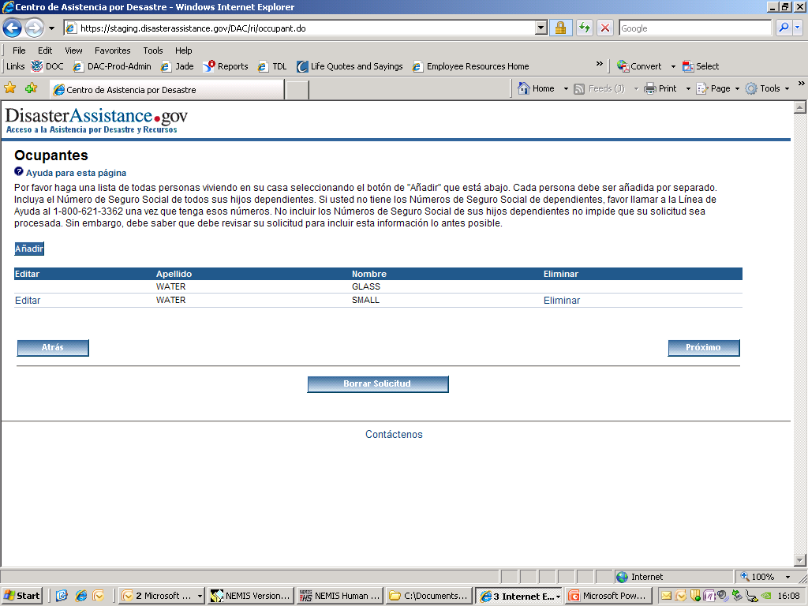
OMB No. 1660-0002. Termina 8-31-2013

Slide 31
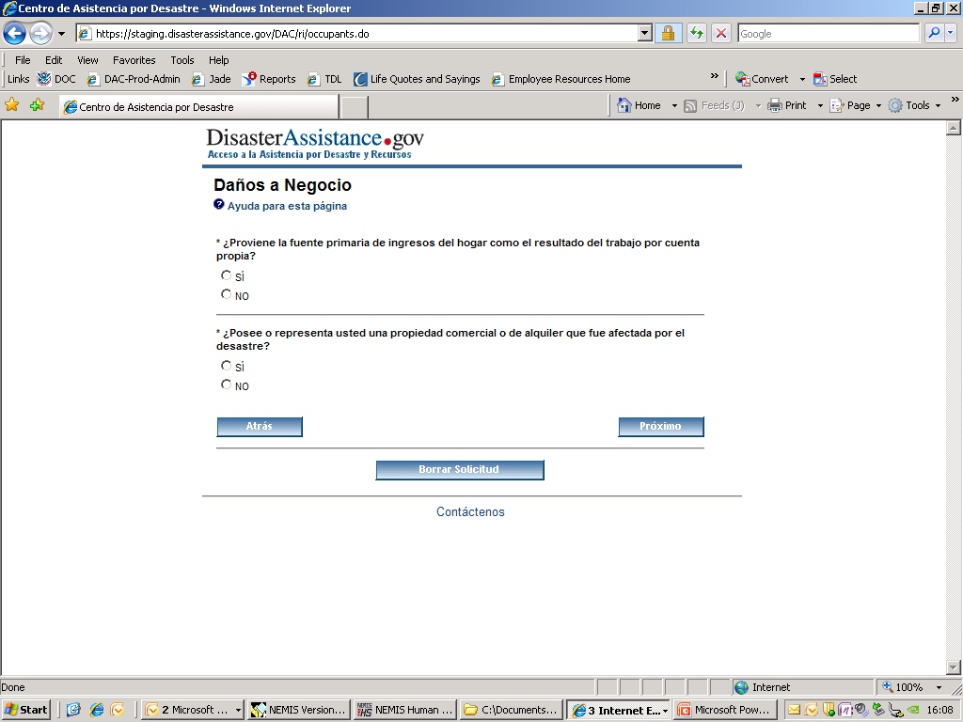
OMB No. 1660-0002. Termina 8-31-2013

Slide 32
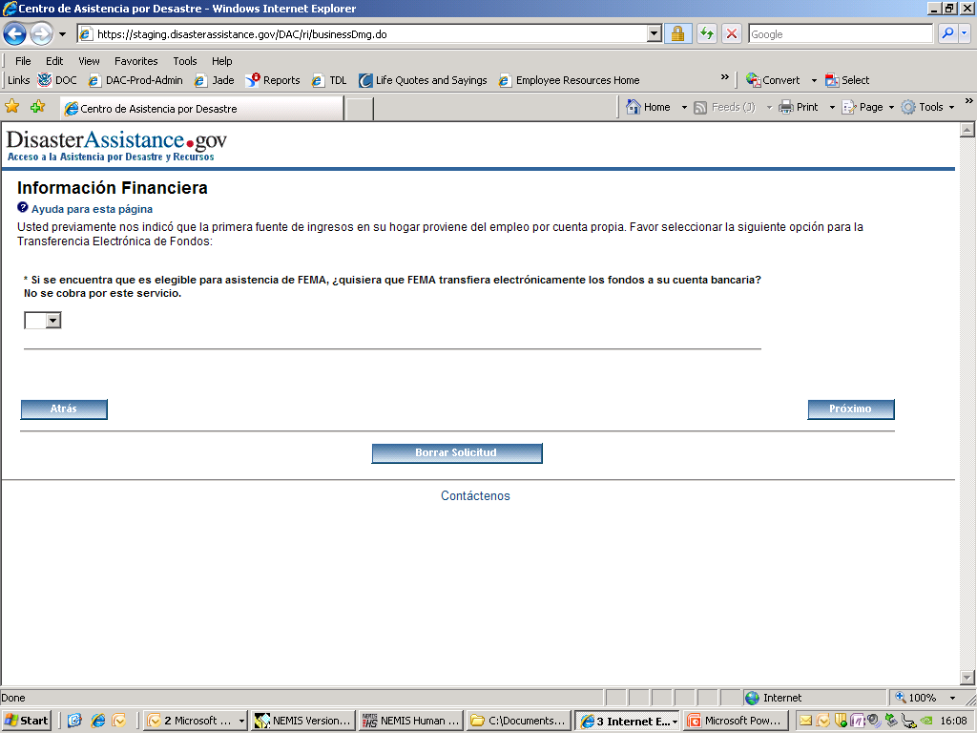
OMB No. 1660-0002. Termina 8-31-2013

Slide 33
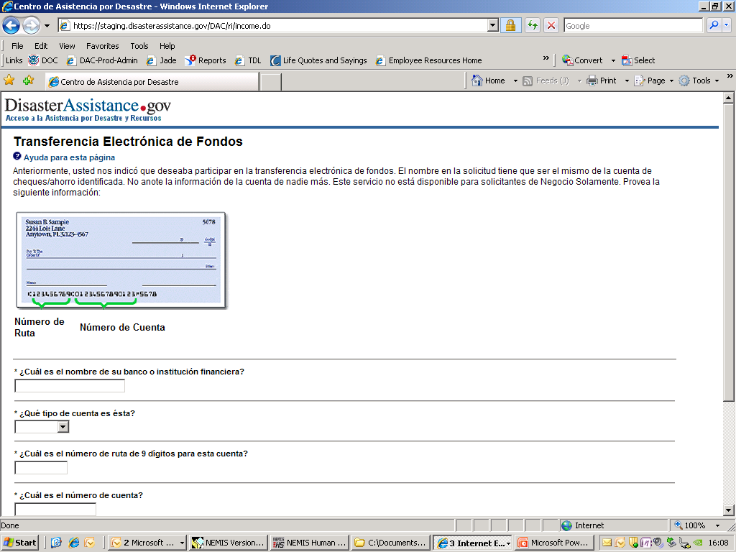
OMB No. 1660-0002. Termina 8-31-2013

Slide 34
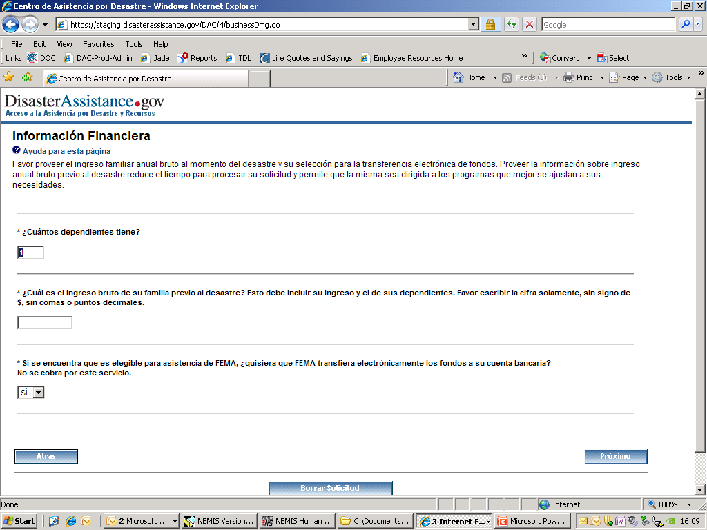
OMB No. 1660-0002. Termina 8-31-2013

Slide 35
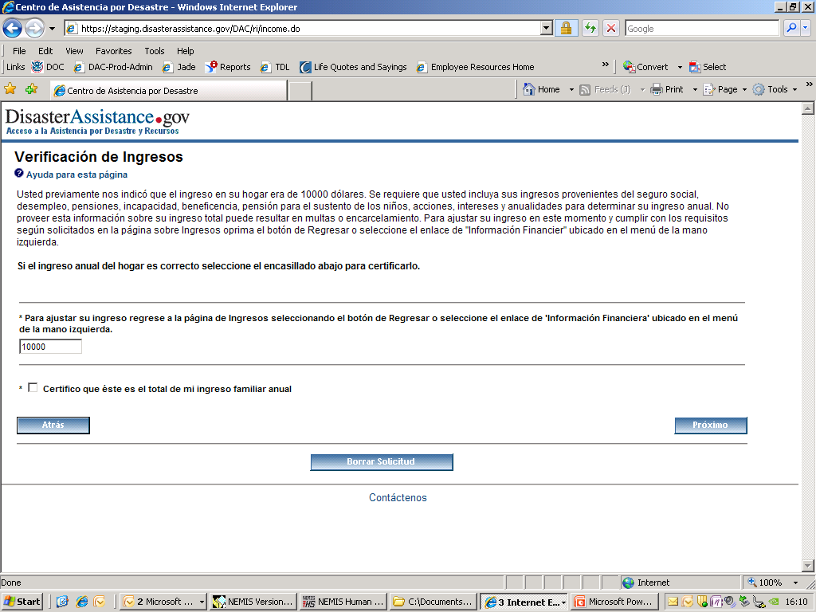
OMB No. 1660-0002. Termina 8-31-2013

Slide 36
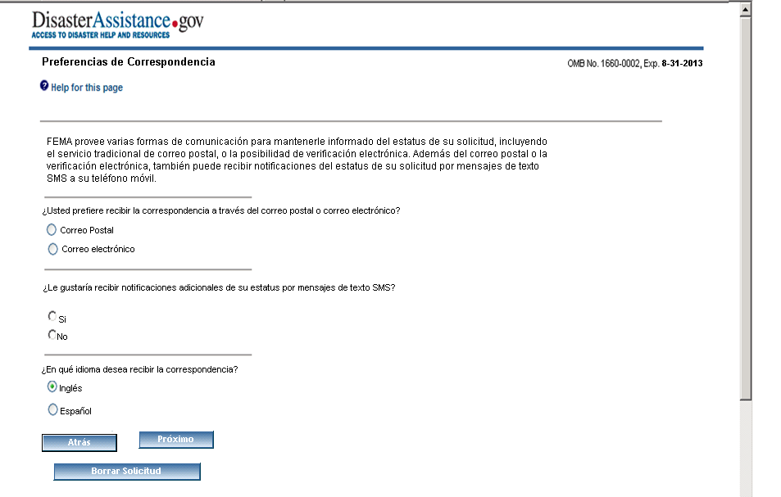

Slide 37
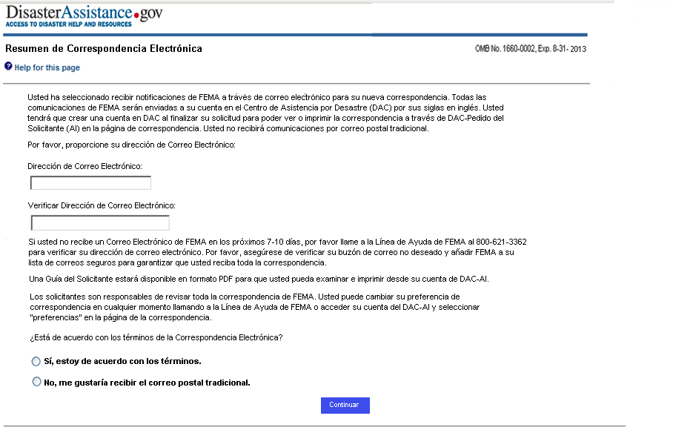

Slide 38
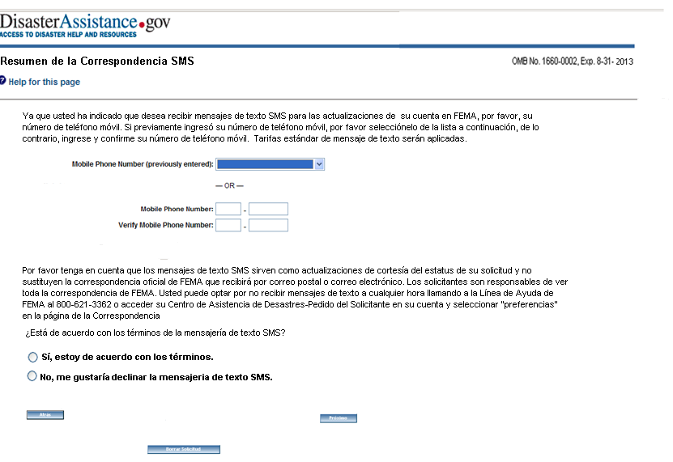

Slide 39
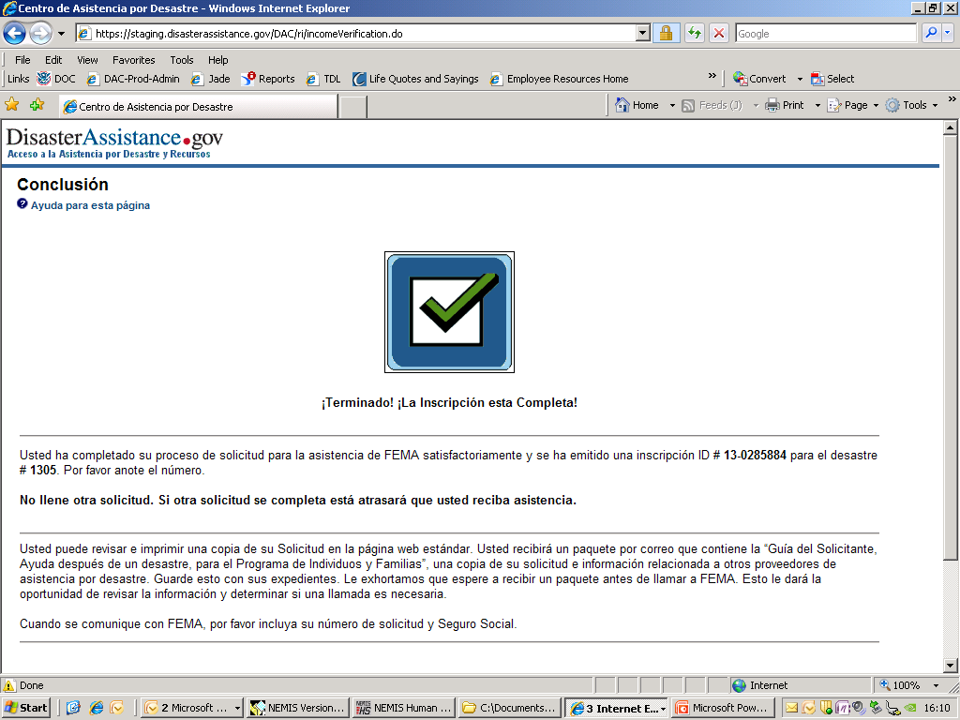
OMB No. 1660-0002. Termina 8-31-2013

Slide 40
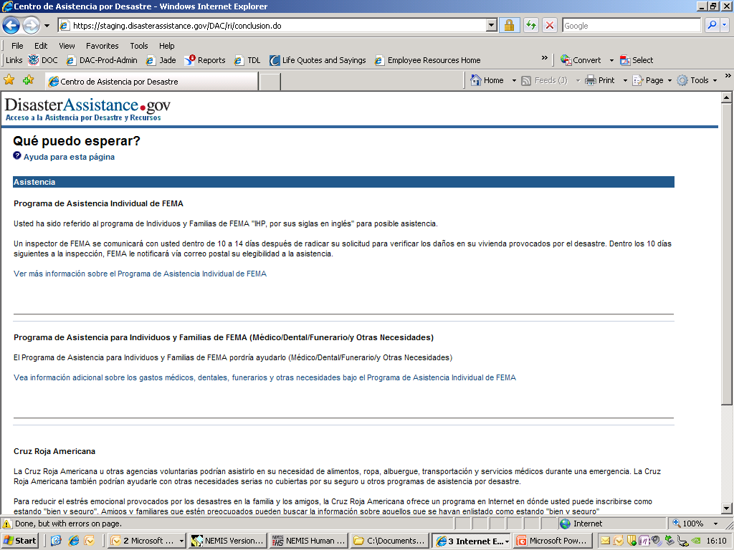
OMB No. 1660-0002. Termina 8-31-2013

Slide 41
