Slide 1
PRA Statement Placeholders and Registered User Form Fields

Slide 2
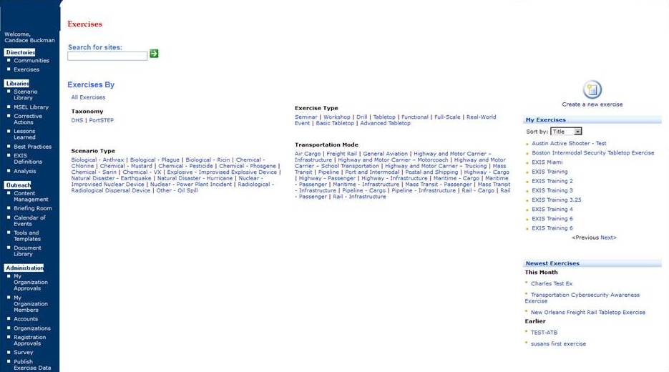
“An agency may not conduct or sponsor, and a person is not required to respond to a collection of information unless it displays a valid OMB control number. Transportation Security Administration estimates that the average burden for collection is XX hours per year. You may submit any comments concerning the accuracy of this burden estimate or any suggestions for reducing the burden to: TSA-11, Attention: PRA 1652-XXXX 601 South 12th Street, Arlington, VA 20598. This collection expires mm/dd/yyyy.”

Slide 3
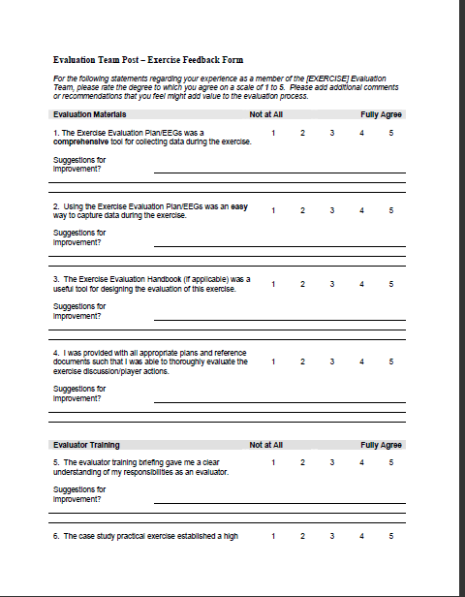
Evaluation Team Post-Exercise Feedback Form
“An agency may not conduct or sponsor, and a person is not required to respond to a collection of information unless it displays a valid OMB control number. Transportation Security Administration estimates that the average burden for collection is XX hours per year. You may submit any comments concerning the accuracy of this burden estimate or any suggestions for reducing the burden to: TSA-11, Attention: PRA 1652-XXXX 601 South 12th Street, Arlington, VA 20598. This collection expires mm/dd/yyyy.”

Slide 4
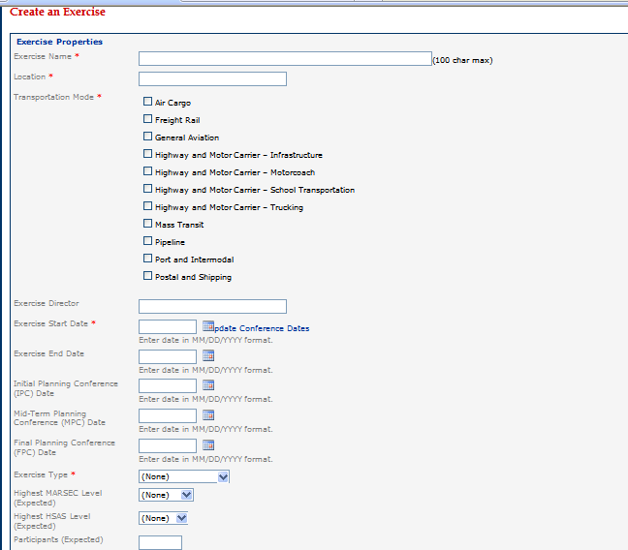
Create an Exercise

Slide 5
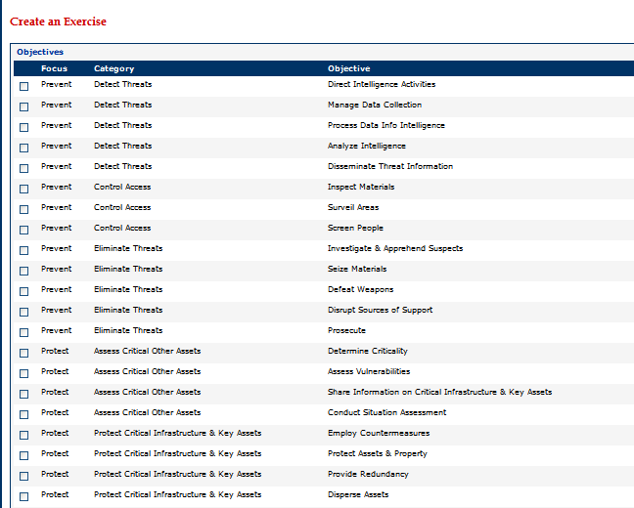
Choose Objectives

Slide 6
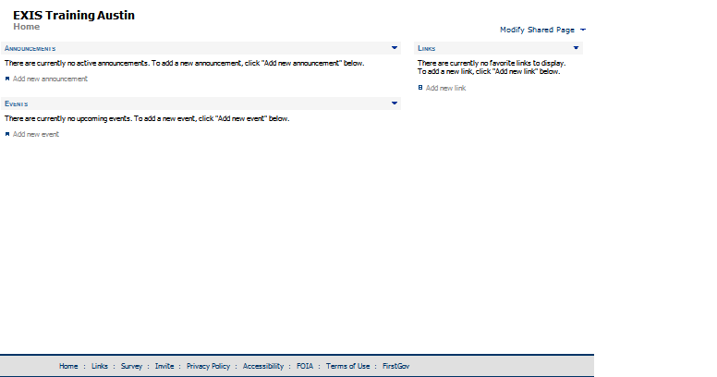
Sample Exercise

