Slide 1
NHTSA Monroney Label Testing
Mall Intercepts Research
Presented by
Strat@comm and Harris Interactive
08/29/08
Notes:
Content Provider –
Content Owner –
Web Address –
Last Updated – December, 2006
Speaker Notes –

Slide 2
Methodology
In-person interviews were conducted by a Harris Interactive research partner specializing in mall intercept surveys.
201 mall intercept interviews were conducted in two locations among those age 18 and older
  152 at Lakeforest Mall in Gaithersburg, MD
  49 at Pentagon City Mall in Arlington, VA
2
Notes:
Content Provider –
Content Owner –
Web Address –
Last Updated – December, 2006
Speaker Notes –
Understand your business challenges and opportunities in the context
of your industry
Design research solutions that ensure valid and reliable data
Research design
Data collection and programming
Representativeness
Quality control
Provide strategic insights to create evidence-driven action plans and recommendations, when needed
Reporting and analysis is standard; consulting should be available as needed
Deliver value
Beyond your budget and timetable, you should gain the confidence and clarity you need
ORIGINAL CONTENT:
It’s So Much More Than Sample
Understanding Your Business Challenge
Designing Research Solutions
Research Design
Data Collection and Programming
Representativeness
Quality Control
Providing Strategic Insights
Reporting and Analysis
Cost Effectiveness
Price

Slide 3
Key Findings
Vehicle safety is extremely important in the selection process. In fact, nearly all (99%) respondents considered safety to be either very (86%) or somewhat (13%) important.
Although government safety ratings are a relatively recent addition to new vehicle window stickers, the majority of respondents (63%) are aware government safety ratings are on new vehicle windows.
While nearly six-in-ten (57%) respondents indicate they interpret the Frontal and Side crash test ratings in Version B are based on more than one test, three-in-four (73%) feel it would be better if there were a footnote to clarify the ratings are based on more than one test.
Despite a preference for some elements of the Version B label (i.e., “5-Star” Safety Rating title and unified footer that includes the website as well as a description of the ratings), respondents overwhelmingly (79%) preferred Version A.
The key driver in opting for Version A appears to be the more descriptive information on the Frontal and Side Crash ratings.
Based on these findings, the final safety ratings label should include a combination of the two versions:
  “5-Star” Safety Rating title,
  Frontal Crash ratings that include Driver and Passenger ratings,
  Side Crash ratings that include Front and Rear seat rating, and
  A unified footer that includes footnotes and contact information.

Slide 4
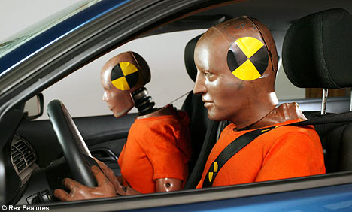
Importance of Safety in Vehicle Selection
Thinking about your next vehicle you purchase or lease, how important is vehicle safety when deciding which car to select?
Very important
Somewhat important
Not too important
Not at all important
86%
13%
-
1%
BASE: All respondents

Slide 5
Awareness of Government Safety Ratings on Vehicle Window Stickers
Are you aware that the Federal Government posts safety ratings on a new vehicle’s window sticker?
Not surprisingly, those who have purchased or leased a new car in the past 12 months or plan to purchase one in the next 12 months (50%) are more likely to be aware of the safety ratings on the sticker than those who have not (29%).
Description Given to Unaware Respondents
Government 5-star safety ratings are based on three aspects of vehicle safety: frontal crash performance, side crash performance, and rollover performance. Star ratings range from 1-5 stars with 5 indicating the highest safety rating.
BASE: All respondents

Slide 6
Monroney Label Options
The following two versions of the labels were shown to all respondents. The differences between labels are circled in red. The left-right sequence of the labels was rotated during the interviewing process to minimize any potential order bias.
BASE: All respondents

Slide 7
Title Preference
The Federal Government vehicle Safety Rating system is based on a 5-Star rating system. The safety ratings for all vehicles are based on multiple aspects of vehicle safety. Thinking about this rating system, which title do you prefer?
35%
65%
Interestingly, men (72%) are more likely than women (58%) to opt for the “5-Star” safety rating label in Version B. Conversely, women (42%) are more likely than men (28%) to opt for the safety rating label in Version A.
BASE: All respondents

Slide 8
Rating Preference
The frontal crash and side crash safety ratings are based on driver and passenger safety as well as front and rear seat safety. Do you prefer the version that provides one overall rating (B) or the version that provides a rating for each test (A)?
74%
26%
BASE: All respondents

Slide 9
Version B Interpretation
If you only saw version B, would you interpret the Frontal Crash and Side Crash Ratings as being based on more than one test?
BASE: All respondents

Slide 10
Version B Alternative Presentation
If the labels on Version B were changed to read “Overall Frontal Crash” and “Overall Side Crash” and were footnoted, would that be a better way to communicate that the ratings are based on more than one test?
BASE: All respondents

Slide 11
Footer Preference
In the label’s footer area, do you think the web address and hotline number should be separate from the star ratings description and source information (Version A) or should it be included as one section (Version B)?
42%
58%
BASE: All respondents

Slide 12
Overall Preference
Given the general information we discussed about these ratings, which of these 2 concepts do you feel better conveys the motor vehicle safety ratings that you would see on the window sticker label of a new car?
79%
21%
BASE: All respondents

Slide 13


Demographics
50% | 50%
Children | %
Yes, have children and living at home | 28%
Yes, have children, but none living at home | 19%
No, do not have any children/never had children | 51%
Age | %
18-29 | 36%
30-39 | 16%
40-49 | 16%
50-64 | 17%
65+ | 14%
Education
Family $$ | %
<20k | 11%
20k-50k | 37%
50k-75k | 19%
75k-100k | 14%
100k+ | 14%
50k-75k | 19%

Slide 14
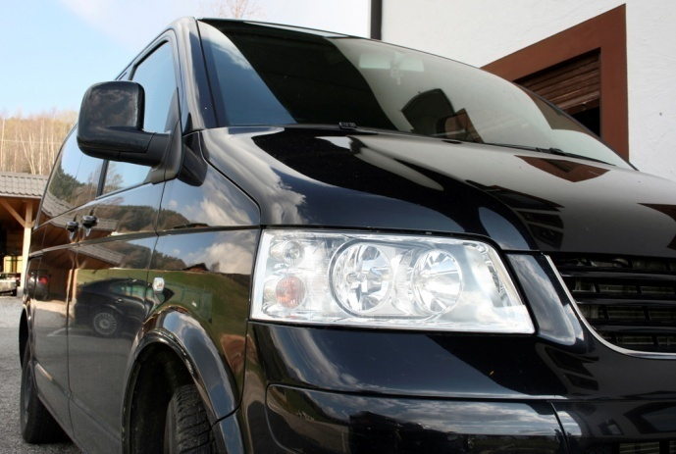
Demographics
Vehicle Past Purchase/Purchase Intent
Location
(purchased a vehicle within the past 6 months)
(considering a vehicle purchase in the next 6 months)
Lakeforest Mall
Pentagon City Mall
76%
24%
BASE: All respondents

Slide 15
NHTSA Monroney Label Testing
Mall Intercepts Research
Presented by
Strat@comm and Harris Interactive
08/29/08
Notes:
15
Content Provider –
Content Owner –
Web Address –
Last Updated – December, 2006
Speaker Notes –

