Slide 1
ODI: Vehicle Safety Focus Groups
Respondent Handouts

Slide 2
Handouts: Taglines

Slide 3
Feel it. File it. Fix it.
NOTES: ________________________________________________________________________________________________________________________________________________________________________________________________________________________________________________________________________
GRADE (CIRCLE ONE): A B C D F

Slide 4
Make your car problem
our problem.
NOTES: ____________________________________________________________________________________________________________________________________________________________________________________________________________________________________________________________________________
GRADE (CIRCLE ONE): A B C D F

Slide 5
Your car problem should be
our car problem.
NOTES: ________________________________________________________________________________________________________________________________________________________________________________________________________________________________________________________________________
GRADE (CIRCLE ONE): A B C D F

Slide 6
No safety problem is too small
for a recall.
NOTES: ________________________________________________________________________________________________________________________________________________________________________________________________________________________________________________________________________
GRADE (CIRCLE ONE): A B C D F

Slide 7
Certify your car problem.
NOTES: ________________________________________________________________________________________________________________________________________________________________________________________________________________________________________________________________________
GRADE (CIRCLE ONE): A B C D F

Slide 8
Handouts: Current Complaint Form

Slide 9
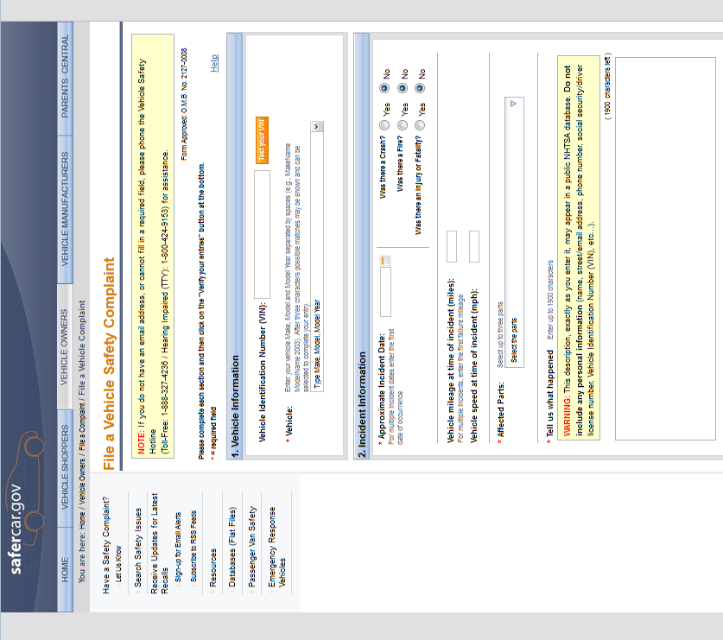

Slide 10
