Slide 1
Voucher Management System
Changes –
Tabular Form layout
Consolidated like items on same tab
Aligned UML and HAP on same row for easier input
Prior Month, Average Last 12 Months, and Average Year to Date data provided for user validation reduction in keying errors.
Pop-up user information regarding data entry field.
Individual Tab saving to prevent data loss prior to monthly submission

Slide 2
Voucher Management System
Changes continued –
Point of Contact Information provided for end user use, includes FMC and Field Office assigned personnel with email and phone number.
Redesigned Submission page to include error messages and Historical data entry status, to include draft (DRA), save (SAV), submissions (SUB), pending hard edit (PHE), approved hard edit (AHE), and denied hard edit (DHE).
Executive Summary – detailing allocation and balance, recap worksheet, utilization graphs, and projection worksheets.

Slide 3
Voucher Management System
Changes continued –
Standardized buttons – Each input screen contains a “Validate”, “Save”, “Reset”, “Cancel”, and “Print” buttons.
New Tabular printing function allows user to make hard copy PDF printout of data entry.

Slide 4
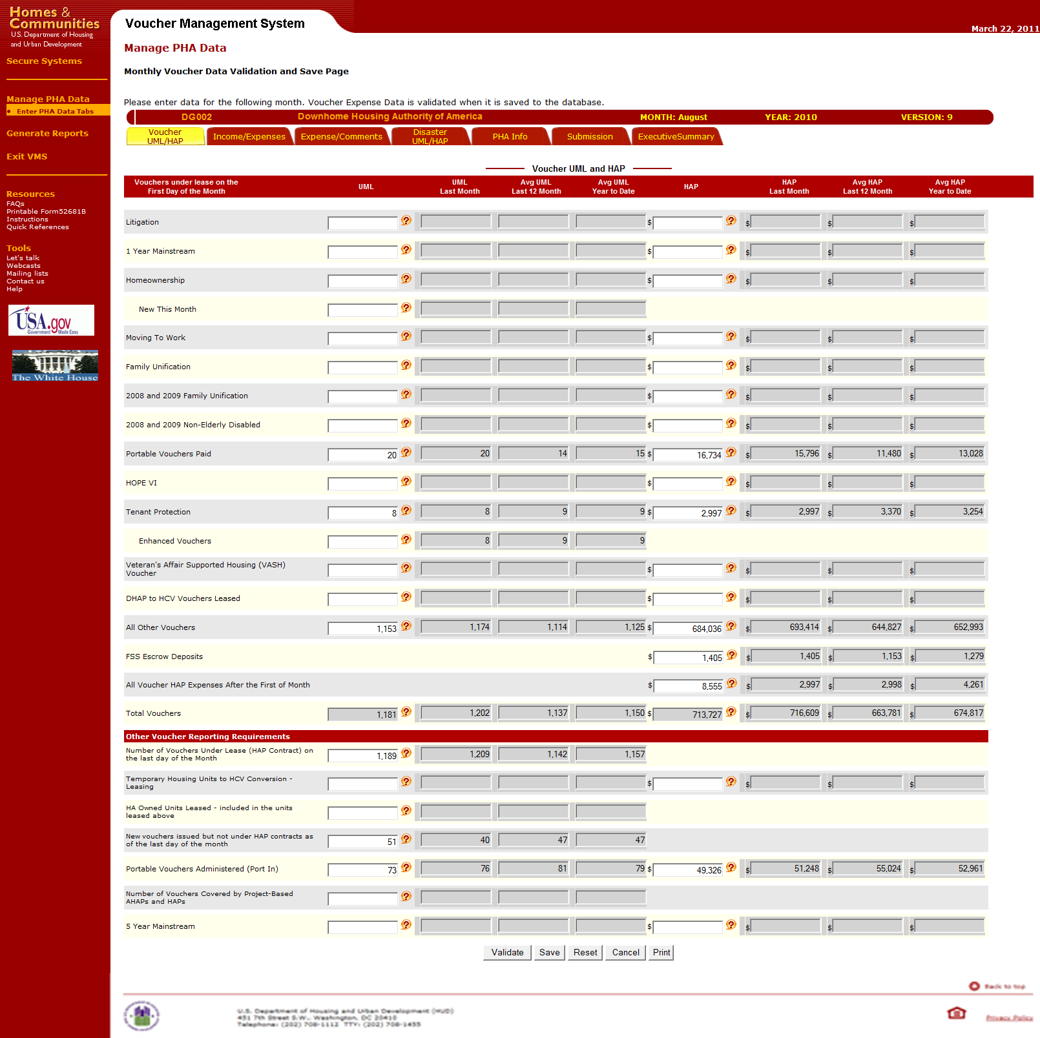
Voucher Management System
Voucher UML and HAP Tab (data input by PHA/user in columns 2 and 6 only all others are system filled)
Screen layed out in two major sections.
Top section used to provide first of the month voucher information by specific categories
Bottom Section used to report other specific monthly reporting requirements
Each section allow for UML and HAP data reporting.

Slide 5
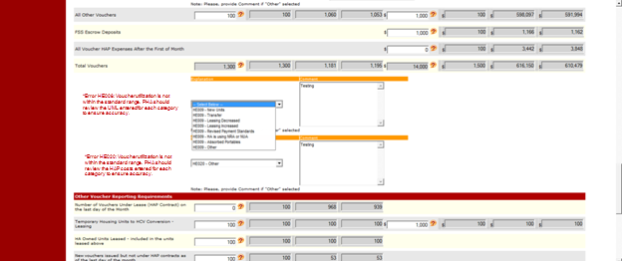
Voucher Management System
Voucher UML and HAP Tab (hard edit input only used if there was a prior error)
All Validation Hard Edit messages with HUD authorized predefined drop down reasons with comment box.
User selects the appropriate pre-defined reason, or chooses the “Other” option and enters further explanation of the data being entered.

Slide 6
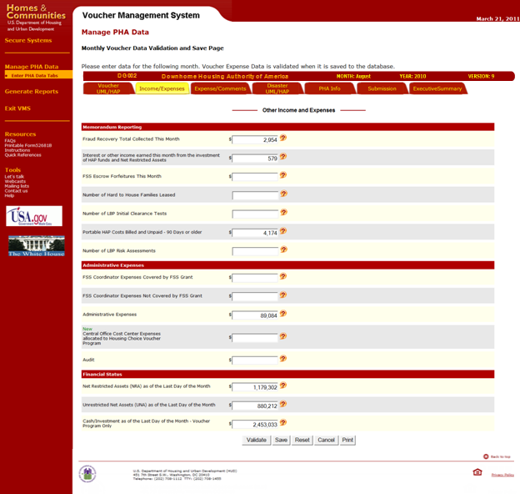
Voucher Management System
Other Income and Expense Tab (data entry no change from prior inputs)
Screen layed out in three major sections.
Top section used to provide Memorandum Reporting items for the reporting month.
Middle section used to input Administrative Expenses for the reporting month
Bottom section used to report the PHA’s Financial Status at the end of the month.

Slide 7
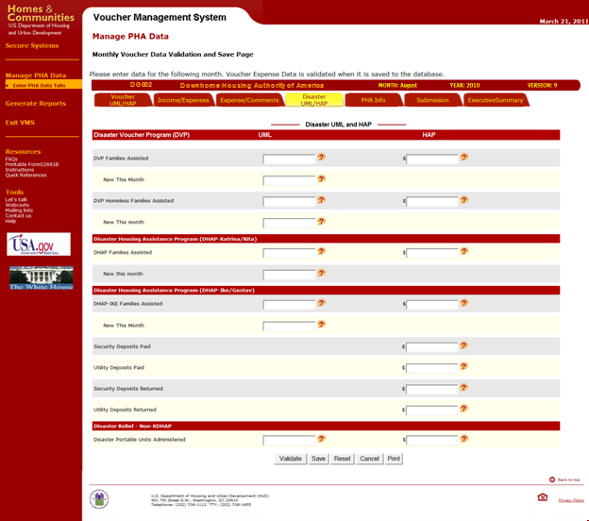
Voucher Management System
Disaster UML and HAP Tab (data entry no change from prior inputs)
Screen layed out in four major sections.
Top section used to provide Disaster Voucher Program leasing and expense incurred during the reporting month.
Top middle section is used to provide Disaster Housing Assistance Program (DHAP Katrina/Rita) leasing and expense incurred during the reporting month.

Slide 8
Voucher Management System
Disaster UML and HAP Tab (data entry no change from prior inputs)
Lower middle section is used to provide Disaster Housing Assistance Program (DHAP Ike/Gustav) leasing and expense incurred during the reporting month.
Bottom section is used to provide Disaster relief (Non KDHAP) leasing and expense incurred during the reporting month.

Slide 9
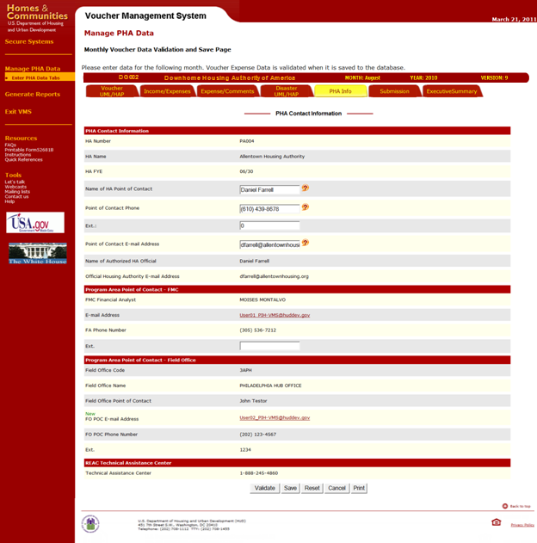
Voucher Management System
PHA Information Tab (data entry no change from prior inputs)
Screen layed out in four major sections.
Top section used to provide PHA and PHA Point of Contact Information
Top middle section provides the Financial Analyst information that is assigned to work with the PHA

Slide 10
Voucher Management System
PHA Information Tab (data entry no change from prior inputs)
Lower middle section provides the Field Office Staff information that are assigned to work with the PHA
Bottom section identifies the REAC Technical Assistance Center’s Phone number
The only information that can be edited/modified is the Field Office POC data, all other data comes from PIC or pre-defined FMC and FO Tables.

Slide 11
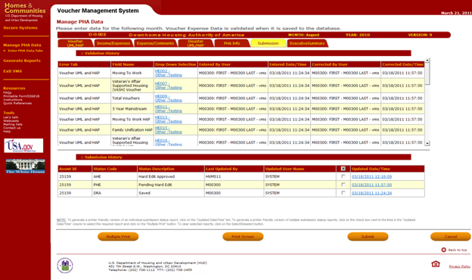
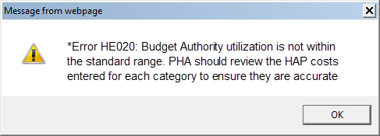
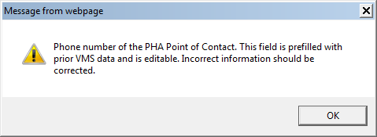
Voucher Management System
Submission Tab (summary of inputs prior to PHA submitting to HUD)
The Submission tab is divided into two major areas of information.
Top section provides the user with a complete listing of the validation history for the selected reporting month.
The latest Hard Edit Record is always on top. User can select on the drop down selection linked item and display the Hard Edit Message.

Slide 12
Voucher Management System
Submission Tab (summary of inputs prior to PHA submitting to HUD)
At the of the Submission tab are four new buttons used by the PHA.
Multiple print enables the user to print out two or more of the Submission History. User puts a check mark in the selection box next to the specific prior submission to be printed out.
Print screen will print out a pdf formatted copy of the submission screen, and will display all the hard edits listed, and will print a complete list of the submission history.

Slide 13
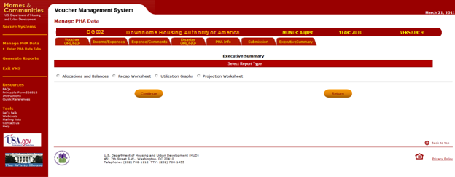
Voucher Management System
Executive Summary Tab (system generated using inputs)
The Executive Summary is a new feature for the users in VMS. This new function provides the PHA Executive Director, Manager, Board Member or interested party with a financial status of the PHAs health and ability to continue to lease units. There are four reports that can be generated to display vital information for decision making.

Slide 14
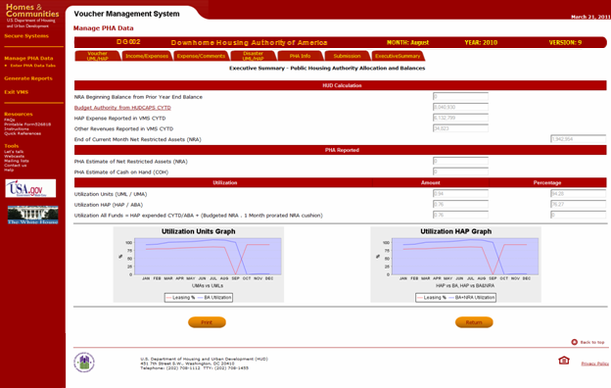
Voucher Management System
Allocations and Balances Report (system generated using inputs)
The Allocations and Balance report provides expense and utilization information for the PHA.
It is separated into three separate areas of financial and utilization information.
The top section of the report identifies the PHA’s beginning Net Restricted Asset for the year, the CYTD budget authority allocated, CYTD HAP Expenses and CYTD Other Revenues that is used to calculate the month ending NRA balance.

Slide 15
Voucher Management System
Allocations and Balances Report (system generated using inputs)
The middle section of the report identifies the PHA’s Estimate of Net Restricted Asset for the reporting month, and the estimate of the Cash on Hand for the reporting month.
The bottom section provides the utilization amount and percentages for the units and hap information. The Executive Director, Manager or Board Member can also look at the graphs and see a quick view of the PHA’s overall utilization health

Slide 16
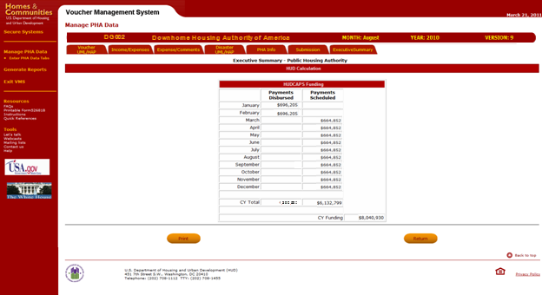
Voucher Management System
Allocations and Balances Report (system generated using inputs)
To help the PHA managers determine current and future balances, the Budget Authority from HUDCAPS is a link to this page that identifies the CYTD disbursed payments by month, and what payments have been scheduled for the rest of the calendar year.
User can print PDF formatted copy of HUDCAPS Funding by clicking on the print button

Slide 17
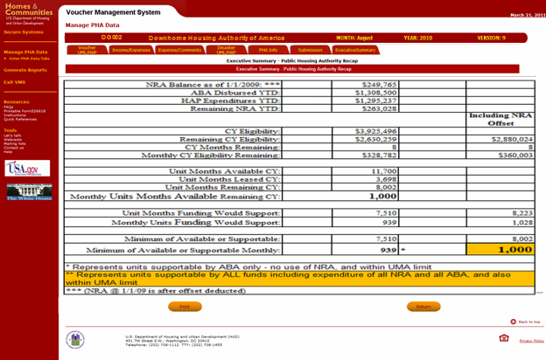
Voucher Management System
Recap Worksheet Report (system generated)
The Recap Worksheet report provides further detail on the PHA’s expense and utilization information.
Report identifies expense and utilization data and includes a section to incorporate the NRA.

Slide 18
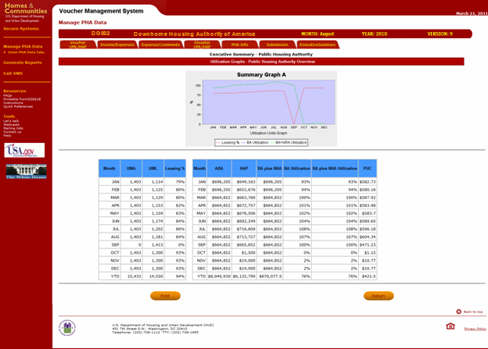
Voucher Management System
Utilization Graph Report (system generated using inputs)
The Utilization Graph report provides a graphical presentation of the PHA’s utilization of Units and Expense information.
Report is divided into two section. Top section provides the user with a graphical picture of the utilization and expense information for each of the calendar year reporting months.

Slide 19
Voucher Management System
Utilization Graph Report (system generated using inputs)
The bottom section provides on a month by month basis actual unit and expense information used to generate the graph.
Users would be able to print out hard copy of Utilization graph for comparison with other months

Slide 20
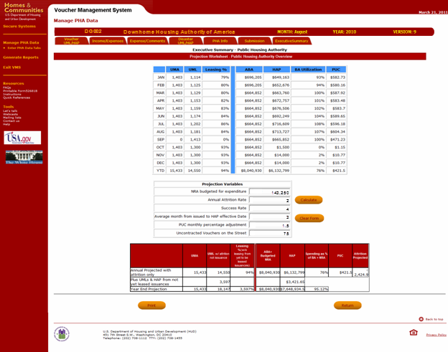
Voucher Management System
Projection Worksheet Report (this purely optional to assist with any “what if” scenarios and analysis)
The Projection Worksheet report provides the user the ability to see what effect certain changes would provide the best process to help maximize their voucher leasing process.
Report is divided into three sections.
Top section provides the user with a view of the actual utilization and expense information for the calendar year.

Slide 21
Voucher Management System
Projection Worksheet Report (this purely optional to assist with any “what if” scenarios and analysis)
The middle section of the report will allow the Executive Director, Manager, or CFO to input proposed changes in specific areas and see how those changes would affect their ability to maximize their voucher leasing process and improve their performance.
Bottom section of the form displays the results of the various values input by the PHA above.
Completed report can be printed out for further analysis.

