Slide 1
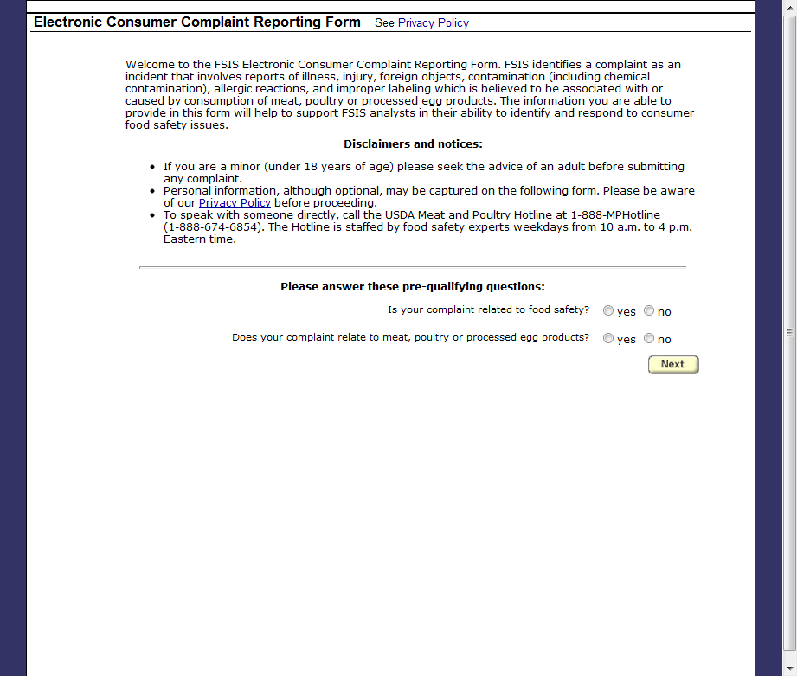
Disclaimer Form

Slide 2
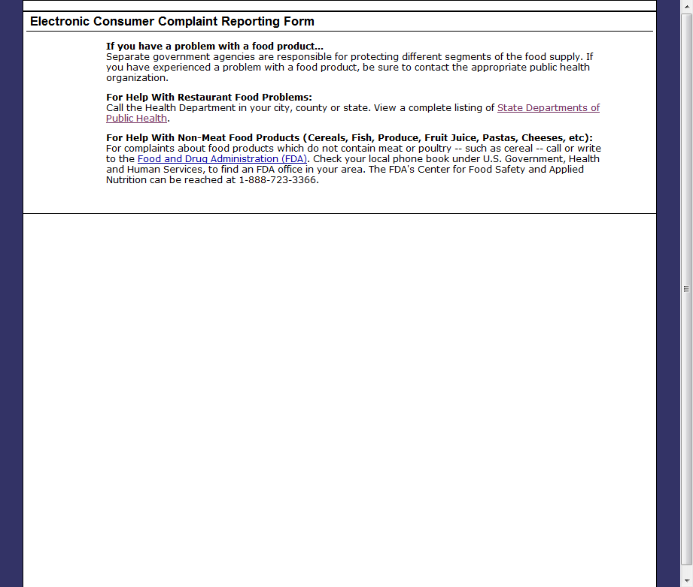
1 or 2 “No” Responses to Pre-Qualifying Questions

Slide 3
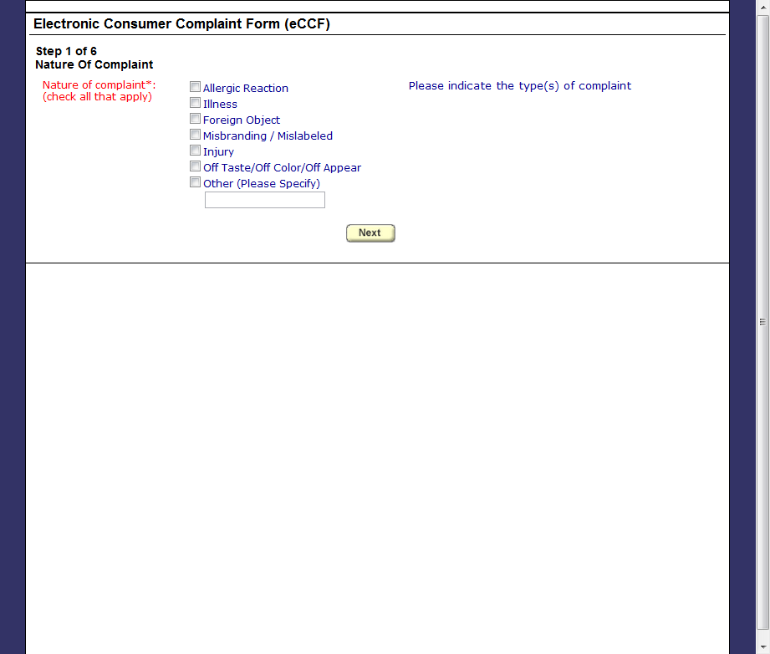
Step 1 – Nature of Complaint

Slide 4
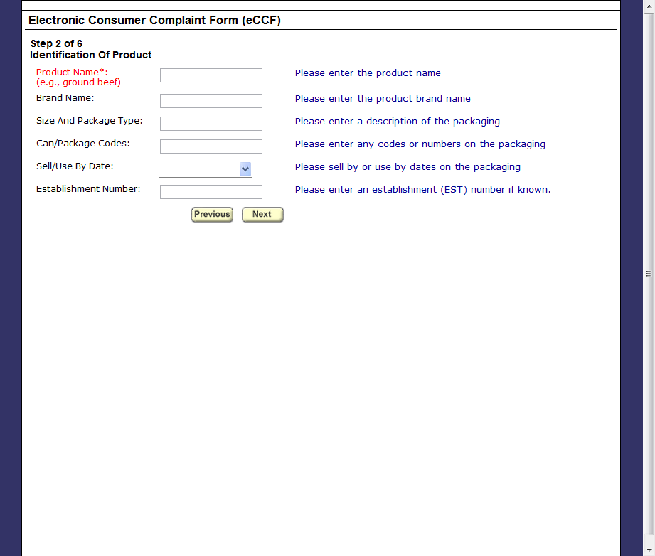
Step 2 – Identification of Product

Slide 5
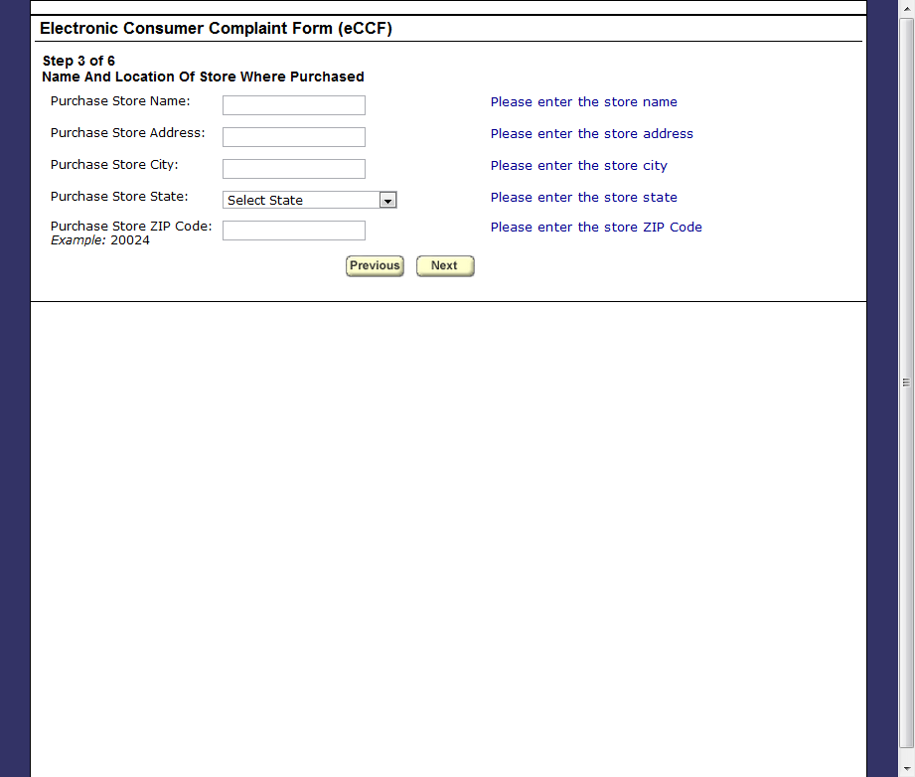
Step 3 – Name and Location of Store Where Purchased

Slide 6
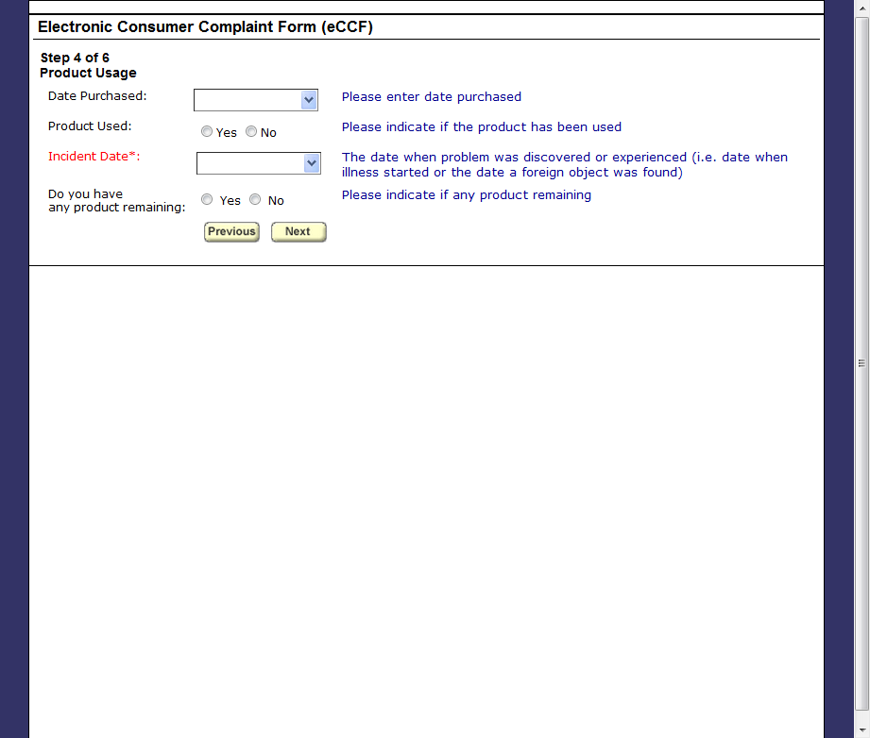
Step 4 – Product Usage

Slide 7
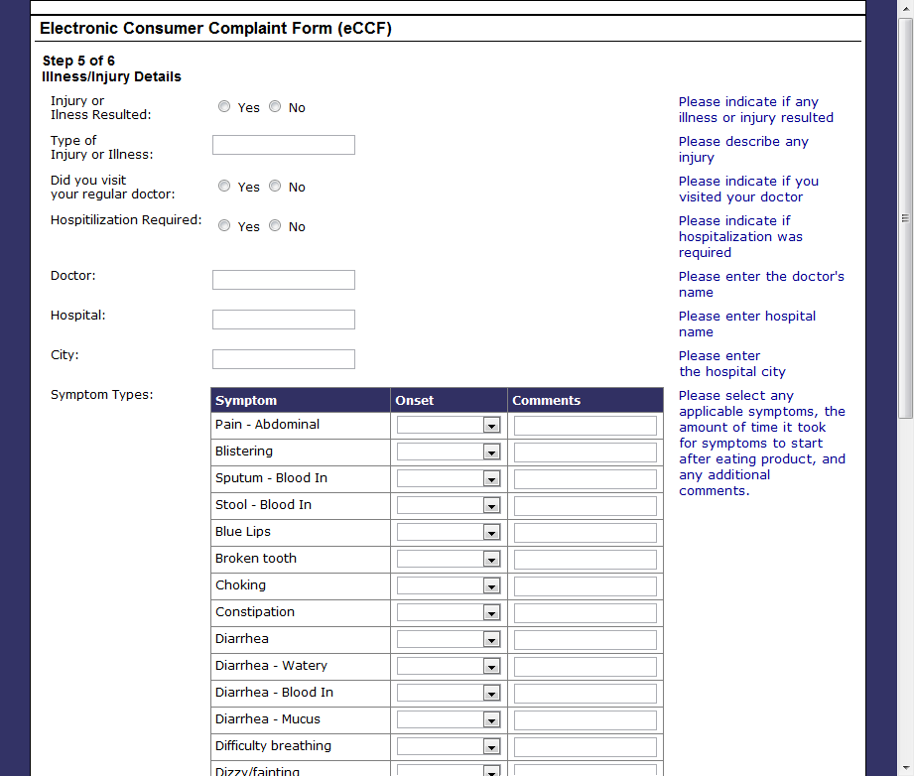
Step 5 – Illness/Injury Details

Slide 8
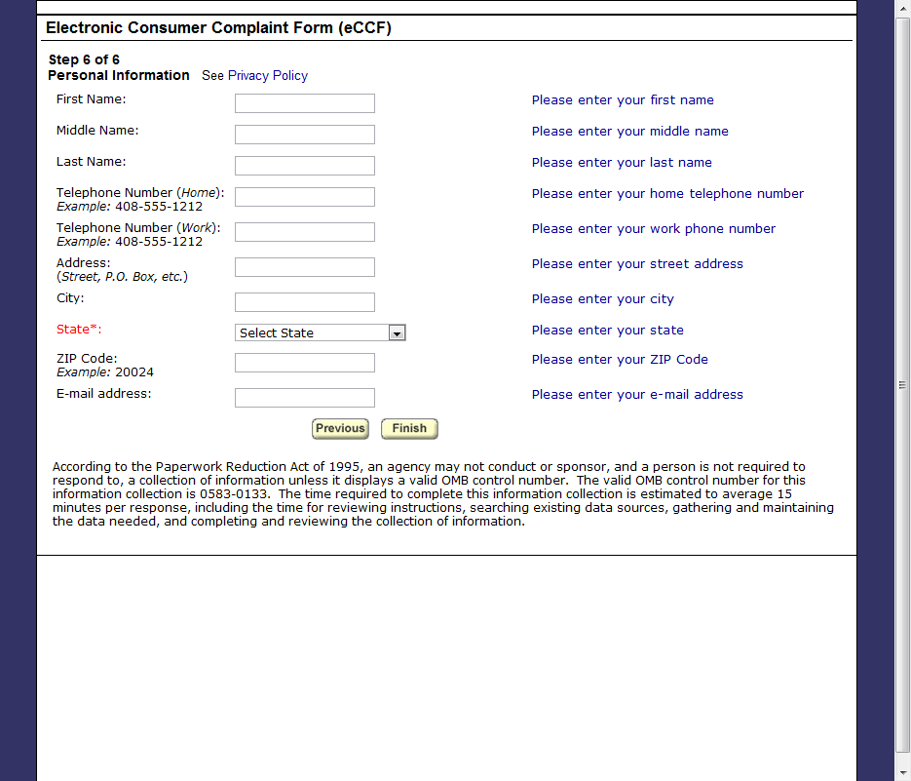
Step 6 – Personal Information

Slide 9
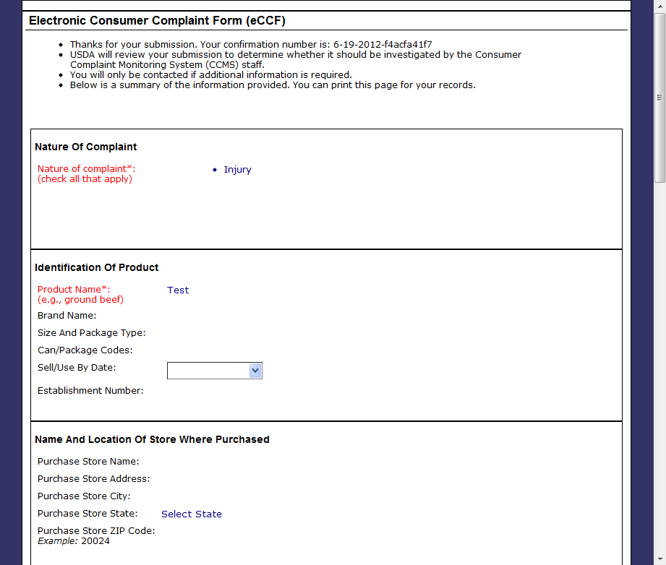
Submission Confirmation

