Slide 1
PEV Community Readiness Scorecard
Scoring Methodology
Trish Cozart
Mike Simpson
Witt Sparks
National Renewable Energy Lab

Slide 2
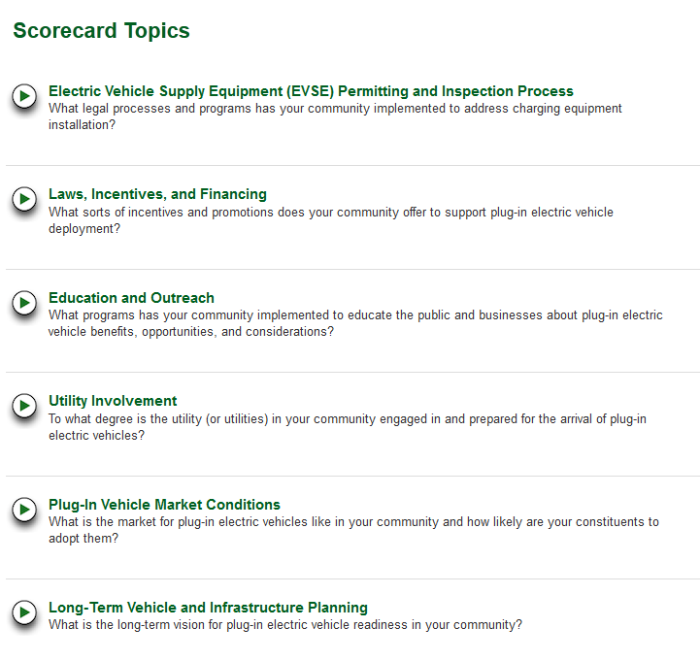
Categorizing “Readiness”
Notes:
How is the scorecard set up and how does it work?
Researched the key sticking points for PEV deployment
Leverage information gained from years of forums, discussions, and reports from Rocky Mountain Institute, NREL, EPRI, etc. and verified with DOE expert advisors
Key areas became scorecard topic areas
Developed questions that evaluate PEV readiness based on topic

Slide 3
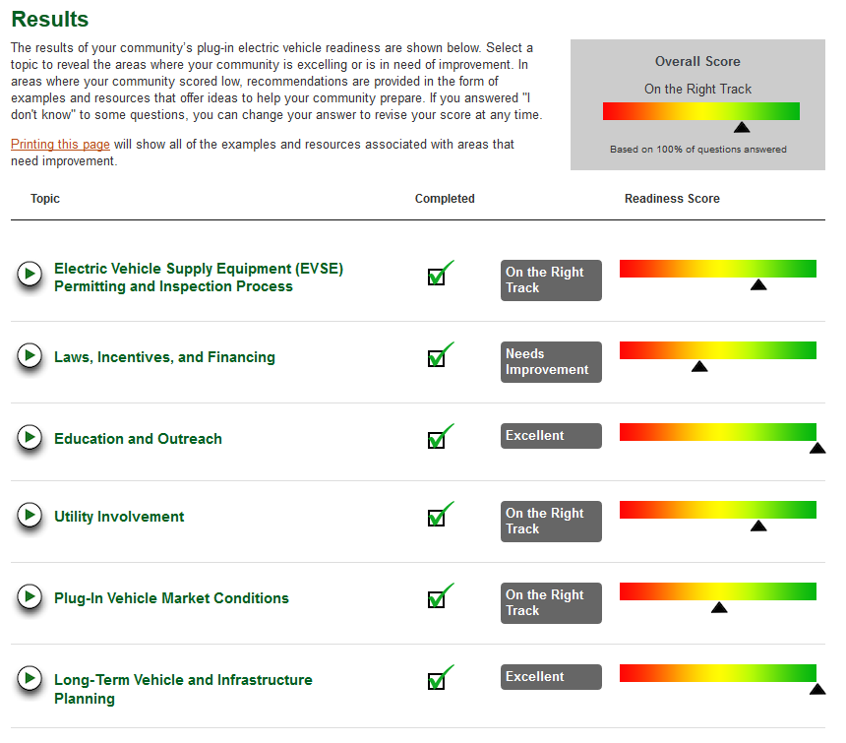
Scoring System
Notes:
Developed a scoring system for PEV readiness
Scoring based on research and expertise around what answers show the “best” readiness
Scores are based on both topic and question weighting
Answers translate to a numeric score, but is shown as a spectrum with encouraging messaging rather than a “score”
Scoring focuses on measuring what a community knows and on connecting municipal, manufacturer, and utility efforts.
Higher ratings are given for:
Lowers fees, ease of access
Higher incentives, higher adoption
More complete plans
Awareness and education
There are multiple ways and combinations to get a good score.

Slide 4
Weighting at Topic Level
Notes:
This shows the topic areas and their overall contribution to score.
It was clear to the plug-in community (manufacturers, early adopters, and on-lookers) that “market conditions” were the most important factor in PEV adoption during the first few years of implementation (what vehicles are available, and what is being purchased and by who). These directly correlate with how “ready” a community is for high adoption rates of PEVs and represent half of the chicken and egg issue (the other half is the ability to get infrastructure installed, or “EVSE Permitting and Inspection Process”). These two categories make up 41% of the readiness score.
Long-term planning is weighted a bit less than the rest because it doesn’t capture the current readiness as much as the other categories. If cities have plans in place, this is good and definitely contributes to readiness, but not nearly as much as previous actions taken to instigate incentives, involved utilities, create education programs, etc.

Slide 5
Weighting at Question Level
Application Process Section
Question | Answer A | Score A | Answer B | Score B | Answer C | Score C | Answer D | Score D | Answer E | Score E | Answer H | Score H | Weighting/ Max Score | Scenario Score | Weighted Score
In your area, what is the average time it takes for an electric vehicle supply equipment (EVSE) owner or site manager to complete the permitting, installation and, if applicable, inspection process? | Less than 1 day | 1 | 1 to 2 days | 0.8 | 2 days to 1 week | 0.5 | > 1 week | 0.1 |  |  | I don't know | 0 | 2 | 0.8 | 1.6
What are the options for submitting an EVSE permitting application? Check all that apply. | Online | 0.5 | In-person | 0.2 | By telephone | 0.2 | Snail mail | 0.1 |  |  | I don't know | 0 | 1 | 0.7 | 0.7
Indicate all the types of EVSE installation permit applications you have that are separate from general electrical work permit applications? Check all that apply. | Residential | 0.2 | Commercial | 0.2 | Public | 0.2 | Level 1 | 0.2 | Level 2 | 0.2 | I don't know | 0 | 1 | 0.8 | 0.8
Max Score = 4
Weighted Score = 3.1
Notes:
Examples of topic areas and sections are weighed at the question level.
For example, in the Application Process Section:
Question #1:
Example of a question with each answer weighed differently based on how fast the process takes. Less time = better score. So, the less time a consumer has to spend dealing with installation of EVSE, the less concern/hesitation they’ll have to work it into their busy life. Notice the weight of this question is double that of the other two questions because speed of permitting and inspection is a very important factor in PEV readiness.
Question #2:
Example of a question where multiple answers may be selected, each with different weights and adding to a cumulative score.
Question #3:
Example of a question where multiple answers add to a cumulative score, but each answer (type of permit application, in this case) have the same weight because they are equally important.
In this section you can score a maximum of 4 points. The way the questions are answered resulted in a score of 3.1, which translates into a score of “Great Job”.

Slide 6
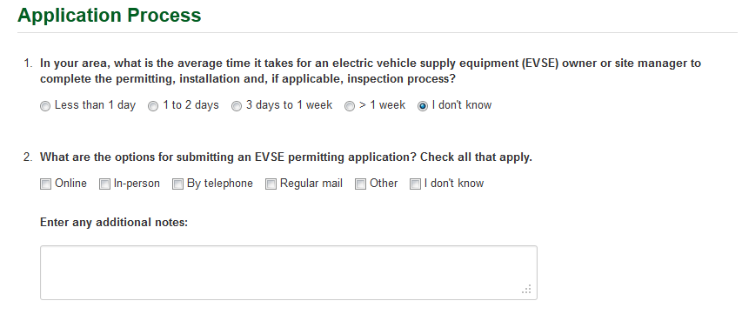
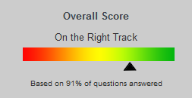
Encouraging Knowledge Gathering
Don’t Know = Low Score
No Answer = No Penalty
Notes:
The whole purpose of this scorecard is to provide useful feedback to communities and guide their path towards readiness for a broad market of PEVs. Our primary focus is to improve their knowledge base. For that reason, if they don’t answer the question, we don’t penalize them to encourage them to find an answer.
However, if they select “I don’t know” (an option for every question), this signifies that they will not be seeking an answer and they will then receive a score of 0.
An incomplete scorecard is indicated in the overall score as shown above and will be recorded in the results database that DOE can use to assess all of the communities.

Slide 7
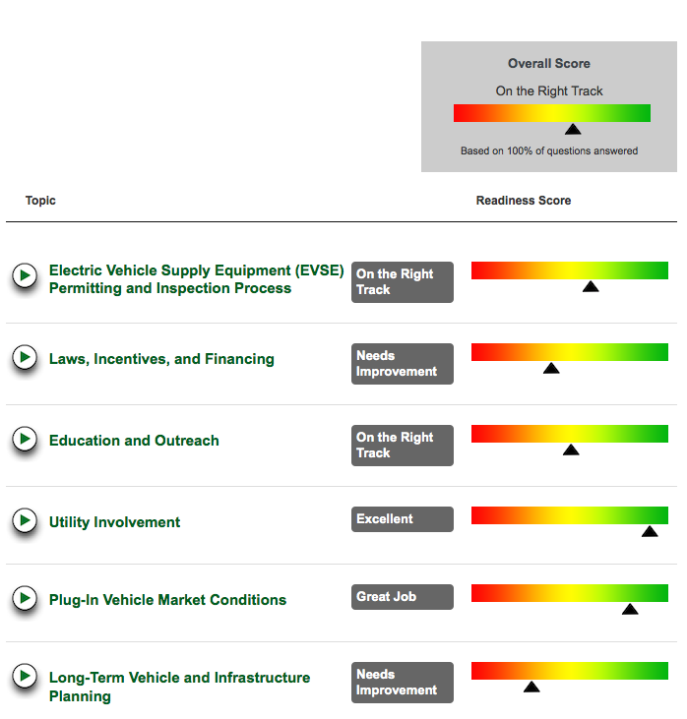
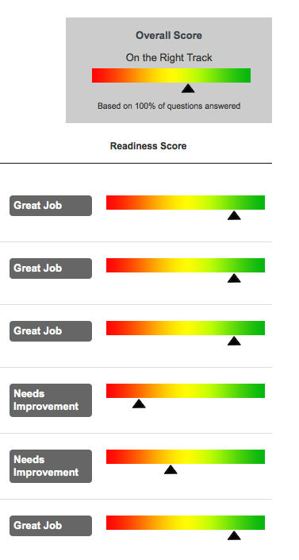
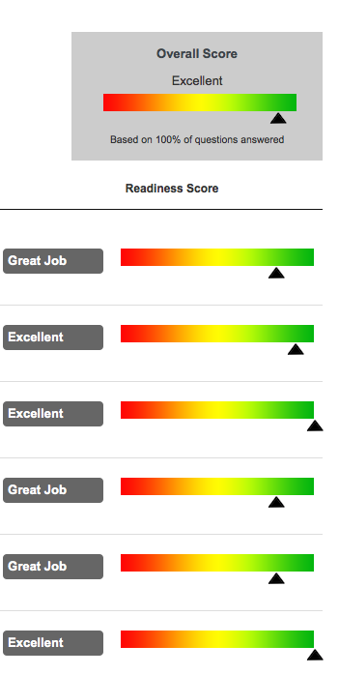
Scoring Scenarios
Low Cost
Scenario
High Cost
Scenario
Excellent
Scenario
Notes:
Three scenarios here demonstrate different pathways to readiness.
Low Cost: The first represents a low cost scenario in which a community answers positively for questions that ask about inexpensive measures like collaborating with a utility and assessing current market conditions.
High Cost: In the second scenario, the community answered positively for high cost initiatives (like incentives, long-term planning, education and outreach), but answered negatively on the low-cost initiatives. This scenario assumes that the community isn't in one of the early adopter areas, so there were not as many vehicles and dealerships, and with a less-involved utility.
Both scenarios of these scenarios give you a similar overall score.
Excellent: With positive answers in all categories, you can get an ‘excellent’ rating.

Slide 8
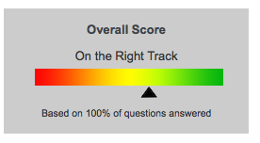
Low Cost Scenario
Notes:
Questions answered positively for topics identified as “low cost” readiness objectives and negatively for “high cost” topics (incentives and outreach)

Slide 9
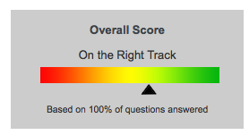
High Cost Scenario
Notes:
Questions answered positively for topics identified as “high cost” readiness objectives, negatively for “low cost” topics

Slide 10
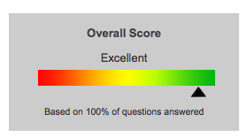
“Excellent” Scenario
Notes:
Most questions answered positively.

Slide 11
Questions?
Mike Simpson
Mike.Simpson@NREL.gov

