Slide 1
Screen Shots of the Online Form for Study Registration

Slide 2
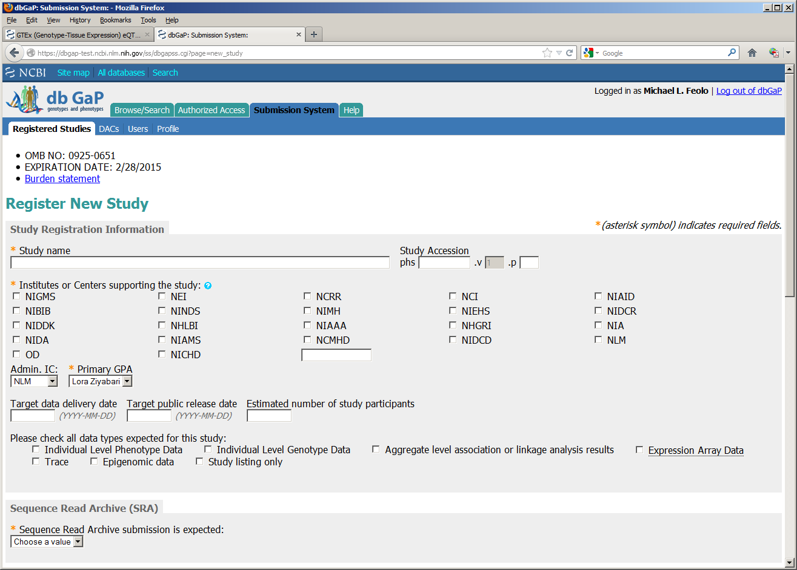

Slide 3
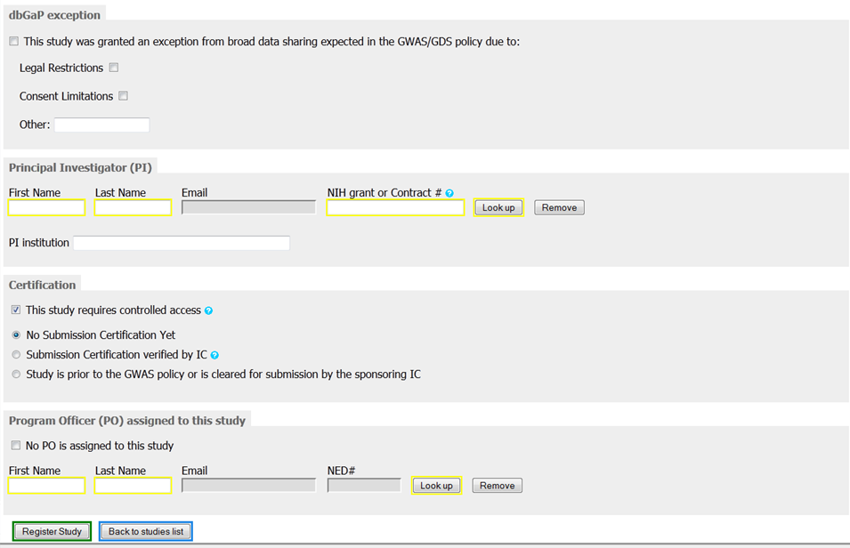

Slide 4
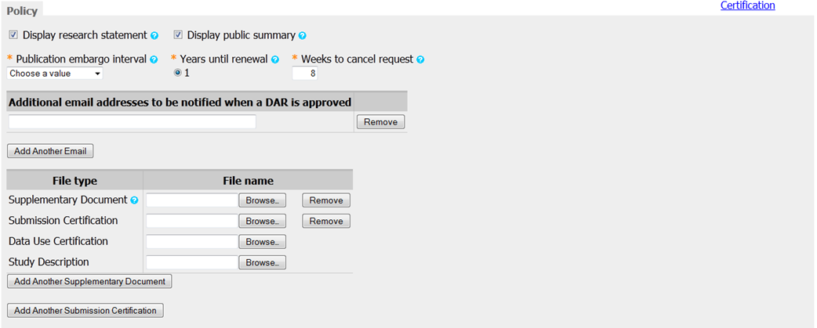

Slide 5
