Slide 1

Disaster Recovery Grant Reporting System Training for NSP Users
Day 1 Session
Admin
Action Plans
Drawdown
QPR
Reports
Grants
Release 7.3

Slide 2
Session Rules
Admin
Action Plans
Drawdown
QPR
Reports
Grants
Ask lots of questions
Set all cell phones to silent or vibrate.
Raise your hand if you are having computer problems or fall behind. We are here to help!

Slide 3
Training Objectives
Admin
Action Plans
Drawdown
QPR
Reports
Grants
Train NSP grantees on how to use the DRGR system for NSP reporting.
Walk through DRGR screens with grantees so they can better understand the basic steps.
Help prevent common problems with the DRGR system.
Show grantees how to tell their story to HUD.
This is not an NSP policy training. When it comes to discussions of policy, we’ll lean on the experience of the HUD staff in the room.

Slide 4
Training Schedule
Admin
Action Plans
Drawdown
QPR
Reports
Grants
DAY 1
  Overview of the System
  Detailed Review of DRGR modules (Action Plans & QPR) and processes
DAY 2
  Review of Day 1 Material
  Detailed Review of DRGR modules (Admin, Drawdown, Reports) and processes
  How to tell your NSP story in DRGR
  Common Issues/Troubleshooting

Slide 5
NSP & DRGR
Admin
Action Plans
Drawdown
QPR
Reports
Grants
Disaster Recovery Grant Reporting – DRGR – system was developed specifically for disaster recovery grantees.
NSP is NOT a disaster recovery program, but it was critical for HUD to act quickly.
DRGR is relatively easy to update to adapt to changes in NSP
DRGR had basic components needed by NSP
DRGR can customize key components quickly and easily
  Activity Types (i.e. Adding Land Banking as a new eligible activity for HUD)
  National objectives (i.e. LH25)
  Narrative fields
  Performance Measures for grantees by appropriation
Notes:
This slide discusses why NSP uses DRGR and how DRGR serves the basic needs of the program in terms of a data collection system.
The Disaster Recovery Grant Reporting — DRGR — system was developed specifically for disaster recovery grantees to help them manage their grants and receive funding. When you are using the system, keep in mind that you will see some activity types and other terminology designed for Disaster Recovery funding; these should not be used for NSP.
NSP is not a disaster recovery program, but the DRGR system was the best suited existing system at HUD to use for NSP.
DRGR is relatively easy to update and change. As NSP has evolved, HUD has been able to make changes to DRGR and adapt to needs of an NSP grantee. HUD will continue to make adjustments to the DRGR system to meet the data collection and reporting needs of NSP. DRGR users are responsible for staying abreast of these changes.
DRGR allows NSP grantees to track and report the basic components of the NSP grants management process. It was not designed to collect all documentation needed for the program.
The system allows the grantee to describe the proposed use of NSP funds by creating an Action Plan.
The system allows the grantee to track expenditures and request NSP funds from its allocation by creating draw vouchers.
The system allows the grantee to track program income generated and how the income is used for additional eligible activities.
The system allows the grantee to report accomplishments and progress by adding and submitting quarterly reports to HUD staff.
DRGR can customize key components of the program quickly and easily. For example:
New activity types such as Land Banking
National objectives
Narrative field (as they change per each NSP round)
Performance Measures

Slide 6
NSP & DRGR: Updates
Admin
Action Plans
Drawdown
QPR
Reports
Grants
Updates included in recent Release 7.3
Receipts, Revolving Loan Funds, and Program Income Accounts
Voucher Improvements
Audit Trail, User Account Management, and User Certifications
Miscellaneous Grantee Functions
Notes:
Given the evolving nature of NSP, DRGR has seen some significant changes over the past year. HUD continues to evaluate the system based on feedback from grantees like yourself and plans on making additional changes to the system in the upcoming year.
DRGR is currently on version 7.3 (as of early December 2011). When you first log in to DRGR, you will see a “DRGR NEWS” section on the first page. It is good practice to review this information for important updates that could affect your program.
Release 7.3 was the last major release and it included the following updates which we will discuss in detail throughout the day.
Program Income receipts, setting up and using Revolving Loan Funds, and Program Income Accounts.
Improvements to Vouchers including documenting the voucher process and making revisions.
Audit Trail, Account Management, and User Certifications.
Other miscellaneous functions including updates to how the users views some data, the ability to verify address information, and more information is provided in the QPR.

Slide 7
The Basics: DRGR Modules
Admin
Action Plans
Drawdown
QPR
Reports
Grants
Action Plans
Identify activities to be funded by organization, activity type, and project.
Drawdowns
Obligate funds
for draws; create, approve, edit vouchers; receipt program income
QPRs
Summarize drawdowns, expenditures, obligations, and achievements for
the quarter
Reports
Look at financial, reporting, and user account information in an easy-to-read and exportable format
Admin
Assign and certify users; add and track TA and Monitoring Events
Notes:
DRGR is now composed of five major modules: Admin, Action Plans, Drawdowns, QPRs, and Reports. The Admin module was enhanced in late 2010 and is now a more prominent feature in DRGR. Each of these modules will be covered today. Even if you will only work within one of the modules, it is important to understand how the five modules inter-relate.
Admin: Admin module allows the grantee admin users to certify other grantee users and assign them to grants. Grantees can also record any monitoring, audit, and technical assistance (TA) events they conduct as part of grant oversight.
Action Plans: The Action Plan in DRGR mirrors the information submitted in the substantial amendment sent to HUD. If the grantee has not yet identified specific organizations and programs, the activities listed in the amendment may show as projects in DRGR. The Action Plan may be resubmitted multiple times as new activities are awarded and entered.
Drawdowns: Once the Action Plan is set up and approved, grantees will use the Drawdown Module to obligate funds, receipt program income, and create draw vouchers.
QPRs: As grantees move forward with their NSP grants, they are required to submit quarterly reports to HUD via DRGR. The information reported in the QPR module is key to demonstrating progress – both financial and performance.
Reports: The DRGR system has a comprehensive set of canned reports available to pull information out of the system, including administrative reports, financial reports, and performance reports. Reports can serve as valuable management tools for two main reasons: (1) to help grantees monitor the status and progress of their various funded projects and subrecipient, and (2) troubleshoot issues or concerns a grantee is facing within DRGR. The reports can be viewed online, printed, or downloaded as a PDF or Excel file.

Slide 8
Telling Your Story
Admin
Action Plans
Drawdown
QPR
Reports
Grants
DRGR is THE place to tell your story to:
  Your CPD Representative
  HUD Headquarters
  Your Citizens
  The wider public
  Organizations and the media who request information on the program’s progress

Slide 9

Getting Started
Admin
Action Plans
Drawdown
QPR
Reports
Grants
Grantee Access to DRGR
DRGR Roles
Testing out the System
DRGR Navigation
9
Notes:
First, we are going to briefly discuss how to get started in DRGR and the key components of the Admin Module. Then, we’ll login to the system to try out different links and conduct our first case study.

Slide 10

Access to DRGR
Admin
Action Plans
Drawdown
QPR
Reports
Grants
Directions located on DRGR Log In page
http://portal.hud.gov/hudportal/HUD?src=/program_offices/comm_planning/communitydevelopment/programs/drsi/drgrs
  Send request to CPD Field Office
  FO staff reviews and forwards to DRGR_Help@hud.gov
Default grantee role: Regular User
Must specifically request additional roles:
  Grantee DRGR Administrator
  Request Drawdowns
  Approve Drawdowns
  View Only
Notes:
This slide summarizes the process to obtain a user ID for the DRGR system and some key points to keep in mind when requesting access.
A complete set of directions is available on the DRGR Log-In page at http://portal.hud.gov/hudportal/HUD?src=/program_offices/comm_planning/communitydevelopment/programs/drsi/drgrs. To obtain an ID, send an email to your HUD CPD Representative requesting DRGR access. Field Office staff will review the request and forward it to DRGR staff for processing. The email must include the following:
Full name of user
Grantee name
C# assigned for IDIS User ID (if current IDIS user)
Address
Phone, fax, and email address
Whether you will be the primary DRGR system administrator for your community
Whether you are authorized to request or to approve drawdowns
A five-digit PIN number, which will be used by the HUD help desk for help tickets
If the email does not request a specific user role, you will automatically be registered as a Grantee User. This role allows editing of the Action Plan and QPR.
Financial management roles, such as Request Drawdowns and Approve Drawdowns, and system management roles, such as the Grantee Administrator, must be requested in the email. You will learn the access rights of all DRGR user roles on the next screen.

Slide 11
DRGR Roles: Grantee
Admin
Action Plans
Drawdown
QPR
Reports
Grants
3 Basic Roles
2 Additional Roles
Must request Additional Role specifically from FO
Can only have one additional role
Grantee – View Only
OR
Grantee – Request Draw
Regular Grantee User
(Default)
OR
Grantee – Approve Draw
OR
Grantee – Request Draw
Grantee Admin
OR
Grantee – Approve Draw
Notes:
There are three basic Roles a user may have in the system:
Grantee Administrator - Every grantee will need at least one Administrator
Regular Grantee User* - When signing up to be a DRGR system user, HUD will automatically default to the Basic Role of Grantee User.
Grantee – View Only
In these Basic Roles, you do not automatically have access to Requesting Draws or Approving Draws. You must request that separately. This includes Grantee Admins. Although contrary to what you may think, Grantee Admins do not automatically have full access to all parts of they system. For example, Admins CANNOT request/approve drawdowns automatically. These roles are requested and added separately and do not come with being an Administrator. These roles are not specific to various grants, they are the Requestor or Approver for all grants.
There are two additional roles a user may have in addition to having a Basic Role: Grantee-Request Draw and Grantee-Approve Draw.
Every grantee needs at least one person with the Request Drawdown role; it is recommended to have at least two in case the primary Requestor is out of the office
Every grantee needs at least one person with the Approve Drawdown role; it is recommended to have at least two in case the primary Approver is out of the office
A User cannot have both Request and Approve Drawdowns for the same NSP grant.

Slide 12

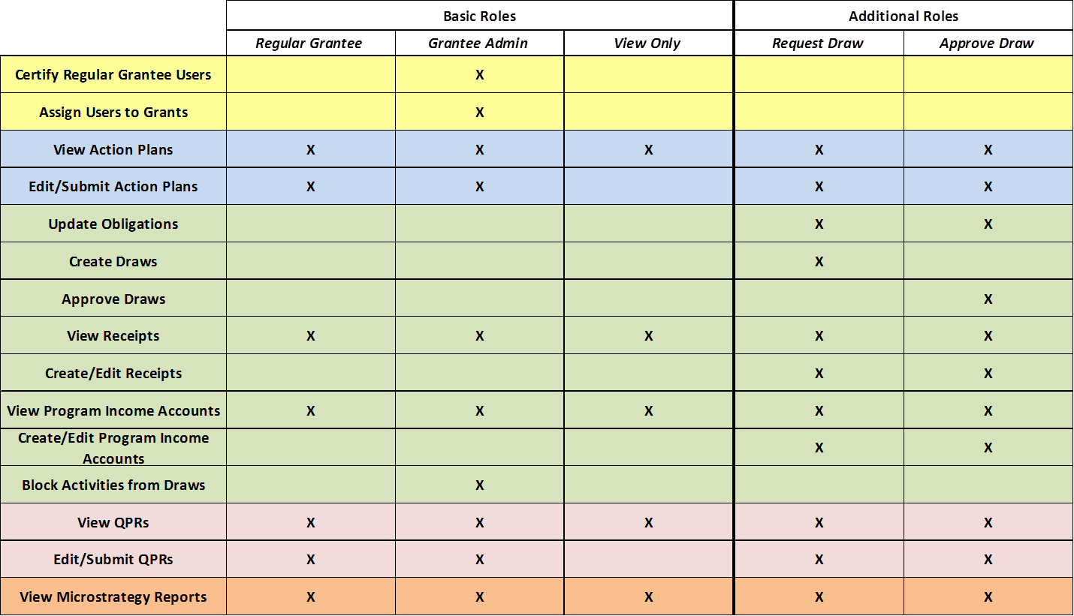
DRGR Roles: Grantee
Admin
Action Plans
Drawdown
QPR
Reports
Grants
Under Release 7.3, grantee users can be associated with multiple grantees with different roles for each.
Notes:
This chart summarizes the functions available to each role. The roles are listed across the top in columns and the different abilities are listed along the left in rows.
A grantee user will be assigned one of the three Basic Roles: Regular, Grantee Administrator, or View Only. The user may also be assigned one of the two Additional Roles: Request Draw or Approve Draw.
The most limited role is View Only. This grantee user can only view the information in the system.
The Regular Grantee User has view and edit abilities for the Action Plan and QPR.
The Grantee Administrator has view and edit abilities for the Action Plan and QPR, plus the ability to assign other users to grants and to block drawdowns at the activity level.
Both of the financial roles can edit obligation information.

Slide 13
DRGR Roles: Grantee Administrator
Admin
Action Plans
Drawdown
QPR
Reports
Grants
Assigning Users to a Grant
  Accessible from the Grantee Admin Page
    Only accessible to Grantee Administrators
  When to Use It:
    New User
    Remove a User
    New Grant
Drawdown module functionality
  Block draws from being processed internally
(Re)Certifying Grantees (will discuss in 4 slides)
Notes:
Each grantee must have at least one user assigned as the Grantee Administrator. This slide discusses the tasks that the Grantee Administrator must complete in order for the grantee and its users to have access to DRGR, including assigning users to a grant and certifying grantee users. In addition, Grantee Administrators have the ability to block drawdown vouchers.
Assigning Users to a Grant: It is important for the Grantee Administrator to assign all of their users to the correct grants. If the Grantee Administrator does not complete this step for a user, that user will not be able to view or edit any information associated with that grant. There are several occasions when the Grantee Administrator will need to update a user’s access to a grant:
The grantee has a new user.
The grantee has been awarded a new grant (e.g., NSP3). Authorized users for one grant, NSP1 for example, are not automatically given authorization to other NSP grants.
The grantee needs to remove a user because the user left the organization or no longer requires access to a specific grant.
Blocking Drawdowns: Grantee Administrators can edit Activity profiles in the DRGR Action Plan to block draws as they are being processed internally. This allows an additional internal control on a community’s drawdown process, if needed. This is done in the Action Plan at the Activity Level.
Certifying Grantee Users: Before a new user can access a grantee’s information, the Grantee Administrator will need to certify the user. In addition, the Grantee Administrator will have to re-certify all current users every six months.

Slide 14
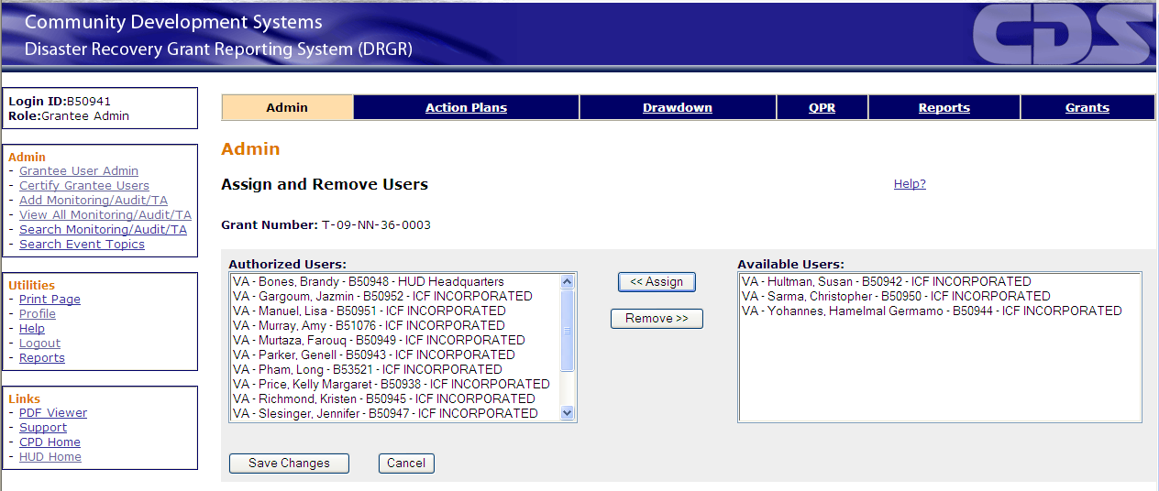
DRGR Roles: Grantee Administrator
Admin
Action Plans
Drawdown
QPR
Reports
Grants
Assigning Users to a Grant
Notes:
This slide illustrates how the Grantee Administrator can assign and remove users from a grant.
Only grantee system administrators will see the link for the screen displayed, Grantee User Admin.
Assignment occurs at the grant level. For example, NSP1 may have one set of assigned users that is different than NSP2 and NSP3.
On this screen, the Grantee Administrators can assign and remove users from the grant selected. Authorized users, listed on the left, are those who will be able to work with the grant — Available users, listed on the right, cannot.
To move a user from the Available list to the Authorized list, click on the user’s name to highlight it (more than one user can be selected at a time using the Control key or Shift key on a PC, and the Command key on a Mac) and click the Assign button.
To remove a user’s authorization for a grant, click on their name under Authorized Users and click the Remove button.
Remember to save the changes before leaving the screen.

Slide 15
Hierarchy of User Certification
Admin
Action Plans
Drawdown
QPR
Reports
Grants
Assign CPD Managers to Field Office in DRGR
HUD HQ DRGR Super User
Certify Other HUD Field Staff users in DRGR
HUD DRGR User: CPD Field Manager
Certify Grantee Contact in DRGR
HUD DRGR User: CPD Rep
Certify Other Grantee Users in DRGR
Grantee User: Sys Admin
HUD FO Managers can certify grantee admins if CPD Reps are unavailable.
CPD rep will certify the identity of the authorized grantee contact & the grantee contact will be contacted by email to certify their DRGR grantee system administrators.
Notes:
With release 6.5, DRGR has added a user certification functionality. DRGR is now required to include certification/recertification of each DRGR users by higher-level users in DRGR.
With release 7.3, the HUD HQ field office managers can now access the HUD Field Admin screens so they can certify grantee admin users if their CPD reps are not available.
And, with release 7.3, DRGR will maintain historical data for each certification and reports will be available to show the history of certifications.
Recertification takes place every six months. If a user is NOT recertified after the expiration period, the user will not be able to access any part of DRGR. When such users log in, they will receive a message that their certification expired. If a user receives this message, refer back to this flow chart and find the individual who is required to recertify the user. For most grantee users – this will be their Grantee Admin user.
To accomplish the certifications, we will use the following process involving HUD and grantee staff. The slide depicts the hierarchy of user certification:
HUD HQ staff will assign CPD Field Managers to Field Offices.
The CPD Field Managers will then certify the HUD field staff in their offices, including the CPD representative for each grant in DRGR.
CPD representatives will then certify the identity of the authorized grantee contact (which may be populated from the grant agreement in LOCCS) and the grantee contact will be contacted by email to certify their DRGR grantee system administrators. This is the one part of the process that is outside of the system.
Grantee administrators will be able to certify/re-certify the remaining users in DRGR using a screen much like the one they use to authorize each user’s access by grant.

Slide 16
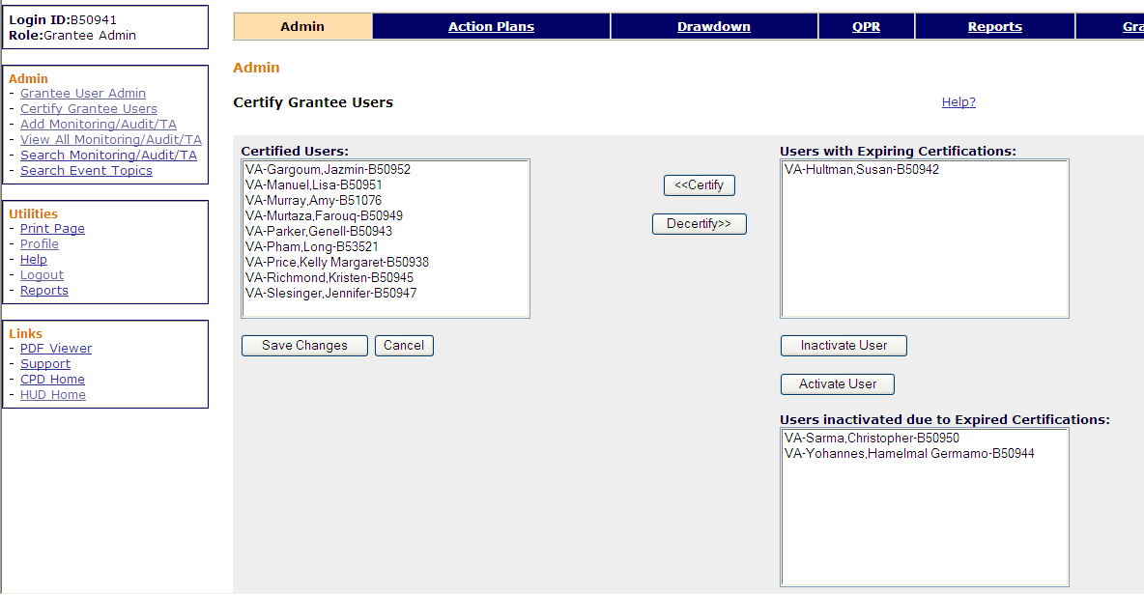
Grantee Administrator Role: Certifying Grantee Users
Admin
Action Plans
Drawdown
QPR
Reports
Grants
Notes:
This slide shows how Grantee Administrators can certify users. Grantee Administrators must certify all new users and re-certify existing users every six months.
The Certify Grantee Users screen is much like the Assign/Remove Users, except certification is done only once per user, not for each grant. Again, only Grantee Administrators will see the link for Certify Grantee Users when they select the Admin module from the main navigation bar.
The column on the left side lists Certified Users. These are the users who can access the system. If necessary, the Grantee Administrator can remove someone from this list by using the Decertify button.
The list on the top right are those users who can currently access the system but whose certifications will soon expire. To recertify a user, highlight the user’s name and click the Certify button.
Below, the system will display those users who have already been Decertified because of expired certifications. To recertify these users, the Grantee will use the Activate User button and then the Certify button. Save your changes

Slide 17
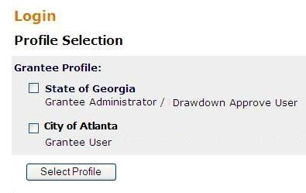
Admin
Action Plans
Drawdown
QPR
Reports
Grants
Multiple User Profiles: Grantee
As of Release 7.3, grantee users can be associated with multiple grantees.
For each grantee account a user has access to, they may have unique DRGR roles.
Each grantee account must:
  Gain access by HUD per account (request access via CPD Rep who sends request to DRGR_Help@hud.gov and include all relevant information such as full name of user, grantee name of the request, contact information, B# or C#, user role for the grantee you are requesting access to, and five digits for a PIN #), and
  Assigned to individual grants by each grantee admin users.
  (Re) certified by each grantee admin users, and
One User
Two grantees with different roles for each
1.
2.
Notes:
As of release 7.3, users are now allowed to have more than one user profiles. For each additional profile, a user must request separate access from a supervisor of the new grantee profile to be added via HUD (make sure to include the type of user role for the grantee you are requesting access to), be assigned and (re)certified by the administrator of that grantee.
In the example shown above, the City of Atlanta is a subrecipient of the State of Georgia. The State of Georgia wants a user from The City of Atlanta to edit Atlanta’s activities under the state grant in DRGR. This can be done with a regular grantee user role for their State profile in addition to the user’s Administrator/Drawdown Approver role for the City.

Slide 18
DRGR Roles: HUD
Admin
Action Plans
Drawdown
QPR
Reports
Grants
Basic roles are:
  Regular HUD User
  HHQ Admin
  HUD – View Only
Additional Roles:
  HUD – Approve Draw
  CPD Rep Assigned to a Grant
  CPD Field Manager (for User Certification)
Notes:
In DRGR, we define three basic roles and three additional roles for HUD users.
Basic roles give you access to the system but not to Approving Draws or certification responsibilities. See the next slide for the full list of functions for each role. And, this is reviewed in full on the afternoon of Day Two.

Slide 19
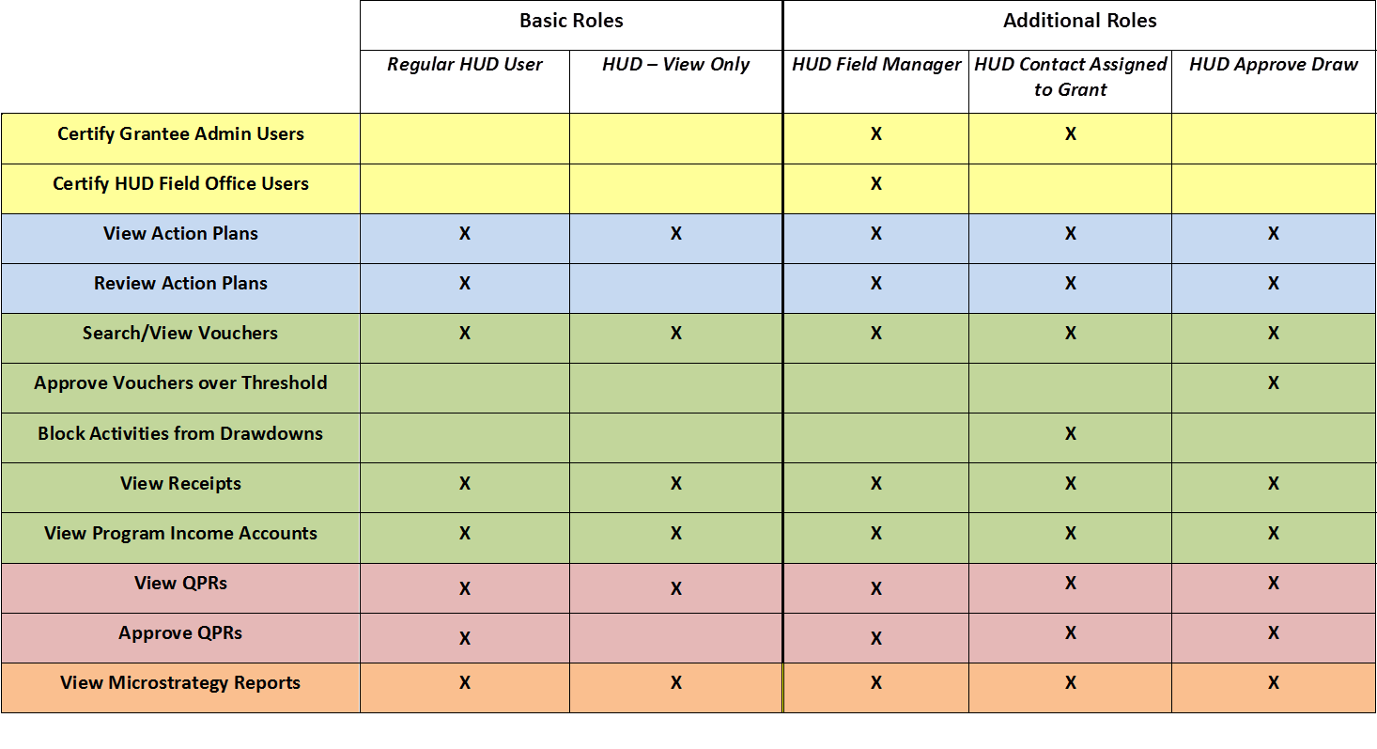
DRGR Roles: HUD
Admin
Action Plans
Drawdown
QPR
Reports
Grants
Under Release 7.3, HUD users can be associated with multiple field offices.
Notes:
On this slide, we see all of the potential roles for a HUD staff person across the top, and the functionality of the system that role can access along the left column.
Like grantees, HUD users can have both a basic role and an additional role.
CPD reps will receive automated notices when an Action Plan or QPR has been submitted.
As mentioned previously, HUD Field Office Managers will be able to view the Certification screens of CPD Field Admins so they Grantee’s Admin users can be recertified if the Field Office Rep is not available.

Slide 20
Admin
Action Plans
Drawdown
QPR
Reports
Grants
Multiple User Profiles: HUD Staff
As of Release 7.3, HUD users may be associated with multiple field offices
Each FO account must gain access per account (request access via the Rep’s Supervisor who sends request to DRGR_Help@hud.gov and include all relevant information such as full name of user, grantee name of the request, contact information, H#, Field Office for which you are requesting access,
Notes:
As of release 7.3, a HUD staff that works with several HUD Field Offices can now request profiles for those Field Offices. An example of this would be an OIG Auditor or investigator who needed access to various field office DRGR accounts.

Slide 21
Assigning Users to a Grant
Admin
Action Plans
Drawdown
QPR
Reports
Grants
3 Helpful Reports:
Admin Rept04a: USERS - Grantee DRGR Users Account Status
Admin Rept04b: USERS - Grantee DRGR Users with System Role and Certification Status
Admin Rept04c: USERS - Grantee DRGR Users Access by Grant
Notes:
There are three reports that will help a grantee user and a Grantee Administrator troubleshoot if a user is having difficulty accessing sections of DRGR for a grant. Users are highly encouraged to use these reports prior to calling the Help Desk for support.
Admin Report 4A will list all users assigned to a grantee, regardless of whether or not they have been assigned to a grant. If they are listed as active here but do not show on other user reports, they have most likely not yet been assigned to a grant. If they show as inactive, the grantee user will have to contact their HUD CPD Representative, who will have to contact HUD HQ to get their account status changed.
Admin Report 4B will list all users along with their account status, recertification status and date, and their system roles. If you suspect a user has not been recertified, this report should provide that information.
Admin Report 4C will list all users and the grants to which they have been assigned. If a user can access one grant but not another, this is a good report to review.

Slide 22
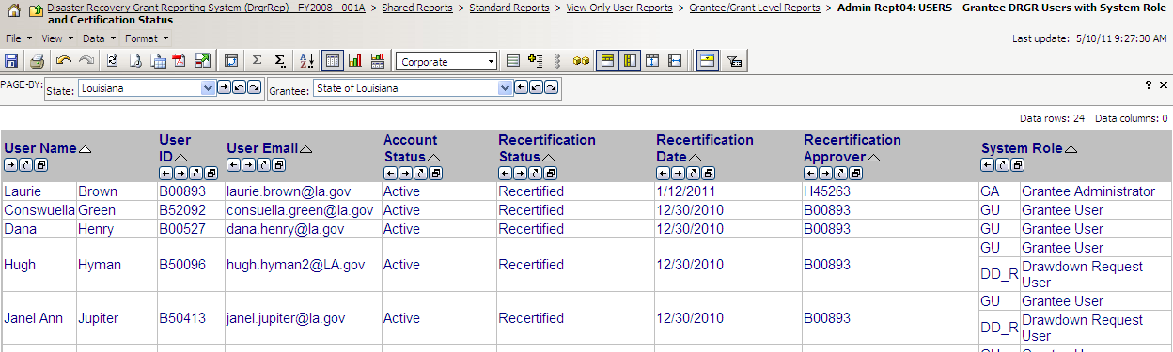
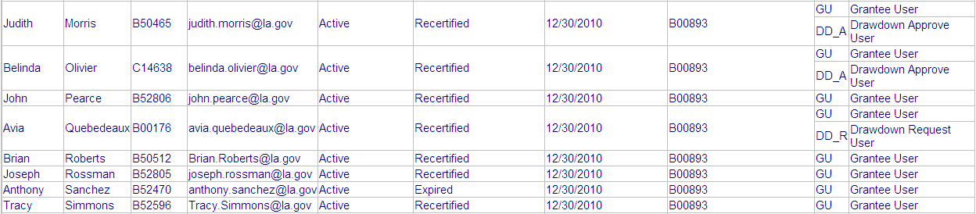
Admin
Action Plans
Drawdown
QPR
Reports
Grants
Troubleshooting: System Roles in DRGR (Admin Rept04b)
Notes:
This slide provides an example of the different roles, as well as of a certification that has expired.
Ms. Morris is this grant’s Drawdown Approver (she has the Basic Role of Grantee User and the Additional Role as Drawdown Approver).
Mr. Sanchez has an Active account, but needs to be recertified in order to access DRGR. He only has the Basic Role as Grantee User.

Slide 23
DRGR Navigation Rules
Admin
Action Plans
Drawdown
QPR
Reports
Grants
Navigate using DRGR Links, rather than your browser’s.
Never use your browser’s BACK button.
Logout using the Logout link in Utilities – don’t just close the window.
Save early, save often! System times-out after 20 minutes.
If you want to copy/paste text into DRGR, do so from Notepad, not Word or WordPad.
Notes:
Before we get started with the first case study, here are some basic navigation rules:
Just like other websites, you will navigate DRGR by clicking on linked text and buttons within the page. Any text that is underlined is typically a link.
Unlike on other websites, users should NOT use the browser’s “back” and “forward” buttons.
If you are inactive for more than 20 minutes and get locked out of your account, email the helpdesk and ask for a “Session Reset”.
When copying and pasting from another document, we recommend taking an intermediate step of pasting into Notepad first. This will remove formatting from the copied text. Once the text is in Notepad, you can copy it again and paste into DRGR. If you copy and paste directly from Word or a PDF, some of the formatting, like bullet points, will be corrupted in the downloadable versions of the action plan and QPR.
When you are finished and would like to leave DRGR, instead of just closing the browser, always log out first. If you do not log out, you will be locked out of the system for at least 30 minutes.

Slide 24
Getting Started Review
Review
DRGR Roles
Getting Access
Grantee Administrator
  Must assign users to grants
  Must re-certify users every six months
Notes:
Every grantee must have one grantee admin, draw requestor, and draw approver; it’s highly recommended to have at least two of each.
The grantee administrator plays an important role, assigning users to grants and certifying access for users every six month, ensuring that everyone has proper access.
If someone has issues accessing parts of the system, have the grantee administrator review the assign/remove user screen and the certification screen or (and everyone can do this part) review the three Microstrategy reports regarding user access.

Slide 25
Action Plan Module
Admin
Action Plans
Drawdown
QPR
Reports
Grants
Adding the Action Plan
Adding Projects
Adding Responsible Organizations
Adding Activities
Submitting the Action Plan
Notes:
Our next topic focuses on the Action Plan Module. The Action Plan serves as the foundation for everything that follows.

Slide 26
Action Plan
Admin
Action Plans
Drawdown
QPR
Reports
Grants
Purpose
  Creates foundation and structure for reporting accurately
  Helps grantees identify the data required to set up budgets and performance goals
Key Actions to an Action Plan
  Add the Action Plan
  Confirm Grant Number
  Add the Overall Narrative data
  Add and edit information on ‘projects’
  Add and edit information on ‘activities’
    Responsible Organizations
    Narratives & Key Features (i.e. National Objective)
    Budgets
    Performance Measures
  Submit to HUD for Review and Approval
Notes:
The Action Plan is the starting point of all reporting in DRGR. Most of the information you will be entering will come straight from the Substantial Amendment that you submitted to HUD. Proper setup of the Action Plan is key to reporting accurately in DRGR. The grantee should give careful consideration to how the information is structured into DRGR projects and DRGR activities, as it will effect how expenditure and accomplishment data, as well as financial data, is reported.
The purpose of the Action Plan in DRGR is to create a foundation, or organizational structure, for the other modules, including the drawdowns and QPRs. All of the data in DRGR will be organized at two different levels: projects and activities. Projects allow you to organize your activities into groups. Activities capture the detail of your NSP programs. The grantee will use activities to establish budgets and performance goals for each component of their programs.
This slide lists the key steps taken to add and submit the Action Plan in DRGR. To complete the first two steps, adding the Action Plan and confirming the grant number, you simply click a few buttons. Adding the narrative is simple data entry or copying and pasting the information from the Substantial Amendment narrative. For this reason, it is helpful to have an electronic copy of the Substantial Amendment open as well so you can copy and paste.
Before adding projects and activities in the system, it is recommended that you carefully review the training materials and map out on paper how you will organize the information. The slides in this section will provide guidance on using the correct number of projects and activities.
When entering data for activities, you will need to know quite a few details regarding the proposed use of funds, including the Responsible Organization, the National Objective, the budget, and the proposed performance measures. If there is information that isn’t clearly delineated, work closely with the grantee’s NSP program lead to identify the particulars. For example, some grantees may not know which subrecipients or developers will be carrying out the redevelopment activities when establishing the Substantial Amendment. If you know everything but a few pieces of information, you can save the information you did provide and come back and provide the missing data at a later time.

Slide 27
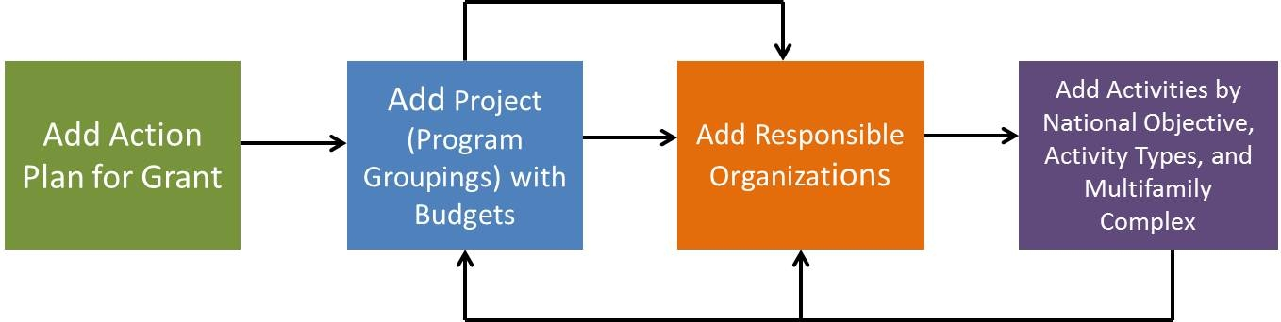
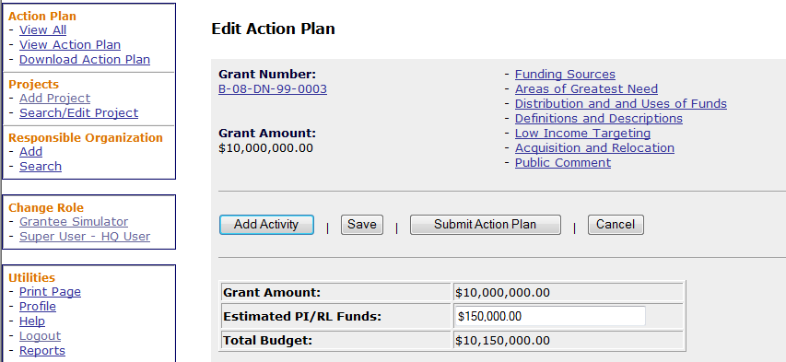
Action Plan: Key Steps
Admin
Action Plans
Drawdown
QPR
Reports
Grants
27
Notes:
Here are the four main steps to setting up the Action Plan:
1. Adding the Action Plan.
2. Adding a Project
2a. Add Responsible Organizations to a Project (Optional)
3. Add Activities
3a. Add Responsible Organizations to an Activity (Required)
The Responsible Organization is mandatory for Activities but NOT for Projects. Do not recommend they add a Responsible Organization at the Project level.

Slide 28
Admin
Action Plans
Drawdown
QPR
Reports
Grants
Action Plan and QPR Review Process
Grantee
HUD
DRAFT
Original in Progress
EDIT
Modified-Resubmit
When Ready
Submitted-
Await for Review
REJECT
Rejected – Await for Modification
APPROVE
Reviewed and
Approved
Action
Plan
AP MUST be in ‘Reviewed and Approved’ status for QPR submission
Submitted-
Await for Review
DRAFT
Original in Progress
EDIT
Modified-Resubmit
When Ready
REJECT
Rejected – Await for Modification
APPROVE
Reviewed and
Approved
QPR
Submitted-
Await for Review
QPR MUST be in ‘Reviewed and Approved’ status for AP submission
Submitted-
Await for Review
Notes:
This slide explains what happens after the grantee submits the Action Plan in DRGR. Unlike the traditional Action Plan, the DRGR Action Plan for NSP is more fluid and may change more often. In most cases, the grantee will have to resubmit the Action Plan and follow this process when changes Aare made to the Action Plan. At some point, due to program income and reprogramming, all grantees will need to make changes to their Action Plan. It is important to understand that changes will trigger a submission to HUD for review and approval and that until that review is completed, the grantee cannot submit a QPR. Given this, grantees must work closely with their HUD representatives to make sure any changes to the Action Plan will not interfere with the timely submission of the QPR. The Status field for the Action Plan and the QPR will tell you where you are in the process.
Both Action Plans and QPRs start in “Original – In Progress” status once they are added to the system. They will stay in this status until submitted by the grantee. At this point, the status changes to “Submitted – Await for Review.” Your HUD Representative will review the information and either approve or reject it.
If the plan is rejected by HUD, the grantee can edit the Action Plan and make the changes that have been requested. At this point, the Action Plan status will show “Modified – Resubmit when Ready.”
After the Action Plan has been reviewed by HUD staff and found acceptable, the status will then change to “Reviewed and Approved.” Any time edits are made to the plan, the status is listed as “Modified – Resubmit When Ready.”
If the grantee is making several small changes to the Action Plan, they may want to wait until all of the changes are made and submit the Action Plan once to the HUD representative for review. When resubmitting the Action Plan, it is helpful to the HUD representative if the grantee summarizes the changes made.
In some cases, changes may be so minor that they can be handled by updating DRGR and resubmitting to HUD for review. Larger changes, however, may trigger additional public participation requirements. Work with your CPD representative to determine if additional public participation is needed.

Slide 29
Cannot edit Action Plan if …
Admin
Action Plans
Drawdown
QPR
Reports
Grants
Action Plan has status of ‘Submitted – Await for Review’
QPR has status of ‘Submitted – Await for Review’
Grantee is not assigned to the grant
Grant is not active
User has View Only
Notes:
You may encounter some instances where you cannot edit the Action Plan and you will be limited to “view only.” The error message will state, “The action plan cannot be edited because: the grantee is not active, the grant is not active, a QPR is in a state of submitted, or you don't have edit capabilities.” In most cases, the issue can be resolved fairly quickly.
If an Action Plan has a status of “Submitted – Await for Review,” this means HUD is in the process of reviewing the Action Plan. The information cannot be edited until a HUD user that can view the grant has either rejected or approved the Action Plan. If you need to make additional changes, you may request that your CPD representative reject the plan. This will allow you to make additional edits and will allow the CPD representative to review all of the changes at once.
If a QPR has a status of “Submitted – Await for Review,” the grantee will not be able to edit the Action Plan. This is because Quarterly Performance Reports depend on data from the most recent DRGR Action Plan approved. The Action Plan cannot be edited until a HUD user that can view the grant has either rejected or approved the QPR. Once HUD is finished with its review of the QPR, you will be able to edit the Action Plan information.
In some cases, the Action Plan cannot be edited because the grantee is not assigned, the grant is not active, or the user does not have access to the grant. If a grantee or grant is not showing as active in DRGR, this may be a mistake by HUD DRGR system administrators. Contact your grantee system administrator and/or DRGR_Help@hud.gov. If the grant is active in the system but the user cannot access it, the Grantee Administrator needs to assign the user to the grant using the Admin module.
Any grantee user who is designated as “View Only” will not be able to edit Action Plans or QPRs. If the user does need edit capabilities, the user will need to contact the DRGR Help Desk to have their access rights changed to regular user.

Slide 30
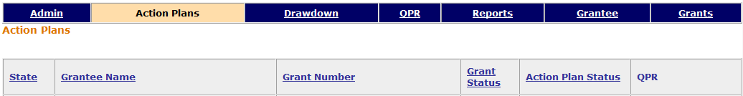
Action Plan status examples
Admin
Action Plans
Drawdown
QPR
Reports
Grants
Notes:
This slide lists fours grants, each with a different Action Plan status.
The status of the Fulton County, GA’s Action Plan is Modified – Resubmit When Ready. This means that the grantee has made changes to a previously approved or rejected Action Plan and the changes have yet to be reviewed by HUD staff. The grantee needs to submit the Action Plan and have it approved by HUD staff before submitting their next QPR.
The status of the Evansville, IN’s Action Plan is Rejected – Await for Modification. This means that HUD found issues with the information included in the plan. The grantee needs to work with HUD staff to determine what changes need to be made. Once the changes have been made, the grantee will re-submit the Action Plan and have it approved by HUD staff before submitting their next QPR.
The status of Cass County, ND’s Action Plan is Submitted – Await for Review. This means that until HUD approves the Action Plan, Cass County cannot submit their QPRs. They can however, continue to drawdown funding.
The status of West Palm Beach’s Action Plan is Reviewed and Approved. This means HUD has reviewed the information in the Action Plan and not found any problems.

Slide 31
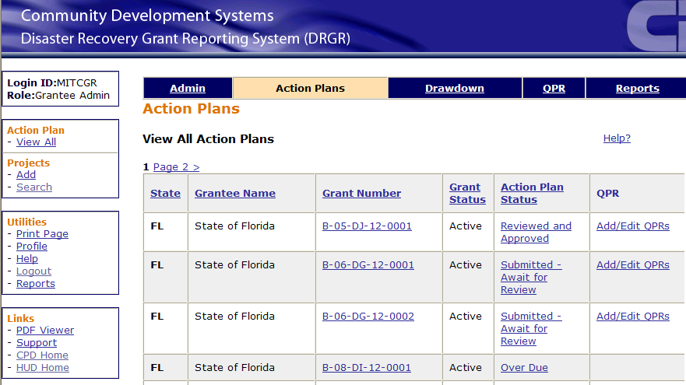
Adding an AP to a Grant
Admin
Action Plans
Drawdown
QPR
Reports
Grants
‘Over Due’ simply means an Action Plan has not yet been added for this grant.
Notes:
This slide shows a screenshot of an Action Plan that has not yet been added to a grant. Do not be alarmed by the “Over Due” message. This simply means that the Action Plan has yet been added. To correct this, you need to click on the “Over Due” link. This is the first step of adding the Action Plan to the grant.

Slide 32
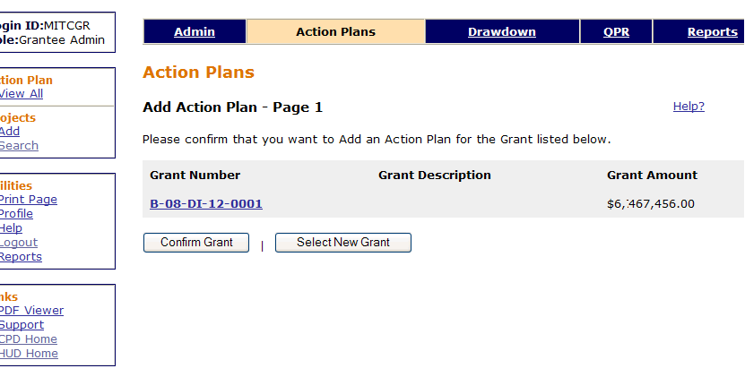
Adding an AP to a Grant
Admin
Action Plans
Drawdown
QPR
Reports
Grants
Notes:
This slide shows a screenshot of the second step of adding the Action Plan to a grant. A grantee should review both the Grant Number and the Grant Amount verifying that these have been entered accurately by HUD. If there is a discrepancy, contact your CPD representative and the DRGR Help Desk.
If the information is correct, simply click the button labeled “Confirm Grant” to continue. The next screen will allow the grantee to provide the Action Plan narratives and add projects and activities to the Action Plan.

Slide 33
Adding an Action Plan: ‘Overall Narrative’ data
Admin
Action Plans
Drawdown
QPR
Reports
Grants
Narrative information at the grant level directly corresponds to the NSP Substantial Amendment
Example of NSP1 sections:
  Area of Greatest Need
  Distribution and Use of Funds
  Definitions and Descriptions
  Low Income Targeting
  Acquisition and Relocation
  Public Comment
Not all sections were established when NSP1 DRGR Action Plans were originally submitted, grantee must enter the information now.
Notes:
The third step to adding the Action Plan is to provide overall narrative. In most cases, this information can be copied and pasted from the Substantial Amendment that was submitted to HUD. For this reason, it is helpful to have an electronic version of your Substantial Amendment.
The narrative information requested by DRGR will be different for each of the three NSP allocations (NSP1, NSP2, and NSP3) based on the regulatory and statutory provisions associated with each. The slide lists the narrative sections required for the NSP1 funding round.
NSP2 grantees will be asked for the following narrative sections: Executive Summary, Target Geography, Program Approach, Consortium Members, and Where to Get Additional Information.
NSP3 grantees will be asked for the following information: Summary of Distribution and Uses of NSP Funds, How Funds will Addresses Market Conditions, Ensuring Continued Affordability, Definition of Blighted Structure, Definition of Affordable Rents, Housing Rehabilitation/New Construction Standards, Vicinity Hiring, Procedures for Preferences for Affordable Rental Development, and Grantee Contact Information.
If you want to copy and paste the narrative from another document, it is recommended that you copy the information and paste it into a plain text editor, such as Notepad (a free program available on most PCs) or into a TextEdit document set to plain text mode on a Mac. By doing so, all of the extra formatting, such as bullets, will be removed. Once the text is Notepad, copy it again and paste it into DRGR. If you paste the information directly from Word or a PDF document, it is possible that DRGR will misinterpret some of the formatting that will cause errors when displaying the data in the system.

Slide 34
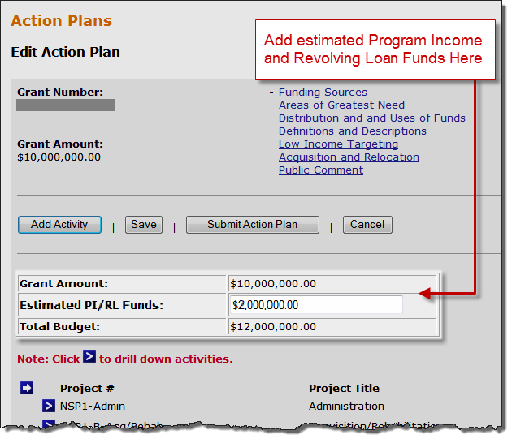
Admin
Action Plans
Drawdown
QPR
Reports
Grants
Adding an AP: Grant Budget
Enter Estimated PI/RLF Funds to establish the Total Budget.
May be updated periodically as grantee re-estimates the program income to be received.
This is the only time the user will enter Program Income separate from Program Funds in a budget.
Since Project and Activity Budgets must now include PI, the Estimated PI/RLF at the grant level must have enough $ to accommodate these increased amounts
Notes:
As of Release 7.3, on the grantee’s overall Action Plan page for each grant, there is now a place for them to enter any future estimated Program Income or Revolving Loan Funds.
Grantees are encouraged to be generous with their estimate so they do not need to continuously go back and modify their Action Plans by adding more estimated PI/RLF.

Slide 35
Adding ‘Projects’
Admin
Action Plans
Drawdown
QPR
Reports
Grants
DRGR is a two-tier hierarchy system
  Projects
    Activities
To enter data:
  Enter Projects first
  Enter Activities second since they must be assigned to projects.
  For example:
Project 1
Activity 1.A
Activity 1.B
Project 2
Activity 2.A
Notes:
Once the narratives have been saved, the next step is to add projects to the Action Plan. For most grantees, this step will not take too long.
The main purpose of DRGR projects is to provide the grantee with a way to organize and group their activities. It is recommended that you map out how you want to structure your projects and activities on paper before entering the data into DRGR. Most grantees choose to add a project for each eligible use of NSP within their Action Plan. Once you start adding projects, you will see that the system requires only a minimum amount of detail at the project level. Most of the data will be provided at the activity level.
Once you add the projects, you will be able to add your activities. You should add your projects first because the system will prompt you to assign each activity to a project. The slide gives an example of a project-activity structure. Project 1 has two activities underneath it and Project 2 has one activity. The following slides will provide more detail on what each project and activity represents.

Slide 36
  Adding ‘Projects’
Admin
Action Plans
Drawdown
QPR
Reports
Grants
PROJECTS should be NSP eligible uses:
  Financing Mechanisms (Eligible Use A)
  Acquisition / Rehabilitation (Eligible Use B)
  Land Bank (Eligible Use C)
  Demolition (Eligible Use D)
  Redevelopment (Eligible Use E)
  Administration
Notes:
HUD recommends setting up a project for each NSP eligible use included in the Substantial Amendment. This is not a hard-and-fast requirement, but it provides grantees a consistent way to structure the information.
Some grantees choose to use this basic framework but expand upon it based on other characteristics of their programs, such as geography or subrecipient. Keep in mind that this information can be tracked at the activity level as well.
Some properties assisted with NSP may include more than one of the eligible uses. For example, a property may be demolished and then redeveloped. In these cases, you do not need to break out the demolition costs from the overall redevelopment and report it under a separate project. This leads to potential double-counting of accomplishment data. This concept is discussed in more depth at the activity level.
The importance of having an acceptable project-activity structure cannot be overstated. If you have any questions, work closely with your CPD representative to get guidance.
As of Release 7.3, a grantee estimates program income for project and activity budgets. A grantee only has to distinguish program income from program (grant) funds at the grant level: for project and activity budgets, it is all-inclusive.

Slide 37
Adding Projects: Examples
Admin
Action Plans
Drawdown
QPR
Reports
Grants
Financing Mechanisms (Eligible Use A)
Acquisition / Rehabilitation (Eligible Use B)
Administration
Activity 1.A
Activity 1.B
…
Activity 2.A
Activity 2.B
…
Activity 3.A
Notes:
This slide provides an example of how projects can be used to group activities.
On the slide we see three projects (listed in red), one for each eligible use included in the grantee’s Substantial Amendment. This grantee is undertaking three NSP Eligible Uses (Financing Mechanisms and Acquisition & Rehabilitation).
Each project will need at least one activity. Without an activity, the grantee will not be able to draw funds or report accomplishments. You can see that some projects have more than one activity. We will discuss how to determine the correct number of activities for each project in the upcoming slides that focus on activities.

Slide 38
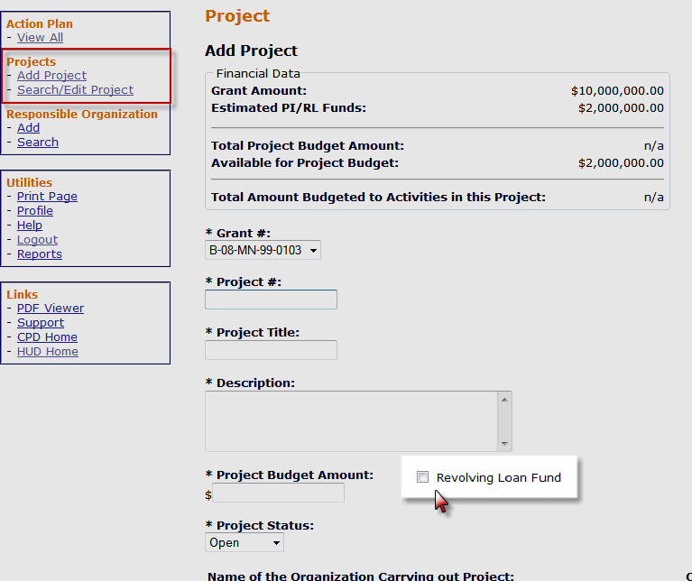
Adding Projects: Revolving Loan Funds
Admin
Action Plans
Drawdown
QPR
Reports
Grants
Revolving Loan Fund (RLF) can now be identified as a Project
Notes:
With the release of DRGR version 7.3, grantees will be able to identify RLFs by selecting this option o the Add Project screen.
Identify RLF by Project: 1 RLF=1 Project
RLF projects can only include activities with a single activity type, per RLF regulations.
Vouchers within an RLF will check for the availability of receipts within the RLF: require RLF funds be drawn before program funds.

Slide 39
Special Project: Restricted Balance
Admin
Action Plans
Drawdown
QPR
Reports
Grants
If activities are in a Restricted Balance project, drawdowns CANNOT be made on them until they are moved to other projects.
Grantees must work with CPD Representatives to figure out why draws are restricted.
Only the HUD Super user can reduce the Restricted Balance project budget so activities can be re-assigned to other projects by grantee users.
Notes:
Some grantees may see a project called “Restricted Balance” pre-loaded into their DRGR data. This is a special project used by HUD to ensure it has all of the required information before the grantee has access to its entire award.
HUD will use the “Restricted Balance” project to restrict the drawdown of any funds that were not covered in Action Plans/Amendments that have been published and approved by HUD. If you fully budgeted your grant allocation to eligible uses in your Substantial Amendment, you should not have anything in this project. Instead, you will add new projects in which to place your activities.
If you have a balance of funds in the “Restricted Balance” project, work with your CPD representative to determine why the funds have been restricted. You can add activities to this project, but grantees cannot draw against activities assigned to this project. Once HUD approves additional funding, the grantee can reduce the Restricted Balance project budget and activities can be re-assigned to other projects.

Slide 40
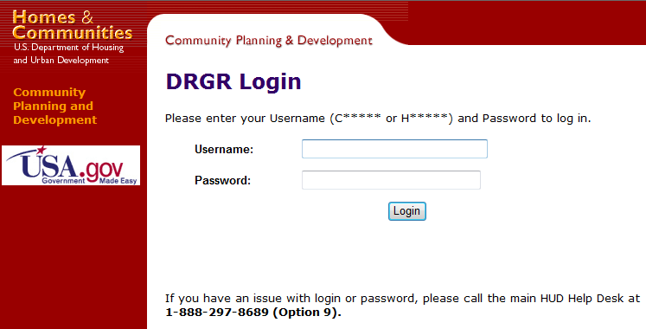
Admin
Action Plans
Drawdown
QPR
Reports
Grants
Testing out the System
USER ID | ROLE
TS##GA | Grantee Admin/Approve Drawdown
TS##GR | Request Drawdown
Notes:
It’s time to log into DRGR. For this training, we will be using a training version of DRGR. This way, any changes we make will not affect the information you are reporting to HUD.
Follow the login instructions provided by the trainer and do not skip ahead.
If you receive the “Username and/or password is invalid. Please try again” error message, check to make sure you do not have CAPS lock enabled before carefully entering this again. If you enter the password incorrectly three times, the system will lock the ID until it is reset by HUD HQ staff.
**This is only applicable if a participant is at the HUD-sponsored training sessions.

Slide 41
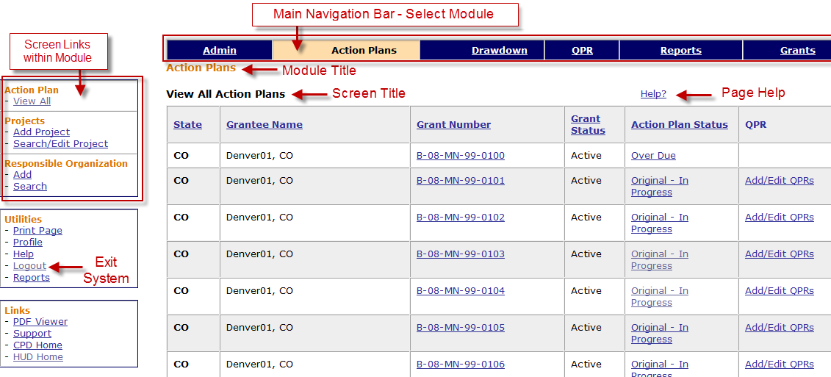
DRGR Navigation
Admin
Action Plans
Drawdown
QPR
Reports
Grants
Use Main Navigation Bar to Select Module.
Use Module Navigation Menu links to select screens.
Notes:
This slide shows the main screen of the Action Plan module and some of the best ways to navigate through the different screens and modules.
The Main Navigation Bar, located at the top of each page, will help you navigate to each of the modules of DRGR. The tab for current module is colored beige while other module tabs have a blue background.
The Module Navigation Menu, located in the column along the left side of the screen, will change based on the module you are viewing. For example, in this screenshot we are in the Action Plan module. In the Module Navigation Menu, you can see the tasks associated with the Action Plan.
The choices in the Module Navigation Menu are also dependent on the access rights assigned to your User ID. For example, only those users with Request Drawdown rights as part of their profile will see the “Create Voucher” link under the Drawdown Menu.
Below the Module Navigation Menu are Utilities that are available on all pages.

Slide 42
DRGR Navigation: Search
Admin
Action Plans
Drawdown
QPR
Reports
Grants
Three ways to Search
  Blank (no criteria – returns everything)
  Partial (i.e. “Sun” for Sunny Day Development LLC)
    Returns “Sunny Day”
    Returns “Sunny Day Development LLC”
    Returns “Sunny Day LLC”
  Exact
The Results
  May be several pages
  Column Headers: click to sort
  Click on the links for the selected item
Always double-check you are searching the CORRECT grant.
Notes:
The Search feature is essentially the same throughout the system. Below are a few ways to search for information in the system.
Each Search screen will provide a number of fields that can be searched. For example, Project Search lets you search by Project #, Project Title, Grant Number, or any combination of the three.
The simplest way to search is to leave all of the search fields blank and click the Search button. This will return all possible results. You may have to scroll through multiple pages to find what you are looking for. Below the results, there will be links to additional pages. You can also sort the results by clicking on the column headers.
The best way to search is using part of a value, instead of trying to guess the exact title. For example, instead of searching for “Sunny Day Development LLC”, the grantee can search by “Sun”. This way, the system will return any variation of Sunny Day and anything else with “Sun” in the name.
With grantees now having multiple grants in DRGR (NSP1, NSP3, etc), always double-check that you are choosing the correct grant.
(Note: When a grantee searches for vouchers in the Drawdown module, the ‘Voucher #’ criteria field must be an exact entry in order to find a specific voucher. A partial entry on this criteria field will yield no results.)

Slide 43
Case Study 1, 2, 3 & 4
1. Managing Accounts
2. Adding the Action Plan & the Overall Narrative
3. Adding
4. Editing Projects
Admin
Action Plans
Drawdown
QPR
Reports
Grants
Notes:
Let’s get started on some Case Studies!

Slide 44
Adding Activities: Overview
Admin
Action Plans
Drawdown
QPR
Reports
Grants
Activities should be broken out, at a minimum, by:
  responsible organization
  activity type
  national objective and
  multifamily building complex(if applicable) .
Must use correct National Objective
  Low/Mod/Middle Income Housing (DRGR=LMMI)
  Low Income Housing 25% Set-aside (DRGR=LH25)
  Admin (DRGR=NA)
All funds are drawn and all performance measures captured at the activity level.
Notes:
Activities are the main building block in DRGR. While NSP guidance on projects is fairly direct, activities can be broken out in a number of different ways. Grantees should work with their HUD representatives to figure out how to break out activities in the most efficient and useful way possible. For all grantees —regardless of size of award — it is essential to map out the Activities offline first to determine the number of Activities and their assignment to Projects.
The following elements should be considered when determining the number of activities to use:
Responsible Organization: This breakout is fairly straight forward and will help the grantee track the performance of specific organizations.
Activity Type: This guidance is less straightforward since some properties assisted with NSP may fall under multiple activity types. For example, a property may be land banked, then demolished, and finally redeveloped. Should this activity be reported under three separate activities? We will explore this issue in more detail in the next few slides.
Multifamily: HUD recommends that each multifamily complex has a separate activity in DRGR. For single-family units, you may aggregate those into one Activity based on the aforementioned categories (national objective, activity type and responsible organization). You’re able to and encouraged to consolidate the single-family properties per the guidelines above.
Each activity will be assigned a national objective. This is how HUD will determine which activities are meeting the low-income set-aside requirement. Because of this, grantees must consider this when adding their activities to the system. For example, a grantee may need two activities for one program: one DRGR activity for the funds used for set-aside units and a separate DRGR activity for funds that are used for units that will serve up to 120 percent of area median income. For Administration activities, a grantee will select “N/A” for the national objective.
Most of the accomplishment data is collected at the activity level and all of the drawdowns are done at the activity level. Breaking out your NSP program into the right number of DRGR activities is essential to getting the system to work correctly.

Slide 45
Adding ‘Activities’: Responsible Organizations
Admin
Action Plans
Drawdown
QPR
Reports
Grants
Required at Activity Level
Defined as an organization with responsibility for completing the activity and meeting applicable federal requirements
  Subrecipients are always responsible organizations
  Developers in NSP are usually responsible organizations
  Contractors are not responsible organizations
Double-check all required data is provided
Optional:
  Responsible Org at Project Level
  Subordinate Organizations
Notes:
In addition to adding projects and activities, the grantee will also have to specify the Responsible Organizations who are carrying out NSP-funded projects. This information can be entered when entering the activities or beforehand as a separate exercise. The following slide has a screenshot of the Add Responsible Organization screen.
For each activity, grantees will be required to specify a responsible organization. Each activity listed in DRGR must list the organization responsible for administering the activity. If a grantee directly administers an activity, either with internal staff or through a contractor, they may list themselves there.
The Responsible Organization is defined as the organization with responsibility for completing the activity and satisfying all applicable federal requirements. If there is a grant/subrecipient agreement that transfers the responsibility from the grantee to a different organization, the name of the organization under this agreement should be listed as the Responsible Organization. Subrecipients should always be listed at responsible organizations. Other entities, such as developers and contractors, are not automatically considered responsible organizations, but usually developers are the entities responsible for carrying out the activities, not contractors.
In earlier versions of DRGR, only the name of the organization was required. As of version 6.5, NSP grantees will be required to enter the organization’s name, type, DUNS number, tax ID number, city, and state. This means grantees may want to review the information currently provided and backfill any missing fields that are now required. If the organization does not have a DUNS, they can obtain one on http://fedgov.dnb.com/webform.
The grantee can assign the Responsible Organization at the project level but this is not required. Grantees also have the option of assigning subordinate organizations at the activity level. This is also optional, but may assist a grantee keep track of progress for specific organizations when they are rolled together into one activity. Subordinate organizations can be used to track contractors if the grantee wants to do that. State governments should never list local governments as subordinate organization. Awards to local governments for each type of activity must be listed as separate activities as these are, inherently, responsible organizations. We will touch more upon this in a few slides.

Slide 46
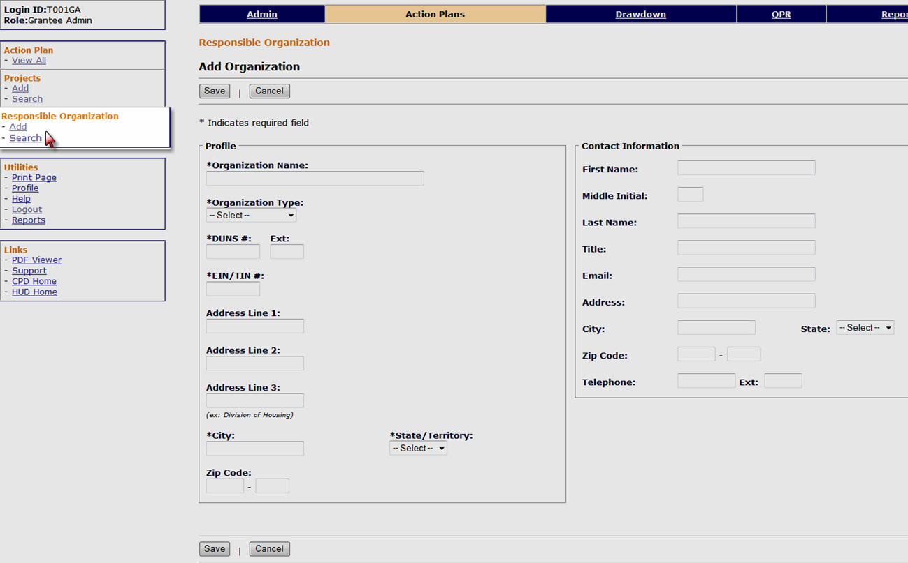
Adding ‘Activities’: Responsible Organizations
Admin
Action Plans
Drawdown
QPR
Reports
Grants
Only add a Responsible Organization once in DRGR.
Notes:
This slide displays a screenshot of the Add Responsible Organization screen.
There are two ways to access the Add Organization screen.
The grantee can access it directly using the links in the Action Plan Module navigation. This was included in one of the later releases (and displayed on this slide).
Alternatively, the grantee can add the organizations as they add their activities. We will see a place on Page 2 of Add Activity screen (next slide) where we must select the Responsible Organization. If the Responsible Organization is not already listed in the system, the grantee will have the option of adding one.
Only the fields marked with an asterisk are required. These include name, organization type, DUNS number, EIN tax number, city and state.
Once an organization has been added to the system, that record will be available to all the other activities. In other words, you only have to add the organization once.
If an organization is not sure if they have a DUNS number or needs to obtain one, call this number 1-866-705-5711, or see the link below.
http://fedgov.dnb.com/webform.

Slide 47
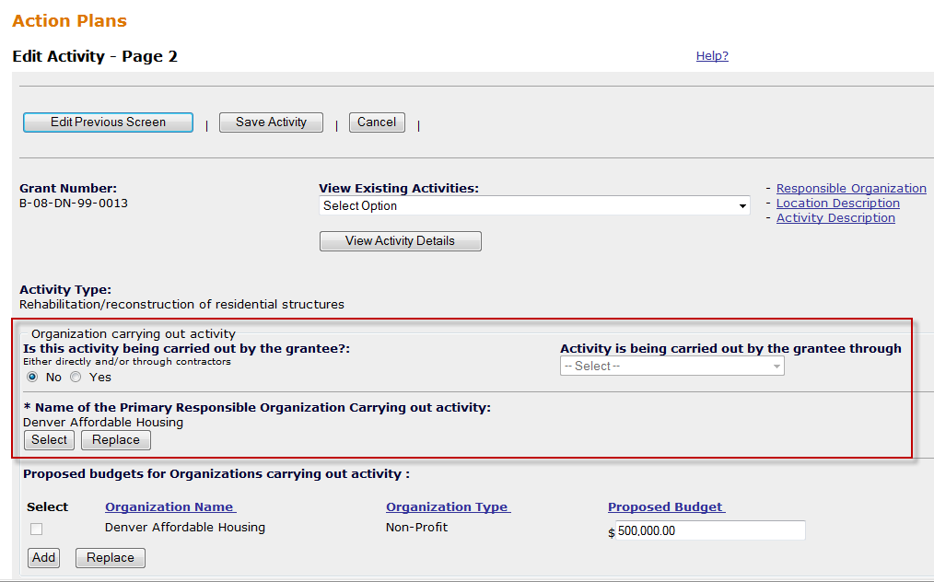
Adding Activities: Select Responsible Organization (Page 2)
Admin
Action Plans
Drawdown
QPR
Reports
Grants
Notes:
This slide shows a screenshot of where the grantee will indicate the Responsible Organization for the DRGR activity on Page 2 of Edit Activity in the Action Plan.
First, the grantee will specify if the activity is being carried out by the grantee. If this question is answered yes, the grantee will then select a choice from the dropdown on the right. The choices are: (1) Grantee employees, (2) Contractors, or (3) Grantee employees and Contractors. If the grantee answers no to the first question, the grantee will press the Select Responsible Organization button to choose the appropriate organization. If you click on the Select Responsible Organization button, you can select the responsible organization from the list you have already added. If the organization is not in the list, you can add it at this time.

Slide 48
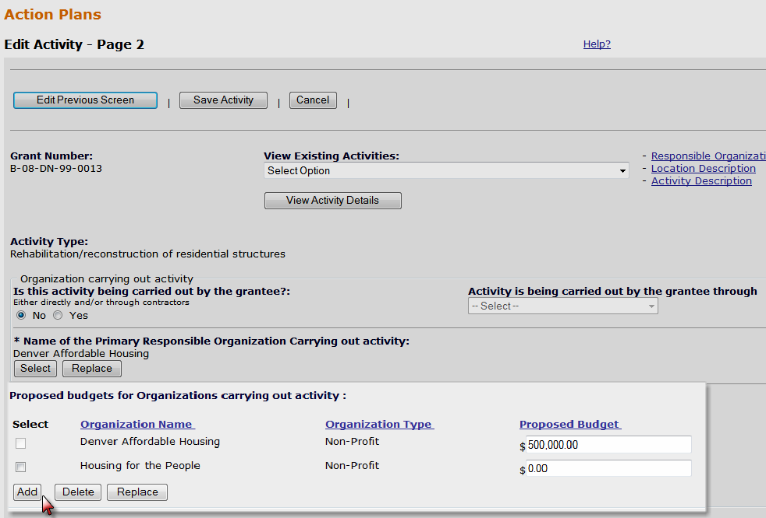
Adding Responsible Organization: Subordinate Organizations (optional)
Admin
Action Plans
Drawdown
QPR
Reports
Grants
Notes:
This slide shows the same screenshot as before. Right below the Responsible Organization section, the grantee has the option of listing subordinate organizations and their respective budgets for the activity.
In the screenshot above, you can see that this grantee has the option of specifying more than one organization to carry out this project. Again, this is optional but this feature may help the grantee track the budget and expenditures of each organization.
Reminder: Subordinate organization functions cannot be used to list multiple UGLGs or subrecipients; each UGLG or subrecipient must be a separate activity. This is used to show budgets and self-reported expenditures for organizations such as contractors, if desired.
It is important to note that only budgets and expenditures will be tracked at the subordinate organization level in DRGR. Subordinate organization budgets are provided here on Add Activity and expenditures for each subordinate organization will be recorded in the QPR. This information is NOT the same as Obligations and Drawdowns. Obligations and Drawdowns will be aggregated at the activity level; they will not be tracked down to the subordinate organization.
Some examples of where this may be helpful include programs in which the grantee has awarded a contract to a housing counseling agency or a consultant to perform program delivery tasks. If these are listed as subordinate organizations, the grantee can track the budgets and activities for these contracts without setting up a new activity.

Slide 49
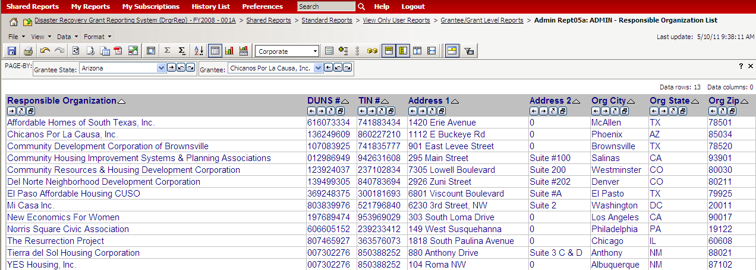
Adding Responsible Organizations (Admin Rept05a)
Admin
Action Plans
Drawdown
QPR
Reports
Grants
Notes:
This slide displays the DRGR report called “Admin Rept05a: ADMIN - Responsible Organization List.” The report includes basic information, such as name, DUNS #, EIN/TIN #, and address. This report is useful to verify that all of the required information has been provided for the responsible organizations listed for your grant. All grantees are encouraged to download and review this report for accuracy and completeness.

Slide 50
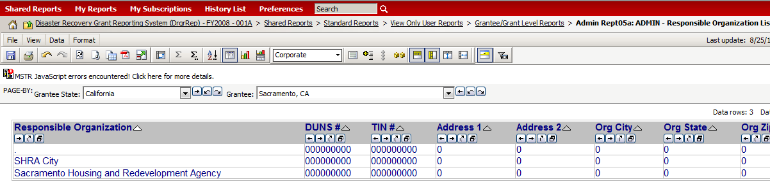
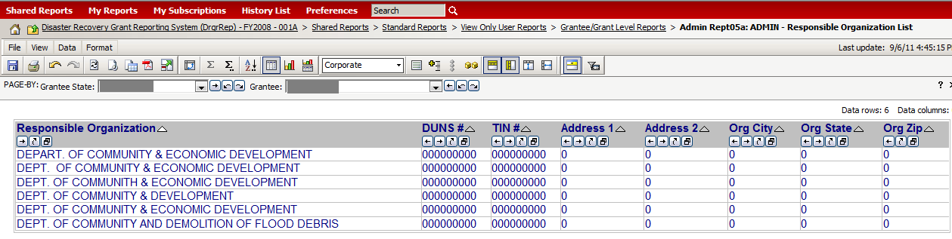
Incomplete Responsible Organizations
Admin
Action Plans
Drawdown
QPR
Reports
Grants
Common Issue #1
Common Issue #2
Notes:
This is an example of two common issues:
A grantee needs to update pertinent information regarding the responsible organization. Information that is mandatory includes the Name, Duns # and TIN #.
A grantee added a responsible organization (e.g. Dept of Community & Economic Development) multiple times instead of adding only once and then selecting this organization when setting up new Activities. As well, this grantee needs to update the pertinent information.
Please note that the images on this slide are pulled from Admin Report05; but keep in mind that names, availability, and order of these reports will change.

Slide 51
Adding Activities: Selecting an NSP Activity Type
Admin
Action Plans
Drawdown
QPR
Reports
Grants
Consolidate multiple “phases” of program into its end use
Common NSP Activity Types:
  Rehabilitation/reconstruction of residential structures
  Administration
  Construction of new housing
  Clearance and Demolition
  Land banking - Acquisition
After a grantee selects an Activity Type, DRGR will auto-populate the associated performance measures and metrics on Page 2 of the Action Plan-Edit Activity screen.
Notes:
The most confusing aspect of dividing a program into DRGR activities is selecting one activity type when several may apply. For example, its possible that a grantee would take the following steps to assist a property:
Acquire the property
Demolish the property
Construct new housing (redevelopment)
Incur disposition costs when selling the property
OR
Acquire
Rehab
Dispose (sell)
Each of the phases is listed as an available activity type in DRGR. These are only two examples. There are several other scenarios in which multiple activity types could apply.
To simplify reporting, HUD recommends combining all of these costs under the “end use.” In the first scenario above, the grantee could report all costs as Construction of New Housing Redevelopment. In the second scenario, the grantee could report everything under Rehabilitation/reconstruction of residential structures.
After a grantee selects an Activity Type, DRGR will auto-populate the associated performance measures and metrics on Page 2 of the Action Plan-Edit Activity screen. Each Activity Type has a specific set of Performance Measures.

Slide 52
Determining Activities:
City of Zorro Example
Admin
Action Plans
Drawdown
QPR
Reports
Grants
  Program Description:
  Financing Mechanisms: Subrecipient will serve only HH at or below 50% AMI.
  Financing Mechanisms: City expects to serve all LMM income levels
  Acquisition/Rehab: Subrecipient proposes to buy, rehab, and sell to 4 foreclosed single-family properties to serve HH below 50% AMI
  Acquisition/Rehab: City proposes to buy, rehab, and rent/sell 12 foreclosed properties. 10 will be single-family to serve all LMM income levels. 2 will be multifamily rental properties for HH at or below 50% AMI
Notes:
Its really important to understand how many activities you should use to structure your Action Plan, so lets walk through an example.
This slide outlines a Substantial Amendment submitted by the City of Zorro. They plan on carrying out only two types of activities: Their Loan Loss Reserve Program will qualify under Financing Mechanisms (Eligible Use A) and they will also buy, rehab, and sell foreclosures under Acquisition/Rehabilitation (Eligible Use B).
The Loan Loss Reserve Program will be carried out by both the City’s subrecipient and the City. The subrecipient will focus on lower-income households.
The Acquisition/Rehab program will also be carried out by both the sub and the City. Again, the sub will focus on households at or below 50% AMI.
In addition to 10 single-family properties, the City proposes to purchase, rehab, and rent two multifamily properties that have been abandoned for some time.
Lets see how this Substantial Amendment will be broken down into DRGR activities on the next slide.

Slide 53
Determining Activities:
City of Zorro Example - Activity Structure
Admin
Action Plans
Drawdown
QPR
Reports
Grants
Financing Mechanisms (Eligible Use A)
  City LLR LH25
  City LLR LMMI
  Sub recipient LLR LH25
Acquisition/Rehab (Eligible Use B)
  Sub recipient Acquisition/Rehab LH25
  City Single Family Acquisition/Rehab LMMI
  City Multi-Family Oak Street Property LH25
  City Multi-Family Elm Street Property LH25
Notes:
The projects are straightforward. Each eligible use becomes a project, so we have Financing Mechanisms and Acquisition/Rehab. Most likely, the grantee will also be funding Admin, so that would be a third project.
Under Financing Mechanisms, we have two responsible organizations: the subrecipient and the City. This means two activities. However, the City thinks it will serve some households at or below 50% AMI and some households above 50% AMI. In order to get credit for the set-aside requirement, the households at or below 50% AMI must be associated with the set-aside national objective. To do this, the City will set up one activity with the LMMI national objective for the proposed households over 50% AMI, and one activity with the set-aside national objective for the proposed households below 50% AMI.
We see the same breakout under Acquisition/Rehab, but we see two additional activities to represent the proposed multifamily properties. Again, HUD would like these multifamily properties reported under their own DRGR activity.
Notice what is not on the slide. Please note that none of the following are “wrong,” but they tend to complicate data entry and make the whole process less efficient.
The City is not creating a separate activity for each single-family property.
The City is not breaking out separate activities for acquisition and rehab.
The City is not creating a separate activity for disposition, which can be lumped under the other activities based on its end use.
KEY POINT: The program description in the Substantial Amendment MUST be adapted for purposes of DRGR. This is not a one-for-one breakout.

Slide 54
Example: Zorro Budget
Admin
Action Plans
Drawdown
QPR
Reports
Grants
  Total Budget for Acq/Rehab Sub recipient Acquisition/Rehab LH25 = $1MM
  Activity Type = Rehabilitation/Reconstruction of residential structures
  All proposed costs associated with that activity are included in that Activity’s budget. A grantee does not need to breakout in DRGR hard costs from activity delivery costs, for example.
Notes:
To further the example of this Activity, grantees need to understand how the budget is determined for each Activity. A grantee does not need to break out in DRGR hard costs from activity delivery costs, for example.
This is an example of the first Activity delineated in the previous slide under the Acquisition/Rehab Project. It is “Sub recipient Acquisition/Rehab LH25.”
The grantee has determined that of the total program income to be generated, $500k will be budgeted for this Activity.
A common example of costs associated with NSP acquisition/rehab programs include:
Acquisition costs
Rehab costs
Disposition costs
Activity Delivery Costs (e.g., Rehab Inspector visiting the unit)
Failed Acquisitions (e.g., appraisals, termite inspections)
Estimated PI budget

Slide 55
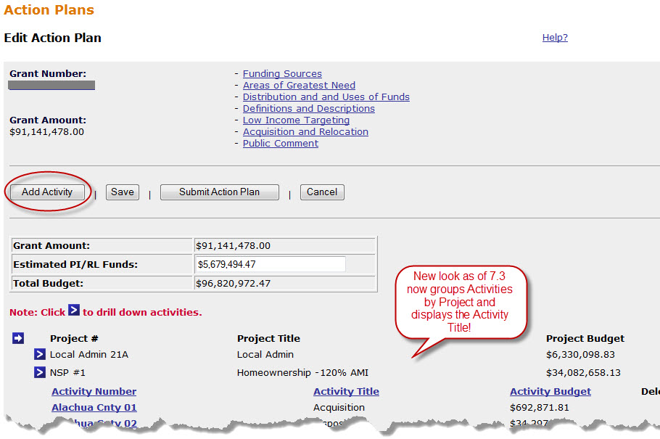
Adding Activities
Admin
Action Plans
Drawdown
QPR
Reports
Grants
Notes:
This slide has a screenshot of the Action Plan page and highlights the Add Activity button. This is the first step to adding an activity to your Action Plan.
As of Release 7.3, the ‘Edit Action Plan” screen was modified. Review key modifications:
A place to enter Estimated Program Income and Revolving Loan Funds for Total Budget
Activities are now grouped by their Project for a consolidated and easy to navigate look. Each Project has an arrow next to it that will expand the list of associated Activities.
In addition to the Activity Number, the Activity Title and Activity Budget is now available.

Slide 56
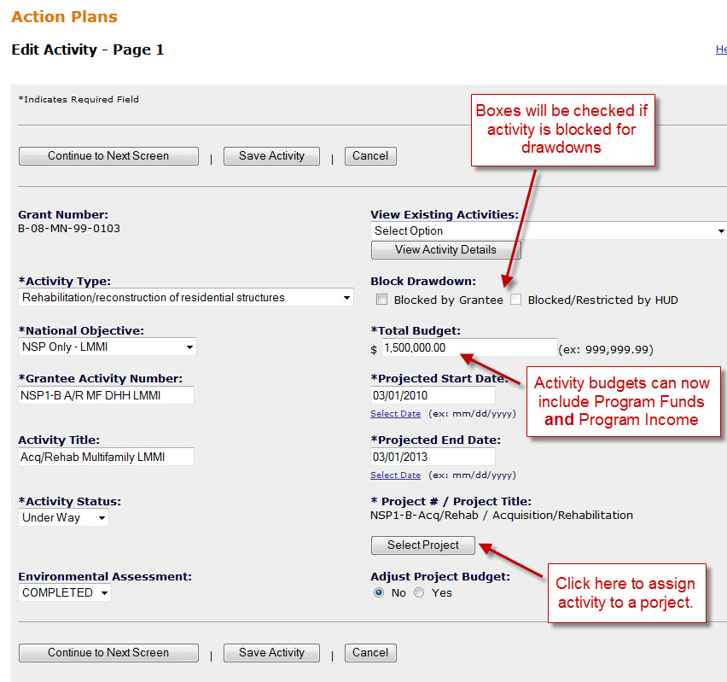
Adding Activities (Page 1)
Admin
Action Plans
Drawdown
QPR
Reports
Grants
As of Release 7.3, a grantee estimates program income budgets. For an Activity budget, program funds plus estimated program income to be used equals Total Budget.
Click here to assign activity to a project
56
Notes:
You will need to complete two pages of data entry to add the activity to the Action Plan. This is a screenshot of the first Add Activity page.
The data collected on the first page includes the following fields. All asterisked fields are required in DRGR in order to ‘Save’ or ‘Continue to Next Screen.’
Activity Type: Activity Type will be discussed in more detail in three slides.
National Objective: NSP grantees should only see three National Objective choices – LMMI, LH25 (Set Aside) , and N/A (for Admin/Planning).
Grantee Activity Number and Title are up to the grantee. The next slide will show an example of some naming conventions.
Activity Status, in most cases, should be Underway
Environmental Assessment will be based on the status of the environmental review.
Total Budget is referring to NSP program dollars and Program income.
Start/End Date are self-explanatory.
You must select the project you want to assign the activity to before you will be able to save your work. To select a project for the activity, click the Select Project button and select the correct project from the list (the next slide has a screenshot of the selection screen). Unless you are moving an activity between projects, leave Adjust Project Budget as “No”.
In addition, this screen will tell you if the activity is blocked for draws if there is a checkmark in either the Blocked by Grantee or Blocked/Restricted by HUD boxes.
It is important to note that as of Release 7.3, Activity Budgets must now factor in estimated program income, not just program funds.

Slide 57
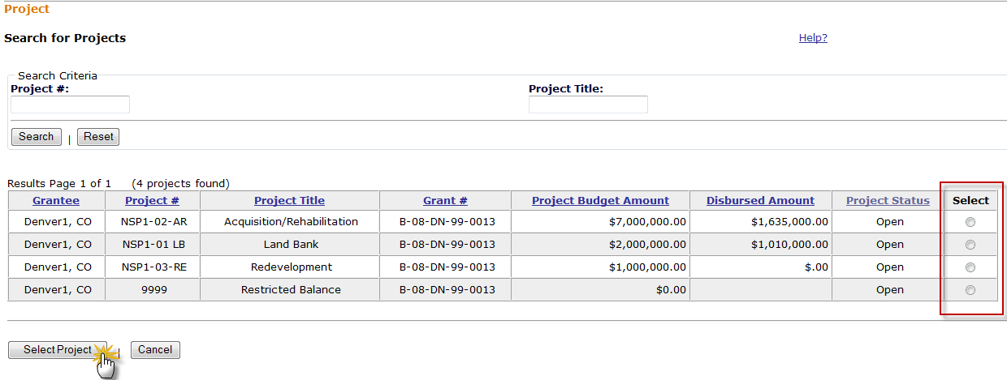
Adding Activities: Select Project Screen
Admin
Action Plans
Drawdown
QPR
Reports
Grants
Notes:
This screen shows the Select Project screen. When you first view the screen, you will only see the Search box at the top. You can provide search terms or simply click the Search button to generate the list of projects. Find the project you want and click on the radio button in the Select column for the desired project. When finished, click on the Select Project button at the bottom of the screen.

Slide 58
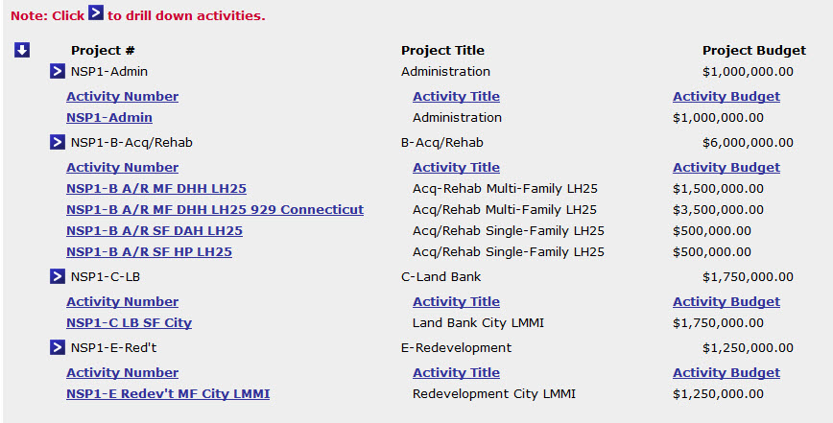
Adding Activities: Example of Naming Conventions
Admin
Action Plans
Drawdown
QPR
Reports
Grants
58
Notes:
This slide is a screenshot of the project-activity structure for a grantee with several Responsible Organizations. The screen shows the Project #, the Project Title, the Grantee Activity #, and the Activity Title.
All the naming conventions shown here are at the discretion of the grantee. For purposes of tracking, a grantee may want to include their financial codes for each Grant Activity # so when it comes to draws, it can be easily identified and reconciled.
There are many good practices to point out in this example:
The project title is clearly defined by Eligible Uses (e.g.; Administration and Financing).
This grantee uses a multi-part naming convention that conveys a lot of information in the Grantee Activity # and Activity Title, including the responsible organizations (e.g., City, DHH, DAH), the use (e.g., Admin, Financing) and the National Objective (e.g., LMMI, LH25).

Slide 59
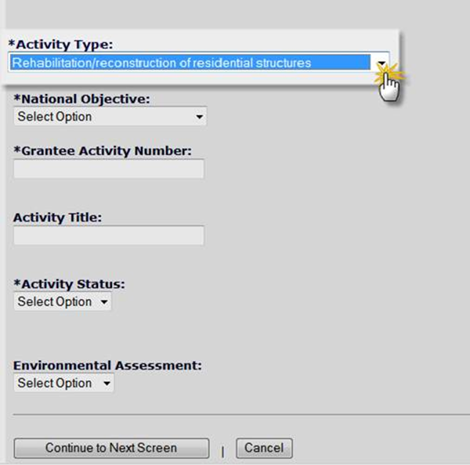
Adding Activities: Proposed Beneficiary Measures (Page 2)
Admin
Action Plans
Drawdown
QPR
Reports
Grants
  Detailed information is required for performance measures.
  Activity Type selected on Page 1 directly ties to the Benefit type a grantee selects and to the proposed measures a grantee may choose from.
  Two Steps:
    Enter proposed beneficiary data (Area Benefit or Direct Benefit)
    Enter proposed accomplishment data
Notes:
The next section of data entry for activities after Responsible Organization is performance measures. It is important for grantees to use the correct performance measures in to be able to fully report on the quarterly reports. Accurate reporting on performance measures allows HUD and other governmental entities to ensure that the projects and activities carried out under NSP are consistent and in compliance with the purpose and legislative intent of the grant. Informally, the performance measures conveys each community’s unique story in its endeavor to redevelop neighborhoods hardest hit by the mortgage foreclosure crisis.
DRGR 7.0 released in September 2010 made significant changes to the tracking of performance measures. More detailed information is required in both the Action Plan and the DRGR Quarterly Performance Report (QPR). On the activity screens in the Action Plan, grantees must provide a more detailed breakout of the proposed beneficiary data and program accomplishments that together comprise the performance measures. Many of the performance measures were not listed when NSP1 grantees first started using DRGR. Grantees may need to revisit the activity screens in the Action Plan to ensure the appropriate proposed beneficiaries and performance measurements are provided. Many of these are new and grantees have not gone back and filled in these data elements. It is important for grantees to do so because if the information is not provided on the Action Plan (the front end), the grantee will not have an option of reporting under these categories in the QPR (the back end).
The Activity Type selected on page 1 of Add Activity will determine which types of performance measures are available to the grantee. Most NSP activity types will provide a Direct Benefit to the households who will occupy NSP-assisted units. Some of the activity types undertaken with NSP, like demolition and land banking, will meet the national objective by providing an Area Benefit. The activity type selected will help determine whether the activity is an area benefit or a direct benefit.
The proposed beneficiary data and accomplishment data requested by the system will differ for area and direct benefit activities. The data entry is a two step process. First, you will describe the type of benefit expected (direct or area) and for direct benefit whether the housing will be owner or rental and multi or single family. The system will change the remaining fields based on how you answer the first few questions.

Slide 60
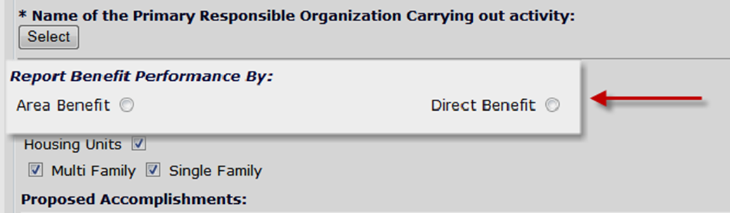
Activity Benefit Type: Area Benefit v Direct Benefit
Admin
Action Plans
Drawdown
QPR
Reports
Grants
Direct and area benefit options will mainly affect the type of beneficiary data that will be entered by grantees for their activities.
For most NSP activities such as housing rehabilitation, construction of new housing, and homeownership subsidy, ‘Direct Benefit’ will be selected.
Notes:
The proposed accomplishments and beneficiary data collected by DRGR is dependent on whether the activity is deemed to be an Area Benefit or Direct Benefit activity.
For most NSP activities, such as housing rehabilitation, construction of new housing, and homeownership subsidy, the grantee will report Direct Benefit data. The system will not give the user the option of using the Area Benefit.
The screenshot displayed on the slide shows an example of where the grantee has an option of choosing between Area Benefit and Direct Benefit.

Slide 61
Proposed vs Actual: Beneficiary Measures
Admin
Action Plans
Drawdown
QPR
Reports
Grants
Area Benefit
Direct Benefit
Census Screens (Persons)
Survey
(Persons)
FHEO Screens
(Households and/or Persons)
Households: Owners/Renters
Housing Units: Multifamily/
Single Family
Enter Data only at AP
Automatic Actuals in QPR equals Projected numbers
Enter Data only at QPR
Projected #s equal TOTAL Households
Enter Data at both the AP & QPR
Notes:
So far, we have discussed the proposed performance measures (goals). This slide will discuss how the choices made under activity setup will affect how the system will collect actual beneficiary data on the quarterly reports.
For Area Benefit activities, the system determines the number of persons living in the activity’s target area based on the census data or survey data entered by the grantee. The grantee does not need to re-enter the data in the QPR. The system will assume that since the activity is being carried out, the persons in the service area are receiving a benefit. In other words, the system automatically sets the actual numbers to equal the proposed accomplishments from the action plan. However, actuals will not show in the Reports Module outputs for Area Benefit beneficiary data.
For Direct Benefit, the grantee must enter the proposed indicators for households for income levels, single-family and multifamily, and tenure (renter vs. owner) in the Action Plan. In the quarterly report, the grantee will report on the actual number of households assisted in the quarter by the same breakouts (tenure, property type, income level). In addition, the grantee will need to provide additional data for each household assisted, including female-headed households, race, and ethnicity.

Slide 62
Activity Type: Area Benefit v Direct Benefit
Admin
Action Plans
Drawdown
QPR
Reports
Grants
Activity Type | Benefit Type |  | Tenure |  | Property Type
 | Area | Direct | Rent | Own | Single- Family | Multi-Family
Acquisition - general | X | X | X | X | X | X
Acquisition, construction, reconstruction of public facilities | X | X
Administration
Capacity building for nonprofit or public entities | X
Clearance and Demolition | X | X |  |  | X | X
Construction of new housing |  | X | X | X | X | X
Construction/reconstruction of streets | X
Disposition | X |  |  |  | X | X
Homeownership Assistance to low- and moderate-income |  | X |  | X | X | X
Land Banking - Acquisition (NSP Only) | X |  |  |  | X | X
Land Banking - Disposition (NSP Only) | X |  |  |  | X | X
Planning | X
Public services |  | X
Rehabilitation/reconstruction of a public improvement | X
Rehabilitation/reconstruction of other non-residential | X
Rehabilitation/reconstruction of public facilities | X
Rehabilitation/reconstruction of a residential structures |  | X | X | X | X | X
Relocation payments and assistance |  | X | X | X
Notes:
The slide displays a grid of common Activity Types and their correlating beneficiary inputs.
Every Activity Type will be either an Area Benefit or a Direct Benefit. For example, Land Banking must be an Area Benefit. On the other hand, Rehabilitation of Residential Structures must be a Direct Benefit.
There are two cases, public facilities and clearance and demolition, where the grantee can choose between Area Benefit or Direct Benefit. In these cases, the grantee should review the NSP rules and regulations or discuss the issue with their CPD Representative for clarification.
The grid also lists whether the grantee will have the option of specifying single family and multifamily units and renter units and owner units.

Slide 63
Activity Type: Area Benefit Data/Census
Admin
Action Plans
Drawdown
QPR
Reports
Grants
Area Benefit
Census
‘Duplicate Activity’
Jurisdiction-Wide
Survey Method
Total # Low
County Code/County Name
(in order to choose smaller geographic area)
Grantee #
Activity #
County Code/County Name
Census Place(s)
Census Tract(s)
All Block Groups
Select Specific Block Groups
Total # Low/Mod
Total Population
Select the Activity Type
Step #1 for Area Benefit
Determine Census or Survey Method
OR
Census Data is Optional
Notes:
This is the first of a set of three slides that review how grantees document compliance for an Area Benefit DRGR activity.
The first step is to select the correct Activity Type. Remember that based on the Activity Type selected, the system will indicate whether the activity should be Direct Benefit or Area Benefit.
Once the system is displaying Area Benefit as an option, the grantee will specify whether the area was designated as eligible for NSP funding based on HUD-provided U.S. Census data or survey data gathered by the grantee.
In the majority of cases, grantees rely on the data provided by HUD to demonstrate eligibility of the target area they are serving. This first example and set of slides will demonstrate using the HUD-provided Census data. The next example will demonstrate the survey screens.

Slide 64
Activity Type: Area Benefit Data/Census
Admin
Action Plans
Drawdown
QPR
Reports
Grants
Area Benefit
Census
‘Duplicate Activity’
Jurisdiction-Wide
Survey Method
Total # Low
County Code/County Name
(in order to choose smaller geographic area)
Grantee #
Activity #
County Code/County Name
Census Place(s)
Census Tract(s)
All Block Groups
Select Specific Block Groups
Total # Low/Mod
Total Population
Select the Activity Type
Step #2 for Area Benefit
Determine geographic location
Census Data is Optional
Notes:
This is the second of a set of three slides that review how grantees document compliance with Area Benefit. In this example, the grantee selected Census data (as opposed to survey data) as the data source to document NSP eligibility of the area. The next step for the grantee is to describe what census areas (census tracts and block groups) are included in the service area of the activity. The system give the grantee three options to do this.
If the grantee already has an Area Benefit activity setup that serves the same target area, the grantee can use the “Duplicate Activity” option. This will copy the selected census tracts and block groups from the existing activity to the current activity.
If the grantee has not limited the activity to a specific area but will provide the NSP service across its entire jurisdiction (please note the jurisdiction has to qualify as NSP-eligible to use this option), the grantee can select Jurisdiction Wide. This eliminates the need for the grantee to go through the manual process of adding all the census tracts and block groups to the activity.
The third option is to specify manually which census tracts and block groups are included in the target area. The first step of manual selection is to identify the county of the service area.

Slide 65
Activity Type: Area Benefit Data/Census
Admin
Action Plans
Drawdown
QPR
Reports
Grants
Area Benefit
Census
‘Duplicate Activity’
Jurisdiction-Wide
Survey Method
Total # Low
County Code/County Name
(in order to choose smaller geographic area)
Grantee #
Activity #
County Code/County Name
Census Place(s)
Census Tract(s)
All Block Groups
Select Specific Block Groups
Total # Low/Mod
Total Population
Select the Activity Type
Step #3 for Area Benefit
Input fields as needed.
Census Data is Optional
Notes:
This is the third of a set of three slides that review how grantees document compliance with Area Benefit. In this example, the grantee selected Census data (as opposed to survey data) as the data source to document NSP eligibility of the area.
Step 3 of the process depends on how the grantee proceeded in Step 2.
If the grantee chose to duplicate an activity, the grantee will specify which activity they want to duplicate.
If the grantee chose Jurisdiction Wide, the grantee will select ‘Service Area is City or County-wide’
If the grantee chose to manually select the census tracts and block groups, depending on the level of specificity it selects.

Slide 66
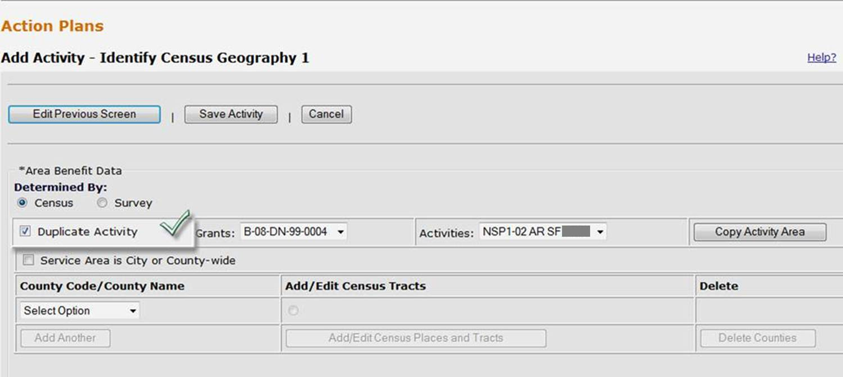
Area Benefit: Census - Duplicate Activity
Admin
Action Plans
Drawdown
QPR
Reports
Grants
Notes:
The slide displays a screenshot of the screen used to specify the area served by an Area Benefit activity.
The first field asks whether the eligibility was determined by Census (HUD-provided data) or Survey (grantee-provided data).
Grantee users can copy the census tracts/block groups for a service area from another activity. To do this, select the check box, choose a Grant # and Activity #, and press the COPY SERVICE AREA button.
By “duplicating an activity”, DRGR copies the Census Tracts (and block groups if the grantee went to the block group level) and the summary data for % low/mod from one activity to another.

Slide 67
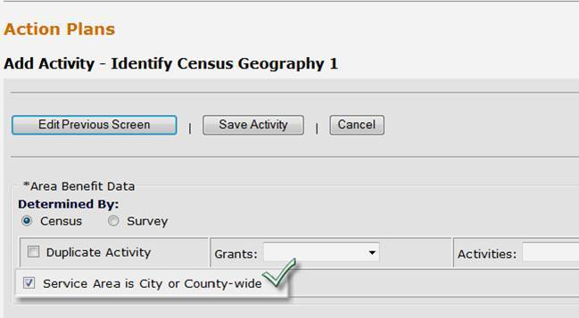
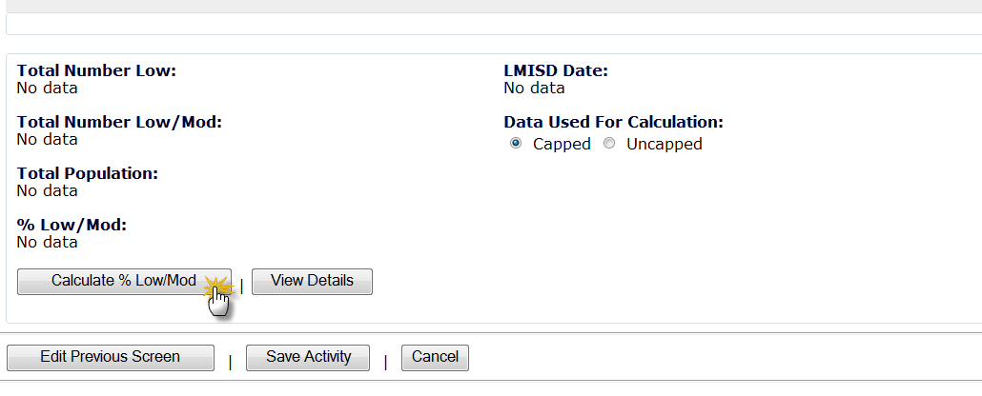
Area Benefit: Census - Jurisdiction-Wide
Admin
Action Plans
Drawdown
QPR
Reports
Grants
Notes:
The slide displays a screenshot of the screen used to specify the area served by an Area Benefit activity. In this case, the grantee has selected the second option and will indicate an entire city or county is the target area.
The first field asks whether the eligibility was determined by Census (HUD-provided data) or Survey (grantee-provided data).
Once the grantee checks the Service Area is City or Countywide, the screen will display a dropdown menu where the grantee will specify the name of the County and, if applicable, City. Again, this eliminates the need for the grantee to manually enter all of the census tracts and block groups within a jurisdiction.

Slide 68
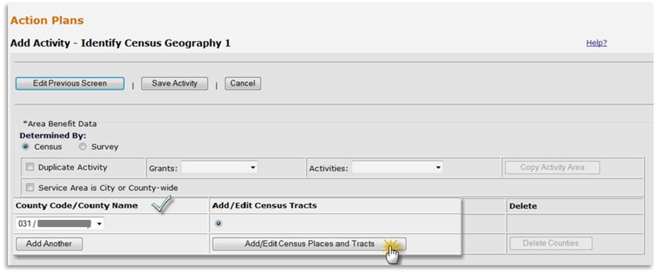
Area Benefit: Census Place/Tract/Block Groups
Admin
Action Plans
Drawdown
QPR
Reports
Grants
Notes:
Grantee users will be prompted to select Census Tracts and Block Groups after they identify the county or counties for the activity.

Slide 69
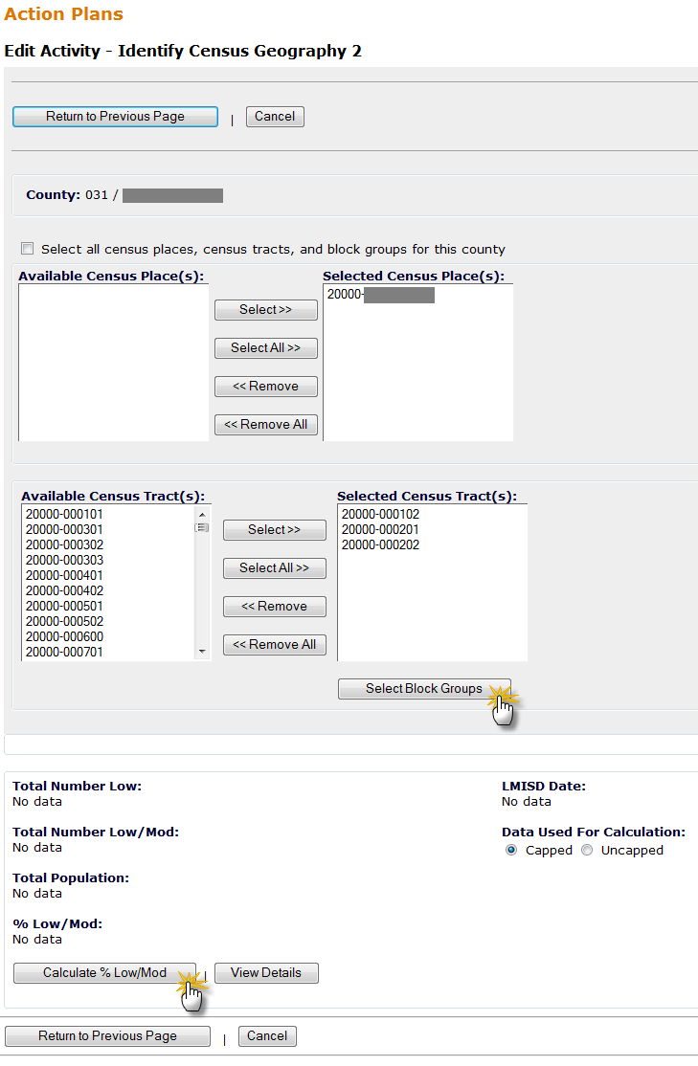
Area Benefit: Census Place/Tract
Admin
Action Plans
Drawdown
QPR
Reports
Grants
To select the geography boundary by delineating Place/Tract/ Block Area Benefit by Census, User has two options.
Option #1
Select Place and Tract and calculate % of low/mod.
Notes:
The slide displays a screenshot of the screen used to specify the area served by an Area Benefit activity. In this case, the grantee has selected the third option and will manually select the census tracts and block groups within the target area.
In the top section of the screen, users can select all Census Places (cities) or select one or more by highlighting them from the AVAILABLE CENSUS PLACE(S) window and using the buttons on the screen.
Once the Census Places are selected, users can select individual or all Census Tracts with the available buttons. Once selected, the census tracts will move from the Available column on the left to the Selected column on the right.
A grantee may choose to Calculate the “% Low/Mod” at the Track level if so chooses.
If only a portion of a census tract is within the service area, the grantee should specify which block groups within the census tract are in the service area by clicking on the Select Block Groups button.

Slide 70
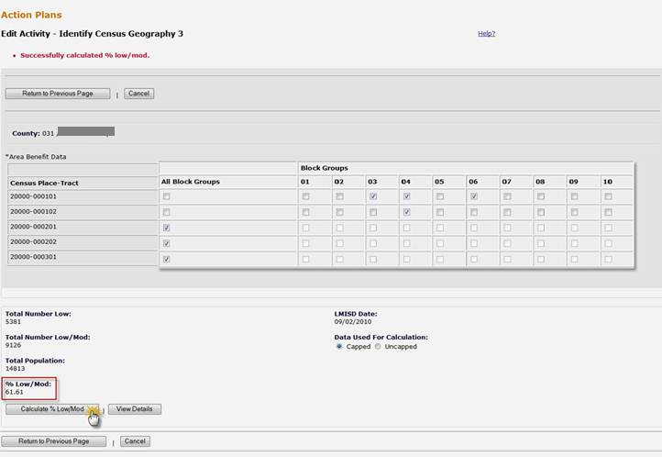
Area Benefit: Census Block Groups
Admin
Action Plans
Drawdown
QPR
Reports
Grants
Option #2
Select Place, Tract AND Block group and calculate % of low/mod.
Notes:
This slide displays a screenshot of the screen used to indicate which block groups for each census tract are included in the activity’s service area.
The screen will display all of the selected census tracts in the left column of the grid. The grantee can choose to select all of the block groups within the census tract by checking the All Block Groups box. If only a portion of the census tract is located within the service area, the grantee should place a check next to each block group within the service area.
To save the data, click on the Return to Previous Page button.
Option #2: Chose Place, Tract AND Block group and calculate % of low/mod.

Slide 71
Activity Type: Area Benefit Data/Survey
Admin
Action Plans
Drawdown
QPR
Reports
Grants
Area Benefit
Census
‘Duplicate Activity’
Jurisdiction-Wide
Survey Method
Total # Low
County Code/County Name
(in order to choose smaller geographic area)
Grantee #
Activity #
County Code/County Name
Census Place(s)
Census Tract(s)
All Block Groups
Select Specific Block Groups
Total # Low/Mod
Total Population
Select the Activity Type
Census Data is Optional
Notes:
The second option is to enter data for an Area Benefit activity is to use grantee-provided survey data. Grantees will only need to use this method if the HUD-provided census data shows that the target area is not eligible.
If the grantee opts to use the survey to document eligibility, they are not required to provide the census tracts and block groups of the target area. The system will give the user the option to provide this information, but it is optional.
When using the survey option, the grantee will specify the number of low-income persons living in the target area, the number of low-moderate income persons living in the target area, and the total population of the target area. Based on these numbers, the system will calculate the % Low Mod for the target area.

Slide 72
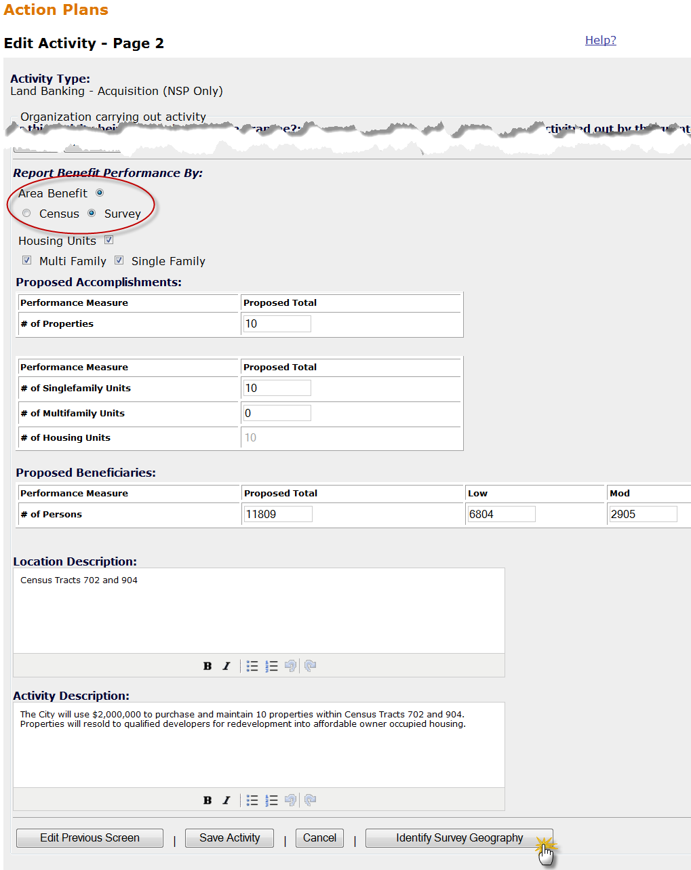
Area Benefit: Survey Method
Admin
Action Plans
Drawdown
QPR
Reports
Grants
Notes:
For the Survey Method, a grantee may use the Census data OR populate the Total Number Low, Total Number Low/Mod, and Total Population for the system to calculate % Low/Mod.

Slide 73
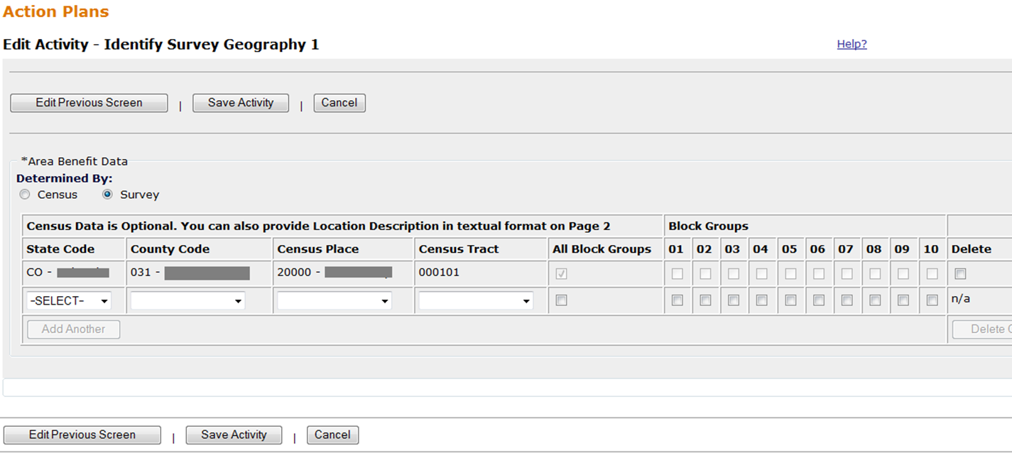
Area Benefit: Survey Method
Admin
Action Plans
Drawdown
QPR
Reports
Grants
Notes:
This slide shows a screenshot of the data entry screen for the survey option.
The census information at the top is optional.
When using the survey option, the grantee will specify the number of low income persons living in the target area, the number of low-moderate income persons living in the target area, and the total population of the target area. Based on these numbers, the system will calculate the % Low Mod for the target area.
For the Survey Method, a grantee may use the Census data OR populate the Total Number Low, Total Number Low/Mod, and Total Population for the system to calculate % Low/Mod.

Slide 74
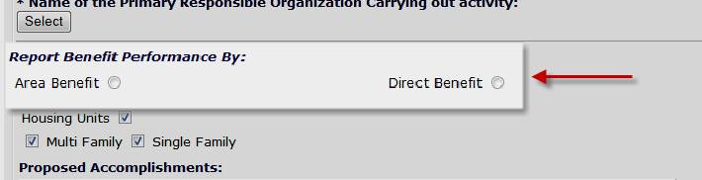
Activity Type: Direct Benefit
Admin
Action Plans
Drawdown
QPR
Reports
Grants
Notes:
We are now finished with Area Benefit and will discuss Direct Benefit data collection for Action Plan activities. This slide displays a screenshot highlighting the first section that grantee will complete when given the option to choose Area Benefit or Direct Benefit.

Slide 75
Adding Direct Benefit Data
Admin
Action Plans
Drawdown
QPR
Reports
Grants
Select the Activity Type
Direct Benefit
Households
Owner
Renter
Housing Units
Single Family
Multi-Family
Fair Housing/Equal Opportunity Data
Race
Ethnicity
Head of Household
Notes:
This slide shows the different elements to the Direct Benefit data collection. The majority of NSP activities will be Direct Benefit activities.
Once the grantee indicates the activity will create a Direct Benefit, they will need to indicate if the households assisted will be owner, renter, or both. The grantee will also want to indicate if the housing units expected to be assisted will be single-family or multifamily. When the grantee enters this information, the system will provide additional fields in the second area of data collection.
When reporting on this activity in the Quarterly Report, the grantee will have to provide race and ethnicity data, head of household data, and income data for each household assisted.

Slide 76
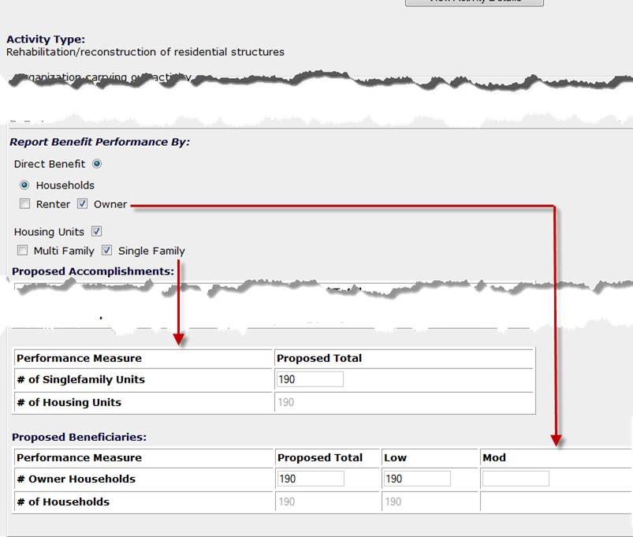
Direct Benefit: Example
Admin
Action Plans
Drawdown
QPR
Reports
Grants
Notes:
This slide shows an example of how the system will update the proposed accomplishments section based on if the user specifies owner, renter, multi family or single family.
After selecting Direct Benefit, a grantee indicates the tenure of the proposed beneficiaries (in this case, owner) and the structure of the property (in this case, single-family). Once the user selects Owner, the system adds a row of proposed accomplishment data for owner -occupied units. If the user indicated there will be single-family units, the system would also add a “# of single-family units” beneficiary measure.
For the household measures, a grantee is required to specify the tenure based on the proposed income levels targeted. For example, if the grantee indicates there will be renter households, the system will add a “# of renter” households beneficiary measure with “proposed total,” “low,” and “mod” data fields to complete. All grantees are required to enter this beneficiary data.

Slide 77
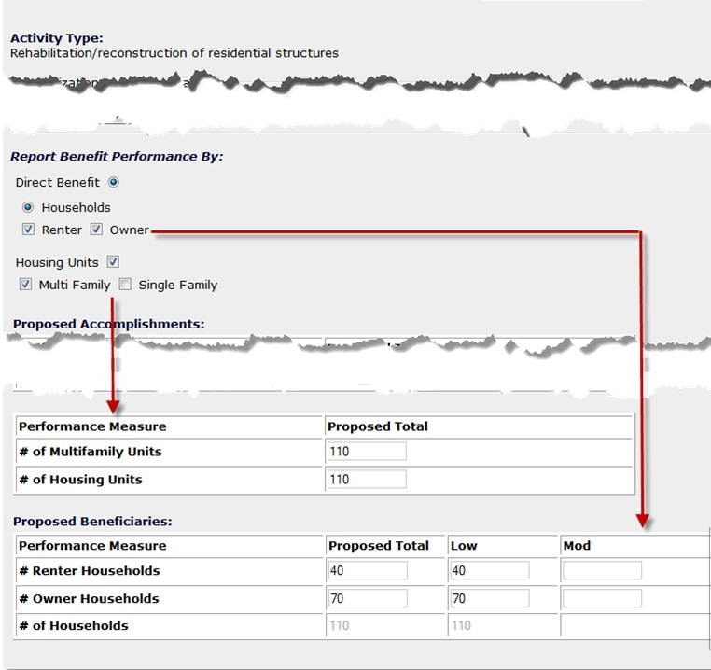
Direct Benefit: Example
Admin
Action Plans
Drawdown
QPR
Reports
Grants
Notes:
Here is a second example of the Direct Benefit section where the user has specified that the activity is expected to serve both renters and owners. As a result, the system added two rows in the detail section, one for the number of renter households and one for the number of owner households.
It is important to enter this information for each activity. If it is missing, the grantee will not be able to provide the correct breakout of accomplishment data on the quarterly reports.

Slide 78
Direct Benefit: Middle Income
Admin
Action Plans
Drawdown
QPR
Reports
Grants
Eligible households may be
  low income (≤ 50% of the area median income)
  moderate income (51%-80% of the area median income)
  middle income (81%-120% of the area median income).
In DRGR, there is NO data field in which to enter middle income data; instead, it must be incorporated into the Proposed Total.
Performance Measure | Projected Total | Low | Mod
# of Renter | 15 | 4 | 6
# of Households benefitting | 15 | 4 | 6
Notes:
It is important to note that in the detailed sections of the proposed accomplishments, the system does not list middle income as a field. This can be a point of confusion for grantee users as middle income households are eligible for assistance under NSP.
There are three levels of income eligible for NSP assistance. Low-income households are those with annual incomes less than 50% of the area median income. Moderate-income households are those with incomes between 50 and 80% of the area median income. Middle-income households are those with incomes between 80 and 120% of the area median income.
DRGR has data fields for total households, low income, and moderate income. There is no data field to enter middle income. This does not mean the grantee should not report these households at all. The grantee can simply include the middle-income households in the total households column.
For example, if a grantee has a Proposed Total of 15 households, with four low income, six moderate income, and five middle income, the information would be entered like the table provided.

Slide 79
Adding Proposed Accomplishments
Admin
Action Plans
Drawdown
QPR
Reports
Grants
Activity Types determine proposed accomplishments. Administration activity does not have accomplishment fields.
All grantees are encouraged to enter data in the fields as applicable.
NSP2 & NSP3 grantees are required to identify and report on certain green features. HUD is requiring all ‘gut rehab’ and new construction must be designed to meet the standard for Energy Star Qualified New Homes.
Notes:
In addition to defining each activity by beneficiary measures, a user may identify proposed totals for Accomplishments in the DRGR Action Plan – Edit Activity Page 2.
As with the beneficiary data, the list of proposed Accomplishments is pre-determined based on an activity’s ”Activity Type” on DRGR Action Plan-Edit Activity Page 1 (refer back to Step 1. Selecting the Activity Type). You will not need to report goals or proposed accomplishments for your administration activity.
All grantees are encouraged to enter data in the fields as applicable, but, as shown in Exhibit 5: Performance Measure Requirements, by NSP Program, only NSP2 and NSP3 grantees are required to identify and report on certain green features. The Energy Start Qualified New Homes standard is the minimum; those grantees who chose to include higher green measures (like Enterprise Green Communities or LEED) in their NSP2 application and/or NSP3 Substantial Amendment should be reporting on that.

Slide 80
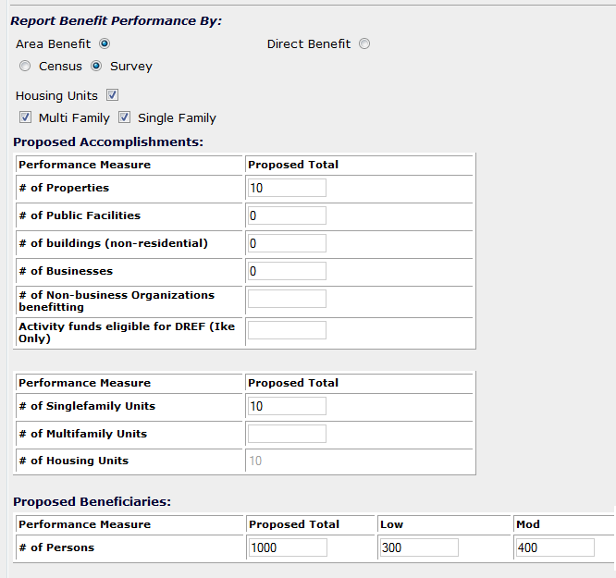
Proposed Accomplishments: Area Benefit Example
Admin
Action Plans
Drawdown
QPR
Reports
Grants
Notes:
Regardless of Census or Survey method, a grantee may have proposed accomplishments they can populate. Users must enter proposed accomplishments or 0 in each measure that they want to show up in QPR. HUD Headquarters DRGR administrators list the type of measures that are options, but putting in estimate is how grantees select the measures they plan to use.
Remember: these metrics (e.g., # of public facilities) are auto-populated based on the Activity Type selected on Page 1 of the Activity screen.

Slide 81
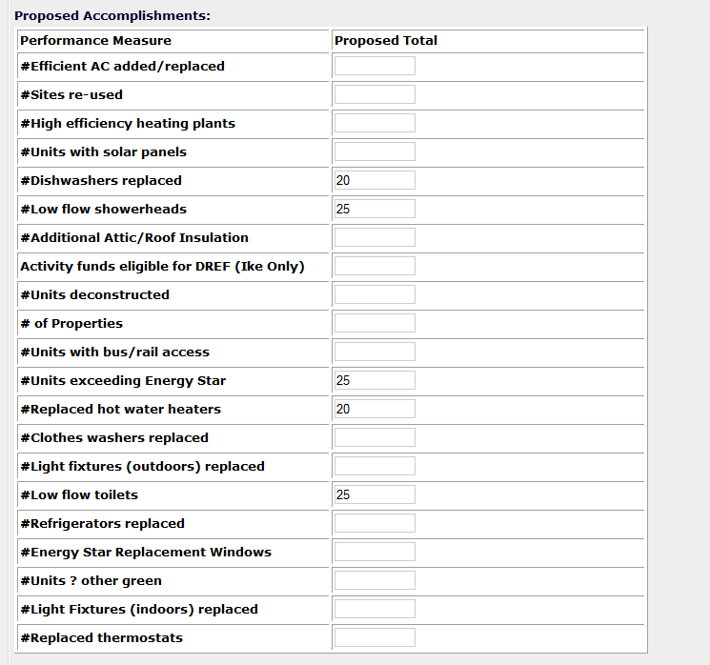
Proposed Accomplishments: Direct Benefit Example
Admin
Action Plans
Drawdown
QPR
Reports
Grants
Notes:
This slide shows a screenshot of some of the Direct Benefit proposed measures for energy efficiency.
The first field, # of Properties, should be used by all grantees. Although its not required, HUD encourages you to report on this measure.
The remainder of the fields were added to capture the types of energy efficiency improvements the grantee plans to include in their programs. Because you will not know the specifications of each NSP-assisted property at this point, you may need to make some educated guesses. HUD is trying to get a sense of what the grantee is proposing.

Slide 82
Performance Measures: Required v Optional
Admin
Action Plans
Drawdown
QPR
Reports
Grants
Performance Measure | NSP1 | NSP2 | NSP3
Households Benefitting | Required | Required | Required
Housing Units | Required | Required | Required
Income Levels | Required | Required | Required
Renter/Owner | Required | Required | Required
Single/Multi Family | Required | Required | Required
Race/Ethnicity | Required | Required | Required
Female-Headed | Required | Required | Required
Number of Properties | Encouraged | Encouraged | Encouraged
Green Measures | Encouraged | Required* | Required*
NSP2 & NSP3 grantees are required to identify and report on certain green features. HUD is requiring all ‘gut rehab’ and new construction must be designed to meet, at a minimum, the standard for Energy Star Qualified New Homes. Those grantees who chose to include higher green measures (like Enterprise Green Communities or LEED) in their application and/or substantial amendment should be reporting on that.
82
Notes:
This slide illustrates which of the accomplishment and beneficiary data is required and which is encouraged.
The majority of fields are required. Some of these fields, like Race/Ethnicity and Female-Headed Households, will only appear on the quarterly report; there is no need to break out your goals by these characteristics.
Again, many grantees have not gone back and back-filled these data elements. It is important for grantees to do so as if the information is not provided on the Action Plan (the front end), the grantee will not have an option of reporting under these categories in the QPR (the back end).
It is recommended that you verify this information is in the system before submitting your next QPR. Some of the Microstrategy Reports can quickly summarize the proposed goals entered for each activity.
You can add a wide variety of additional accomplishment data, but if you don’t have that particular item as a regular component of your program and you won’t be tracking it, don’t include it.

Slide 83
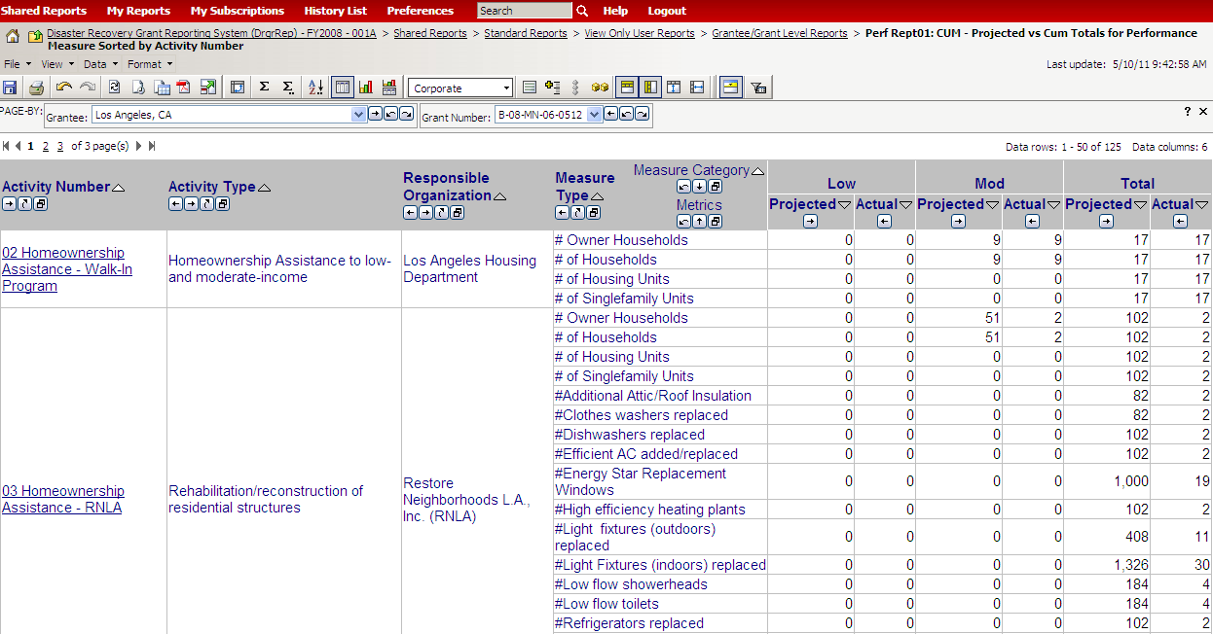
Performance Measures (Perf Rept01)
Admin
Action Plans
Drawdown
QPR
Reports
Grants
Notes:
The slide shows a screenshot of Performance Report 01. This report is a helpful tool to determine what the grantee has proposed and what has been accomplished for each activity. Grantees are encouraged to compare the performance measures listed for each activity against the list of required performance measures. If some are missing, the grantee must go back and edit the Action Plan to add them.
The columns to the left are Grantee Activity Number, Activity Type and Responsible Organization. Later, we will learn how to filter and sort using these types of columns to quickly find specific activities.
For each activity, you should see multiple performance measures, each in its own row. For example, the first activity listed on this report has four performance measures.
For each performance measure, the report will list the proposed and actual accomplishments by income level. As discussed earlier, the system does not explicitly capture numbers for middle income. These households are rolled into the Total Households field.
The second activity listed on this report is a good example of using the energy efficiency performance measures.

Slide 84
Adding Activities
Case Study 5
Admin
Action Plans
Drawdown
QPR
Reports
Grants
Notes:
Let’s add an Activity!

Slide 85
Edit Projects and/or Activities
Admin
Action Plans
Drawdown
QPR
Reports
Grants
Delete
Combine/Collapse Activities
Move/Reassign
*Each AP edit to budget or goals will change only the QPRS going forward rather than changing past QPRs.
*History of Activity budget changes will be maintained along with the User ID and time each change was made. Reports will be available to show these changes.
Notes:
There are three major functionalities a user can do when editing projects and/or activities: delete, combine/collapse activities, move/reassign projects or activities

Slide 86
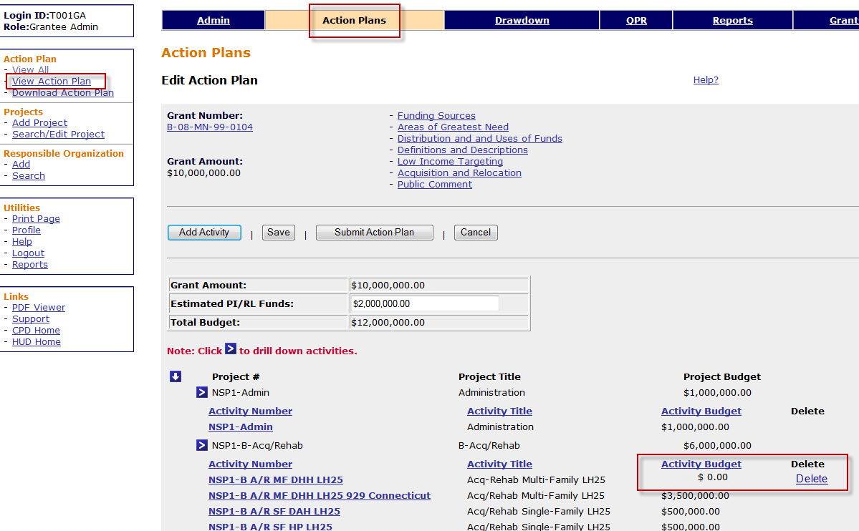
Editing Projects and Activities: Delete
Admin
Action Plans
Drawdown
QPR
Reports
Grants
Notes:
Grantees may delete activities that have a zero budget. Activities with obligations and draws cannot be deleted. If activities have completed draws, the draws must be revised to other activities before obligations can be reduced. If the activity has an obligation it must be reduced before program fund budgets can be set to zero. To delete activities that have zero budgets, the grantee will go to the ACTION PLAN module, the VIEW ACTION PLAN. The "delete" option will be available to the grantee as long as the activities have a zero budget.
Grantees may delete projects as long as there are no activities associated with the project and the project has a zero budget. Projects may be deleted by going to the ACTION PLAN module, then SEARCH BY PROJECT. A "delete" option will be available under ACTION as long as there is a zero budget for the project.
NOTE: Projects will only show up on the Edit Action Plan – Activity Index if activities have been assigned to the project. The same thing applies to project reports in Microstrategy.

Slide 87
Editing Activities: Combining/Collapsing
Admin
Action Plans
Drawdown
QPR
Reports
Grants
Some properties reported under multiple activities:
  Acquisition
  Rehabilitation
  Disposition
Options
  Combine two activities into one
  Keep existing setup and report performance measures under “end use” activity
Additional Guidance: March 2011 Troubleshooting Webinar.
Notes:
During the initial implementation of their NSP programs, some grantees set up separate activities for the acquisition and the rehabilitation of the same property. As discussed earlier, it is advisable to combine the phases of NSP assistance into the “end use” activity.
The most common NSP activity is Acquisition/Rehab/Resale. When setting up their DRGR Action Plan, some grantees added three activities to capture this program: one for acquisition costs, one for rehabilitation costs, and one for disposition costs. Now that grantees are reporting accomplishments, this type of activity structure raises questions in terms of where to report the accomplishment data. Reporting one property under more than one activity has the potential to skew performance measurement.
HUD has provided two options on how to correct/adjust data entry for such cases.
The first option is to combine all of these costs under the “end use.” For example, with Acquisition/Rehab/Resale, the grantee could report everything under Rehabilitation/Reconstruction of residential structures. This may require a lot of data entry to edit the information in the Action Plan (as well as adjust obligations and potentially revise drawdown vouchers).
Alternatively, the grantee can choose to keep the separate activities and only report the performance measures and beneficiaries under one of the activities. In this case, the grantee will want to make use of the accomplishment narrative for the activities with zero beneficiaries to cross reference and explain to HUD where the beneficiaries are reported.
For further information on how to collapse two or more activities into one activity, view the Troubleshooting Webinar, available at: http://www.hudnsphelp.info/media/resources/DRGRTroubleshootingWebinar_Slides.pdf.

Slide 88
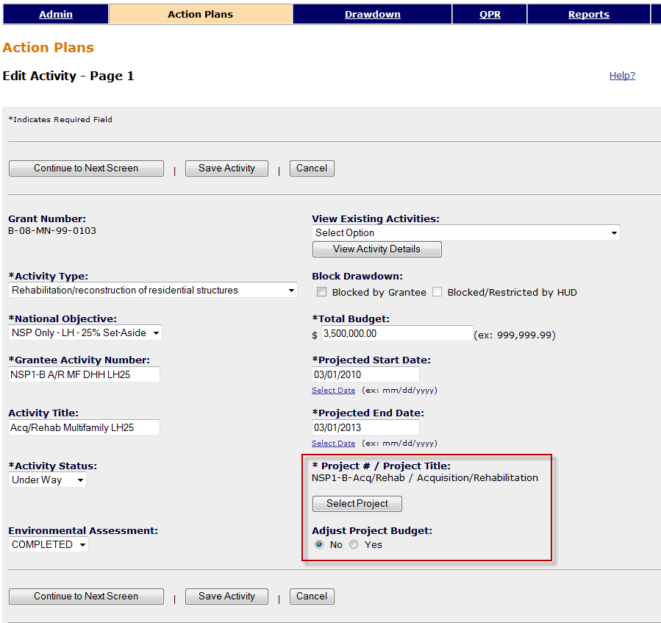
Edit Activities: Moving/Reassigning
Admin
Action Plans
Drawdown
QPR
Reports
Grants
Notes:
In some cases, the grantee may need to move an activity from one project to another. For example, some grantees set up a separate project to track their set-aside. These grantees may need to move activities in and out of the set-aside project based on the income of the household that actually occupies the unit. This is a screenshot of Edit Activity Page 1 under the Action Plan module. The screenshot is highlighting the section used to move a DRGR activity from one project to another.
The system will display the name of the project where the activity is currently located. For example, this screenshot shows the activity is connected with the Project #0001, which is titled “Owner Occup Housing.” To move the activity to a different project, click on the Select Project button.
The next screen will allow the user to search through the list of existing projects and select a new project.
If, when moving this activity to a new project, a grantee wants to adjust the project budget without going to the project screen, they may select ‘Yes’ under the next line, ‘Adjust Project Budget. This will reduce the project budget the activity was originally assigned to by the amount of the activity budget. It will then increase the project budget the activity is moved to by the same amount. If you don’t do this, the system may give you an error if there is not enough budget available in the destination project. Additionally, you will have to adjust the two project budgets yourself in the Edit Project screen.
If the budgets of the effected projects are already at their desired amounts, then you should leave the “Adjust Project Budget” default setting at “No.”

Slide 89
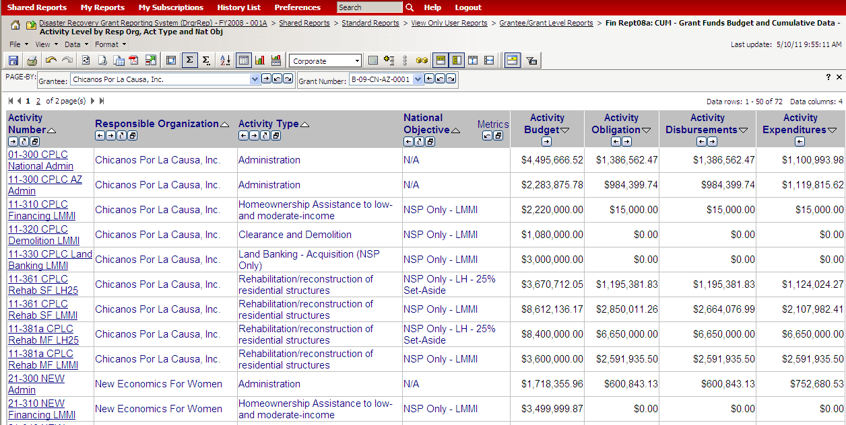
Editing Activities: Review (FinRept07b)
Admin
Action Plans
Drawdown
QPR
Reports
Grants
Notes:
This slide displays a screenshot of the Financial Report 07B. This report is helpful to review the basic financials for each activity and responsible organization, including the activity budget, obligation, disbursements, and expenditures. It can assist a user in identifying steps for restructuring activities – adding or deleting activities – because to do so a grantee may need to modify obligations or draws made against the activities.
The activity budget is entered when adding the activity on Page 1 of Add Activity.
The activity obligation is entered using the obligations screen.
The activity disbursements is total amount of NSP funds that have been drawn for the activity on drawdown vouchers.
The activity expenditures is reported as part of the QPR. Expenditures may differ than drawdowns because expenditures may include costs that have been incurred at the local level but have not yet been drawn in DRGR.
Overall, this report is especially useful for checking if there is enough grant funds obligated to make a draw or identifying steps for restructuring activities — adding or deleting activities.

Slide 90
Edit Activities: Action Plan Status
Admin
Action Plans
Drawdown
QPR
Reports
Grants
Any change can trigger ‘Modified’ status.
Check on the status of your AP to ensure QPR submission won’t be delayed
Communicate with HUD Rep to expedite the review process; Courtesy call/email to highlight the specific changes you’ve made.
Field Office staff should regularly check on Action Plan status: grantees may not be aware that they need to resubmit/still need to be approved.
Notes:
When editing activities, canceling activities, and moving activities from one project to another, the grantee should keep in mind that these changes will trigger the Action Plan status to revert to “Modified – Submit When Ready.”
In most cases, grantees will need to make changes to the Action Plan as they administer their programs. Making even small changes to the Action Plan can cause status to change to “Modified.” As discussed earlier, this will prevent the grantee from submitting their QPR. These changes in the Action Plan must be approved by HUD before each quarterly report can be submitted. Grantees can continue to process draws before the DRGR Action Plan is re-approved by HUD.
Try to time the submission of the Action Plan review well before your QPR due date. As a courtesy, send your CPD representative an email detailing what changes you made to help them in their review process.
Field Office staff should regularly check on Action Plan status. Check in with grantees to see where they are in the Action Plan process, and if they’re aware that they need to resubmit or the Action Plan still needs to be approved. After the Action Plan has been reviewed by HUD staff and found acceptable, the status will then change to “Reviewed and Approved.” Any time edits are made to the plan, the status is listed as “Modified – Resubmit When Ready.”

Slide 91
Editing Activities
Case Study 6
Admin
Action Plans
Drawdown
QPR
Reports
Grants
Notes:
Let’s edit an activity.

Slide 92
Action Plan Module Review
Review
Adding the Action Plan
Projects
Responsible Organizations
Activities
  Adding
    Basics
    Beneficiary Data
    Proposed Accomplishments
  Moving / Re-assigning Activities
  Combining Activities
Submitting the Action Plan
Notes:
The three key parts to the Action Plan are narratives, projects, and activities.
It is crucial to set up the activities correctly according to the prescribed guidance: National Objectives, Activity Type, Responsible Organization and Multi-family complex, if applicable.
Performance measure fields have drastically changed since the inception of NSP1. A grantee must go back into each activity and review to ensure all steps have been completed (the Reports Module will help identify issues — more to come on this).
The Action Plan is not a one-and-done process. Chances are, the grantee will need to go back and change data or provide data for fields where HUD is requesting additional data.
Work closely and communicate with your CPD representative to ensure a timely submission and review process as delays could affect the ability to submit QPRs.

Slide 93
QPR Module
Admin
Action Plans
Drawdown
QPR
Reports
Grants
Purpose of QPRs
Show Progress: Grant Level
Show Progress: Activity Level
Prior Period Adjustments
Submission & Deadlines
93
93
93
Notes:
For today’s session, we’ll review the following for QPRs:
Why it is essential to correctly fill out the QPRs
How to show progress at the overall grant level
How to show progress at the activity level
Correcting prior period reporting errors
QPR deadlines for submission and review

Slide 94
QPR Overview
Admin
Action Plans
Drawdown
QPR
Reports
Grants
Purpose
  Report progress for quarter and cumulative basis by:
    Identifying accomplishments once a national objective has been met
    Pulling financial data as entered in the Drawdown Module
    Detail, in narrative format, progress of the grant as a whole and per activity
HUD FO role
  Approval or rejection of the QPR in a timely manner
  Provide and share comments with grantees (if desired)
Notes:
Given the urgency associated with NSP, HUD wanted to make sure there was good communication between the grantees and the HUD Field Office regarding performance. The QPR module in DRGR provides a tool and framework for that communication. It is the tool to identify progress towards statutory requirements, such as national objectives being met and progress toward expenditure milestones.
You, the grantee, will show progress on three levels:
Performance – by identifying actual metrics once a national objective has been met
Financial – by all the financial data entered into Drawdown Module that quarter
Narrative – by explaining how the program is progressing
After the end of each quarter, the grantee will create and submit a QPR. The HUD Field Office will review it and approve or reject the report in a timely manner.

Slide 95
QPR-Action Plan Relationship
Admin
Action Plans
Drawdown
QPR
Reports
Grants
QPRs cannot be submitted if changes have been made to the Action Plan such as
  Projects added
  Activities added
  Budgets changed
Submit changes to Action Plan in advance of QPR due dates to allow time for review
Performance goals changed Action Plan locked when QPRs is submitted
Notes:
Since QPRs depend on Action Plans for some of their data, QPRs are integrally tied to the Action Plan/Reporting Process. Consequently, there are some basic rules about the relationship of DRGR Action Plans and QPRs.
New QPRs cannot be submitted if changes have been made to the Action Plan, such as adding projects/activities, changing budgets, or changing performance goals.
Action Plan changes should be submitted in advance of QPR due dates to allow review of Action Plan changes.
Action Plans cannot be edited when there are one or more QPRs in Submitted status.

Slide 96
Admin
Action Plans
Drawdown
QPR
Reports
Grants
Action Plan and QPR Review Process
Grantee
HUD
DRAFT
Original in Progress
EDIT
Modified-Resubmit
When Ready
Submitted-
Await for Review
REJECT
Rejected – Await for Modification
APPROVE
Reviewed and
Approved
Action
Plan
AP MUST be in ‘Reviewed and Approved’ status for QPR submission
Submitted-
Await for Review
DRAFT
Original in Progress
EDIT
Modified-Resubmit
When Ready
REJECT
Rejected – Await for Modification
APPROVE
Reviewed and
Approved
QPR
Submitted-
Await for Review
QPR MUST be in ‘Reviewed and Approved’ status for AP submission
Submitted-
Await for Review
Notes:
This slide is a review from yesterday as we focused on the Action Plan Module. As this also pertains to the QPR, it is essential to review.
In most cases, the grantee will have to resubmit the Action Plan and follow this process when changes Aare made to the Action Plan. At some point, due to program income and reprogramming, all grantees will need to make changes to their Action Plan. It is important to understand that changes will trigger a submission to HUD for review and approval and that until that review is completed, the grantee cannot submit a QPR. Given this, grantees must work closely with their HUD representatives to make sure any changes to the Action Plan will not interfere with the timely submission of the QPR. The Status field for the Action Plan and the QPR will tell you where you are in the process.
Both Action Plans and QPRs start in “Original – In Progress” status once they are added to the system. They will stay in this status until submitted by the grantee. At this point, the status changes to “Submitted – Await for Review.” Your HUD Representative will review the information and either approve or reject it.
If the plan is rejected by HUD, the grantee can edit the Action Plan and make the changes that have been requested. At this point, the Action Plan status will show “Modified – Resubmit when Ready.”
After the Action Plan has been reviewed by HUD staff and found acceptable, the status will then change to “Reviewed and Approved.” Any time edits are made to the plan, the status is listed as “Modified – Resubmit When Ready.”
If the grantee is making several small changes to the Action Plan, they may want to wait until all of the changes are made and submit the Action Plan once to the HUD representative for review. When resubmitting the Action Plan, it is helpful to the HUD representative if the grantee summarizes the changes made.
In some cases, changes may be so minor that they can be handled by updating DRGR and resubmitting to HUD for review. Larger changes, however, may trigger additional public participation requirements. Work with your CPD representative to determine if additional public participation is needed.

Slide 97
QPR Data: Sources
Admin
Action Plans
Drawdown
QPR
Reports
Grants
ACTION PLAN | Project Number and Title Activity Number and Title Activity Budget Activity Description and Location Activity Type and National Objective Performance goals
DRAWDOWN | Grant Fund obligations Grant Fund and Program Income (PI) draws completed Program Income Received
QPR | Activity Beneficiaries Assisted Activity Addresses Assisted Performance Accomplishments Expenditures Match Contribution
ADMIN | Visit count Report count
Notes:
This slide summarizes the sources of all of the different data elements. For the QPR, there are many elements that are auto-populated based on information the grantee submitted in other modules (the Action Plan and the Drawdown and Admin modules, in particular).
You can see that a lot of the information is coming from the Action Plan. This is why when the QPR is submitted, the Action Plan is locked from any edits. On the next slide, we will see some of the ways the Action Plan and QPR affect each other.

Slide 98
Show Progress: Grant Level
Admin
Action Plans
Drawdown
QPR
Reports
Grants
Report on BOTH the overall grant progress and per Activity
Grant Level
  Overall Progress Narrative
  Matching Funds
  Overall Financial Data (pulled from each Activity)
  QPRs will track and display all Action Plan changes that occurred within that quarter, not after the end of the quarter
Notes:
To show progress at the Grant Level, you will insert your overall progress and any matching funds not related to an individual activity (optional). Overall financial data will be pulled by DRGR from each activity.

Slide 99
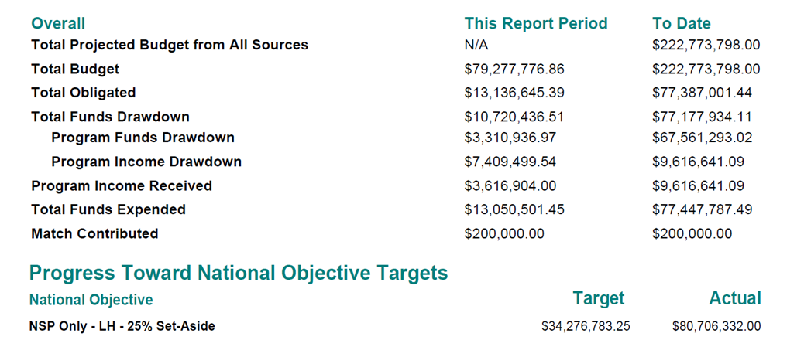
Show Progress: Grant Level
Admin
Action Plans
Drawdown
QPR
Reports
Grants
Financial Data at the Grant Level:
  Aggregate financial information that has been entered at the Activity to provide a grant level analysis (except Match)
  Only view this info once the QPR is ‘downloaded’ or ‘view’.
Notes:
With the exception of match contribution, the DRGR system will aggregate financial information that has been entered at the Activity Level to provide a grant level analysis. All information in the box is pulled straight from a downloaded or viewed QPR. Match Contribution comes from both the grant level and the activity level.
The grant-level financial data has a field that automatically calculates the “limit on admin/planning” and the 25% set-aside requirement. This may be reviewed to determine the progress towards those limits.

Slide 100
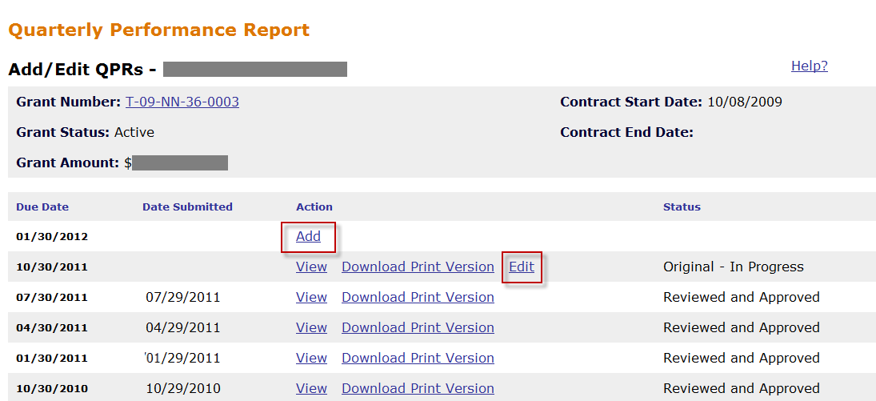
Show Progress: Add/Edit a QPR
Admin
Action Plans
Drawdown
QPR
Reports
Grants
Notes:
The QPR module will show current and past QPRs. You will have the option to “Add’” a new QPR or “Edit” an existing QPR in progress. Once a QPR is Reviewed and Approved by the Field Office, it cannot be edited.

Slide 101
Show Progress: Add/Edit a QPR
Admin
Action Plans
Drawdown
QPR
Reports
Grants
Data Entry Steps
  From QPR Module
  Select Contact Name
  Click on Grantee Activity Number to edit
  Provide Overall Narrative
  Click Submit
Notes:
Click “Add” to add a QPR and “Edit” to re-open one.
The top of the QPR edit page will show information about the grant. You will be able to select a contact person for the QPR here as well.
To do individual reports on activities, you should click on the activity number. You must report on any activities that had financial activity during the quarter, and may enter narrative for activities that did not.
At the bottom of the screen, you’ll be able to enter narrative about your overall progress for the quarter, as well as matching fund data.
In addition to having space for progress on individual activities, there is space for an overall progress narrative as well as for new matching funds not related to individual activities.
This space can also be used to report on other accomplishments for programs that do not fit into performance measures. These could include special accomplishments under the activity, such as community outreach or special performance measure accomplishments beyond standard measures.
If your Action Plan is in the right status, you’ll see a “Submit” button at the top of the QPR report when you open it. You will click this when you are ready to submit.

Slide 102
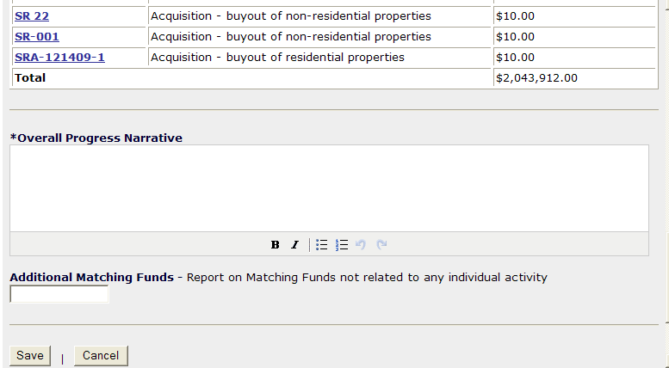
Show Progress: Grant Level
Admin
Action Plans
Drawdown
QPR
Reports
Grants
Notes:
Include Overall Progress Narrative and Additional Matching funds, if desired.
The progress narrative is especially helpful to report on status for activities before expenditures begin, such as number of contracts awarded/agreements signed, pending environmental review or procurement, etc. This can help to communicate why it doesn't look like progress is being made. The level of detail is up to the grantee.

Slide 103
Show Progress: Activity Level
Admin
Action Plans
Drawdown
QPR
Reports
Grants
  NOT required to report on each activity every quarter, only on the ones with financial or performance changes from the previous quarter
  Accomplishments: QPR will show all the measures for which grantees have entered estimates in the Action Plan.
    Enter once an end use has been met for Addresses, Beneficiary Data, Accomplishments.
  Financial: all data pulled from the Drawdown EXCEPT
    Expenditures
    Matching Funds
  Activity Status
Notes:
The submitted QPR will show expenditures and accomplishments by individual activities. DRGR will automatically include an activity in the QPR that had obligation updates or draws during the quarter. You must manually select other activities and report accomplishments or progress narrative for those activities to show in a QPR.
The QPR displays activity-level data in columns for the current quarter and cumulative totals to date. Financial data such as obligations, program income receipted and drawn down, and grant funds drawn down are calculated by DRGR based on data from the drawdown module. All other financial and performance data is entered manually. The cumulative totals showing under the “To Date” heading are calculated using the in-quarter data entered in the current and previous QPRs. This includes beneficiary data and other performance accomplishments. Only the address entered in the current QPR will be displayed in the QPR.
Activity Level:
DRGR will include any activity with a change to the drawn or obligated amount. Even if there are no performance indicators to provide for that activity, grantees should at least update the activity narrative can to give the HUD reviewer a sense of the progress made.
The “Completed Activity Actual End Date” field should be filled in at completion of the Activity if the activity has been completed and all required beneficiary, performance and financial information has been entered on the activity. The Status of the activity is changed to Complete in the Action Plan Module.

Slide 104
Show Progress: Activity Level
Admin
Action Plans
Drawdown
QPR
Reports
Grants
Beneficiary & accomplishments
  Report once end-use has been met
    Addresses: Manual Entry and Geocode validation
  Prior Period Adjustments (negative #s allowed)
  FHEO Data: Based on Activity Type and Benefit data defined in the Action Plan, QPR - Page 1 may require FHEO data.
Financial Data
  Expenditure vs. Drawdown data
Activity-specific narrative
Notes:
You are not required to report on each activity every quarter, but rather on the activities with changes to the obligated or drawn amount. However, you may want to talk to your CPD representative. They are the ones who will review the information and they may want additional detail on activities that are not progressing as well.
Remember that in order to appear on the QPR, accomplishments must be estimated in the Action Plan.
Accomplishments, including addresses, are entered only once an end use has been met. As of DRGR 7.0, grantees can now “back out” data incorrectly in prior QPRs by making “Prior Period Adjustments.” This includes allowing a grantee to enter negative numbers in order to correct prior period reporting errors.
On the Activity screen, you will see an area to enter addresses. Many grantees want to provide the address information as soon as funds are expended on the address or as soon as the address was acquired. However, HUD only wants grantees to report addresses when a national objective has been met. This usually means the unit is occupied by an LMMI household. Grantees may find themselves in situations in which an address was acquired under one activity and rehabbed under another activity. Again, HUD wants the address reported when the unit meets a national objective. Currently, a grantee cannot delete addresses entered in previous QPRs. Therefore, a grantee should make a note in the narrative on any errors in address reporting in previous QPRs.
Many grantees have questions regarding the difference between the Expenditures field and the Drawdown field. The expenditures field is used to track expenditures at the local level. If a grantee works on a reimbursement basis, the local expenditures may or may not have been processed as a drawdown. Grantees now have the opportunity to break out expenditures by subordinate organizations as well.
You can enter narrative on individual activity progress at the bottom of each activity report. This is a good place to explain to the CPD representative any milestones achieved that do not show up in the numbers. It is also a good place to explain any delays. There is usually a lag between when funds are drawn for an activity to when accomplishments are entered. Some representatives like to see estimated completion dates.

Slide 105
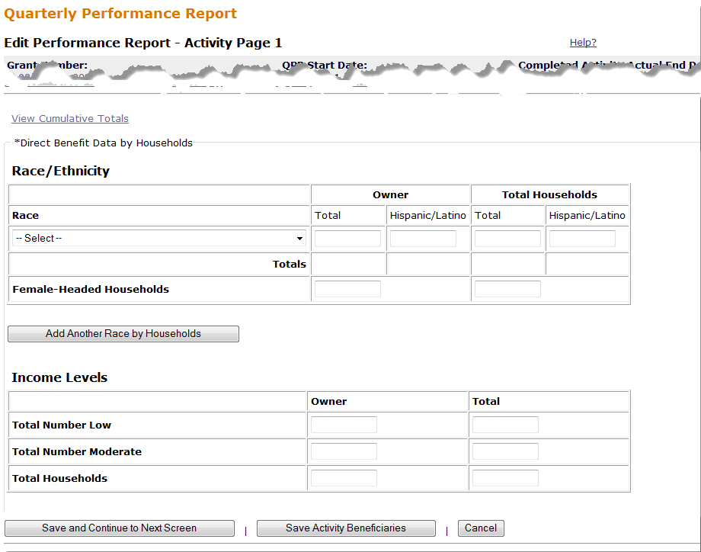
Show Progress: Activity Level – Beneficiary Data
Admin
Action Plans
Drawdown
QPR
Reports
Grants
Notes:
DRGR now collects Fair Housing and Equal Opportunity (FHEO) direct benefit data in the QPR, similar to what is collected in IDIS. The data elements that need to be collected at the household level include race, ethnicity, income, and female-headed household for Direct Benefit activities. This screen shows the first page of the Edit Activity – QPR screen: it will only be the first page for Direct Benefit activities.
If grantees provided rental/owner data for the activity in the action plan, the QPR will provide columns to separate out renters and owners.
A key point to understand about the QPR is that the system will compare the cumulative numbers reported for an activity in different categories, such as race and income, and give the user an error of the numbers do not match. (By cumulative we mean the numbers reported in prior QPRs and the current QPR.)

Slide 106
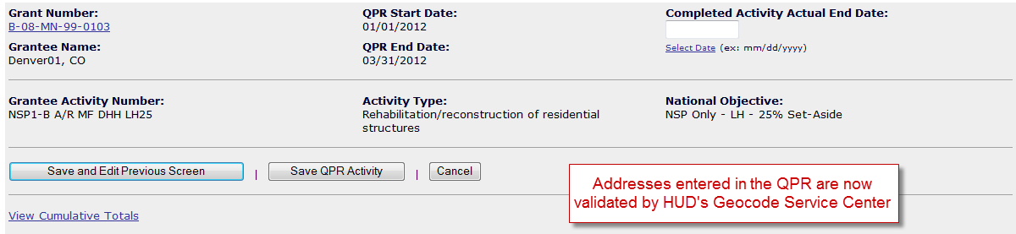

Show Progress: Activity Level- Addresses
Admin
Action Plans
Drawdown
QPR
Reports
Grants
1. Start entering your address information by clicking on Add Address
Notes:
With Release 7.3, DRGR has a new address function that will allow the user to confirm the accuracy of the addresses they have entered. Using HUD’s Geocode Service Center, DRGR will submit the address and validate the accuracy of the information to make sure it is entered correctly.
A user will enter specific address information for each property that met an end use for that quarter.
Common problem: Entering data incorrectly when there is more than one Responsible Organization at one address completing more than one Activity.
There are times when a grantee has two Responsible Organizations carrying out separate activities at the same location. When this occurs, the grantee should report the beneficiary measures associated with the primary activity, and housing units for both. Again, entering addresses exactly the same is crucial to back-end data cleanup efforts HUD performs. An example of this would be one organization performing the rehab at a property, and another providing NSP direct homeownership assistance. The accomplishments for households and housing units would be entered with the rehab (primary activity) and only households for the homeownership activity.

Slide 107


Show Progress: Activity Level- Addresses
Admin
Action Plans
Drawdown
QPR
Reports
Grants
2. Check the boxes of the addresses you wish to Validate click Validate Selected
This message may appear while you wait
Notes:
Once the address has been entered, click on Validate Selected and the status will show the user whether or not the address is valid.

Slide 108


Show Progress: Activity Level- Addresses
Admin
Action Plans
Drawdown
QPR
Reports
Grants
Using HUD's Geocode Service Center (GSC), DRGR will check the addresses you have entered and confirm whether or not they are valid.
By Clicking on the View Results button, the user can see why an address may not be valid and then Accept
Notes:
After viewing the results of the valid or invalid addresses that have been entered, the grantee can Accept the results.

Slide 109


Show Progress: Activity Level- Addresses
Admin
Action Plans
Drawdown
QPR
Reports
Grants
The View Map function will display the actual location of a valid address
Notes:
If the address is correct, the user should see a 100% Status and then be able to view the address on a map. This slide shows the map results of the second address.

Slide 110



Show Progress: Activity Level– Accomplishments
Admin
Action Plans
Drawdown
QPR
Reports
Grants
Example of ‘Rehabilitation/ reconstruction of residential structures’
The ‘Actual Accomplishments’ fields included in the QPR are determined by the fields entered in the Action Plan under ‘Proposed Accomplishments.’
Notes:
For many activities, this will be Page 2 on the Edit QPR screens. However, if there is no FHEO data required (e.g., an Area Benefit – Clearance and Demolition activity), then there will be a modified version of this screen as Page 1.
Additional information collected on this page is shown on the next slide.

Slide 111
Show Progress: Activity Level- Accomplishments
Admin
Action Plans
Drawdown
QPR
Reports
Grants
For Direct Benefit activities, the Actual Beneficiary section is pulled from Edit Performance Report – Activity Page 1.
Notes:
Continued from the previous screen – outlines the Housing Units and the Households.
For HH, DRGR does not automatically add the Low + Mod for the entry of the “Actual Total” field. A grantee must enter the data in the “Actual Total” field.
Tips on identifying these data points:
For all NSP appropriations, eligible households may be low income (≤ 50% of the area median income), moderate income (51%-80% of the area median income), or middle income (81%-120% of the area median income). In DRGR, there is no data field in which to enter middle-income data; instead, it must be incorporated into the Actual Total.

Slide 112

Show Progress: Activity Level - Financial
Admin
Action Plans
Drawdown
QPR
Reports
Grants
Read Only (info from Drawdown Module & AP): this information is automatically taken from the system on the last day of the quarter.
Notes:
As of Release 7.3, the Program Income Received line item is pulled from the Drawdown module by summing all receipts in the Program Income Receipts sections per Activity.
Note that the DRGR system pulls most information into the QPR from activity in DRGR. These numbers cannot be edited in the QPR. If they are incorrect, corrections must be made at the Action Plan or activity level. Cumulative amounts are based on system information, including information entered in prior QPRs.
You will need to enter funds expended but not drawn down, as well as match contributions.

Slide 113

Admin
Action Plans
Drawdown
QPR
Reports
Grants
Show Progress: Activity Level - Financial
Record funds that have been EXPENDED during the quarter. Expended means outlays for either internal costs or external (subgrantee, developer, contractor) payments of goods and services. These may or may not have been drawn yet.
Notes:
Expenditures is often an overlooked reporting requirement within DRGR. (a unique field to DRGR – not in IDIS).
DRGR will generate Program Funds Drawdown from system information. You must enter the amount of Program Funds Expended (not yet drawn) every quarter.
Key definitions for understanding expenditures are:
Drawn means funds were drawn down from US Treasury to grantee bank accounts. Grantees should adhere to a 3 day rule in terms of drawing funds in advance of need.
Expended means the grantee paid for goods and services.

Slide 114

Showing Progress: Activity Example
Admin
Action Plans
Drawdown
QPR
Reports
Grants
Notes:
This slide provides an example of a downloaded QPR Activity.
Review the difference between items pulled from the Action Plan and those entered in that QPR.
Action Plan:
All descriptors of the Activity (fields above the financial data).
Financial Data – all except expenditures and match.
Activity Description

Slide 115

Admin
Action Plans
Drawdown
QPR
Reports
Grants
Showing Progress: Activity Example
Notes:
Example continues…

Slide 116

Showing Progress: Activity Example
Admin
Action Plans
Drawdown
QPR
Reports
Grants
Notes:
Example continues…
Note that it is a 45-unit single-family Activity serving low-income renters.
In this reporting period, eight households met the end use for “rehab/reconstruction of residential structures.”

Slide 117
Prior Period Adjustments (Direct Benefit Activity)
Admin
Action Plans
Drawdown
QPR
Reports
Grants
DRGR will check the cumulative totals for total households from the race/ethnicity data and compare it to the cumulative totals by income level. Additionally, it checks cumulative totals by tenure and by housing unit.
If there is an inconsistency, DRGR will display an error message and a user must make prior-period corrections.
Error message example:
Cumulative sum of income levels for ‘Households - Total’ must be equal to cumulative sum of ‘Owner – Total’ <Number>
Notes:
For a variety of reasons, grantees may need to make prior period corrections. This can cause a ripple effect in reporting at the QPR level. DRGR will check the cumulative totals for total households from the race/ethnicity data by tenure and compare it to the cumulative totals by income level by tenure. It also checks cumulative totals by housing units.
Since the release of Version 7.0, DRGR accommodates negative numbers and grantees may enter prior-period accomplishments in a QPR to bring cumulative totals to their correct amount. As with financial data discrepancies, it may help to enter explanations in the accomplishment narratives any time in-quarter totals entered do not match the sum of their subcategories.

Slide 118
Prior Period Adjustments (Direct Benefit Activity)
Admin
Action Plans
Drawdown
QPR
Reports
Grants
Common reasons for a grantee needing to make prior period adjustments:
In the Action Plan during the quarter, a new benefit type was selected. However, in prior QPRs, the grantee has already reported accomplishment data.
In the Action Plan during the quarter, benefit measures (i.e. owner/renter, single-family/multi-family) are added or modified. However, in prior QPRs, the grantee has already reported accomplishment data.
Backing out incorrect data
Notes:
For a variety of reasons, grantees may need to make prior period corrections. The common reasons include:
A new benefit type (area or direct) is selected and, in prior QPRs, the grantee has already reported on accomplishment data
The benefit measures (i.e. owner/renter, single-family/multi-family) are modified and, in prior QPRs, the grantee has already reported on accomplishment data.
A grantee, in error, recorded data in previous QPRs that is now proven incorrect.

Slide 119
Prior Period Adjustments
Admin
Action Plans
Drawdown
QPR
Reports
Grants
Purpose:
Bring key categories and subcategories into balance depending on what has already been entered.
How to:
Step A: Determine the correct ACTUAL cumulative data for that Activity (regardless of what DRGR shows).
Step B: Determine the cumulative data showing in the DRGR (based on information from the immediately prior QPR).
Step C: Adding Step A and Step B together, calculate the IN QUARTER data to be entered in the QPR.
Notes:
The purpose of making prior period adjustments is to bring key categories and subcategories into balance depending on what has already been reported in prior QPRs.
A grantee can follow a step-by-step process so they can troubleshoot the issues and bring the accomplishment data in balance.
The first step is to have, on hand, the cumulative data for that activity based on a your own records (regardless of what you’ve ever entered into DRGR).
Second, you need to determine what you have put into DRGR in the past QPRs.
Last, you need to add Step A and Step B together to calculate the in quarter data to be entered in the QPR.

Slide 120

Prior Period Adjustments
Admin
Action Plans
Drawdown
QPR
Reports
Grants
Two methods to review and analyze data:
  Pull DRGR PerfReport 1 and PerfReport 6
  ‘View Cumulative Totals’ Link
120
Notes:
Step B: Determining the cumulative data already entered into DRGR form prior QPRs.
If there are already data in prior quarters, two methods to examine data that need to be included in the current quarter for prior period corrections are:
Use ComCon’s Step-by-Step Analysis plus REPORTS tab: PerfReport 1 {Actuals v Proposed} and PerfReport 6 {FHEO data} - NEXT SCREEN.
Use the VIEW QPR screen to see current quarter vs. cumulative totals - DETAIL THIS SCREEN.

Slide 121

Prior Period Adjustments
Admin
Action Plans
Drawdown
QPR
Reports
Grants
Step A. Identify and enter totals from grantee’s own data tracking
Step B. Identify data already in DRGR
(Use last approved QPR for cumulative totals)
Notes:
HUD posted a helpful step-by-step spreadsheet on Community Connections website to assist grantees in calculating Direct Benefit breakout data to correct past period entry errors.
This slide demonstrates an example of making prior period adjustments using that tool.
In the tool, Step A shows the cumulative data that a grantee is trying to show in the CURRENT QPR and Step B in the spreadsheet shows cumulative data showing in the PRIOR QPR. For Step A, a good cross-check to verify that all information you have collected is accurate, all the total households and race/ethnicity data (and by tenure) must be the same. For example, find the number of columns that have 139 as their total in Step A.

Slide 122
Prior Period Adjustments
Admin
Action Plans
Drawdown
QPR
Reports
Grants
Step C. Automatically sums totals for grantee to enter into current APR
(combines in-quarter data and prior period corrections)
Notes:
And, a continuation of the example. The spreadsheet automatically calculates the IN QUARTER data to be entered in the QPR.

Slide 123
Prior Period Adjustments
Admin
Action Plans
Drawdown
QPR
Reports
Grants
Issue | Guidance
New benefit measure selected with existing data in old QPRs | The “HOUSING UNIT” data in yellow demonstrates an example where 135 housing units were entered through the prior QPR, but the grantee had not entered any data in “SF” (i.e., single-family). If the grantee selected SINGLE FAMILY in the Action Plan during the last quarter and another 14 units were completed, they would enter 11 in HOUSING UNITS and 146 in SF HOUSING UNITS.
Backing out old data | Grantees can enter negative numbers in QPRs in different beneficiary data fields as long as cumulative totals equal.
Regular data entry (categories and subcategories already selected in prior QPRs) | If there is only one subcategory and it was selected before the last QPR, then there is a low likelihood for prior period corrections needed. In this case, there are 11 new households showing and 11 new owner households.
Notes:
This chart provides a key to assist you in analyzing some of the prior period adjustments that were made in the previous example.
The cells highlighted in yellow demonstrates an example of a new benefit measure selected (that is Single-Family as a subcategory to Housing Units) and pervious information was already entered at the Housing Unit category level in prior QPRs. The grantee selected Single-Family as a subcategory in the Action Plan during the last quarter, and therefore needs to make sure that the Single-Family entry and the Total Housing Units entry – for the cumulative, are equal.
The cells highlighted in blue demonstrate an example of a grantee that entered data incorrectly in prior QPRs and needs to back-out the data using negative numbers. A grantee must make sure that the cumulative totals equal or they will receive an error message.
The cells highlighted in green demonstrate an example when there is a low likelihood to for prior period adjustments. However, it is important to note that this information is necessary to know in order to fill out the Race/Ethnicity data that was not entered into DRGR in prior QPRs.

Slide 124

Prior Period Adjustments: Example
Admin
Action Plans
Drawdown
QPR
Reports
Grants
For Activity: NSP1-B A/R SF HP LH25
This quarter end-use met
  1 low-income household, White/Hispanic, female head of household, Single Family unit
Notes:
Trainer must walk through this example as a group.
Go to QPR and try to add in this quarter’s data (do so several times so it causes an error message). Evaluate the error message and begin to back-out the non-cumulative errors.
For cumulative errors, pull the ‘View Cumulative Total’ link.
Fill out the Tool
Enter the data based on the tools analysis.

Slide 125
Submission
Admin
Action Plans
Drawdown
QPR
Reports
Grants
Prior to submitting the QPR, review the following:
Make sure Action Plan is not under review
Are you in compliance of funding restrictions?
Is Overall Progress Narrative sufficient to explain the progress or lack of progress?
When reviewed as a whole, does QPR provide HUD enough information to show sufficient progress?
Are all the performance metrics entered in compliance? Have they met an end-use?
Notes:
Before submitting the QPR, check the following:
Make sure Action Plan is not under review.
Are you in compliance of funding restrictions?
Is Overall Progress Narrative sufficient to explain the progress or lack of progress?
When reviewed as a whole, does QPR provide HUD enough information to show sufficient progress?
Are all the performance metrics entered in compliance? Have they met an end-use?

Slide 126
Deadlines
Admin
Action Plans
Drawdown
QPR
Reports
Grants
First QPR is due: 30 days after the first full quarter after the grant agreement is executed. Then,
For NSP1 and NSP3, remaining QPRs are due within 30 days of the end of the calendar quarter.
For NSP2, remaining QPRs are due within 10 days of the end of the calendar quarter.
If a QPR has been rejected, a grantee has 10 days to remedy the issue and resubmit. Second consecutive late QPR = finding
HUD’s Action:
QPR action is due within 30 days of QPR submission.
Notes:
The due date of the first QPR is triggered by the contract effective date (often the date of the second signature in LOCCS).
Remaining QPRs are due within 30 days of the end of the calendar quarter for NSP1 and NSP3.
NSP2 grantees only have 10 days after end of the quarter to submit the QPR.
Field office staff have 30 days to review the grantee QPR submission.
If the Action Plan is rejected, grantees will have 10 days to resubmit a rejected QPR.
If you are going to be late with the QPR submission, call your Rep to give advance notice. If a grantee misses the deadline twice in a row for QPR submission, the result is a finding on noncompliance.
Due dates are established by the Notice. Do not pay attention to what DRGR says as the Due Date (for NSP2, it shows that its due 30 days from the end of the quarter instead of 10).

Slide 127
Add/Edit/Save a QPR
Case Study 7
Admin
Action Plans
Drawdown
QPR
Reports
Grants
Notes:
Let’s work in the QPR module.

Slide 128
QPR Review
Review
QPRs are crucial for showing progress – both financial and performance!
Performance Measure data is directly tied to the Activity Type entered in the Action Plan.
Timing
  NSP1 & 3: due within 30 days
  NSP2: due within 10 days
  Do not be late in submission!
  Plan out timing for changes to Action Plan
Notes:
Remember that the QPR is critical to your ability to demonstrate progress in terms of both use of funds and impact of those funds.
Performance measure data is tied to the Activity Type in the Action Plan.
Timely submission is essential. Action Plan changes should be planned around QPR deadlines.

Slide 129
Key Basics
Day 1 Review
5 Modules of DRGR
User Roles
Elements of the Action Plan
  Projects
  Activities: 4 items
  Benefit Type and Projected Accomplishments
Drawdowns & Obligations
Program Income

Slide 130
Pop Quiz
Admin
Action Plans
Drawdown
QPR
Reports
Grants
Don’t Worry…No Grading!
Please organize into teams of three or four.
I will present you with a potential issue a grantee confronts. Please brainstorm and let the class know what measures you would take to solve it.
Notes:
Question 1: A grantee wants Jill to remain as the Drawdown Requester for NSP1 but be the Drawdown Approver for NSP3. What steps do they need to take to make that happen?
Question 2: How many activities (all Eligible Use B) will you need to set up in the following scenario (write the chart with the whole class contributing):
2 subrecipients
Each doing single-family acquisition-rehabilitation program (10 units each)
One doing multi-family acquisition-rehabilitation (1 building: 30 units)
The subrecipient conducting the MF acquisition-rehabilitation will be a rental property. For all the SF units and ½ of the units associated with the MF building, the income target will be 50% of AMI or less. For the other ½ of the MF units, the income target will be 51% to 120% AMI.
The other subrecipient will be targeting owners have ½ their units for 50 % AMI or less and the other ½ for 51% to 120% AMI.
Question 3: True or False: In a data clean-up effort, HUD will require grantees who have two DRGR activities for the same property (i.e. one activity for acquisition and one activity for rehab) to combine the activities.
Question 4: What type of information may you want to include in your project number?
Question 5: How often do grantee users have to recertify in DRGR?
Question 6: Is Demolition a Project?

Slide 131
Q&A: Who do I to talk to if…
Admin
Action Plans
Drawdown
QPR
Reports
Grants
…I need a password reset or the DRGR system is down?
  HITS Help Desk @ 1-888-297-8689.
  TIP: Be ready to provide your user ID and PIN to the Help Desk staff. Please keep track of the service desk ticket # they provide you.
…I need a session reset and/or other technical assistance?
  DRGR Help Desk @ 1-800-998-9999, Option 3.
  E-mail: DRGR_Help@hud.gov
  DRGR question lookup system posted online at: https://lmco.custhelp.com
Notes:
The HITS help desk should be contacted for any technical issues and password problems. Session resets should come through the HUD Help Desk (DRGR_Help@hud.gov or the 800 number). If you need a password reset, you’ll get a message that says you have exceeded the number of login attempts. If you have been idle for 30 minutes within the system and you are automatically logged out, you will likely be unable to log in again and will need to reset your password.

Slide 132
Q&A: Who do I to talk to if…
Admin
Action Plans
Drawdown
QPR
Reports
Grants
…I am a grantee and am missing information in LOCCS (TIN or Bank Routing Information).
  Your HUD CPD Representatives!
…I have more than a quick question or our NSP team needs some one-on-one, intensive Technical Assistance?
  NSP Resource Exchange www.hud.gov/nspta
  ‘Request Assistance’ section
Notes:
A grantee should contact their CPD rep if there is missing information in LOCCS immediately.
If a grantee is seeking an answer, in writing, to a specific issue, they may enter it at the NSP Resource Exchange. A grantee may also request one-on-one technical assistance at this website.

Slide 133


Additional Resources
Admin
Action Plans
Drawdown
QPR
Reports
Grants
NSP Resource Exchange Official NSP Help Site (features FAQs, videos, manuals, intensive Technical Assistance) : http://hudnsphelp.info
DRGR Help e-mail
(DRGR_Help@hud.gov)
1-800-998-9999
Community Connections (step-by-step manuals, trainings): http://www.comcon.org/programs/drgr.html
DRGR question lookup system posted online at: https://lmco.custhelp.com/
DRGR home page (page that pops up once you sign in)
Official DRGR Help Site (features videos, module guides, etc.): http://www.hud.gov/offices/cpd/communitydevelopment/programs/drsi/drgrs.cfm
Notes:
You can find information about any updates or major changes to the DRGR system on the DRGR website. For DRGR resources, the resource site listed above is best; NSP policy documents are all posted on the NSP Resource Exchange. For help with the system outside of password reset issues, please contact the Help Desk using the email above or by calling the 800 number listed on the previous slide.

Slide 134
End of 1st Day Session
Admin
Action Plans
Drawdown
QPR
Reports
Grants
Additional Questions…
Thanks for attending – please feel
free to share any feedback you have with us!
Items we’ll be covering tomorrow:
  Admin Module
  Drawdown Module
  Reports Module
  Telling Your NSP Story via DRGR
  Common Issues & Troubleshooting
Notes:
Thank you so much for your participation!
We’ll be starting tomorrow by digging into the other 3 Modules (Admin, QPR, and Reports), talking about how to best tell your story to HUD and the public, and delve into some common issues grantees face in DRGRs and how to troubleshoot from your desk.
Please feel free ask any additional questions you may have.

