Slide 1
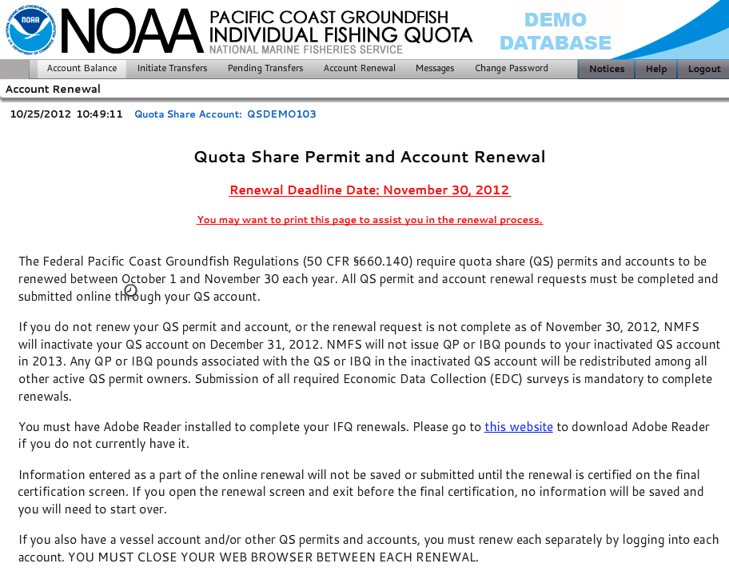
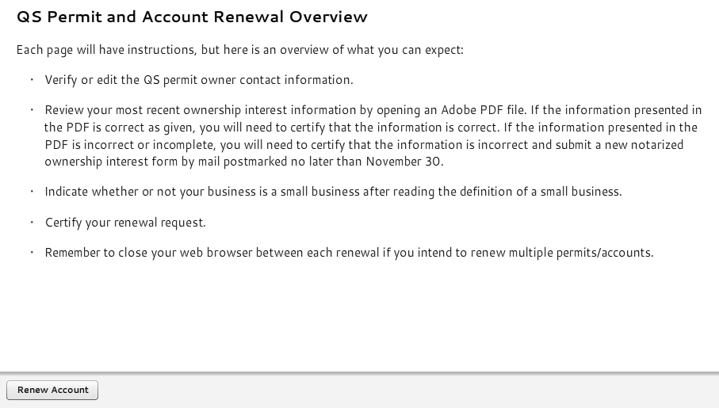
OMB Control No. 0648-0620, Expires on: 11/30/2014

Slide 2
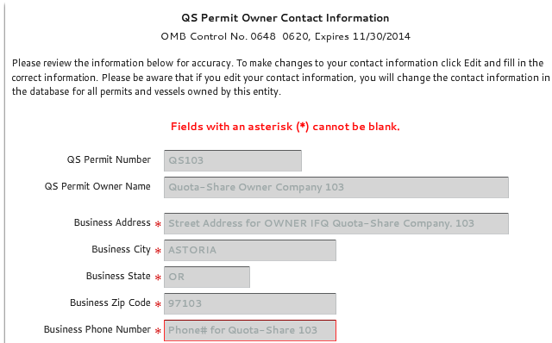
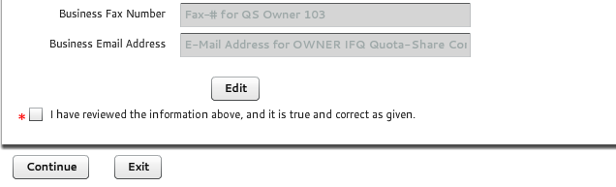
Expires on: 11/30/2014

Slide 3
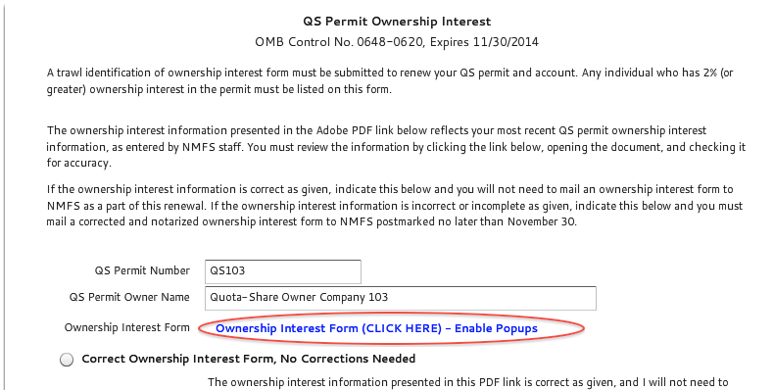
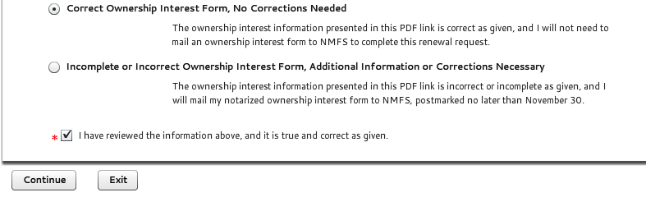
Trawl Identification of Ownership Interest Form – Listed Separately
Expires on: 11/30/2014

Slide 4
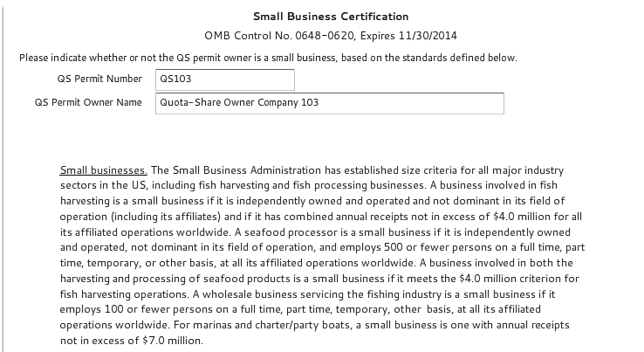
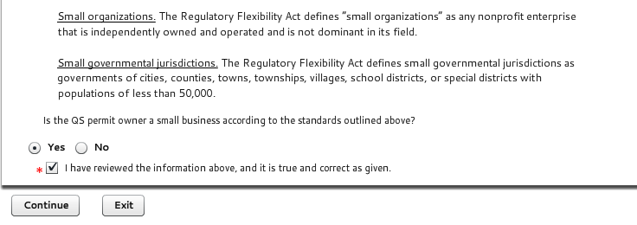
Part of the Trawl Identification of Ownership Interest Form – Listed Separately
Expires on: 11/30/2014
As part of various rulemakings related to the Pacific Coast groundfish fishery, the National Marine Fisheries Service (NMFS) is required to analyze the effect of such regulations. To assist with these Regulatory Impact Reviews (RIR)/Initial Regulatory Flexibility Analysis (IRFA), NMFS must determine if permit and license owners participating in the fishery are big businesses or small businesses as defined by the Small Business Administration.
Small businesses. The Small Business Administration has established size criteria for all major
industry sectors in the US, including fish harvesting and fish processing businesses.
A business involved in fish harvesting is a small business if it is independently owned and operated and not dominant in its field of operation (including its affiliates) and if it has combined annual receipts not in excess of $4.0 million for all its affiliated operations worldwide.
A seafood processor is a small business if it is independently owned and operated, not dominant in its field of operation, and employs 500 or fewer persons on a full time, part time, temporary, or other basis, at all its affiliated operations worldwide.
A business involved in both the harvesting and processing of seafood products is a small business if it meets the $4.0 million criterion for fish harvesting operations.
A wholesale business servicing the fishing industry is a small business if it employs 100 or fewer persons on a full time, part time, temporary, or other basis, at all its affiliated operations worldwide.
For marinas and charter/party boats, a small business is one with annual receipts not in excess of $7.0 million.
Small organizations. The Regulatory Flexibility Act defines small organizations as any nonprofit enterprise that is independently owned and operated and is not dominant in its field.
Small governmental jurisdictions. The Regulatory Flexibility Act defines small governmental jurisdictions as governments of cities, counties, towns, townships, villages, school districts, or special districts with populations of less than 50,000.
Are you a small business, small organization, or small governmental jurisdiction according to the standards outlined above? Please indicate below.

Slide 5
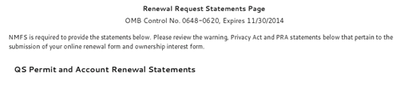
Expires on: 11/30/2014
WARNING STATEMENT: A false statement on this form is punishable by permit sanctions (revocation, suspension, or modification) under 15 CFR Part 904, a civil penalty up to $100,000 under 16 USC 1858, and/or criminal penalties including, but not limited to, fines or imprisonment or both under 18 USC 1001.
PRIVACY ACT STATEMENT: Some of the information collection described above is confidential under section 402(b) of the Magnuson-Stevens Act and under NOAA Administrative Order 216-100, Protection of Confidential Fisheries Statistics. Business phone number, fax number, and email are not released to the public. The information collected is part of a Privacy Act System of Records, COMMERCE/NOAA #19, Permits and Registrations for United States Federally Regulated Fisheries. A notice was published in the Federal Register on April 17, 2008 (73 FR 20914) and became effective on June 11, 2008 (73 FR 33065).
PRA STATEMENT: Public reporting burden for this collection of information is estimated to average 10 minutes per response, including the time for reviewing the instructions, searching existing data sources, gathering and maintaining the data needed, and completing and reviewing the collection of information. Send comments regarding this burden estimate or any other suggestions for reducing this burden to NOAA/National Marine Fisheries Service, Northwest Region, Attn: Assistant Regional Administrator, Sustainable Fisheries Division, 7600 Sand Point Way NE, Seattle, WA 98115. Notwithstanding any other provisions of the law, no person is required to respond to, nor shall any person be subjected to a penalty for failure to comply with, a collection of information subject to the requirements of the Paperwork Reduction Act, unless that collection of information displays a currently valid OMB Control Number.
WARNING STATEMENT: A false statement on this form is punishable by permit sanctions (revocation, suspension, or modification) under 15 CFR Part 904, a civil penalty up to $100,000 under 16 USC 1858, and/or criminal penalties including, but not limited to, fines or imprisonment or both under 18 USC 1001.
PRIVACY ACT STATEMENT: Some of the information collection described above is confidential under section 402(b) of the Magnuson-Stevens Act and under NOAA Administrative Order 216-100, Protection of Confidential Fisheries Statistics. TIN or DOB, business phone number, fax number, and email are not released to the public. The names of individuals who have an ownership interest in an entity that owns a permit, vessel or processing plant and the actual percentage of ownership are considered business confidential and are not released to the public. The information collected is part of a Privacy Act System of Records, COMMERCE/NOAA #19, Permits and Registrations for United States Federally Regulated Fisheries. A notice was published in the Federal Register on April 17, 2008 (73 FR 20914) and became effective on June 11, 2008 (73 FR 33065).
PRA STATEMENT: Public reporting burden for this collection of information is estimated to average 0.75 hours per response for new entrants, and is estimated to average 5 minutes when pre-filled for renewing entities, including the time for reviewing the instructions, searching existing data sources, gathering and maintaining the data needed, and completing and reviewing the collection of information. Send comments regarding this burden estimate or any other suggestions for reducing this burden to NOAA/National Marine Fisheries Service, Northwest Region, Attn: Assistant Regional Administrator, Sustainable Fisheries Division, 7600 Sand Point Way NE, Seattle, WA 98115. Notwithstanding any other provisions of the law, no person is required to respond to, nor shall any person be subjected to a penalty for failure to comply with, a collection of information subject to the requirements of the Paperwork Reduction Act, unless that collection of information displays a currently valid OMB Control Number.

Slide 6
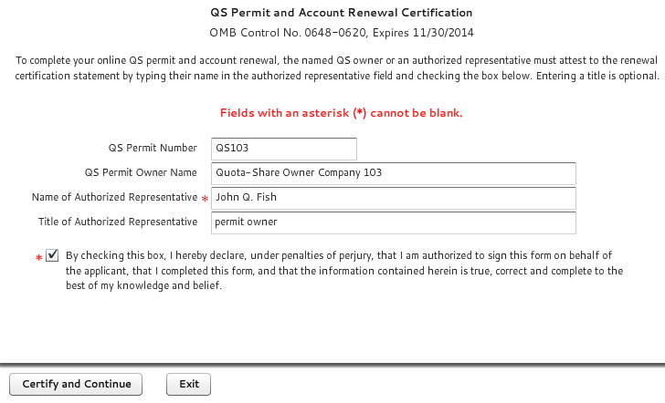
Expires on: 11/30/2014

Slide 7
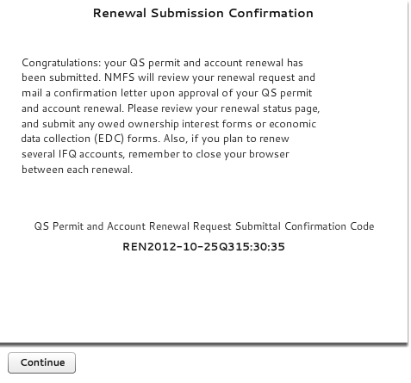

Slide 8
