Slide 1
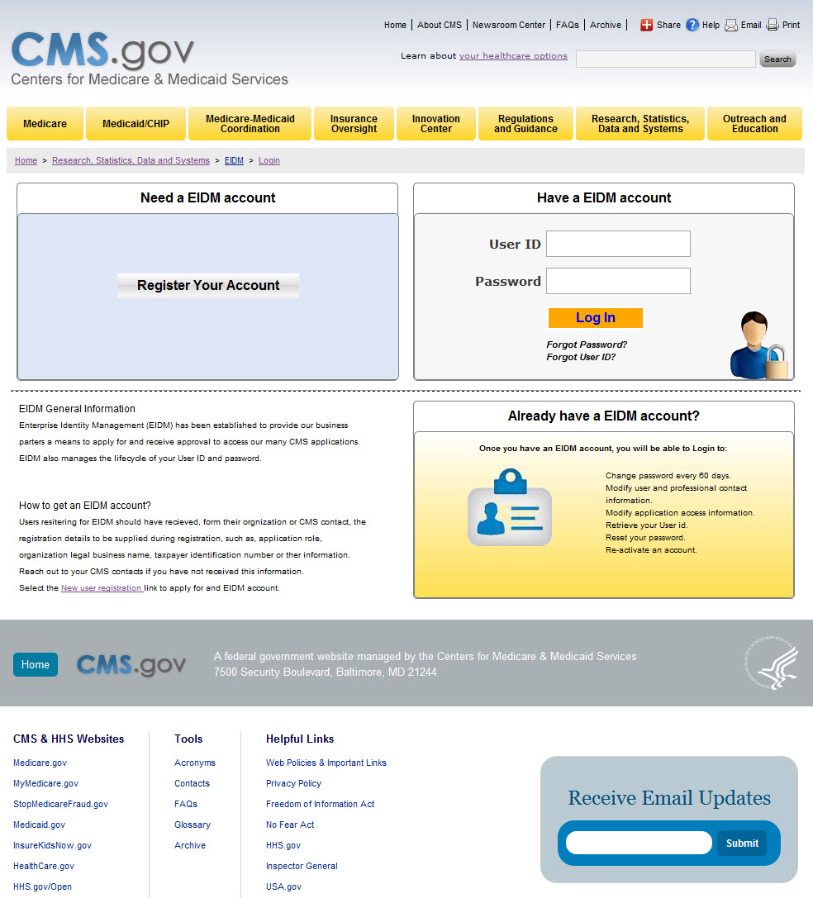
CMS Enterprise Portal: EIDM Account Logon and New Registration Screen

Slide 2
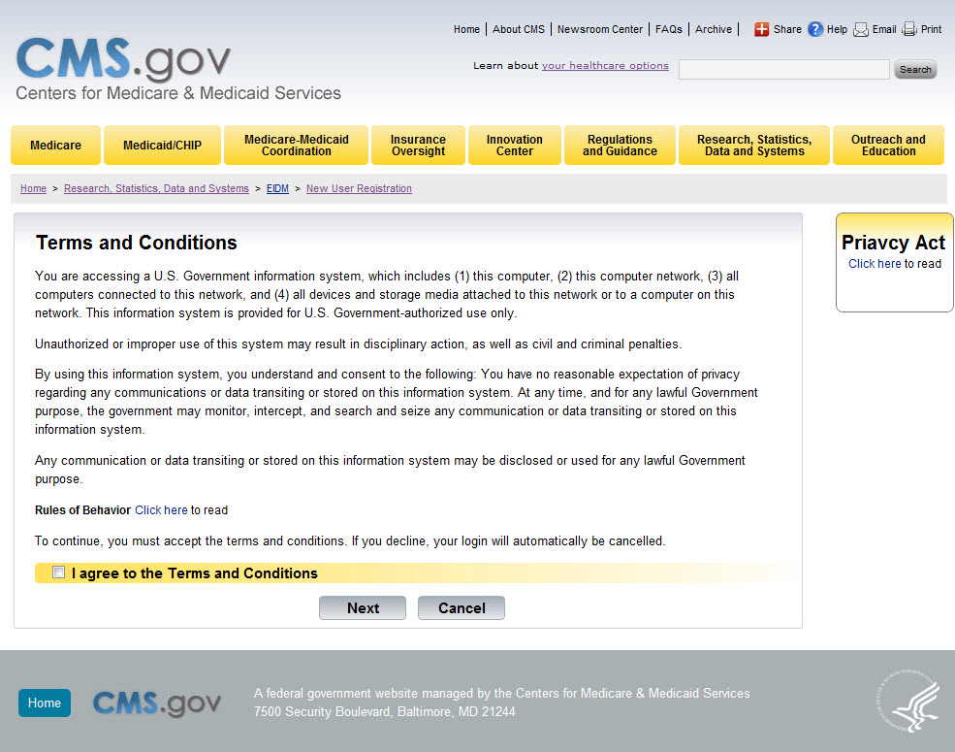
CMS Terms and Conditions Screen

Slide 3
Full Sample Text for CMS Terms and Conditions for EIDM
Terms and Conditions:
Consent to Monitoring
By logging onto this website, you consent to be monitored. Unauthorized attempts to upload information and/or change information on this web site are strictly prohibited and are subject to prosecution under the Computer Fraud and Abuse Act of 1986 and Title 18 U.S.C. Sec.1001 and 1030. We encourage you to read our Rules of Behavior for more details.
Protecting your Privacy
Protecting your Privacy is a top priority at CMS. We are committed to ensuring the security and confidentiality of the user registering to EIDM. Please read the CMS Privacy Act Statement which describes how we use the information you provide.
Collection of Personal Identifiable Information (PII)
"Personal" information is described as data that is unique to an individual, such as a name, address, telephone number, social security number, and date of birth (DOB).
CMS is very aware of the privacy concerns around PII data. In fact, we share your concerns. We will only collect personal information to verify your identity, when you set up an account. Your information will be disclosed to Experian, an external authentication service provider, to help us verify your identity. We will share your Social Security number with Experian only for the purposes of verifying your identity. Experian verifies the information you give us against their records. We may also use your answers to the challenge questions and other PII to later identify you in case you forget or misplace your User ID /Password.

Slide 4
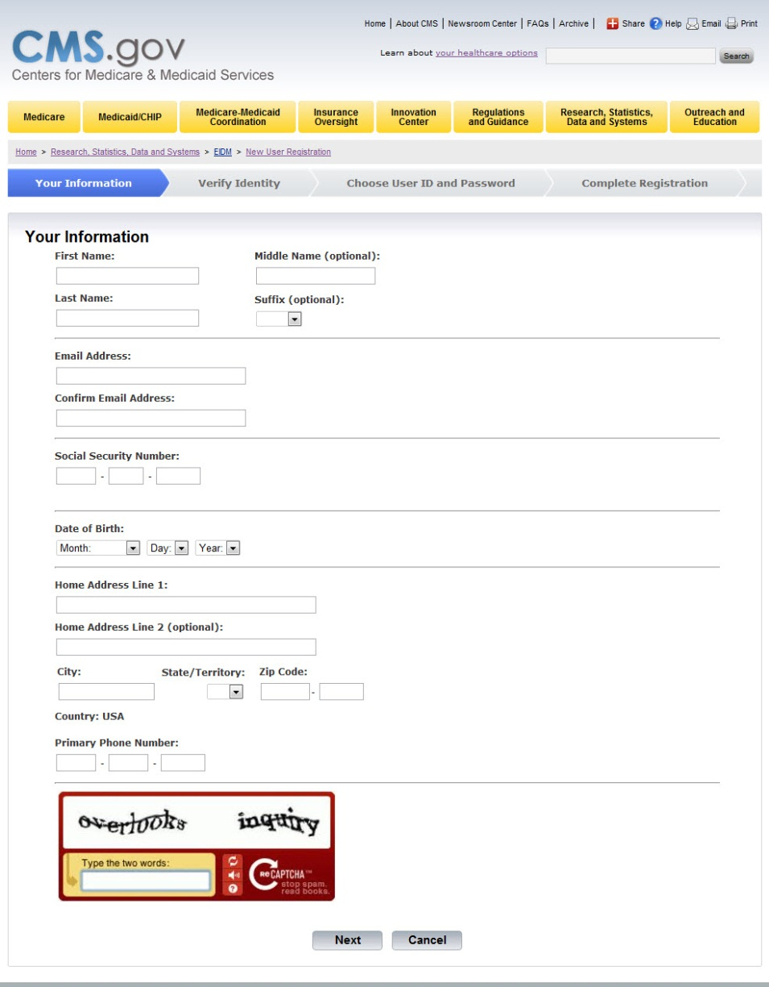
New Registration: Personal Information Entry Screen

Slide 5
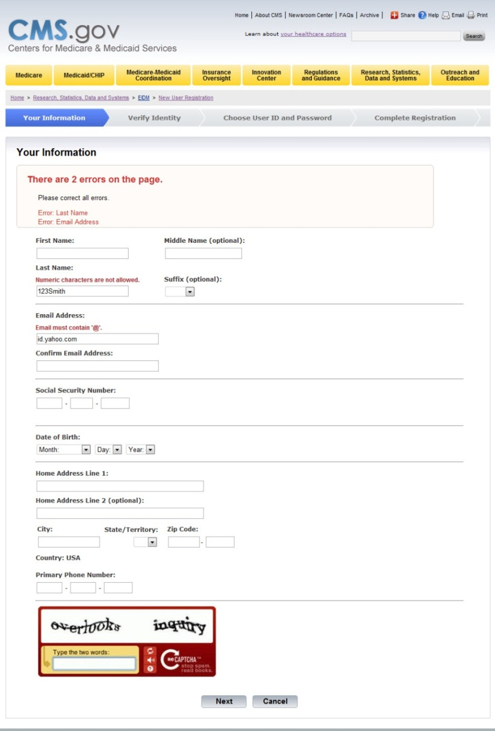
New Registration: Personal Information Entry Error Screen

Slide 6
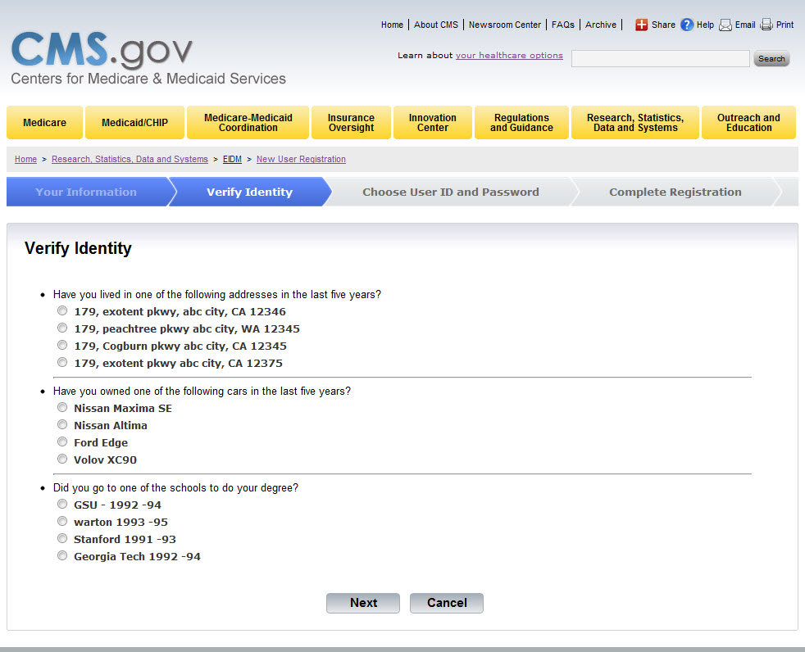
New Registration: Additional Personal Information to Verify Identity Screen

Slide 7
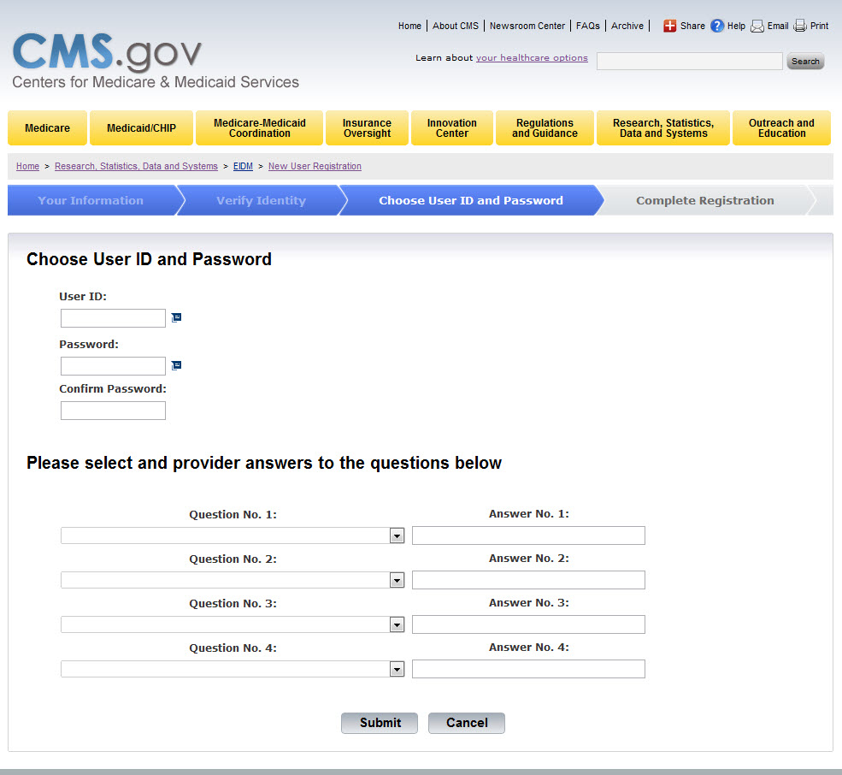
New Registration: Choose User ID and Password Screen

Slide 8
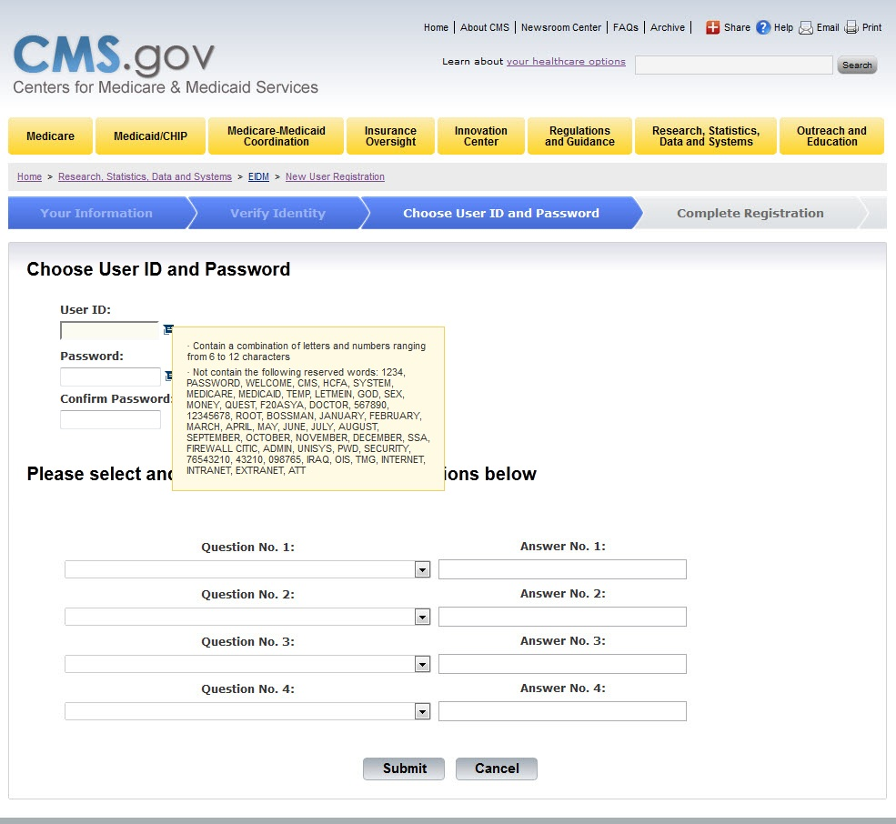
New Registration: Choose User ID and Password Entry Help

Slide 9
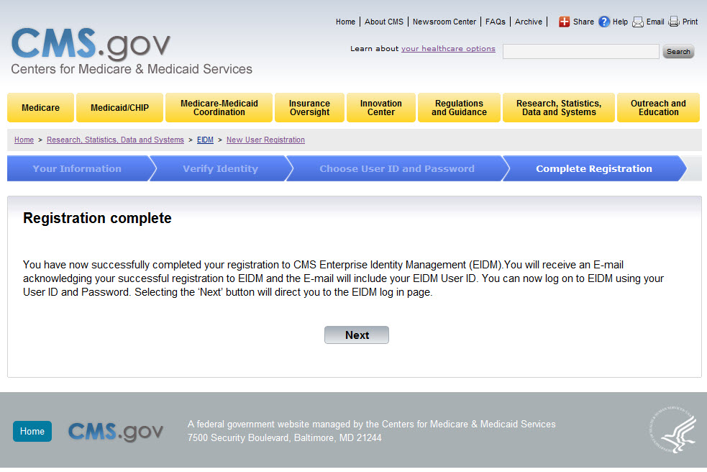
New Registration: Registration Complete Screen

Slide 10
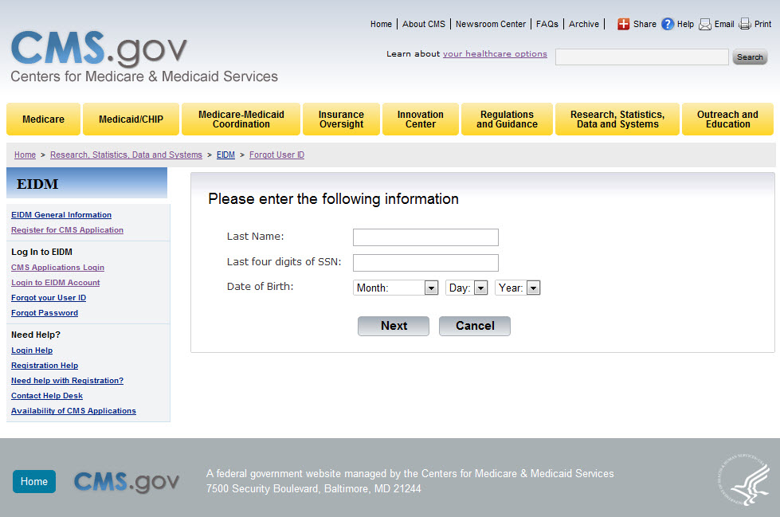
EIDM Existing User: Forgot User ID Screen

Slide 11
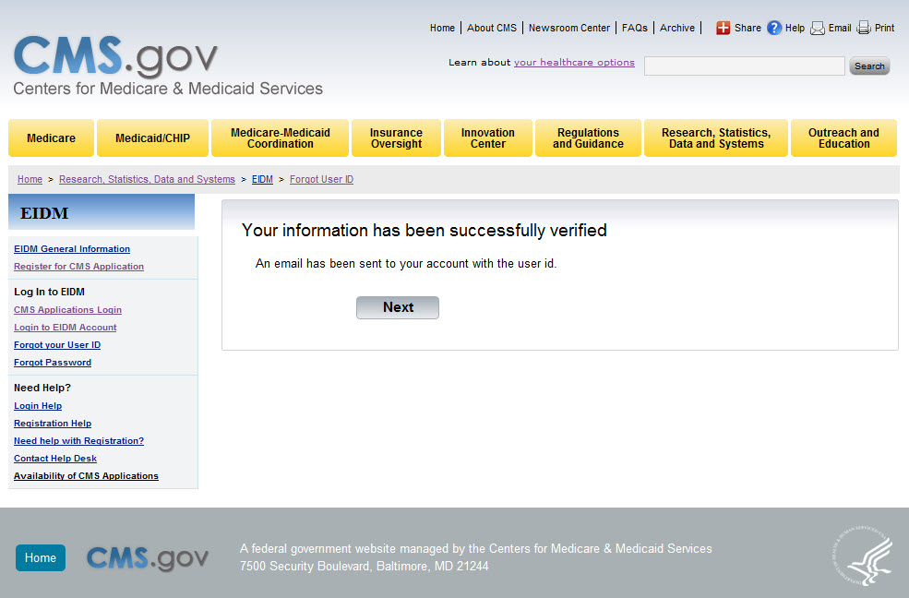
EIDM Existing User: Forgot User ID Completion Screen

Slide 12
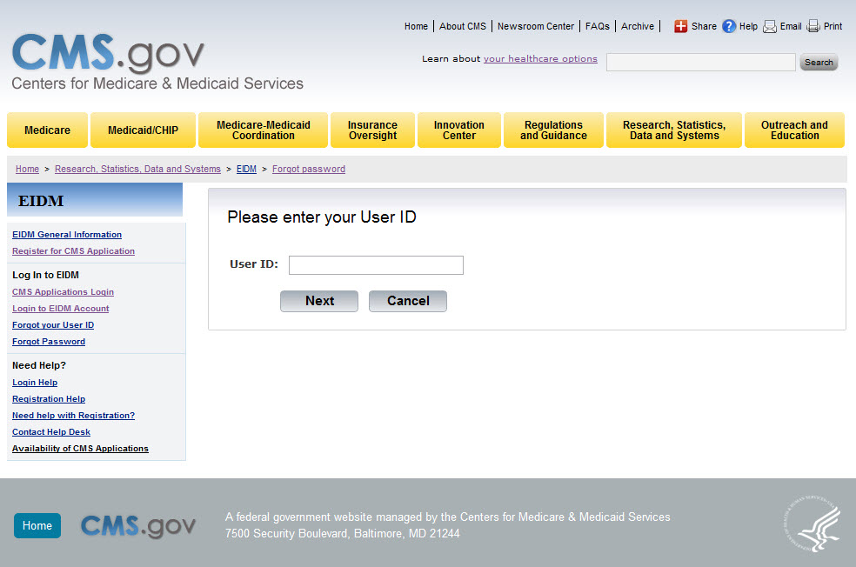
EIDM Existing User: Forgot Password Screen

Slide 13
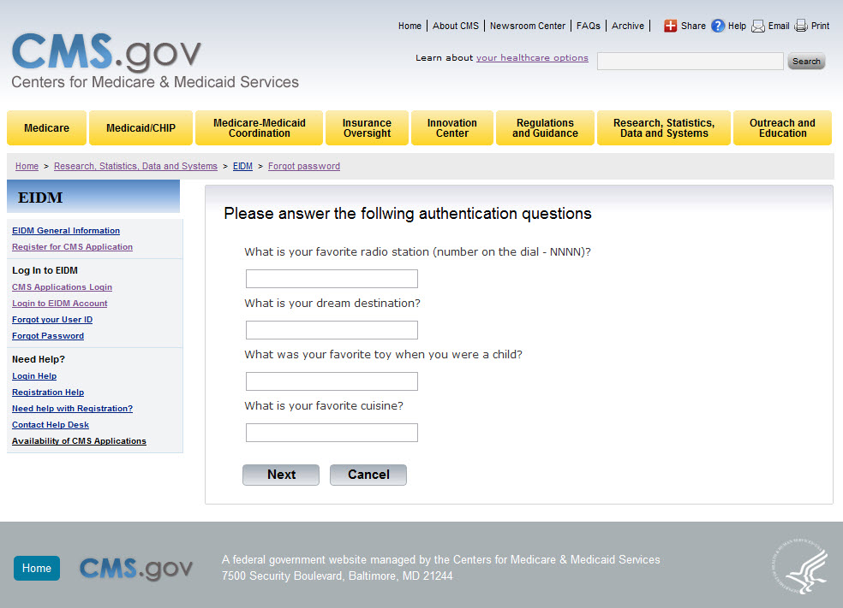
EIDM Existing User: Forgot Password Authentication Questions Screen

Slide 14
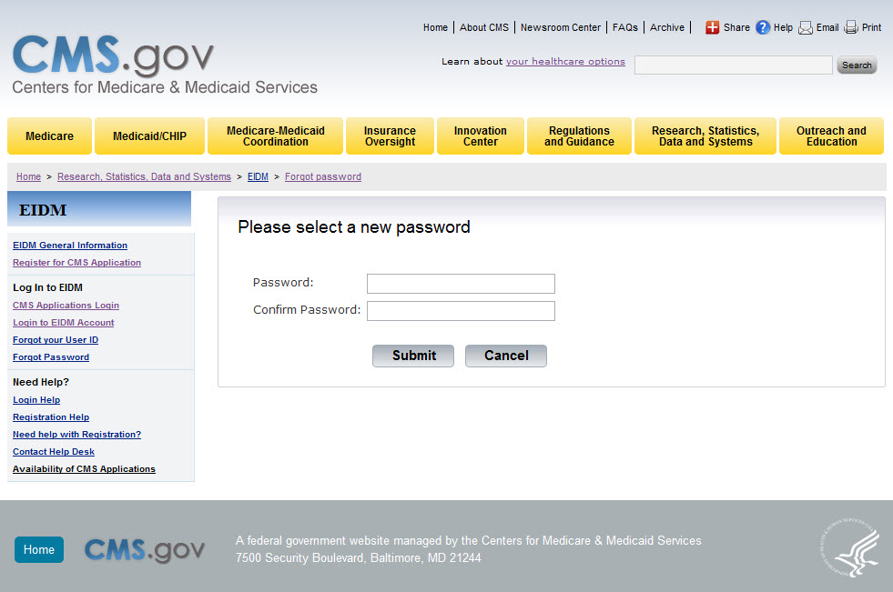
EIDM Existing User: Forgot Password Select New Password Screen

Slide 15
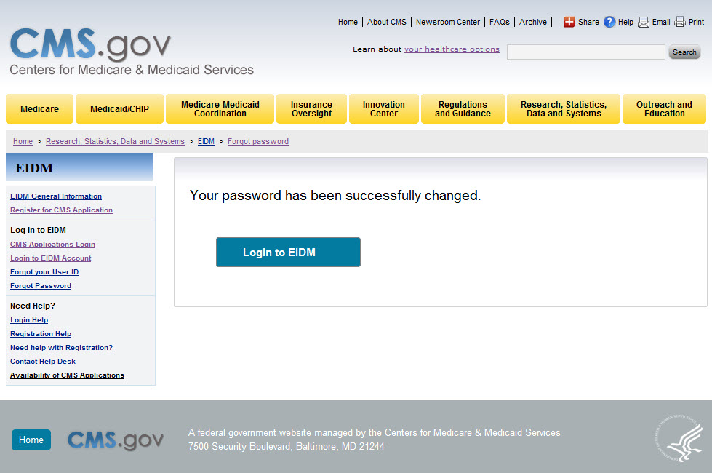
EIDM Existing User: Forgot Password Completion Screen

Slide 16
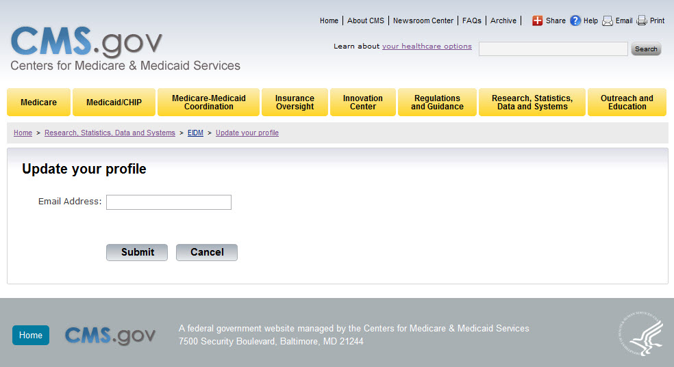
EIDM Existing User: Update User Profile Screen

Slide 17
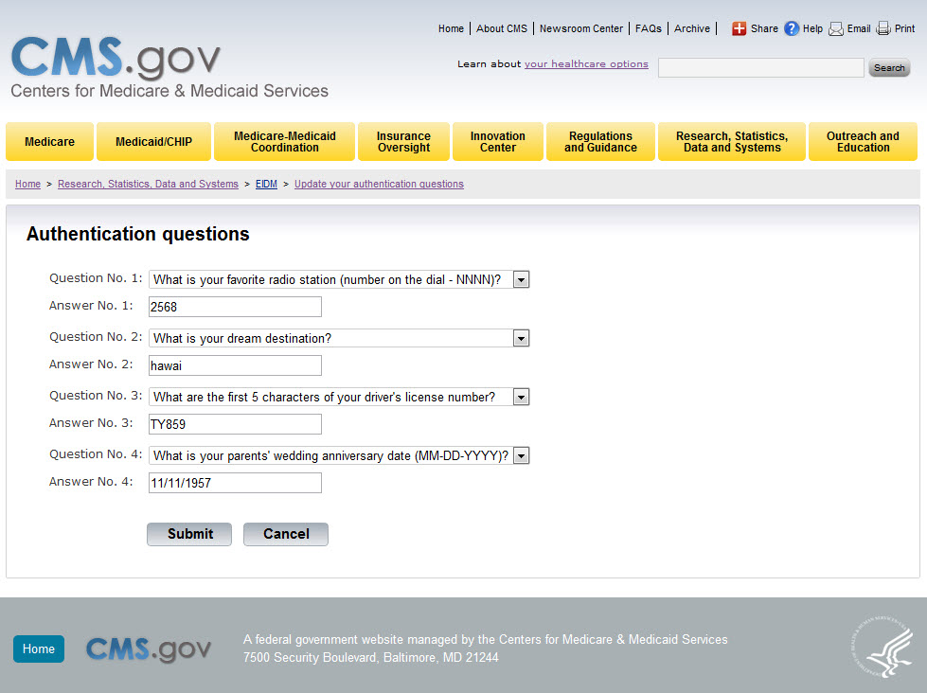
EIDM Existing User: Update Authentication Questions Screen

Slide 18
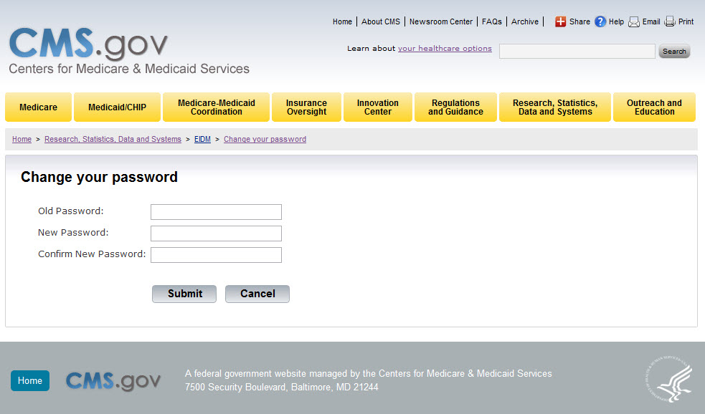
EIDM Existing User: Change Password Screen

Slide 19

EIDM Existing User: Re-Enable User ID Screen

Slide 20

EIDM Existing User: Re-Enable User ID Select New Password Screen

