Slide 1
J Visa Waiver Online (JWOL) 02.00.00
User Interface Design
as of September 18, 20013

Slide 2
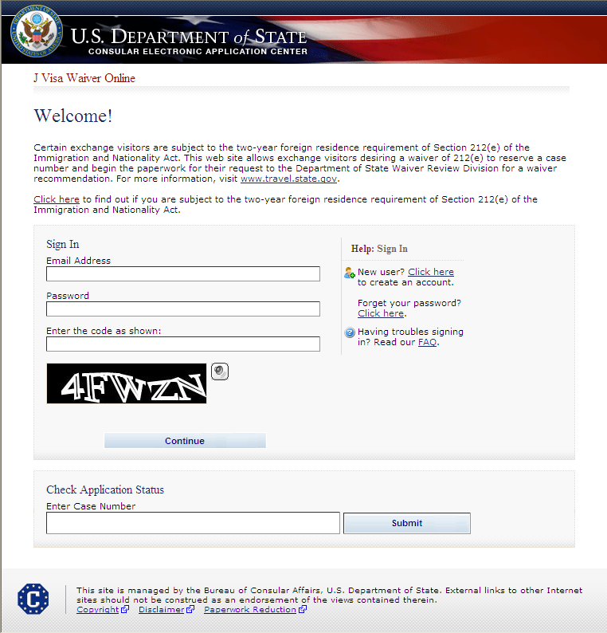
Login to Account
SAMPLE

Slide 3
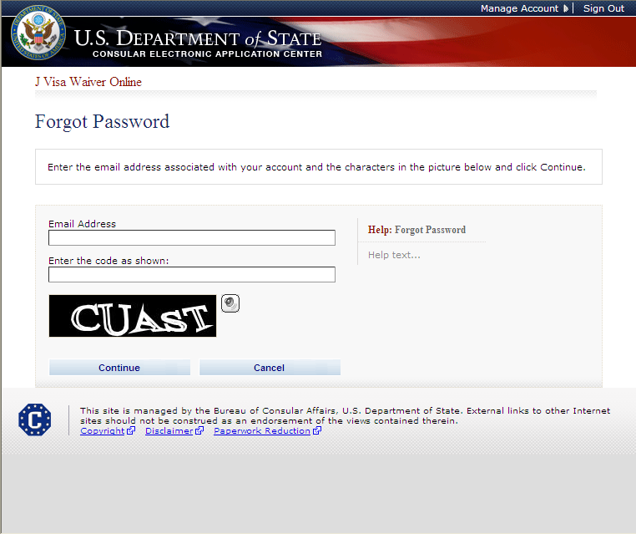
Forgot Password

Slide 4
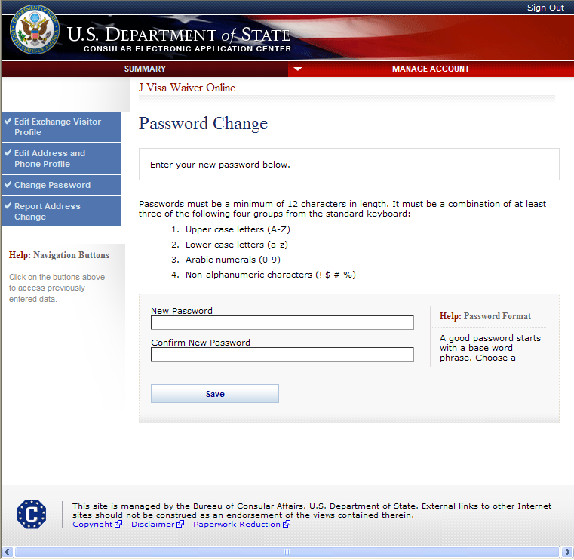
Change Password

Slide 5
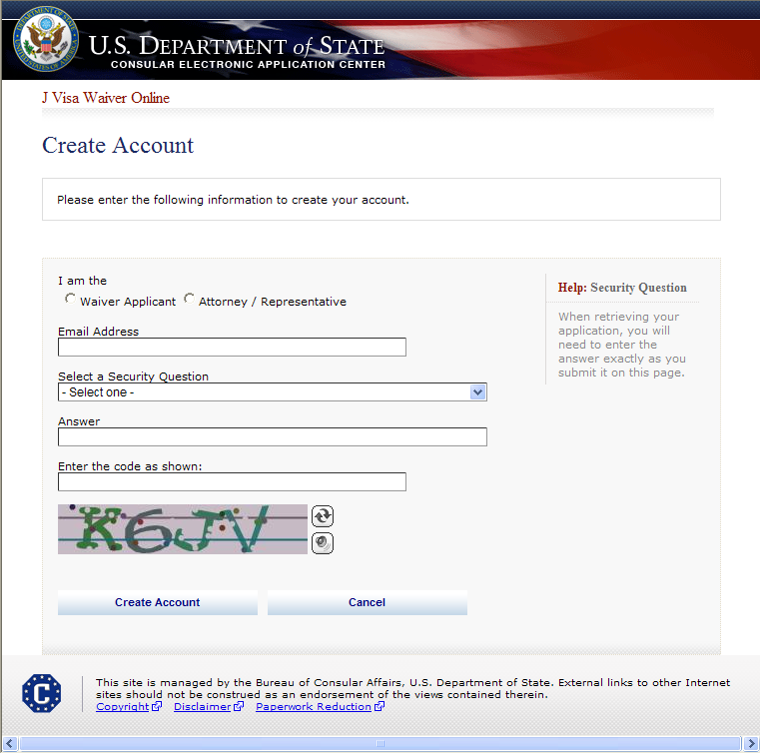
Create New Account

Slide 6
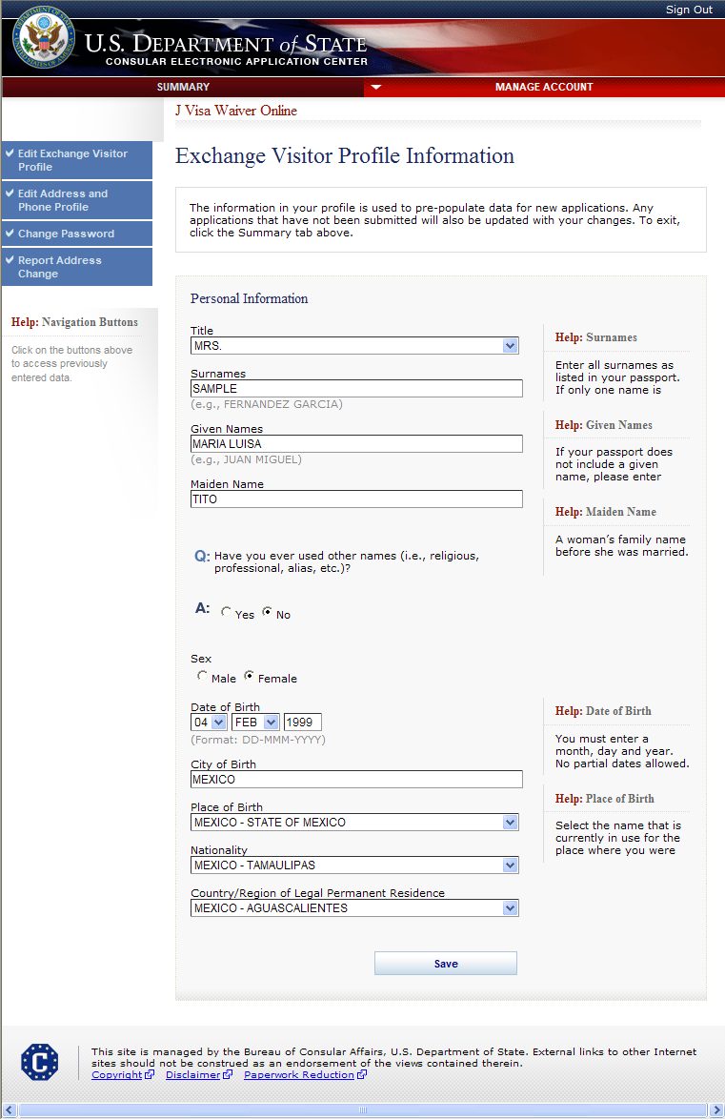
Create Applicant Profile If Account Type is Waiver Applicant

Slide 7
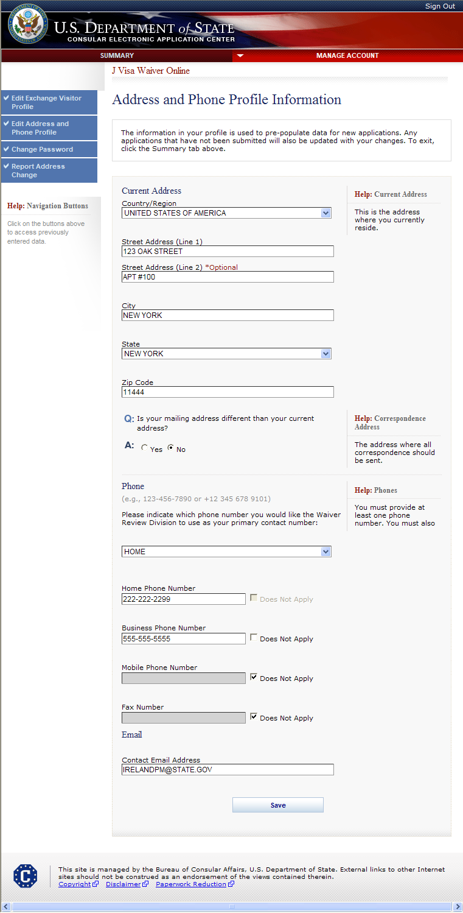
Create Applicant Profile (cont.) Address and Phone Profile Information

Slide 8
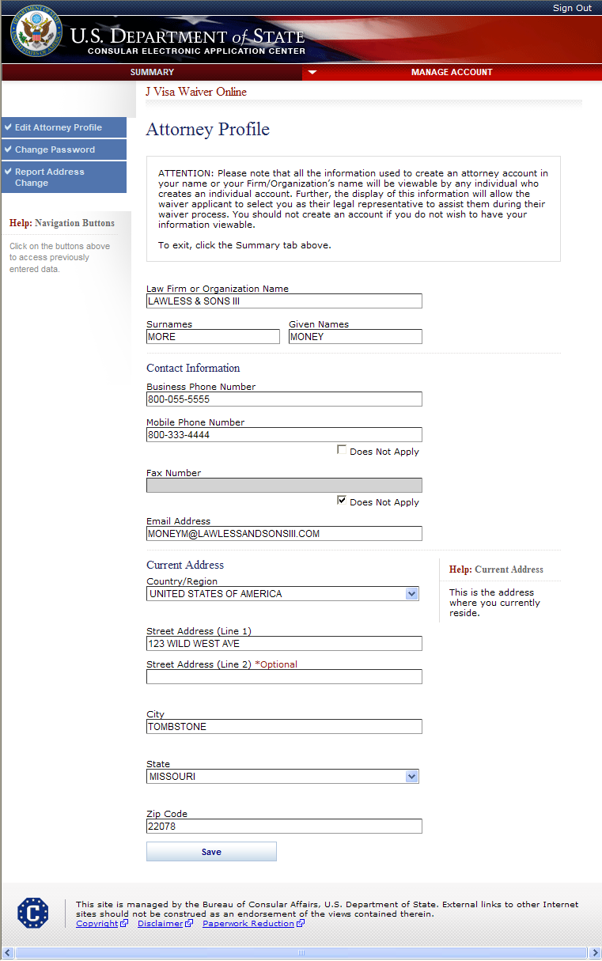
Create Attorney Profile If Account Type is Attorney/Representative

Slide 9
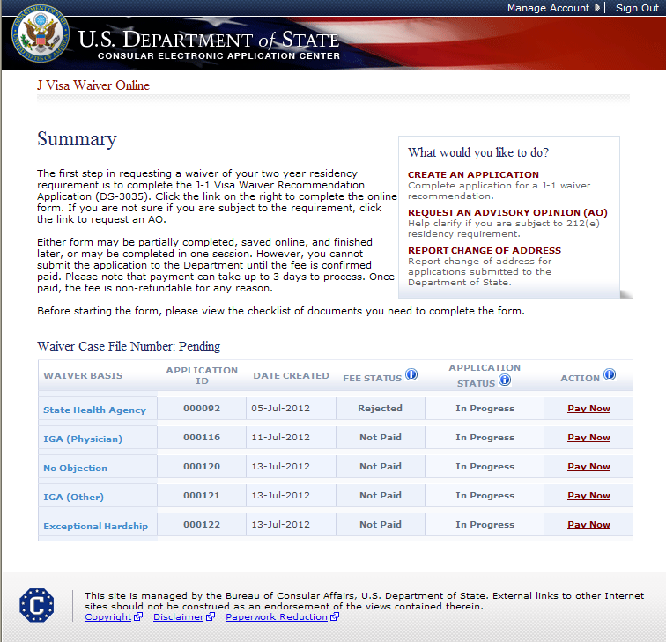
Summary Page For Waiver Applicants
SAMPLE

Slide 10
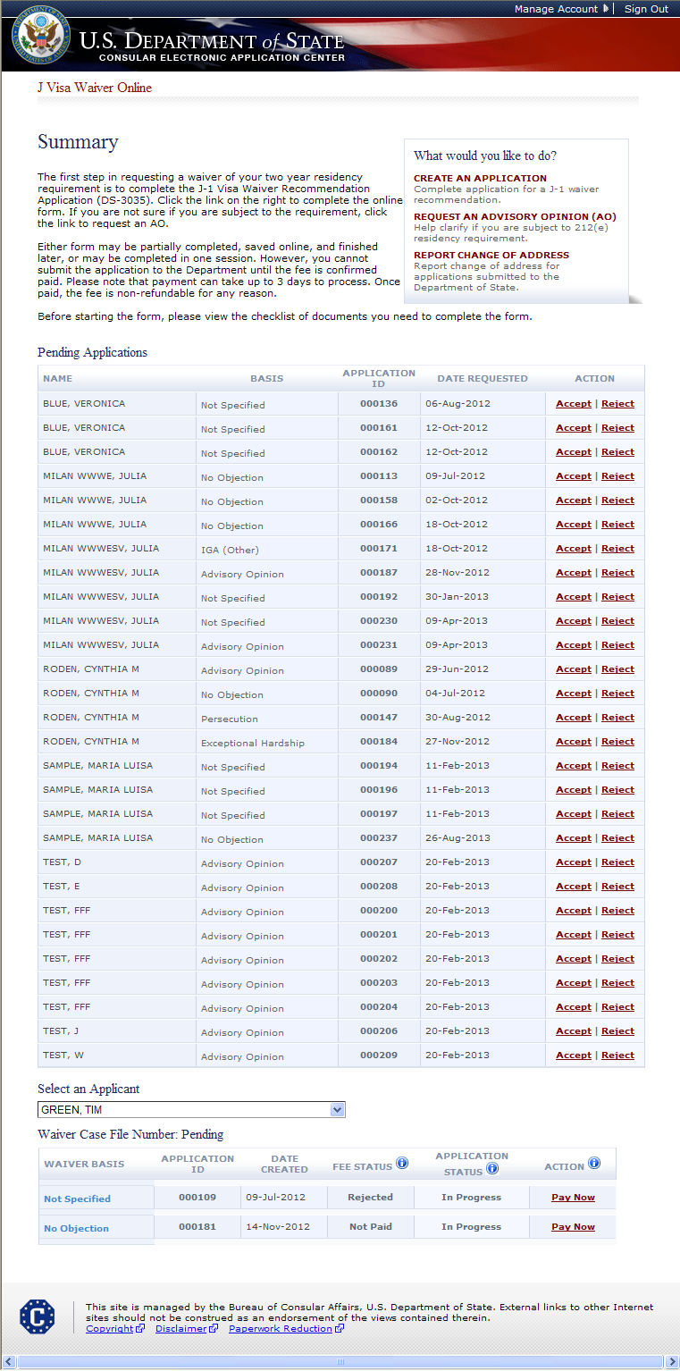
Summary Page For Attorneys
SAMPLE

Slide 11
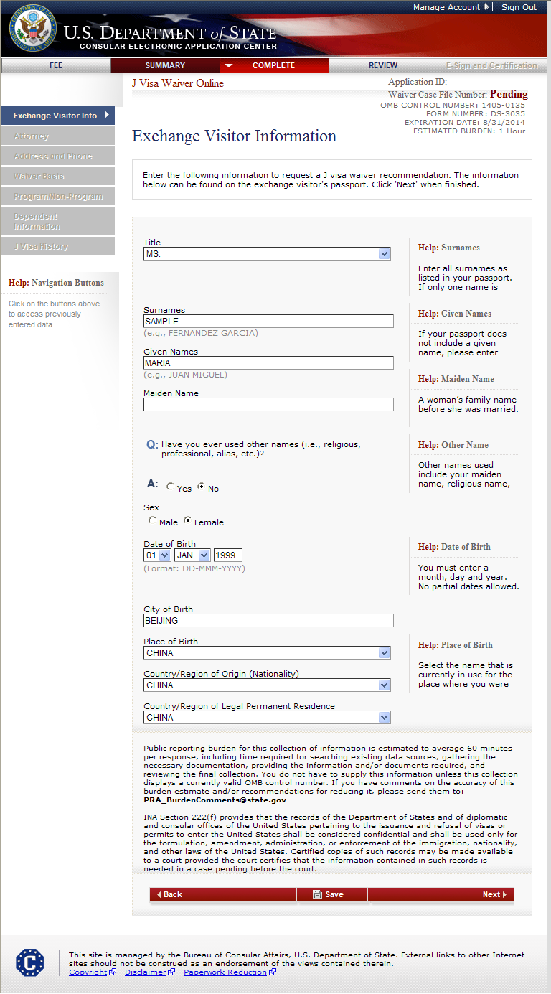
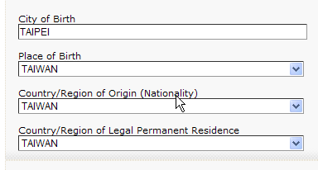
Exchange Visitor Information Page
Changed the labels on the following fields:
Country of Birth changed to Place of Birth
Citizenship Country changed to Country/Region of Origin
Country of Legal Permanent Residence changed to Country/Region of Legal Permanent Residence
Please provide for OMB Purpose an expanded view of the drop down list showing these changes. Regarding Taiwan and China.
CHANGED FROM A/ISS/DIR, Room 2400 SA-22 US Department of State, Washington D.C 20522-2202 to PRA_BurdenComments@state.gov

Slide 12
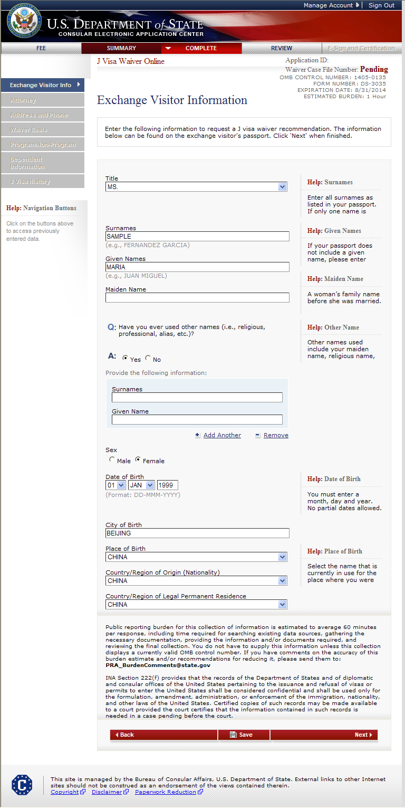
Exchange Visitor Information Page Displays if user indicates other names were used
CHANGED FROM A/ISS/DIR, Room 2400 SA-22 US Department of State, Washington D.C 20522-2202 to PRA_BurdenComments@state.gov

Slide 13
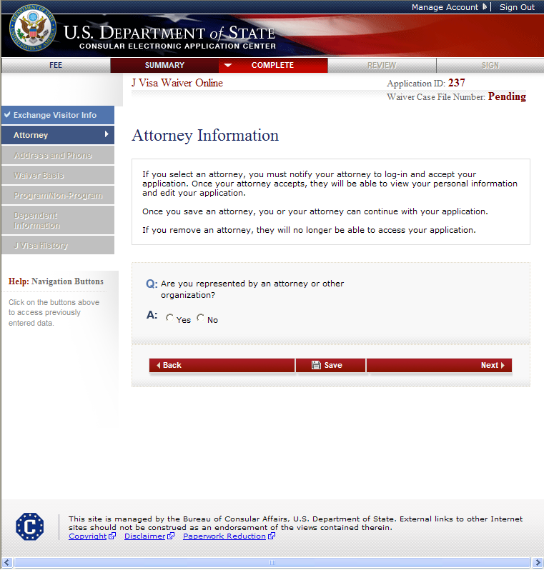
Attorney Information Page

Slide 14
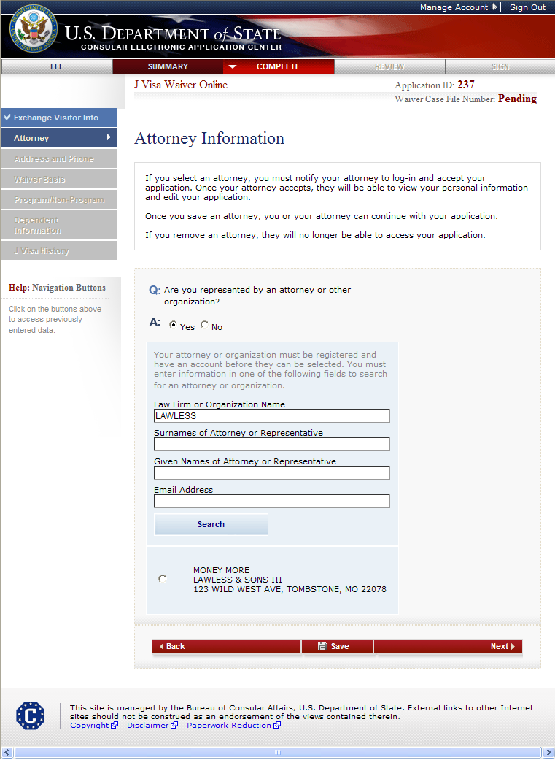
Attorney Information Page (cont.) Displayed if user indicates they are represented by an attorney or other organization

Slide 15
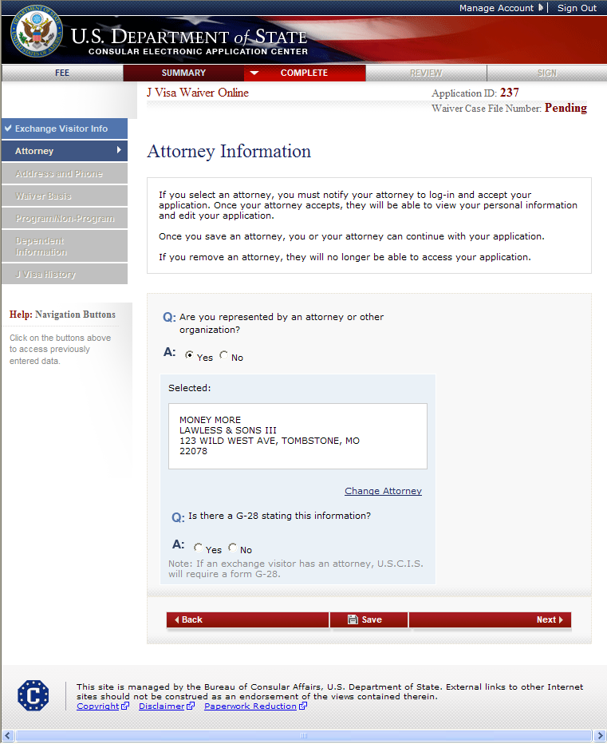
Attorney Information Page (cont.) G-28 question displayed after user selects an attorney/representative

Slide 16
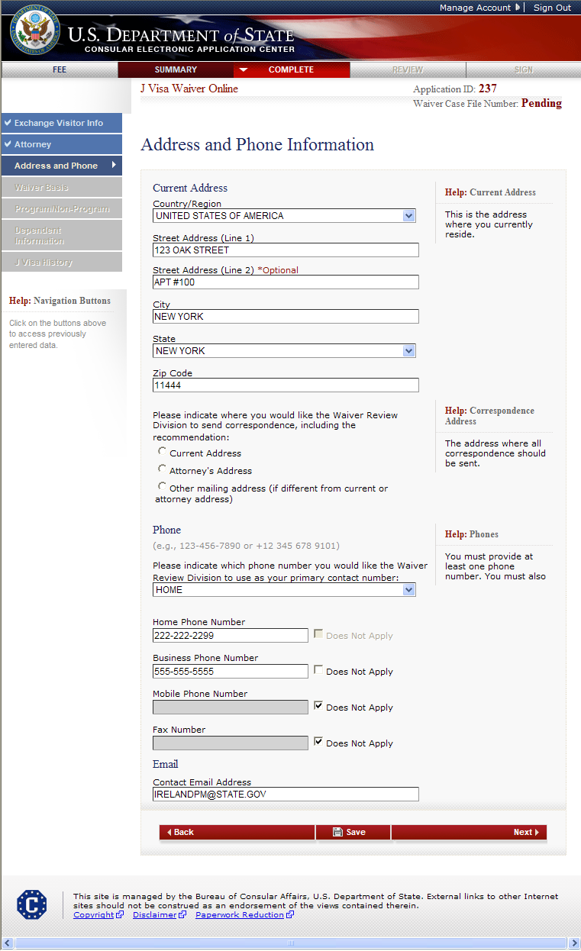
Address and Phone Page

Slide 17
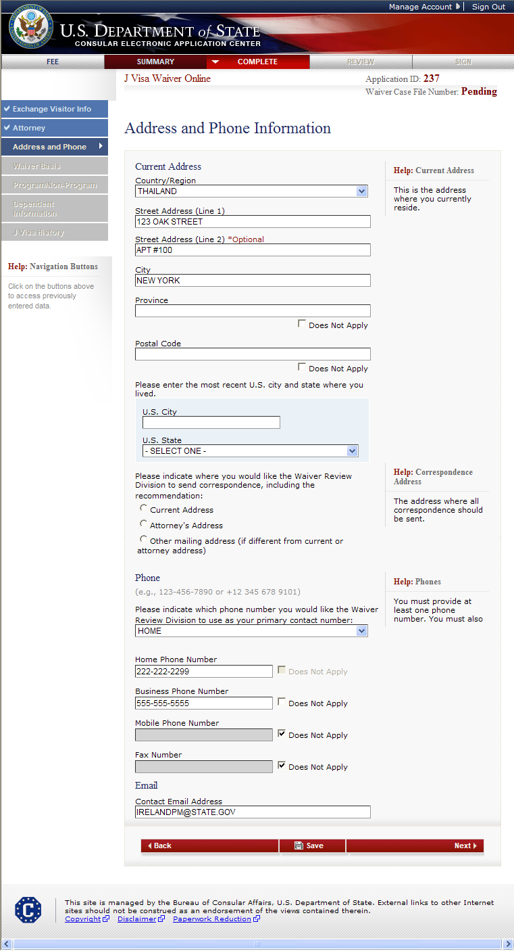
Address and Phone Page (cont.) Displays if current address is not in U.S.

Slide 18
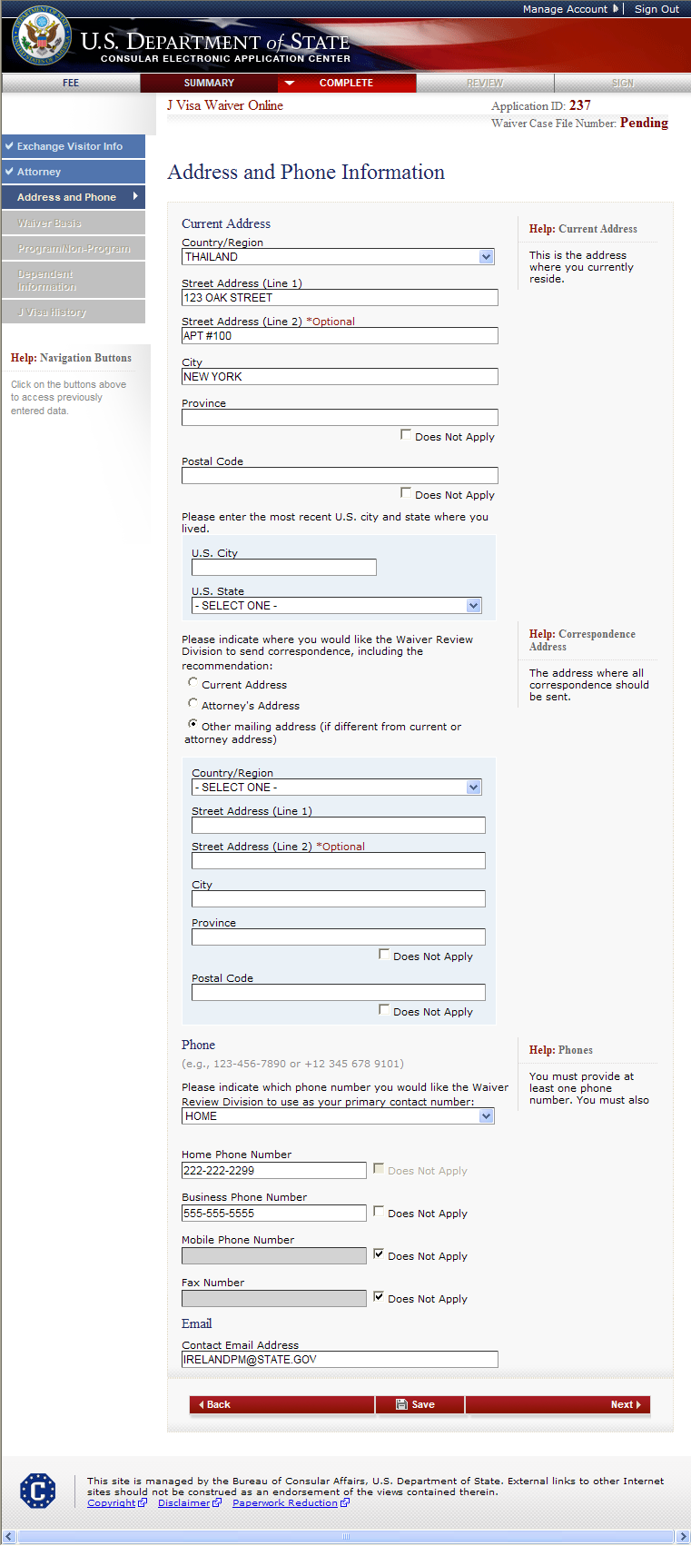
Address and Phone Page (cont.) Displays if another mailing address for correspondence is selected

Slide 19
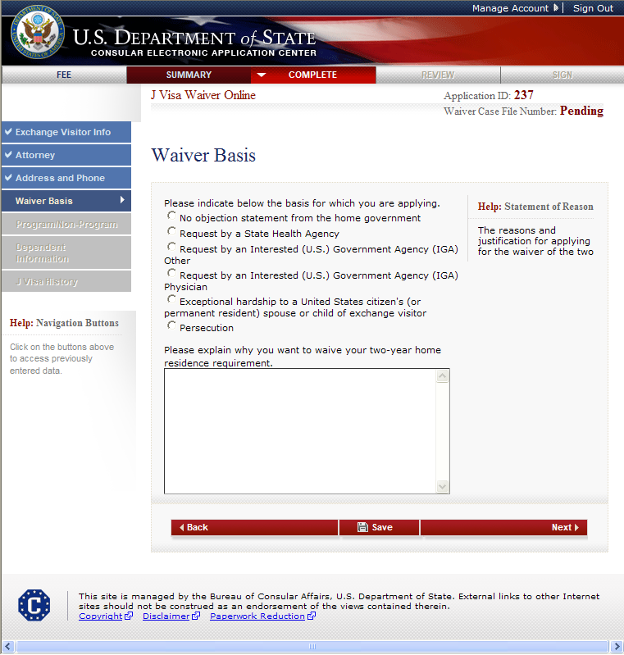
Waiver Basis Page Displayed for all users

Slide 20
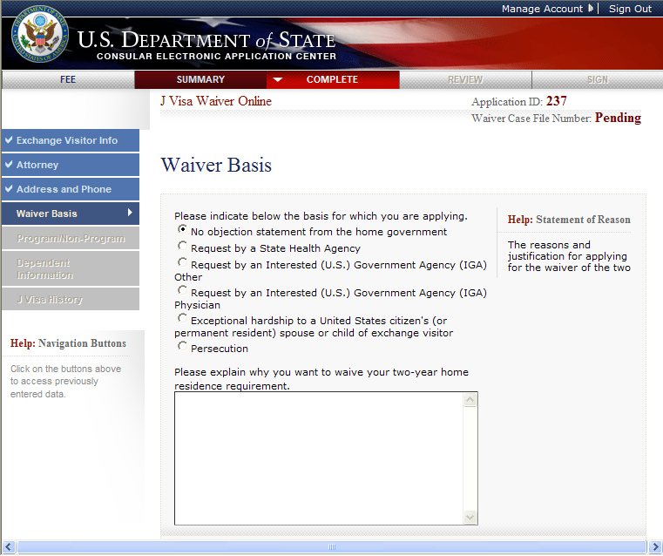
Waiver Basis Page Displays if No objection from home government selected

Slide 21
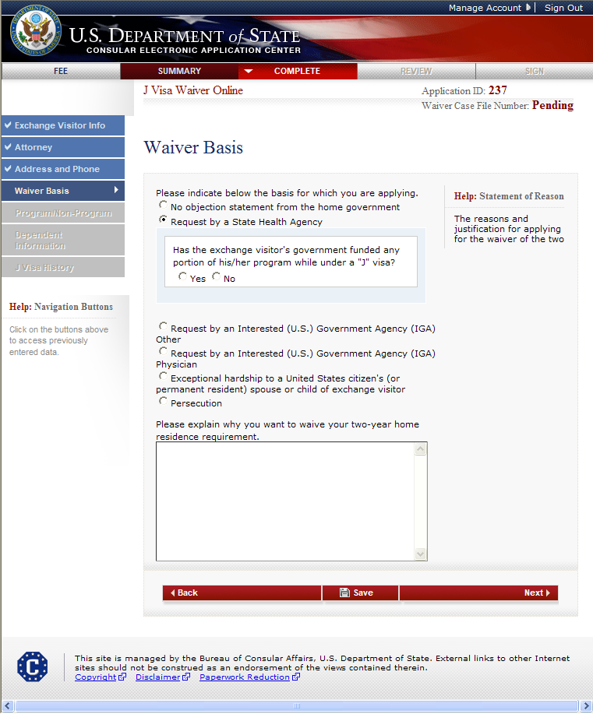
Waiver Basis Page Displays if Request by State Health Agency selected

Slide 22
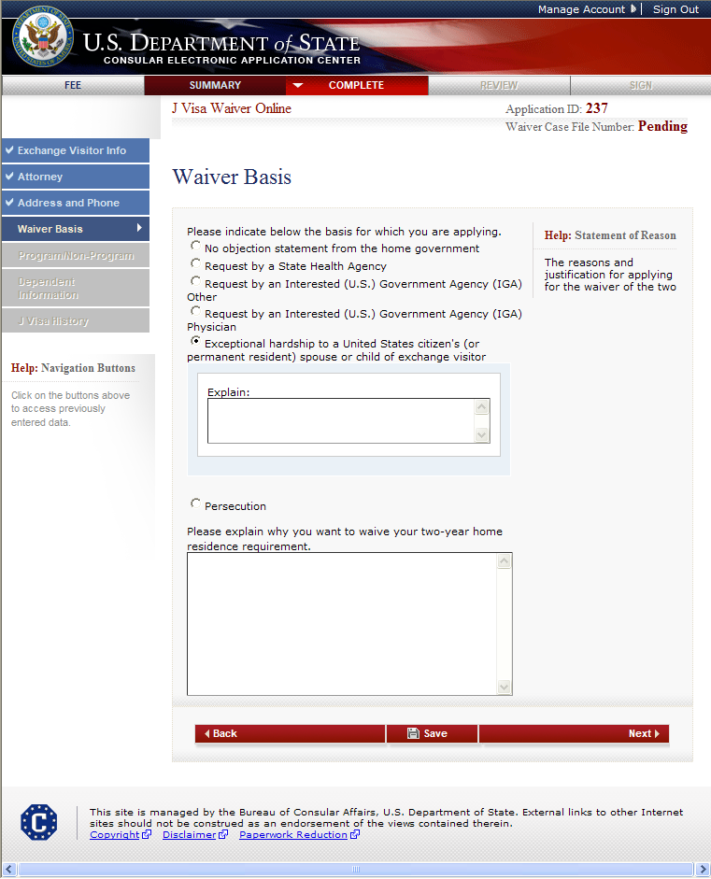
Waiver Basis Page Displays if Exceptional Hardship selected

Slide 23
Waiver Basis Page Displays if Persecution selected
The user must enter an explanation.

Slide 24
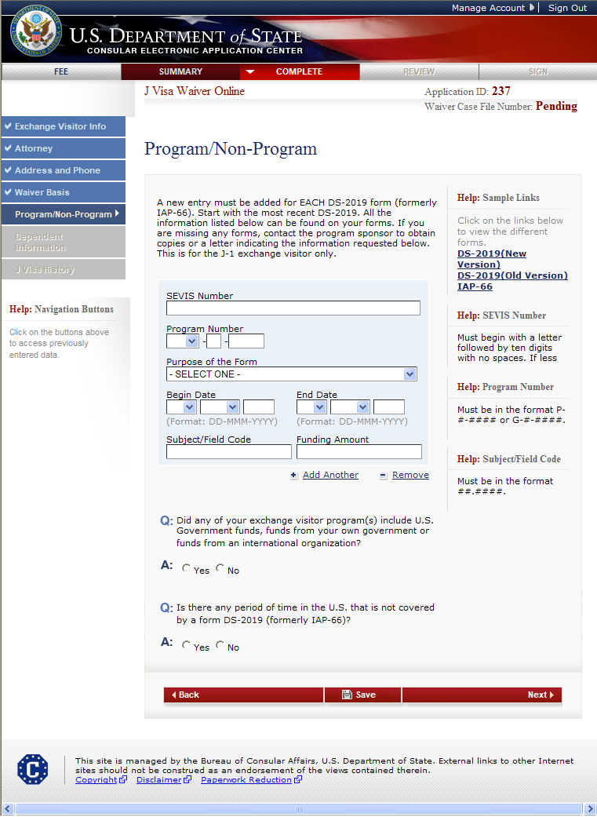
Program/Non-Program Page

Slide 25
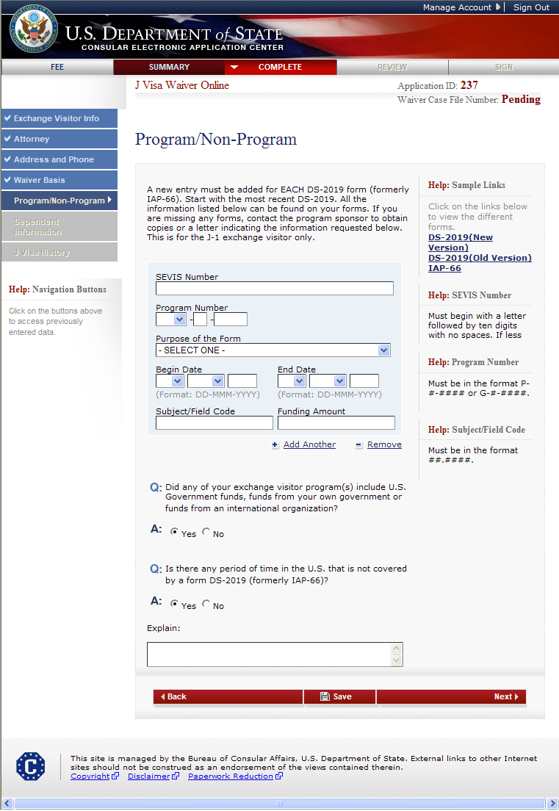
Program/Non-Program Page (cont.) Answers Yes to “Is there any period of time in the U.S. that is not covered by a DS-2019 or IAP-66 form?”

Slide 26
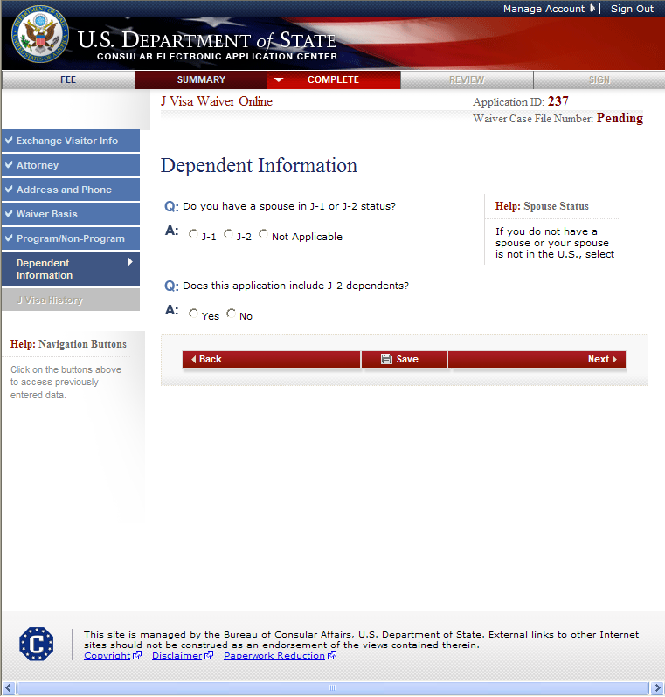
Dependent Information Page

Slide 27
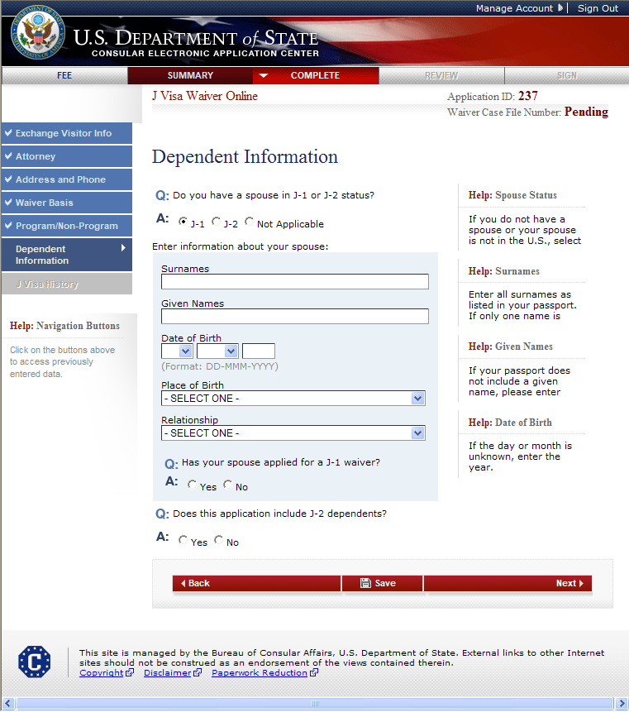
Dependent Information Page Spouse in J-1 Status

Slide 28
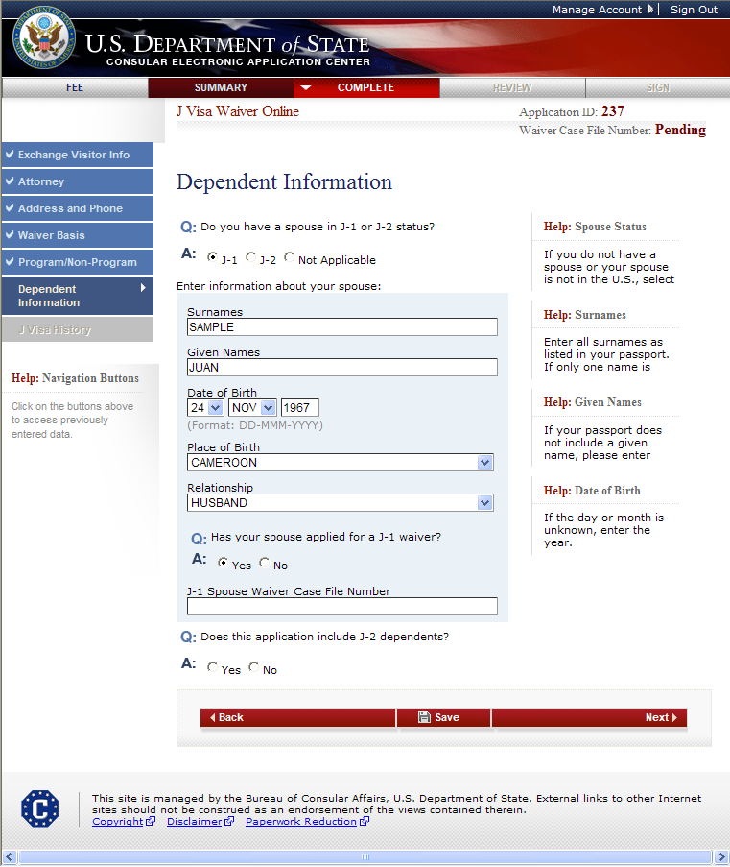
Dependent Information Page Spouse in J-1 status and applied for a waiver

Slide 29
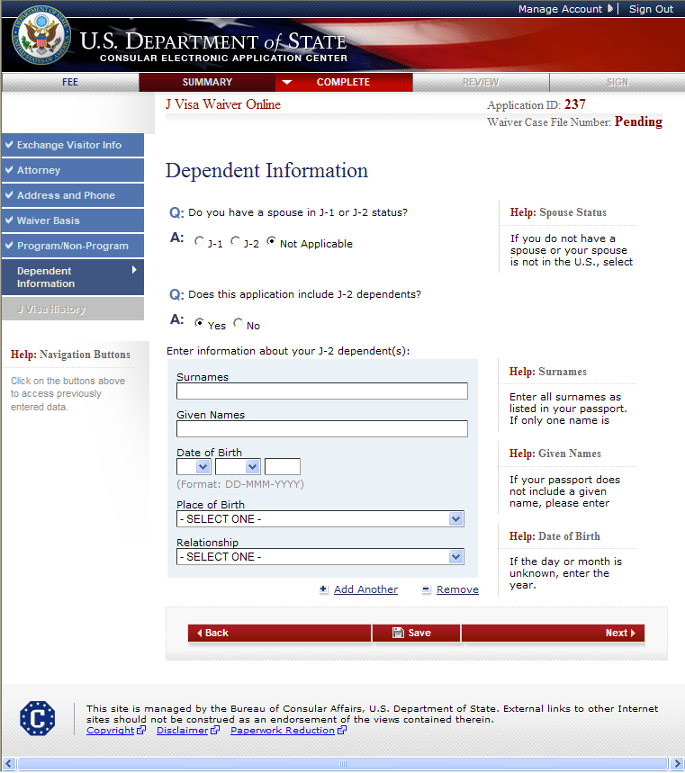
Dependent Information Page There are J-2 dependents

Slide 30
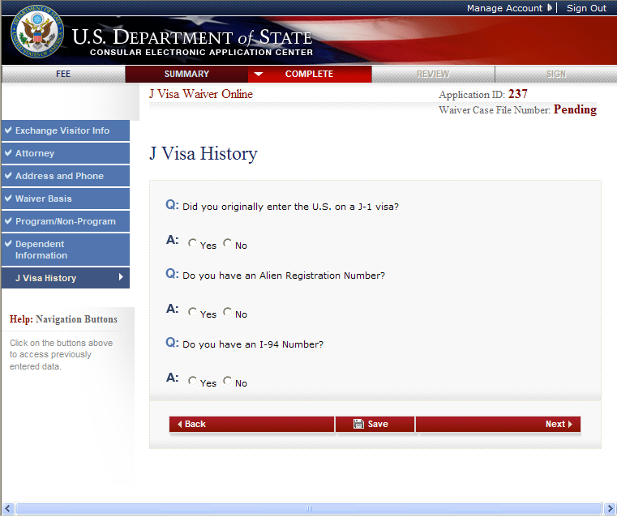
J Visa History Page

Slide 31
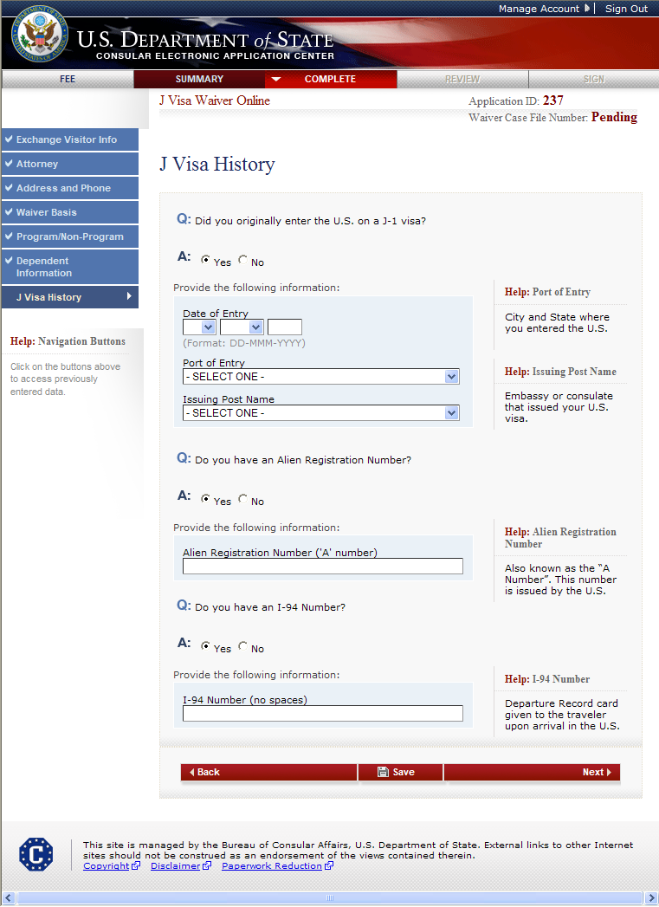
J Visa History Page (cont.) Answers Yes to all questions
The user must enter the date of entry, select Port of Entry from the drop-down list and select the Issuing Post from the drop-down list.
The user must enter the Alien Registration Number and I-94 Number.

Slide 32
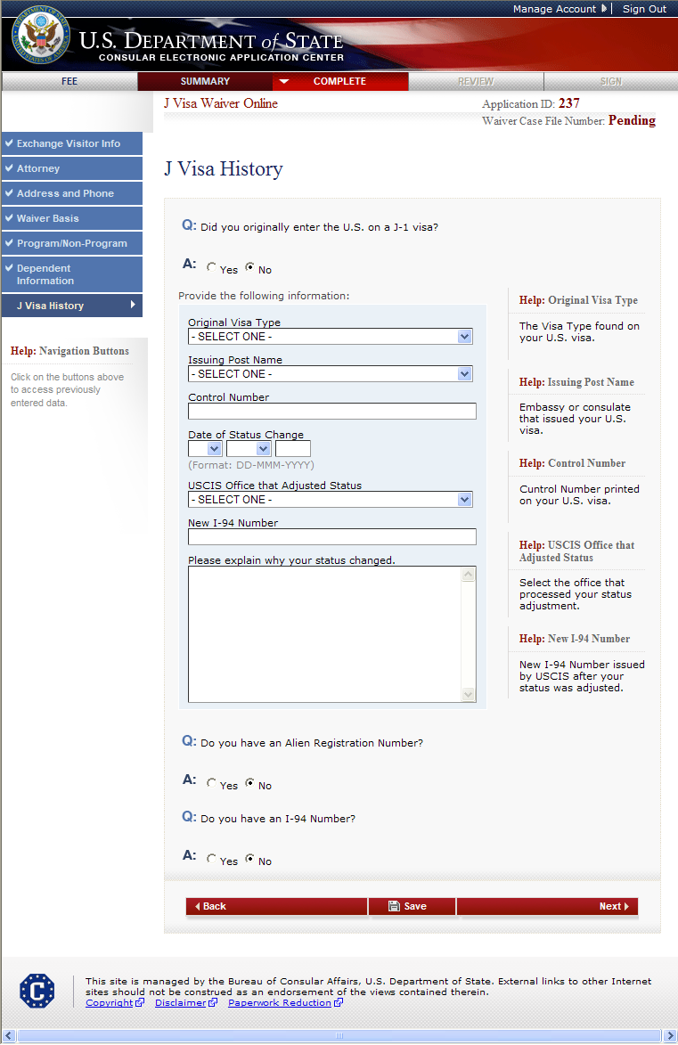
J Visa History (cont.) Answers No to all questions
The user must enter the Date of Status Change, Original Visa Type, New I-94 Number, Control Number, Issuing Post of the Visa and explain why their status changed.

Slide 33
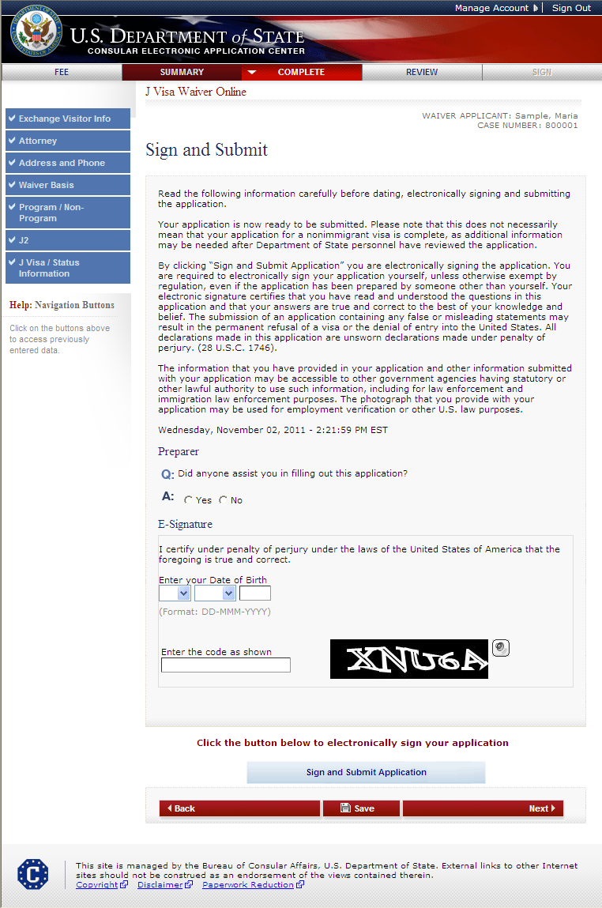
Sign and Submit Page
SAMPLE

Slide 34
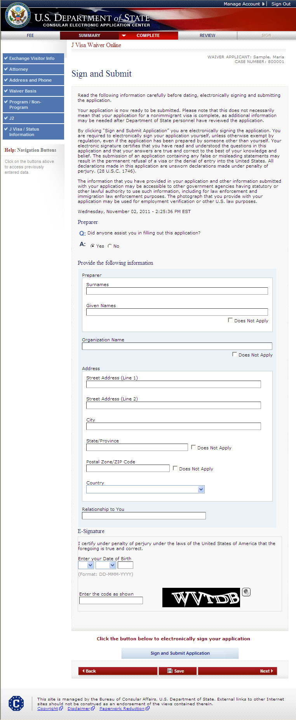
Sign and Submit Page (cont.) Answers Yes to “Did someone assist you in filling out this application?”
SAMPLE

Slide 35
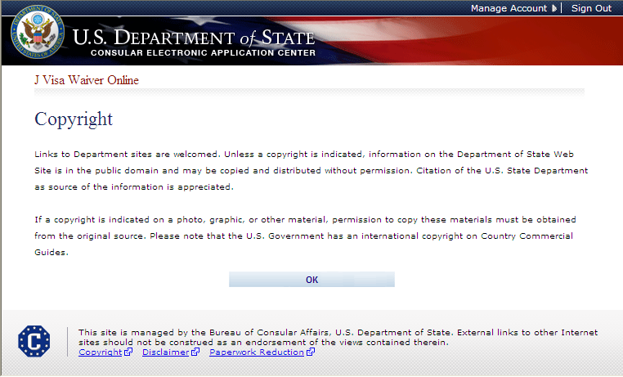
Copyright Page

Slide 36
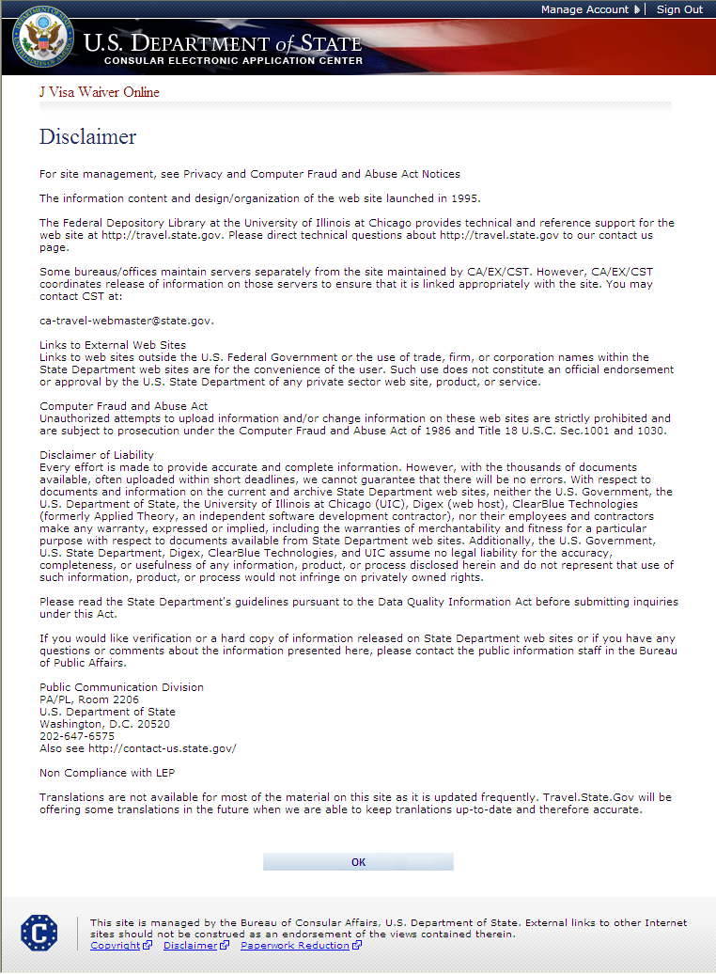
Disclaimer Page

Slide 37
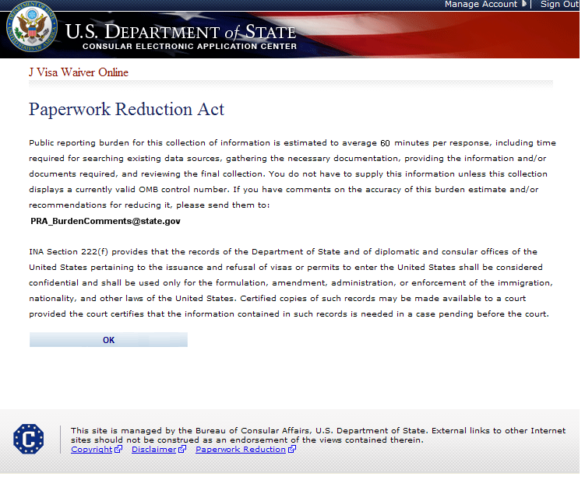
Paperwork Reduction Act Page
Changed from 75 minutes to 60 minutes
CHANGED: A/ISS/DIR, Room 2400 SA-22 US Department of State, Washington D.C 20522-2202 to

