Slide 1
Registration Intake
Call Center Script
FEMA Form 009-0-1T (English)
Tele-Registration (Call Center)
OMB Control Number: 1660-0002
Expiration Date: 7/31/2015

Slide 2
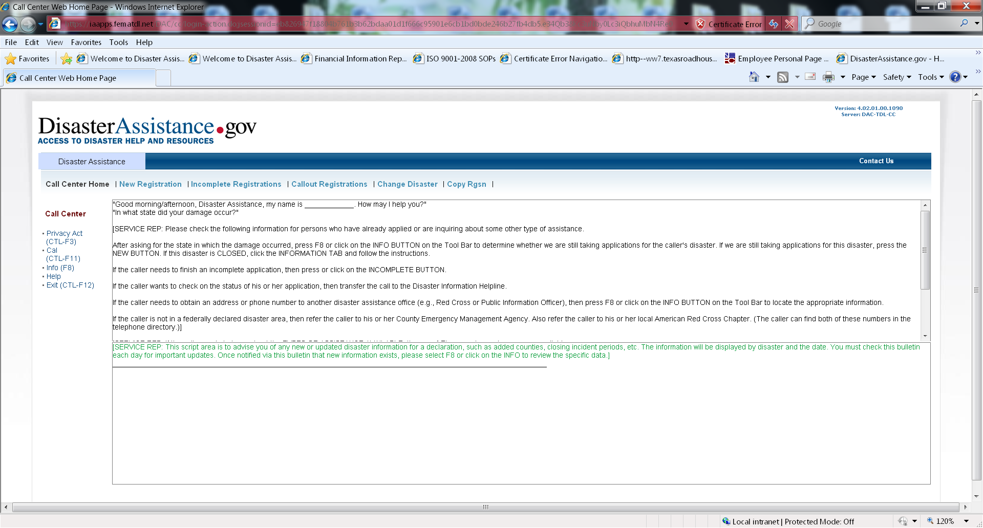

Slide 3
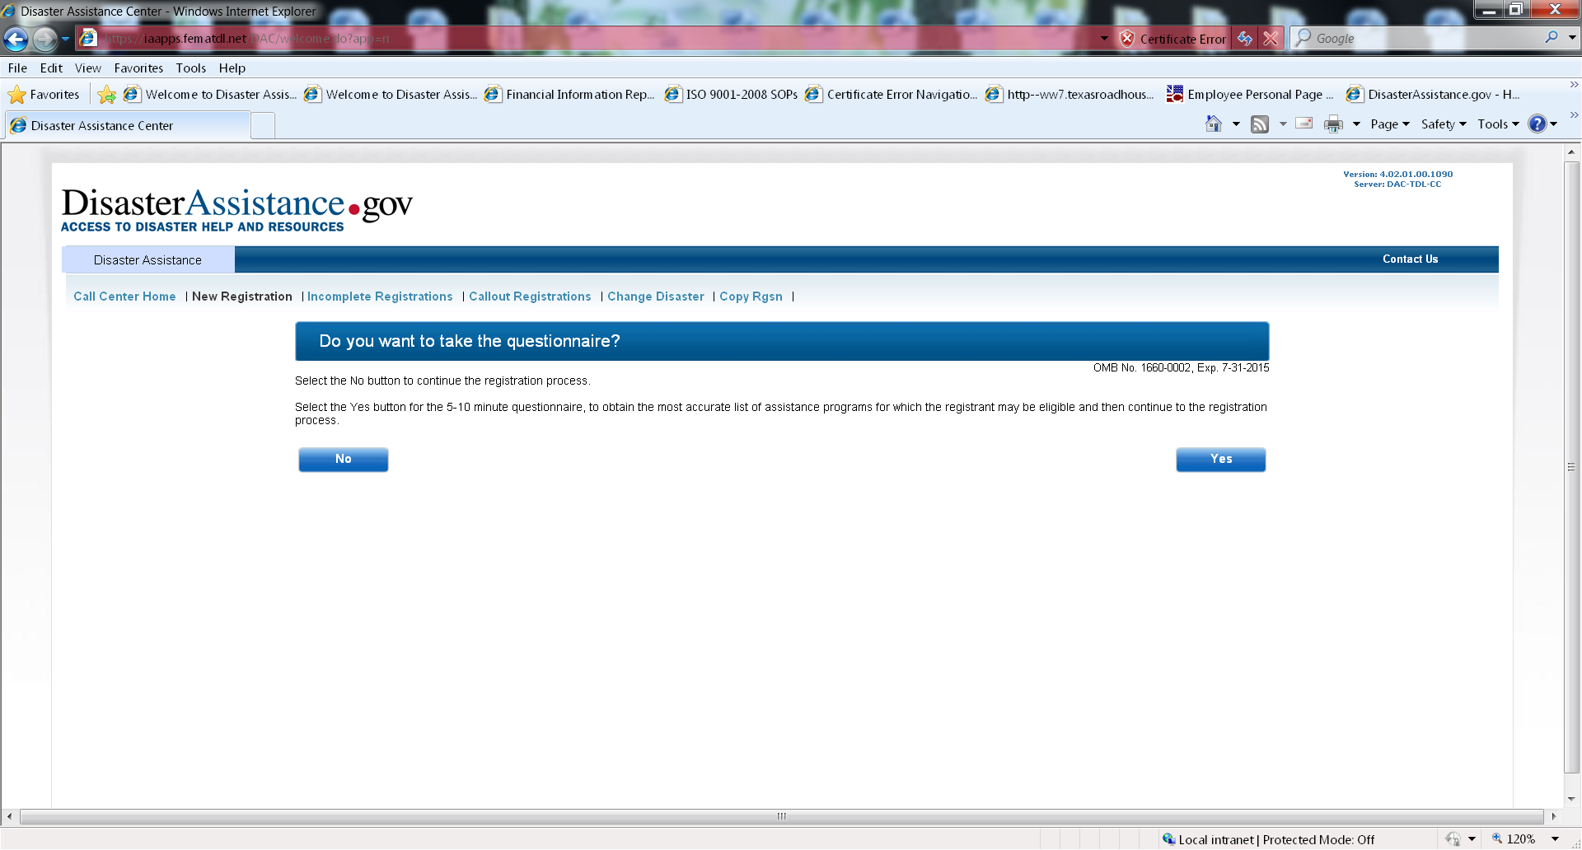

Slide 4
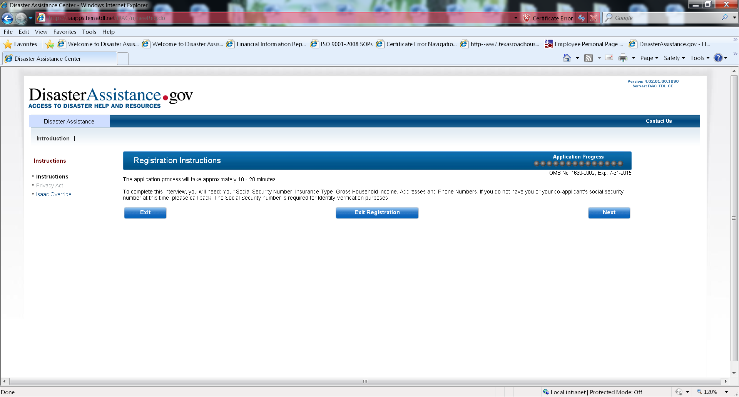

Slide 5
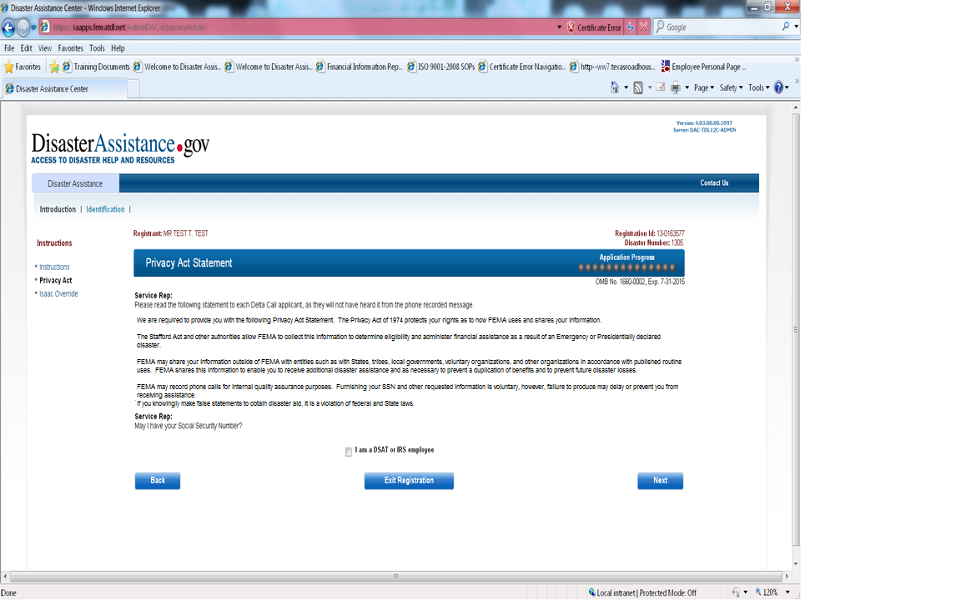

Slide 6
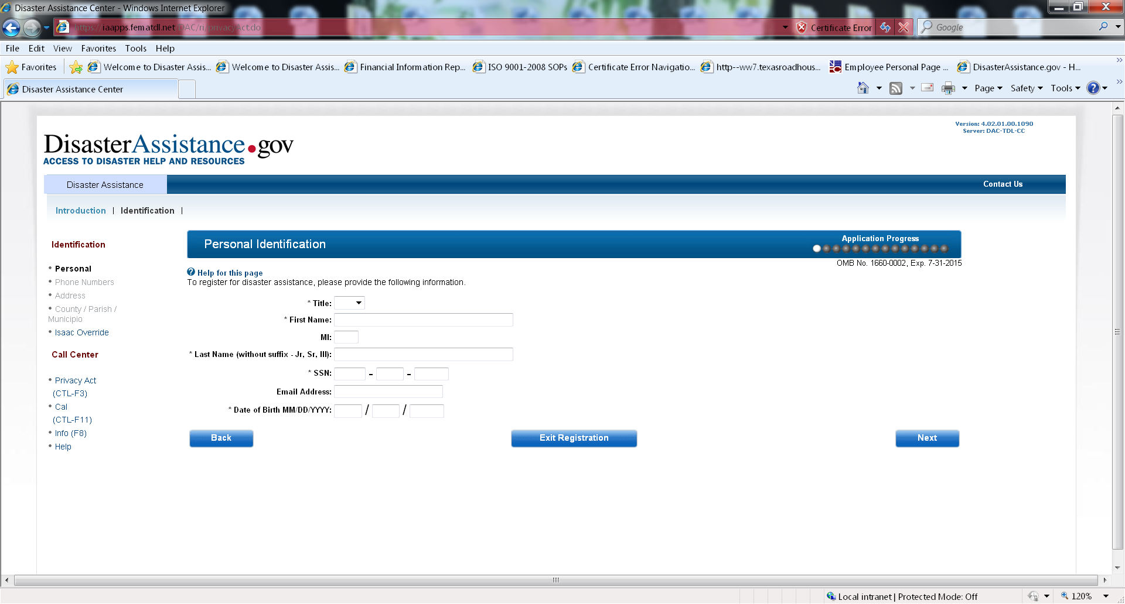

Slide 7
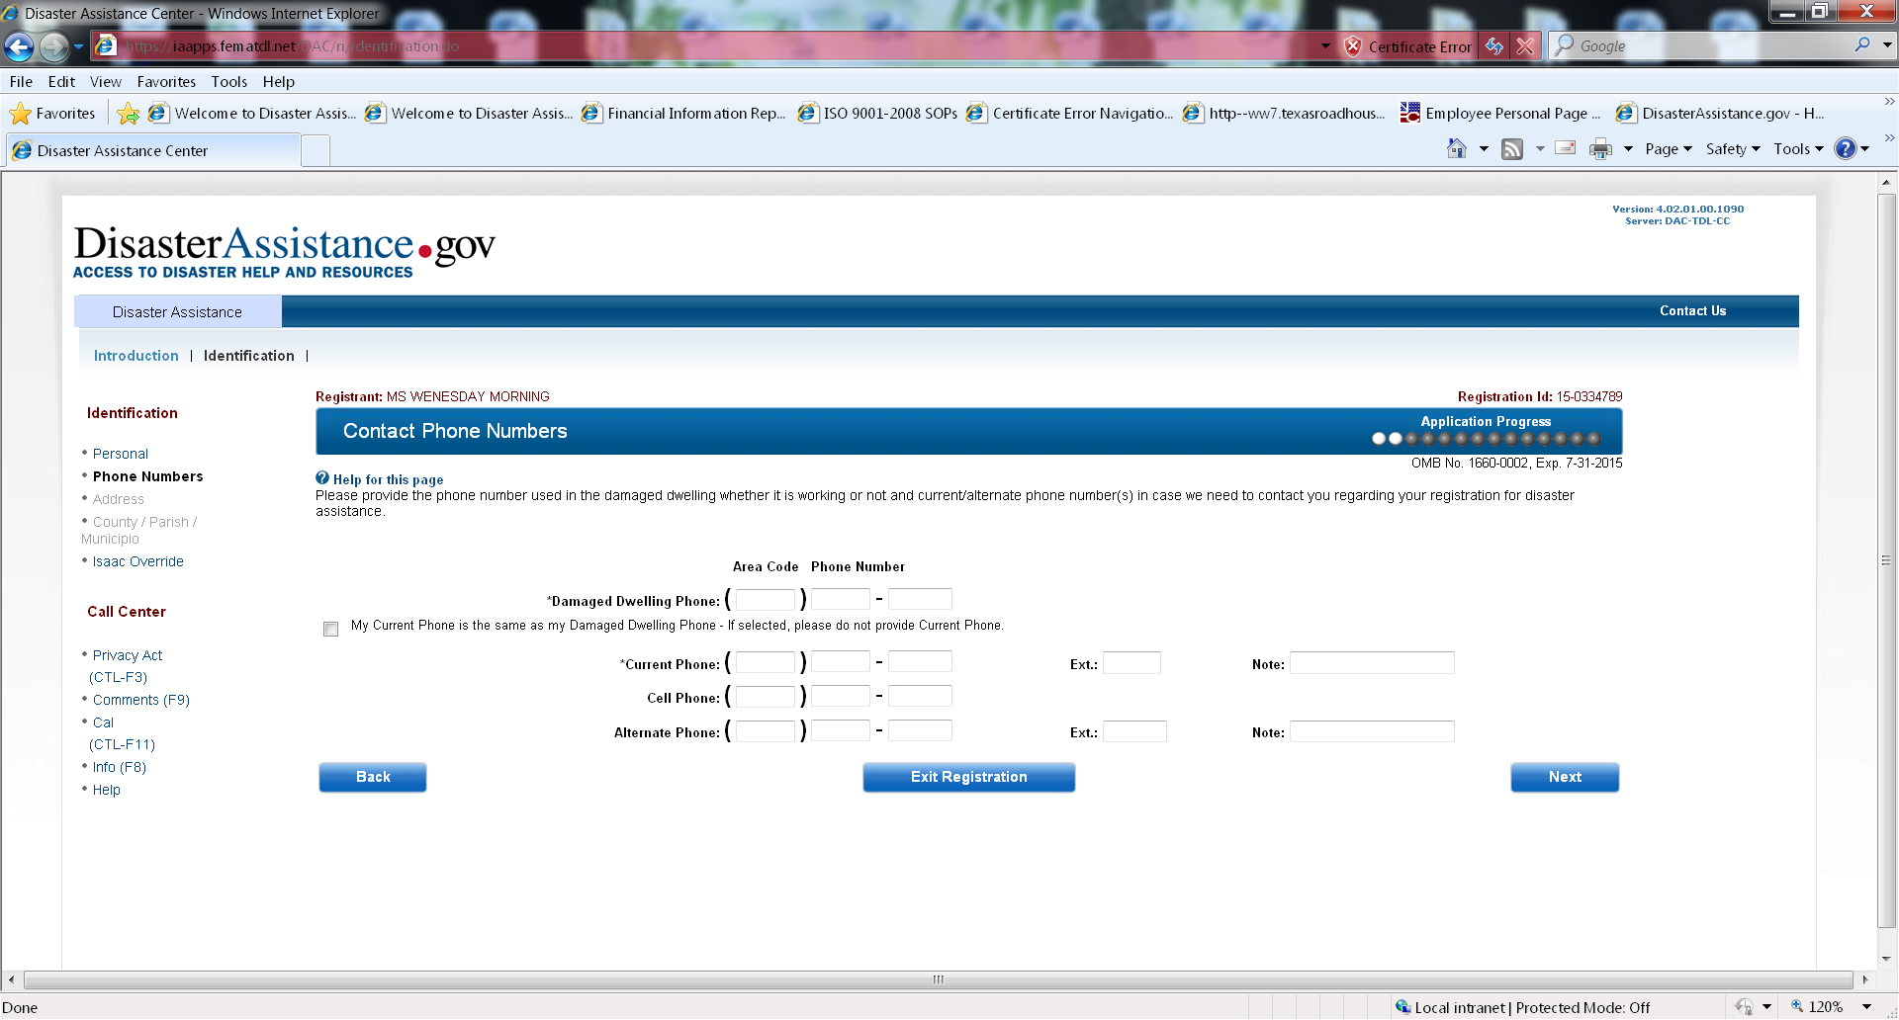

Slide 8
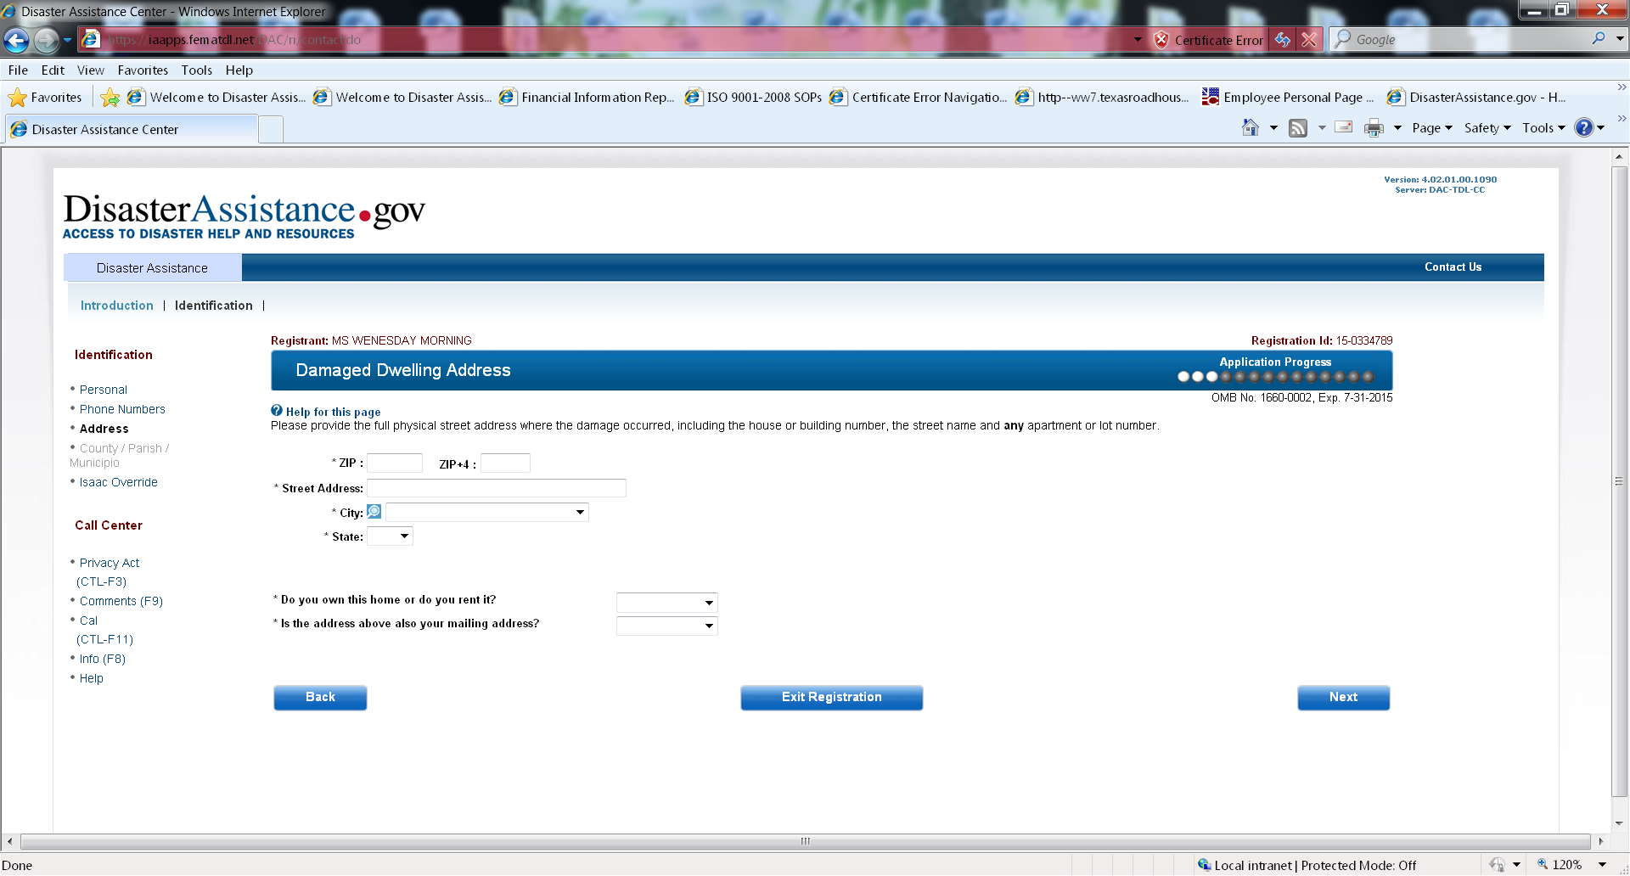

Slide 9
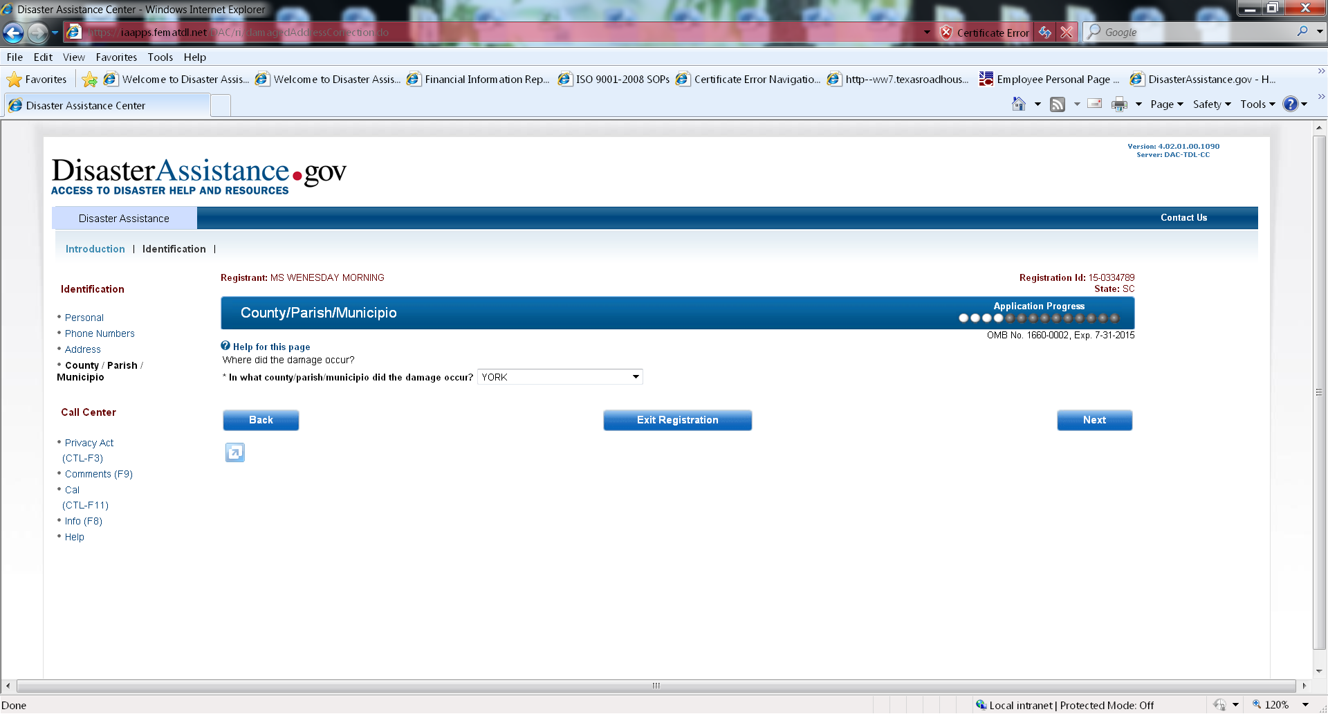

Slide 10
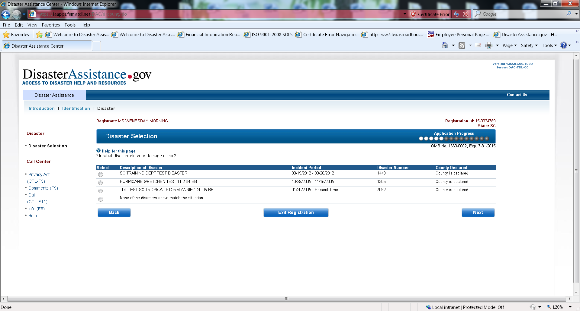

Slide 11
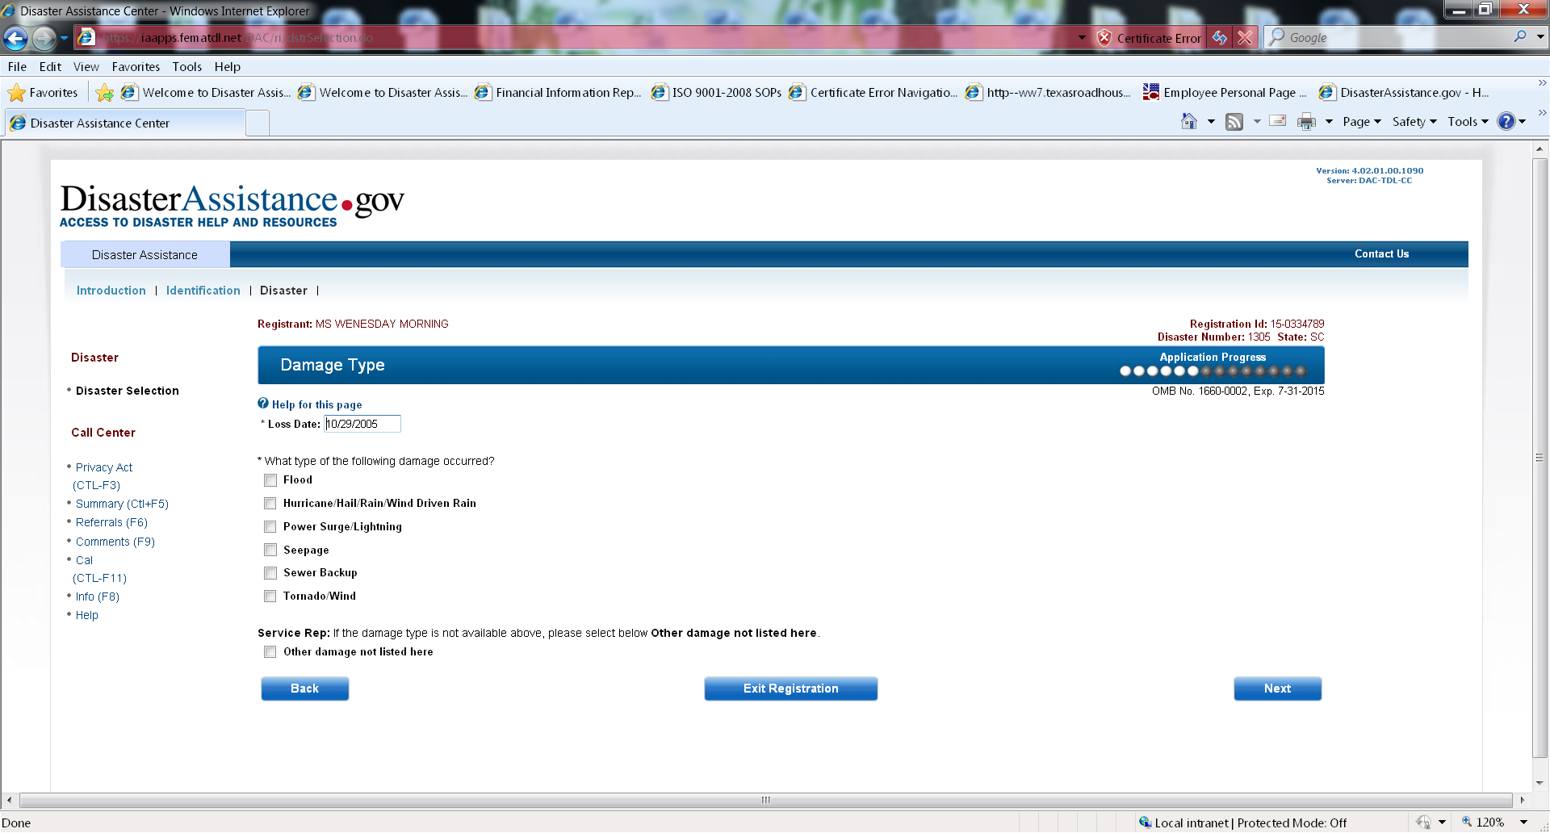

Slide 12
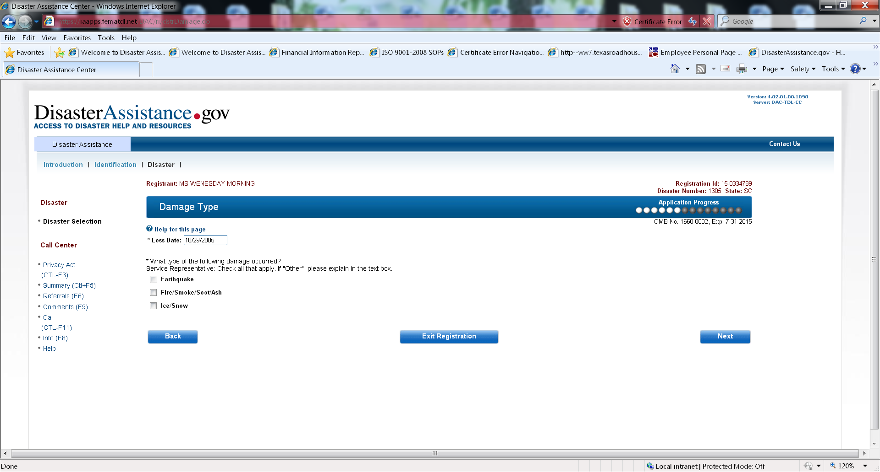
Notes:
This screen appears if you chose other from the Damage Type screen and the help screen remains the same.

Slide 13
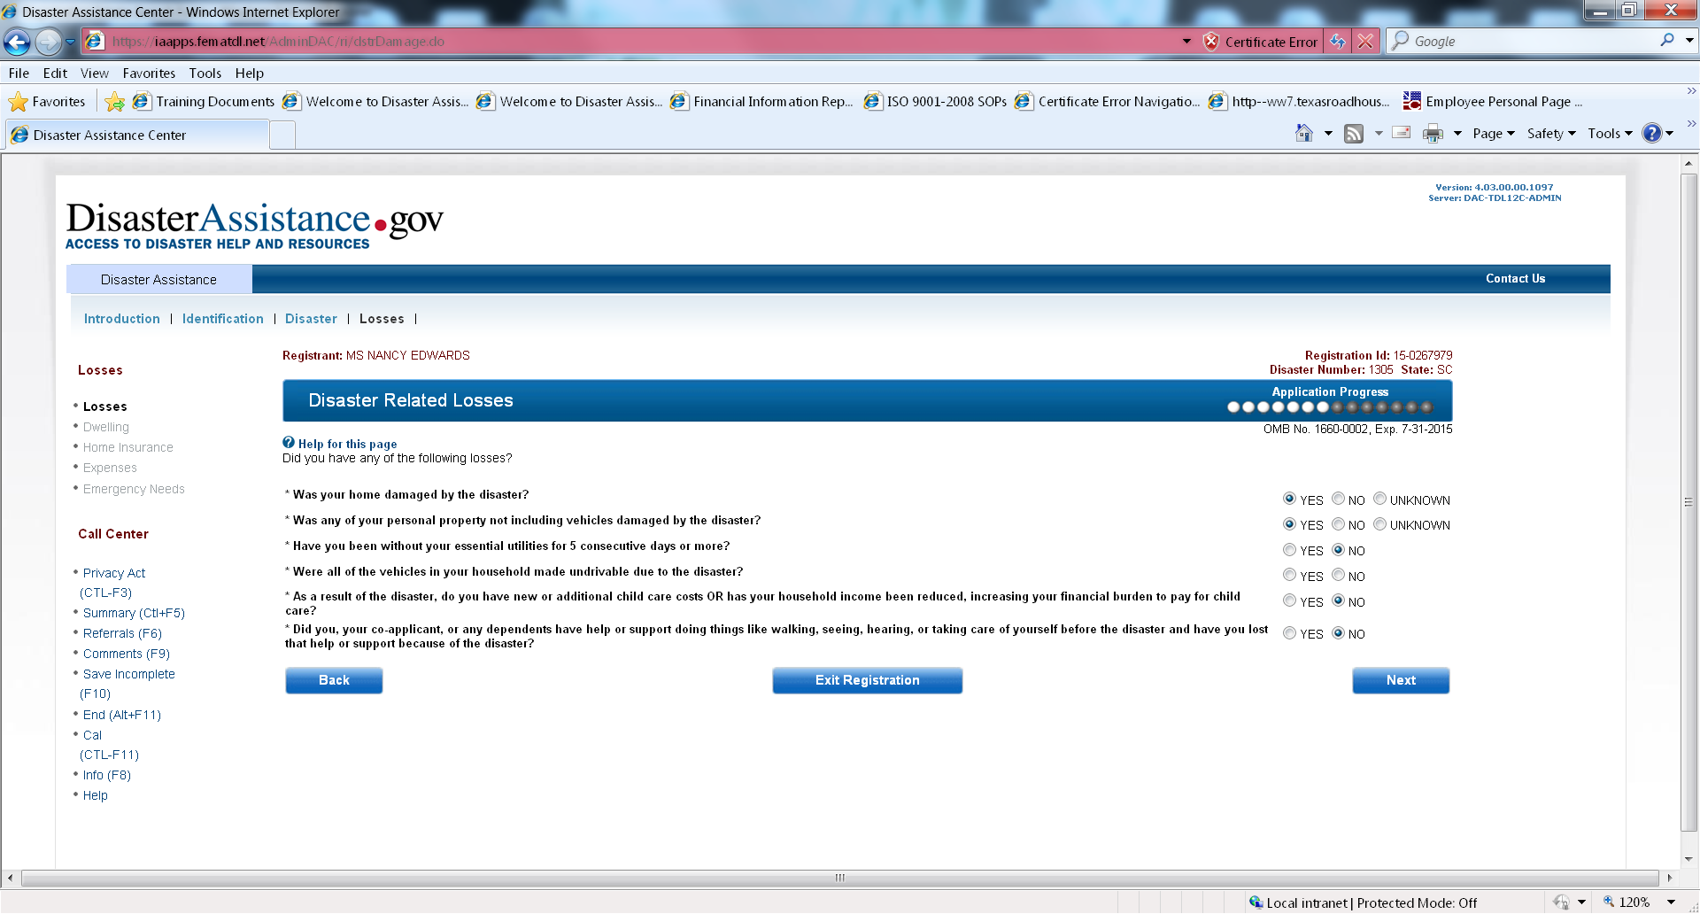

Slide 14
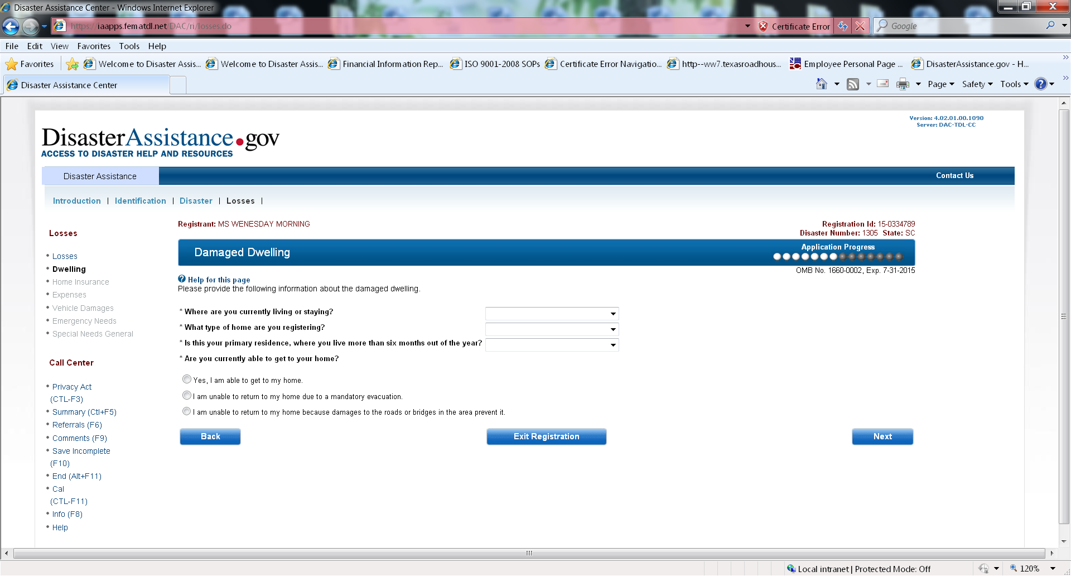

Slide 15
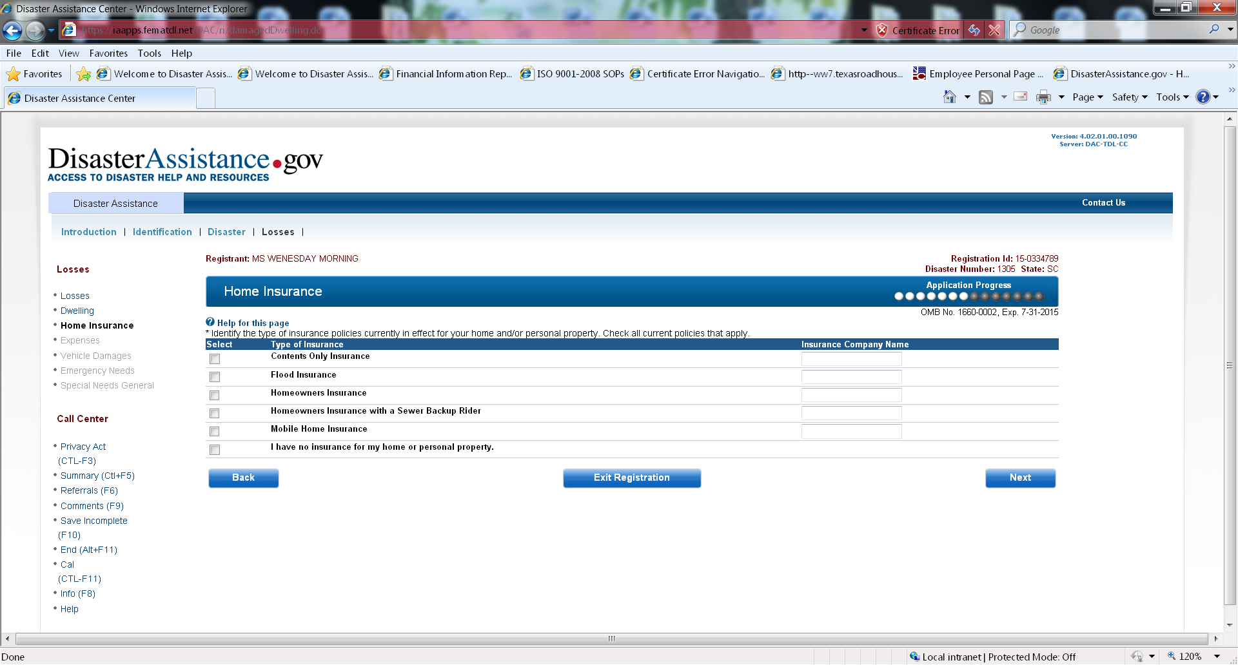

Slide 16
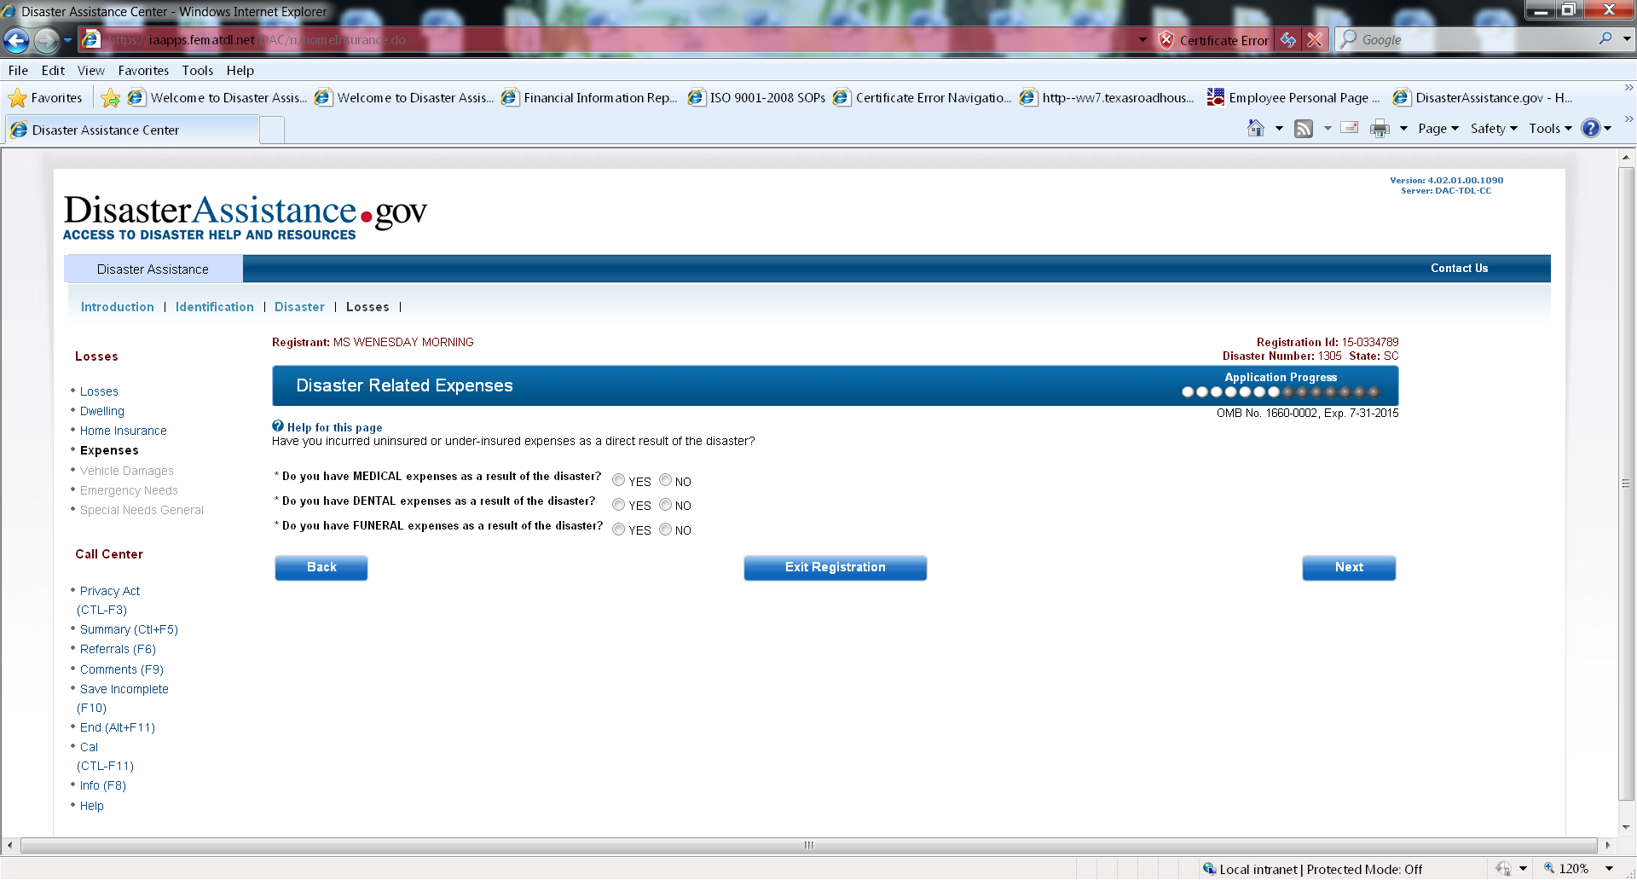

Slide 17
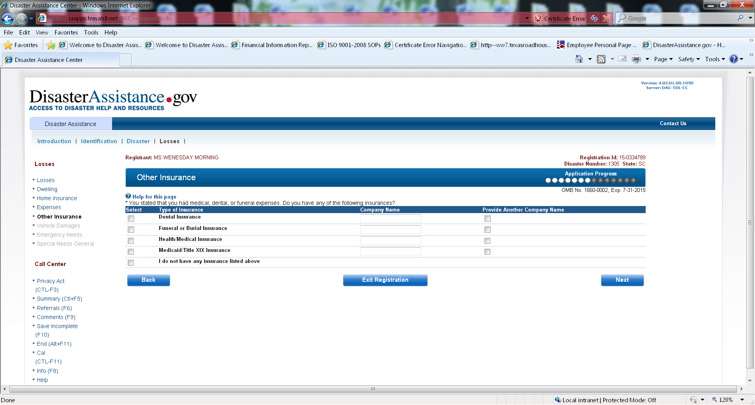
Notes:
This screen appears when you select one of the items from the Disaster Related Expenses screen

Slide 18
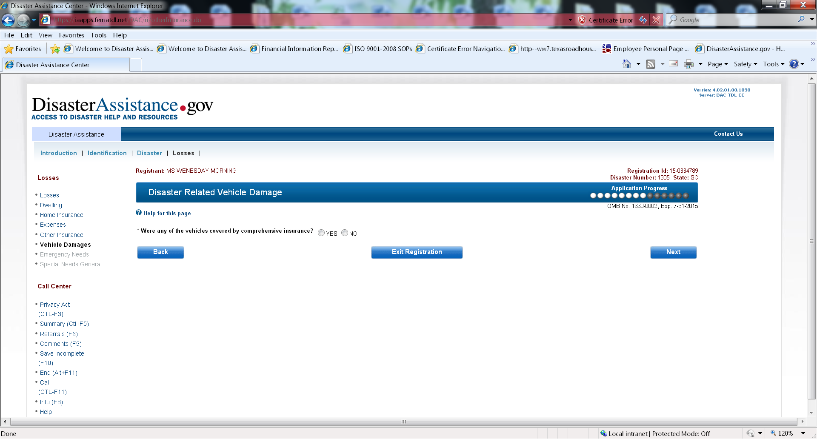
Notes:
This screen appears when selecting vehicle damage from the Disaster Related Losses screen

Slide 19
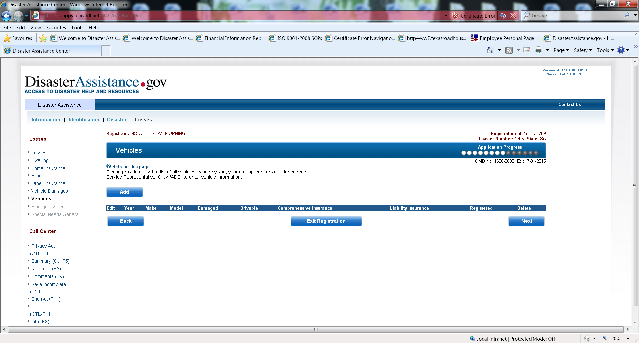
Notes:
This screen appears when selecting no to the previous screen

Slide 20
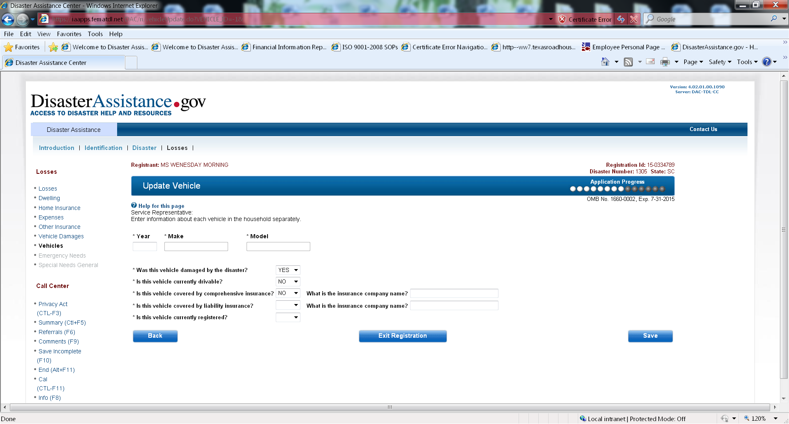

Slide 21
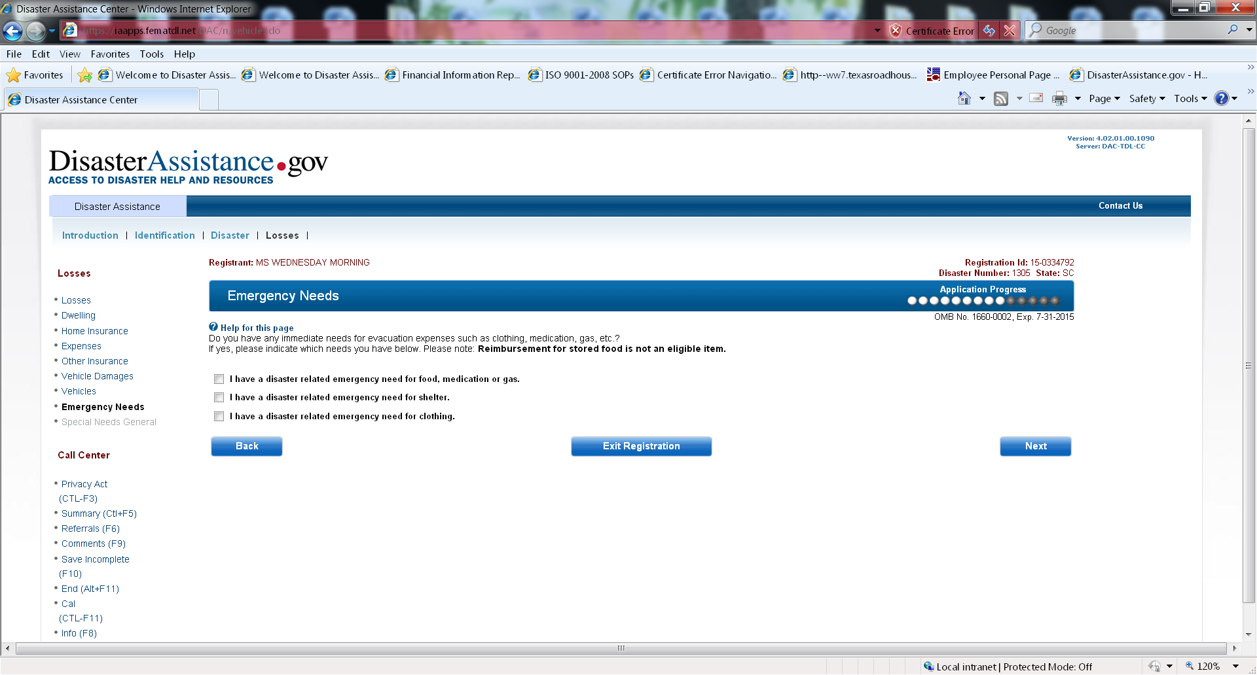

Slide 22
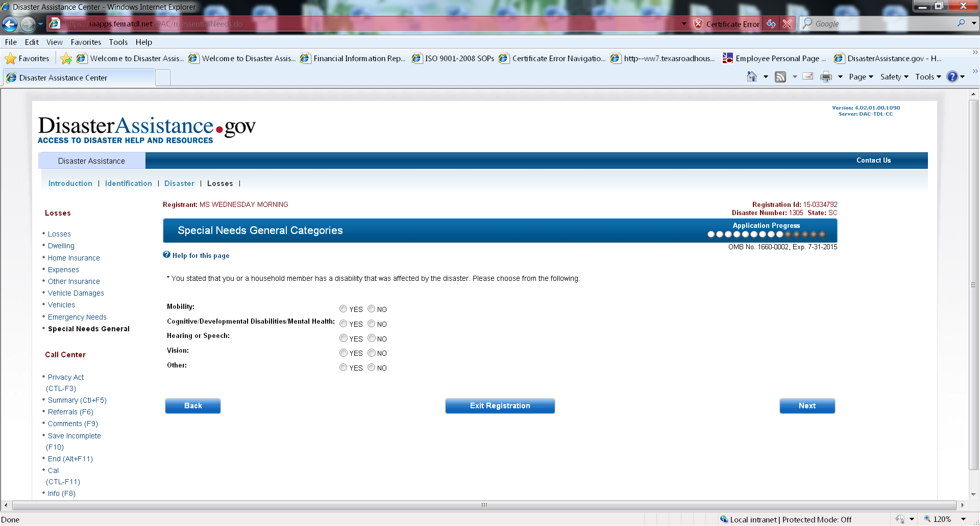

Slide 23
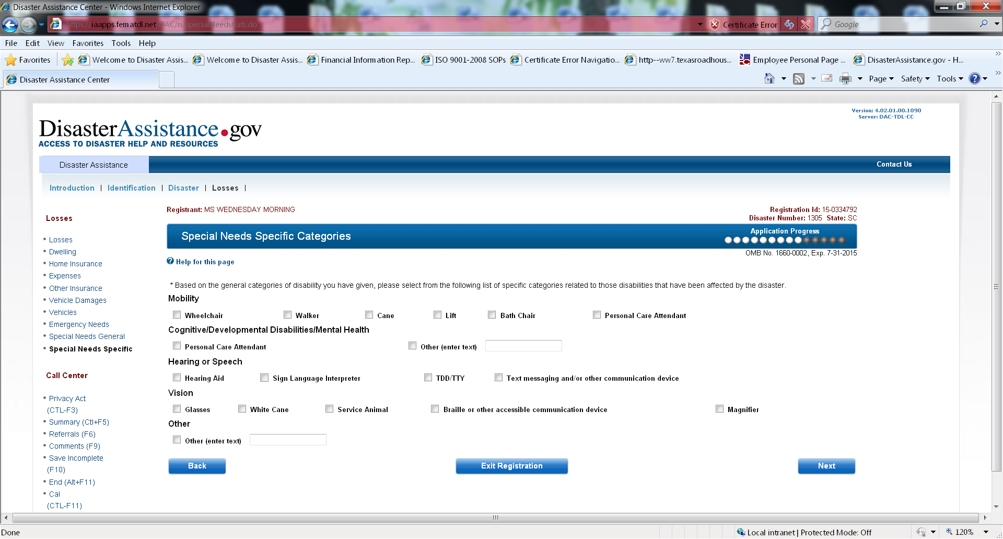

Slide 24
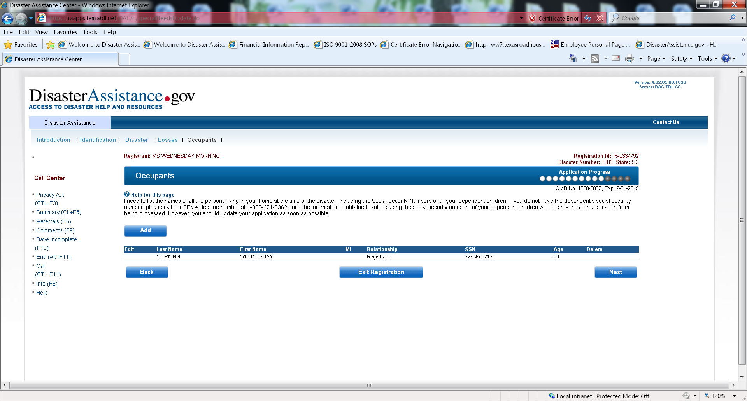

Slide 25
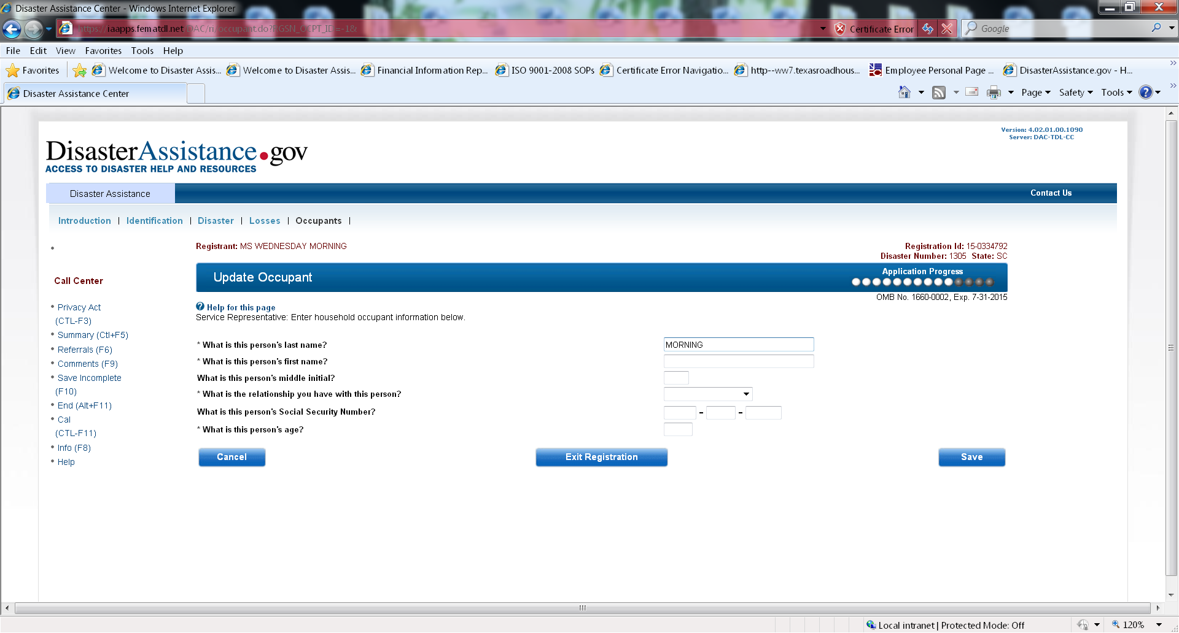

Slide 26
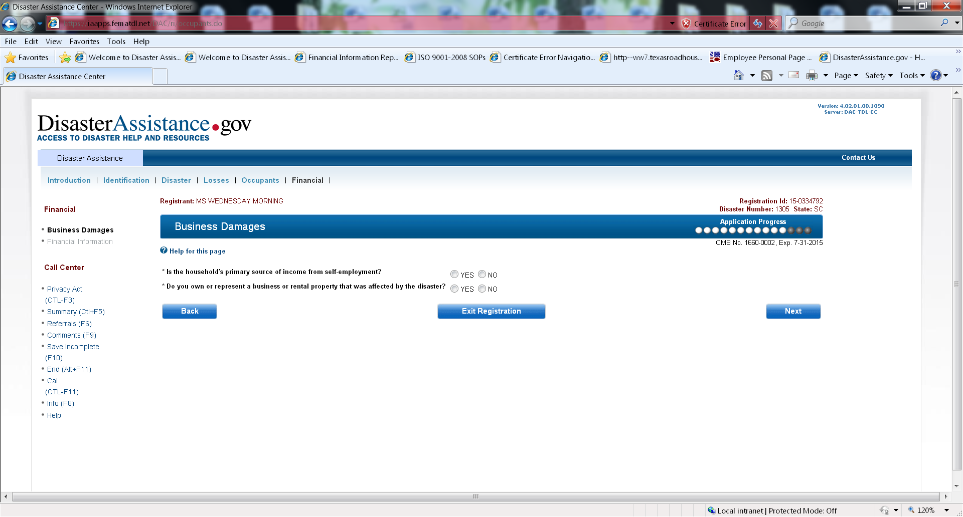

Slide 27
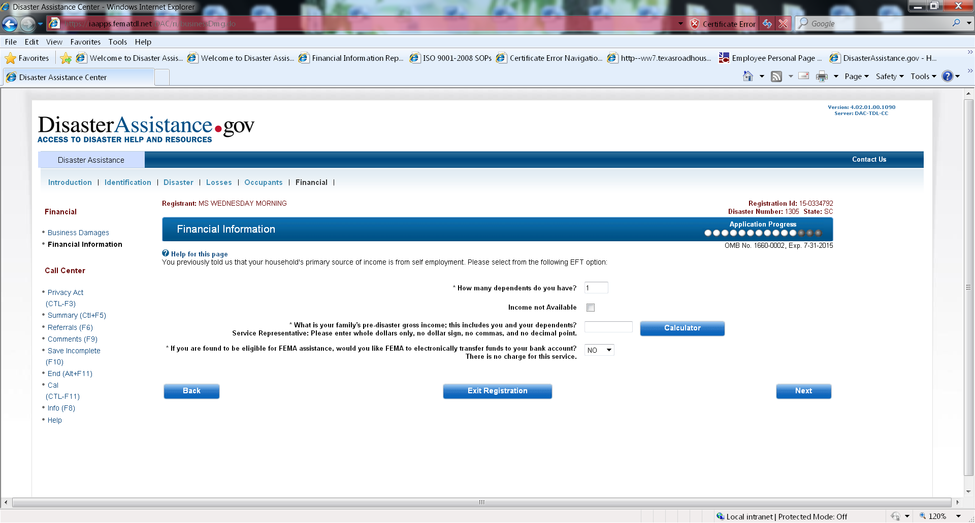
Notes:
This screen appears when selecting yes to both questions asked on the Business Damages screen

Slide 28
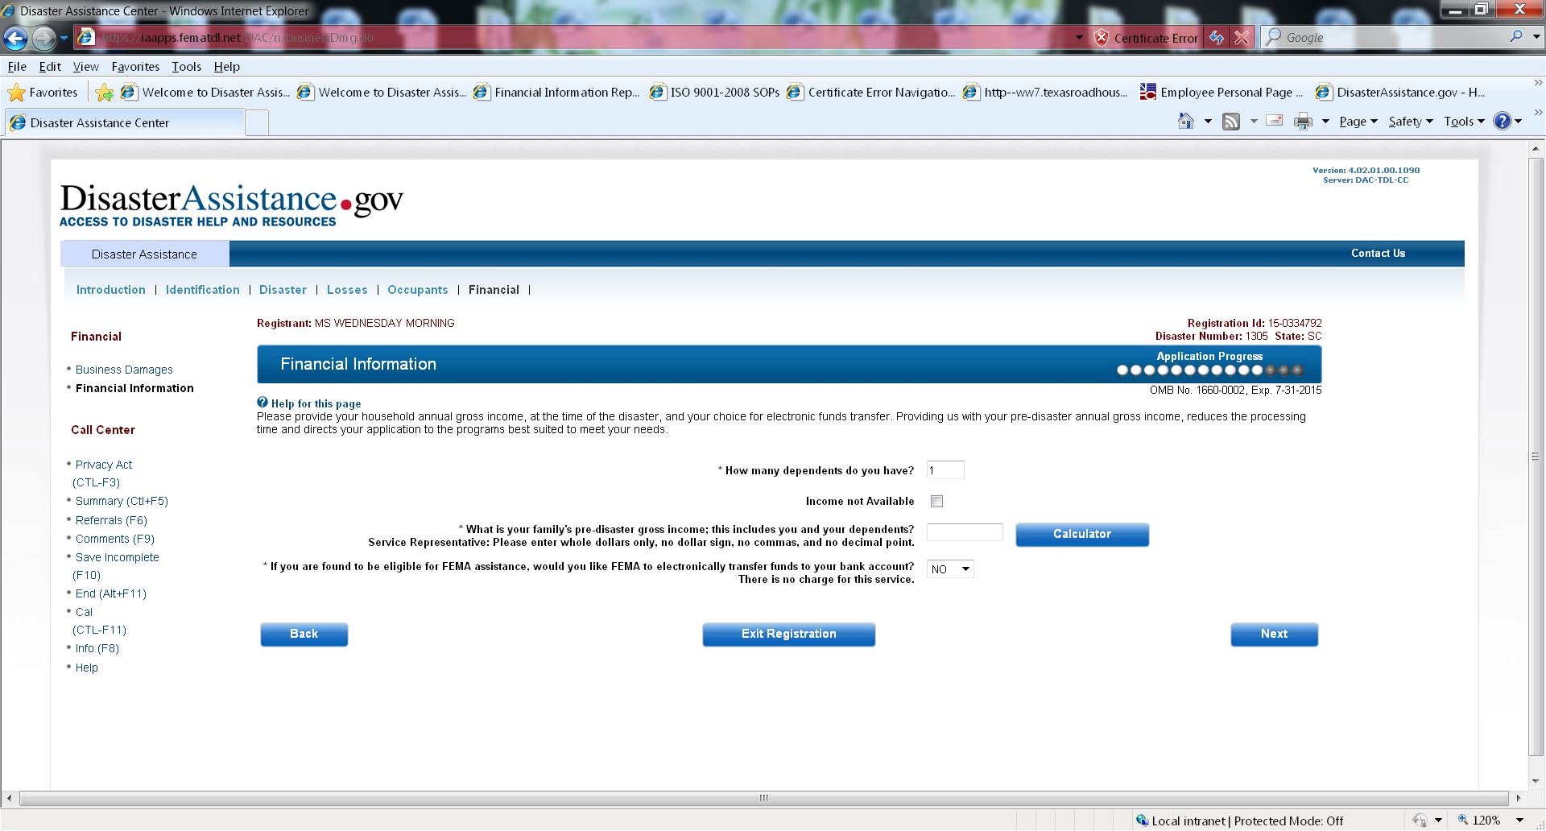
Notes:
This screen appears when selecting yes to own or represent a business or NO to both questions asked on the Business Damages screen

Slide 29
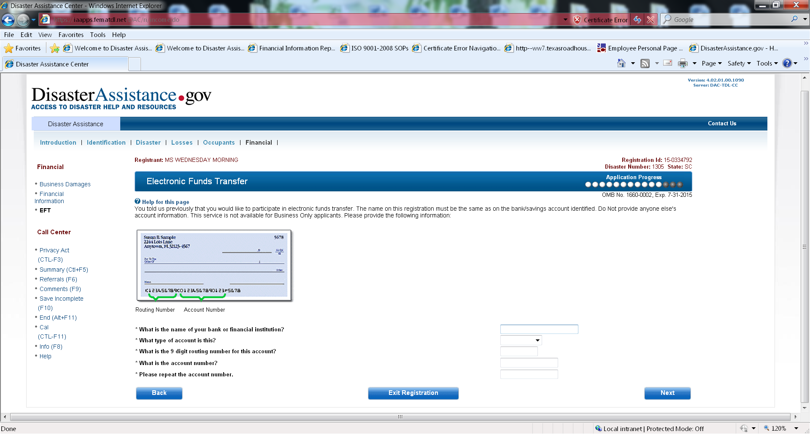
Notes:
This screen appears when selecting yes to the Electronic Funds Transfer from the Financial Information screen

Slide 30
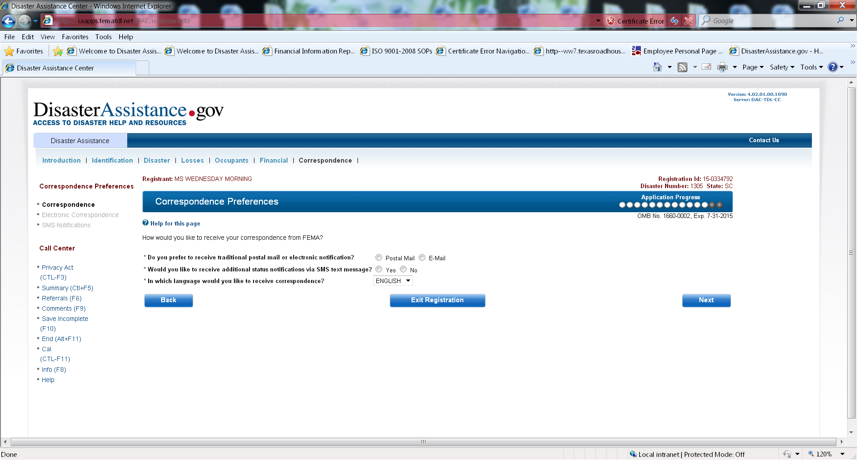

Slide 31
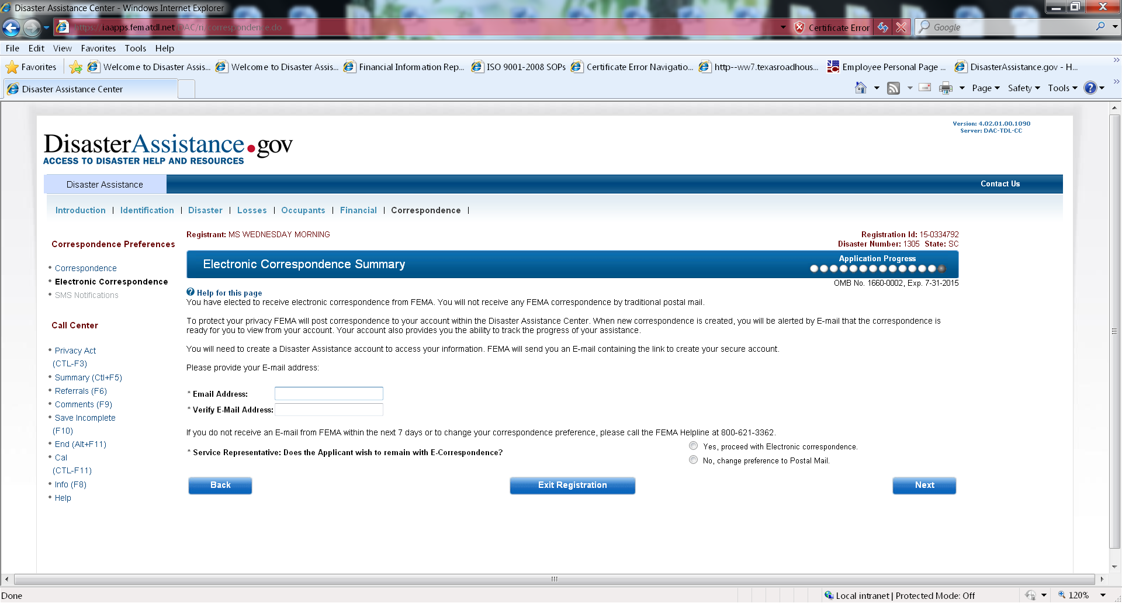
Notes:
This screen appears when selecting yes to Do you prefer to receive traditional postal mail or electronic notification from the Correspondence Preferences screen

Slide 32
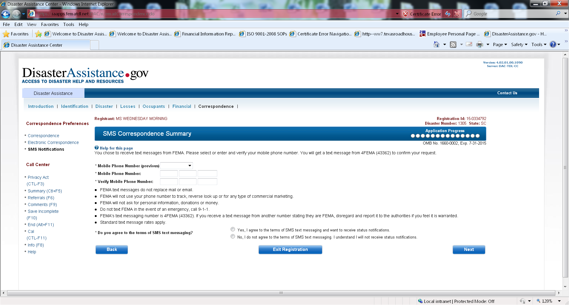
Notes:
This screen appears when selecting yes to receiving SMS text messaging from the Correspondence Preference screen

Slide 33
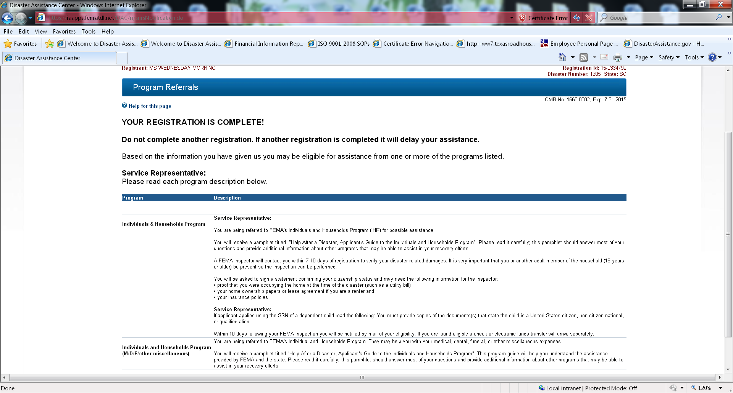

Slide 34
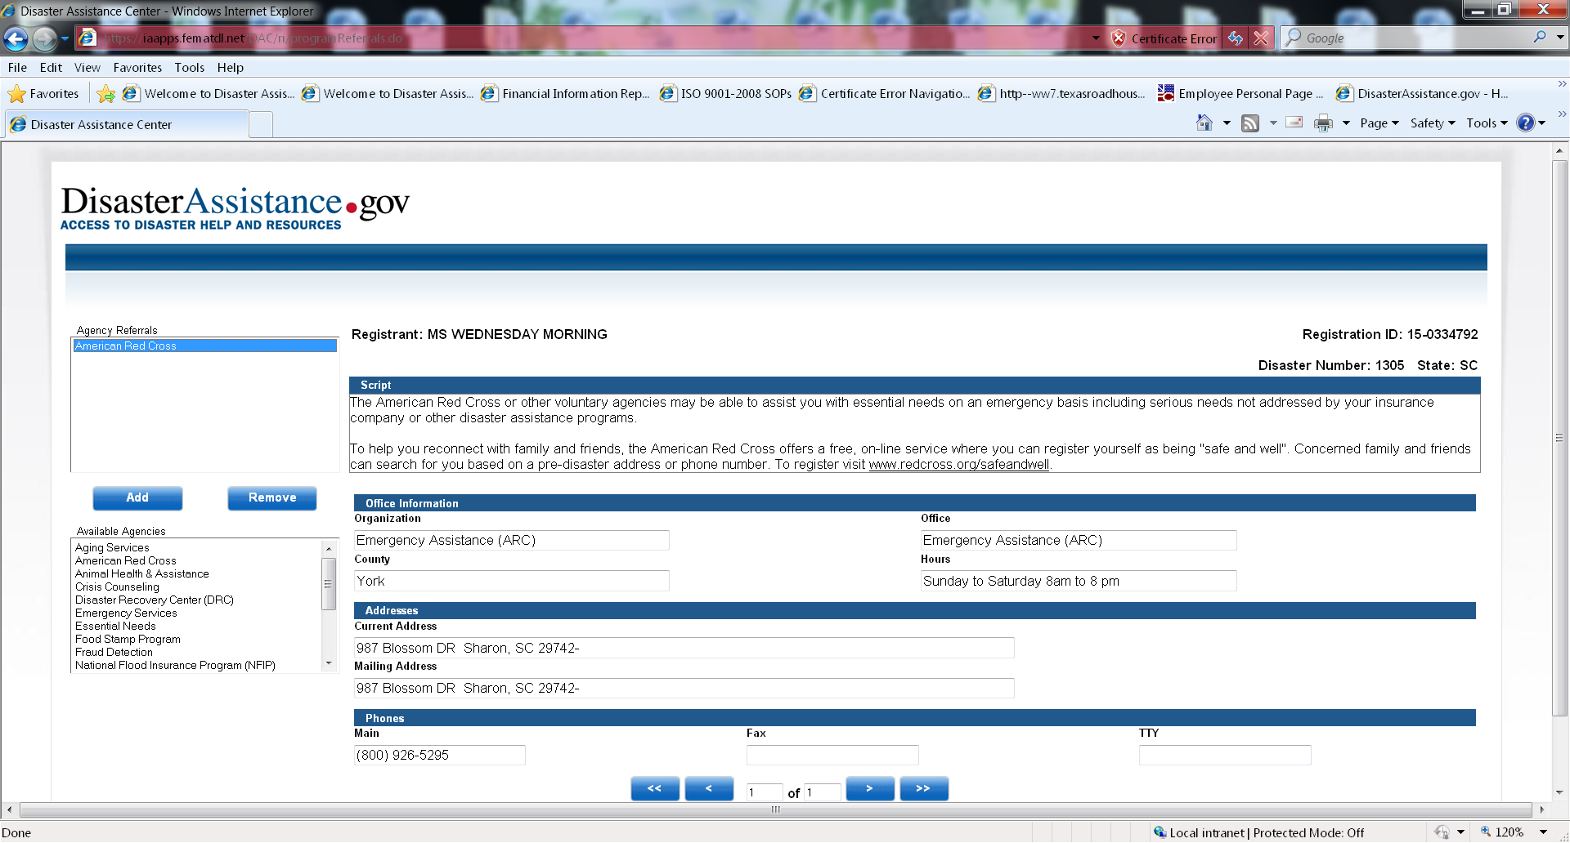

Slide 35
