Slide 1
Center Director Structural Information Report
Data Collection Process & Materials

Slide 2
Overview
Data are collected in the Fall on an annual basis from each center with and active I/UCRC grant during the most recently completed fiscal year
The 8-tab Excel workbook detailed in the following slides is sent to the Center Director of each eligible I/UCRC
The Center Director is responsible for getting data from their partner sites (we provide a Partner Site Information Sheet to facilitate that process) and compiling the report for the center as a whole
Data that does not typically change from one year to the next is pre-populated into the Excel workbook for Centers who have completed the report in the previous data collection year
Centers are given 1 month to complete the report, with extensions available to those with a scheduling conflict
When data are submitted, the NCSU Evaluation team checks the data for completeness, accuracy, and consistency
Data are aggregated at the Center level and used to create an annual report for the I/UCRC program nation-wide
The emailed letter accompanying the Excel workbook is available on slide 3 and screen captures from each tab of the Excel workbook are available on slides 4-13.

Slide 3
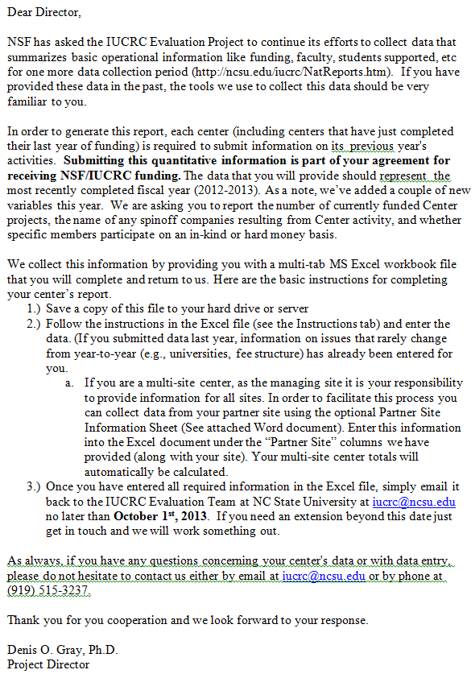

Slide 4
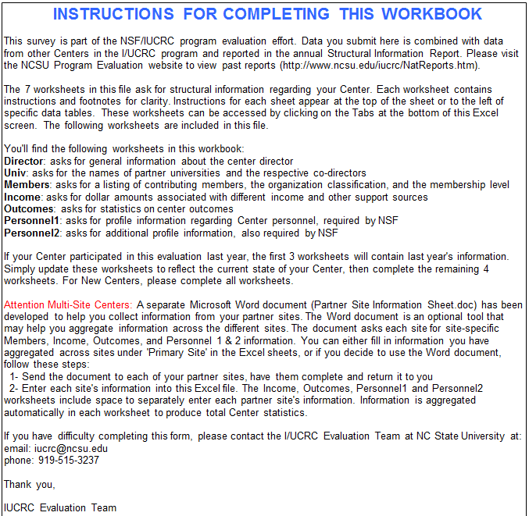

Slide 5
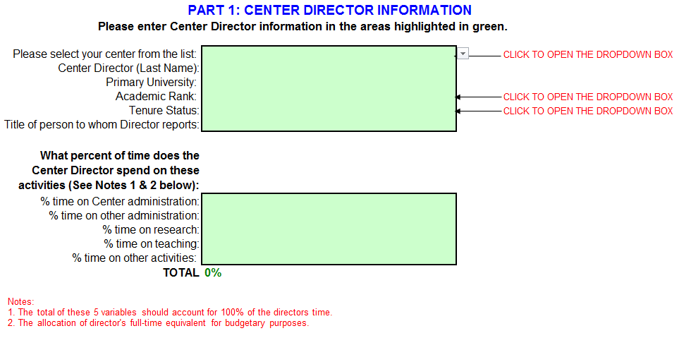

Slide 6
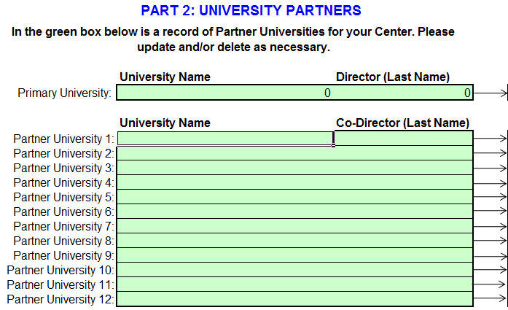

Slide 7
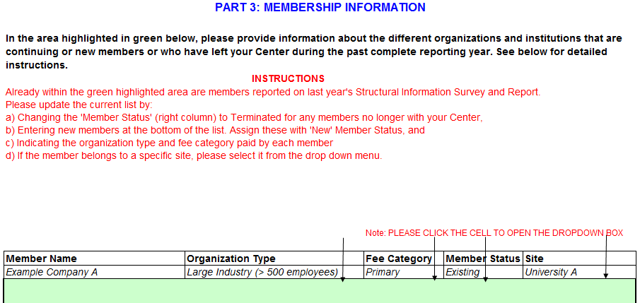
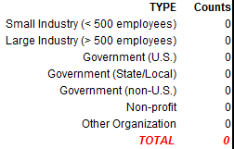

Slide 8
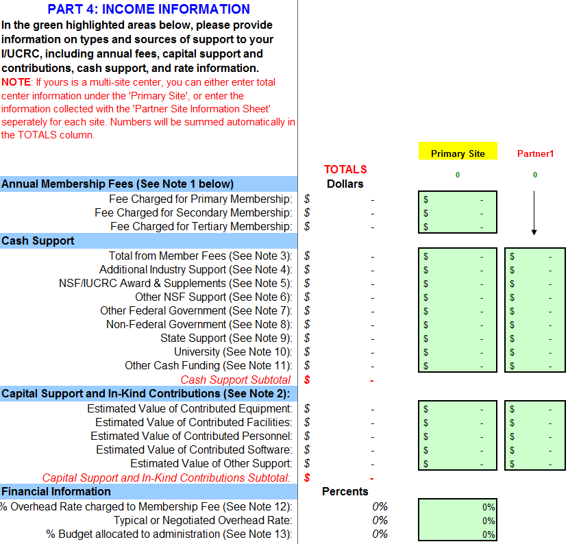
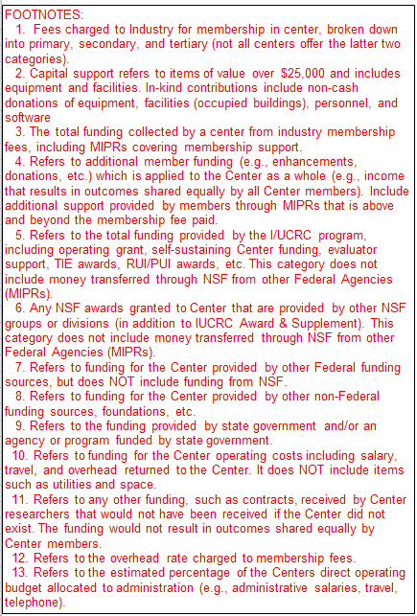
Additional columns available to enter this information on a site-by-site basis

Slide 9
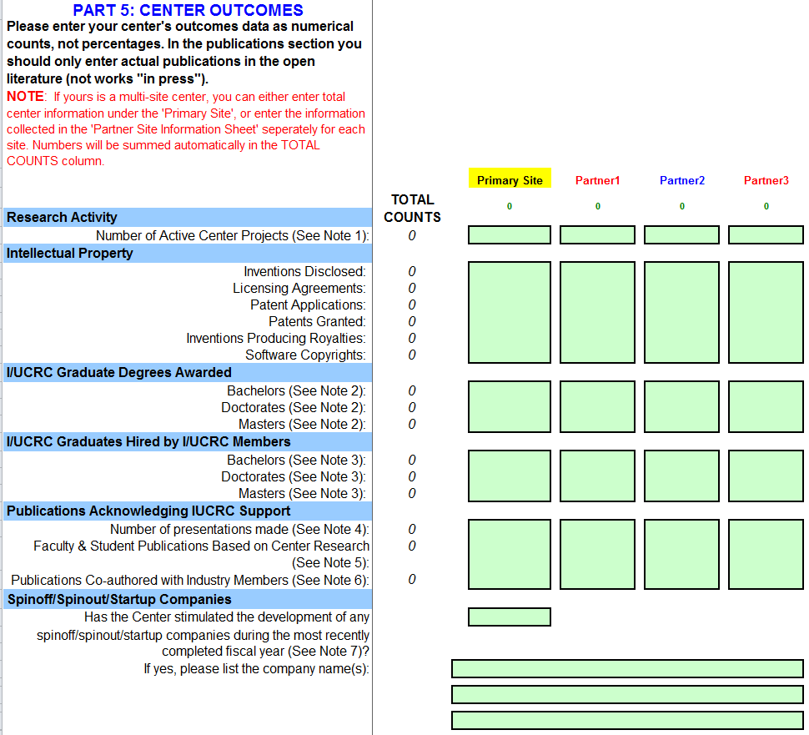
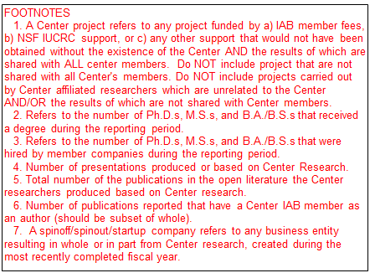
Yes/No

Slide 10
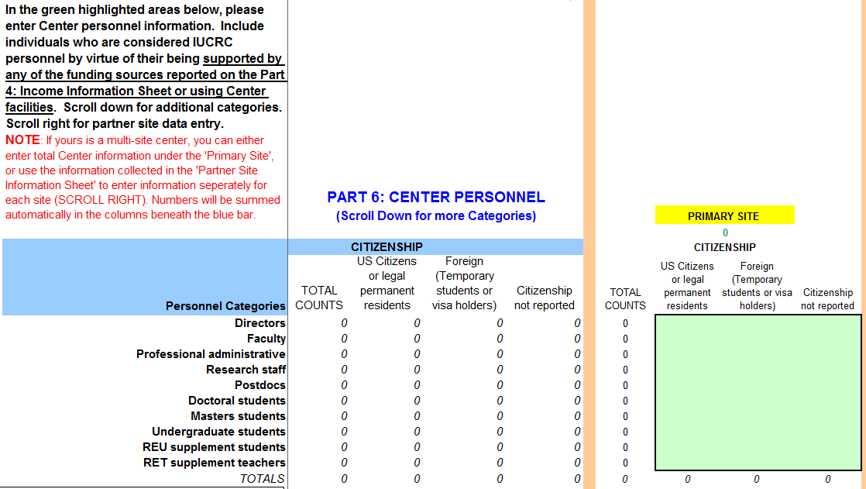
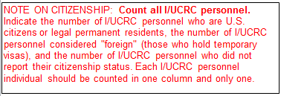
Additional columns available to enter information on a site-by-site basis. See next slide for additional demographic information collected for each personnel category listed in the table above.

Slide 11
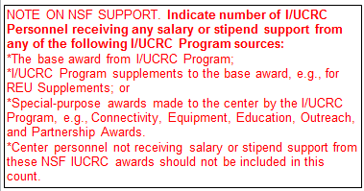
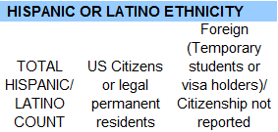
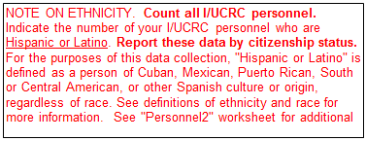

Slide 12
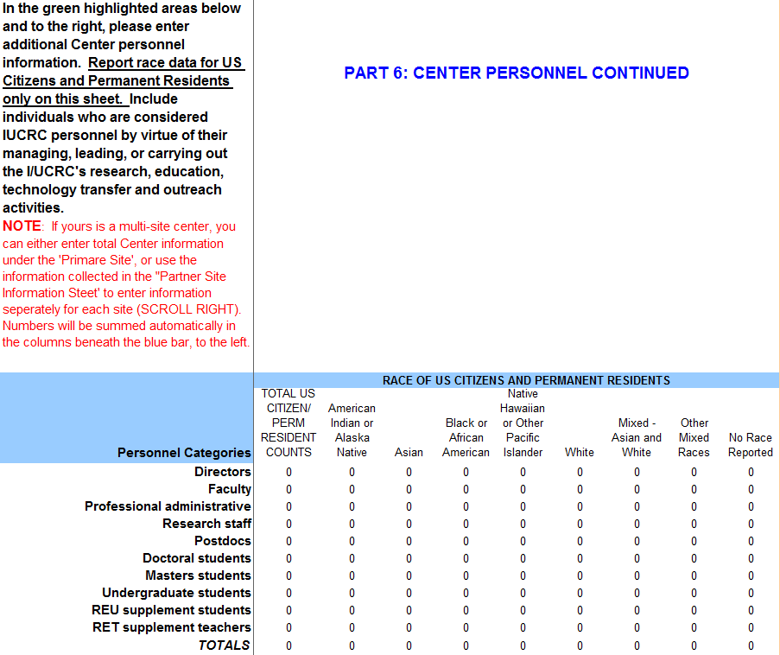
Additional columns available to enter information on a site-by-site basis. See next slide for additional notes on race and ethnicity.

Slide 13
