Slide 1
Notes:
Do you have any comments on this screen?
What is the difference between an apartment building and an urbanizacion?
What does “neither” mean to you in the second option category: “house or detached home in a barrio or urbanizacion (or neither)”
Who would answer that?

Slide 2
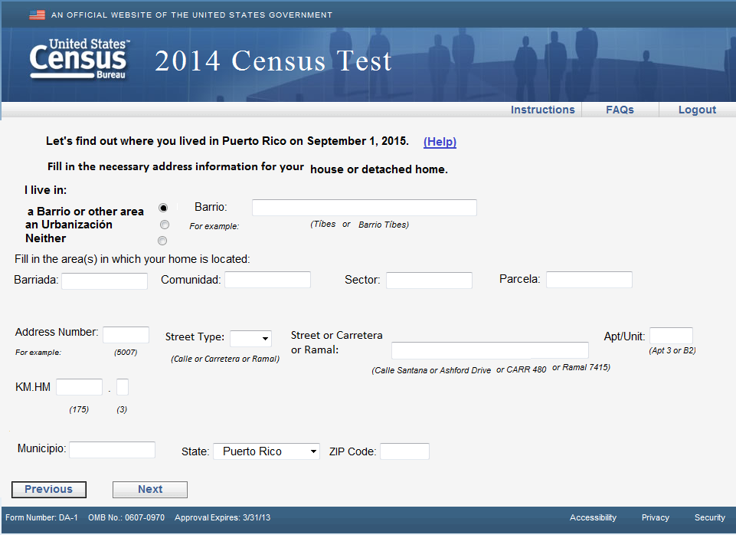
Notes:
Do you have any comments on this screen?/Did you have trouble filling in any of this information?
Is there ever a situation when an address includes both a barrio and an urbanizacion?
Is there anything missing on this screen for people who live in a barrio?
Would someone living in a house in Puerto Rico have all this address information? Are there any spaces they wouldn’t need, or any spaces that are missing that they would need to fill out their address?
IF R FILLED OUT THIS SCREEN:
What did you put in each of these spaces? (Probe to understand what information goes in barrio, municipio, barriada, comunidad, sector, parcela, KM.HM)

Slide 3
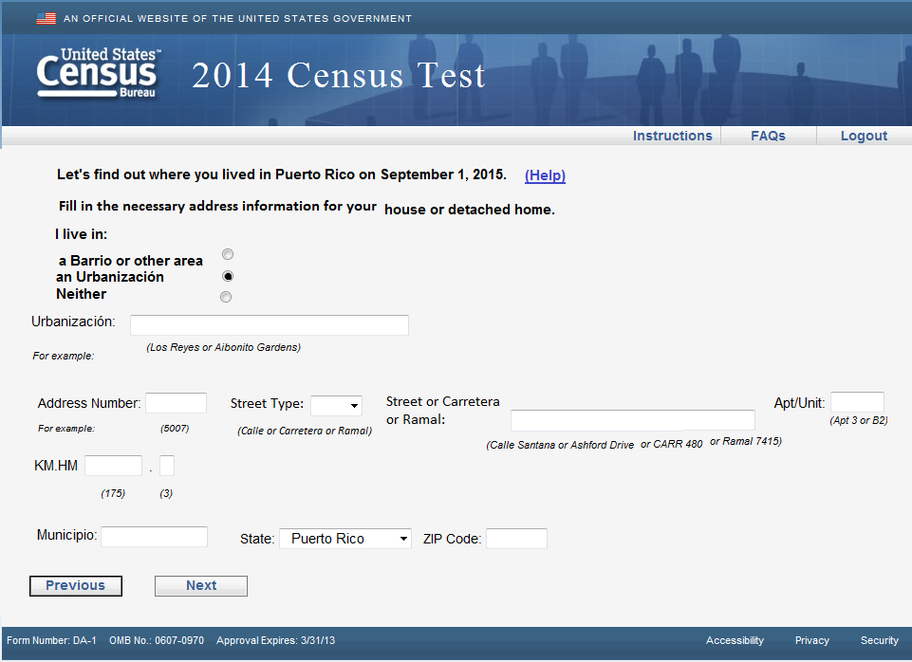
Notes:
Do you have any comments on this screen? /Did you have trouble filling in any of this information?
Would someone living in a house in Puerto Rico have all this address information? Are there any spaces they wouldn’t need, or any spaces that are missing that they would need to fill out their address?
Is there anything missing on this screen for people who live in an urbanizacion?
IF R FILLED OUT THIS SCREEN:
What did you put in each of these spaces? (Probe to understand what information goes in urbanizacion, municipio, KM.HM)

Slide 4
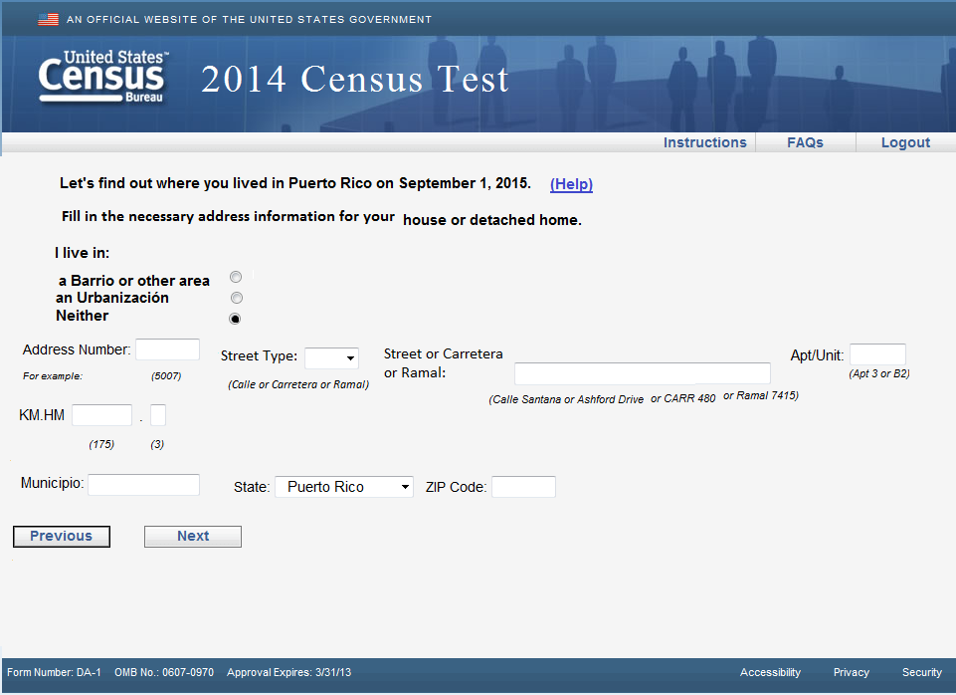
Notes:
Do you have any comments on this screen? /Did you have trouble filling in any of this information?
Do these fields make sense for the situation where the address has neither a barrio or an urbanizacion?
Which ones do not make sense…
Is there anything missing?
Would any of these fields be difficult to answer? Why?
IF R FILLED OUT THIS SCREEN:
What did you put in each of these spaces? (Probe to understand what information goes in municipio, KM.HM)

Slide 5
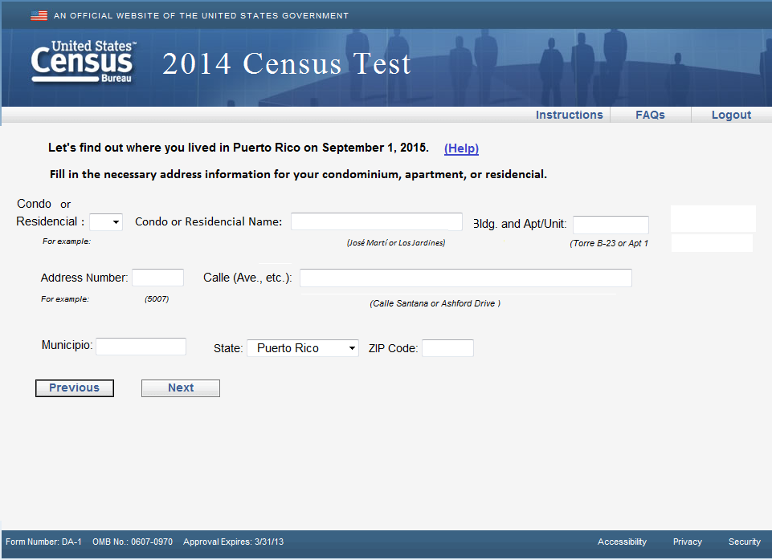
Notes:
Do you have any comments on this screen? /Did you have trouble filling in any of this information?
Would someone living in a condominium, apartment, or residencial in Puerto Rico have all this address information? Are there any spaces they wouldn’t need, or any spaces that are missing that they would need to fill out their address?
IF R FILLED OUT THIS SCREEN:
What did you put in each of these spaces? (Probe to understand what information goes in municipio, KM.HM)

