Slide 1
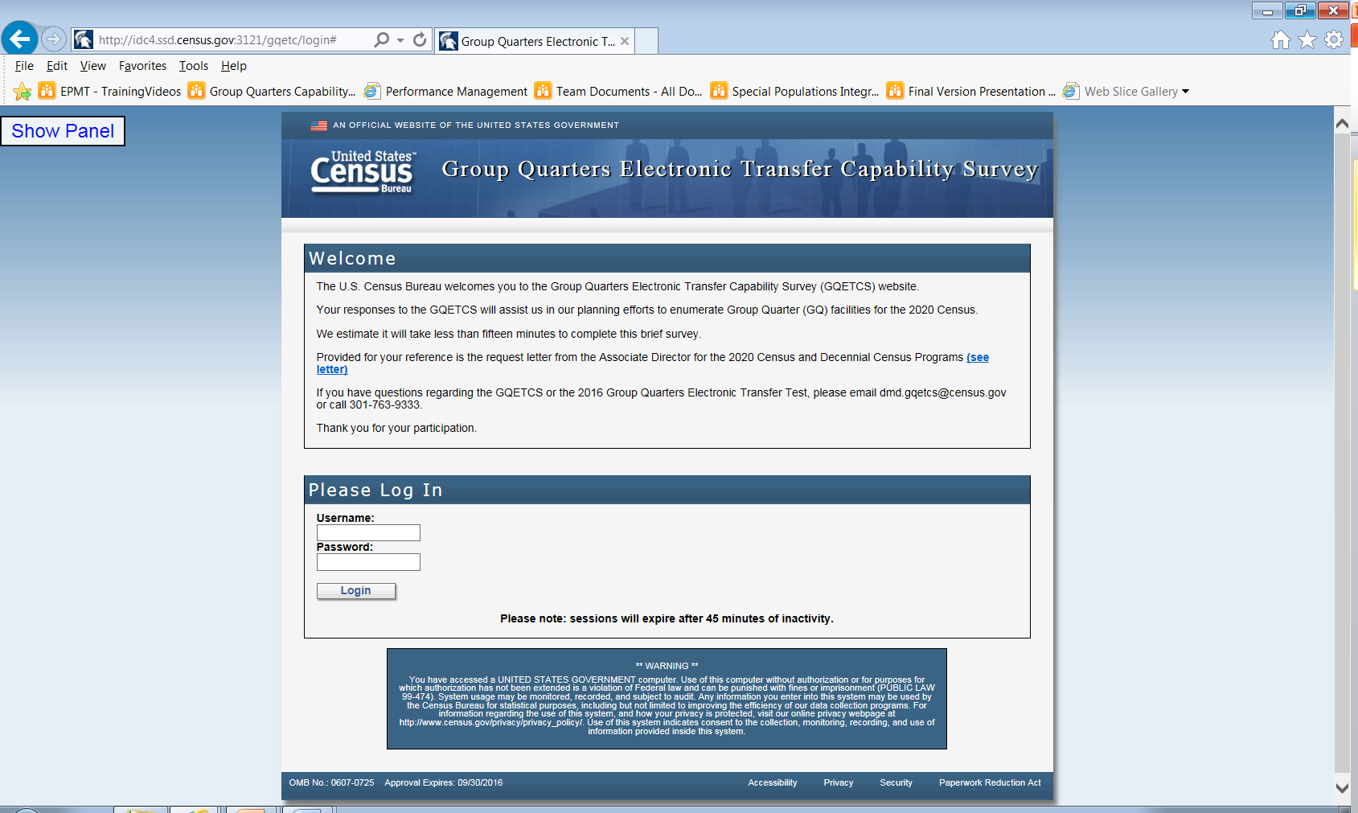
Attachment 2

Slide 2
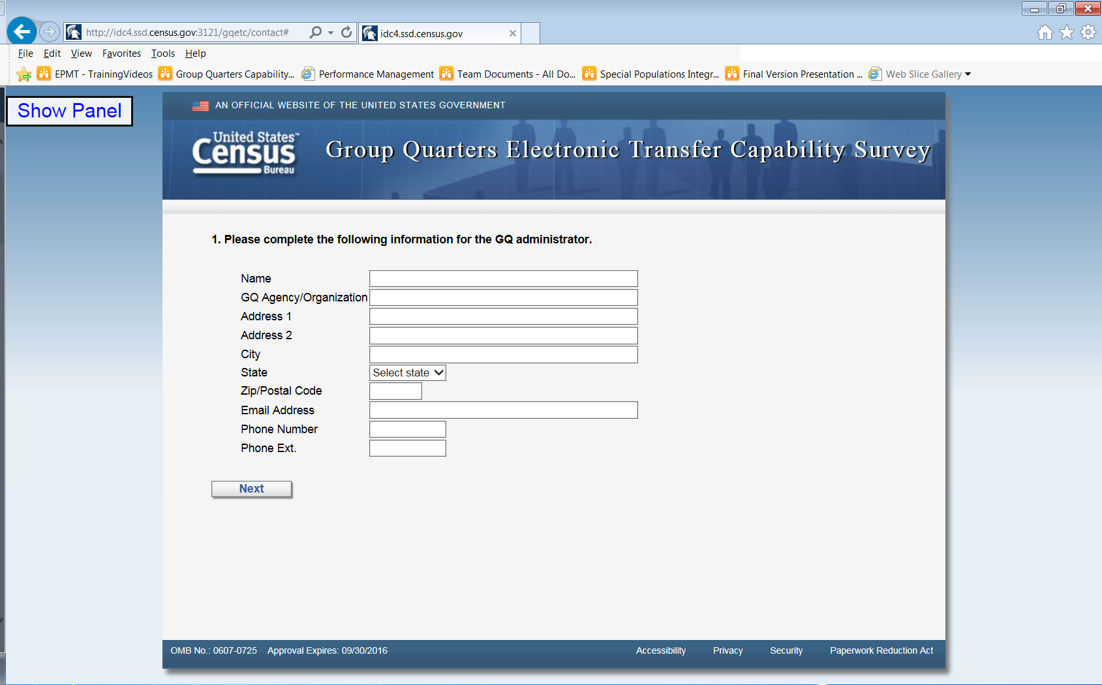
Attachment 2 continued

Slide 3
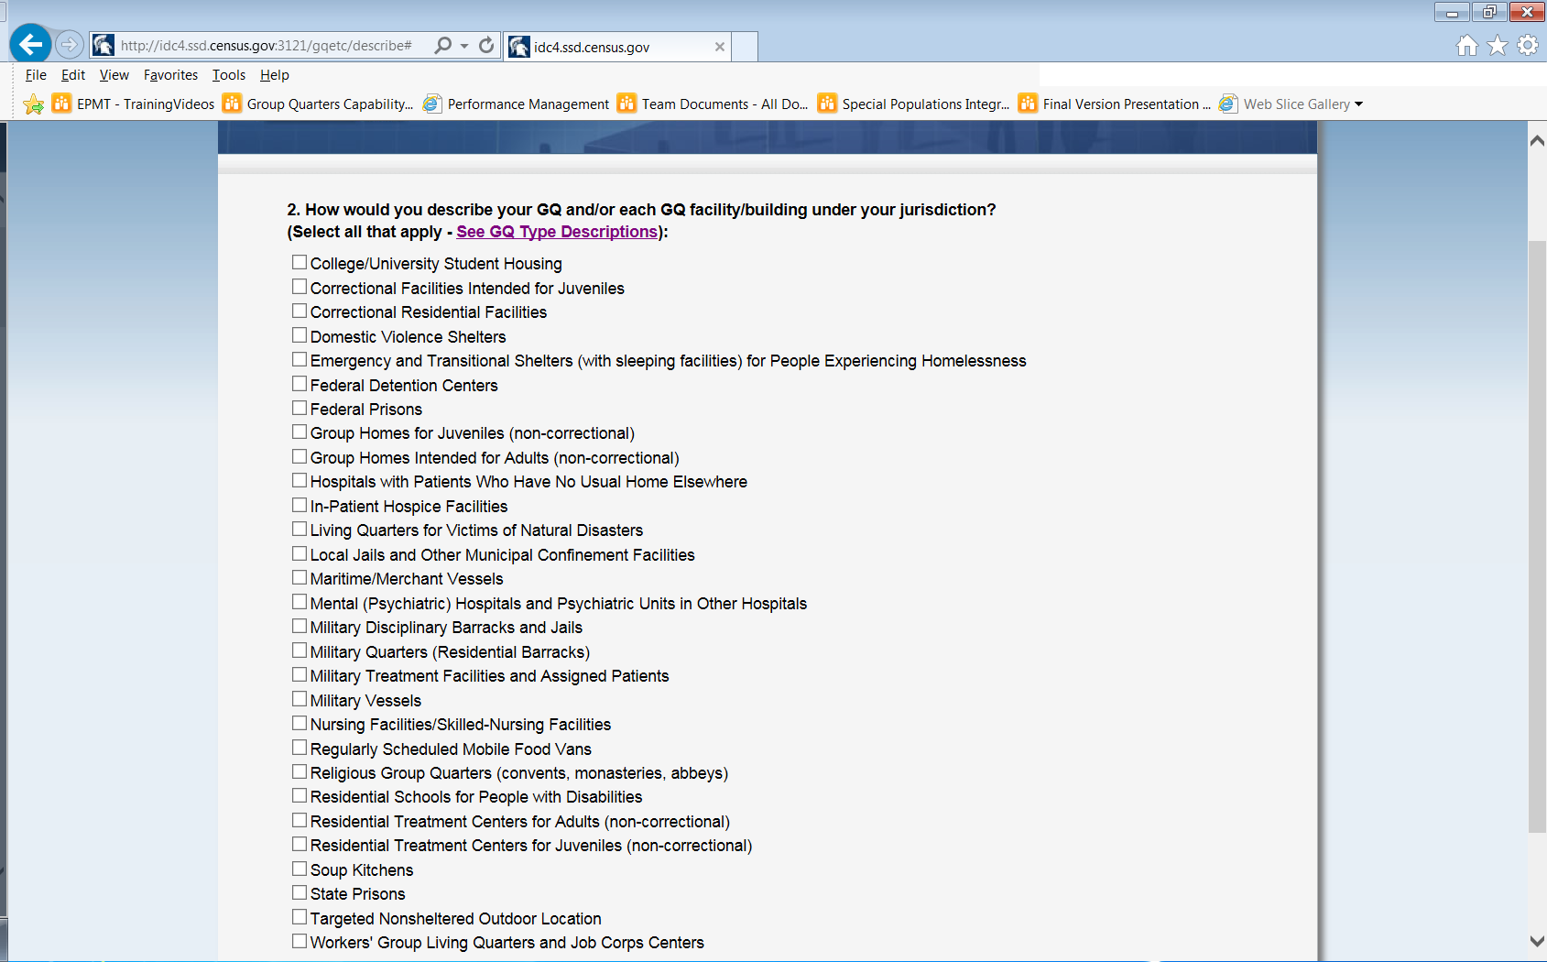
Attachment 2 continued

Slide 4
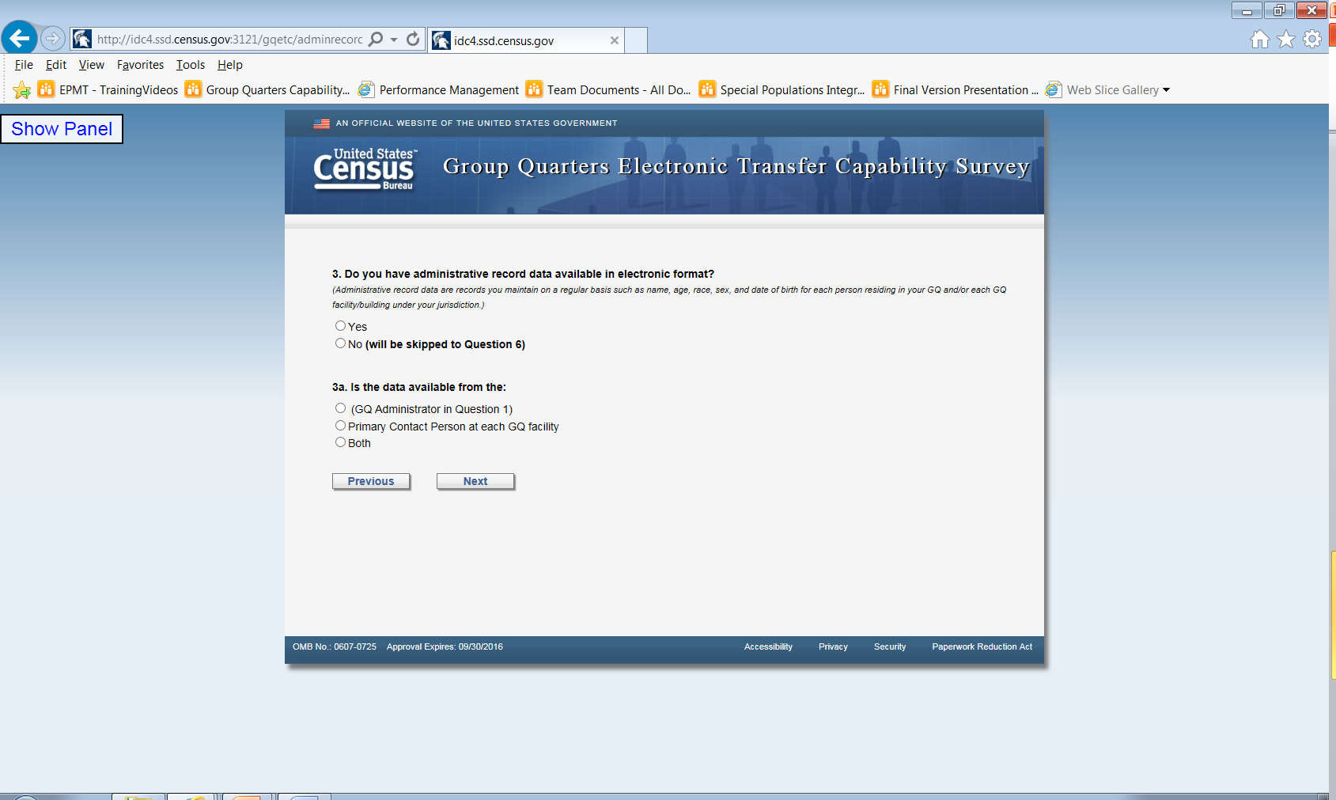
Attachment 2 continued
If respondent selects this option, their name (entered from question 1) will precede the verbiage in parenthesis.

Slide 5
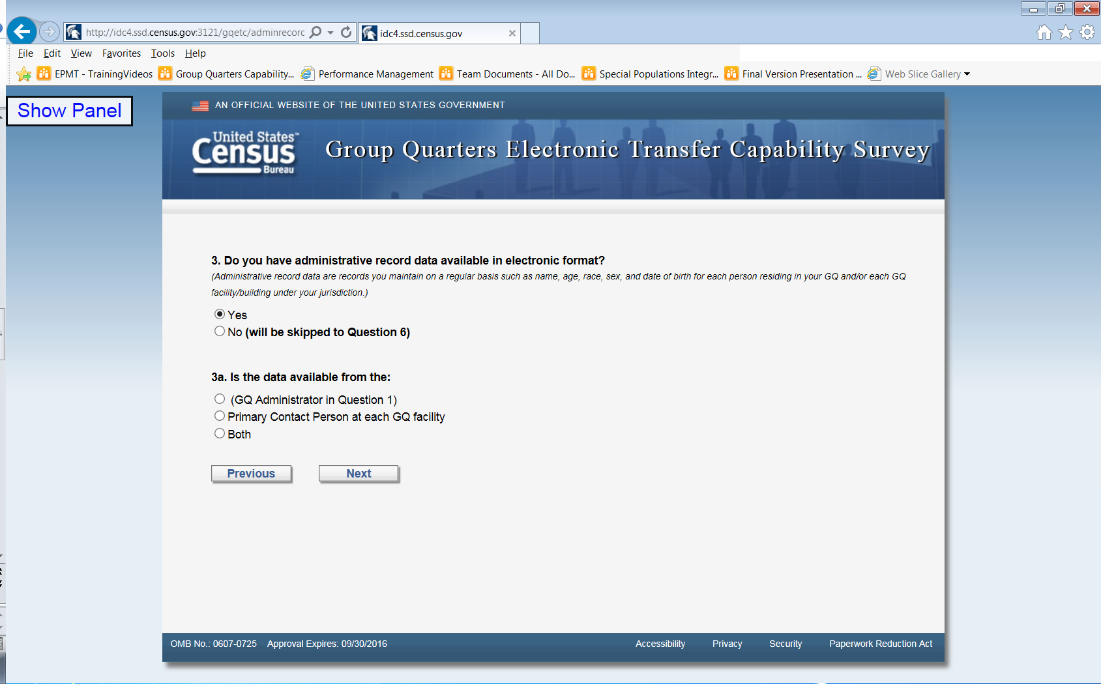
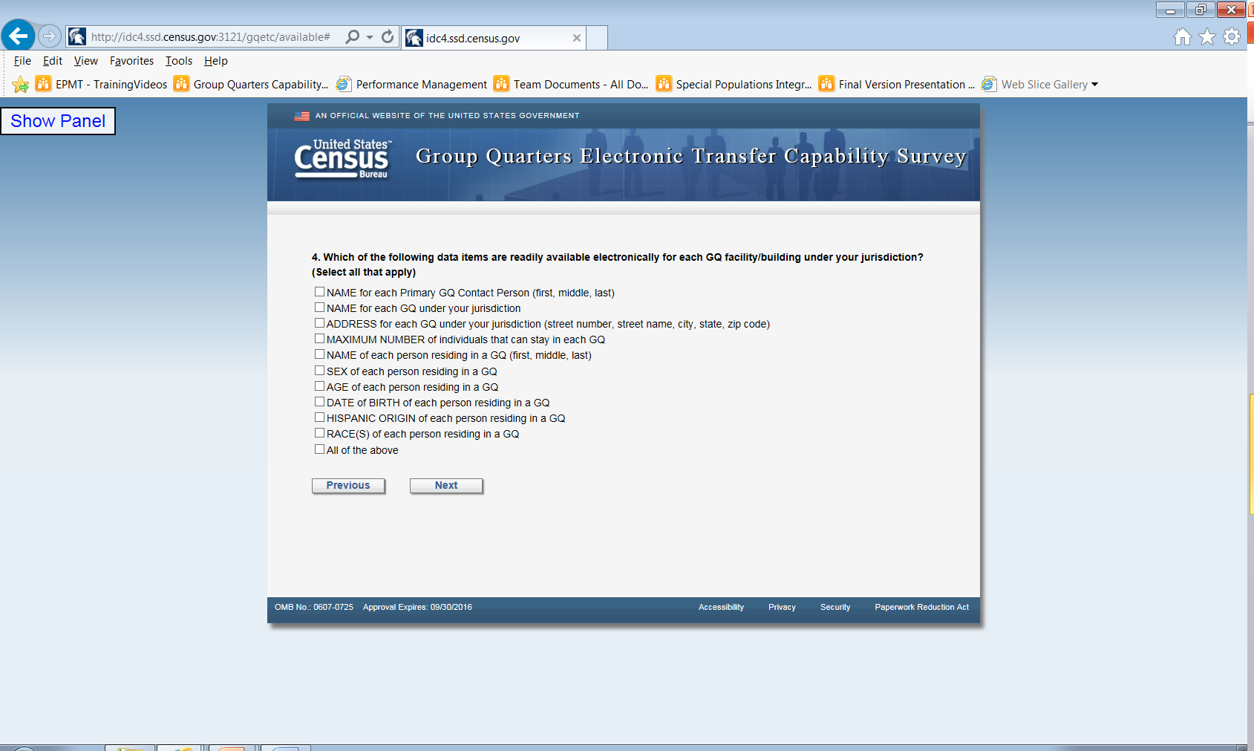
Attachment 2 continued
Attachment 2 continued

Slide 6
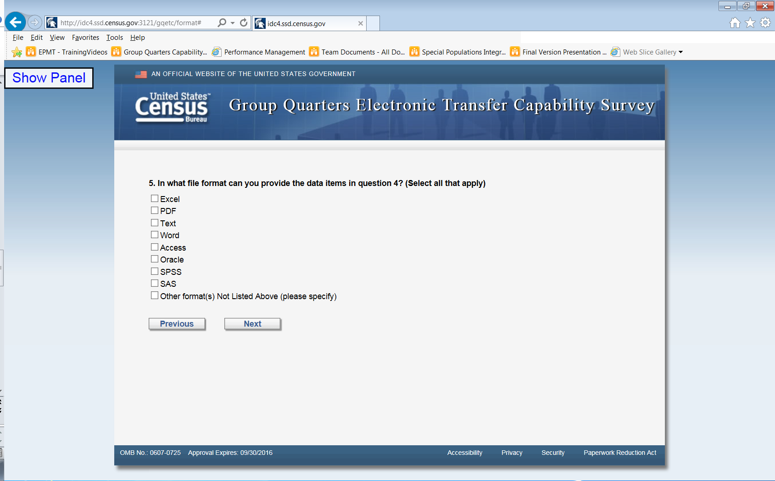
Attachment 2 continued

Slide 7
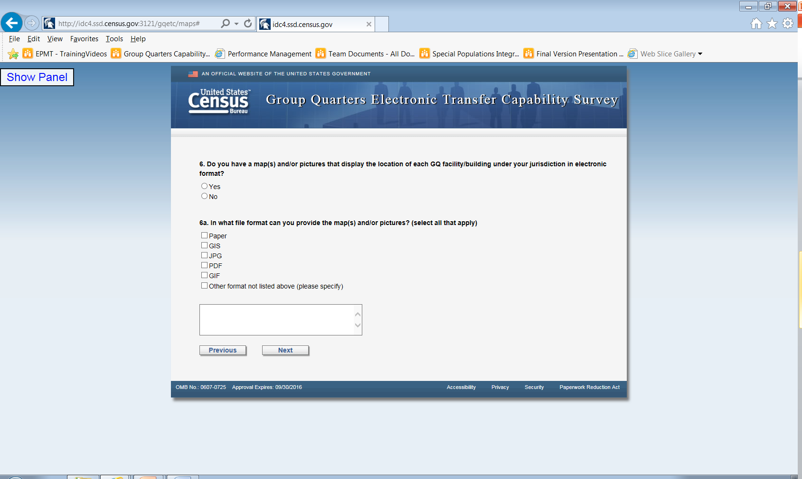
Attachment 2 continued

Slide 8
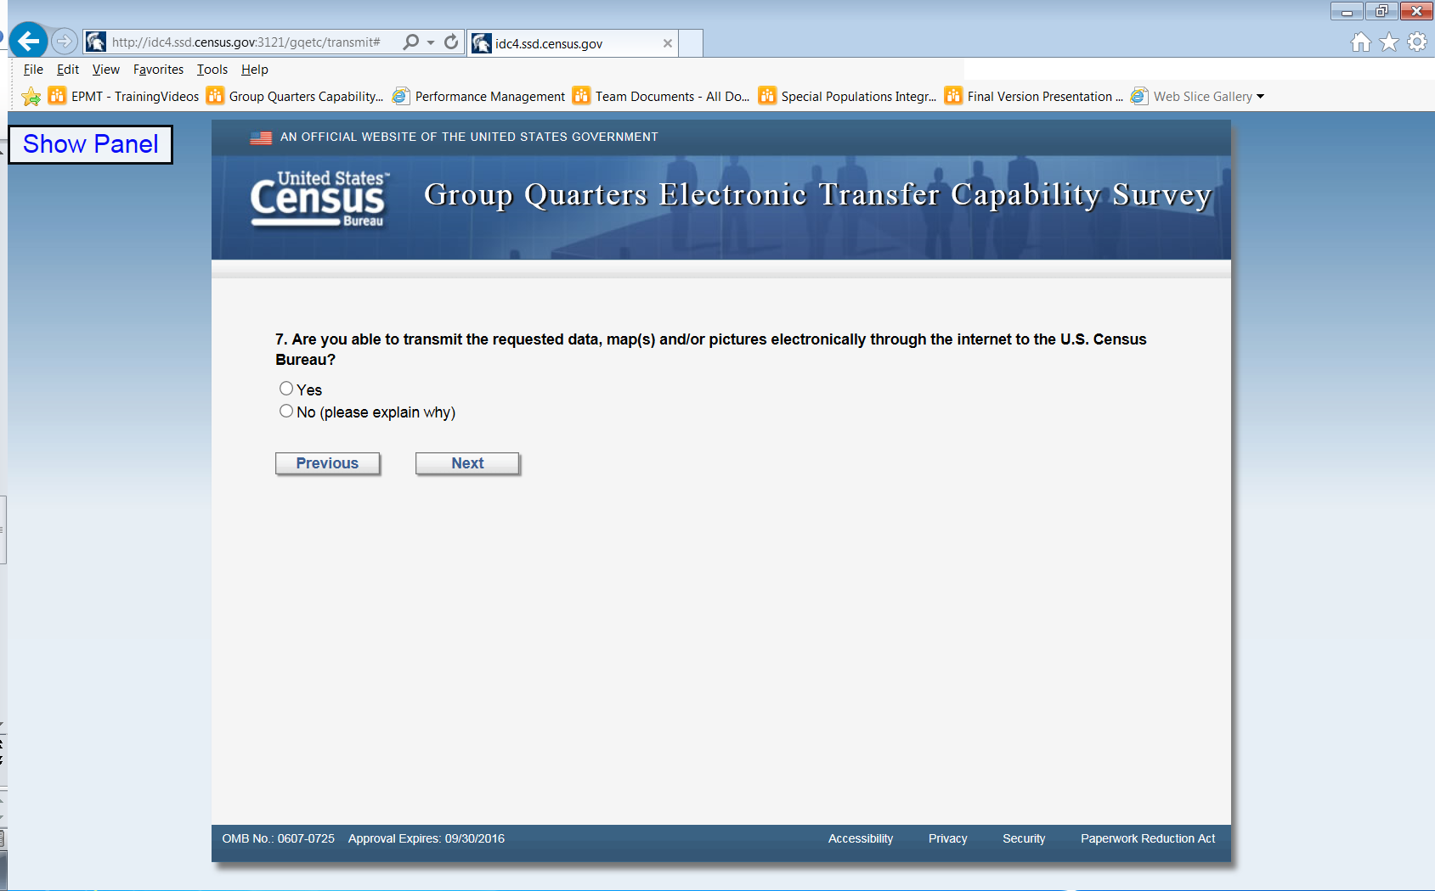
Attachment 2 continued

Slide 9
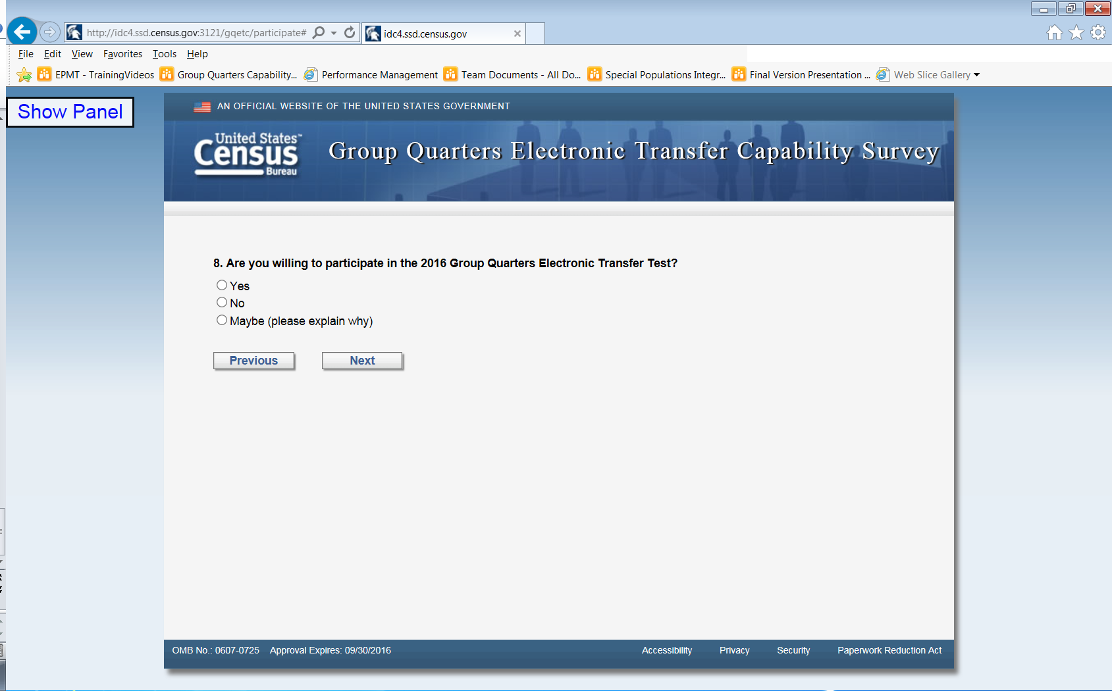
Attachment 2 continued

Slide 10
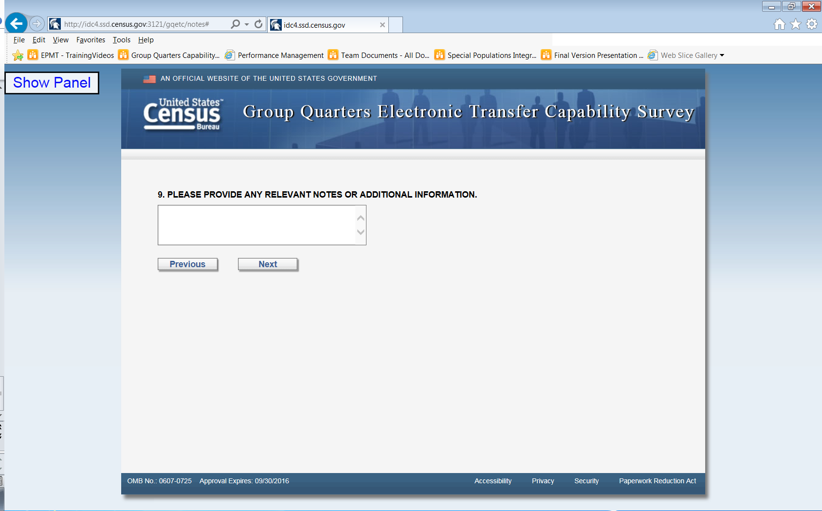
Attachment 2 continued

