Slide 1
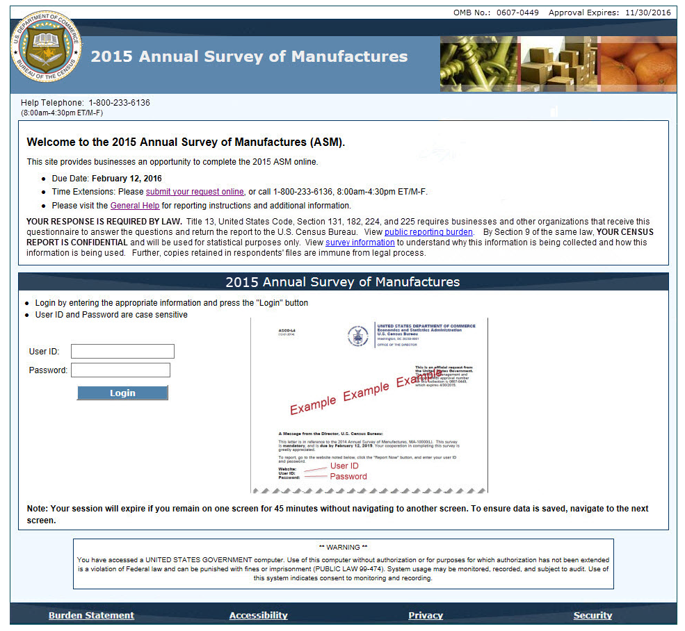
LOGIN
SCREEN NAME
RESPONSE/QUESTION TITLE
Skip Pattern, Notes

Slide 2
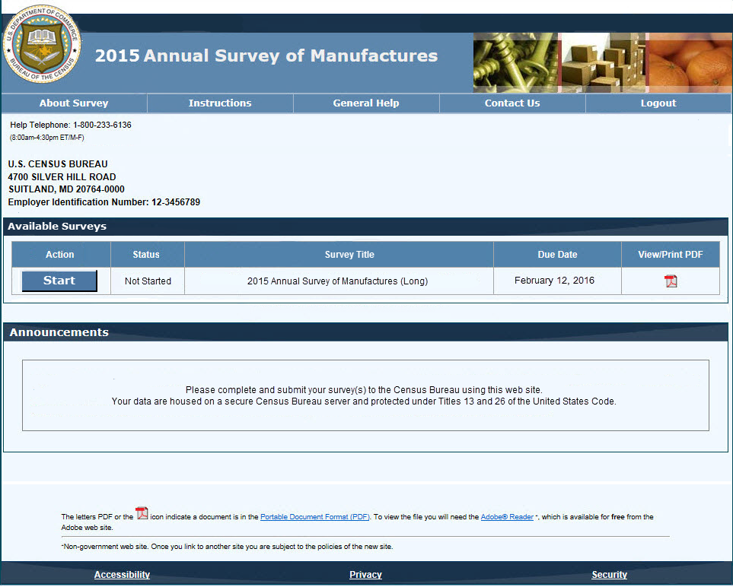
MAIN MENU (DASHBOARD)

Slide 3
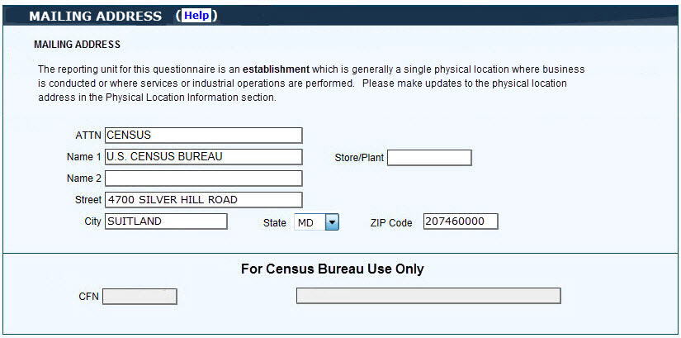

MAILING ADDRESS
BACK
SAVE AND CONTINUE

Slide 4

EIN A
EMPLOYER IDENTIFICATION NUMBER VALIDATION
Is (XX-XXXXXXX) the Employer Identification Number (EIN) used on this establishment's latest 2015 Internal Revenue Service Form 941, Employer’s Quarterly Tax Return?
Yes
No
BACK
SAVE AND CONTINUE

Slide 5
EIN B [EIN A] = NO
EMPLOYER IDENTIFICATION NUMBER
What is this establishment’s 9-digit Employer Identification Number (EIN) used on the latest 2015 Internal Revenue Service Form 941, Employer’s Quarterly Tax Return?
EIN
BACK
SAVE AND CONTINUE

Slide 6

OWNERSHIP OR CONTROL A1
OWNERSHIP OR CONTROL
Is your company owned or controlled by another domestic company?
Yes
No
BACK
SAVE AND CONTINUE

Slide 7
OWNERSHIP OR CONTROL A2 [OWNERSHIP OR CONTROL A1] = NO
OWNERSHIP OR CONTROL: MORE THAN ONE LOCATION
Does your company operate in more than one location?
Yes
No
BACK
SAVE AND CONTINUE

Slide 8
OWNERSHIP OR CONTROL B1 [OWNERSHIP OR CONTROL A1] = YES OWNERSHIP OR CONTROL A2] = YES
OWNERSHIP OR CONTROL: VOTING STOCK VALIDATION
Does another domestic company own more than 50 percent of the voting stock of your company?
Yes
No
BACK
SAVE AND CONTINUE

Slide 9
OWNERSHIP OR CONTROL B2 [OWNERSHIP OR CONTROL B1] = NO
OWNERSHIP OR CONTROL: MANAGEMENT AND POLICY
Does another domestic company have the power to control the management and policies of your company?
Yes
No
BACK
SAVE AND CONTINUE

Slide 10
OWNERSHIP OR CONTROL B3 [OWNERSHIP OR CONTROL B2]= Yes or Blank
OWNERSHIP OR CONTROL: PERCENT OF VOTING STOCK HELD
What percent of voting stock was held by the owning or controlling company?
(Check only ONE box)
Less than 50%
50%
More than 50%
BACK
SAVE AND CONTINUE

Slide 11
OWNERSHIP OR CONTROL B4 [OWNERSHIP OR CONTROL B1 or B2] = YES
OWNERSHIP OR CONTROL : COMPANY INFORMATION
What is the name, address, and 9-digit Employer Identification Number (EIN) of the
owning or controlling company?
Name of owning or controlling company:
Home office address (Number and street):
City, town, village, etc:
State
ZIP Code
EIN
BACK
SAVE AND CONTINUE

Slide 12
NUMBER OF ESTABLISHMENTS A
NUMBER OF ESTABLISHMENTS
How many establishments operated under EIN (XX-XXXXXXX) at the end of 2015?
Number
BACK
SAVE AND CONTINUE

Slide 13

NUMBER OF ESTABLISHMENTS B [NUMBER OF ESTABLISHMENTS A ] > 1 - Duplicated based on the establishment count value reported in the NUMBER OF ESTABLISHMENTS screen - Initial add screen is pre-filled with the physical location information, additional screens are blank
ADDED ESTABLISHMENT INFORMATION
Name
Secondary Name Store/Plant Number
Physical Location (Number and street)
City, town, village, etc. State ZIP Code
Describe kind of business at this location
For employees that worked at more than one location,
report the employment and payroll data for employees at
the ONE location where they spent most of their working
time.
2015
Number
Number of Employees for
Pay Period including March 12
2015
First Quarter Payroll
(Jan – March)
Annual Payroll
Sales, Shipments,
Receipts, or Revenue
BACK
SAVE AND CONTINUE

Slide 14
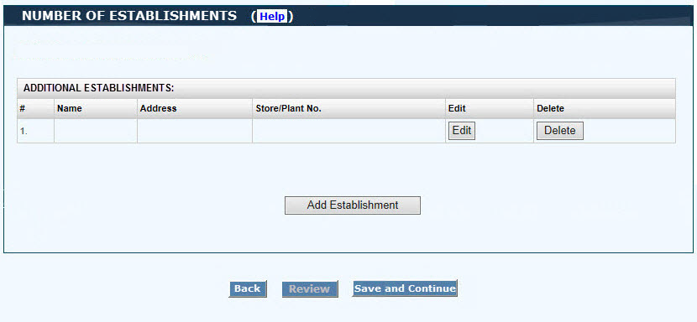
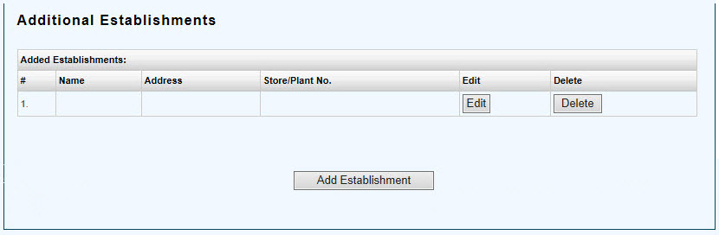
NUMBER OF ESTABLISHMENTS C [NUMBER OF ESTABLISHMENTS A] > 1 - Summary lists all added establishments - Allows Edit and/or Delete added establishments
BACK
SAVE AND CONTINUE

Slide 15
NUMBER OF ESTABLISHMENTS D [NUMBER OF ESTABLISHMENTS] > 1
ADDITIONAL ESTABLISHMENT INSTRUCTIONS
Consolidating Data for Added Establishments:
The sum value of Sales, Shipments, Receipts or Revenue for all locations of the EIN should also be reported as a consolidated value in the Sales, Shipments, Rcpts/Revenue section, and also in the Details Sales, Shipments, Rcpts/Revenue section that follows.
The sum of Employment, First Quarter Payroll, and Annual Payroll for all locations of the EIN, should also be reported as consolidated values in the respective areas of the Employment and Payroll section that follows.
BACK
SAVE AND CONTINUE

Slide 16


PHYSICAL LOCATION A1
PHYSICAL LOCATION VALIDATION
Is this establishment's physical location the same as the address shown above?
P.O. Box and rural route addresses are not physical locations
Yes
No
BACK
SAVE AND CONTINUE

Slide 17
PHYSICAL LOCATION A2 [PHYSICAL LOCATION A1] = NO
PHYSICAL LOCATION INFORMATION
What is this establishment's physical location?
(P.O. Box and rural route addresses are not physical locations)
Number and Street
City, town, village, etc
State
ZIP Code
BACK
SAVE AND CONTINUE

Slide 18
PHYSICAL LOCATION B
LEGAL BOUNDARY AND MUNICIPALITY:
Is this establishment physically located inside the legal boundaries of the city, town, village, etc?
Yes
No
No legal boundaries
Do not know
In what type of municipality is this establishment physically located?
City, village, or borough
Town or township
Other
Do not know
BACK
SAVE AND CONTINUE

Slide 19
OPERATIONAL STATUS A
OPERATIONAL STATUS
Which of the the following best describes this establishment’s operational status at the end of 2015?
(Check only ONE box)
In operation
Under construction, development, or exploration
Temporarily or seasonally inactive
Ceased operation
Sold or leased to another operator
BACK
SAVE AND CONTINUE

Slide 20
OPERATIONAL STATUS B [OPERATIONAL STATUS A] = Ceased operation
CEASED OPERATION DATE
When did this establishment cease operation?
MMDDYYYY
BACK
SAVE AND CONTINUE

Slide 21
OPERATIONAL STATUS C [OPERATIONAL STATUS A] = Sold or leased to another operator
SOLD OPERATION DATE AND INFORMATION
When was this establishment sold or leased to another operator?
MMDDYYYY
What is the name, address, and 9-digit Employer Identification Number (EIN) of this establishment's new owner or operator?
Name of new owner/operator
Mailing address (Number and street, P.O. Box, etc.)
City, town, village, etc.
State
ZIP Code
EIN
BACK
SAVE AND CONTINUE

Slide 22

MONTHS IN OPERATION If “0”, go to REMARKS
MONTHS IN OPERATION
How many months was this establishment in operation during 2015?
Number
BACK
SAVE AND CONTINUE

Slide 23

ADDITIONAL REPORTING GUIDELINES
ADDITIONAL REPORTING GUIDELINES:
Prior Year Data: Where available, your establishment’s Prior Year data is prelisted in the 2014 column. The figures may differ from those actually reported because of the changes made by the U.S. Census Bureau as a result of correspondence or a comparison of prior data. Check these figures and make any necessary corrections as needed. If 2014 Inventories figures are not prelisted, report these figures in the appropriate sections as instructed.
How to Report Dollar Figures:
Dollar figures should be rounded to thousands of dollars
BACK
SAVE AND CONTINUE

Slide 24

SALES, SHIPMENTS, RECEIPTS, OR REVENUE A
SALES, SHIPMENTS, RECEIPTS, OR REVENUE
What was the total value of products shipped and other receipts?
(Report details in the DETAIL SALES, SHIPMENTS, RECEIPTS, OR REVENUE section)
Exclude:
Freight charges
Excise Taxes
BACK
SAVE AND CONTINUE

Slide 25
SALES, SHIPMENTS, RECEIPTS, OR REVENUE B
EXPORTS
What was the value of products exported?
(This is a breakout of the ($XXXXXXXXXX,000.00) reported in total value of products shipped and other receipts in the SALES, SHIPMENTS, RECEIPTS, OR REVENUE area)
Include:
Shipments to customers in the Commonwealth of Puerto Rico and U.S. possessions
Products shipped to exporters or other wholesalers for export
Products sold to the U.S. Government to be shipped to be shipped to foreign governments
Exclude:
Products shipped for further manufacture, assembly or fabrication in the U.S.
BACK
SAVE AND CONTINUE

Slide 26
SALES, SHIPMENTS, RECEIPTS, OR REVENUE C [NUMBER OF ESTABLISHMENTS A] > 1
PRODUCTS SHIPPED FOR FURTHER MANUFACTURE
What was the market value of products shipped to other domestic plants of your company for further assembly, fabrication, or manufacture?
(This is a breakout of the ($XXXXXXXXXX,000.00) reported in total value of products shipped and other receipts in SALES, SHIPMENTS, RECEIPTS, OR REVENUE area)
BACK
SAVE AND CONTINUE

Slide 27

E-SHIPMENTS
E-SHIPMENTS
What percent of the ($XXXXXXXXXX,000.00) reported in total value of products shipped and other receipts, in the SALES, SHIPMENTS, RECEIPTS, OR REVENUE area, were for goods that were ordered or whose movement was controlled or coordinated over electronic networks? (Report whole percents. Estimates are acceptable.)
Electronic networks include:
Electronic Data Interchange (EDI)
E-mail
Internet
Extranet
Other online systems
2015 2014
BACK
SAVE AND CONTINUE

Slide 28

EMPLOYMENT AND PAYROLL A
EMPLOYMENT
Include:
Full- and part-time employees working at this establishment whose payroll was reported on Internal Revenue Service Form 941, Employer’s Quarterly Tax Return, and filed under EIN (XX-XXXXXXX)
Spread on stock options that are taxable to the employee wages
Exclude:
Full- or part-time leased employees whose payroll was filed under an employee leasing company's EIN
(Report values on line A in the OTHER OPERATING EXPENSES area of the SELECTED EXPENSES section)
Temporary staffing obtained from a staffing service.
(Report values on line A in the OTHER OPERATING EXPENSES area of the SELECTED EXPENSES section)
Purchased professional and technical services.
(Report values on line I in the OTHER OPERATING EXPENSES area of the SELECTED EXPENSES section)
What was the 2015 2014
A. Number of production workers for pay periods Number Number
including
1. March 12?
2. June 12?
3. September 12?

Slide 29
EMPLOYMENT AND PAYROLL A con’t
2015 2014
Number Number 4. December 12?
TOTAL Production Workers (Add lines A1 through A4)
B. Average annual production workers ?
(Divide TOTAL Production Workers by 4
and round to nearest whole number)
C. All other employees for pay period
including March 12?
TOTAL (Add lines B and C)
BACK
SAVE AND CONTINUE

Slide 30
EMPLOYMENT AND PAYROLL B
HOURS WORKED
What was the annual number of hours worked by the (XXXXXXXXXX)
average annual production workers reported in the EMPLOYMENT area?
2015 2014
Hours Hours
BACK
SAVE AND CONTINUE

Slide 31

EMPLOYMENT AND PAYROLL C
PAYROLL:
Exclude: Employer costs for fringe benefits
What was the annual payroll before deductions for…
A. Production workers?
B. All other employees?
TOTAL (Add lines A and B)

Slide 32
EMPLOYMENT AND PAYROLL C
PAYROLL:
What was the first quarter payroll before
deductions (January-March 2015)?
BACK
SAVE AND CONTINUE

Slide 33


EMPLOYMENT AND PAYROLL D
EMPLOYER’S ANNUAL COST FOR FRINGE BENEFITS
(This is the employer's annual cost for legally required programs and programs not required by law).
What were the employer’s annual costs for…
A. Health Insurance - Insurance premiums on hospitals, medical plans, and
single service plans such as dental, vision, and prescription drug plans
Include:
Premium equivalents for self-insured plans and fees
paid to third-party administrators (TPAs).
Exclude:
Employee contributions
Disbursement from trusts or funds to
satisfy health insurance claims
B. Pension Plans:
1. Defined benefit pension plans - Cost for both qualified
and nonqualified defined pension plans. Plans that specify the
benefit to be paid to employees upon retirement, generally either a
specific amount or a percentage of compensation.
Employer contributions are based on actuarial computations
that include employee's compensation and years of service
and are not allocated to specific accounts maintained for
employees.
2. Defined contribution plans - Costs under defined
contribution plans. Pension plans that define the employer
contributions to a separate account provided for each employee.
The employee "benefit" at retirement depends on the amount
contributed and the results of the account's activity.
Examples:
Profit sharing plans
Money purchase (e.g. 401k, 403b)
Stock bonus plans (e.g., ESOPs)
C. Payroll taxes, employer-paid insurance premiums, and
other employer-paid benefits
Include:
- Legally required fringe benefits
Examples:
- Social Security
- Workers’ compensation insurance
- Unemployment tax
- State disability insurance programs
- Medicare
- Benefits for life insurance
- “Quality of life” benefits
Examples:
- Childcare assistance
- Subsidized commuting, etc.
- Employer contributions to pre-tax benefit accounts
(e.g. Health savings account)
- Education assistance
- Other benefits not specified above
Exclude:
- Disbursements from trusts or funds to
satisfy health insurance claims
TOTAL (Add lines A, B1, B2, and C)
BACK
SAVE AND CONTINUE

Slide 34

VALUE OF INVENTORIES A - Only for Select NAICS codes that are allowed to have no inventories.
INVENTORIES:
Did this establishment own inventories, regardless of where held, at the end of 2015 and/or 2014?
Yes
No
BACK
SAVE AND CONTINUE

Slide 35
VALUE OF INVENTORIES B [VALUE OF INVENTORIES A] = YES
VALUE OF INVENTORIES:
What were the value of inventories owned by this establishment
as of December 31 before Last-in,
First-out (LIFO) adjustment (if any) for… End of 2015 End of 2014
A. Finished goods?
B. Work in progress?
C. Materials, supplies, fuels, etc.?
TOTAL (Add lines A through C)
BACK
SAVE AND CONTINUE

Slide 36
INVENTORIES BY NON-LIFO VALUATION METHODS [VALUE OF INVENTORIES A] = YES
INVENTORIES BY NON-LIFO VALUATION METHODS:
Of the ($XXXXXXXXXXX,000.00) reported in total value of inventories owned by this establishment as of December 31,
how much is subject to the following valuation methods…
End of 2015 End of 2014
A. First-In, First-out (FIFO)?
B. Average Cost?
C. Standard Cost?
D. Other non-LIFO valuation method(s)?
Specify method:
TOTAL (Add lines A through D)
BACK
SAVE AND CONTINUE

Slide 37
INVENTORIES BY LAST-IN, FIRST-OUT (LIFO) VALUATION METHOD A [VALUE OF INVENTORIES A] = YES
LIFO VALUATION METHOD:
Did this establishment use the Last-in, First-out (LIFO) valuation method?
Yes
No
BACK
SAVE AND CONTINUE

Slide 38
INVENTORIES BY LAST-IN, FIRST-OUT (LIFO) VALUATION METHOD B - [INVENTORIES BY LAST-IN, FIRST-OUT (LIFO) VALUATION METHOD A]=YES - Auto fill INV_VAL_NLIFO_END from INV_VAL_NLIFO_TOT_END (screen 36)
INVENTORIES BY LIFO VALUATION METHOD:
Of the ($XXXXXXXXXXX,000.00) reported in total value of inventories owned by this establishment as
of December 31, what was the…
End of 2015 End of 2014
A. Amount subject to LIFO?
(gross LIFO amount)
B. Amount not subject to LIFO?
(should equal ($XXXXXXXXXXX,000.00)
TOTAL Inventories by Non-LIFO valuation method)
TOTAL (Add lines A and B)
Amount of LIFO reserve? (if any)
BACK
SAVE AND CONTINUE

Slide 39
INVENTORIES OUTSIDE THE US
INVENTORIES OUTSIDE THE UNITED STATES
Of the ($XXXXXXXXXX,000.00) reported in total value inventories, what was the value of inventories stored or en route OUTSIDE the 50 U.S. states and the District of Columbia for 2015?
Exclude:
Inventory held in Foreign Trade Zones or
in bonded warehouses in the U.S.
For more detailed definitions, please see
http://enforcement.trade.gov/ftzpage/info/ftzstart.html
End of 2015 End of 2014
BACK
SAVE AND CONTINUE

Slide 40

CAPITAL EXPENDITURES A
CAPITAL EXPENDITURES
(Refer to the instructions on how to report leasing arrangements)
What were the capital expenditures for new and used depreciable assets spent in 2015 for …
A. New and used building and other structures?
Exclude:
- Land
B. New and used machinery and equipment?
TOTAL (Add lines A and B)
BACK
SAVE AND CONTINUE

Slide 41
CAPITAL EXPENDITURES B [CAPITAL EXPENDITURES A] CAPEX_MACH not blank
CAPITAL EXPENDITURES: MACHINERY DETAIL
What is the breakdown of expenditures for new and used machinery and equipment by type?
(This is a breakout of the ($XXXXXXXXXX,000.00) reported in new and used machinery and equipment in
the CAPITAL EXPENDITURES area)
A. Automobiles, trucks, etc., for highway use?
B. Computers and peripheral data processing
equipment?
C. All other expenditures for machinery and
equipment?
TOTAL (Add lines A, B, and C)
BACK
SAVE AND CONTINUE

Slide 42
RENTAL PAYMENTS
RENTAL PAYMENTS
Include:
- Operating leases
Exclude:
- Capital leases
(leases with a contract to own at the end of the lease)
What were the payments for
A. Rental or lease of buildings?
Include:
- Job-site trailers
- Other structures
- Land
B. Rental or lease of machinery and equipment?
Include:
- Construction equipment
- Tools
- Office equipment
- Furniture
TOTAL (Add lines A and B)
BACK
SAVE AND CONTINUE

Slide 43

SELECTED EXPENSES A
SELECTED PRODUCTION COSTS AND ELECTRICITY
A. What were the selected production related
costs in 2015 for 2015 2014
1. Materials, parts, containers, packaging, etc used?
2. Products bought and sold without further
processing? (Report sales in code 9998991 in the
DETAILS SALES, SHIPMENTS, REVENUE, RECEIPTS section)
3. Purchased fuels consumed for heat, power,
or the generation of electricity?
4. Purchased electricity?
(Report comparable quantity on line B1)
5. Work done by you or others on your materials?
TOTAL (Add lines A1 through A5)

Slide 44
SELECTED EXPENSES A con’t
SELECTED PRODUCTION COSTS AND ELECTRICITY
B. What was the quantity of…
2015 2014
Kilowatt Hours Kilowatt Hours
1. Purchased electricity?
(Quantity comparable to cost reported in line A4)
2. Generated electricity?
(Gross less generating station use)
3. Electricity sold and transferred to other
establishments? (Also include on lines B1 or B2)
BACK
SAVE AND CONTINUE

Slide 45

SELECTED EXPENSES B This item may undergo some changes and be broken up across multiple screens.
OTHER OPERATING EXPENSES
What were the other operating expenses paid by this establishment in 2015 for 2015 2014
A. Temporary staff and leased employees?
(Professional Employer Organizations and staffing agencies for personnel )
Include all charges for: Payroll, benefits, services
B. Expensed equipment?
(Expensed computer hardware and other equipment)
Include:
Copiers
Fax machines
Telephones
Shop and lab equipment
CPUs
Monitors
(Report packaged software in line C)
C. Expensed purchases of software?
(Purchases of prepackaged, custom coded or vendor customized software)
Include:
Software developed or customized by others
Web-design services and purchases
Licensing agreements
Upgrades of software
Maintenance fees related to software upgrades
and alterations
D. Data processing and other purchased computer services?
Include:
Facilities management services
Computer input preparation
Data Storage
Computer time rental
Optical scanning services
Other computer related advice and services, including training.
Exclude:
Expensed integrated systems
Repair and maintenance of computer equipment
Payroll processing and credit card transaction fees
Expenses for telecommunication services,
(e.g., internet, connectivity, telephone.)
E. Purchased communication service?
Include:
Telephone, cellular, and fax services,
Computer-related communications
(e.g., Internet, connectivity, online)
Other wired and wireless communication services

Slide 46
SELECTED EXPENSES B con’t
OTHER OPERATING EXPENSES
F. Purchased repairs and maintenance to buildings and/or
machinery and equipment?
Exclude:
Materials, parts, and supplies used for repairs and maintenance performed by this firm's employees.
G. Water, sewer, refuse removal, and other non-electric
utility payments?
Include:
Cost of hazardous waste removal
(Report electric utility payments in line A4 in the SELECTED
PRODUCTION COSTS AND ELECTRICITY area of
the SELECTED EXPENSES section)
H. Purchased advertising and promotional services?
Include:
Marketing and public relations services
I. Purchased professional and technical services?
Include:
Management consulting
Accounting
Auditing
Bookkeeping
Legal
Actuarial
Payroll processing
Architectural
Engineering
Other professional services
Exclude:
Salaries paid to your own employees for these services
J. Governmental taxes and license fees?
(Payments to government agencies for taxes and licenses)
Include:
Business and property taxes
Exclude:
Income taxes
K. All other operating expenses not reported elsewhere?
Exclude:
Purchases of merchandise for resale
Nonoperating expenses
Specify:
2015 2014

Slide 47
SELECTED EXPENSES B con’t
OTHER OPERATING EXPENSES
TOTAL (Add lines A through K)
2015 2014
BACK
SAVE AND CONTINUE

Slide 48
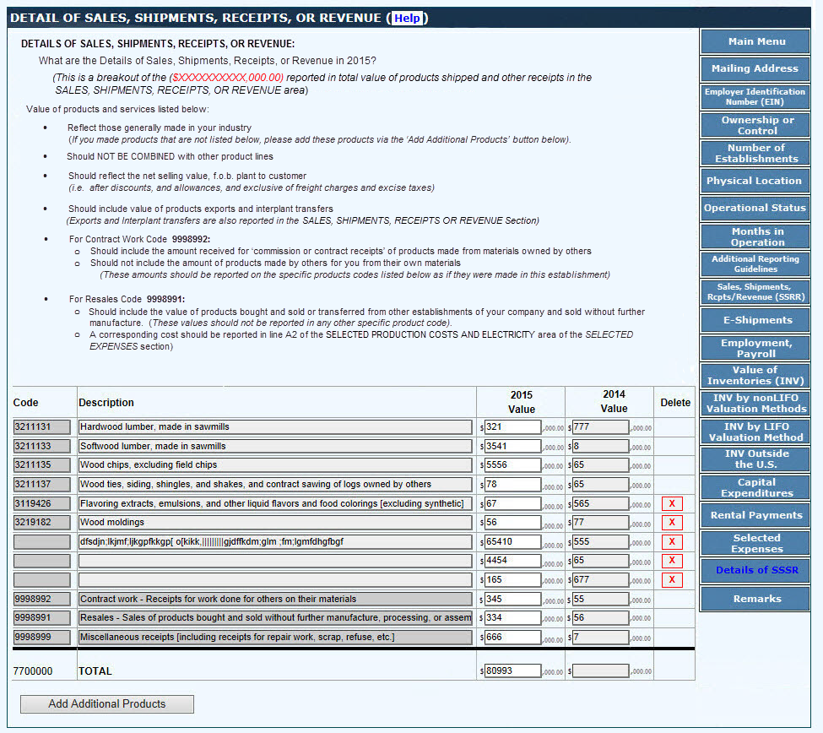
- Autofill of the sales, receipts, or revenue will be added. Will function as Item 22 in 2014 ASM DIR does unless there is time to make any improvements.
DETAILS OF SALES, SHIPMENTS, RECEIPTS, OR REVENUE
BACK
SAVE AND CONTINUE

Slide 49
REMARKS
(Please use this space for any explanations that may be essential in understanding your reported data.)
BACK
SAVE AND CONTINUE

Slide 50

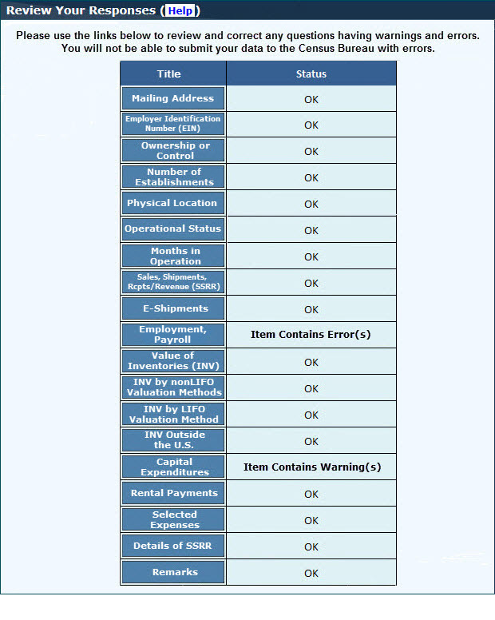
REVIEW If Errors on this screen, Save and Continue button disabled until Errors are cleared
BACK
SAVE AND CONTINUE

Slide 51
CERTIFICATION A1
CALENDAR YEAR TIME PERIOD
Is the time period covered by this report a calendar year?
Yes
No
BACK
SAVE AND CONTINUE

Slide 52


CERTIFICATION A2 [CERTIFICATION A1] = NO
TIME PERIOD COVERED
What time period does this report cover?
Month Year Month Year
From: To:
BACK
SAVE AND CONTINUE

Slide 53
CERTIFICATION B
CERTIFICATION
I certify that this report is substantially accurate and was prepared in accordance with the instructions
Name of person to contact regarding this report Title
Phone Number Fax Number
E-mail address Date Completed: MMDDYYYY
BACK
SUBMIT

Slide 54
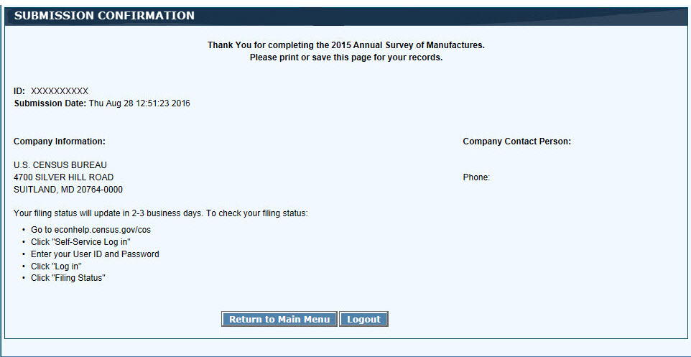
SUBMISSION CONFIRMATION

