Slide 1
Attachment 2

Slide 2
Attachment 2 continued

Slide 3
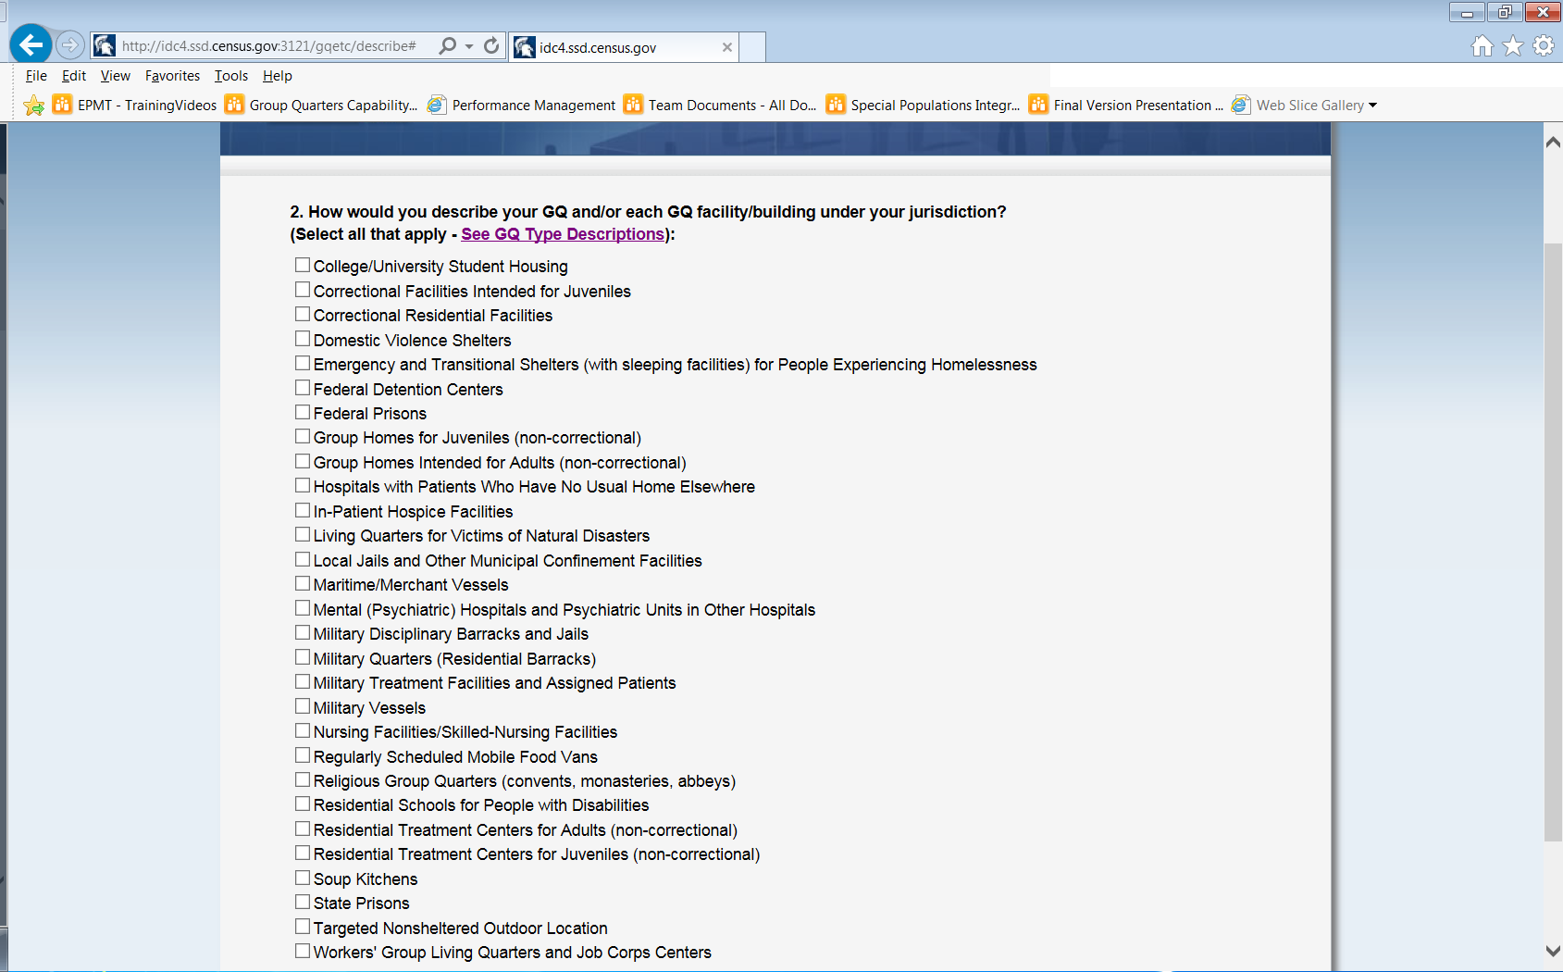
Attachment 2 continued

Slide 4
Attachment 2 continued
If respondent selects this option, their name (entered from question 1) will precede the verbiage in parenthesis.

Slide 5
Attachment 2 continued
Attachment 2 continued

Slide 6
Attachment 2 continued

Slide 7
Attachment 2 continued

Slide 8
Attachment 2 continued

Slide 9
Attachment 2 continued

Slide 10
Attachment 2 continued

