Slide 1
Notes:
Do you have any comments on this screen?
If the user had trouble logging in, make note of that and say
Tell me about your experience logging in.

Slide 2
Notes:
Do you have any comments on the information on this screen?
Would you read it if you were at home and really completing the survey?
Do you think it is necessary to include this screen?

Slide 3
Notes:
What do you think about this design instead?

Slide 4
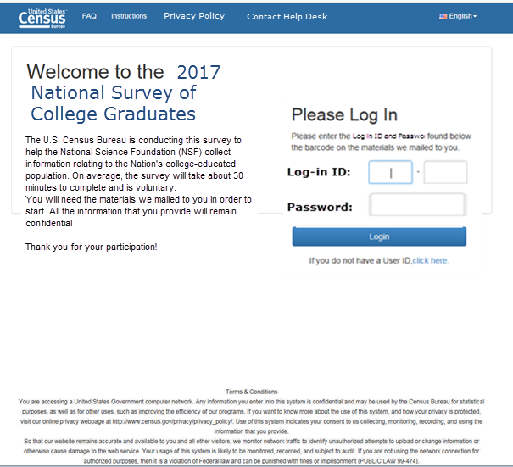
Notes:
What do you think about this design instead - where some of that information is included on the login page?

Slide 5
Notes:
Do you have any comments on the information on this screen?
Would you read it if you were at home and really completing the survey?
Do you think it is necessary to include this screen?

Slide 6
Notes:
(only review the screens they saw)
Do you have any comments on these screens?
If the user had difficulty on this screen, make note of that and say
Tell me about your experience answering these questions.

Slide 7
Notes:
(only review the screens they saw)
Do you have any comments on this screen?
If the user had difficulty on this screen, make note of that and say
Tell me about your experience answering this question.

Slide 8
Notes:
(only review the screens they saw)
Do you have any comments on this screen?
If the user had difficulty on this screen, make note of that and say
Tell me about your experience answering this question.

Slide 9
Notes:
(only review the screens they saw)
Do you have any comments on this screen?
If the user had difficulty on this screen, make note of that and say
Tell me about your experience answering this question.

Slide 10
Notes:
(only review the screens they saw)
Do you have any comments on this screen?
If the user had difficulty on this screen, make note of that and say
Tell me about your experience answering this question.

Slide 11
Notes:
(only review the screens they saw)
Do you have any comments on this screen?
If the user had difficulty on this screen, make note of that and say
Tell me about your experience answering this question.

Slide 12
Notes:
(only review the screens they saw)
Do you have any comments on either of these screens?
If the user had difficulty on this screen, make note of that and say
Tell me about your experience answering this question.

Slide 13
Notes:
(only review the screens they saw)
Do you have any comments on this screen?
If the user had difficulty on this screen, make note of that and say
Tell me about your experience answering this question.

Slide 14
Notes:
(only review the screens they saw)
Do you have any comments on this screen?
If the user had difficulty on this screen, make note of that and say
Tell me about your experience answering this question.

Slide 15
Notes:
(only review the screens they saw)
Do you have any comments on this screen?
If the user had difficulty on this screen, make note of that and say
Tell me about your experience answering this question.

Slide 16
Notes:
(only review the screens they saw)
Do you have any comments on these screens?
If the user had difficulty on this screen, make note of that and say
Tell me about your experience answering this question.

Slide 17
Notes:
(only review the screens they saw)
Do you have any comments on this screen?
If the user had difficulty on this screen, make note of that and say
Tell me about your experience answering this question.

Slide 18
Notes:
(only review the screens they saw)
Do you have any comments on this screen?
If the user had difficulty on this screen, make note of that and say
Tell me about your experience answering this question.

Slide 19
Notes:
(only review the screens they saw)
Do you have any comments on this screen?
If the user had difficulty on this screen, make note of that and say
Tell me about your experience answering this question.

Slide 20
Notes:
(only review the screens they saw)
Do you have any comments on this screen?
If the user had difficulty on this screen, make note of that and say
Tell me about your experience answering this question.

Slide 21
Notes:
There could be several slides here. All on employment branching.
Do you have any comments on this screen?
If the user had difficulty on this screen, make note of that and say
Tell me about your experience answering this question.

Slide 22
Notes:
For someone who is not retirement age, how would you feel about being asked this question.

Slide 23
Notes:
What does “principal employer” mean to you in this question?

Slide 24
Notes:
(only review the screens they saw)
Do you have any comments on this screen?
If the user had difficulty on this screen, make note of that and say
Tell me about your experience answering this question.

Slide 25
Notes:
(only review the screens they saw)
Do you have any comments on this screen?
If the user had difficulty on this screen, make note of that and say
Tell me about your experience answering this question.

Slide 26
Notes:
What does “principal employer” mean to you in this question?

Slide 27
Notes:
(only review the screens they saw)
Do you have any comments on this screen?
If the user had difficulty on this screen, make note of that and say
Tell me about your experience answering this question.

Slide 28
Notes:
(only review the screens they saw)
Do you have any comments on this screen?
If the user had difficulty on this screen, make note of that and say
Tell me about your experience answering this question.

Slide 29
Notes:
(only review the screens they saw)
Do you have any comments on this screen?
If the user had difficulty on this screen, make note of that and say
Tell me about your experience answering this question.

Slide 30
Notes:
(only review the screens they saw)
Do you have any comments on this screen?
If the user had difficulty on this screen, make note of that and say
Tell me about your experience answering this question.

Slide 31
Notes:
(only review the screens they saw)
Do you have any comments on this screen?
If the user had difficulty on this screen, make note of that and say
Tell me about your experience answering this question.

Slide 32
Notes:
(only review the screens they saw)
Do you have any comments on this screen?
If the user had difficulty on this screen, make note of that and say
Tell me about your experience answering this question.

Slide 33
Notes:
(only review the screens they saw)
Do you have any comments on this screen?
If the user had difficulty on this screen, make note of that and say
Tell me about your experience answering this question.

Slide 34
Notes:
(only review the screens they saw)
Do you have any comments on this screen?
If the user had difficulty on this screen, make note of that and say
Tell me about your experience answering this question.

Slide 35
Notes:
(only review the screens they saw)
Do you have any comments on this screen?
If the user had difficulty on this screen, make note of that and say
Tell me about your experience answering this question.

Slide 36
Notes:
(only review the screens they saw)
Do you have any comments on this screen?
If the user had difficulty on this screen, make note of that and say
Tell me about your experience answering this question.

Slide 37
Notes:
(only review the screens they saw)
Do you have any comments on this screen?
If the user had difficulty on this screen, make note of that and say
Tell me about your experience answering this question.

Slide 38
Notes:
What if the previous two questions were combined to look something like what is on this screen. What are your thoughts about keeping the two questions separate versus combining them on one screen.
(you can refer back to the previous slides if needed)

Slide 39
Notes:
(only review the screens they saw)
Do you have any comments on this screen?
If the user had difficulty on this screen, make note of that and say
Tell me about your experience answering this question.

Slide 40
Notes:
(only review the screens they saw)
Do you have any comments on this screen?
If the user had difficulty on this screen, make note of that and say
Tell me about your experience answering this question.

Slide 41
Notes:
(only review the screens they saw)
Do you have any comments on this screen?
If the user had difficulty on this screen, make note of that and say
Tell me about your experience answering this question.

Slide 42
Notes:
(only review the screens they saw)
Do you have any comments on this screen?
If the user had difficulty on this screen, make note of that and say
Tell me about your experience answering this question.

Slide 43
Notes:
(only review the screens they saw)
Do you have any comments on this screen?
If the user had difficulty on this screen, make note of that and say
Tell me about your experience answering this question.

Slide 44
Notes:
(only review the screens they saw)
Do you have any comments on this screen?
If the user had difficulty on this screen, make note of that and say
Tell me about your experience answering this question.

Slide 45
Notes:
(only review the screens they saw)
Do you have any comments on this screen?
If the user had difficulty on this screen, make note of that and say
Tell me about your experience answering this question.

Slide 46
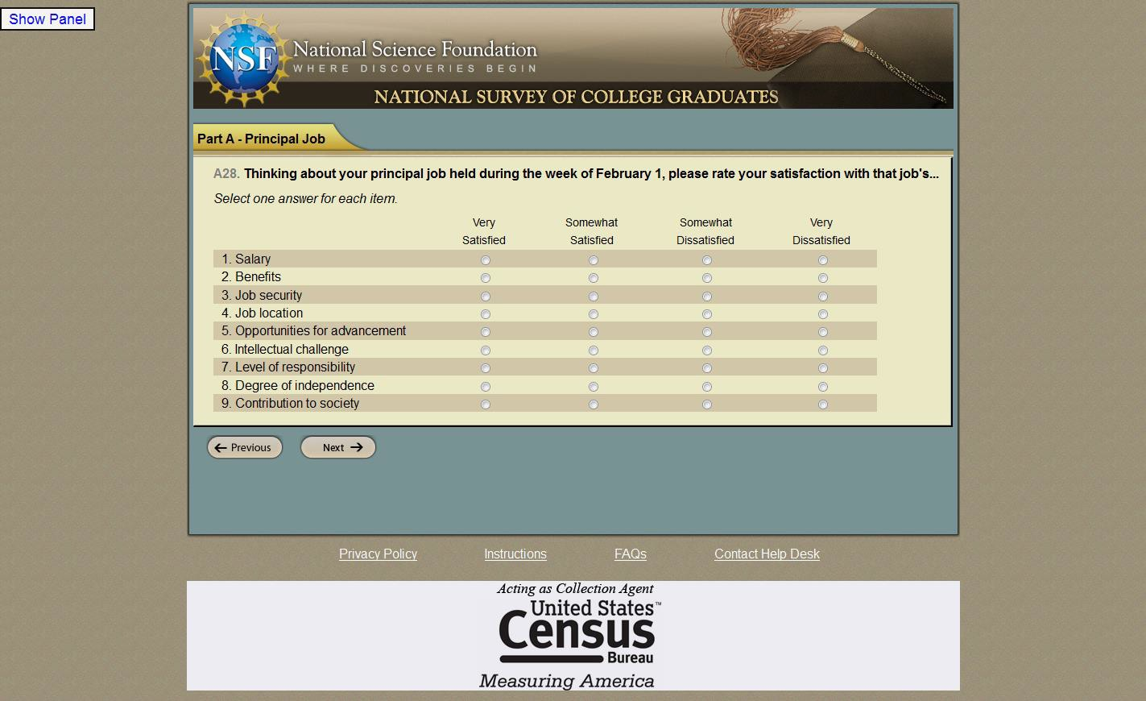
Notes:
(only review the screens they saw)
Do you have any comments on this screen?
If the user had difficulty on this screen, make note of that and say
Tell me about your experience answering this question.

Slide 47
Notes:
How do you feel about answering this question about your current employer?
Do you believe your responses to the survey are confidential?
Do you think your employer will have access to your responses?

Slide 48
Notes:
(only review the screens they saw)
Do you have any comments on this screen?
If the user had difficulty on this screen, make note of that and say
Tell me about your experience answering this question.

Slide 49
Notes:
(only review the screens they saw)
Do you have any comments on this screen?
If the user had difficulty on this screen, make note of that and say
Tell me about your experience answering this question.

Slide 50
Notes:
(only review the screens they saw)
Do you have any comments on this screen?
If the user had difficulty on this screen, make note of that and say
Tell me about your experience answering this question.

Slide 51
Notes:
(only review the screens they saw)
Do you have any comments on this screen?
If the user had difficulty on this screen, make note of that and say
Tell me about your experience answering this question.

Slide 52
Notes:
(only review the screens they saw)
Do you have any comments on this screen?
If the user had difficulty on this screen, make note of that and say
Tell me about your experience answering this question.

Slide 53
Notes:
(only review the screens they saw)
Do you have any comments on this screen?
If the user had difficulty on this screen, make note of that and say
Tell me about your experience answering this question.

Slide 54
Notes:
(only review the screens they saw)
Do you have any comments on this screen?
If the user had difficulty on this screen, make note of that and say
Tell me about your experience answering this question.

Slide 55
Notes:
(only review the screens they saw)
Do you have any comments on this screen?
If the user had difficulty on this screen, make note of that and say
Tell me about your experience answering this question.

Slide 56
Notes:
(only review the screens they saw)
Do you have any comments on this screen?
If the user had difficulty on this screen, make note of that and say
Tell me about your experience answering this question.

Slide 57
Notes:
(only review the screens they saw)
Do you have any comments on this screen?
If the user had difficulty on this screen, make note of that and say
Tell me about your experience answering this question.

Slide 58
Notes:
What is this question asking you?
Did you have difficulty responding?
If so, tell me more about that? Any recommendations to improve this?

Slide 59
Notes:
(only review the screens they saw)
Do you have any comments on this screen?
If the user had difficulty on this screen, make note of that and say
Tell me about your experience answering this question.

Slide 60
Notes:
(only review the screens they saw)
Do you have any comments on this screen?
If the user had difficulty on this screen, make note of that and say
Tell me about your experience answering this question.

Slide 61
Notes:
(only review the screens they saw)
Do you have any comments on this screen?
If the user had difficulty on this screen, make note of that and say
Tell me about your experience answering this question.

Slide 62
Notes:
(only review the screens they saw)
Do you have any comments on this screen?
If the user had difficulty on this screen, make note of that and say
Tell me about your experience answering this question.

Slide 63
Notes:
(only review the screens they saw)
Do you have any comments on this screen?
If the user had difficulty on this screen, make note of that and say
Tell me about your experience answering this question.

Slide 64
Notes:
(only review the screens they saw)
Do you have any comments on this screen?
If the user had difficulty on this screen, make note of that and say
Tell me about your experience answering this question.

Slide 65
Notes:
(only review the screens they saw)
Do you have any comments on this screen?
If the user had difficulty on this screen, make note of that and say
Tell me about your experience answering this question.

Slide 66
Notes:
(only review the screens they saw)
Do you have any comments on this screen?
If the user had difficulty on this screen, make note of that and say
Tell me about your experience answering this question.

Slide 67
Notes:
(only review the screens they saw)
Do you have any comments on this screen?
If the user had difficulty on this screen, make note of that and say
Tell me about your experience answering this question.

Slide 68
Notes:
(only review the screens they saw)
Do you have any comments on this screen?
If the user had difficulty on this screen, make note of that and say
Tell me about your experience answering this question.

Slide 69
Notes:
(only review the screens they saw)
Do you have any comments on this screen?
If the user had difficulty on this screen, make note of that and say
Tell me about your experience answering this question.

Slide 70
Notes:
Do you believe your responses to the survey are confidential?
Do you think your employer will have access to your responses?

Slide 71
Notes:
(only review the screens they saw)
Do you have any comments on this screen?
If the user had difficulty on this screen, make note of that and say
Tell me about your experience answering this question.

Slide 72
Notes:
(only review the screens they saw)
Do you have any comments on this screen?
If the user had difficulty on this screen, make note of that and say
Tell me about your experience answering this question.

Slide 73
Notes:
(only review the screens they saw)
Do you have any comments on this screen?
If the user had difficulty on this screen, make note of that and say
Tell me about your experience answering this question.

Slide 74
Notes:
(only review the screens they saw)
Do you have any comments on this screen?
If the user had difficulty on this screen, make note of that and say
Tell me about your experience answering this question.

Slide 75
Notes:
(only review the screens they saw)
Do you have any comments on this screen?
If the user had difficulty on this screen, make note of that and say
Tell me about your experience answering this question.

Slide 76
Notes:
(only review the screens they saw)
Do you have any comments on this screen?
If the user had difficulty on this screen, make note of that and say
Tell me about your experience answering this question.

Slide 77
Notes:
(only review the screens they saw)
Do you have any comments on this screen?
If the user had difficulty on this screen, make note of that and say
Tell me about your experience answering this question.

Slide 78
Notes:
(only review the screens they saw)
Do you have any comments on this screen?
If the user had difficulty on this screen, make note of that and say
Tell me about your experience answering this question.

Slide 79
Notes:
(only review the screens they saw)
Do you have any comments on this screen?
If the user had difficulty on this screen, make note of that and say
Tell me about your experience answering this question.

Slide 80
Notes:
(only review the screens they saw)
Do you have any comments on this screen?
If the user had difficulty on this screen, make note of that and say
Tell me about your experience answering this question.

Slide 81
Notes:
(only review the screens they saw)
Do you have any comments on this screen?
If the user had difficulty on this screen, make note of that and say
Tell me about your experience answering this question.

Slide 82
Notes:
(only review the screens they saw)
Do you have any comments on these screens?
If the user had difficulty on this screen, make note of that and say
Tell me about your experience answering these questions.

Slide 83
Notes:
(only review the screens they saw)
Do you have any comments on this screen?
If the user had difficulty on this screen, make note of that and say
Tell me about your experience answering this question.

Slide 84
Notes:
(only review the screens they saw)
Do you have any comments on this screen?
If the user had difficulty on this screen, make note of that and say
Tell me about your experience answering this question.

Slide 85
Notes:
(only review the screens they saw)
Do you have any comments on this screen?
If the user had difficulty on this screen, make note of that and say
Tell me about your experience answering this question.

Slide 86
Notes:
(only review the screens they saw)
Do you have any comments on this screen?
If the user had difficulty on this screen, make note of that and say
Tell me about your experience answering this question.

Slide 87
Notes:
(only review the screens they saw)
Do you have any comments on this screen?
If the user had difficulty on this screen, make note of that and say
Tell me about your experience answering this question.

Slide 88
Notes:
(only review the screens they saw)
Do you have any comments on this screen?
If the user had difficulty on this screen, make note of that and say
Tell me about your experience answering this question.

Slide 89
Notes:
(only review the screens they saw)
Do you have any comments on this screen?
If the user had difficulty on this screen, make note of that and say
Tell me about your experience answering this question.

Slide 90
Notes:
(only review the screens they saw)
Do you have any comments on this screen?
If the user had difficulty on this screen, make note of that and say
Tell me about your experience answering this question.

Slide 91
Notes:
If someone does not know the month that they were awarded their degree but knows the year, how should they respond?

Slide 92
Notes:
(only review the screens they saw)
Do you have any comments on this screen?
If the user had difficulty on this screen, make note of that and say
Tell me about your experience answering this question.

Slide 93
Notes:
(only review the screens they saw)
Do you have any comments on this screen?
If the user had difficulty on this screen, make note of that and say
Tell me about your experience answering this question.

Slide 94
Notes:
What if the previous two questions were combined to look something like what is on this screen. What are your thoughts about keeping the two questions separate versus combining them on one screen.
(you can refer back to the previous slides if needed)
There were many screens like this in the instrument. Do you have a general preference for keeping each question separate or combining them?

Slide 95
Notes:
(only review the screens they saw)
Do you have any comments on this screen?
If the user had difficulty on this screen, make note of that and say
Tell me about your experience answering this question.

Slide 96
Notes:
(only review the screens they saw)
Do you have any comments on this screen?
If the user had difficulty on this screen, make note of that and say
Tell me about your experience answering this question.

Slide 97
Notes:
(only review the screens they saw)
Do you have any comments on this screen?
If the user had difficulty on this screen, make note of that and say
Tell me about your experience answering this question.

Slide 98
Notes:
Make sure you understand the degrees this person received and when. It looks like there can be up to 5 degrees listed.

Slide 99
Notes:
(only review the screens they saw)
Do you have any comments on this screen?
If the user had difficulty on this screen, make note of that and say
Tell me about your experience answering this question.

Slide 100
Notes:
(only review the screens they saw)
Do you have any comments on this screen?
If the user had difficulty on this screen, make note of that and say
Tell me about your experience answering this question.

Slide 101
Notes:
(only review the screens they saw)
Do you have any comments on this screen?
If the user had difficulty on this screen, make note of that and say
Tell me about your experience answering this question.

Slide 102
Notes:
(only review the screens they saw)
Do you have any comments on this screen?
If the user had difficulty on this screen, make note of that and say
Tell me about your experience answering this question.

Slide 103
Notes:
Was this question easy or difficulty to answer? Why?

Slide 104
Notes:
Was this question easy or difficulty to answer? Why?

Slide 105
Notes:
(only review the screens they saw)
Do you have any comments on this screen?
If the user had difficulty on this screen, make note of that and say
Tell me about your experience answering this question.

Slide 106
Notes:
(only review the screens they saw)
Do you have any comments on this screen?
If the user had difficulty on this screen, make note of that and say
Tell me about your experience answering this question.

Slide 107
Notes:
(only review the screens they saw)
Do you have any comments on this screen?
If the user had difficulty on this screen, make note of that and say
Tell me about your experience answering this question.

Slide 108
Notes:
(only review the screens they saw)
Do you have any comments on this screen?
If the user had difficulty on this screen, make note of that and say
Tell me about your experience answering this question.

Slide 109
Notes:
(only review the screens they saw)
Do you have any comments on this screen?
If the user had difficulty on this screen, make note of that and say
Tell me about your experience answering this question.

Slide 110
Notes:
(only review the screens they saw)
Do you have any comments on this screen?
If the user had difficulty on this screen, make note of that and say
Tell me about your experience answering this question.

Slide 111
Notes:
(only review the screens they saw)
Do you have any comments on this screen?
If the user had difficulty on this screen, make note of that and say
Tell me about your experience answering this question.

Slide 112
Notes:
(only review the screens they saw)
Do you have any comments on this screen?
If the user had difficulty on this screen, make note of that and say
Tell me about your experience answering this question.

Slide 113
Notes:
(only review the screens they saw)
Do you have any comments on this screen?
If the user had difficulty on this screen, make note of that and say
Tell me about your experience answering this question.

Slide 114
Notes:
(only review the screens they saw)
Do you have any comments on this screen?
If the user had difficulty on this screen, make note of that and say
Tell me about your experience answering this question.

Slide 115
Notes:
(only review the screens they saw)
Do you have any comments on this screen?
If the user had difficulty on this screen, make note of that and say
Tell me about your experience answering this question.

Slide 116
Notes:
(only review the screens they saw)
Do you have any comments on this screen?
If the user had difficulty on this screen, make note of that and say
Tell me about your experience answering this question.

Slide 117
Notes:
(only review the screens they saw)
Do you have any comments on this screen?
If the user had difficulty on this screen, make note of that and say
Tell me about your experience answering this question.

Slide 118
Notes:
(only review the screens they saw)
Do you have any comments on this screen?
If the user had difficulty on this screen, make note of that and say
Tell me about your experience answering this question.

Slide 119
Notes:
(only review the screens they saw)
Do you have any comments on this screen?
If the user had difficulty on this screen, make note of that and say
Tell me about your experience answering this question.

Slide 120
Notes:
(only review the screens they saw)
Do you have any comments on this screen?
If the user had difficulty on this screen, make note of that and say
Tell me about your experience answering this question.

Slide 121
Notes:
(only review the screens they saw)
Do you have any comments on this screen?
If the user had difficulty on this screen, make note of that and say
Tell me about your experience answering this question.

Slide 122
Notes:
(only review the screens they saw)
Do you have any comments on this screen?
If the user had difficulty on this screen, make note of that and say
Tell me about your experience answering this question.

Slide 123
Notes:
(only review the screens they saw)
Do you have any comments on this screen?
If the user had difficulty on this screen, make note of that and say
Tell me about your experience answering this question.

Slide 124
Notes:
(only review the screens they saw)
Do you have any comments on this screen?
If the user had difficulty on this screen, make note of that and say
Tell me about your experience answering this question.

Slide 125
Notes:
(only review the screens they saw)
Do you have any comments on this screen?
If the user had difficulty on this screen, make note of that and say
Tell me about your experience answering this question.

Slide 126
Notes:
(only review the screens they saw)
Do you have any comments on this screen?
If the user had difficulty on this screen, make note of that and say
Tell me about your experience answering this question.

Slide 127
Notes:
(only review the screens they saw)
Do you have any comments on this screen?
If the user had difficulty on this screen, make note of that and say
Tell me about your experience answering this question.

Slide 128
Notes:
(only review the screens they saw)
Do you have any comments on this screen?
If the user had difficulty on this screen, make note of that and say
Tell me about your experience answering this question.

Slide 129
Notes:
(only review the screens they saw)
Do you have any comments on this screen?
If the user had difficulty on this screen, make note of that and say
Tell me about your experience answering this question.

Slide 130
Notes:
(only review the screens they saw)
Do you have any comments on this screen?
If the user had difficulty on this screen, make note of that and say
Tell me about your experience answering this question.

Slide 131
Notes:
(only review the screens they saw)
Do you have any comments on this screen?
If the user had difficulty on this screen, make note of that and say
Tell me about your experience answering this question.

Slide 132
Notes:
(only review the screens they saw)
Do you have any comments on this screen?
If the user had difficulty on this screen, make note of that and say
Tell me about your experience answering this question.

Slide 133
Notes:
(only review the screens they saw)
Do you have any comments on this screen?
If the user had difficulty on this screen, make note of that and say
Tell me about your experience answering this question.

Slide 134
Notes:
(only review the screens they saw)
Do you have any comments on this screen?
If the user had difficulty on this screen, make note of that and say
Tell me about your experience answering this question.

Slide 135
Notes:
(only review the screens they saw)
Do you have any comments on this screen?
If the user had difficulty on this screen, make note of that and say
Tell me about your experience answering this question.

Slide 136
Notes:
(only review the screens they saw)
Do you have any comments on this screen?
If the user had difficulty on this screen, make note of that and say
Tell me about your experience answering this question.

Slide 137
Notes:
(only review the screens they saw)
Do you have any comments on this screen?
If the user had difficulty on this screen, make note of that and say
Tell me about your experience answering this question.

Slide 138
Notes:
(only review the screens they saw)
Do you have any comments on this screen?

