Slide 1
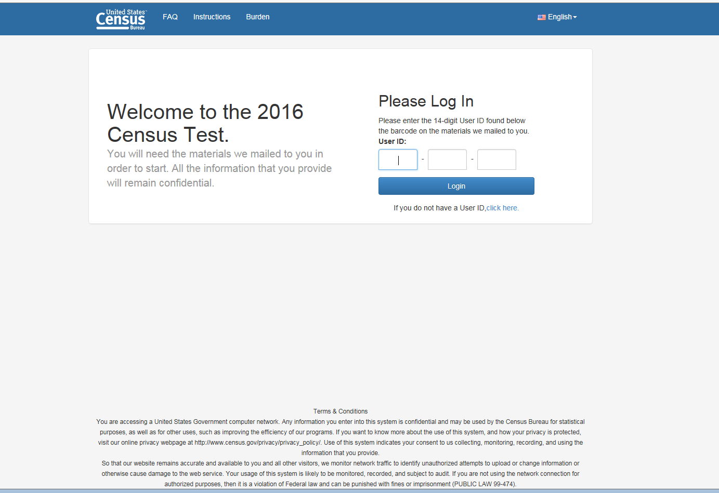
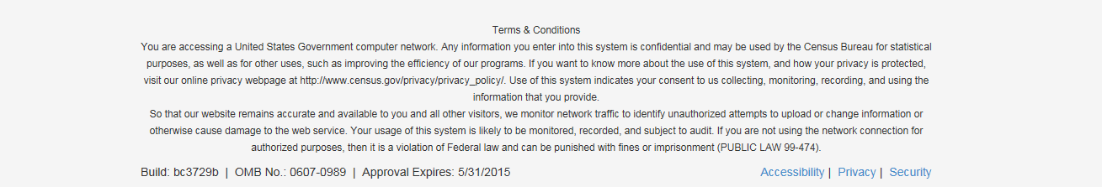
Notes:
Show respondents the screen they saw.
Do you have any comments on this screen?
If there were issues with entering the ID:
Tell me about your experience with this screen.
Did you read the message at the bottom of the screen? Y/N
If Y: What did you think this message is about?
If N: Please take a moment and read it now. What do you think this message is about?

Slide 2
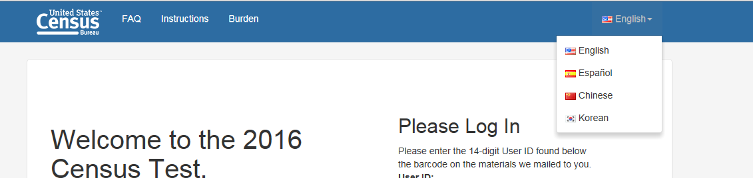
Notes:
NEW: Did you see the English button at the top.
Do you have any comments on this?

Slide 3
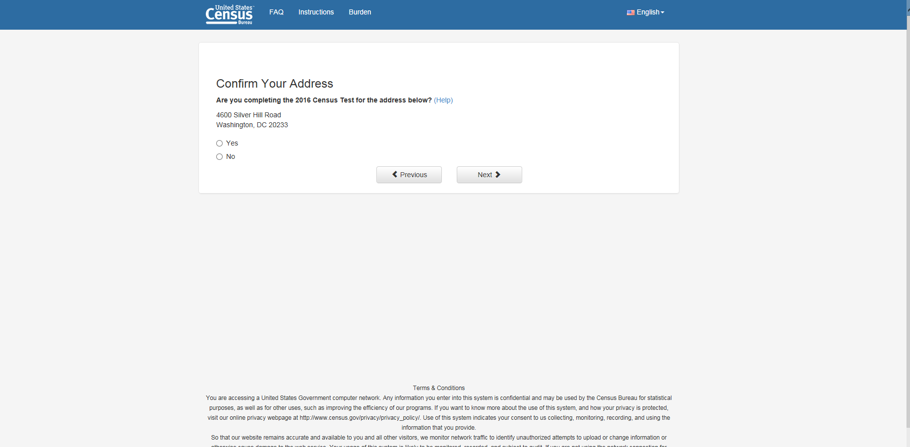
Notes:
Do you have any comments on this screen?

Slide 4
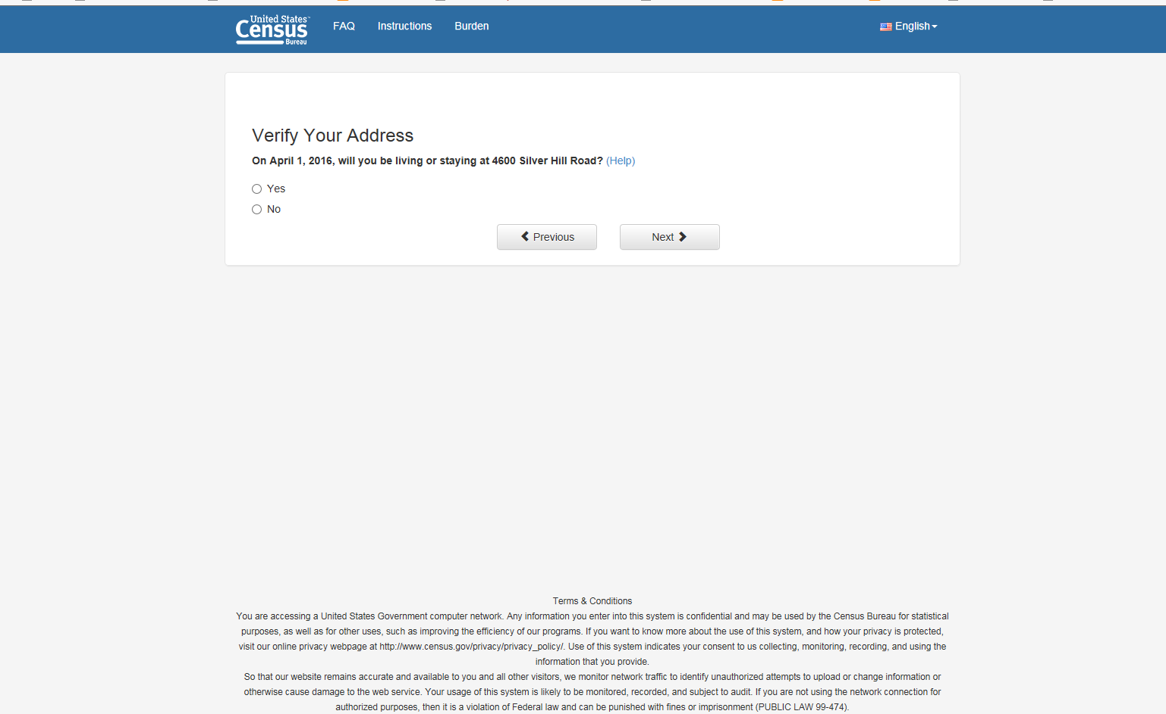
Notes:
Do you have any comments on this screen?
NEW SCREEN

Slide 5
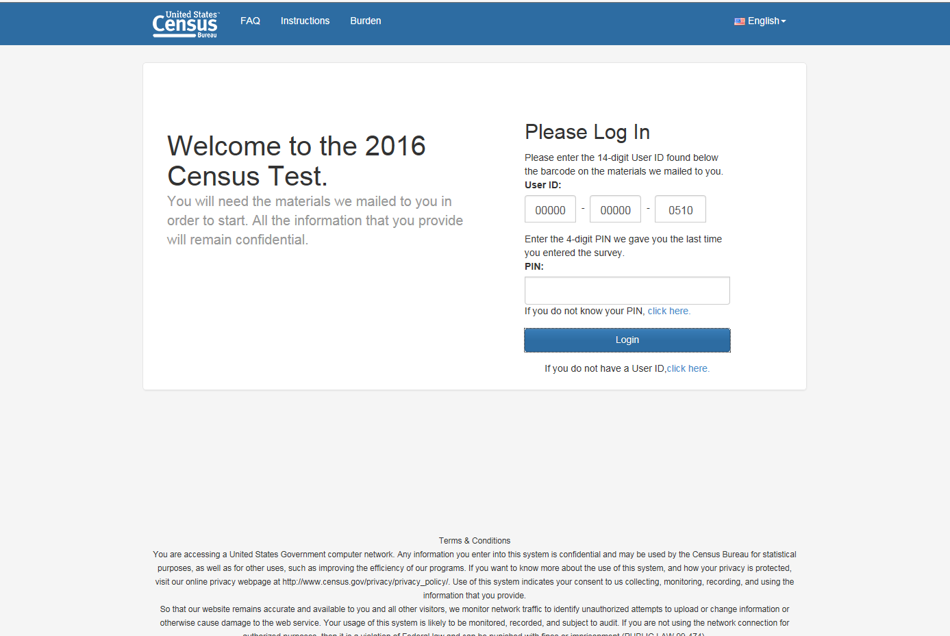
Notes:
If there were issues with entering the ID or re-entry
Tell me about your experience with this screen.
Do you have any comments on this screen?

Slide 6
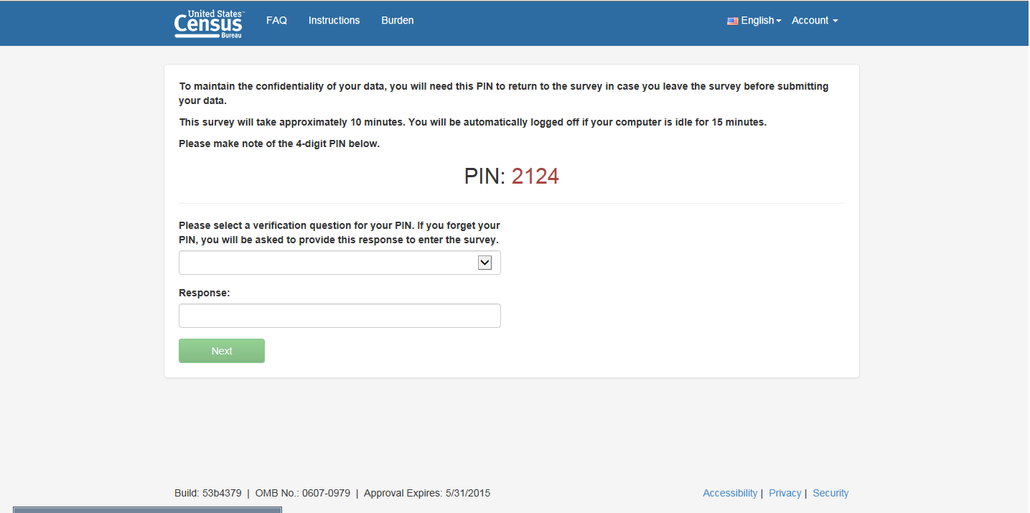
Notes:
(I included this screen in case there were any issues) Probe only if there were issues.

Slide 7
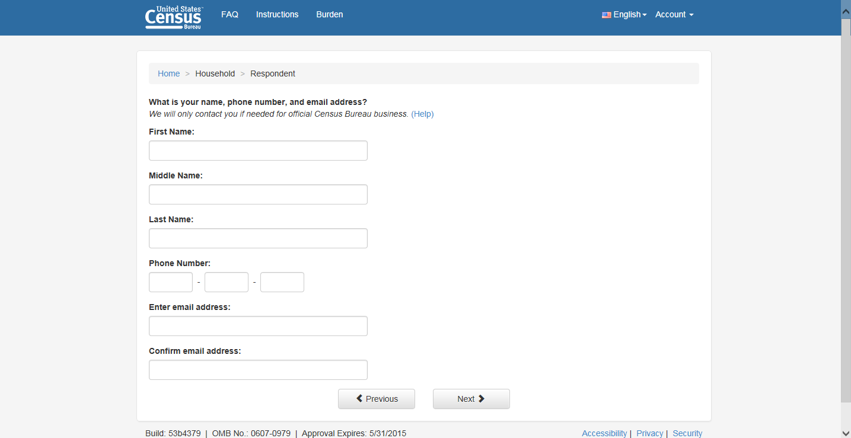
What is your name, phone number, and email address? We will only contact you if needed for official Census Bureau business. (Help)
Notes:
Did you read this instruction: (Point to instruction by name and telephone number (It is my understanding that this instruction will be different on the 2015 NCT.)
What does the instruction mean in your own words.
Is that the phone number most likely to reach you? If no, probe more about why R didn’t give a phone # he or she answers.
Is that the email address you are most likely to check? If no, probe more about why R didn’t give an email he or she checks often.

Slide 8
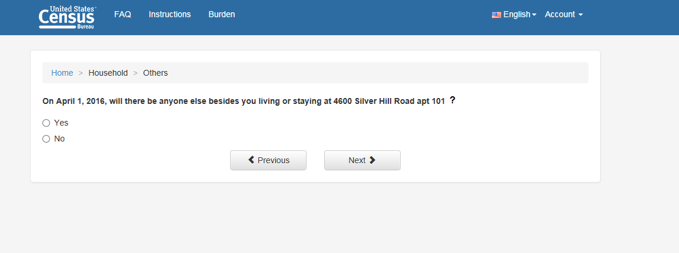
Notes:
INTERNET_ROSTER=3
If they received this screen. Do you have any comments on this screen?
If they added people later in the interview ask
I believe you entered x people at this question, can you tell me a little more about why you did not include y or z at this question but you added them later?
If they didn’t get this screen: This is a screen you could have received. Do you have any comments on this screen?
Where should college students be included?

Slide 9
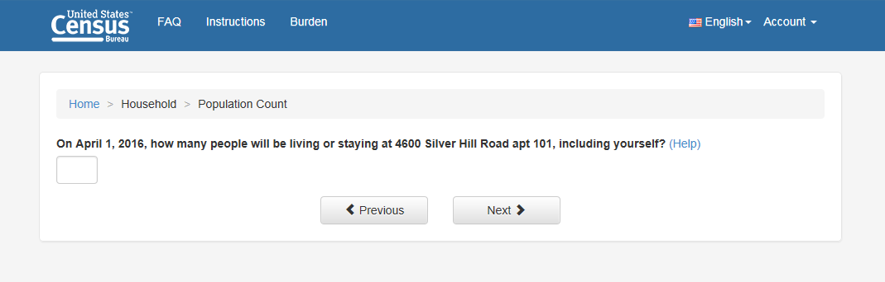
Notes:
INTERNET_ROSTER=2
If they received this screen. Do you have any comments on this screen?
If they added people later in the interview ask
I believe you entered x people at this question, can you tell me a little more about why you did not include y or z at this question but you added them later?
If they didn’t get this screen: This is a screen you could have received. Do you have any comments on this screen?
Where should college students be included?

Slide 10
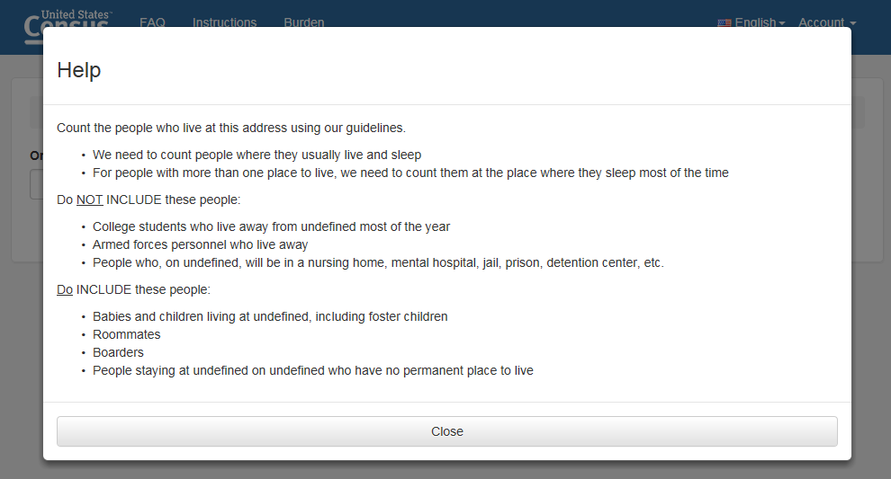
Notes:
INTERNET_ROSTER=3
This is the help screen for the last one.
Based on these instructions, where should college students be included?

Slide 11
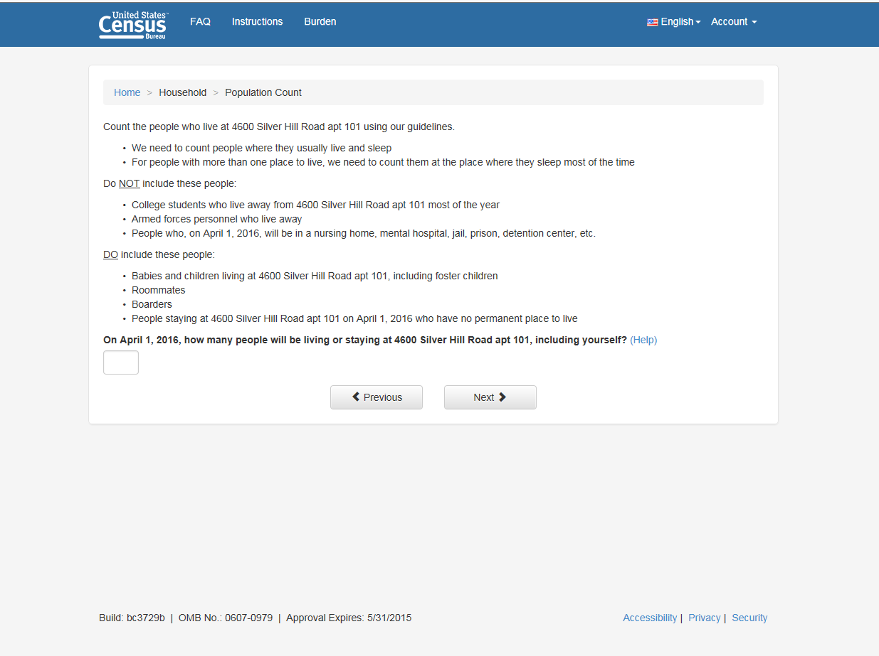
Notes:
INTERNET_ROSTER=1
If they received this screen: Do you have any comments on this screen?
If they added people later in the interview ask
I believe you entered x people at this question, can you tell me a little more about why you did not include y or z at this question but you added them later?
If they didn’t get this screen: This is a screen you could have received. Do you have any comments on this screen?
Based on these instructions, where should college students be included? (this might have been answered on the last page)

Slide 12
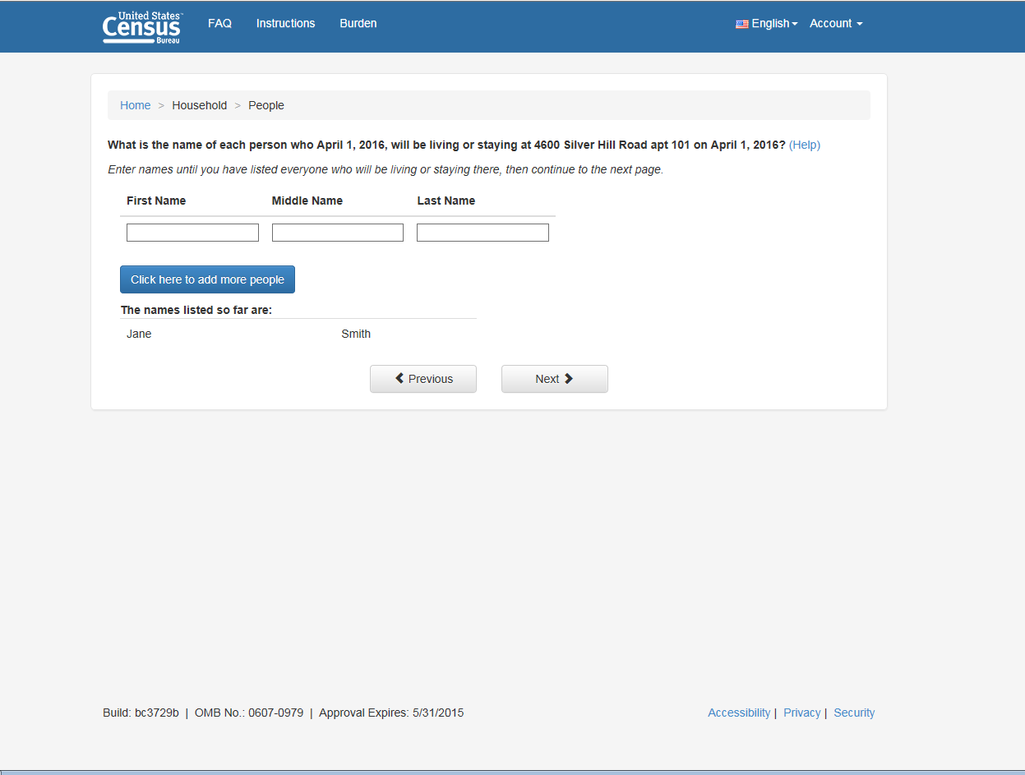
Notes:
Do you have any comments on this screen?
SPANISH ONLY: What does “editar” mean to you in this question?

Slide 13
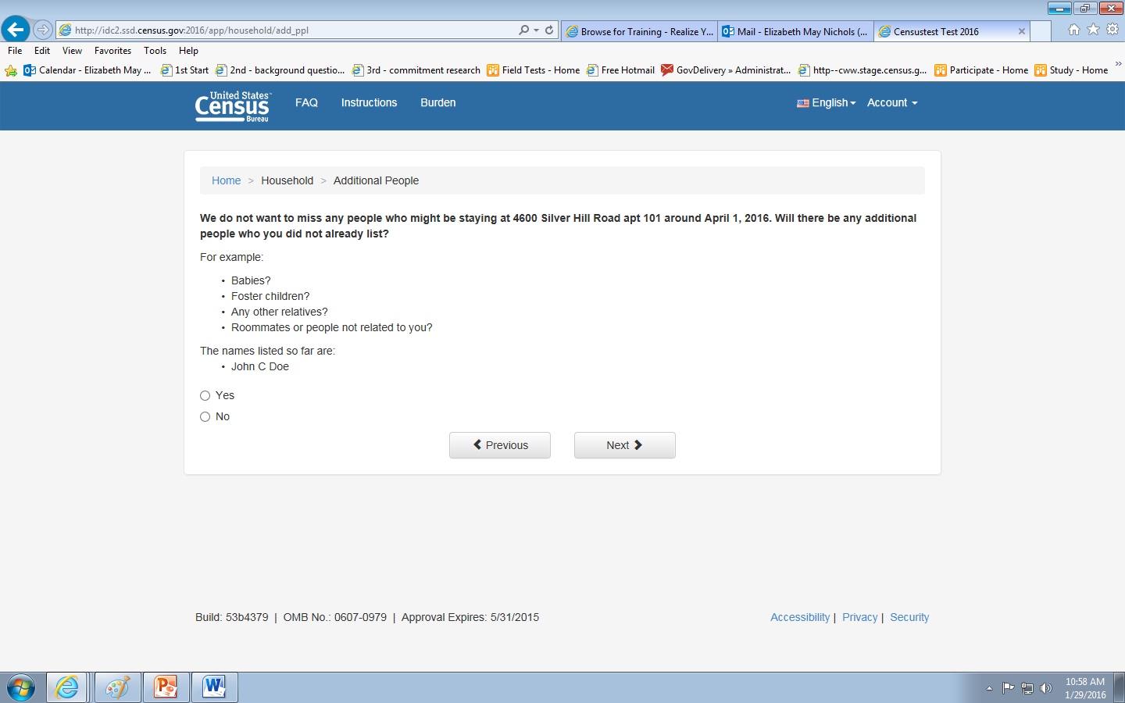
We do not want to miss any people who might <FILL1> at <ADDRESS> around <REFDATE>. <FILL2> any additional people who you did not already list?
For example:
Babies?
Foster children?
Any other relatives?
Roommates or people not related to you?
The names listed so far are:
<NAMES FROM RESPONDENT AND PEOPLE>
Notes:
INTERNET_UNDERCOUNT=2 (part 1)
If you received this screen and the next one:
Probe only if there were issues. Such as “Do you have any comments on this screen?”
If they didn’t get this screen: This is a screen you could have received. Do you have any comments on this screen?
SPANISH: what does the term roommate mean to you here?

Slide 14
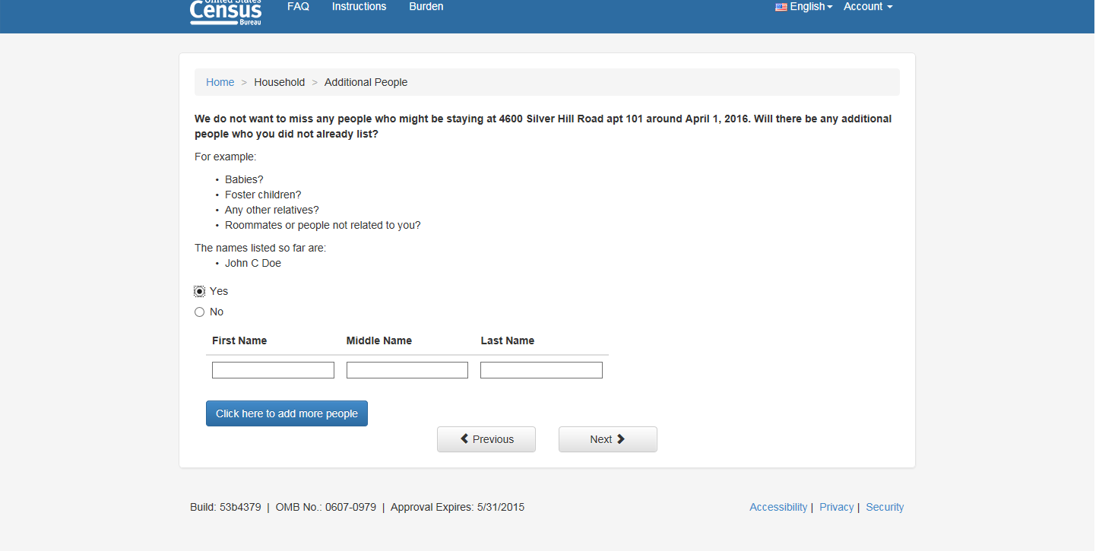
Notes:
INTERNET_UNDERCOUNT=1 (part 1)
DUPLICATE SCREEN FROM PREVIOUS ONE BUT SHOWS WHAT IT LOOKS LIKE WHEN THE NAME FIELD IS ENGAGED
If you received this screen and the next one:
Probe only if there were issues. Such as “Do you have any comments on this screen?”
If they didn’t get this screen: This is a screen you could have received. Do you have any comments on this screen?
SPANISH: what does the term roommate mean to you here?

Slide 15
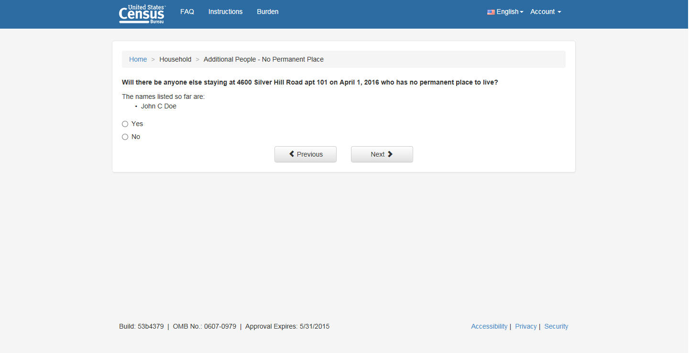
Notes:
INTERNET_UNDERCOUNT=1 (part 2)
If you received this screen:
Probe only if there were issues. Such as “Do you have any comments on this screen?”
This is a screen along with the last one which you could have received. Do you have any comments on this screen?

Slide 16
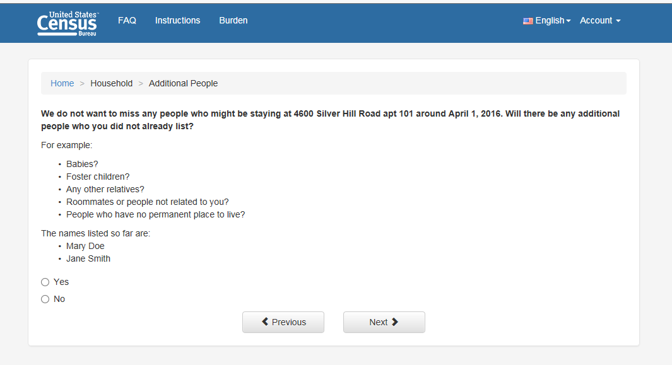
Notes:
INTERNET_UNDERCOUNT=2
Here is a different version of the last two screens.
You saw this/you did not see this.
“Do you have any comments on this screen?”
SPANISH: what does the term roommate mean to you here?

Slide 17
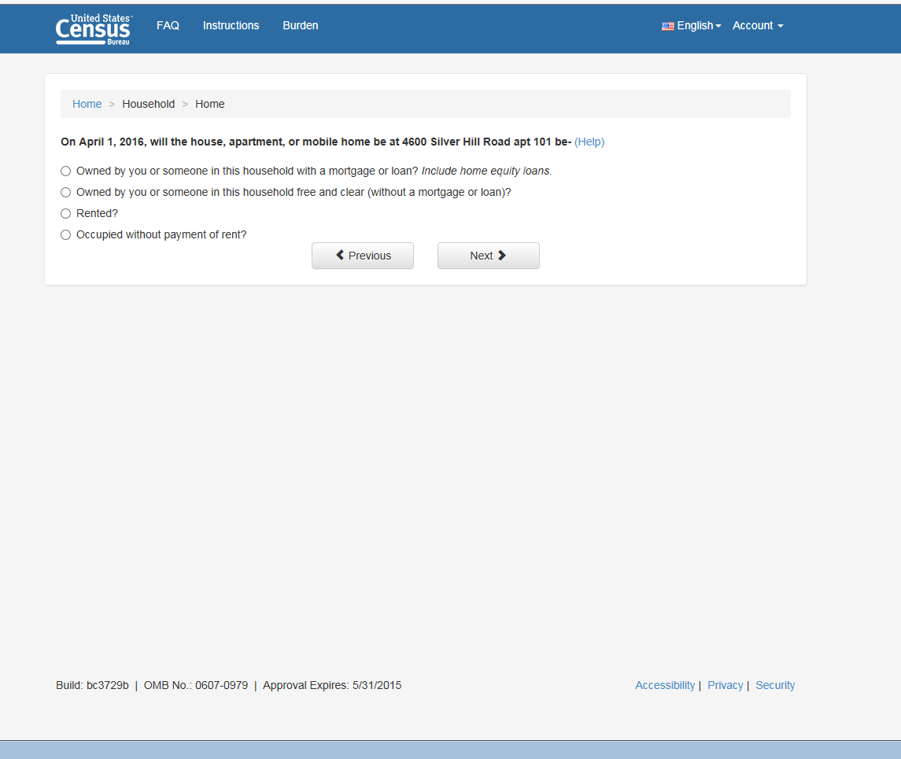
Notes:
Tell me more about why you chose [their answer].
SPANISH ONLY: Here where it says 'préstamo sobre el valor líquido de la casa', what do you think they are referring to, what does that mean here? // Now, here ’s another phrase in Spanish that I want to show you. [Show alternate translation for ‘home equity loan.’] What does the phrase ‘home equity loan’ mean to you here? IF R HAD UNDERSTOOD THE PHRASE IN THE FORM AS INTENDED, ASK: Is it the same or different as ‘préstamo sobre el valor líquido de la casa?’ Which version is easier to understand?”

Slide 18
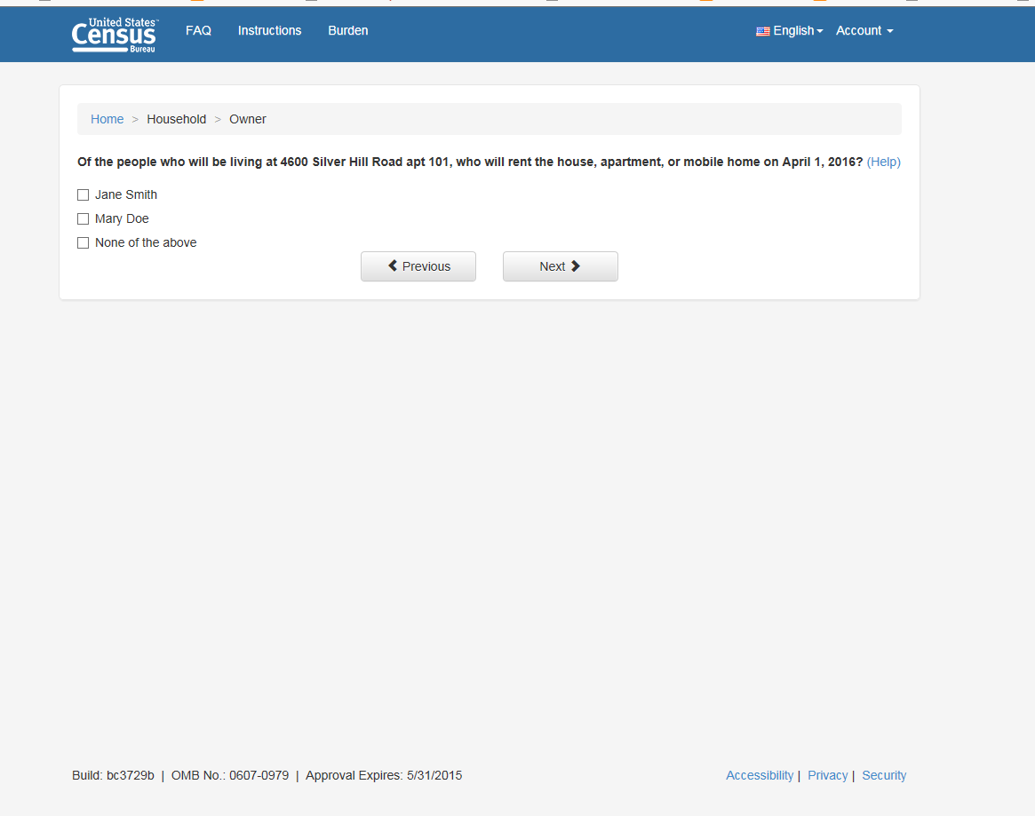
Notes:
I included this screen in case there were any issues.
Probe only if there were issues. Such as “Do you have any comments on this screen?”
SPANISH ONLY: How did you come up with your answer to this question?

Slide 19
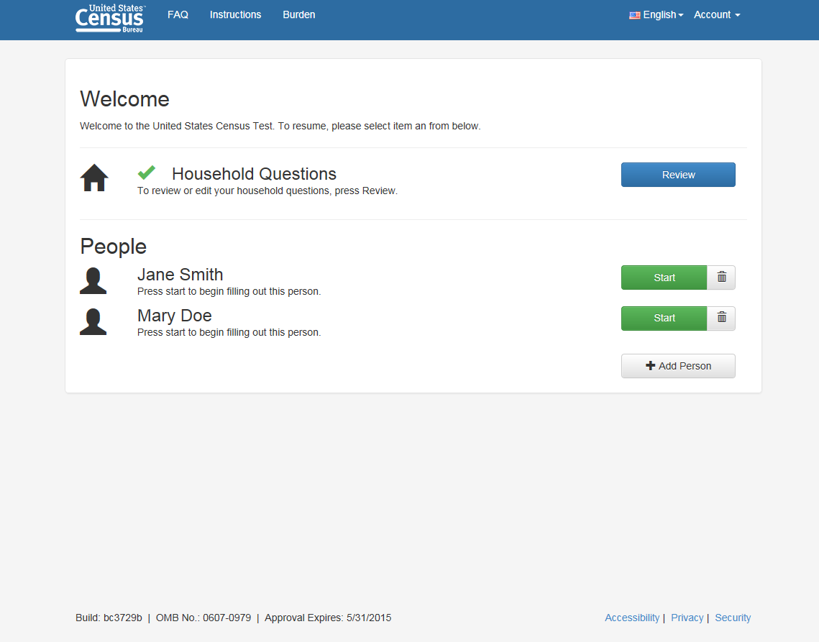
Notes:
NEW SLIDE
Do you have any comments on this screen?

Slide 20
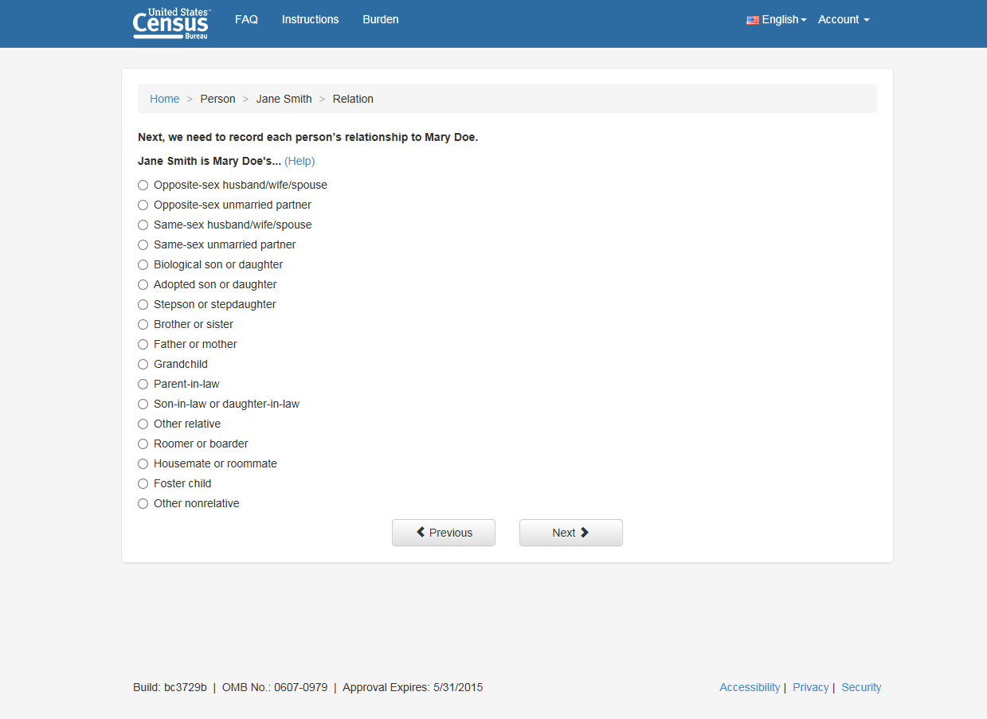
Notes:
INTERNET_RELATIONSHIP=1
You received this screen. OR You did not receive this screen.
Do you have any comments on this screen.
Did you have any difficulty finding the correct relationship.
SPANISH ONLY: What does the term hijo/a foster mean to you here?
RETROSPECTIVE VIGNETTE
Now, I have a situation I would like to run past you, to see how you think someone in this situation might answer this question.
INTERVIEWER: Hand the description to R. Read aloud with R.
Vignette 1 for Smartphones. Anna and Mary are friends who share a 2 bedroom apartment. They both contribute to the rent and they each have their own bedroom. Based on this situation, how is Mary related to Anna?
Using this list, which category would you choose and why?
If participant says same-sex unmarried partner go back one screen and show them the other relationship question and ask them if their answer would change if they had these categories…
Vignette 2 for Tablet. Jane and John are friends who share a 2 bedroom apartment. They both contribute to the rent and they each have their own bedroom. Based on this situation, how is Jane related to John?
Using this list, which category would you choose and why?
If participant says opposite-sex unmarried partner go back one screen and show them the other relationship question and ask them if their answer would change if they had these categories…
Vignette 2 for PC. Jane recently moved into the area and is renting a room at Mary’s house. Based on this situation, how is Jane related to Mary? Using this list, which category would you choose and why?
If participant says same-sex unmarried partner go back one screen and show them the other relationship question and ask them if their answer would change if they had these categories…

Slide 21

Notes:
INTERNET_RELATIONSHIP=2
You received this screen. OR You did not receive this screen.
Do you have any comments on this screen.
Did you have any difficulty finding the correct relationship.
SPANISH ONLY: What does the term hijo/a foster mean to you here?
RETROSPECTIVE VIGNETTE
Now, I have a situation I would like to run past you, to see how you think someone in this situation might answer this question.
INTERVIEWER: Hand the description to R. Read aloud with R.
INTERVIEWER: Hand the description to R. Read aloud with R.
Vignette 1 for Smartphones. Anna and Mary are friends who share a 2 bedroom apartment. They both contribute to the rent and they each have their own bedroom. Based on this situation, how is Mary related to Anna?
Using this list, which category would you choose and why?
If participant says same-sex unmarried partner go back one screen and show them the other relationship question and ask them if their answer would change if they had these categories…
Vignette 2 for Tablet. Jane and John are friends who share a 2 bedroom apartment. They both contribute to the rent and they each have their own bedroom. Based on this situation, how is Jane related to John?
Using this list, which category would you choose and why?
If participant says opposite-sex unmarried partner go back one screen and show them the other relationship question and ask them if their answer would change if they had these categories…
Vignette 2 for PC. Jane recently moved into the area and is renting a room at Mary’s house. Based on this situation, how is Jane related to Mary? Using this list, which category would you choose and why?
If participant says same-sex unmarried partner go back one screen and show them the other relationship question and ask them if their answer would change if they had these categories…

Slide 22
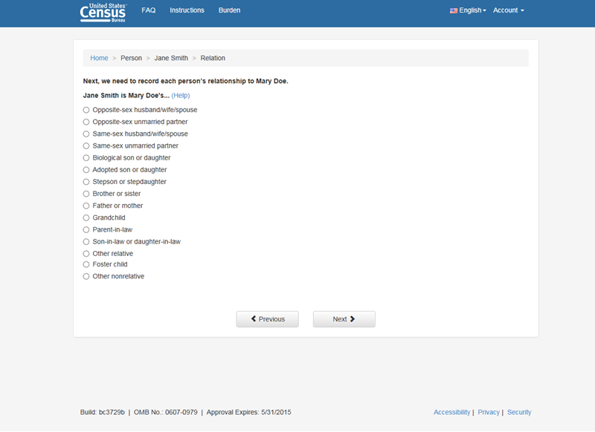
Notes:
INTERNET_RELATIONSHIP=3
You received this screen. OR You did not receive this screen.
Do you have any comments on this screen.
Did you have any difficulty finding the correct relationship.
SPANISH ONLY: What does the term hijo/a foster mean to you here?
RETROSPECTIVE VIGNETTE
Now, I have a situation I would like to run past you, to see how you think someone in this situation might answer this question.
INTERVIEWER: Hand the description to R. Read aloud with R.
Vignette 1 for Smartphones. Anna and Mary are friends who share a 2 bedroom apartment. They both contribute to the rent and they each have their own bedroom. Based on this situation, how is Mary related to Anna?
Using this list, which category would you choose and why?
If participant says same-sex unmarried partner go back one screen and show them the other relationship question and ask them if their answer would change if they had these categories…
Vignette 2 for Tablet. Jane and John are friends who share a 2 bedroom apartment. They both contribute to the rent and they each have their own bedroom. Based on this situation, how is Jane related to John?
Using this list, which category would you choose and why?
If participant says opposite-sex unmarried partner go back one screen and show them the other relationship question and ask them if their answer would change if they had these categories…
Vignette 2 for PC. Jane recently moved into the area and is renting a room at Mary’s house. Based on this situation, how is Jane related to Mary? Using this list, which category would you choose and why?
If participant says same-sex unmarried partner go back one screen and show them the other relationship question and ask them if their answer would change if they had these categories…

Slide 23
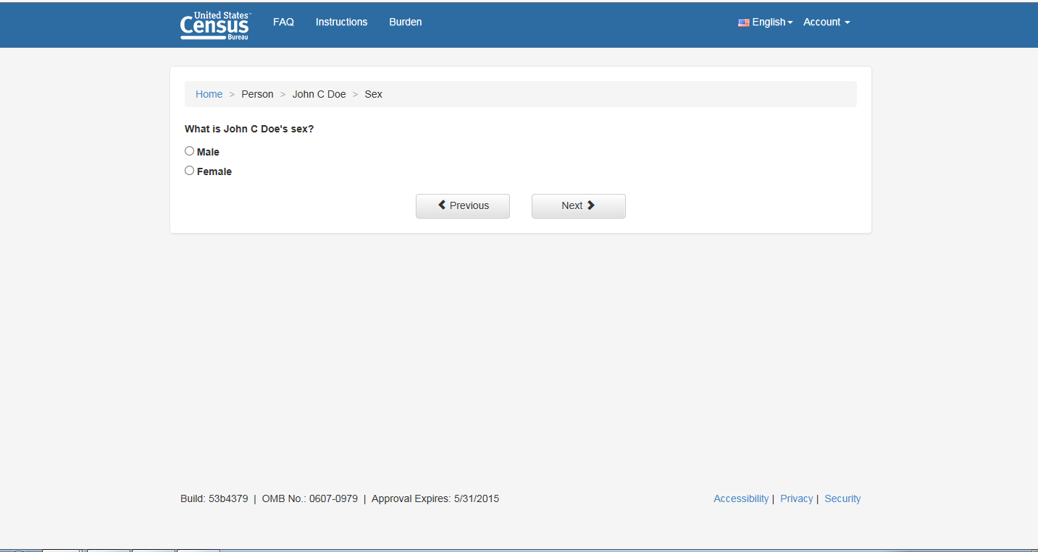
What is <NAME#>’s sex? (Help)
Radio Buttons Male Female
Notes:
Probe if any issues

Slide 24
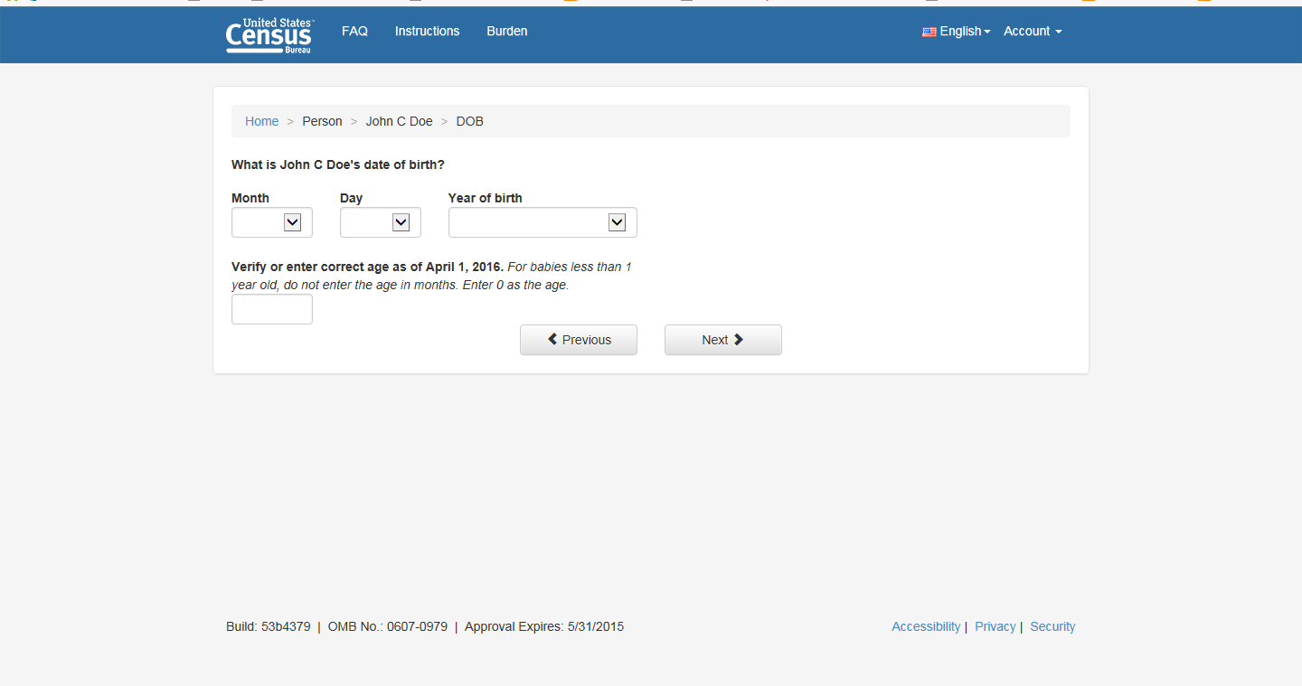
What is <NAME#>’s date of birth? (Help)
Verify or enter correct age as of <REFDATE>. For babies less than 1 year old, do not enter the age in months. Enter 0 as the age.
Notes:
Were there any household member’s whose age you didn’t know?
If so, what did you do? (Fill in what you knew? Leave the question blank? Making something up?)
I included this screen in case there were any issues.
Probe only if there were issues. Such as “Do you have any comments on this screen?”
SPANISH ONLY: What does “entre” mean to you in this question? What about “verificar?”

Slide 25
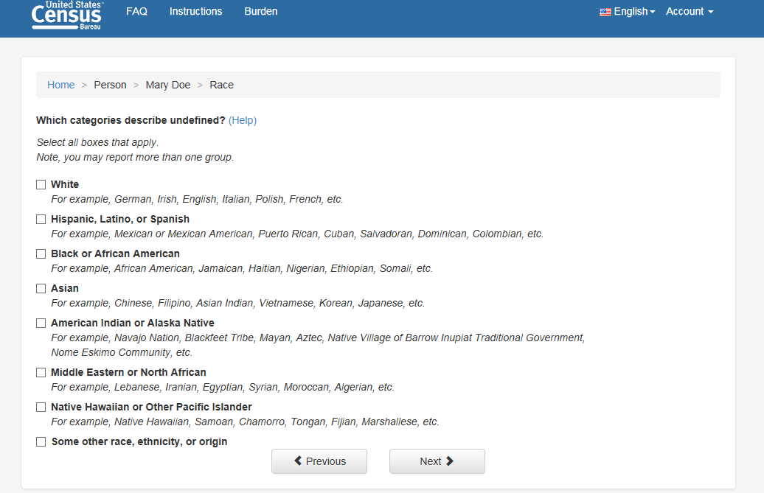
Notes:
INTERNET_AFRAM=2
Take a look at this page.
Do you have any comments on the introduction, the question or answer options?
What word would you use to describe these choices?
What does “categories” mean to you in this question?
If someone identified with more than one of these categories, could they choose more than one or could they just choose one?
What does “Select all boxes that apply.” mean to you?
What does “Note, you may report more than one group.” mean to you?
Are those two instructions telling you the same thing or different things? If different – please explain how they are different.
SPANISH: [If indigenous & saw this version but did not select indigenous] Did you notice this answer option? Did you think about choosing this answer? Who do you think this option is for?

Slide 26
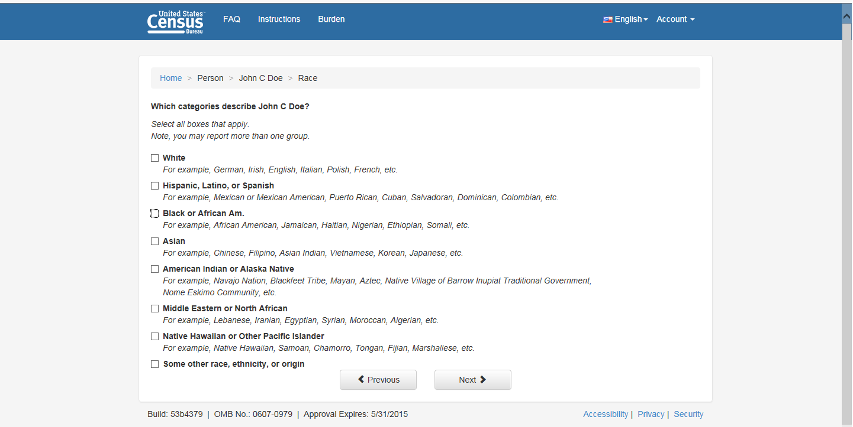
Notes:
INTERNET_AFRAM=1
Take a look at this page.
(NEW PROBE)
The difference between this page and the previous page is the word African American in the Black category. On this screen is African Am. Abbreviated and on the earlier screen it is not. Do you have a preference?
SPANISH: [If indigenous & saw this version but did not select indigenous] Did you notice this answer option? Did you think about choosing this answer? Who do you think this option is for?

Slide 27
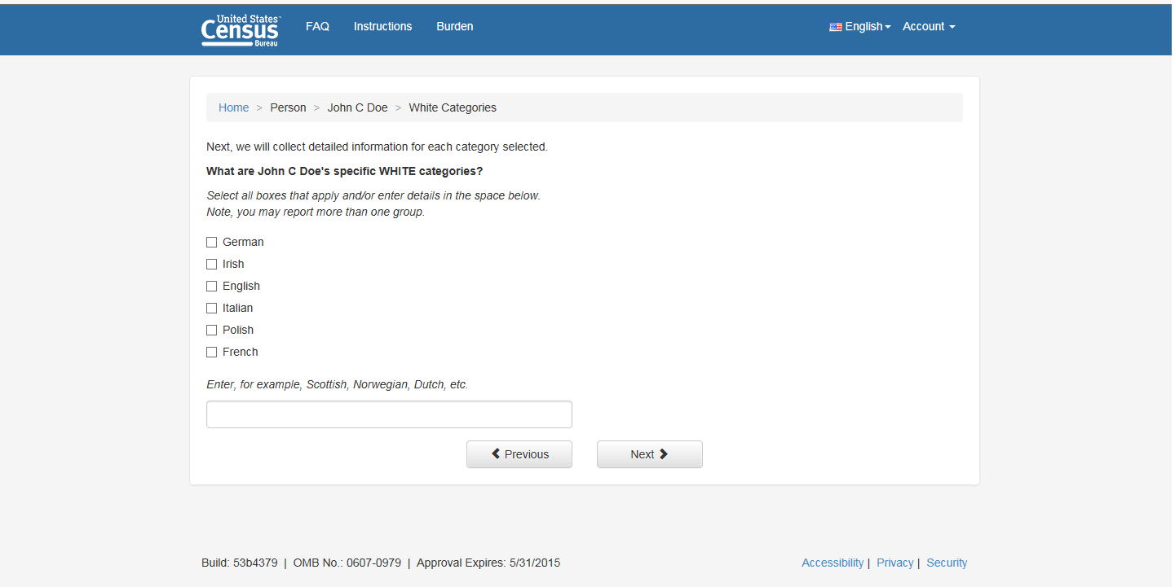
Notes:
Show them only the page they saw.
Probe if there were any problems first.
Do you have any comments on the question?
What word would you use to describe these choices?
If someone identified with more than one of these groups, could they choose more than one or could they just choose one?
What should they do if their group was not listed?
What does, “Select all boxes that apply and/or enter details in the space below.” mean to you?
What does, “Note, you may report more than one group.” mean to you?
Are those two instructions telling you the same thing or different things? If different – please explain how they are different.
SPANISH ONLY: What does “detailed information” mean to you in this question?

Slide 28
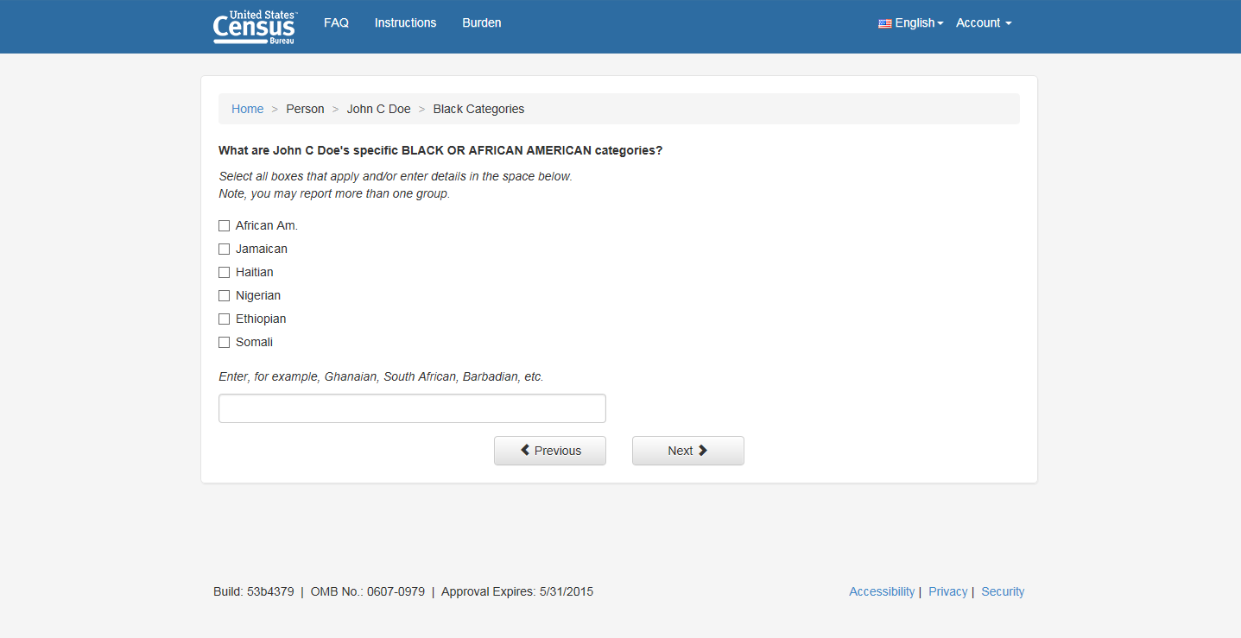
Notes:
Show them only the page they saw.
Probe if there were any problems first.
Do you have any comments on the question?
What word would you use to describe these choices?
If someone identified with more than one of these groups, could they choose more than one or could they just choose one?
What should they do if their group was not listed?
What does, “Select all boxes that apply and/or enter details in the space below.” mean to you?
What does, “Note, you may report more than one group.” mean to you?
Are those two instructions telling you the same thing or different things? If different – please explain how they are different.

Slide 29
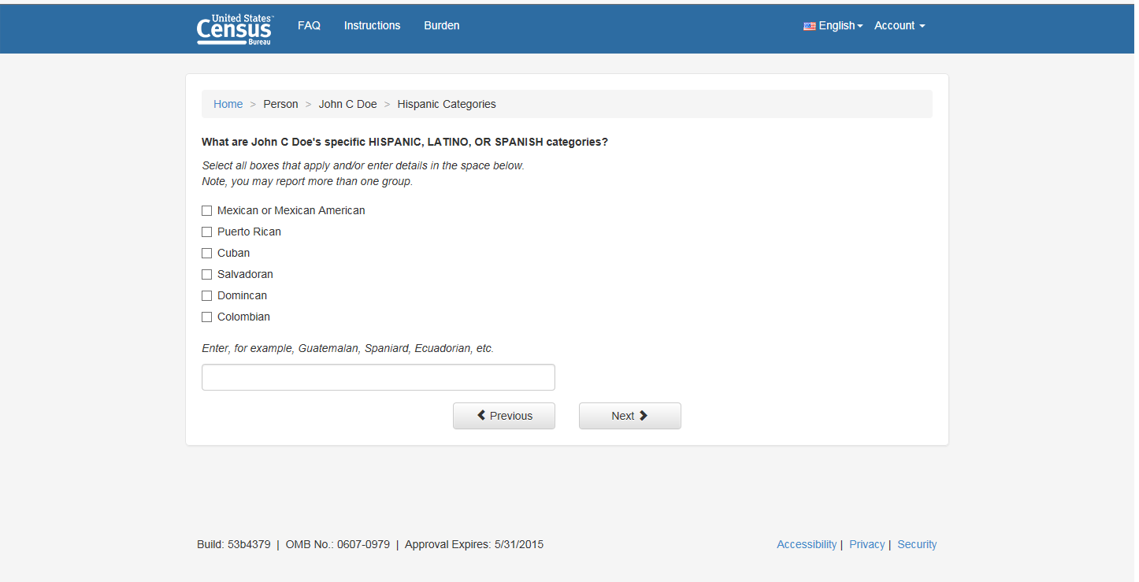
Notes:
Show them only the page they saw.
Probe if there were any problems first.
Do you have any comments on the question?
What word would you use to describe these choices?
If someone identified with more than one of these groups, could they choose more than one or could they just choose one?
What should they do if their group was not listed?
What does, “Select all boxes that apply and/or enter details in the space below.” mean to you?
What does, “Note, you may report more than one group.” mean to you?
Are those two instructions telling you the same thing or different things? If different – please explain how they are different.

Slide 30
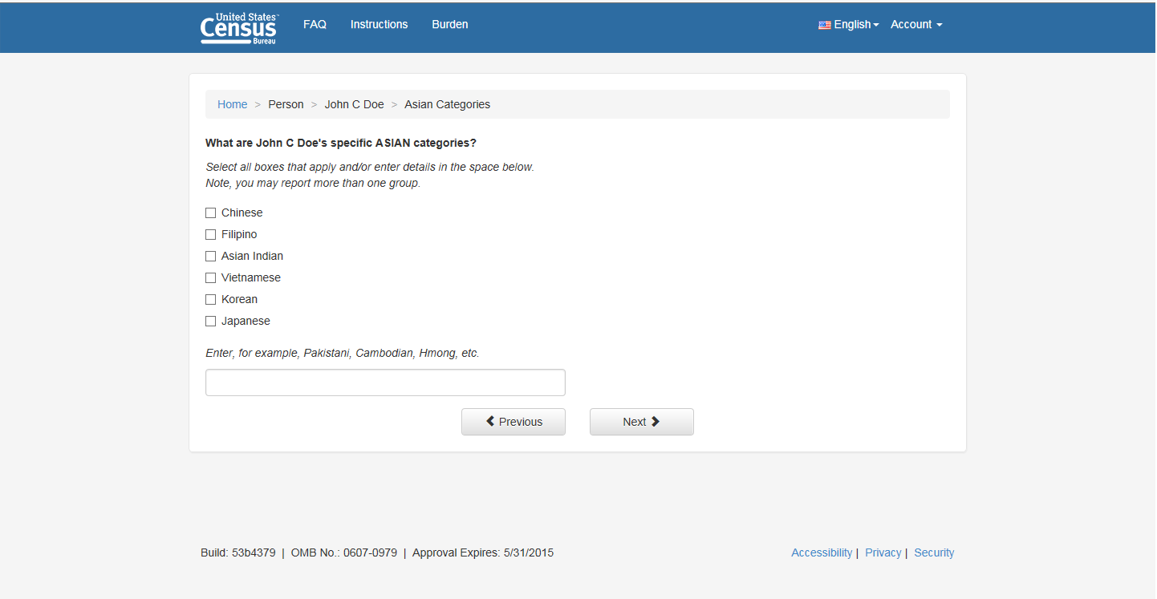
Notes:
Show them only the page they saw.
Probe if there were any problems first.
Do you have any comments on the question?
What word would you use to describe these choices?
If someone identified with more than one of these groups, could they choose more than one or could they just choose one?
What should they do if their group was not listed?
What does, “Select all boxes that apply and/or enter details in the space below.” mean to you?
What does, “Note, you may report more than one group.” mean to you?
Are those two instructions telling you the same thing or different things? If different – please explain how they are different.

Slide 31
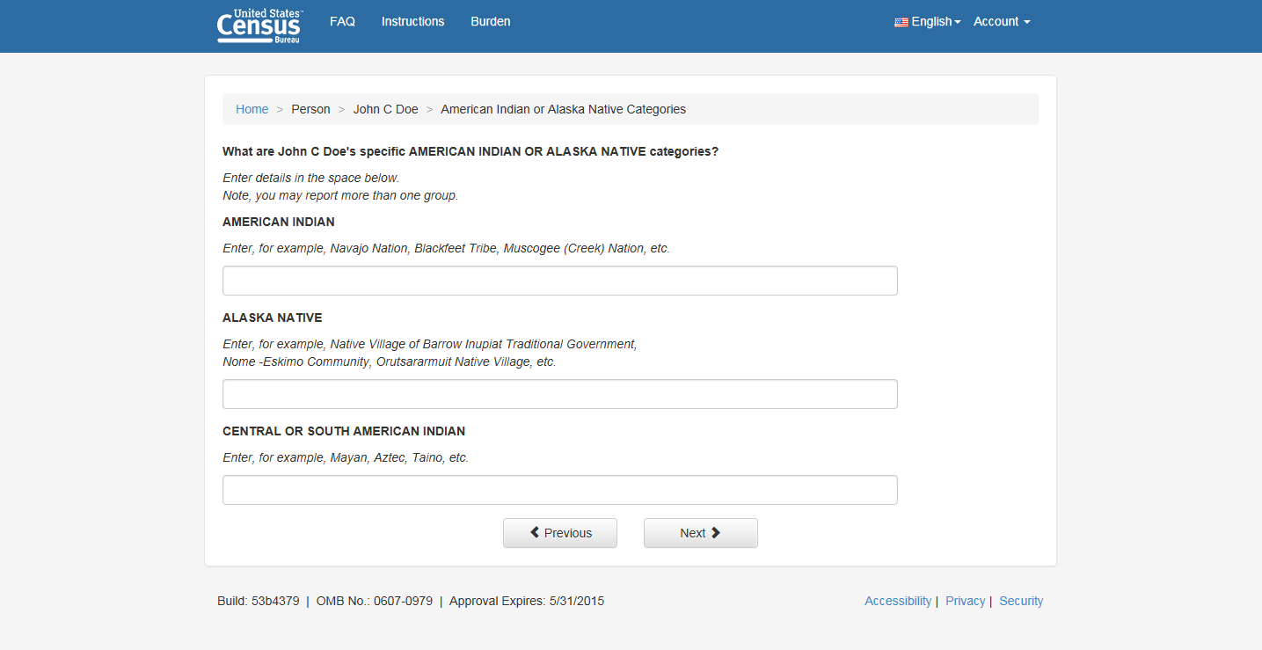
Notes:
Show them only the page they saw.
Probe if there were any problems first.
Do you have any comments on the question?
What word would you use to describe these examples?
If someone identified with more than one of these groups, could they enter more than one or could they just enter one?
What should they do if their group was not listed?
What does the word “details” mean to you in the instruction “enter details in the space below.”
What does, “Note, you may report more than one group.” mean to you?
SPANISH ONLY:
Who should write something at “American Indian?” What about “Alaska Native?” What about “Central or South American Indian?”
What do you think about the examples for Central or South American Indian? Is anything missing from this list that should be included, or anything on the list that doesn’t belong there?

Slide 32
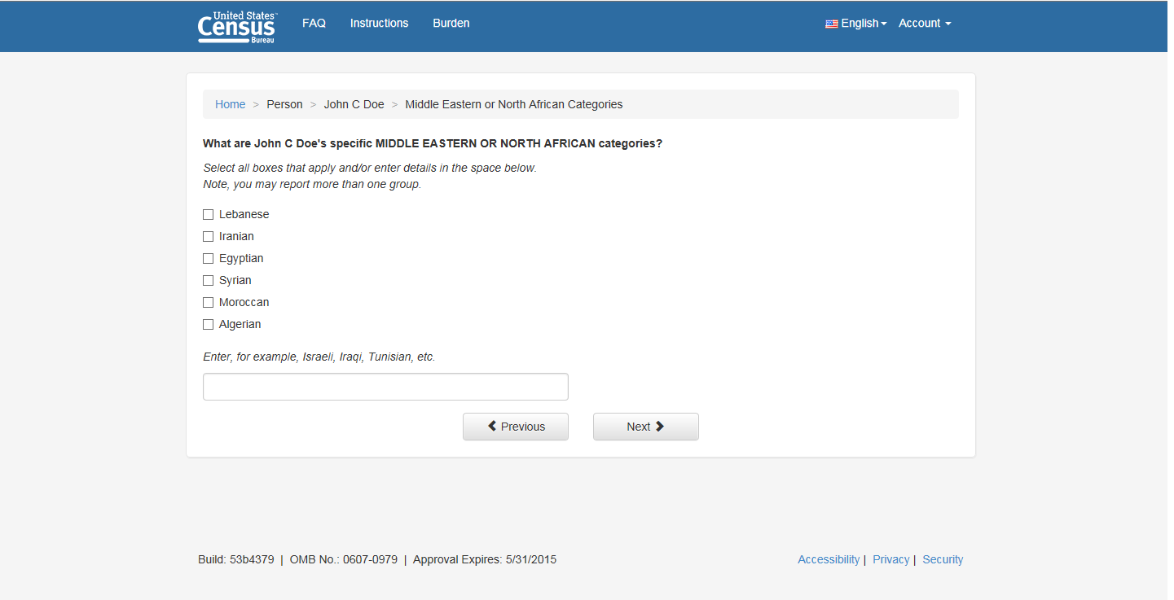
What are <NAME#’s> specific MIDDLE EASTERN OR NORTH AFRICAN categories?
Select all boxes that apply and/or enter details in the space below.
Note, you may report more than one group. (Help)
Notes:
Show them only the page they saw.
Probe if there were any problems first.
Do you have any comments on the question?
What word would you use to describe these choices?
If someone identified with more than one of these groups, could they choose more than one or could they just choose one?
What should they do if their group was not listed?
What does, “Select all boxes that apply and/or enter details in the space below.” mean to you?
What does, “Note, you may report more than one group.” mean to you?
Are those two instructions telling you the same thing or different things? If different – please explain how they are different.

Slide 33
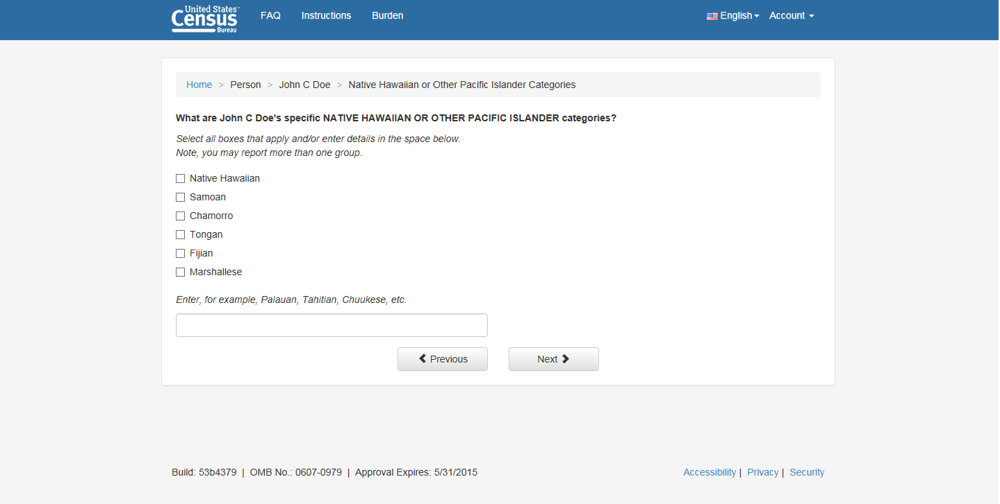
Notes:
Show them only the page they saw.
Probe if there were any problems first.
Do you have any comments on the question?
What word would you use to describe these choices?
If someone identified with more than one of these groups, could they choose more than one or could they just choose one?
What should they do if their group was not listed?
What does, “Select all boxes that apply and/or enter details in the space below.” mean to you?
What does, “Note, you may report more than one group.” mean to you?
Are those two instructions telling you the same thing or different things? If different – please explain how they are different.

Slide 34
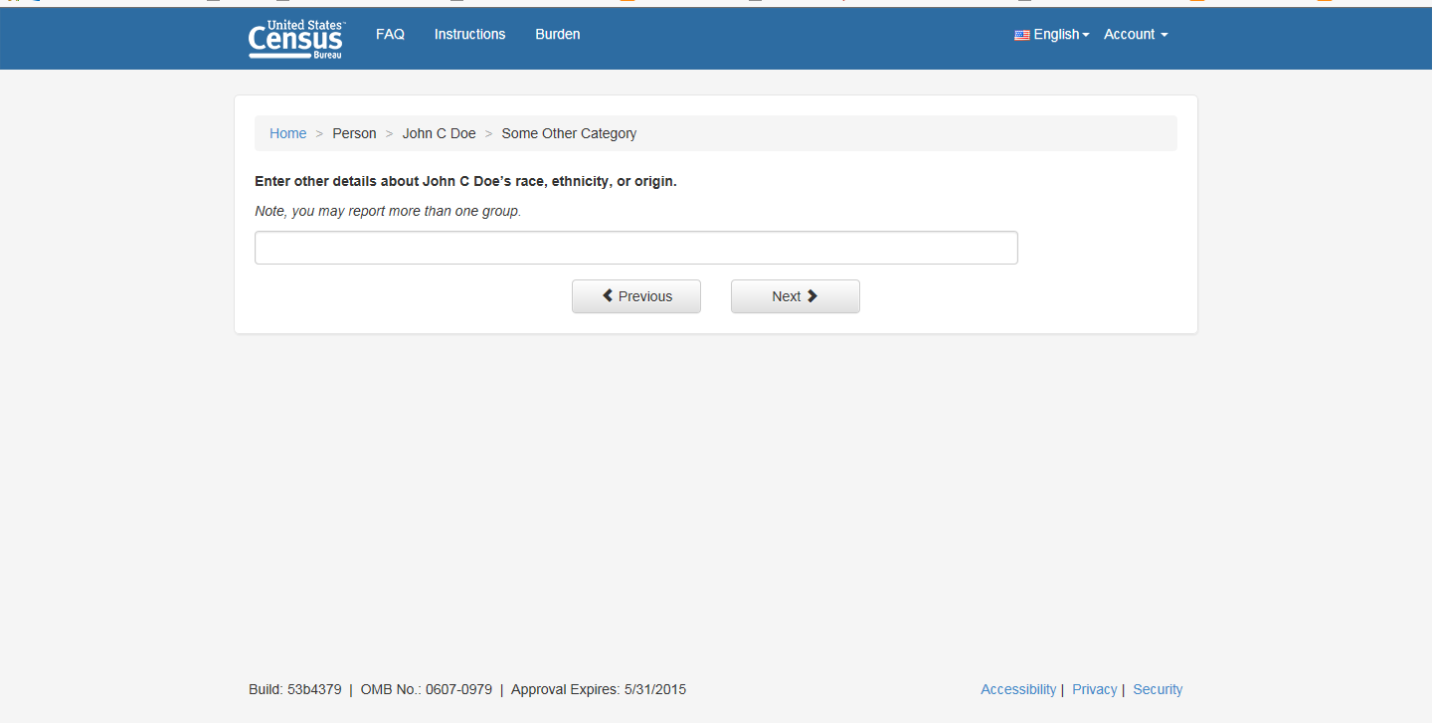
Enter other details about <NAME#>’s race, ethnicity, or origin.
Note, you may report more than one group. (Help)
Notes:
Show this to everyone -
Take a look at this page. What if you received this question, what would you type in?
Do you have any comments on this question compared to the other question you received?

Slide 35
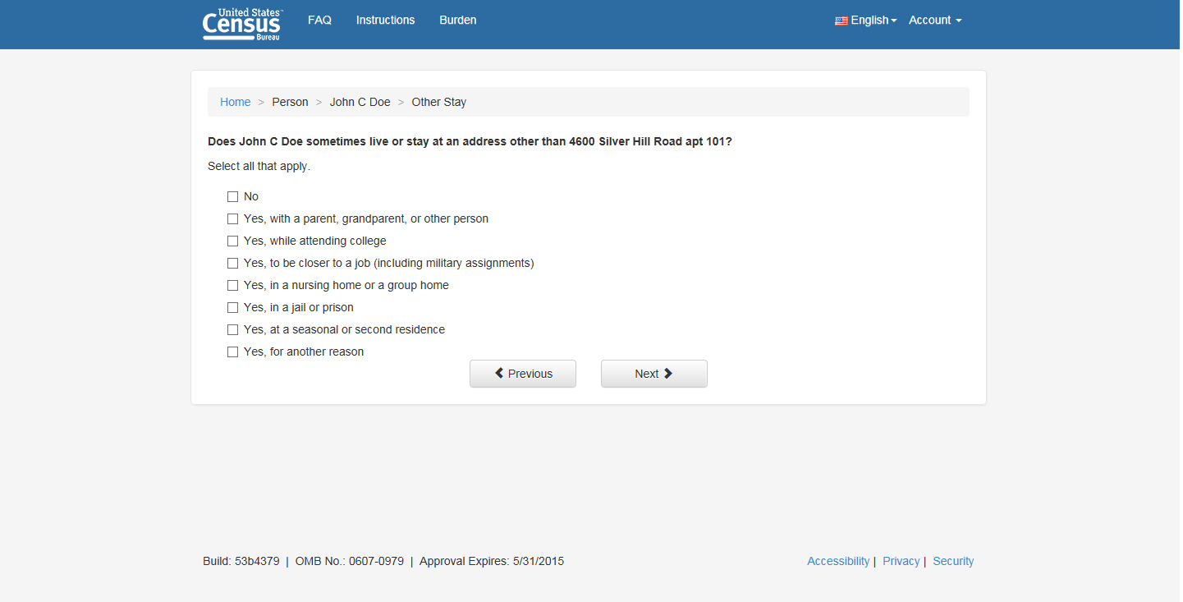
Does <NAME#> sometimes live or stay at an address other than <ADDRESS>? (Help)
Select all that apply.
Notes:
I included this screen in case there were any issues.
Probe only if there were issues. Such as “Do you have any comments on this screen?”
What time period were you thinking of when you answered this question.
Verify or probe that they do not have any other address where they could be counted.
SPANISH ONLY: What does “nursing home” mean to you in this question? What about “group home?”

Slide 36
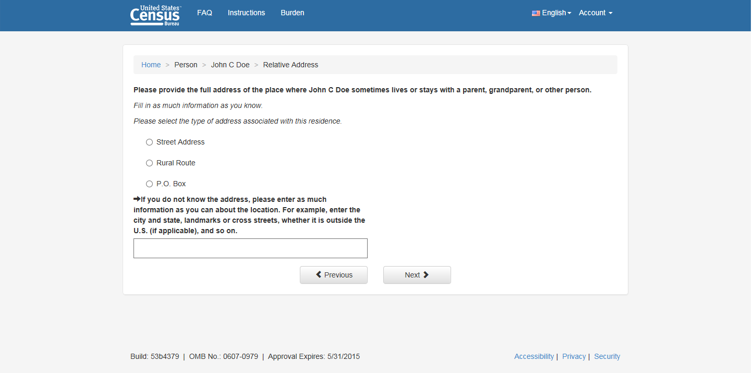
Notes:
If they received this screen, “Do you have any comments on this screen?”

Slide 37
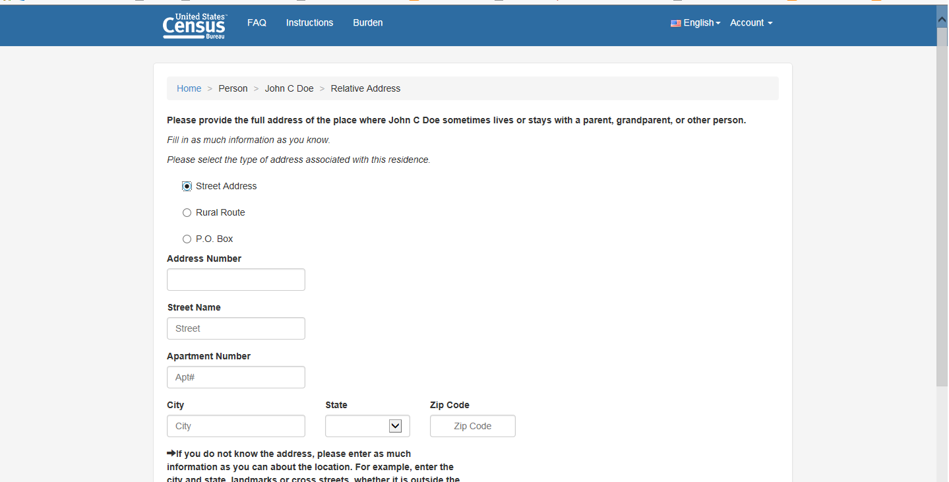
Please provide the full address of the place where <NAME#> sometimes lives or stays with a parent, grandparent, or other person. Fill in as much information as you know. (Help)
Please select the type of address associated with this residence.
If you do not know the address, please enter as much information as you can about the location. For example, enter the city and state, landmarks or cross streets, whether it is outside the U.S. (if applicable), and so on.
Notes:
If they received this screen, “Do you have any comments on this screen?”
DUPLICATE SCREEN from last one

Slide 38
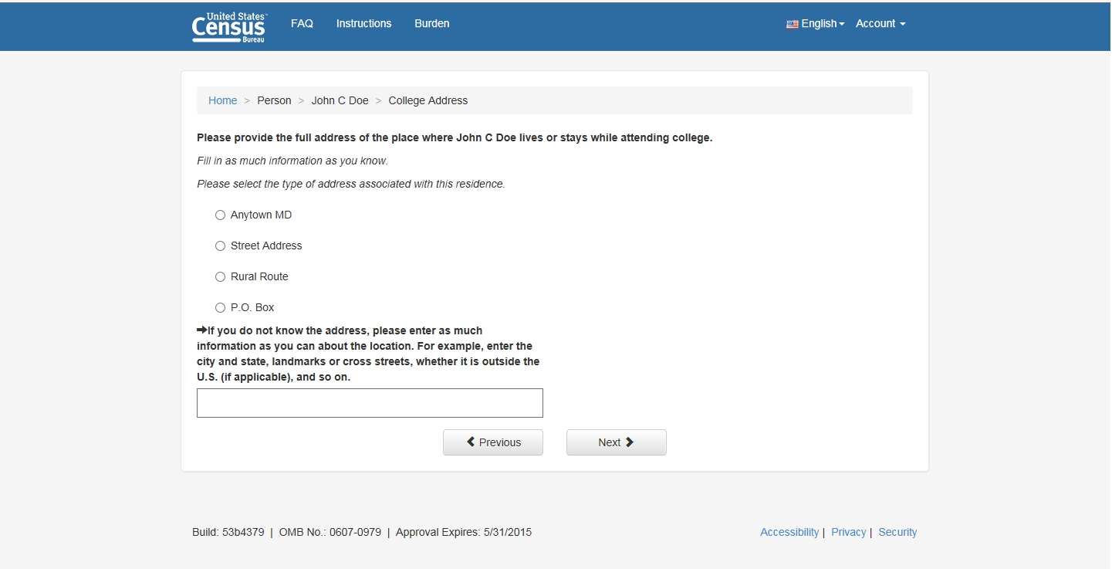
Please provide the full address of the place where <NAME#> lives or stays while attending college. Fill in as much information as you know. (Help)
Please select the type of address associated with this residence.
If you do not know the address, please enter as much information as you can about the location. For example, enter the city and state, landmarks or cross streets, whether it is outside the U.S. (if applicable), and so on.
Notes:
If they received this screen, “Do you have any comments on this screen?”

Slide 39
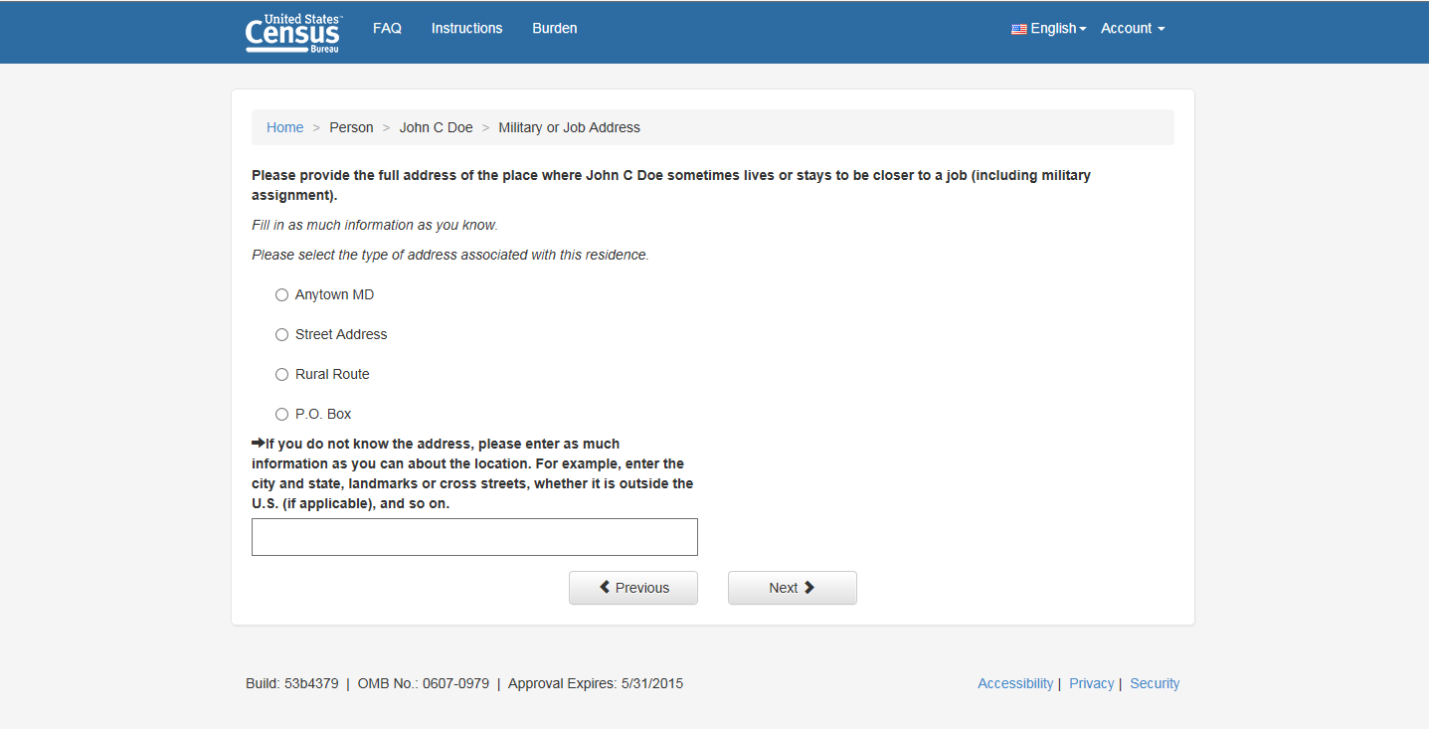
Please provide the full address of the place where <NAME#> sometimes lives or stays to be closer to a job (including military assignment). Fill in as much information as you know. (Help)
Please select the type of address associated with this residence.
If you do not know the address, please enter as much information as you can about the location. For example, enter the city and state, landmarks or cross streets, whether it is outside the U.S. (if applicable), and so on.
Notes:
If they received this screen, “Do you have any comments on this screen?”

Slide 40
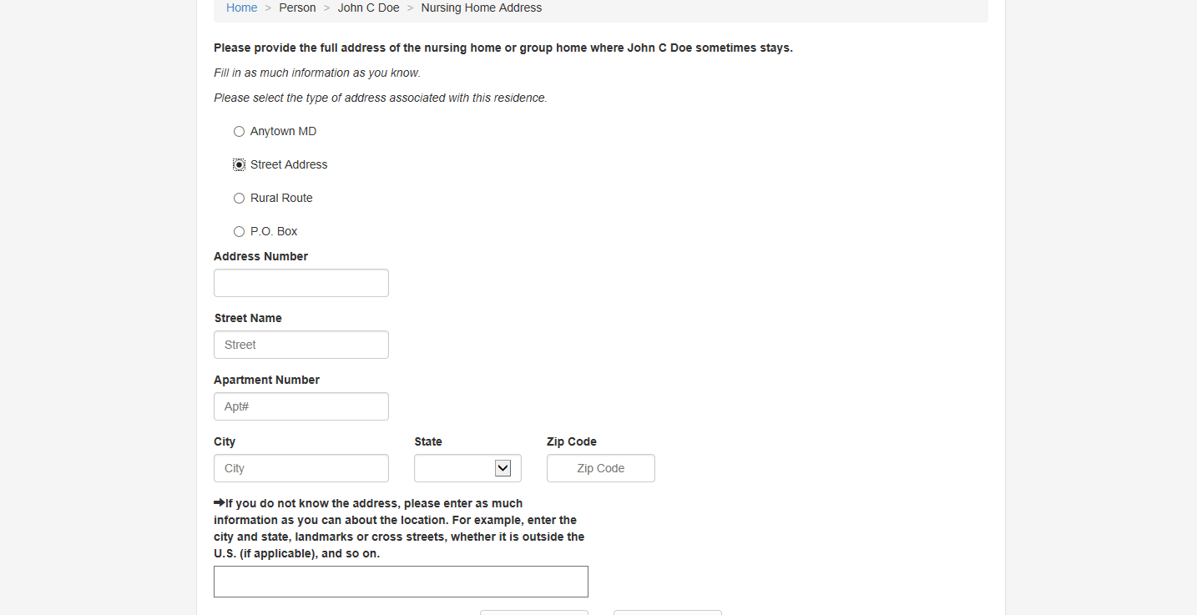
Notes:
If they received this screen, “Do you have any comments on this screen?”

Slide 41
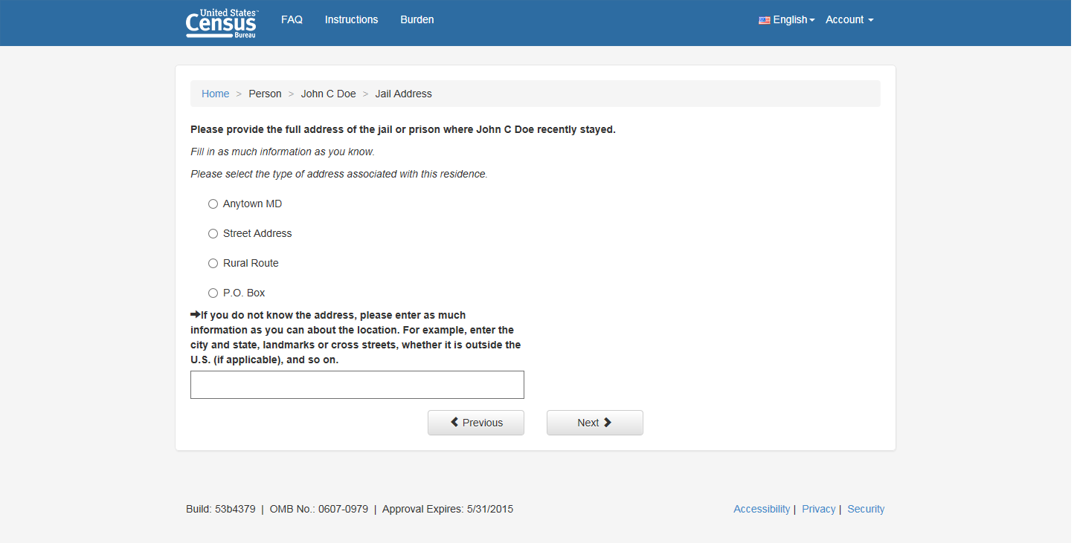
Please provide the full address of the jail or prison where <NAME#> recently stayed. Fill in as much information as you know. (Help)
Please select the type of address associated with this residence.
If you do not know the address, please enter as much information as you can about the location. For example, enter the city and state, landmarks or cross streets, whether it is outside the U.S. (if applicable), and so on.
Notes:
If they received this screen, “Do you have any comments on this screen?”

Slide 42
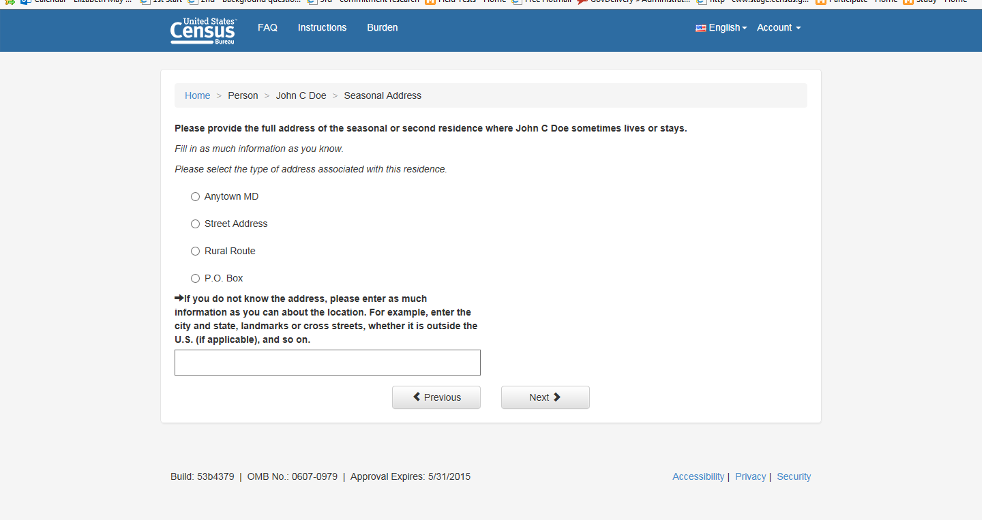
Please provide the full address of the seasonal or second residence where <NAME#> sometimes lives or stays. Fill in as much information as you know. (Help)
Please select the type of address associated with this residence.
If you do not know the address, please enter as much information as you can about the location. For example, enter the city and state, landmarks or cross streets, whether it is outside the U.S. (if applicable), and so on.
Notes:
If they received this screen, “Do you have any comments on this screen?”

Slide 43
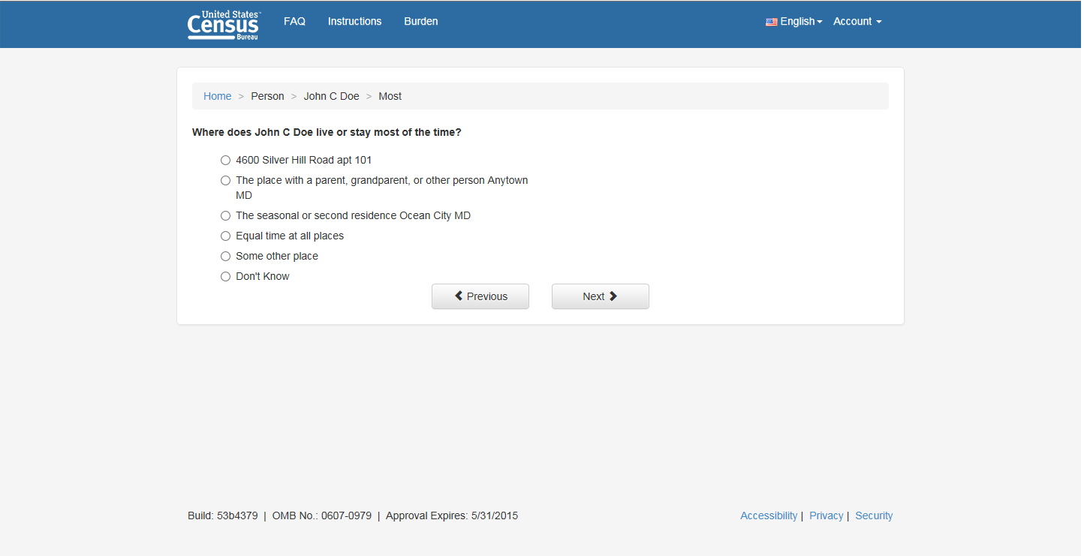
Notes:
If they received this screen, “Do you have any comments on this screen?”
What time period were you thinking of?
Describe how often you stay at the other residence.
Probe if their answer to this question didn’t make sense based on what you knew about how long they stayed at the other residence.

Slide 44
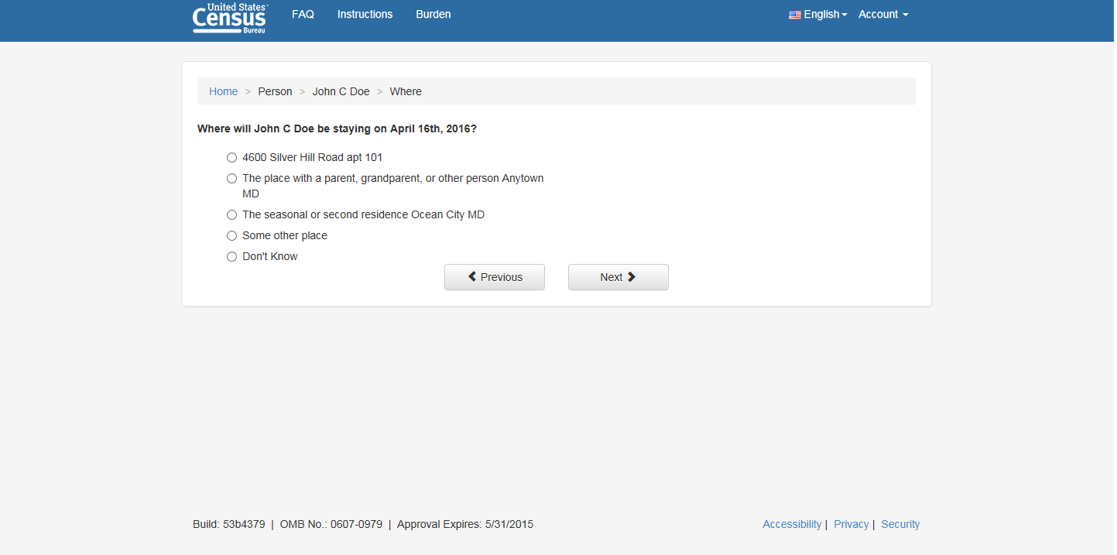
Notes:
If they received this screen, “Do you have any comments on this screen?”
What time period were you thinking of?
Describe how often you stay at the other residence.
Probe if their answer to this question didn’t make sense based on what you knew about how long they stayed at the other residence.

Slide 45
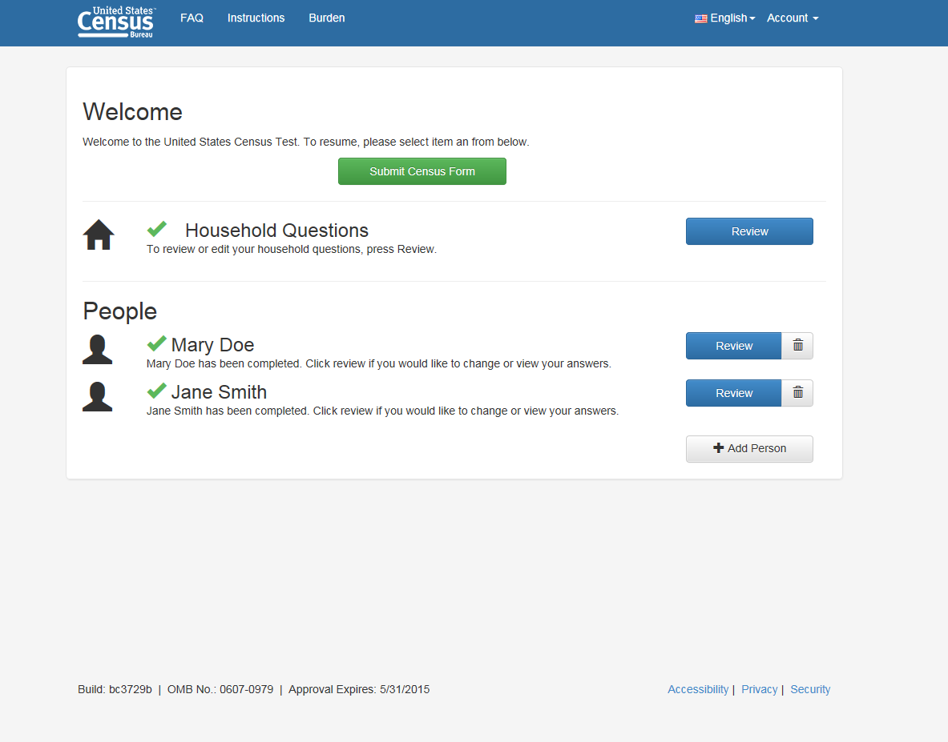
Notes:
“Do you have any comments on this screen?”

Slide 46
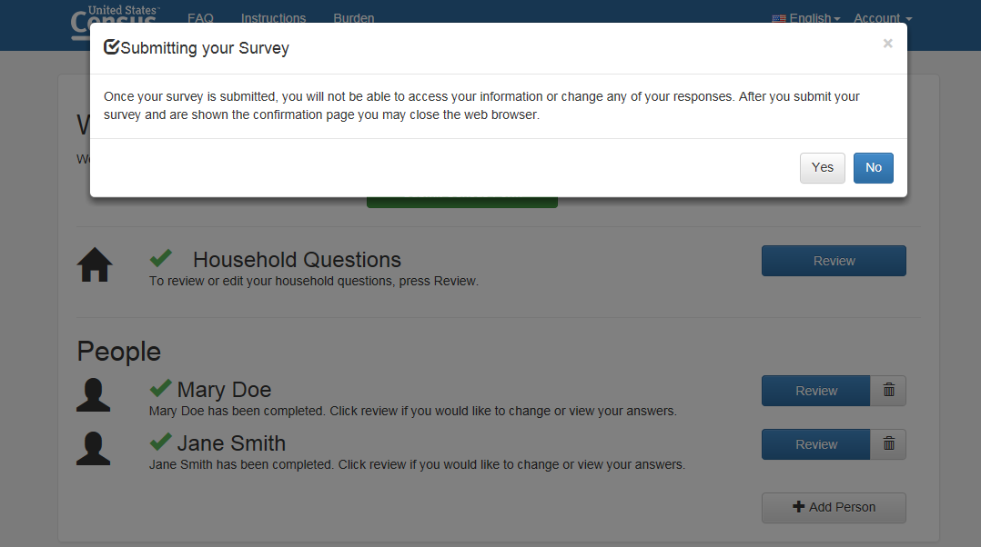
Notes:
“Do you have any comments on this screen?”
NEW

Slide 47
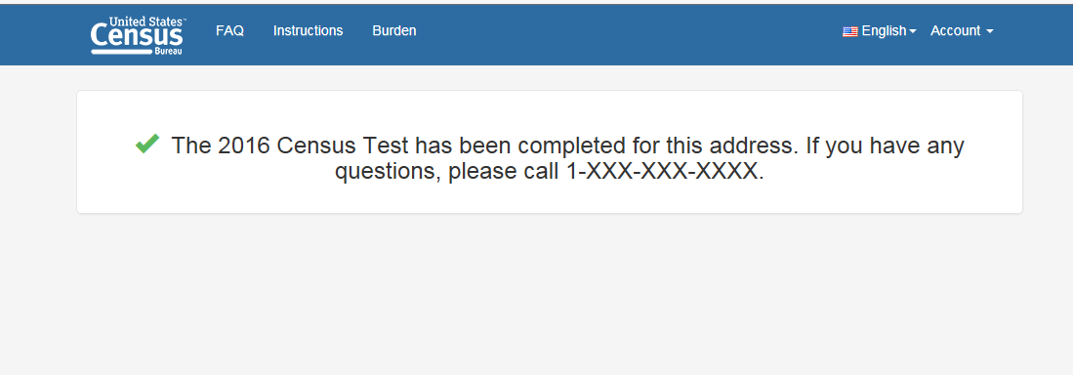
Notes:
“Do you have any comments on this screen?”
NEW

Slide 48
Show brochure
Notes:
Please take a moment to look over this brochure. What was your first impression of the brochure? Does reading this make you want to participate in the Census?" Why or why not?

