Slide 1
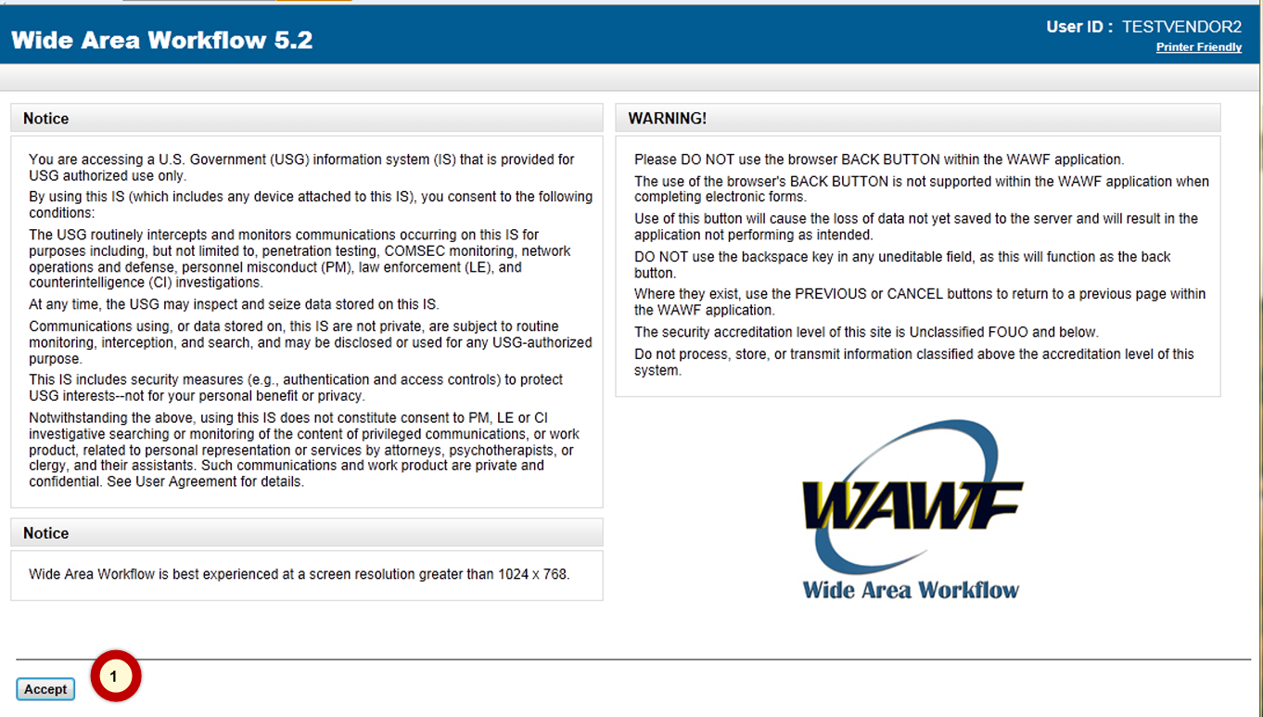
Log into WAWF, DoD single face to industry for submitting invoices, as normal

Slide 2
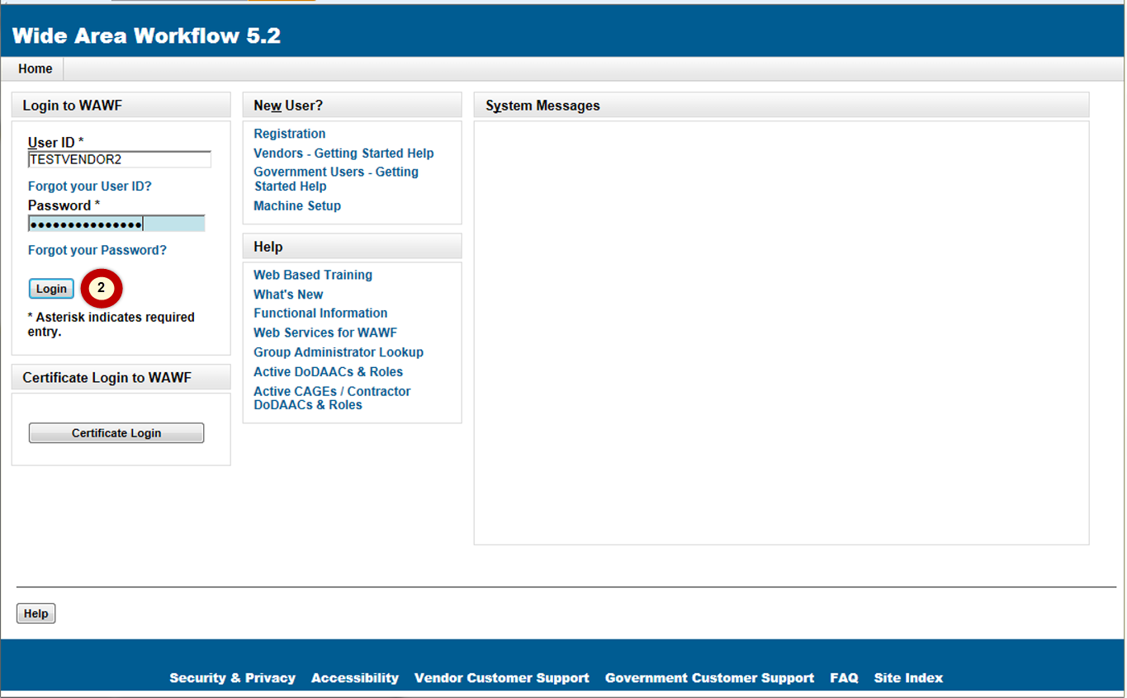
User ID and password management remains with WAWF administrator

Slide 3
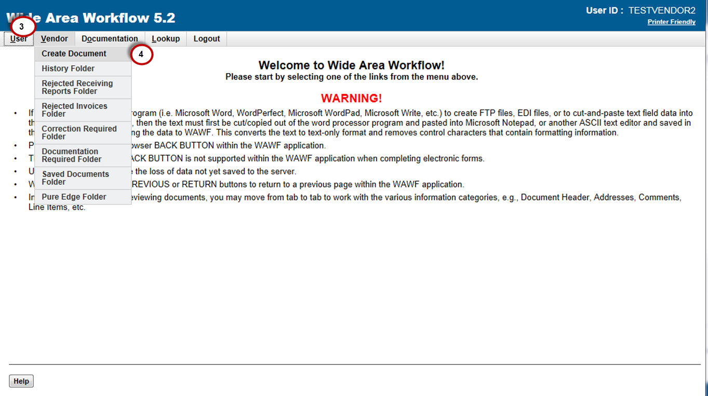
To begin the process to submit an invoice select Vendor > Create Document

Slide 4
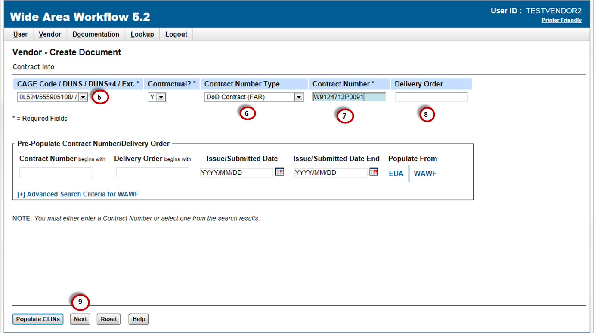
Enter CAGE, contract type, contract number and delivery order (optional)

Slide 5
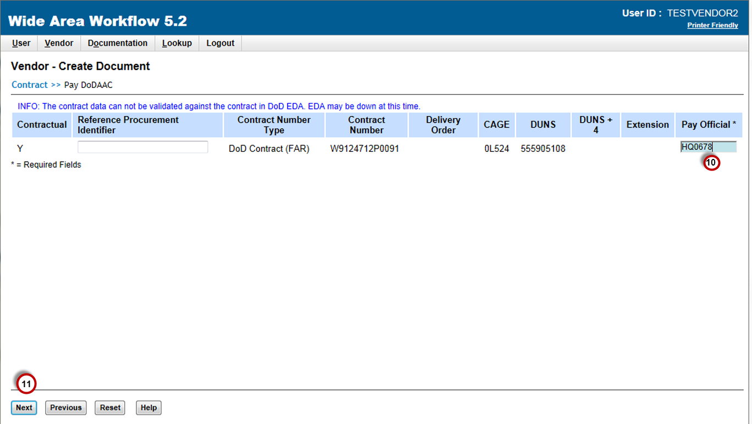
Once informed by Contracting Officer that contract is modified (administratively) to the new SUS Pay Official (i.e., SUS Pay Office DoDAAC = HQ0678), enter to be directed to GFEBS SUS

Slide 6
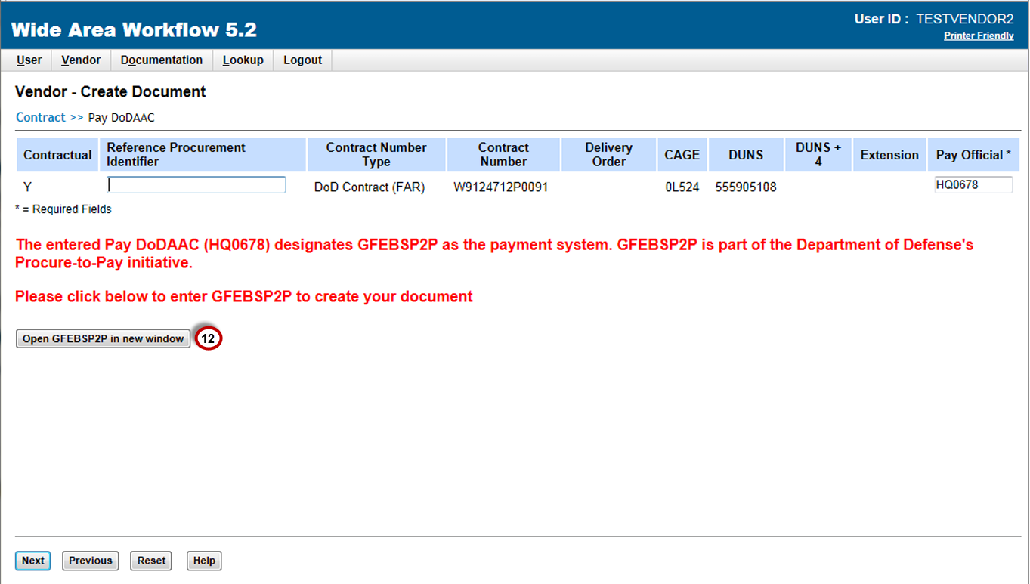
Message given – select to “Open GFEBSP2P in new window”
NOTE: SUS is a component of the end-to-end Procure-to-Pay (P2P) pilot the Army is conducting.

Slide 7
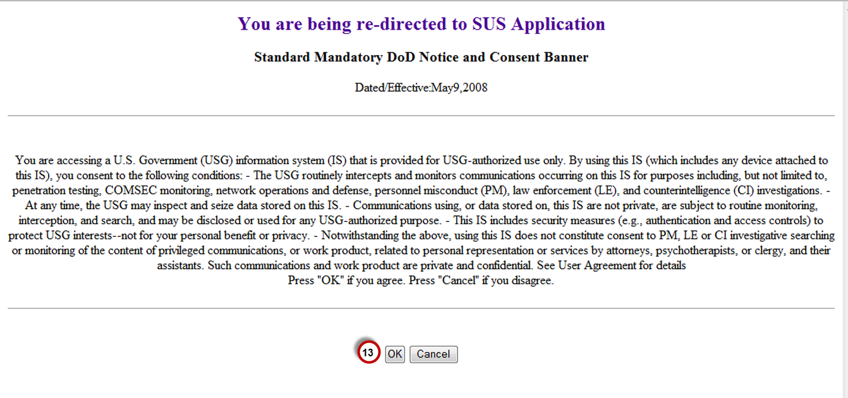
Read and select “OK” to be directed to SUS

Slide 8
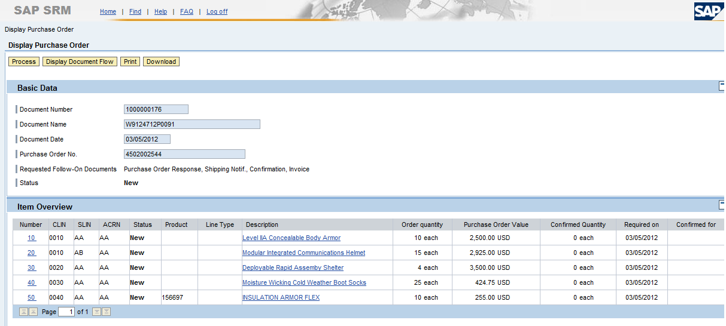
Example of Supply or Quantity based Contract Data replicated to SUS from GFEBS for shipment and invoice processing
Contract number entered in WAWF will direct user to the associated SUS document
Basic (or header) data is shown as well as item information of awarded contract
Select “Process” to prepare one-time Acknowledgment of PO

Slide 9
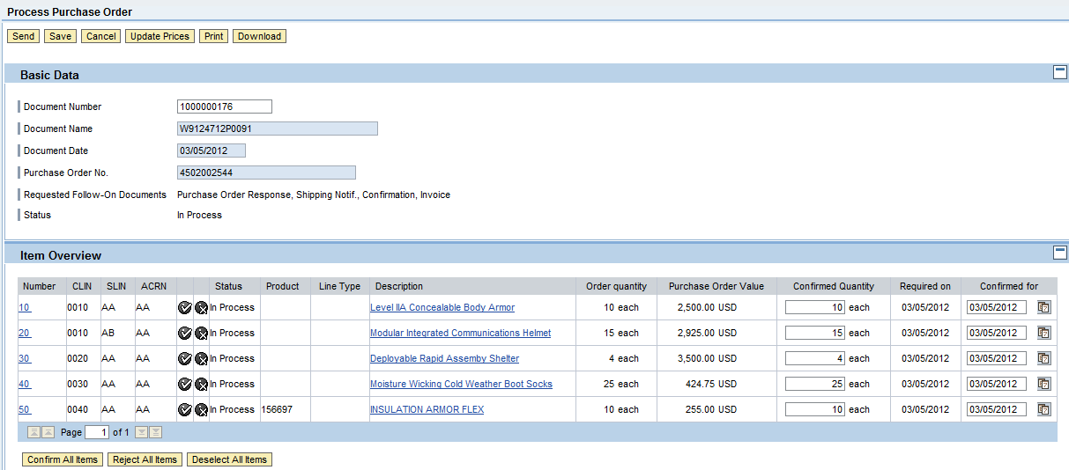
Review data and if correct, select “Confirm all items”
NOTE: Any errors should be reported to Contracting Officer

Slide 10
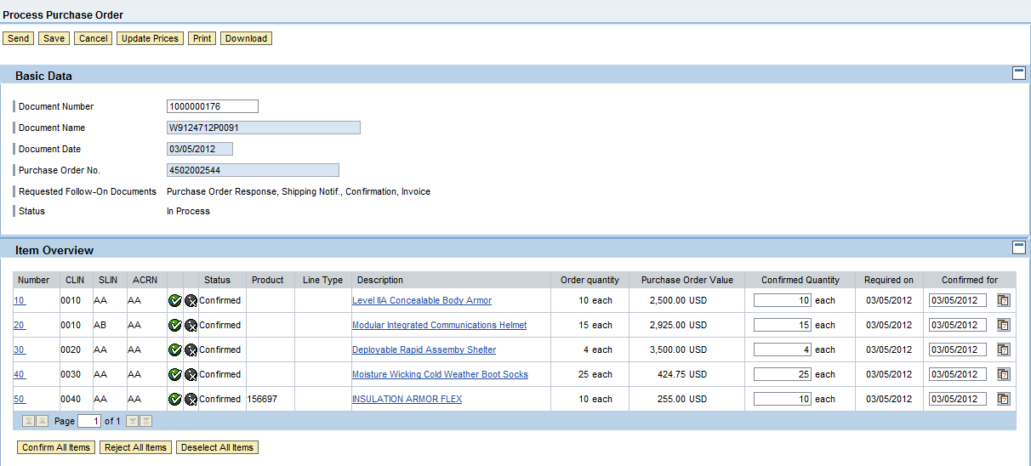
Confirmed items will show GREEN check and “Send” to submit
NOTE: If item is rejected (RED “X”), no follow-on documents can be submitted without contract (GFEBS PO) update

Slide 11
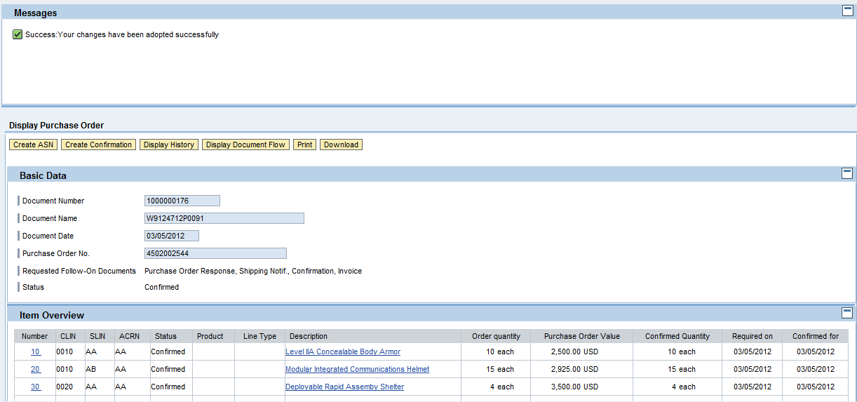
When ready to submit Advance Ship Notice (ASN, similar to WAWF Receiving Report), select “Create ASN”

Slide 12
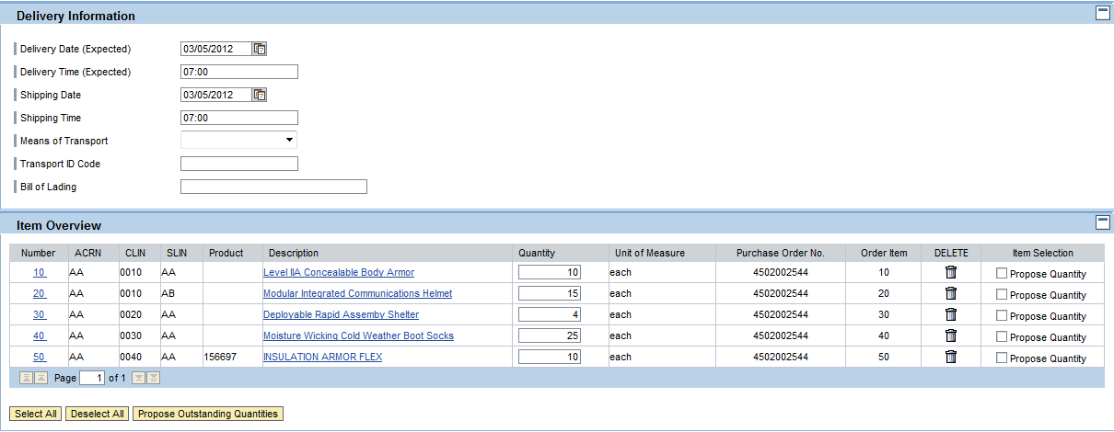
(Optional)
Can enter shipping data

Slide 13
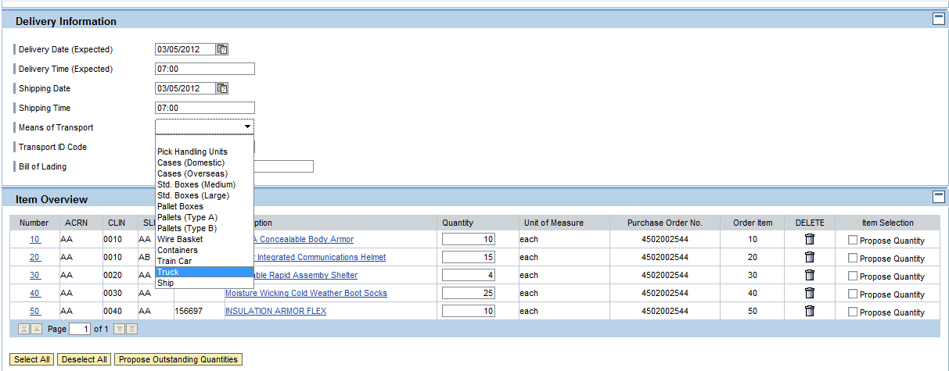
(Optional)
Means of Transport has allowed fields to choose from

Slide 14
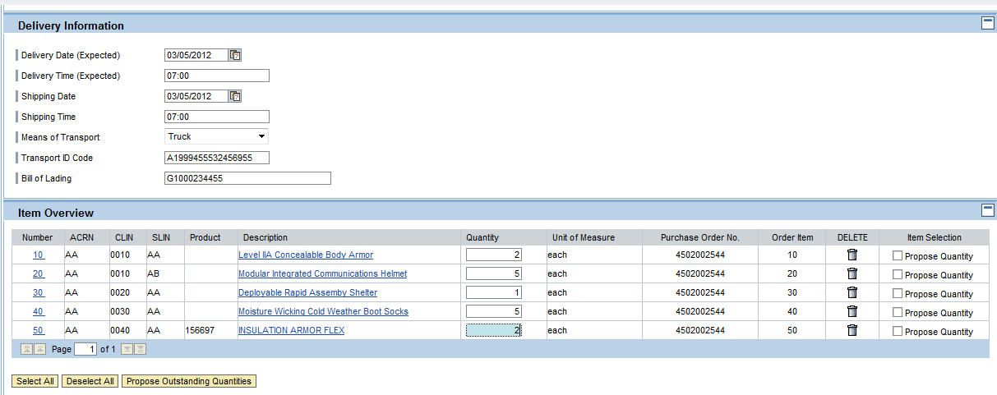
(Optional) Select “Propose Outstanding Quantities” to provide near real-time open quantity available in GFEBS
Update quantity for each item that shipment/delivery includes
NOTE: if quantity is incorrect, contact Contracting Officer

Slide 15
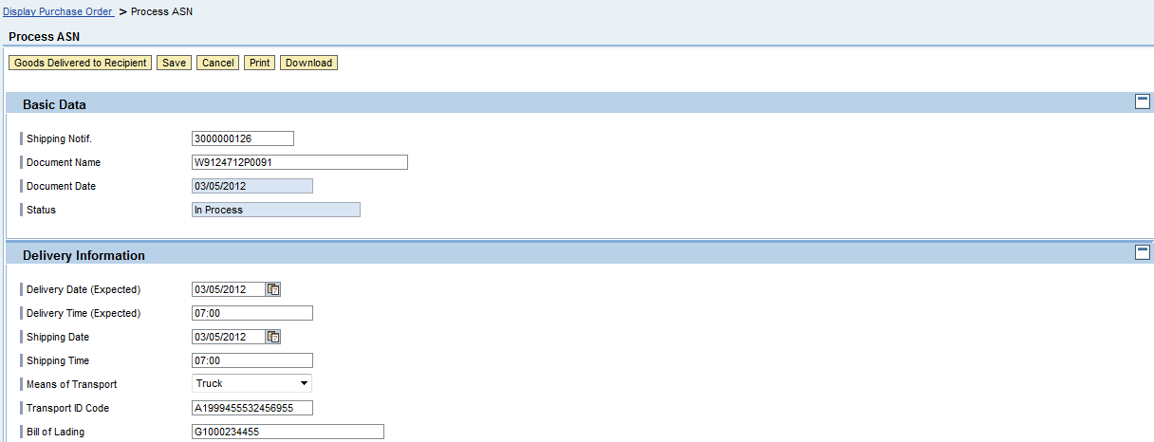
When ASN data is complete, select “Goods Delivered to Recipient” to send

Slide 16
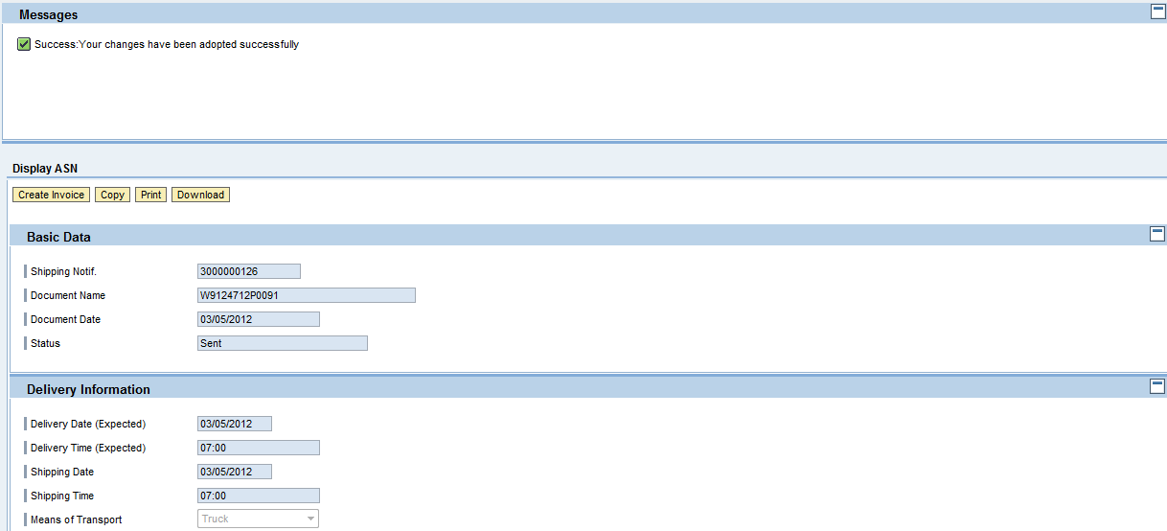
Message given

Slide 17
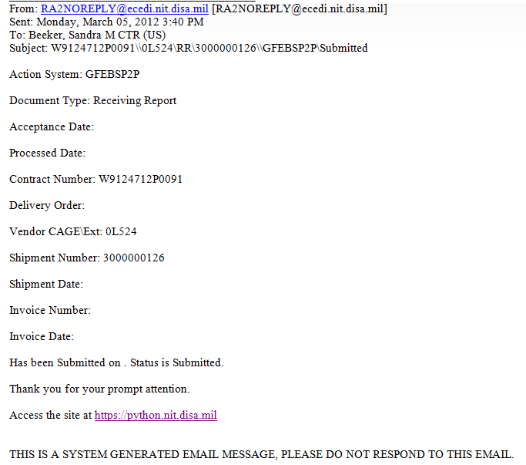
Contractor to receive normal WAWF email notification when documents are posted
NOTE: Update to WAWF from SUS happens approximately once per hour

Slide 18
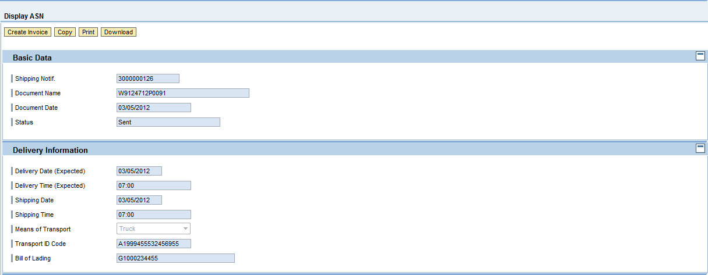
(Optional) Ability to Download or Print ASN document

Slide 19
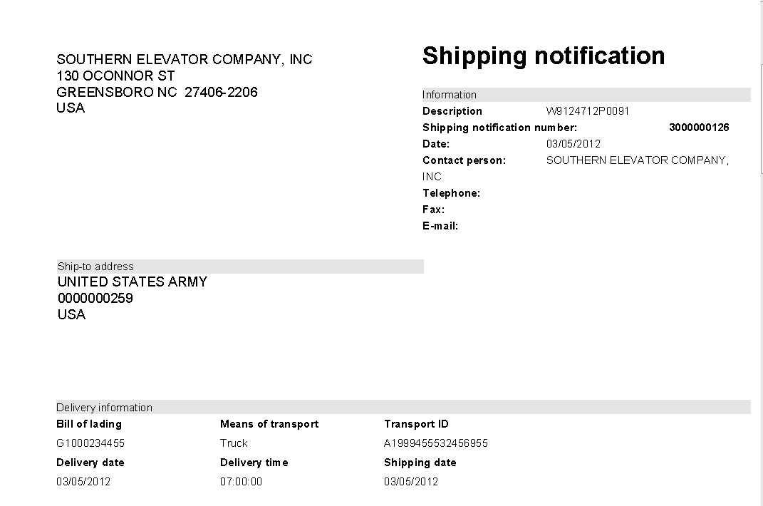
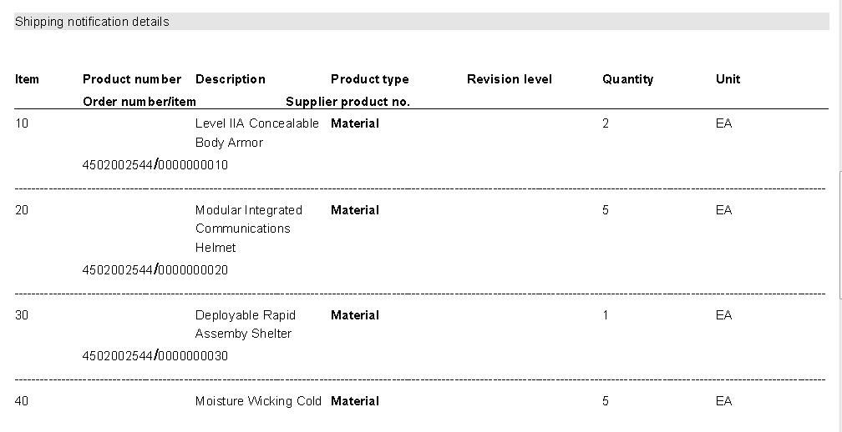
Example ASN
(Optional to print or save)

Slide 20
After ASN is submitted, may select “Create Invoice” to create with reference to the ASN

Slide 21
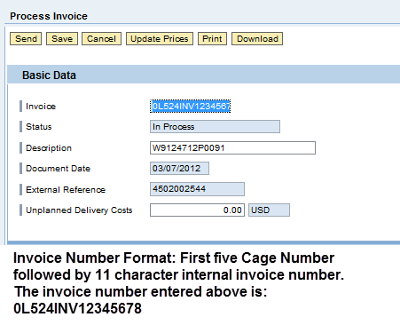
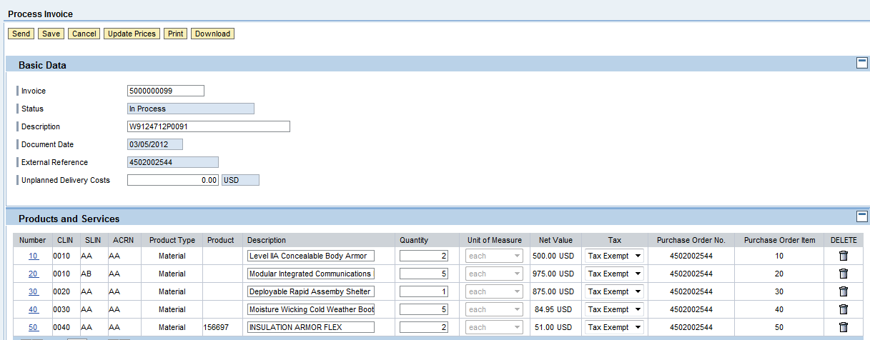
System generated sequential number is assigned, but request you enter your CAGE followed by your reference invoice number (up to 11 characters)

Slide 22
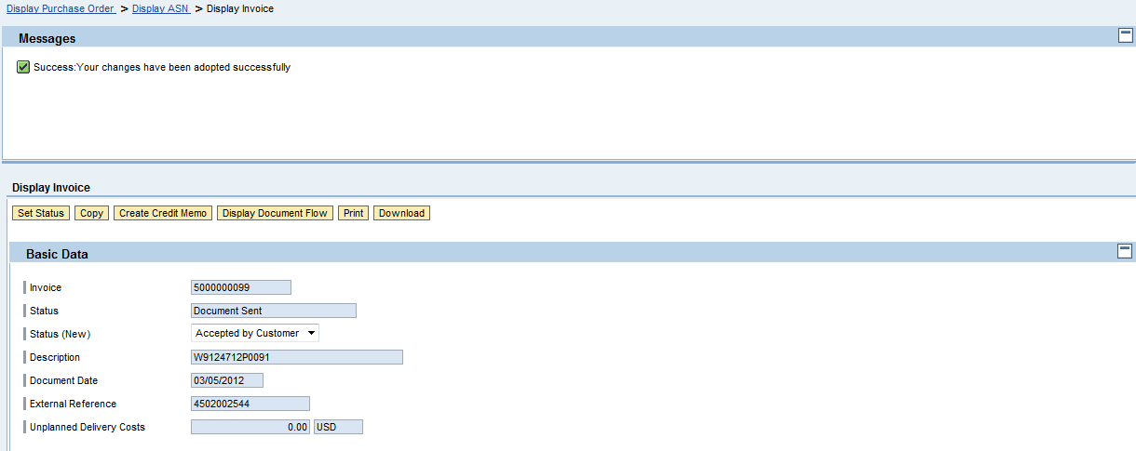
Message given
NOTE: WAWF status is also updated
All documents entered, whether through normal WAWF or SUS, will be available in document history

Slide 23
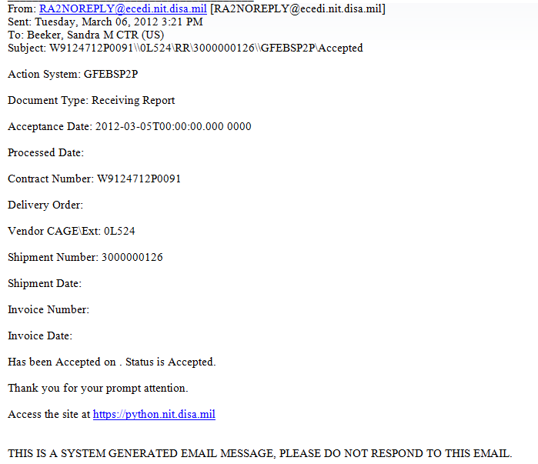
Contractor to receive
Email notification of Acceptance

Slide 24
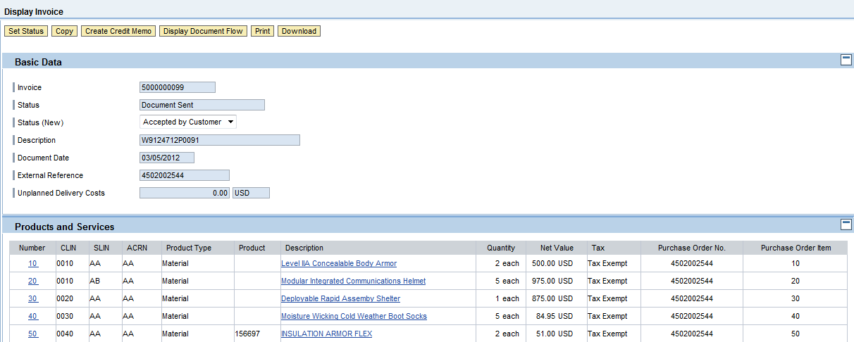
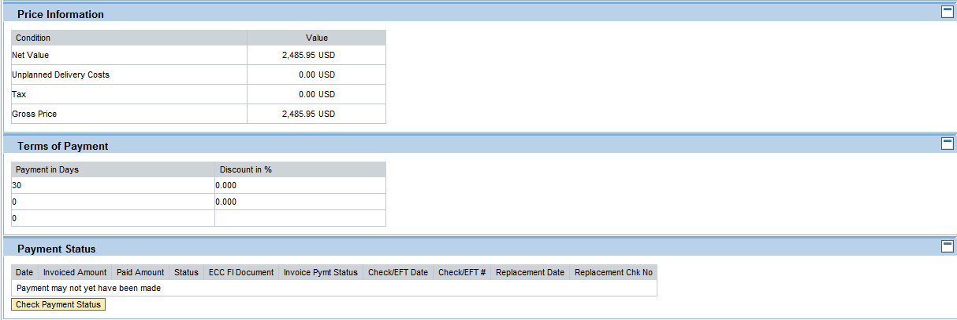
(Optional) Scroll down to see additional data including
ability to check near real-time payment status

Slide 25
When referenced ASN is received and processed by the Acceptor, the invoice will be
available to be “Scheduled for Payment”
NOTE: Invoice linked to ASN, so should match without error
Scroll to the right

Slide 26
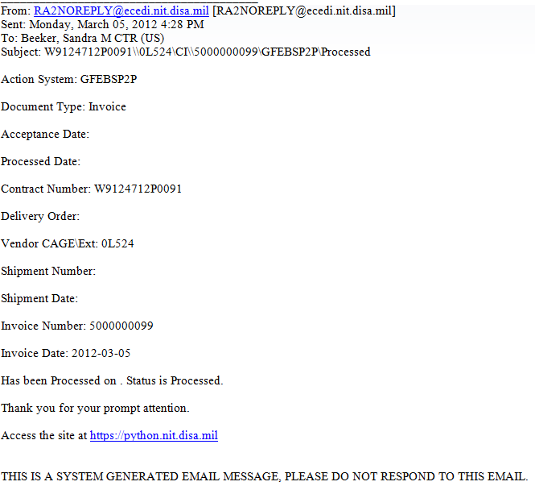
Contractor to receive
Email notification of Invoice Processed

Slide 27
Once invoice is disbursed, data is updated to show the Check/EFT#
SUS retains list display of documents with drill-down capability to find associated documents

