Slide 1


USCIS ELIS I-526 Screenshots

Slide 2
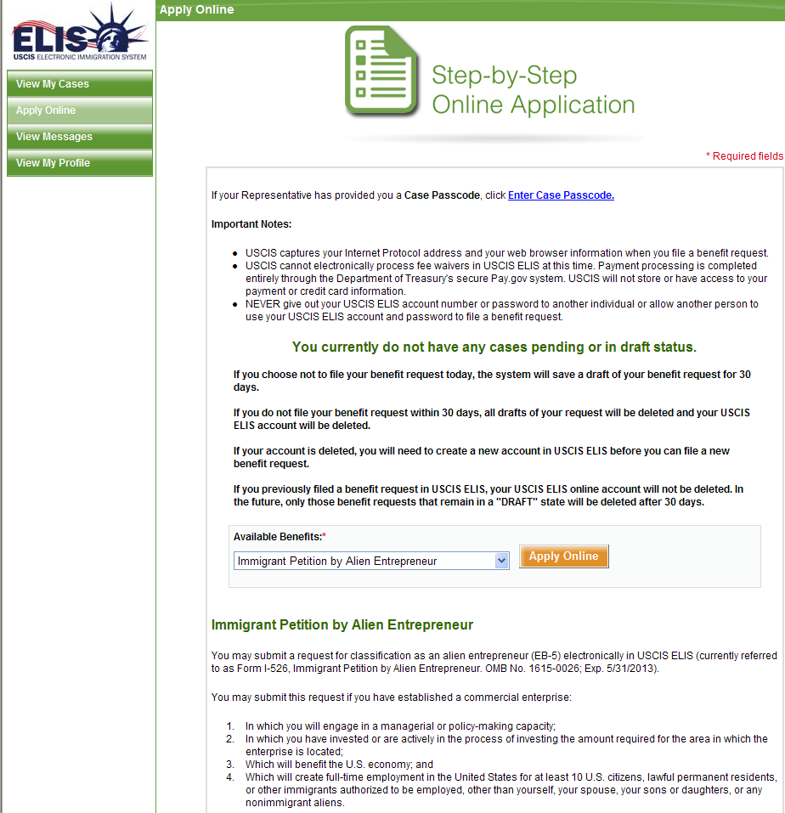
I-526 – Online Application

Slide 3
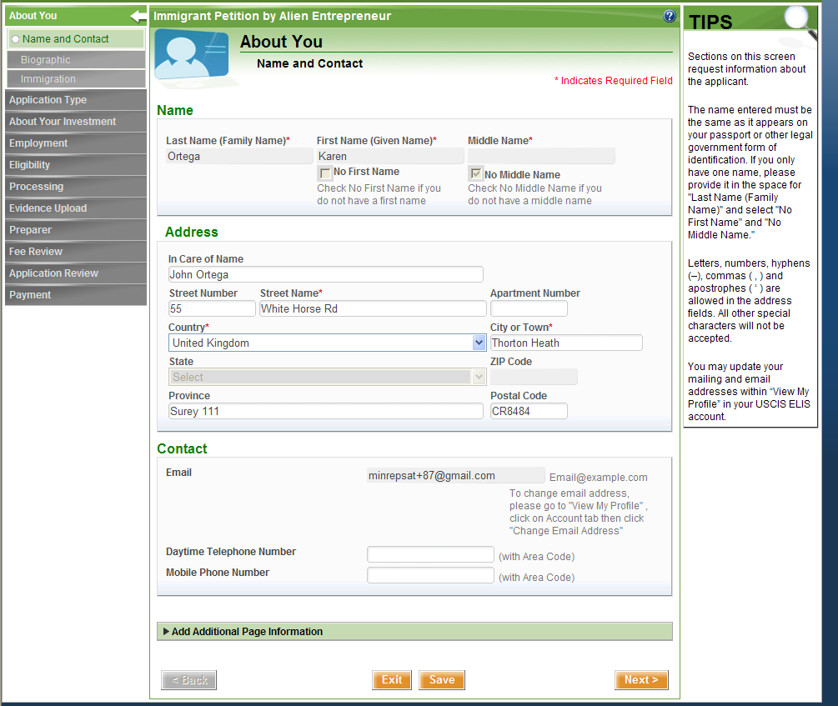
I-526 About You Section

Slide 4
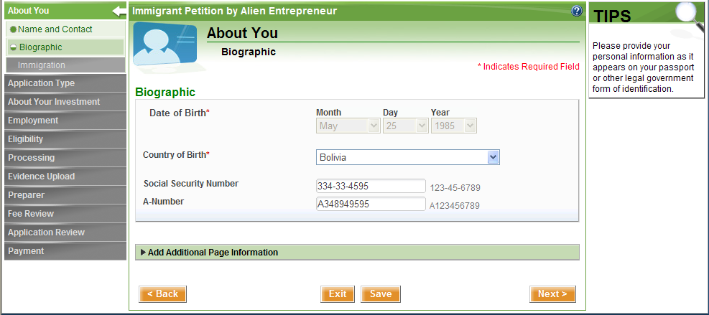
I-526 – Biographic Information

Slide 5
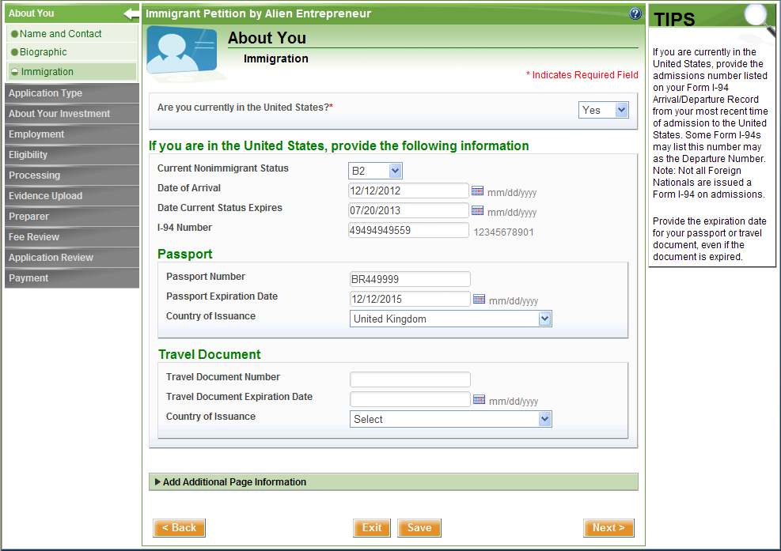
I-526 Immigration Information

Slide 6
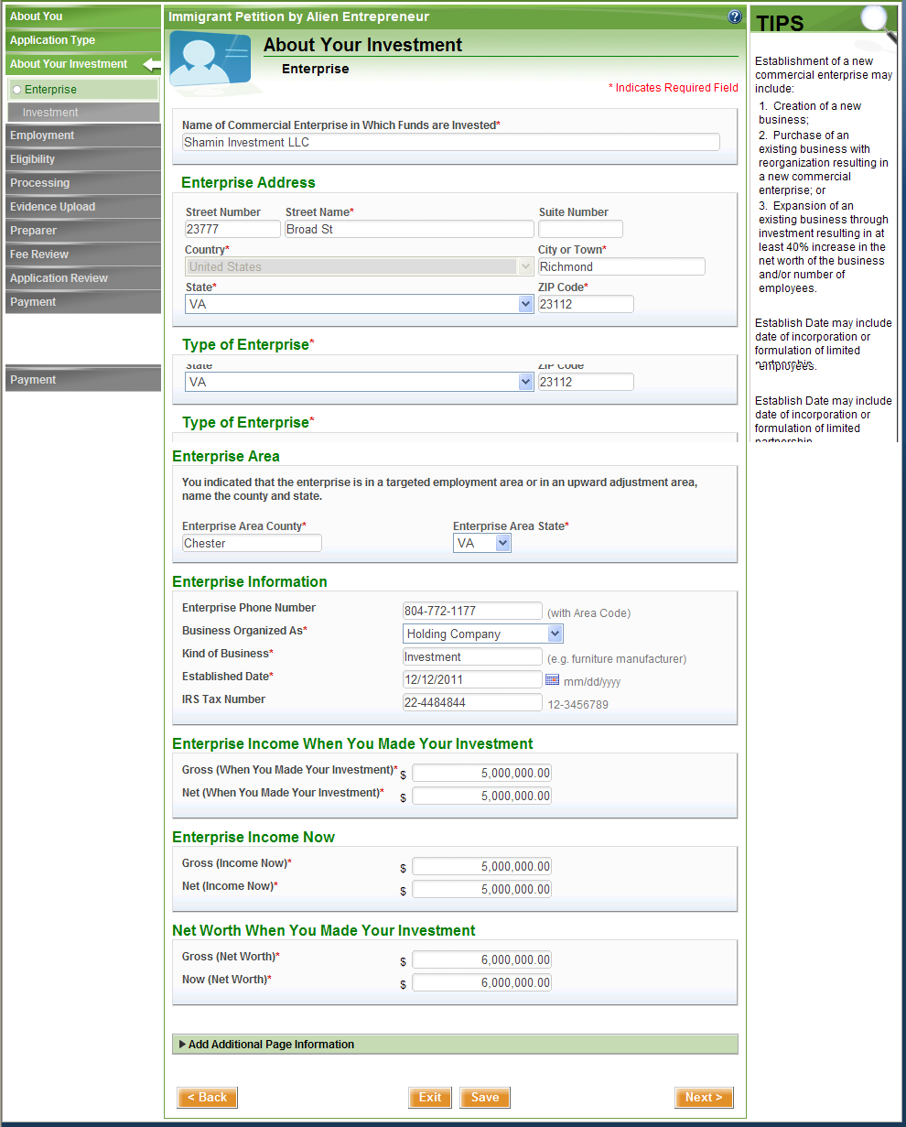
I-526 – Enterprise Information

Slide 7
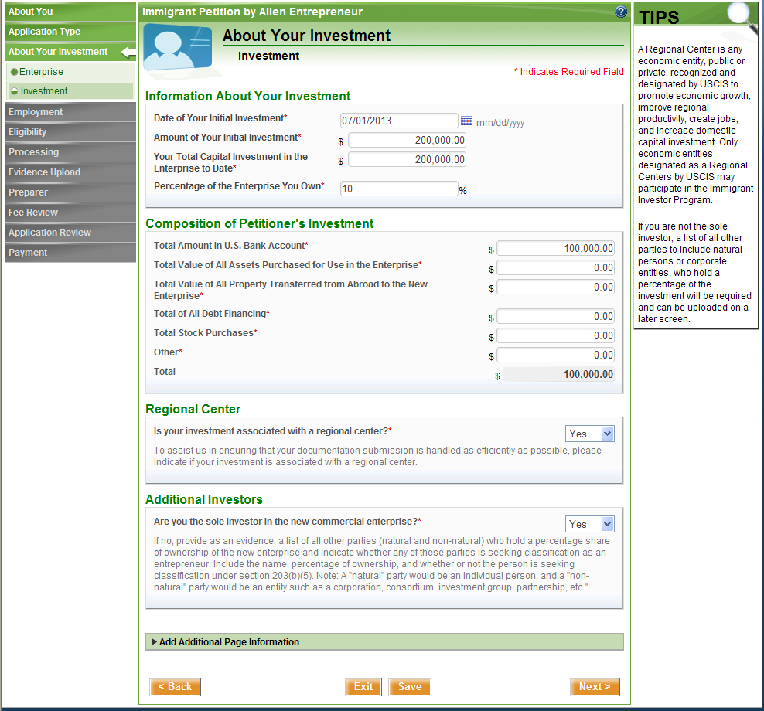
I-526 – Investment Information

Slide 8
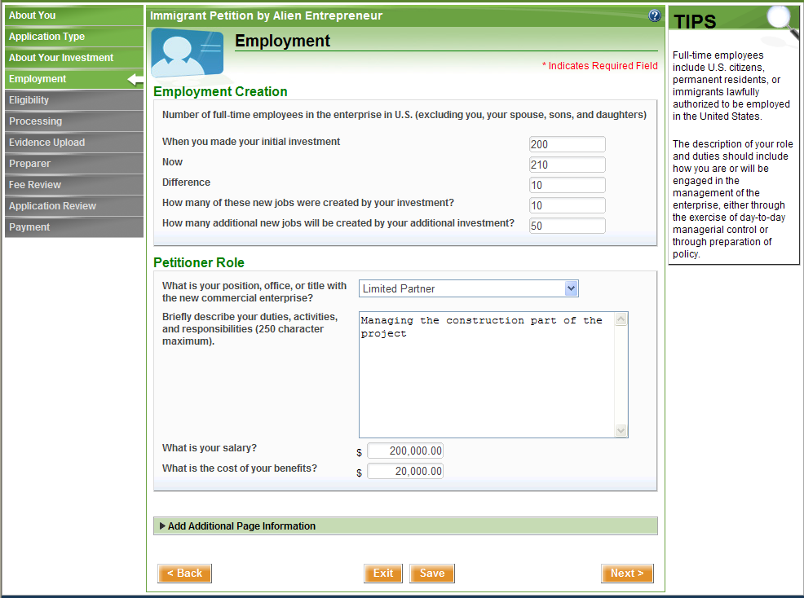
I-526 – Employment Information

Slide 9
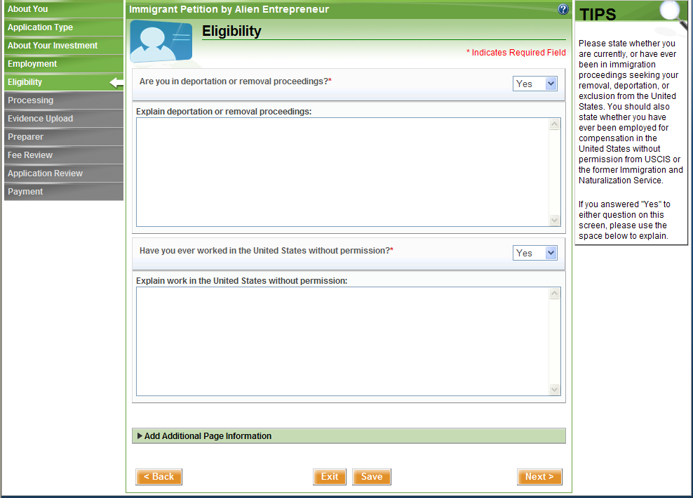
I-526 Eligibility Information

Slide 10
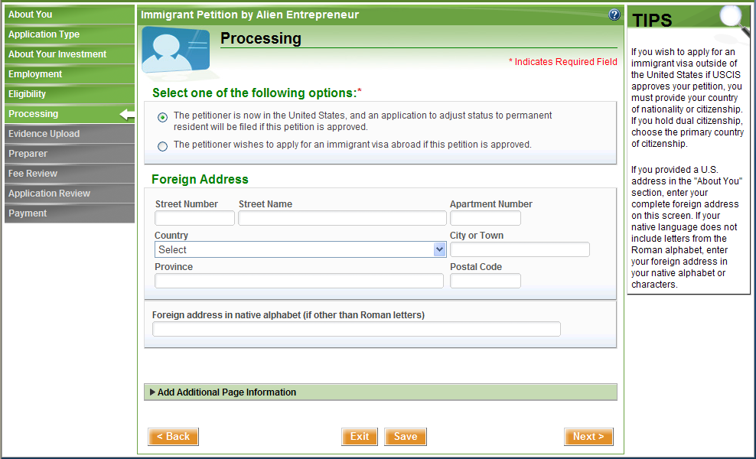

Slide 11
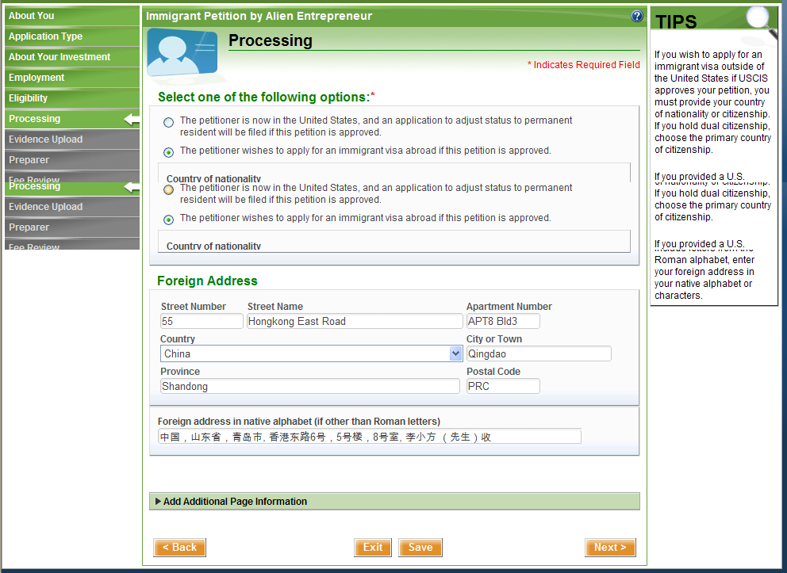

Slide 12
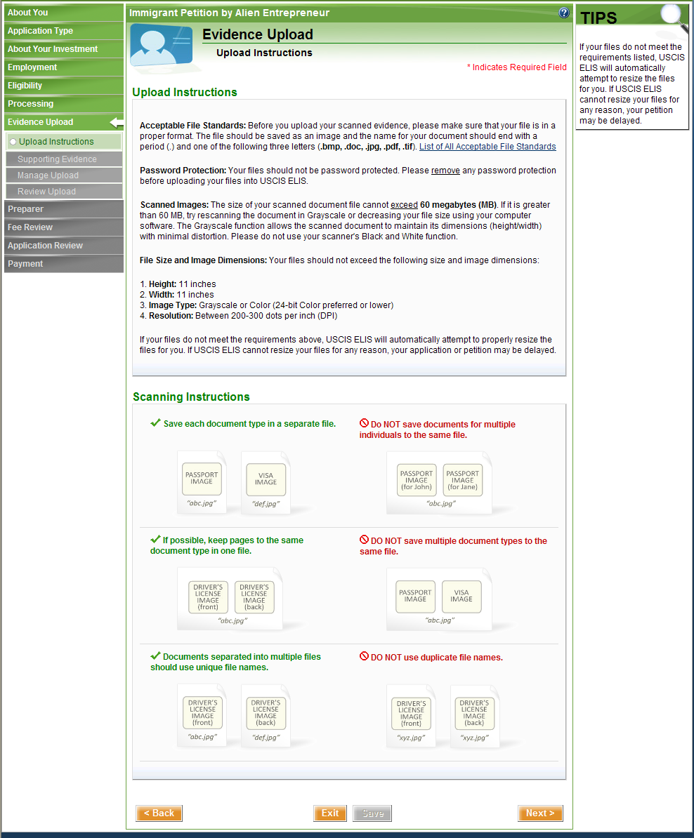

Slide 13
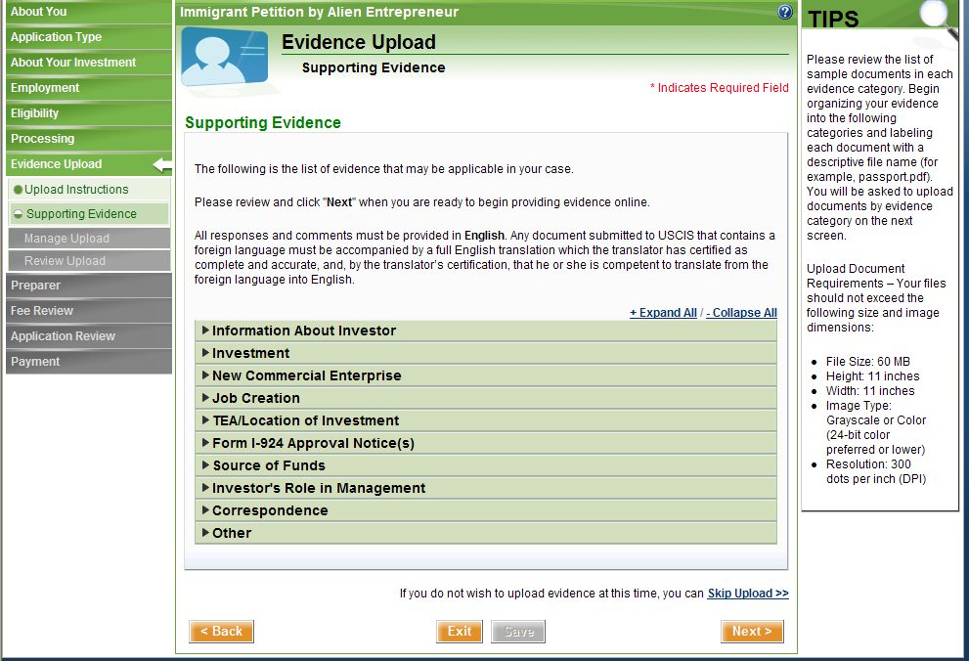
I-526 – Supporting Evidence Categories

Slide 14
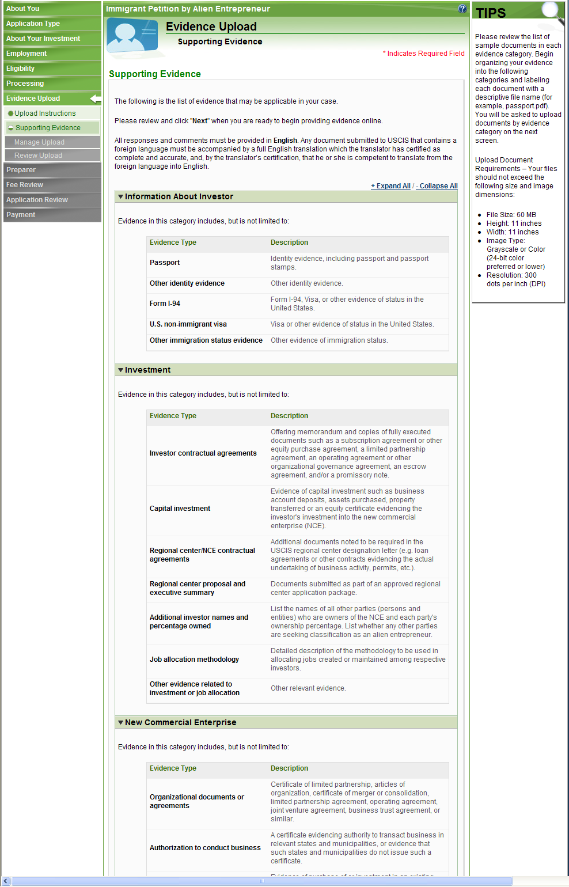
I-526 – Supporting Evidence Examples

Slide 15
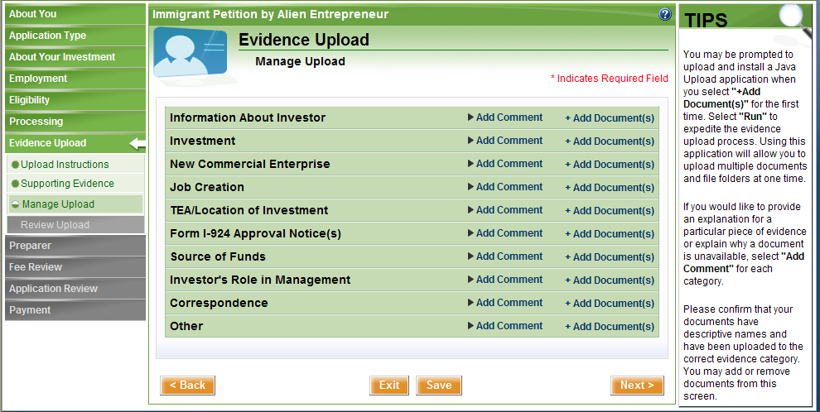
I-526 – Manage Evidence Upload

Slide 16
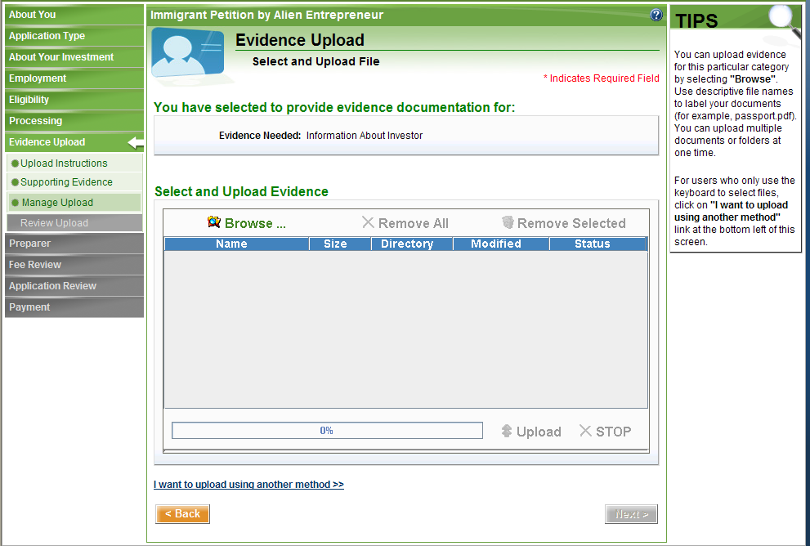
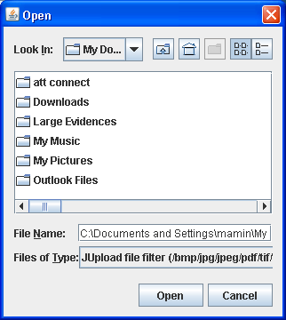
I-526 – Upload Evidence via Applet

Slide 17
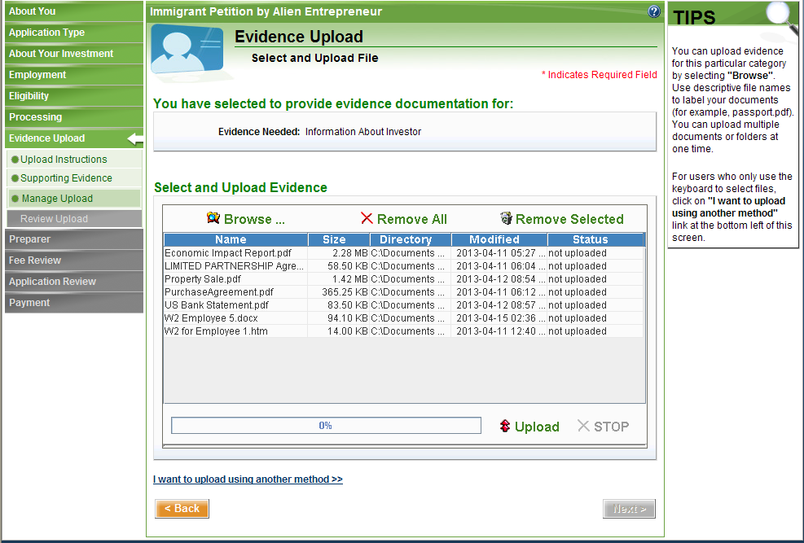
I-526 – Selected Evidence for Upload

Slide 18
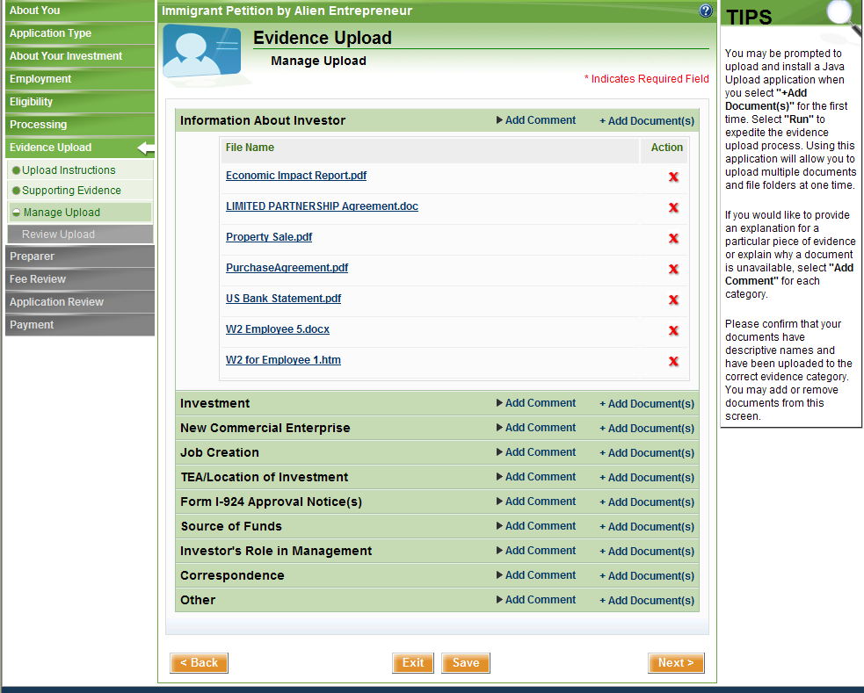
I-526 – Manage Upload - Uploaded Evidences

Slide 19
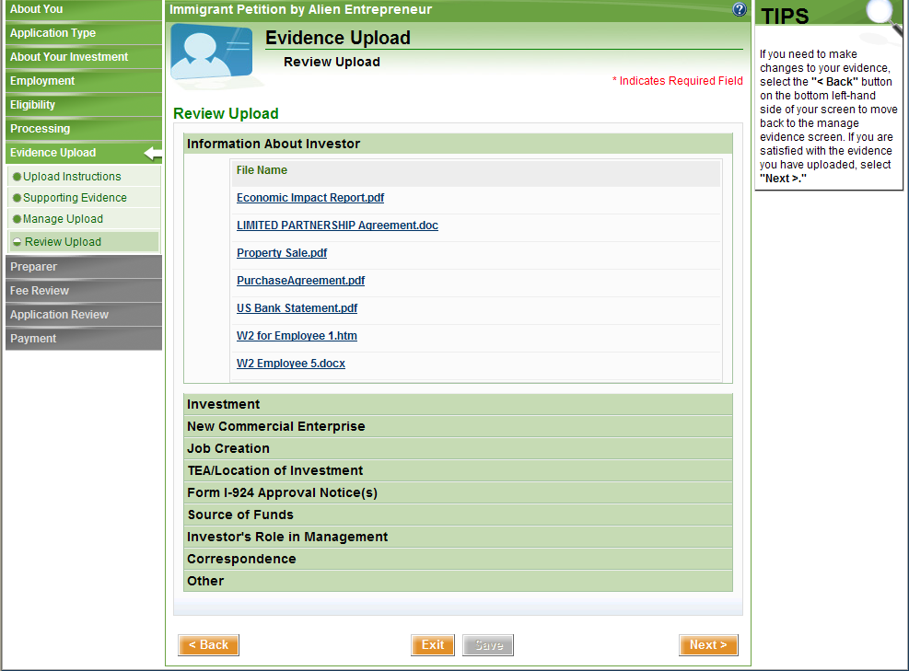
I-526 – Review Uploaded Evidences

Slide 20
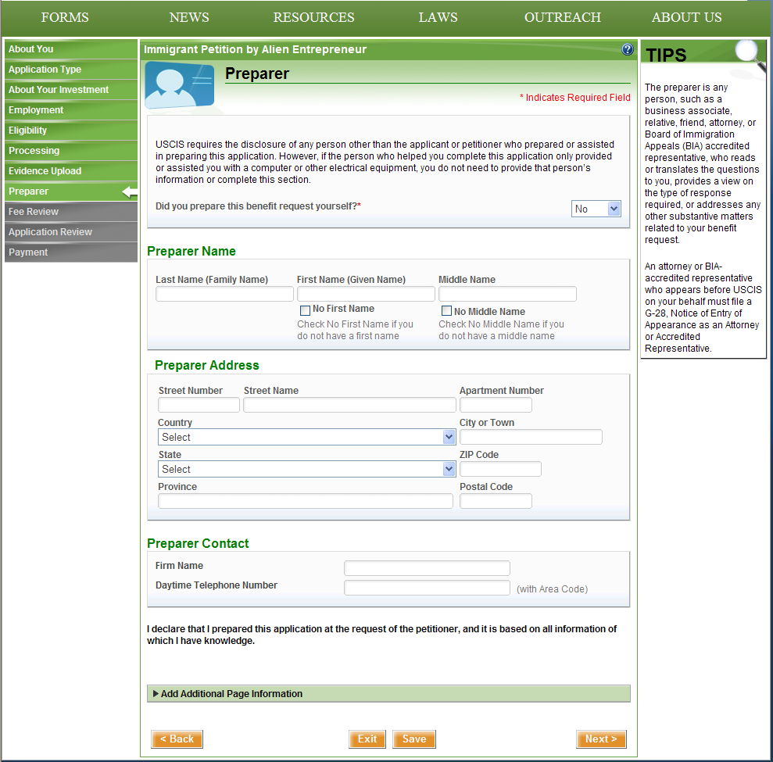
I-526 – Preparer Section

Slide 21
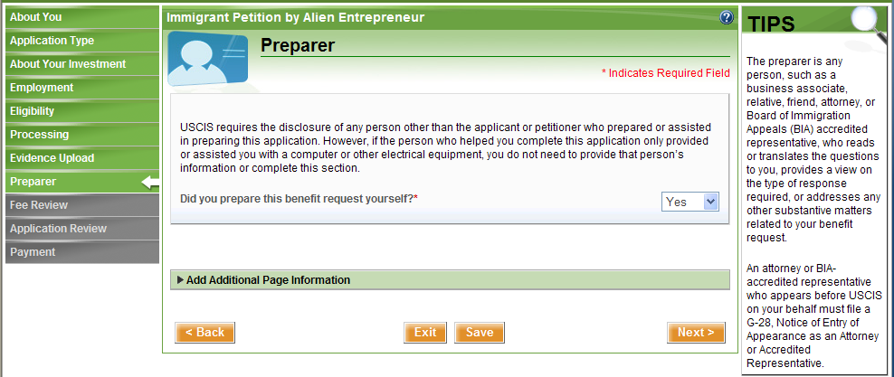
I-526 – Preparer Section

Slide 22
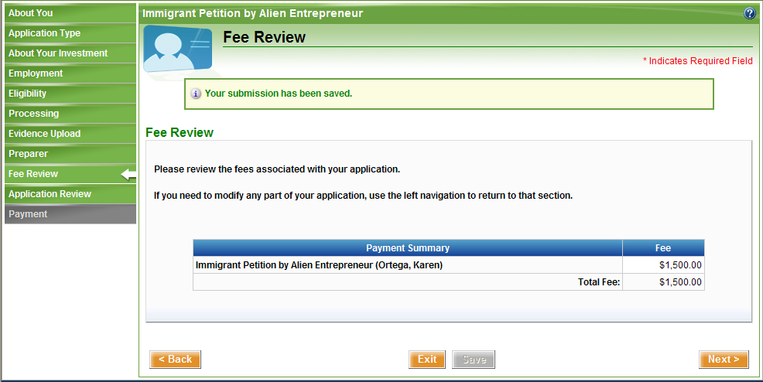

Slide 23
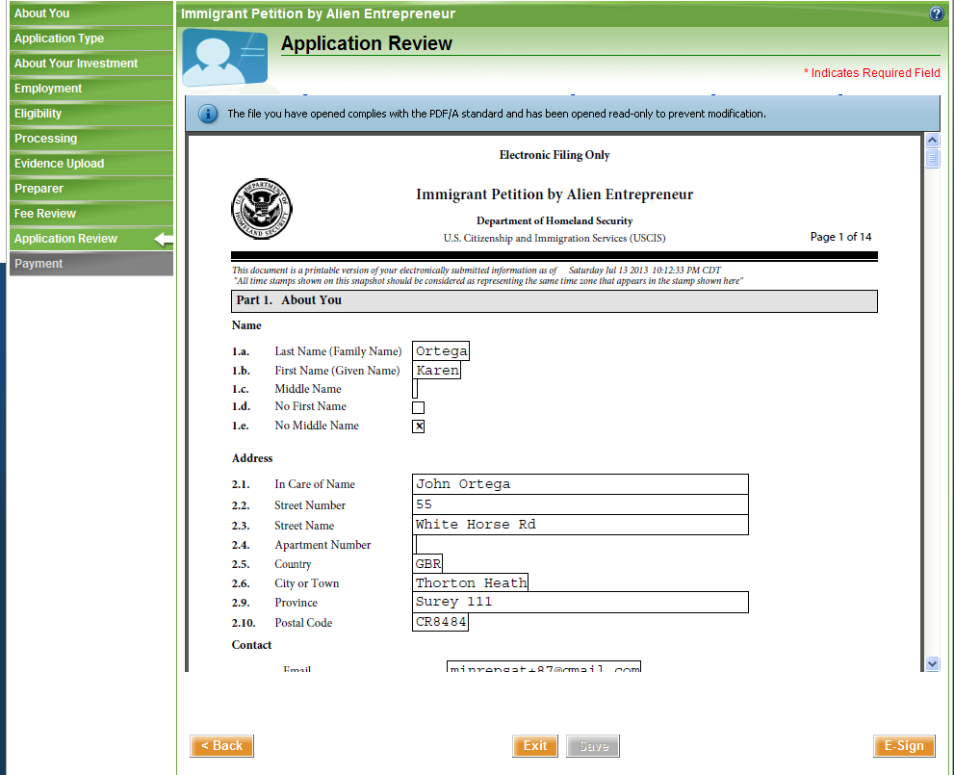

Slide 24
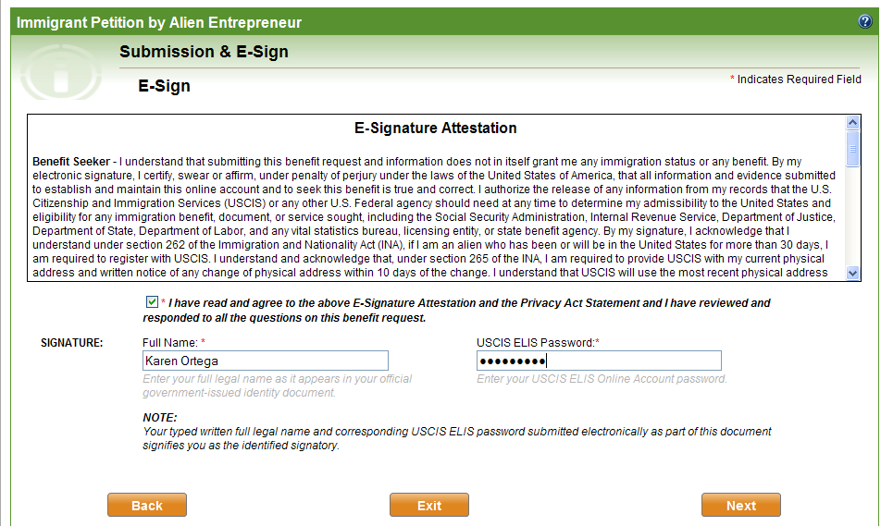

Slide 25
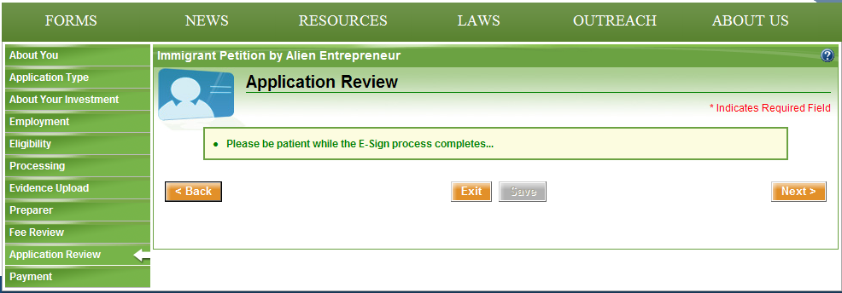
I-526 – Application Review

Slide 26
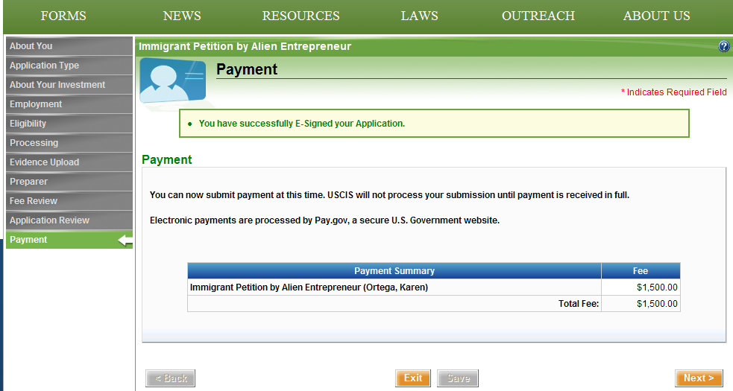
I-526 - Payment

Slide 27
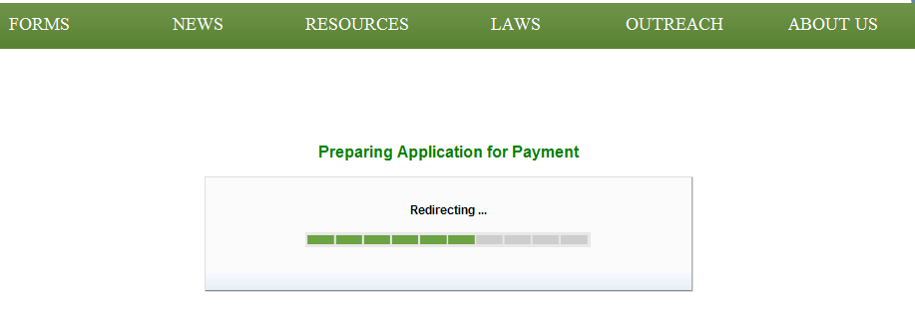
I-526 – Preparing Application for Payment

Slide 28
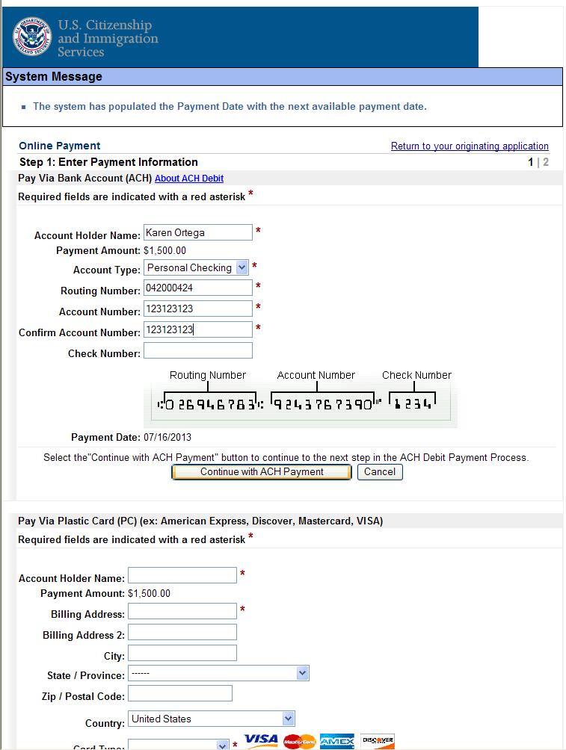
I-526 – Pay.Gov for Payment

Slide 29
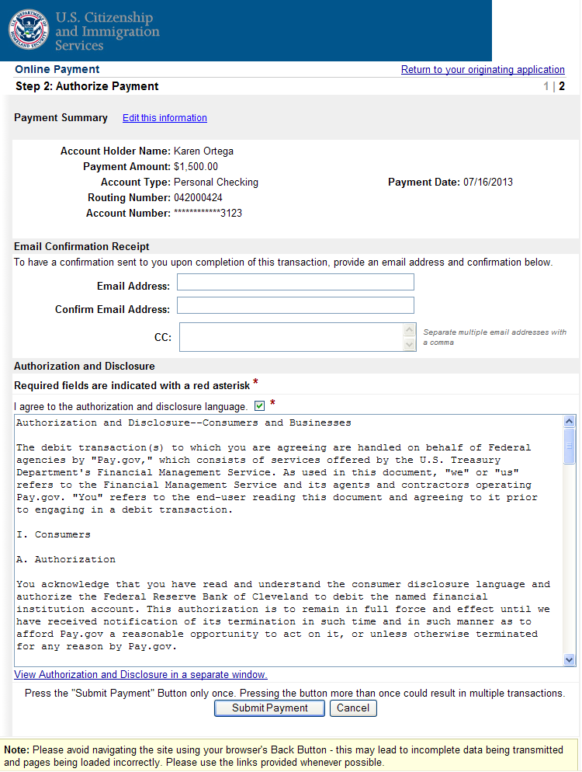
I-526 – Pay.Gov – Payment Confirmation Screen

Slide 30
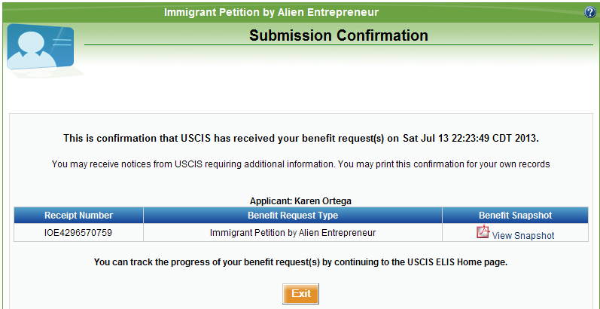
I-526 – Payment Submission Confirmation

Slide 31
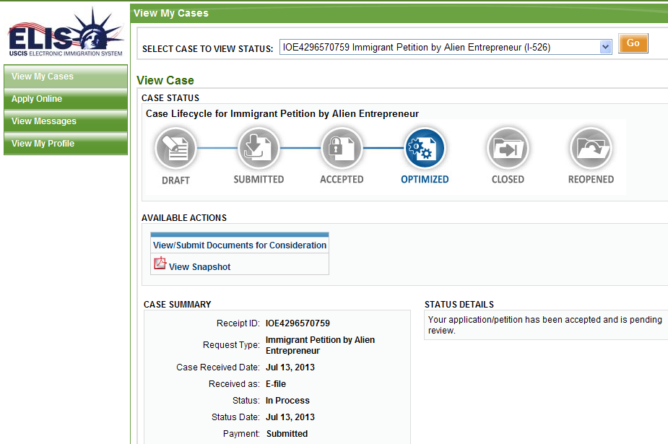
I-526 – View my Cases

