Slide 1
EFRI Reporting Systems
For EFRI officers to complete
For EFRI PIs to complete
Active awardees
Post-award
Active awardees
Post-award
Reference Indicators List here:

Slide 2
EFRI Reporting Systems
For EFRI officers to complete
For EFRI PI’s to complete
Active awardees
Post-award

Slide 3
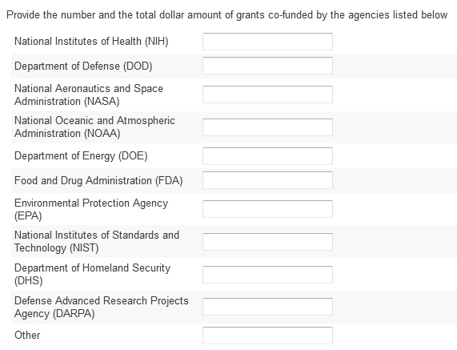

Original Indicator #7
#
$$
Select to add additional fields

Slide 4
Programmatic Evolution (Original Indicator #18)
Please indicate if this EFRI research has led to new programs at any research funding agency
Program Name | Program Description | Agency
Select to add additional fields

Slide 5
EFRI Reporting Systems
For EFRI officers to complete
For EFRI PIs to complete
Active awardees
Post-award

Slide 6
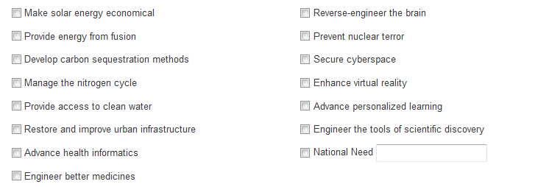
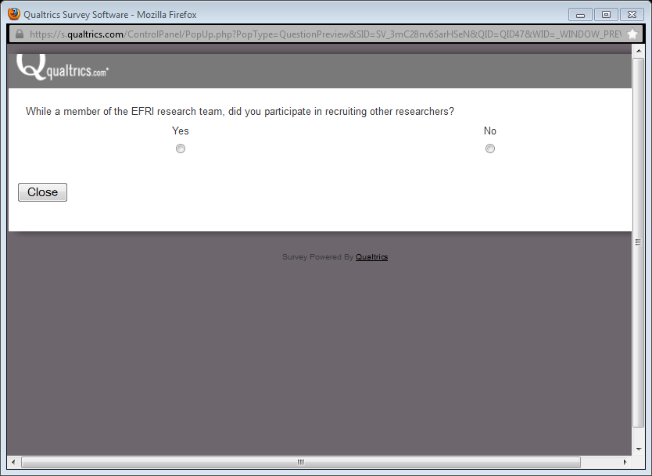
Question 1 (Indicator #9)
EFRI Monitoring Systems
For EFRI PIs to complete
Active awardees
Post-award
Please check the Grand Challenges and/or National Needs that this EFRI research initially set out to address as indicated in the grant proposal
Does the research project currently address the same set of Grand Challenges and/or National Needs that the research initially set out to address?
If not, please indicate below the set of Grand Challenges and/or National Needs the research currently addresses.

Slide 7
Question 2 (Indicator #1 and 8)
EFRI Monitoring Systems
For EFRI PIs to complete
Active awardees
Post-award
Please indicate the nature of the collaboration and whether the partner is international (check all that apply)
Please list all collaborators/partners that you consider to be interdisciplinary
Name | Institution | Discipline
II | DI
C | NP | G
I
Engineering
Physics
Biology
Chemistry
…
Other
Define: ________
Select to add additional fields
Key
Degree Granting Institutions II = Intra-institution (within same institution) DI = Domestic Inter-institution (different institutions)
Non-Degree Granting Institutions C = Corporation NP = Non-profit G = Government
I = International

Slide 8
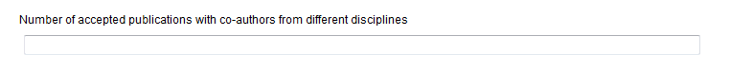
Question 3 (Indicator #2)
EFRI Monitoring Systems
For EFRI PIs to complete
Active awardees
Post-award
Number of accepted publications with co-authors from different disciplines that have resulted from this award
# field only

Slide 9
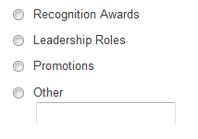
Question 4 (Indicator #4)
EFRI Monitoring Systems
For EFRI PIs to complete
Active awardees
Post-award
Please list all achievements of any of the PIs and Co-PIs involved in the EFRI research in the appropriate category
PI Name | Achievement | Description
Lead PI (name pre-populated)
Co-PI #1 (name pre-populated)
Co-PI #2 (name pre-populated)
Etc…
Select to add additional fields
Select to add additional fields
Select to add additional fields

Slide 10
Question 5 (Indicator #5 and 10)
EFRI Monitoring Systems
For EFRI PIs to complete
Active awardees
Post-award
Has this research generated additional funding from other sources (other NSF programs or other agencies) for all PIs and Co-PIs involved in this EFRI project research?
Please collect this data for all PI’s listed below.
Past-PIs are displayed in gray, with option to add information if additional funding is in any way related to the EFRI research
PI Name | Grant Title | Agency | > $2 Million/ grant
Lead PI (name pre-populated) |  |  | Yes/No
Co-PI #1 (name pre-populated)
Co-PI #2 (name pre-populated)
Etc…
Select to add additional fields
Select to add additional fields
Select to add additional fields

Slide 11
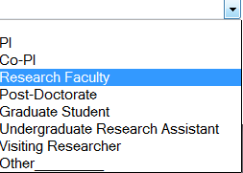
Question 6 (Indicator #6)
EFRI Monitoring Systems
For EFRI PIs to complete
Active awardees
Post-award
Please list any researchers who have spent more than 10% of their time in a laboratory at a different institution (including EFRI partner laboratories)
Name | Host Institution | Title
Select to add additional fields

Slide 12
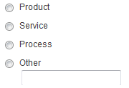
Question 7 (Indicator #11)
EFRI Monitoring Systems
For EFRI PIs to complete
Post-award
Post award monitoring systems only
Please list any companies or start-ups that were developed directly or indirectly based on the research funded by EFRI
Companies/Start-Ups | Product/Service/ Process | Description of Product/Service/ Process | Year Founded
Select to add additional fields

Slide 13
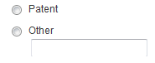
Question 8 (Indicator #13)
EFRI Monitoring Systems
For EFRI PIs to complete
Active awardees
Post-award
Please provide the following information about any licensing activity that has resulted from your EFRI research
Technology being licensed | Type of license | Year of licensing agreement
Select to add additional fields

Slide 14
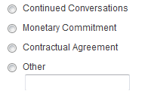
Question 9 (Indicator #14)
EFRI Monitoring Systems
For EFRI PIs to complete
Active awardees
Post-award
Please list any companies that have demonstrated interest in partnership activities related to your EFRI research. Please gather this information from all leadership in the EFRI grant.
Company | Please describe nature of interest for partnership
Select to add additional fields

Slide 15
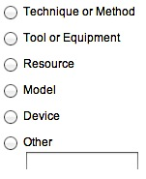
Question 10 (Indicator #15)
EFRI Monitoring Systems
For EFRI PIs to complete
Post-award
Post award monitoring systems only
Please list new research capabilities resulting from EFRI research that are being utilized and adopted by the research community and their appropriate categories
Description | Type
Select to add additional fields

Slide 16
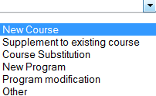
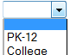
Question 11 (Indicator #16, 17, and 18)
EFRI Monitoring Systems
For EFRI PIs to complete
Active awardees
Post-award
Please indicate if this EFRI research has led to curriculum changes at any educational level, collegiate or pre-collegiate
Curriculum change | Describe | Education Level
Select to add additional fields

Slide 17
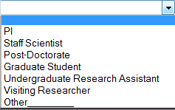
Question 12 (Indicator #20)
EFRI Monitoring Systems
For EFRI PIs to complete
Post-award
Post award monitoring systems only
Please provide the following information about former EFRI-supported students who have become involved in high-risk/ high-reward research.
Name | Current Title | Field of Research
Select to add additional fields
Could possibly pre-populate fields with names of researchers from RPPR

Slide 18
Question 13 (Indicator #21)
EFRI Monitoring Systems
For EFRI PIs to complete
Active awardees
Post-award
Please list any activities of new research communities that have formed around EFRI topics
New meetings/ conferences
New journals
New workshops/ working groups
News coverage/ press release
Other (ex: congressional hearings, website, social media, professional society)
Select to add additional fields

Slide 19
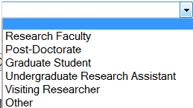
Question 14 (Indicator #22 and 23)
EFRI Monitoring Systems
For EFRI PIs to complete
Active awardees
Post-award
Your research team, including senior, stipend, for-credit, and volunteer personnel, will be contacted to collect information on demographics and career path decisions. Please list all researchers that have participated in the EFRI research.
Name | Email | Role in the laboratory
Select to add additional fields
Could possibly pre-populate fields with names of researchers from RPPR
(capturing current and past trainees within the grant)
Auto-generate different emails for different categories of researchers (ie. Grad students, post-docs, etc.) to be sent out to those participants asking them the following questions found on the following slides

Slide 20
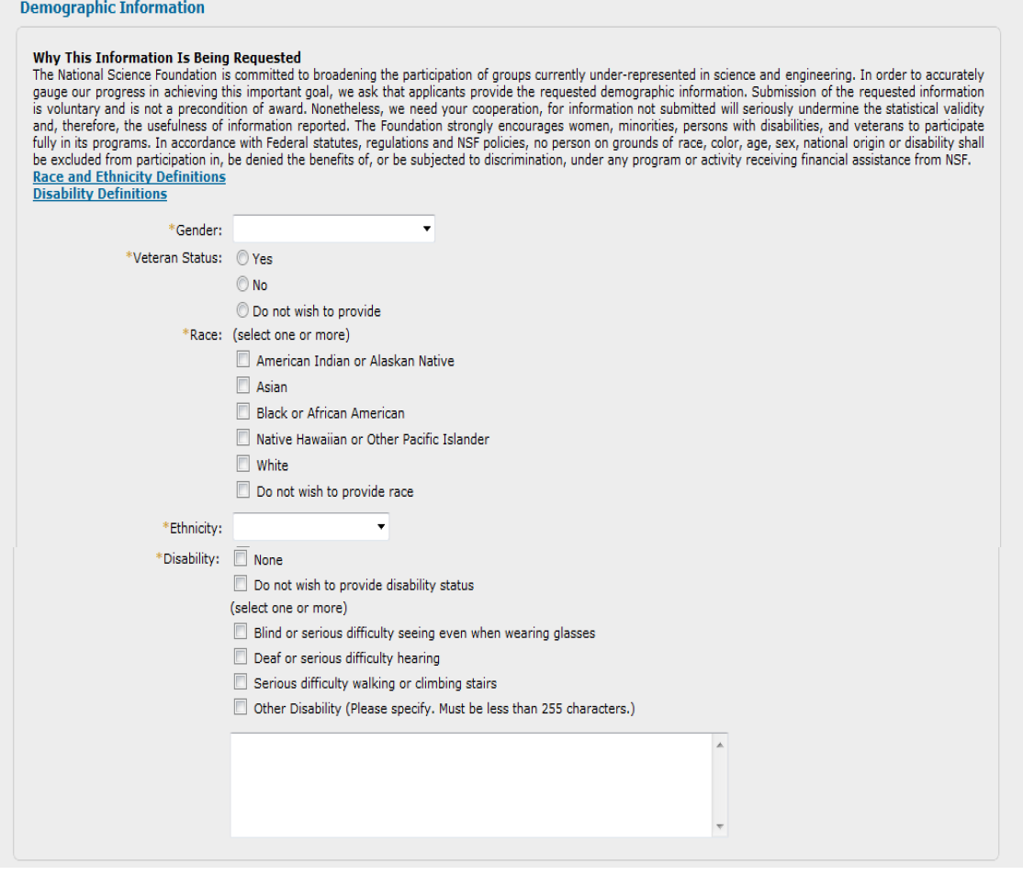
Email generated to researchers: Demographic information may not be necessary to include if it is going to be collected through RPPR

Slide 21
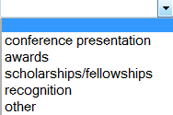
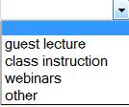
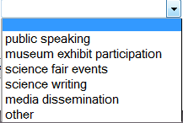
Please list any significant achievements that resulted from your EFRI research involvement.
Achievement | Describe
Select to add additional fields
Please list any outreach activities you participated in for work related to your EFRI project.
Formal Education | Describe
Select to add additional fields
Informal Education | Describe
Is there any other information you would like to share with us regarding your experience with this EFRI project?

Slide 22
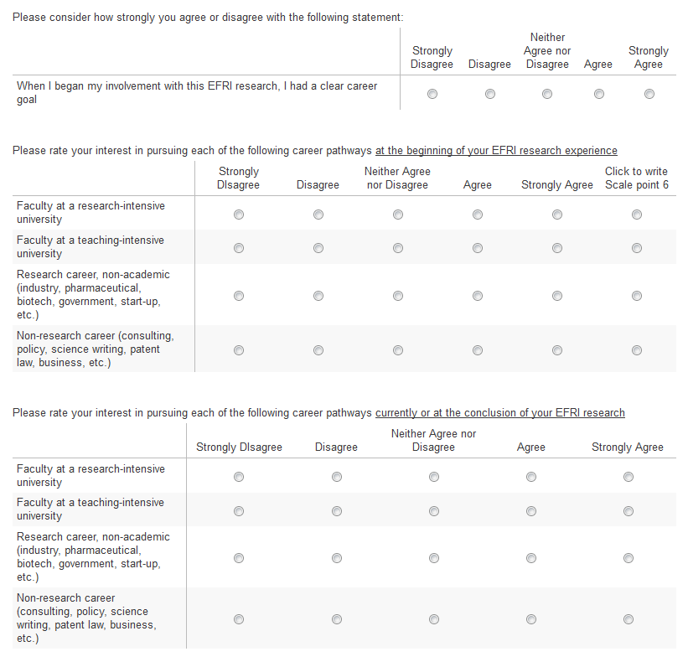
Questions sent to students
Comments:
Comments:

