Slide 1
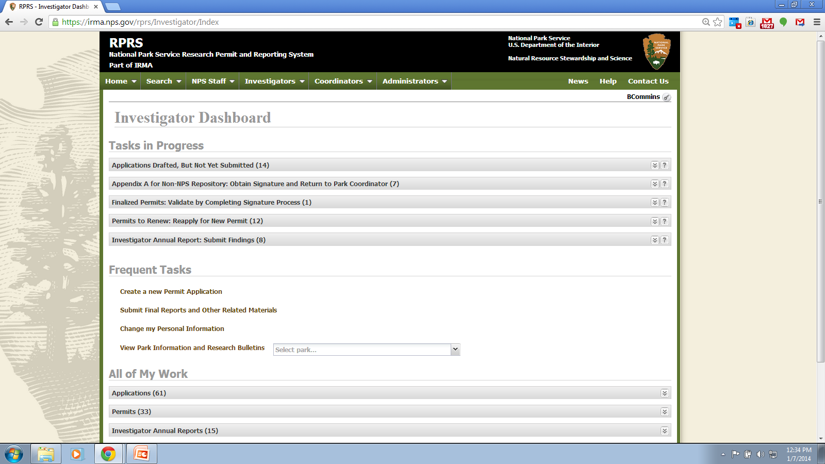
Notes:
Investigator dashboard: home page for investigators who log into their password protected account. To submit IARs the investigator clicks on the “Tasks in Progress” panel labeled “Investigator Annual Report: Submit Findings”. A listing of permits for which IARs are (or will be) due is listed.

Slide 2
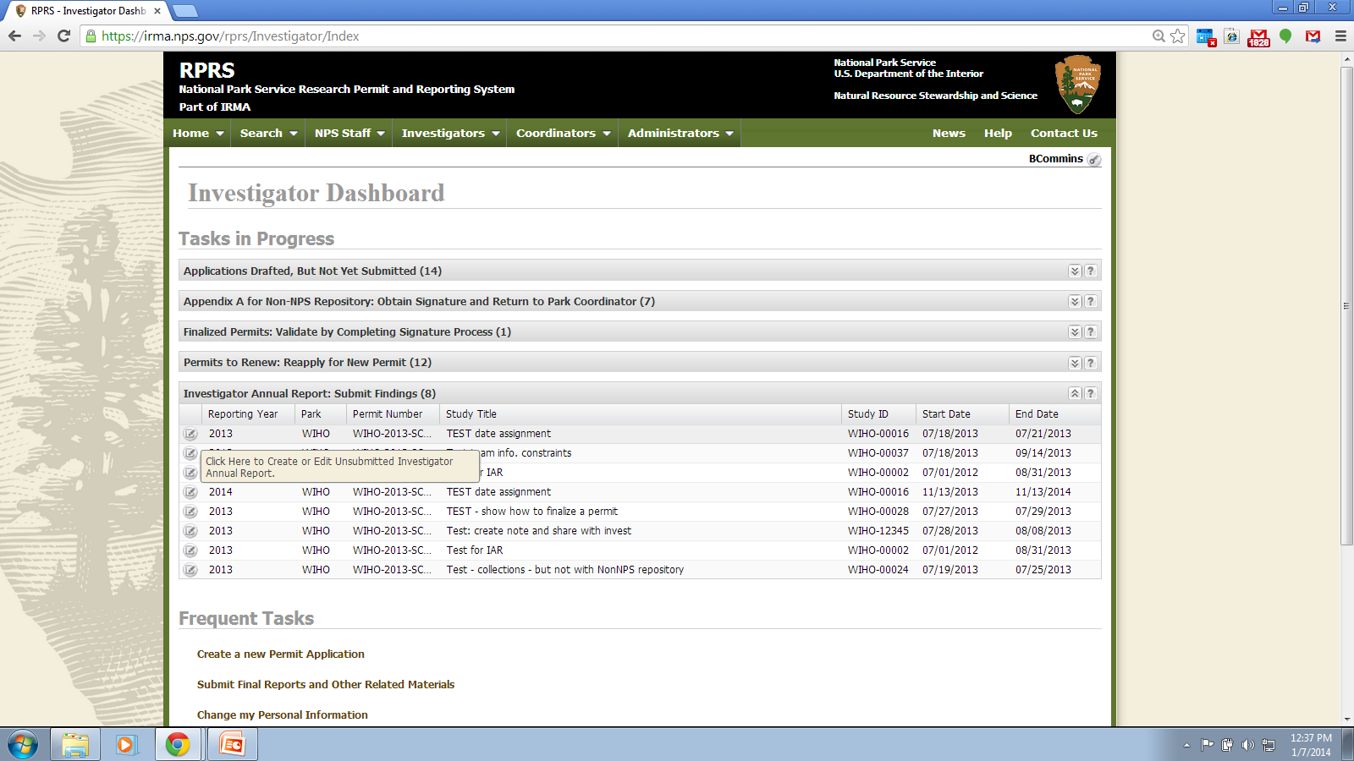
Notes:
Investigator Annual Report: Submit Findings panel clicked. See listing. Click on icon to right of listing to open up the IAR on-line form.

Slide 3
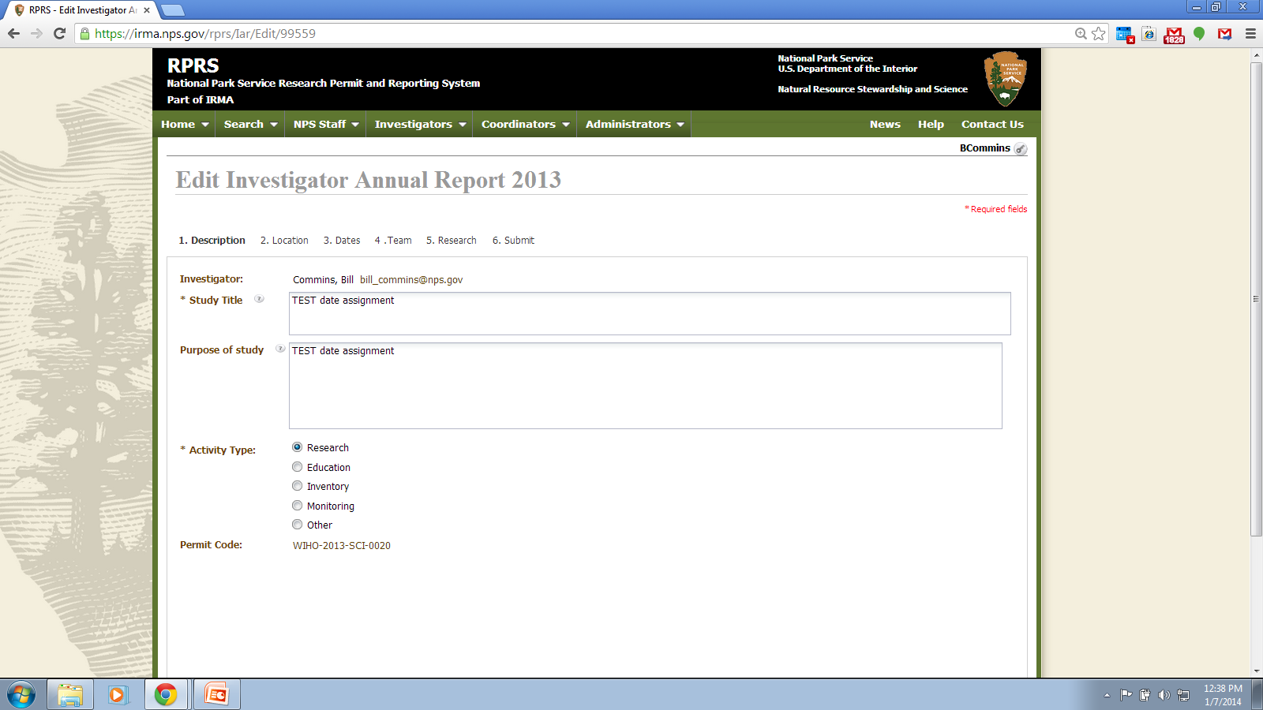
Notes:
Description Tab: All fields pre-filled with permit data. All fields are editable by submitter except permit code.

Slide 4
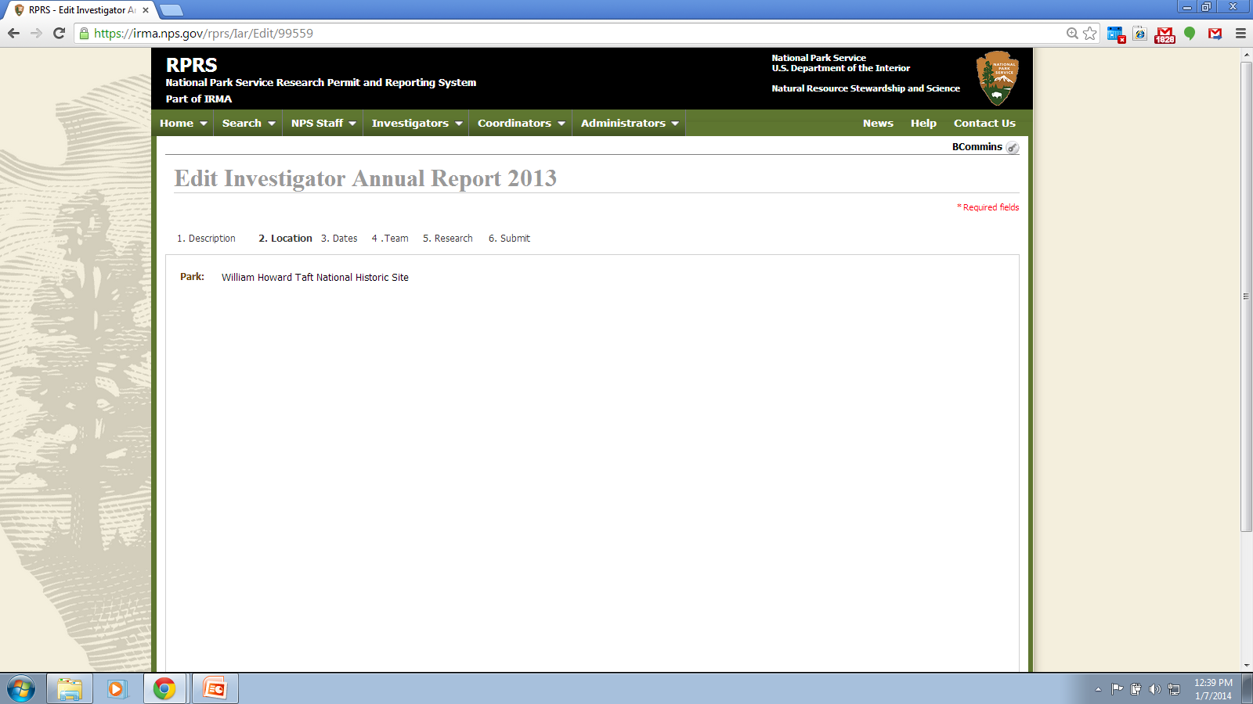
Notes:
Location Tab: Information is pre-filled from permit data and not editable.

Slide 5
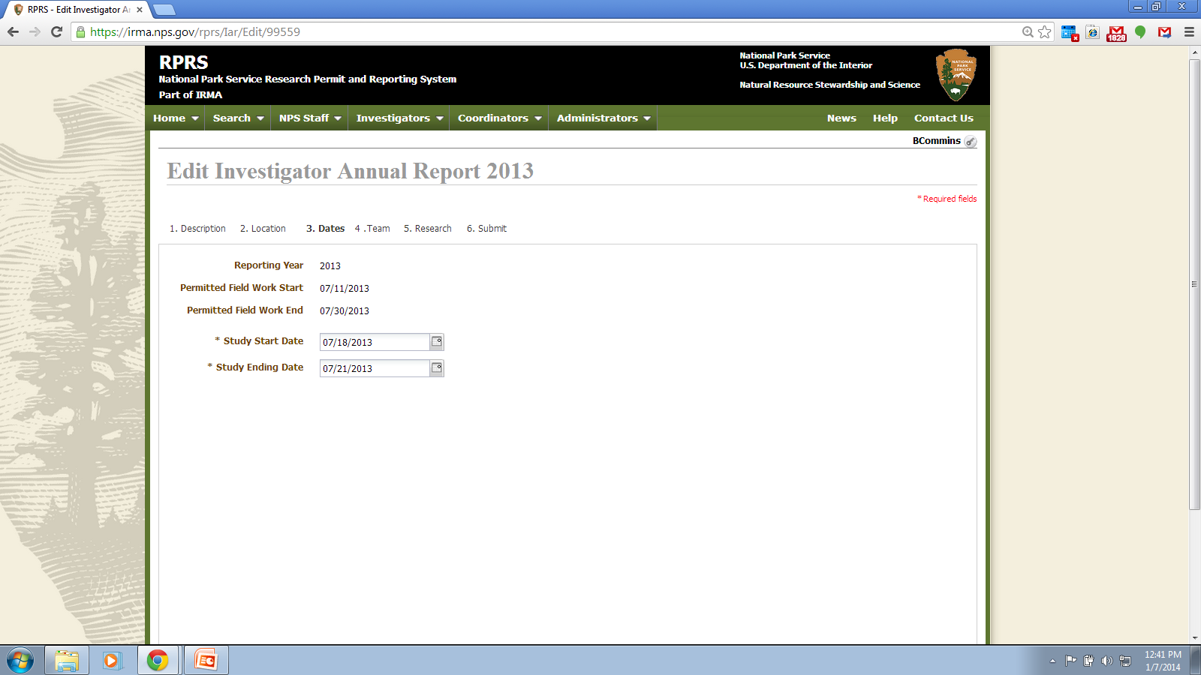
Notes:
Dates Tab: Field work dates not editable, pulled from application/permit record. Study Start and Ending Dates are pre-filled form application/permit record, but are editable.

Slide 6

Notes:
Team tab: data is carried from application/permit, if there is any data to carry. Submitter may edit, delete or add data to IAR form.

Slide 7
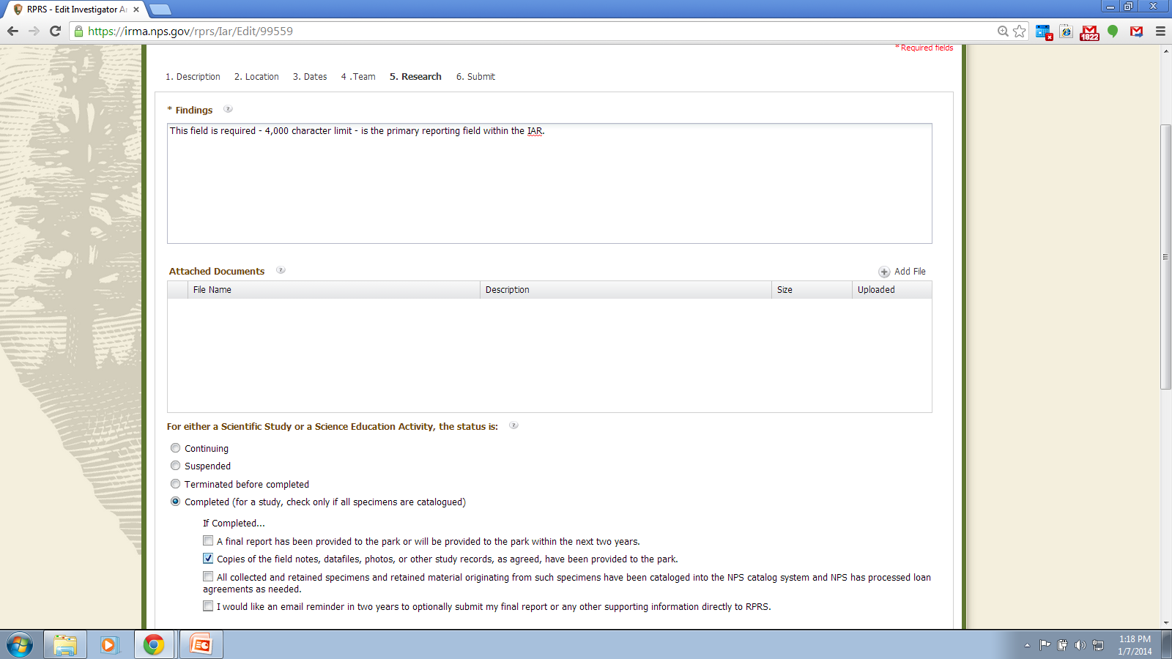
Notes:
Research Tab: Most of the reporting input by submitter occurs on this page. Findings is the primary reporting field. It is blank (not pre-filled), and has a 4,000 character limit.
Attached documents is optional. Provides a means for investigator to submit additional study files to park.

Slide 8
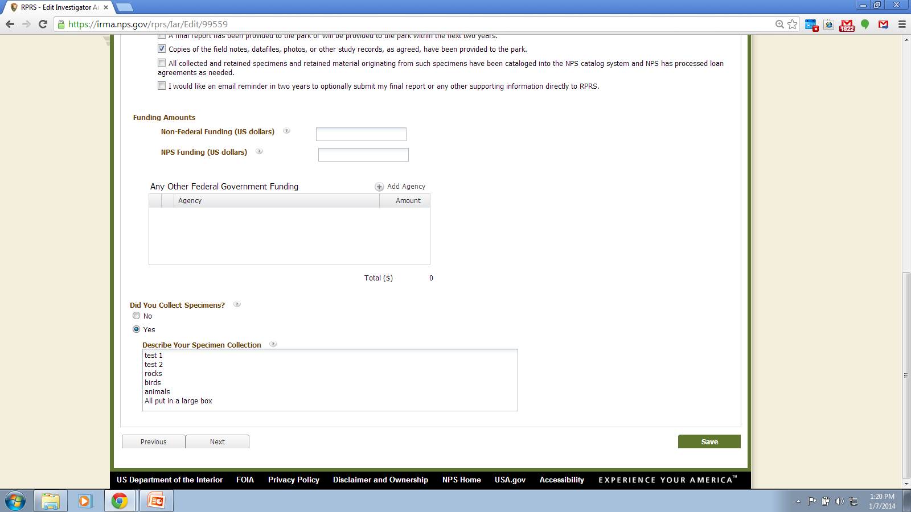
Notes:
Research Tab (continued): Asks funding information and whether collecting occurred. If collecting occurred a description of the collections is required.

Slide 9
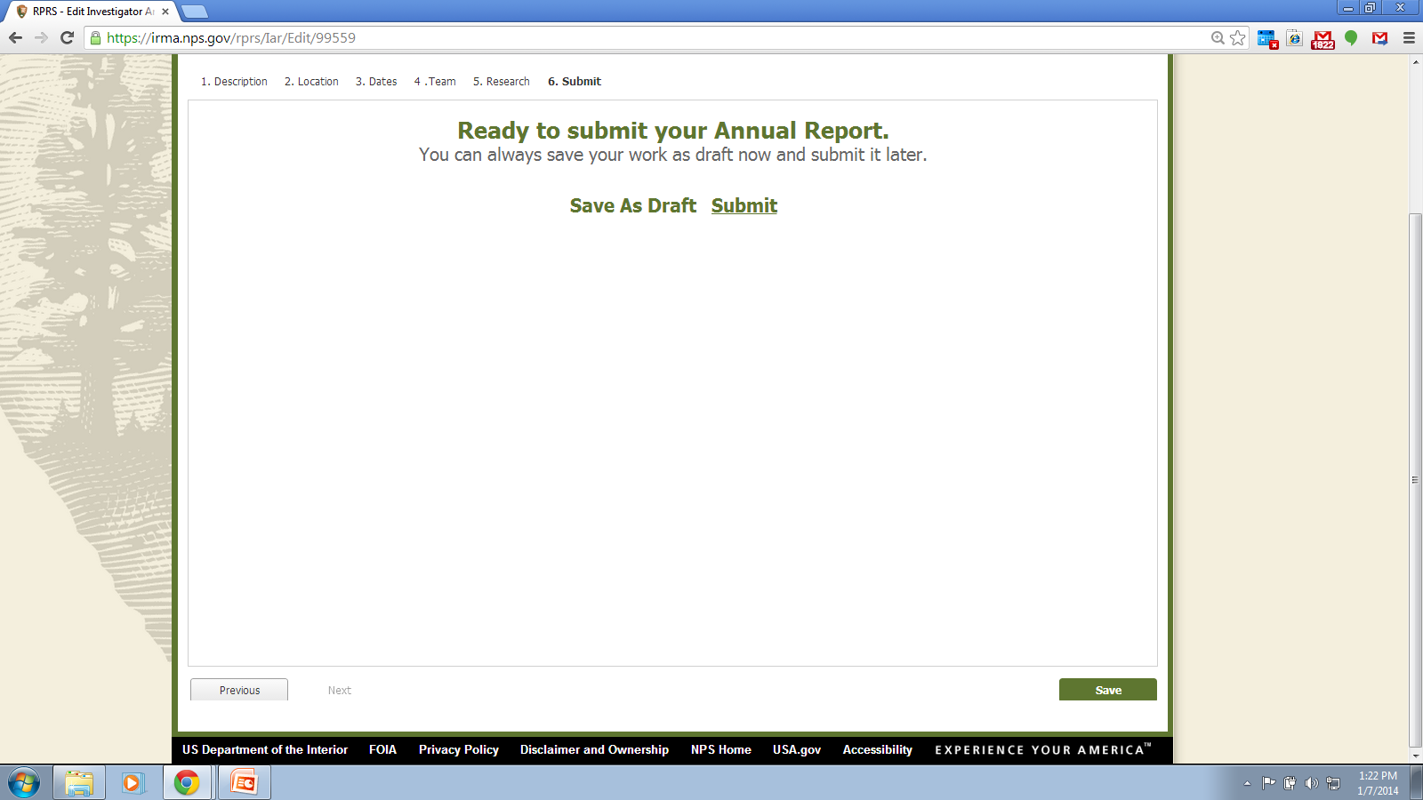
Notes:
Submit tab: may submit or save as draft.

Slide 10
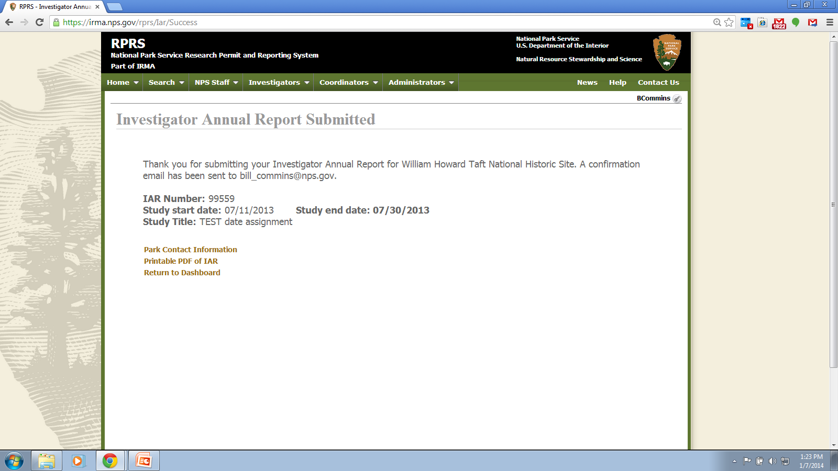
Notes:
Report submitted page.

