Slide 1
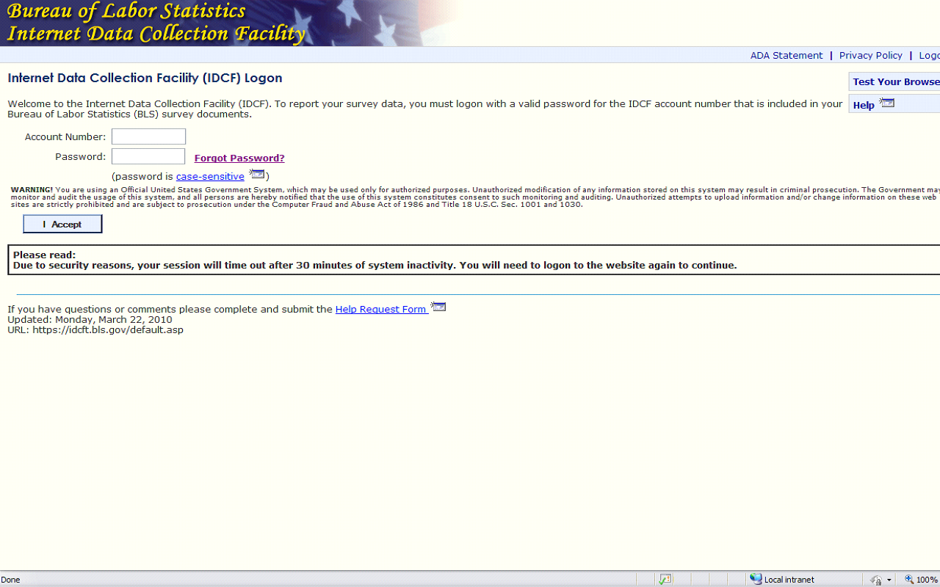
Notes:
Some respondents may already have an IDCF account; if not, these are the steps they will follow to set up an account.
Access the IDCF system using the link the field economist sent them.
Enter the temporary account number and password; both were included in the emails the field economist sent them.
If the respondent needs their temporary account number and/or password re-sent to them, the field economist is able to do that.
(Field Economists can always go back to DRA and re-send the respondent the emails with the temporary account number or password. A better option is for the field economist to resend those emails from their Outlook Sent folder, if they haven’t deleted them.)
After the account is set up the respondent will only have to enter their account number and password when they access the application; they will need to go thru only 2 screens.
(In the future, after they have set up their account, if the respondent forgets their account number or password they can retrieve either or both using the IDCF help feature or the field economist can have the NCS - CAS Utility administrator do this thru the CAS system.)

Slide 2
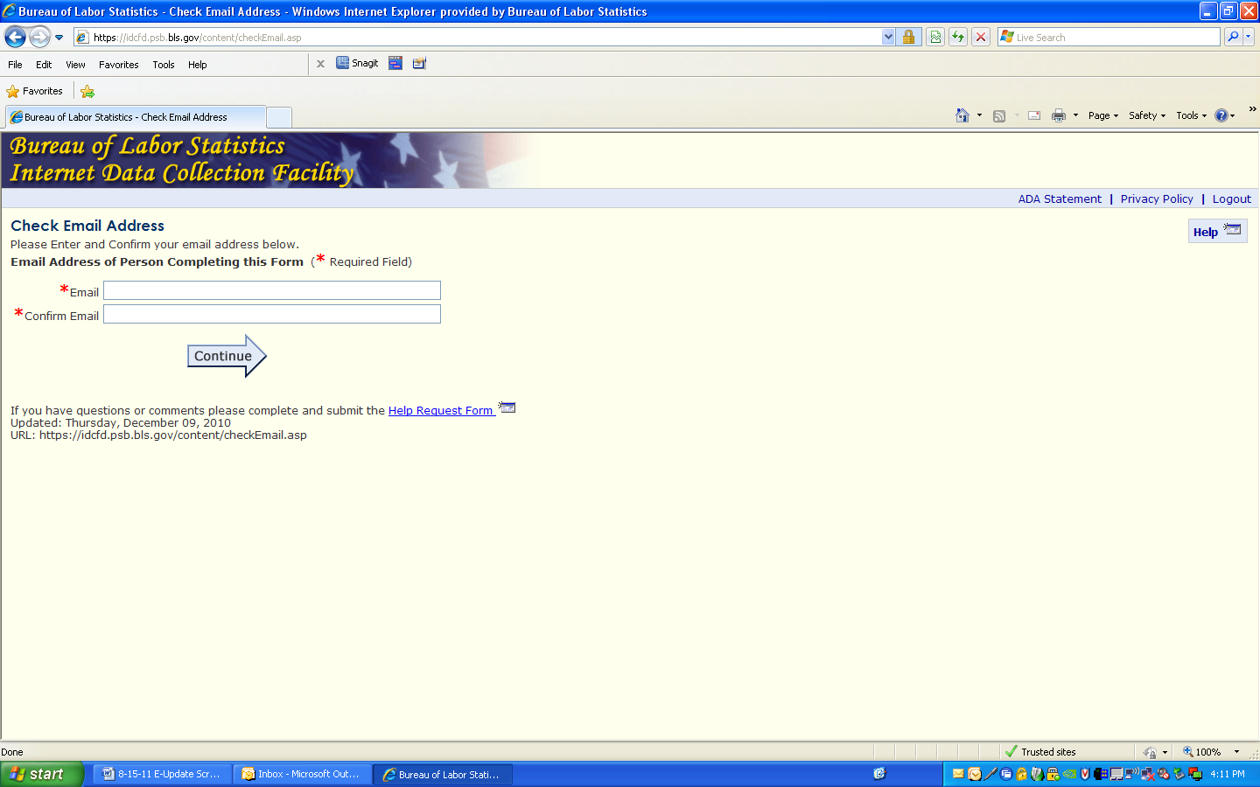
Notes:
On the next screen, the respondent will enter their email address and confirm it.

Slide 3
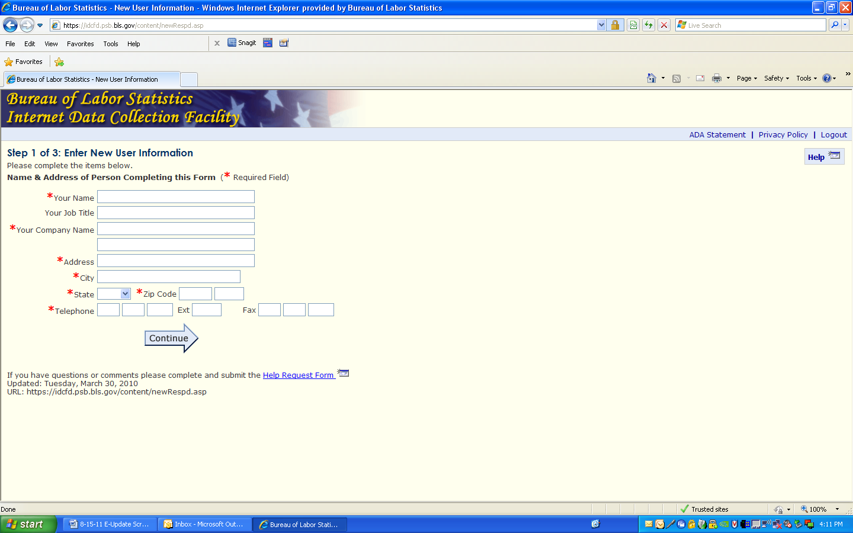
Notes:
Next, they will enter their contact information.

Slide 4
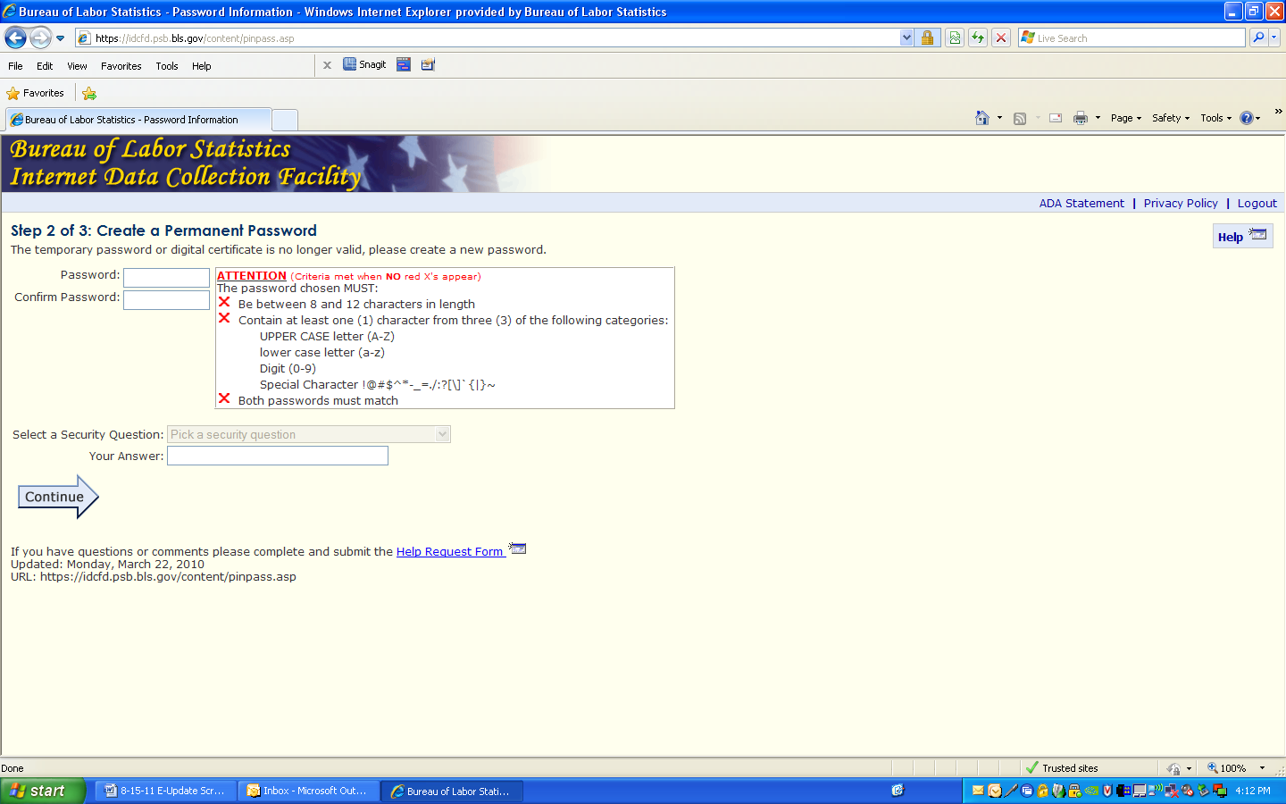
Notes:
Finally, the respondent will be prompted to create their own permanent password. As each password criteria is met the ‘red x’ next to it becomes a green ‘checkmark’ so the respondent knows immediately that their password is accepted.

Slide 5
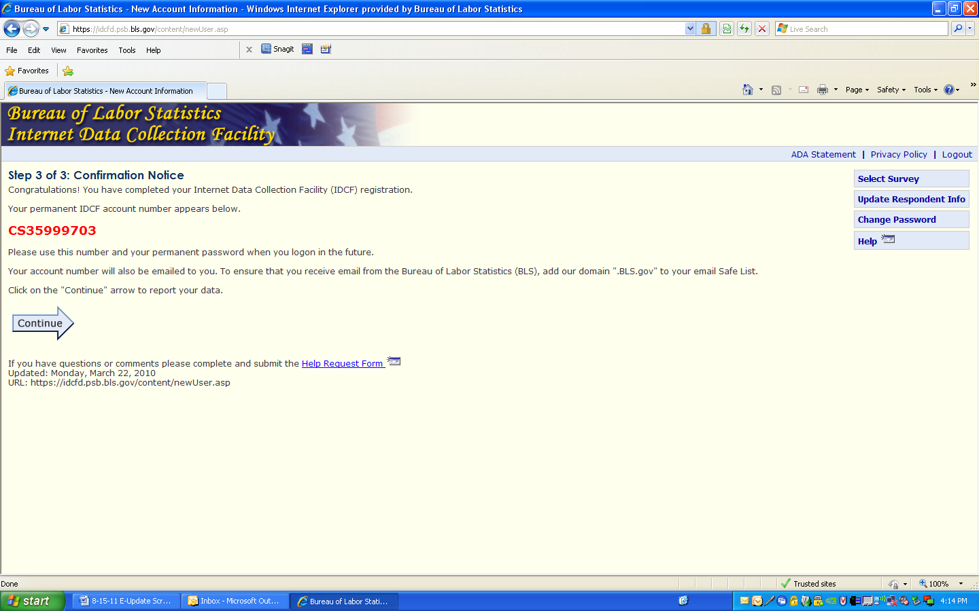
Notes:
Respondents quickly see a confirmation notice with their permanent IDCF account number.
They also receive an short email with this same information in it so they will have it for their records and future use.

Slide 6
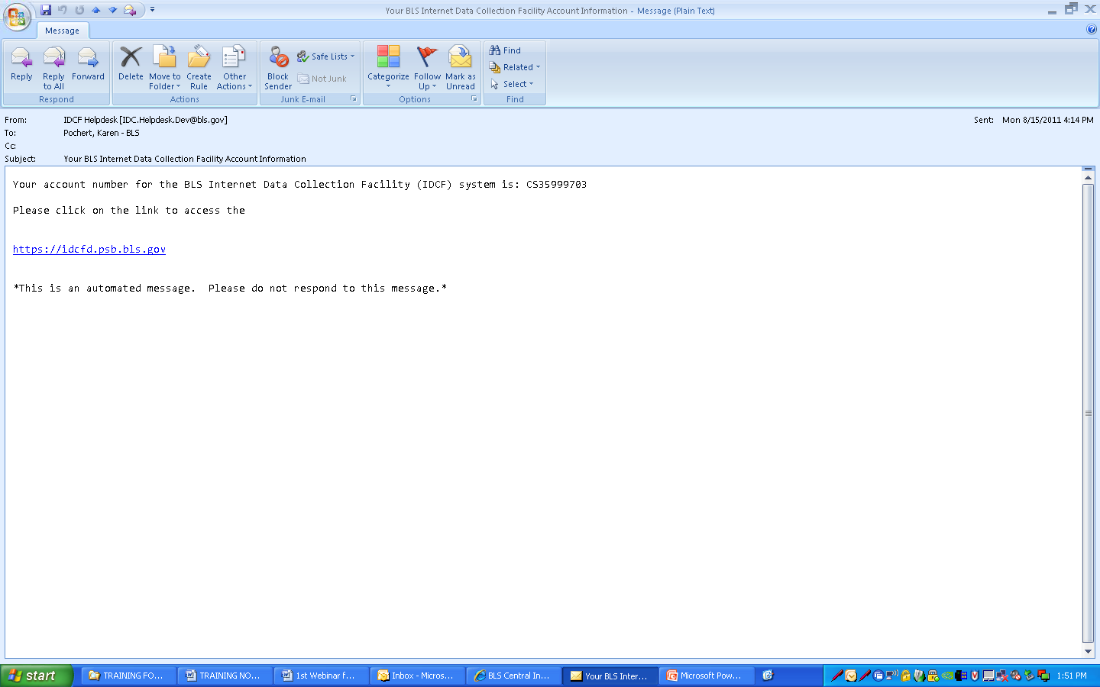
Notes:
This is the automated email the respondent will receive after they register.
For security purposes, respondents/users must access the E-Update application via the Gatekeeper Login page. The system is expecting a one-to-one link between DRA packages and (solicitation) account numbers. That means one account number = one package.
If they bookmark a page in the application or paste a page’s URL in the browser’s address line and then hit ‘Enter’, they will be taken to the Login page; they must log in every time they enter the system.
Your emails to them will include the link for the IDCF system.

Slide 7
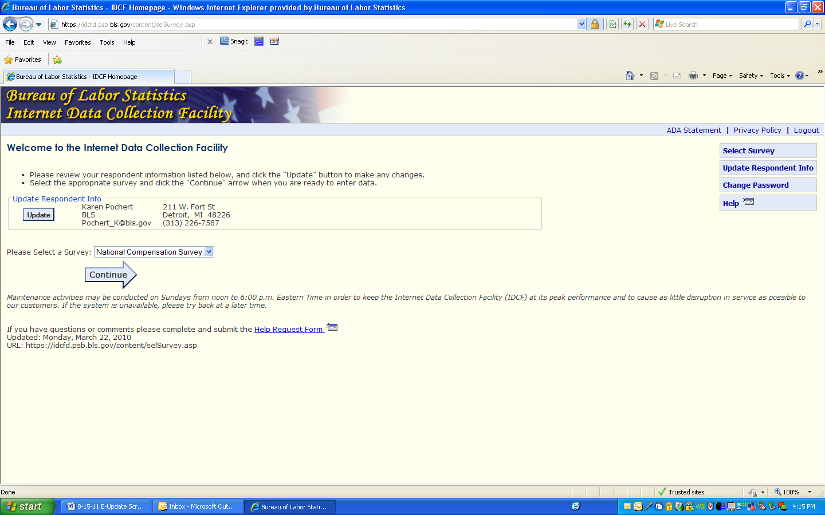
Notes:
When respondents enter the IDCF system they see this welcome screen. If they are only enrolled for the NCS survey that will appear in the drop down automatically.
If they report for more than one survey in IDCF (not one schedule) they will choose the survey from the drop down box. If they do not choose a survey they will get a prompt to do so before they can continue.
Notice in the upper right corner that they have the option to select a survey to work on, update their information, change their password or request help. We’ll take a quick look at those at the end of this presentation.

Slide 8
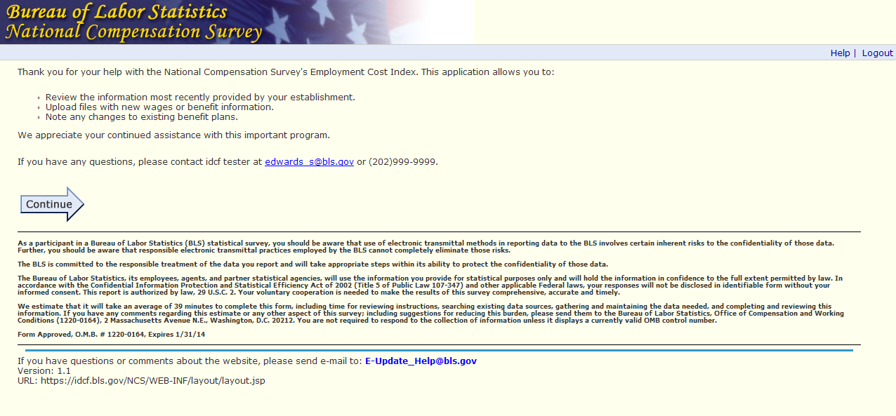

Slide 9
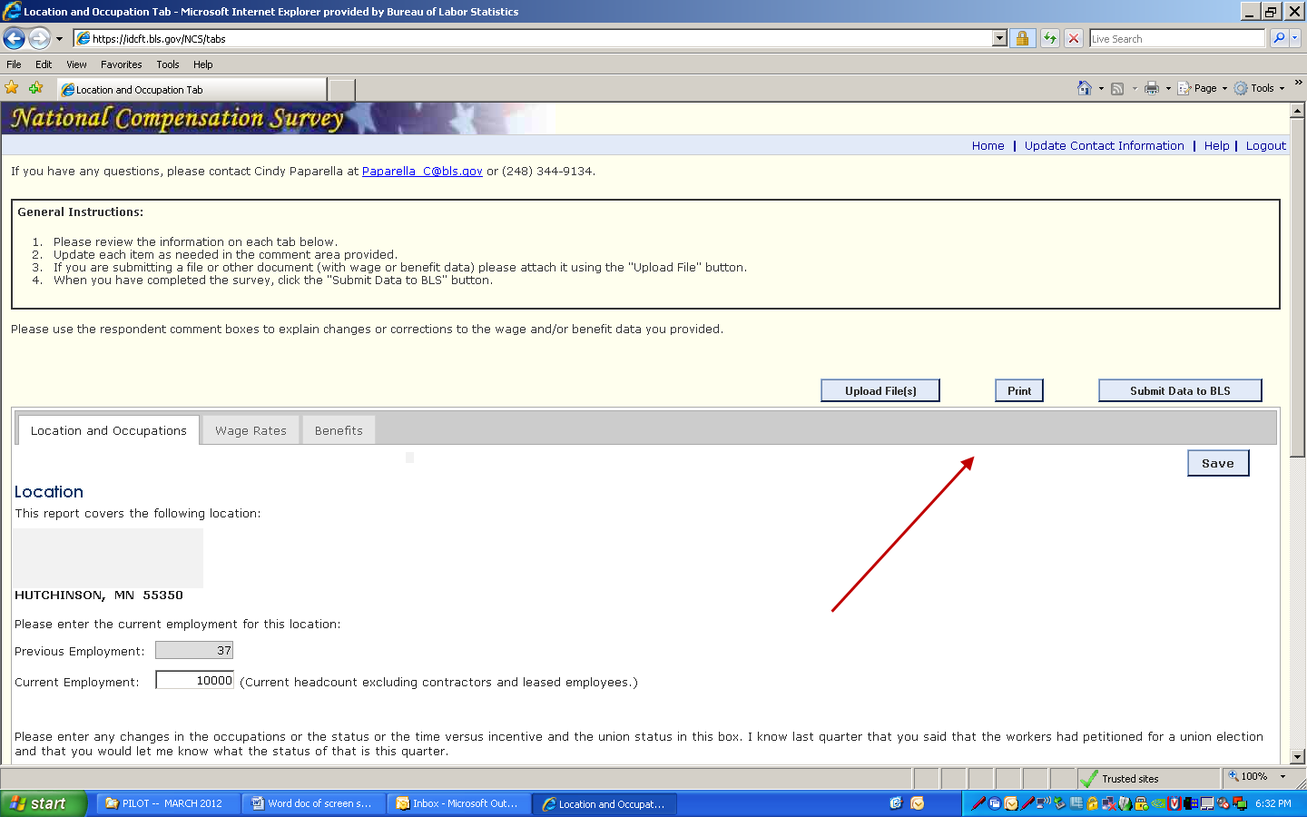
Notes:
When respondents get to the location and occupation screen they will see General Instructions in the box at the top. These are brief, step by step, instructions for the application. They are in the header of the application and will be visible to the respondent at all times.
The respondent will also see several option buttons -‘Upload Files’, ‘Print,’ ‘Submit Data to BLS,’ and ‘Save’ on the right side of the screen. These remain visible the entire time they are ins the application. Respondents will be able to upload files from any screen once they are inside the application.
This screen is where the respondent will enter a new employment figure in the current employment box and enter any remarks in the text box. They cannot change the location or occupation information shown on the screen.

Slide 10
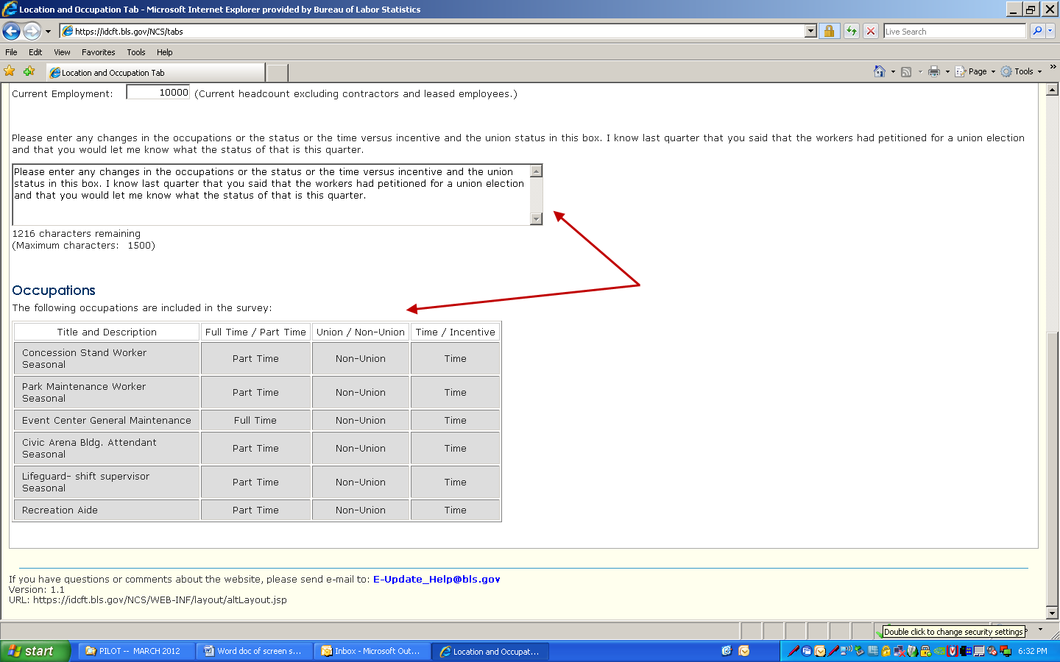
Notes:
A look at the bottom of the location and occupation tab shows you how the occupations will look.
The respondent comments are above the occupations. (These are test comments)

Slide 11
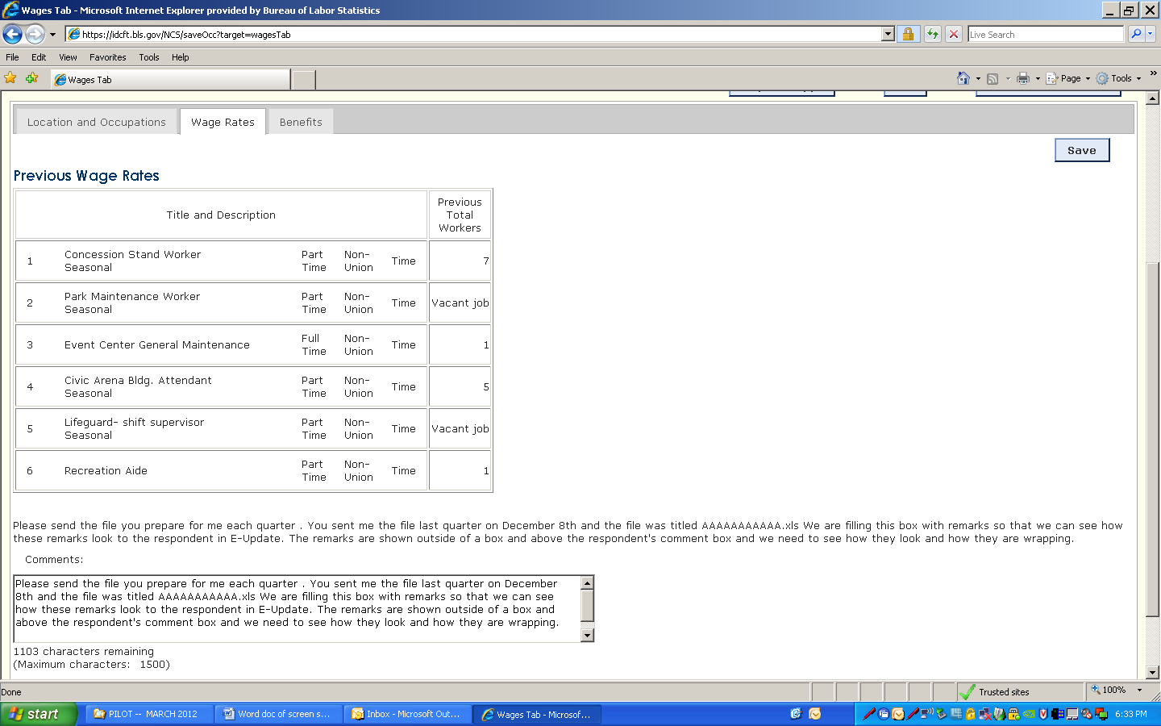
Notes:
This is a look at the (short form) wage screen the respondent sees in E-Update and the comments box the respondent will enter any remarks in.

Slide 12
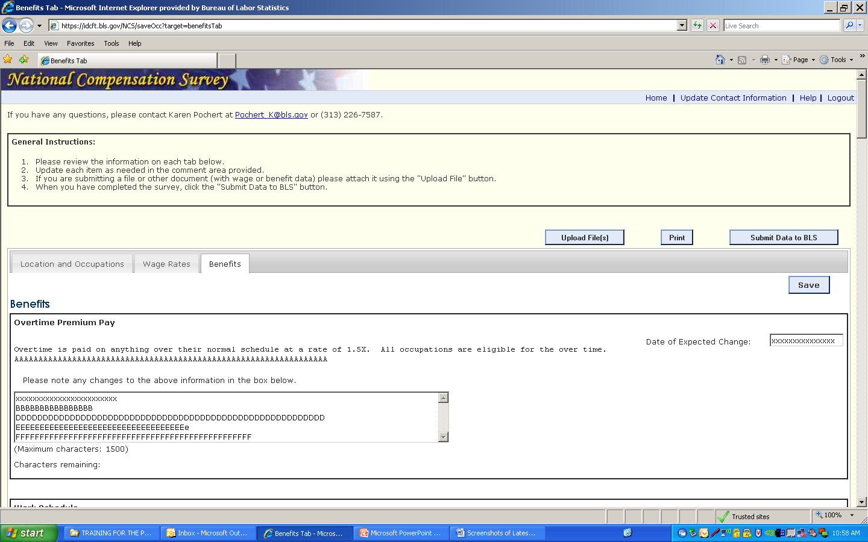
Notes:
The next few screens show how the benefits will look to the respondent.
The respondent will be making all changes or corrections to the benefit data in the comments boxes. They will not be able to change the actual benefit text that the field economist has entered.

Slide 13
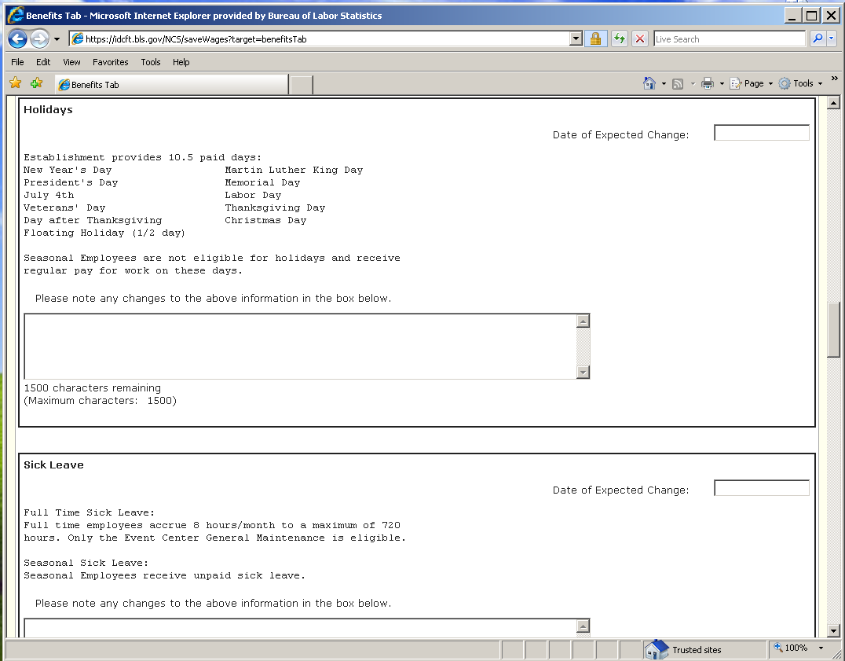

Slide 14
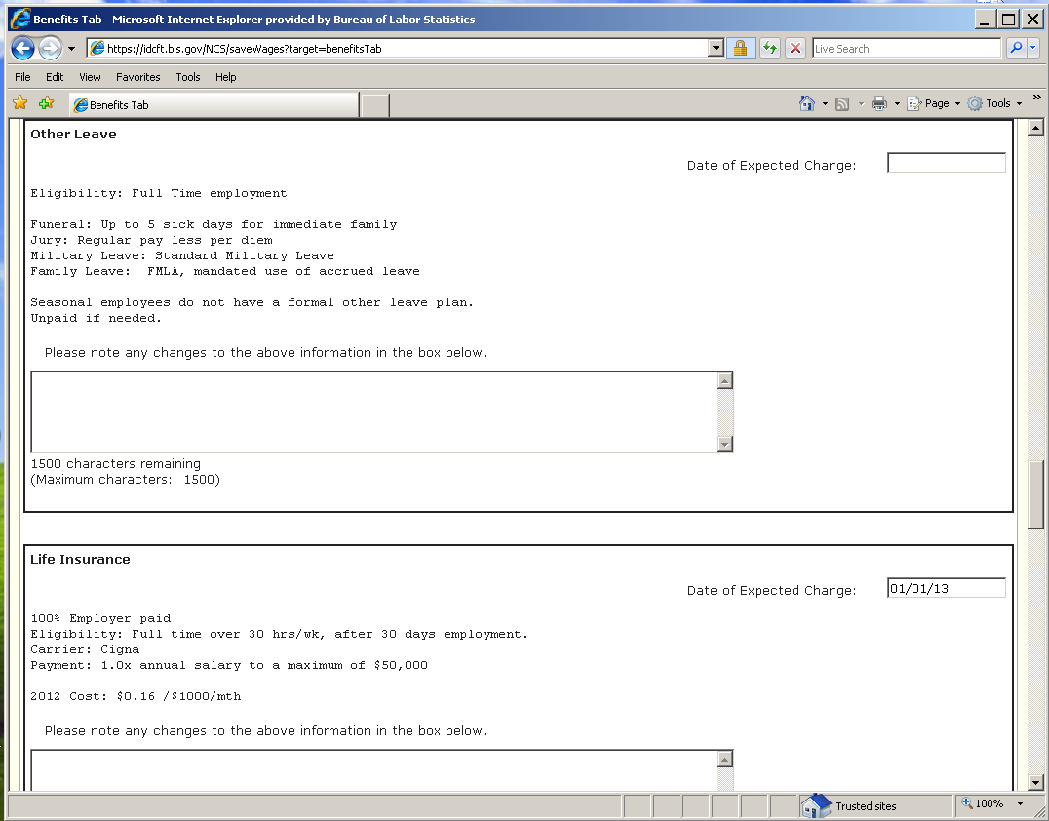

Slide 15
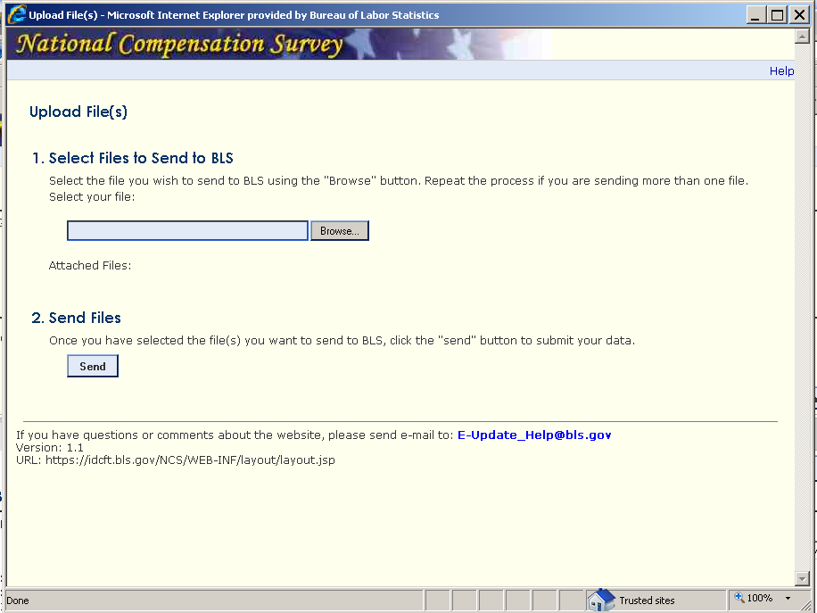
Notes:
When the respondent selects the ‘Upload Files’ button this is the window they’ll see. It’s a very easy process to send files; they use ‘Browse’ to select the file they want to send and hit the ‘Send’ button.

Slide 16
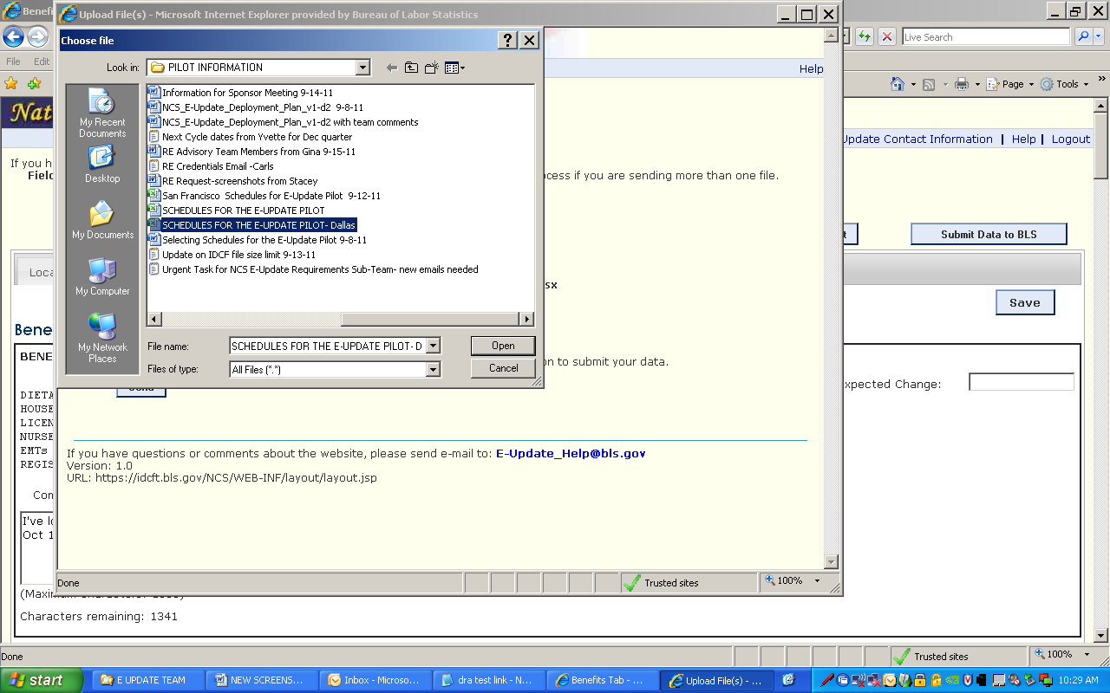
Notes:
The ‘browse’ pop up looks like any other; similar to what we see in Outlook or E2 when we want to attach or upload files. Respondents will select the file they want to send and click ‘Open’.

Slide 17
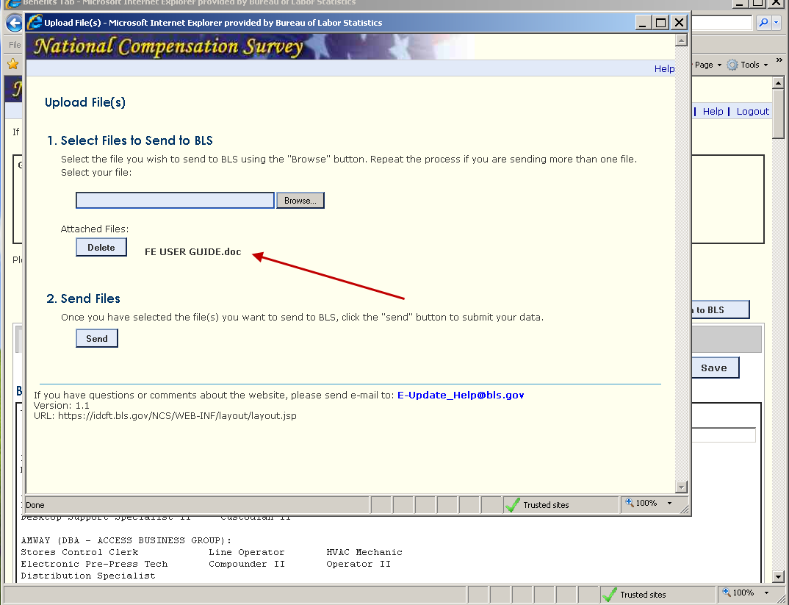
Notes:
Once the respondent selects the file they want to upload the name of the file is shown below the ‘Attached Files’ verbiage/

Slide 18
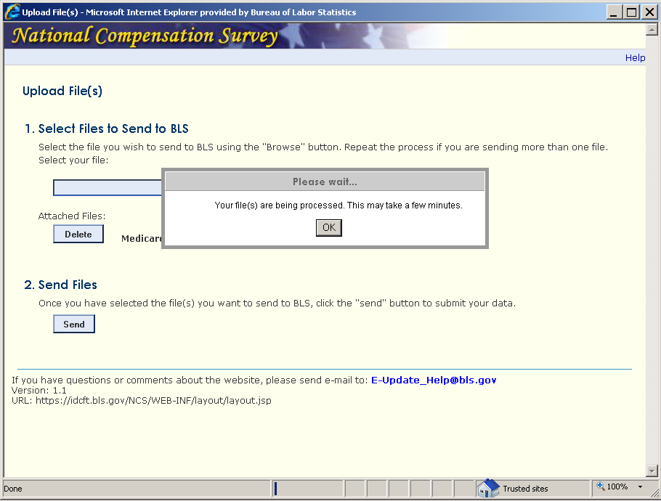
Notes:
When the respondent selects the “Send Files’ button they will see this alert that lets them know their file is being uploaded. The upload happens very quickly.

Slide 19
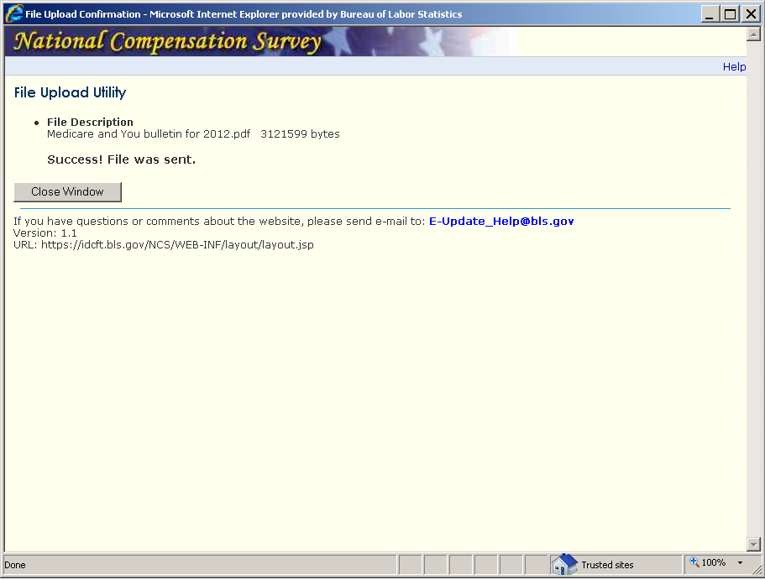
Notes:
Here’s the confirmation respondents see when the files are submitted successfully; the file names are visible.
Respondents are able to submit data and upload files as often as they like until the collection cycle ends.

Slide 20
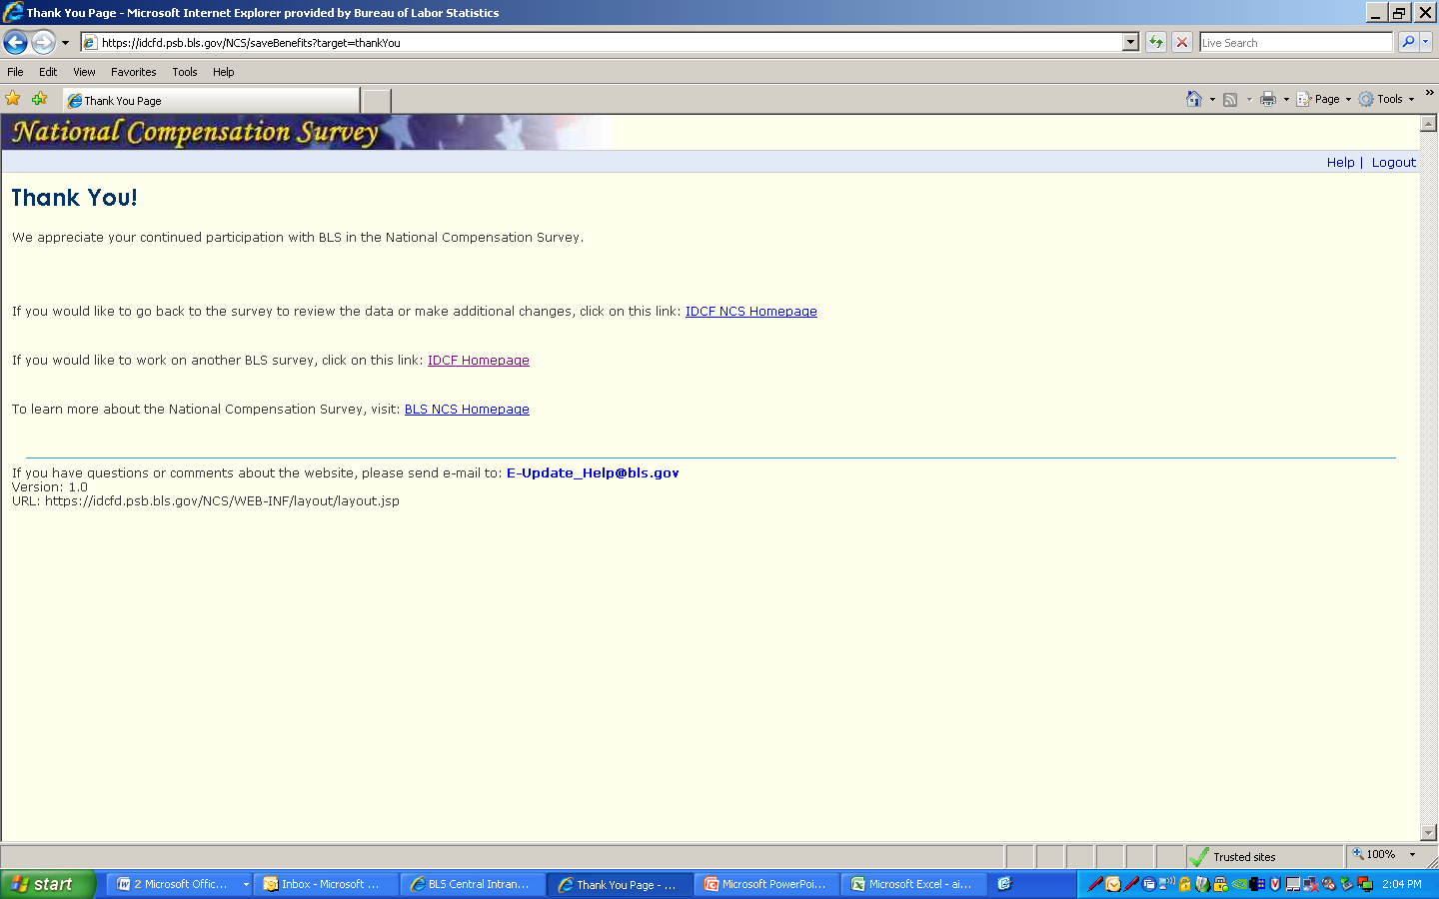
Notes:
Respondents are taken to the ‘Thank You’ page when data has been ‘Submitted’. There are several options on this page and each is explained.
they can go back into the application to review or add data without having to log in again
they can go back to the login page if they wish to work on another survey; they will need to log in again
they can go to the BLS NCS Homepage to get more information about the NCS survey, data and publications
There are a few options/alerts in this system also.

Slide 21
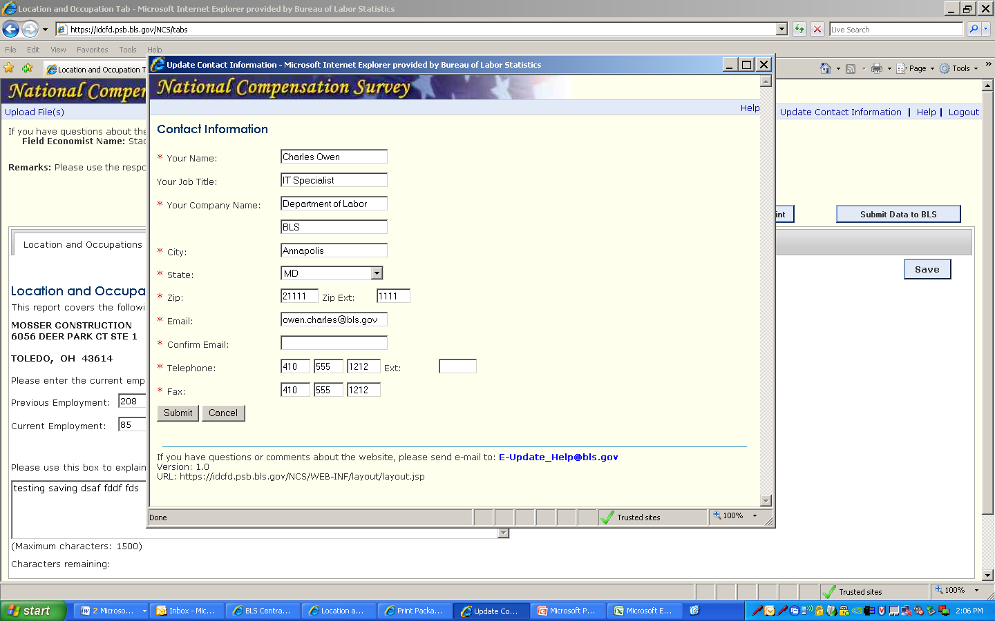
Notes:
Let’s look at some of the other options of E-Update:
If the respondent chooses to ‘Update Contact Information’ this is the pop up they will see that allows them to make the changes.

Slide 22
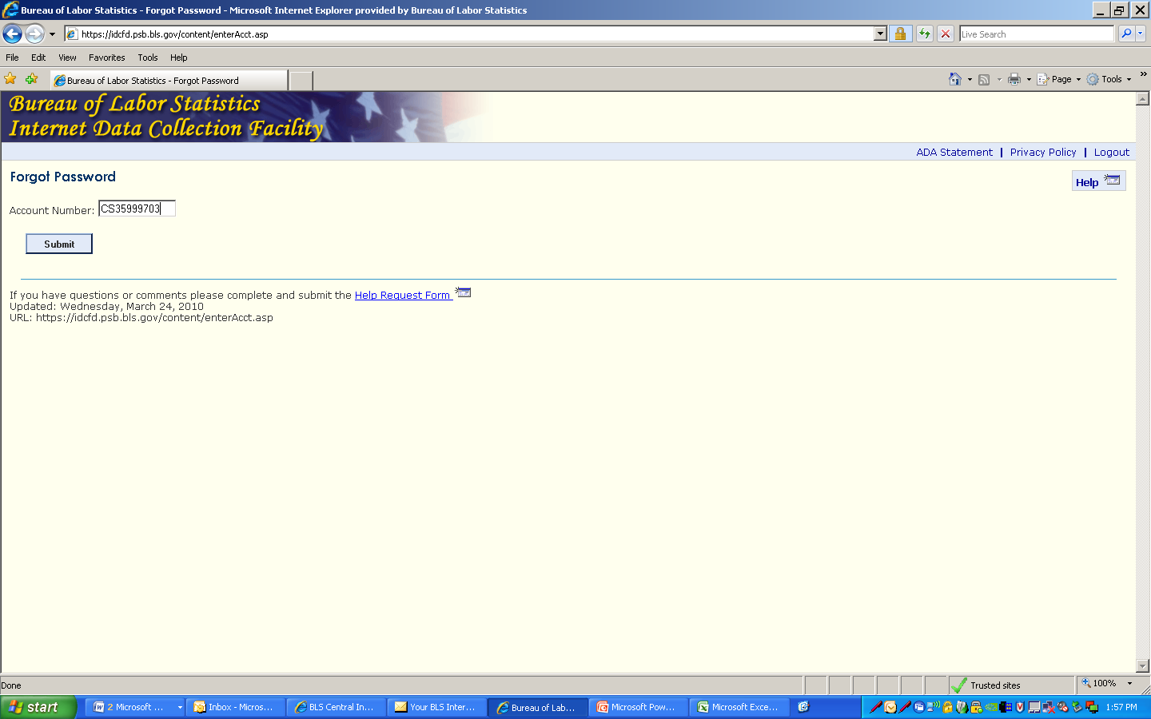
Notes:
If the respondent forgets their password, it’s a relatively easy process for them to select a new one.
First, they will be asked to enter their account number.

Slide 23
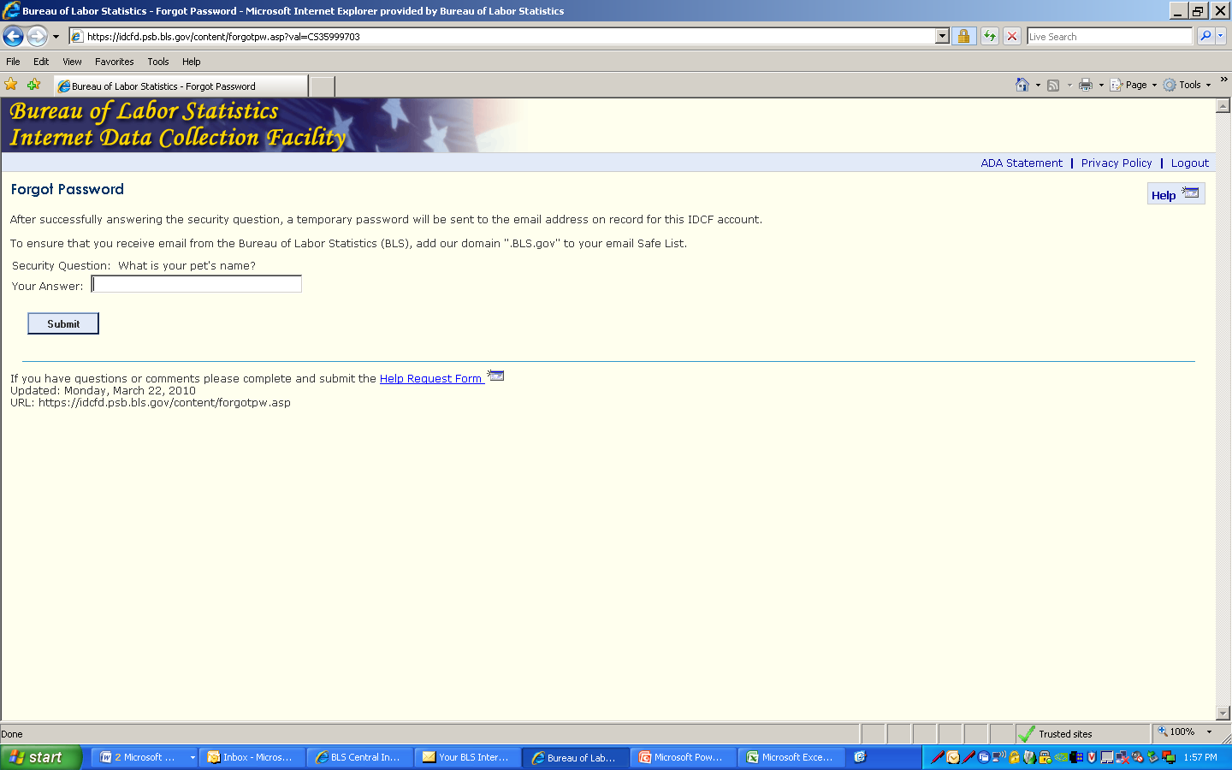
Notes:
Next they will be asked to answer one security question.

