Slide 1
Technical Assistance Training for Data Collection
Evaluation of the Frontier Community Health Care Network Coordination Grant
3/18/2014

Slide 2
Presenters and Evaluation Team
Presenter
Donald Nichols, IMPAQ
Evaluation Team
NORC | Alana Knudson
 | Shena Popat
Altarum | Cathy Call
 | Dora Hunter
IMPAQ | Guido Cataife
 | Sharanjit Toor

Slide 3
Objectives of the TA
To introduce Quarterly Report data collection to Community Health Workers
To provide detail on data elements of the data collection instrument
To ensure that CHWs have a clear understanding of the data collection effort

Slide 4
Background: Montana Grant
The HRSA Office of Rural Health Policy (ORHP) released the Frontier Community Health Care Coordination Grant, and the Montana Department of Public Health and Human Services was awarded this grant to support a network that focuses on clinical service coordination working with community health workers to:
Improve quality of care
Reduce avoidable hospitalizations
Facilitate independent living to Medicare beneficiaries

Slide 5
Background: Evaluation
The Federal Office of Rural Health Policy (ORHP), who funds the Frontier Community Health Care Network Coordination Grant program, is interested in learning how the program has impacted the lives of your clients.
As such, ORHP contracted with the Altarum Institute and its partners (IMPAQ and NORC) to conduct an evaluation of the program.

Slide 6
Background: Elements of the Evaluation
Site visits and telephone interviews
Access to care
Implementation of model
Sustainability
Quarterly reports
Recruitment activities and successes
Client interventions and successes
Resources necessary for success
Effectiveness analysis
More efficient use of health care services
Fewer preventable readmissions
Better self-disease management and foster independent living
Client Satisfaction - assess experiences and satisfaction

Slide 7
Quarterly Report Overview
Purpose:
To keep ORHP updated on the progress, successes, and lessons learned
Report contents:
Summary of recruitment efforts
Census of clients
Description of client interventions and progress
Accounting of all resources used in program administration and interventions
Accurate reports:
Helped by information from you (CHWs)!

Slide 8
Quarterly Reporting Overview
Frequency = quarterly
Longitudinal
EXCEL worksheets
Client data tab
Implementation data tab
Provide information to Heidi Blossom, safely
She will consolidate and submit securely to us
Report # | Analysis Period | Collection Date
1 | Beginning – 12/31/2013 | 2/21/2014
2 | 1/1/2014 – 3/31/2014 | 4/14/2014
3 | 4/1/2014 – 6/30/2014 | 7/14/2014
4 | 7/1/2014 – 8/31/2014 | 9/15/2014

Slide 9
Reporting Expectations
What we expect the CHWs to do for this current reporting cycle
Capture current and previous client information
From <enter dates > to 12/31/2013
Submit EXCEL file to Heidi Blossom

Slide 10
Data Collection Introduction
Client Information
Intervention Information
Program Operation Information

Slide 11
Client Data Overview
Location
Client number
Medicare ID number
Medicaid ID number
Chronic health conditions
Payers
Intervention start date
Intervention goal
Intervention activities
Goal achievement update
Involved partners
Additional resources
Intervention completion/exit date
Reason for completion/ exit

Slide 12
Client Data: Location and Identification Number
Location and ID
for each client:

Slide 13
Client Data: Health Information
Health Information
More than one response could be chosen.
“Yes”/ “No” response for each qualifying conditions
Free text response for other conditions that influence a client’s participation and intervention design

Slide 14
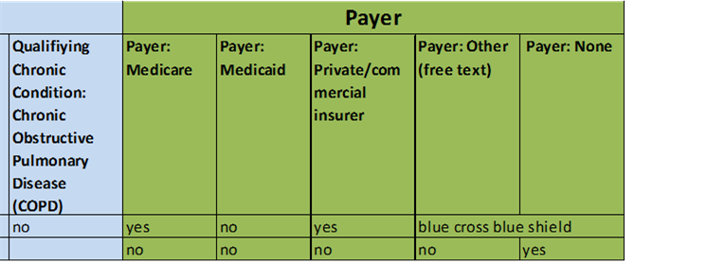
Client Data: Payer information
Payer Information:
Yes”/ “No” response for each qualifying conditions
Free text response for any other payer (e.g., TRICARE)

Slide 15
Client Data: Intervention Characteristics
Intervention Goal
Client’s goal in participating in the program.
Goals that are numerically measureable are helpful.
More detail is better.
Intervention Activities/Design
Client’s intervention activities and/or design of the client’s intervention.
More detail is better. (e.g., reason for selecting activity; frequency and duration of activities; missed appointments)

Slide 16
Client Data: Intervention Information (2)
Update on achievement of goal
Progress toward or complete achievement of the intervention goals.
If goal is measureable, provide numerical updates.
Partners involved in intervention
Non-CHW and non-hospital organizations
E.g., senior center, Meals on Wheels, church
List name/type and describe what they do

Slide 17
Client Data: Additional Resources
Resources that are not provided by grant
Resources used directly in client interventions.
Choose “Yes” or “No” for type of additional resource.
Provide description of resource.
Estimate financial value (note if used for multiple clients, so that value is not double counted).
Price of equipment
Wages to pay someone to supply volunteer services
Describe how resource is/was used in client’s intervention.

Slide 18
Client Data: Intervention Completion
Intervention Completion Date
Date when intervention was complete
Date when the client left program before completion of goal
Also indicate the reason for the early departure
If client is still active in intervention, the completion status can be left blank

Slide 19
Implementation Data Summary
Captures recruitment efforts, successes, and challenges
Assesses whether CHWs have enough time
Accounts for additional resources in management of program (non-intervention work)
Only concerned with current analysis quarter

Slide 20
Implementation Data
Number of client recruitment attempts
Source of recruited clients
Method of recruitment
Number of new clients from attempts
Understood reasons for unsuccessful attempts
Total hours worked by CHW on program
Additional resources (financial, equipment, volunteers, other)

Slide 21
Implementation Data: Recruitment
Source of attempts
Source from which the CHW identified the potential clients whom s/he attempted to recruit.
If multiple sources, note how many from each source.
Examples: hospital case managers/staff, senior center, family/friends of patients
Method(s) of recruitment
Describe how the program was introduced to potential clients to recruit them into the program.
If multiple methods of recruitment, note number of potential clients for each.

Slide 22
Implementation Data: Enrollments
Number of new clients
Number of new clients recruited to the observation quarter.
If multiple methods of recruitment, note number of successful recruitments from each method.
Understood reason(s) for unsuccessful attempts
The reasons provided by recruited potential clients to CHWs for declining to participate in the program.
Total hours spent by CHWs on program
The total number of hours that the CHW spent working on all aspects of the program (recruitment, interventions, administrative).
Greater than, equal to, or less than 8 hours allocated by grant.

Slide 23
Implementation Data: Other Resources
Resources used to support all non-intervention aspects of program (administration, recruitment, etc.)
Choose “Yes "or “No” for type of additional resource.
Provide description of resource.
Estimate financial value.
Price of equipment
Wages to pay someone to supply volunteer services
Describe how resource is/was used to support program.

Slide 24
Conclusion
Questions?
First data collection date = 2/21/2014
Thanks in advance!
Contact
Donald Nichols
dnichols@impaqint.com
510.465.7884, ext. 283

