Slide 1
FAPIIS and SAM System Screen Shots
Reporting and Use of Information Concerning Integrity and Performance of Recipients of Grants and Cooperative Agreements (ICR 3090-0293)

Slide 2
Paperwork Reduction Act Statement
OMB Control No: 3090-0293
Expires: 01/31/2015
Public reporting burden of this collection of information is estimated to average 60 minutes per response, including the time for reviewing instructions searching existing data sources, gathering and maintaining the data needed, and completing and reviewing the collection of information. Send comments regarding the burden estimate or any other aspect of this collection of information, including suggestions for reducing this burden, to the Federal Acquisition Service, General Services Administration, 1800 F Street, NW, Washington, DC 20405.

Slide 3
Access to FAPIIS
Government Users: FAPIIS is a distinct application that federal acquisition professionals accessed through the Past Performance Information System (PPIRS) for their use in award and responsibility determinations. Access to FAPIIS is granted when approved for access to PPIRS.
Government Awardees: Access to FAPIIS is part of your current PPIRS access.
Public Access: In accordance with the passing of the Supplemental Appropriations Act of 2010 (Pub. L. 111-112) public access to the data within FAPIIS was made publicly available for records entered into FAPIIS on or after April 15th 2011.

Slide 4
FAPIIS Public Access Home Page https://www.fapiis.gov/fapiis/index.jsp

Slide 5
Public Search https://www.fapiis.gov/fapiis/govt/search.jsp

Slide 6
FAPIIS Help https://www.fapiis.gov/fapiis/help.jsp

Slide 7
FAPIIS Policy

Slide 8
Access to SAM
Government Users: Government users logged in with a SAM user account will have access to Entity Management - For Official Use Only (FOUO) information, which includes the ability to view TIN information as well as view entities that have opted out of the Public search and those government entities which are registered for IGTs.
Entities: All entity records from CCR/FedReg and ORCA and exclusion records from EPLS, active or expired, were moved to SAM. Entities can search for records and create new ones in SAM.
Public Access: SAM records are public, including all active exclusion records entered by the Federal government identifying those parties excluded from receiving Federal contracts, certain subcontracts, and certain types of Federal financial and non-financial assistance and benefits.

Slide 9
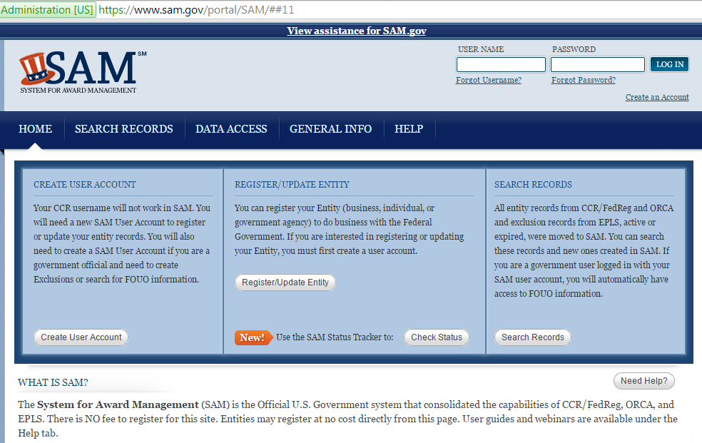
SAM Home Page

Slide 10
SAM Public Search

Slide 11
SAM Proceedings Entity Entry

Slide 12
SAM Help

